Slide 1
Convertor

Slide 2
What is it for?
It is used to convert a file from one type to another. This can be useful to reduce file size or simply to save the file in a different format. Supported types of file conversion includes:
Video files
Audio files
Image files
Document files

Slide 3
Supported file format
Video
mp4
mkv
mov
avi
wmv
Audio
mp3
wav
ogg
flac
mp4 (upload only)
Image
jpg
jpeg
tiff
png
bmp
eps
Document
docx
pdf

Slide 4

Advantages of using convertor
Easy to use
Easy to access (phone or computer)
Support most of the popular format types
Secured connection (SSL)
It’s FREE :)

Slide 5
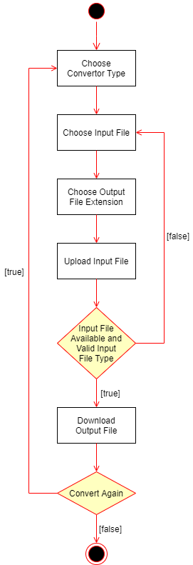
Activity Diagram

Slide 6
How to use?
Head over to convertorwebapp.pythonanywhere.com
Select desired file conversion from the menu on the top right
Choose file to be uploaded
Select output file format
Upload file
Wait for the file to be converted
Download converted file

Slide 7
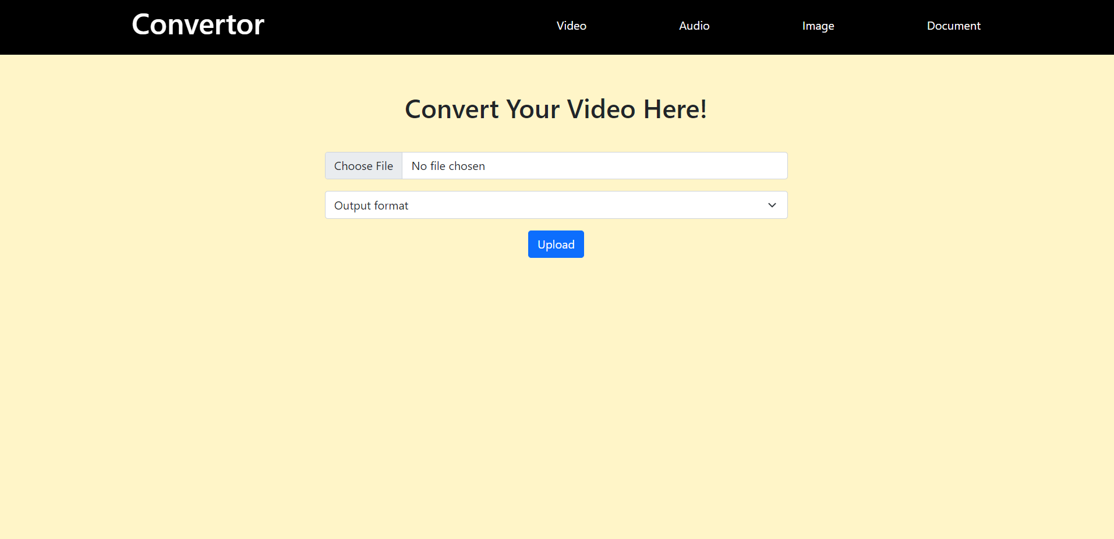

Slide 8
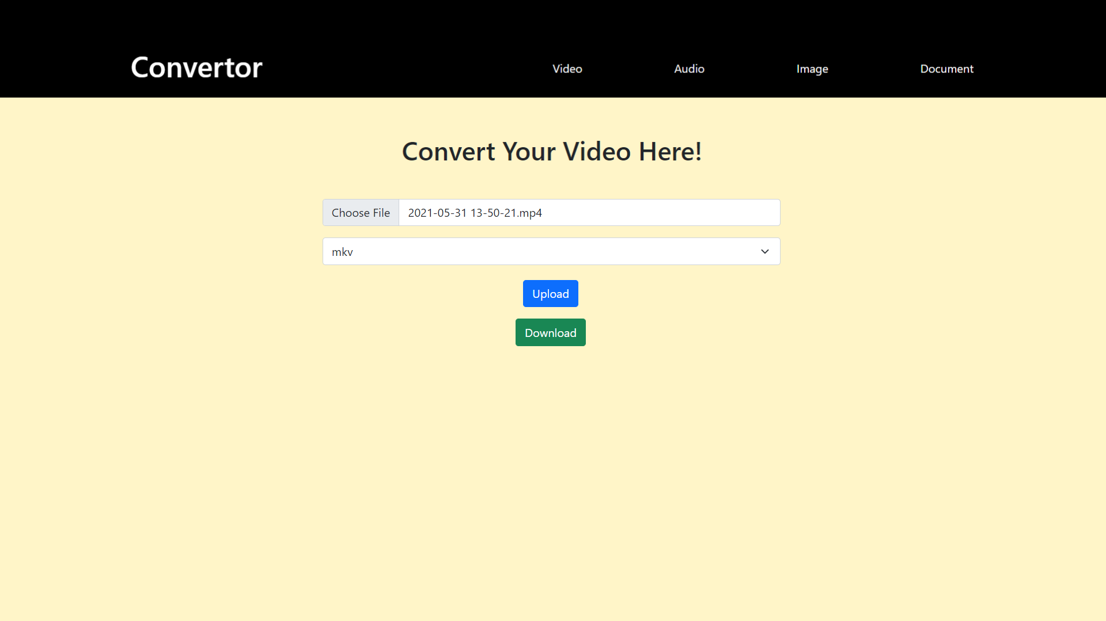

Slide 9
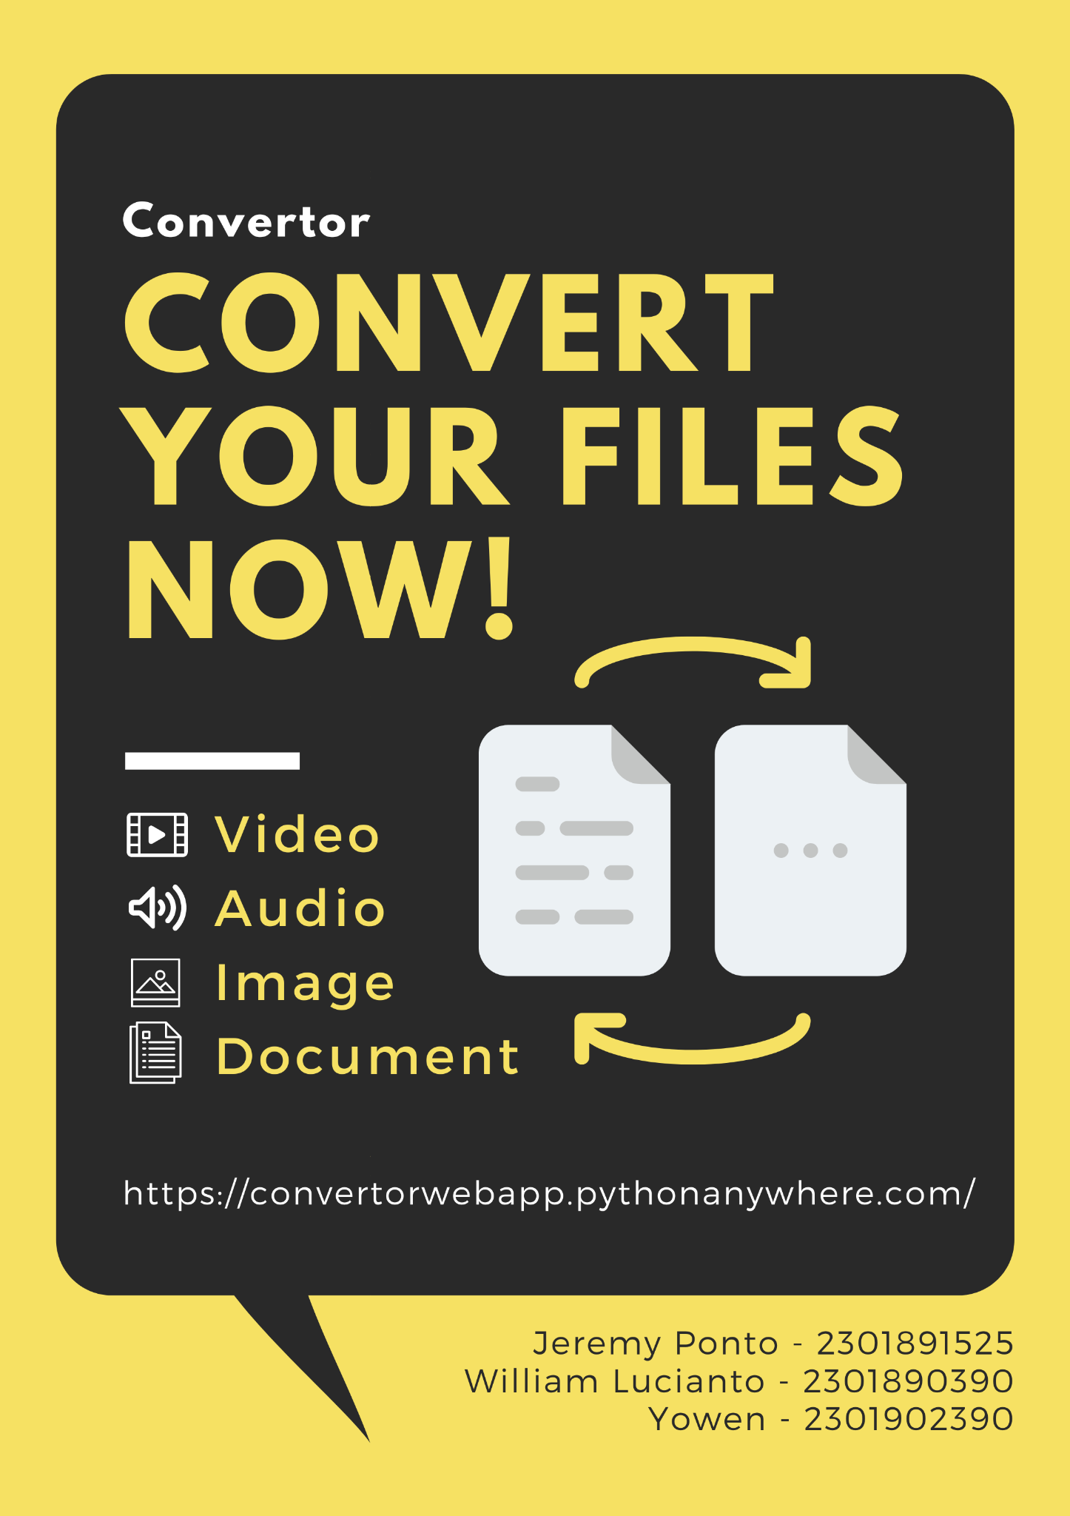
Poster

