Slide 1
A | B | C | D | F | SOP | POS
0 | 0 | 0 | 0 | 1 | m0
0 | 0 | 0 | 1 | 0 |  | M1
0 | 0 | 1 | 0 | 1 | m2
0 | 0 | 1 | 1 | 0 |  | M3
0 | 1 | 0 | 0 | 0 |  | M4
0 | 1 | 0 | 1 | 0 |  | M5
0 | 1 | 1 | 0 | 0 |  | M6
0 | 1 | 1 | 1 | 0 |  | M7
1 | 0 | 0 | 0 | 1 | m8
1 | 0 | 0 | 1 | 1 | m9
1 | 0 | 1 | 0 | 1 | m10
1 | 0 | 1 | 1 | 1 | m11
1 | 1 | 0 | 0 | 0 |  | M12
1 | 1 | 0 | 1 | 1 | m13
1 | 1 | 1 | 0 | 0 |  | M14
1 | 1 | 1 | 1 | 1 | m15

Slide 2
K-Map
Minimized SOP=B’D’+AD
Minimized POS=(A’+D)*(B+D’)
AB CD | 00 | 01 | 11 | 10
00 | 1 | 0 | 0 | 1
01 | 0 | 0 | 0 | 0
11 | 0 | 1 | 1 | 0
10 | 1 | 1 | 1 | 1

Slide 3
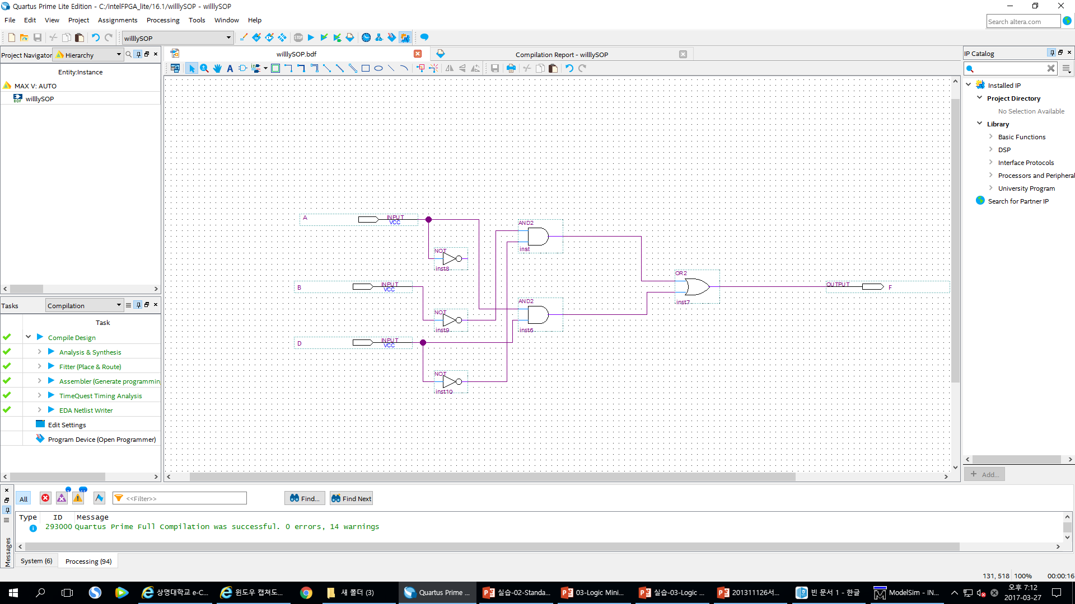
SOP

Slide 4
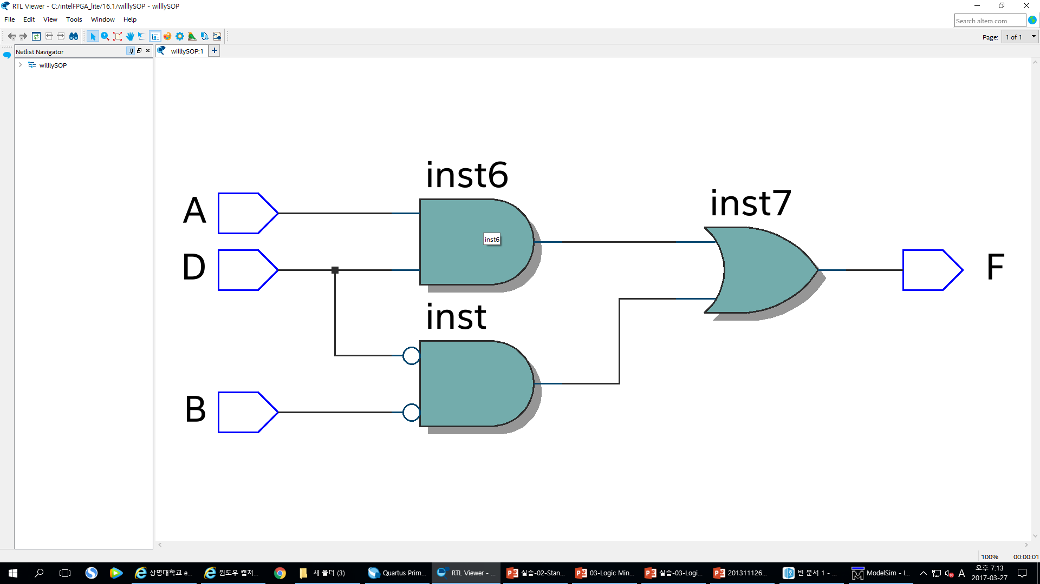
Cost : 6+3 =9
Minimized SOP=AD
AD+B’D’
Minimized SOP=B’D’

Slide 5
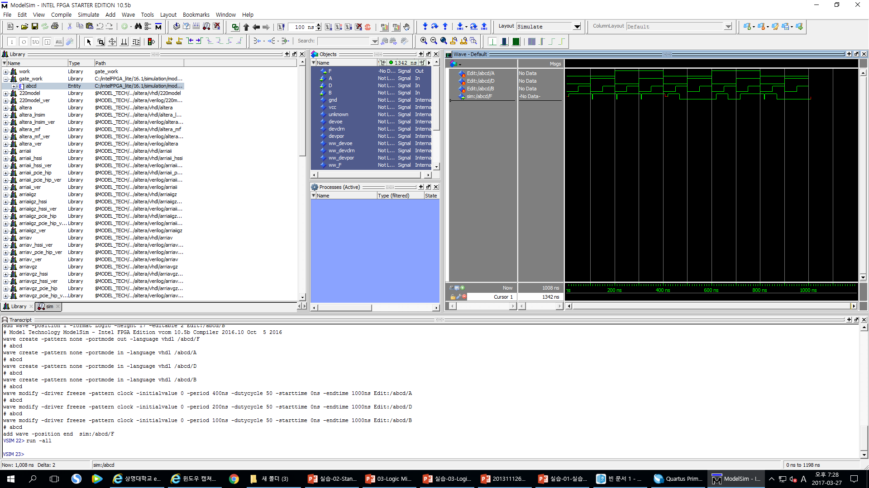
ADBF
0
0
01
0
0
11
0
1
01
0
111
10
0
1
1
0
11
1
1
0
1
1
1
1
1

Slide 6
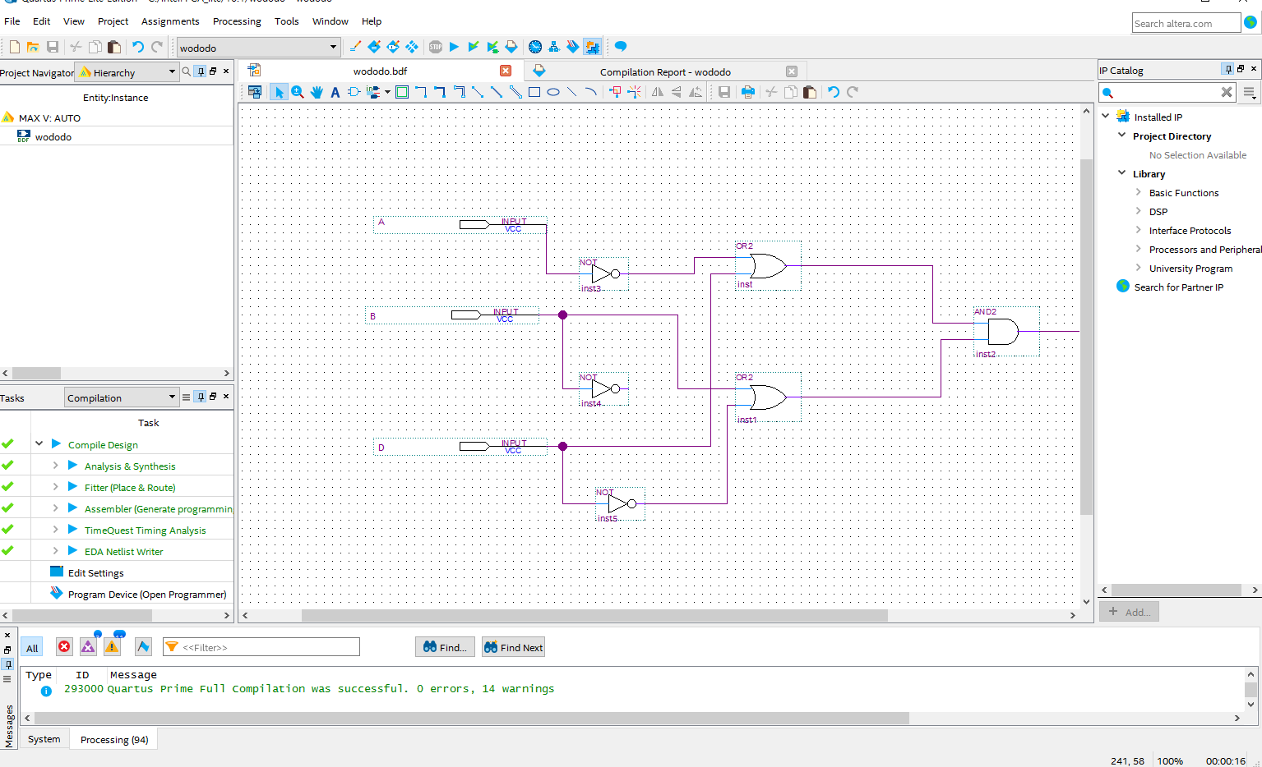
POS

Slide 7
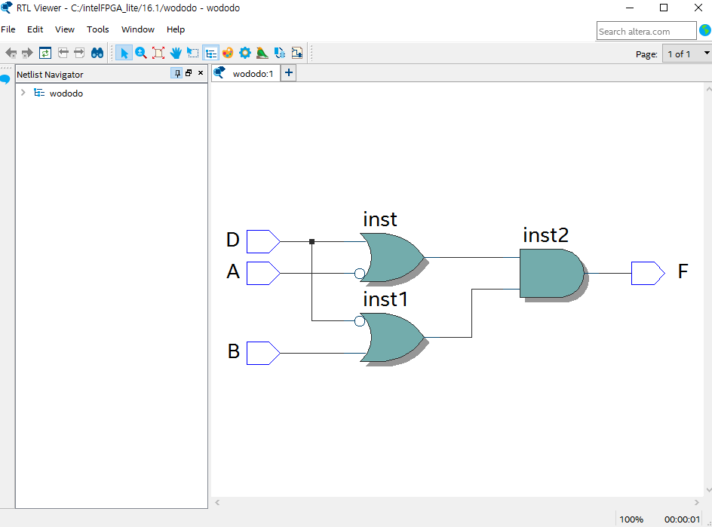
Cost : 6+3 =9
Minimized POS = A’+D
(A’+D)*(B+D’)
Minimized POS = B+D’

Slide 8
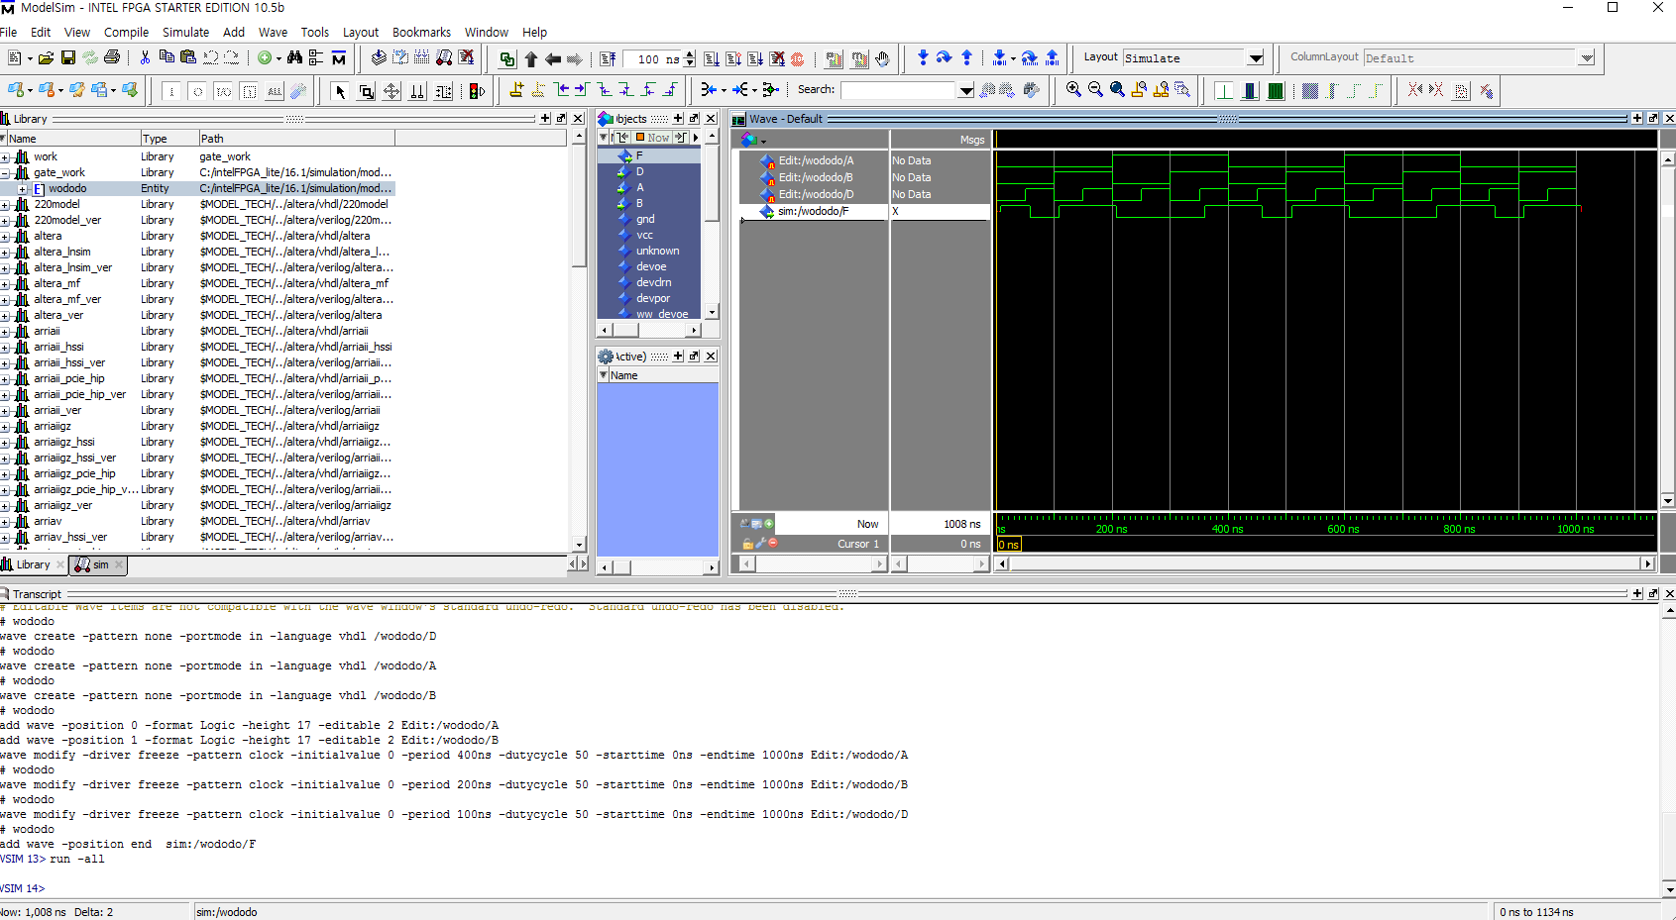
A
B
D
F
0
0
01
0
0
1
0
0
1
0
1
0
1
1
1
1
0
0
0
1
0
1
0
1
1
0
0
1
1
1
1
0
0
01
0
01
0
0
1
0
1
0
1
11
0
0
01
1
0
1
0
1
1
0
0
1
1
1
1
0
0
01
0
0
1
0
0
1
0
1
0
1
1
1
0
111

Slide 9
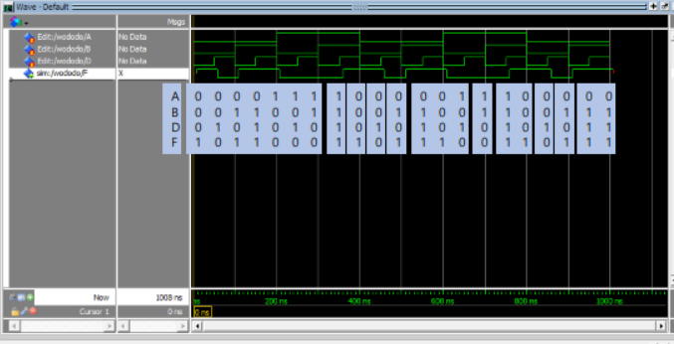
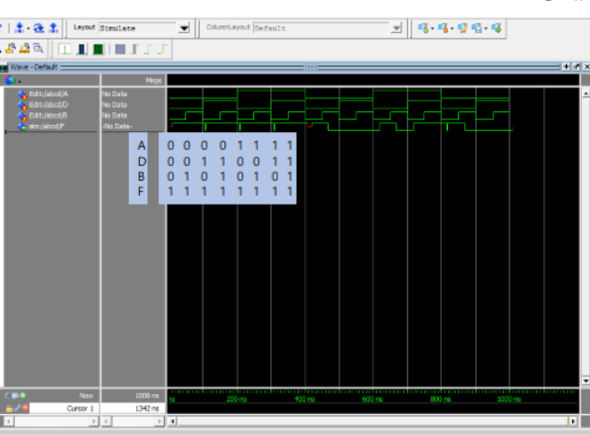
Discusstion
Minimized SOP Gate Level Simutlation과 Minimized POS Gate Level Simulation에서 진리표 순서대로 한 싸이클이 나온것을 확인했습니다.

