Slide 1
Smart Fridge
Madhur Rajput
Willahelm Wan

Slide 2
Objective
Create a smart fridge prototype that allows the users to add, delete, and order items through the smart fridge app
Design a database that is able to create, read, update, and delete records using MySQL
Create a graphical user interface using Java
Connect the graphical user interface to the database
Use the graphical user interface to modify the database
Test the prototype thoroughly to eliminate bugs

Slide 3
Project Overview
Smart Fridge is a fridge that tracks and orders items through an embedded computer system that is connected to the Internet.
It tracks its inventory automatically with a built-in MySQL database by scanning the barcode of the items as soon as they are placed inside of the fridge.
It orders items automatically if there is a quantity threshold set for those particular items. Or the users can order items using the touch screen graphical user interface that is on the fridge door.
Since we are not able to demonstrate the project on a real fridge, we have created some interactive buttons on the graphical user interface to simulate placing items in the fridge, removing items from the fridge, etc.

Slide 4
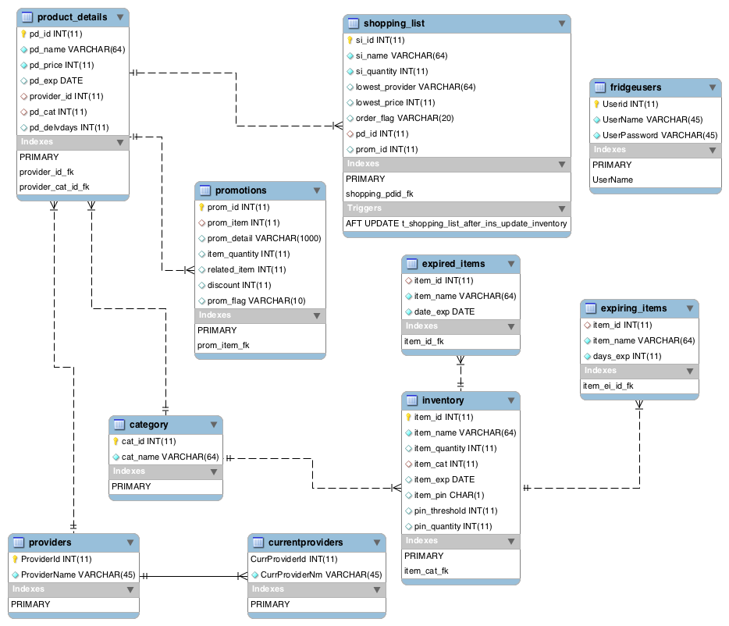
Database

Slide 5
Database
Product_detail(pd_id, pd_name, pd_price, pd_exp, provider_id, pd_cat, pd_delvdays)
Promotions(prom_id, prom_item, prom_detail, item_quantity, related_item, discount, prom_flag)
Shopping_list(si_id, si_name, si_quantity, lowest_provider, lowest_price, order_flag, pd_id, prom_id)
Fridgeusers(Userid, Username, UserPassword)
Category(cat_id, cat_name)
Inventory(item_id, item_name, item_quantity, item_cat, item_exp, item_pin, pin_threshold, pin_quantity)
Expired_items(item_id, item_name, date_exp)
Expiring_items(item_id, item_name, days_exp)
Providers(ProviderId, ProviderName)
Currentproviders(CurrProviderNm)

Slide 6
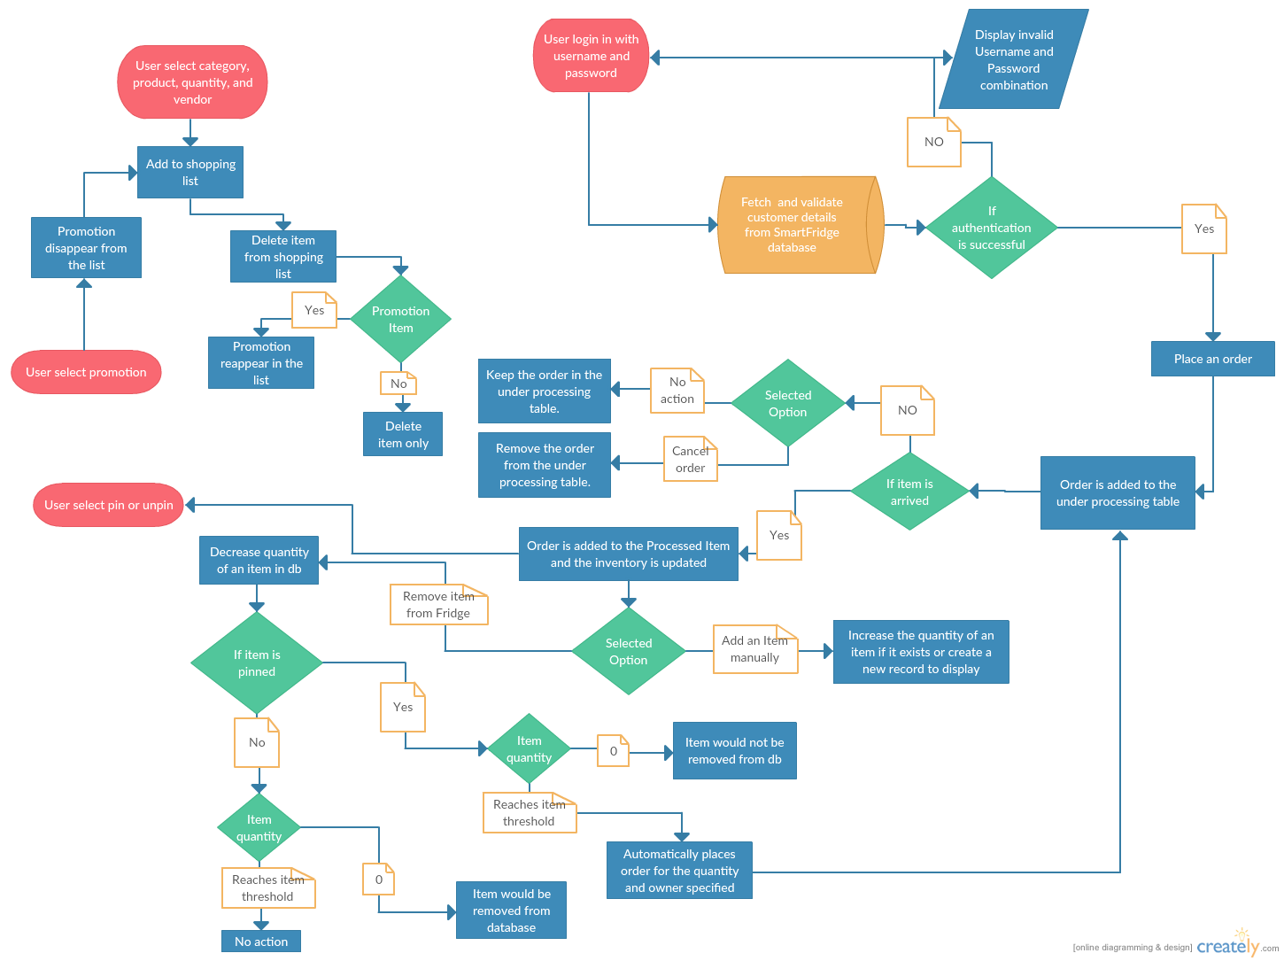
User Interaction Diagram

Slide 7
Demo

Slide 8
Future Improvements
Expand the database
Make the graphical user interface more user friendly
Add more types of promotion
Include pictures in the database for each item
Development mobile application that can be linked to the smart fridge remotely

Slide 9
QUESTIONS?

