Slide 1
Final Project 1 – Lightning Presentation
By: Will Akkaya GA – DS - 27

Slide 2
Potential Topic – NBA All Star Prediction THE PROBLEM
Can we use data science models and methods to predict who is more likely to be an NBA all star in the next coming season?
Lets say we are working for Nike or Adidas and we are considering who our next big athlete is to sponsor… Is there a way we can make utitlize big data to help make our decision?
If we could create a model to find out who was more likely to be an all star, we could sign those athletes for considerably amount of less money, therefore maximizing our sponsorship $$$
Analytics in sports is becoming a more and more common practice, a similar analysis of the NBA was conducted on who was more likely to win regular season games in the upcoming season and be a playoff team
https://www.stat.berkeley.edu/~aldous/Research/Ugrad/Stanley_Yang%20_Thesis.pdf
In the study he was able to predict almost every playoff team using regression analysis and other summary statistics to determine correlation of variables to overall winning %

Slide 3
Potential Topic – NBA All Star Prediction THE DATA
The good thing about Basketball is that nearly all of the statistics involved are readily available..
I was able to find nearly every statistic about every team and individual player in .csv format from 1947 – present... basketball–reference.com
The data contains obvserations extensive from the players city of birth to his nickname..
This is very beneficial as we have more than enough data to conduct EDA and find out which methods/variables we can use that can are relevant and optimal
Also because All – Star selection is partly determined by fans who vote... We can also utilize a twitter api to find out how often a particular player is mentioned, as well analyze the sentiment of the tweets using Alchemey language http://www.alchemyapi.com/products/alchemylanguage/sentiment-analysis
My main concern is because I have never used these data mining techniques involved that could be a potential challenge to overcome in my analysis

Slide 4
Potential Topic – NBA All Star Prediction THE HYPOTHESIS
Given all the relevant data metrics such as players points per game, age, experience, twitter mentions/ sentiment analysis and other factors that determine all – star selection we will be able to create a model that will predict who will be an all – star in the upcoming season
True success is if our model can correctly predict who will be a first time all – star in the upcoming season.. Then we have truly created something that Nike/Adidas can utilize for efficient sponsorship decision making..
The data science methods used to create this model are still relatively unknown and undecided as my knowledge in the subject is still in infancy

Slide 5
Potential Topic – Predict Census Income THE PROBLEM
Another interesting topic to explore using data science would be if we were able to predict a persons income solely based on census data
Lets say we are working for a big marketing firm and we want to find out which customers fall into our target market of gross income of >$50k a year
Can we create a model to help us predict who will fall into our target market, thus making us more efficient in our marketing process..?

Slide 6
Potential Topic – Predict Census Income THE DATA
I was able to find an already cleaned .csv data set from the UCI machine learning repository… The data contains 15 observations which include ‘age’, ‘workclass’,’education’,’marital status’,’occupation’,’relationship’,’race’,’sex’,’capital-gain’,’capital-loss’,’hours-per-week’,’native-country’,’<=50K’,”>50K’..
The data is relatively simple and contains over 32k indexes..
Models have already been created using this data https://www.kaggle.com/uciml/adult-census-income
Thus potentially could give a better idea on where to start

Slide 7
Potential Topic – Predict Census Income THE HYPOTHESIS
My conclusion is that after utilizing the proper demographic data we will be able to create a model that will best will closely predict who is more likely to make over >$50k
Regression analysis could be used to identify which coefficients directly affect Income the most which will help give a good model for our marketing team to use which demographic to target..

Slide 8
Potential Topic – Loan Analysis? THE PROBLEM
Another potential aspect to explore using data science would be to analyze loans and come up with a model that could predict which loans were more likely to default based on historical data and other features .
Lets say we work at Lending Club and we want to get a general idea of which of our loans would paid and not paid back, we can use this model to make better financial decisions on who should qualify for a loan or not…

Slide 9
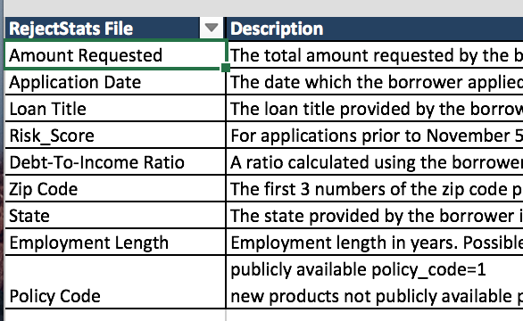
Potential Topic – Loan Analysis? THE DATA
Lending Club has released loan data from 2007 – 2016 Q2 from the accepted loans and the rejected loans, the data is csv format two different spreadsheets containing several different statistics relatively clean data
The file comes complete with a data dictionary fully explaining each variable
Several analyses have already been conducted on this particular loan data which is another beneficial factor in giving us an idea on where to start see: http://res.cloudinary.com/general-assembly-profiles/image/upload/v1416535475/uwumoooppttsmpgu1goo.pdf

Slide 10
Potential Topic – Loan Analysis? THE HYPOTHESIS
My conclusion is that there is definitely a model we can create that will determine whether or not a certain loan will default or not…
True sucess can be identified if our model can accurately predict which loans should be declined and which will be more subject to default

