Slide 1
Final Project 2 – Project Design Write – Up
By: Will Akkaya GA – DS - 27

Slide 2
Potential Topic – NBA All Star Prediction
THE PROBLEM
Can we use data science models and methods to predict who is more likely to be an NBA all star in the next coming season?
Lets say we are working for Nike or Adidas and we are considering who our next big athlete is to sponsor… Is there a way we can make utitlize big data to help make our decision?
If we could create a model to find out who was more likely to be an all star, we could sign those athletes for considerably amount of less money, therefore maximizing our sponsorship $$$
Analytics in sports is becoming a more and more common practice, a similar analysis of the NBA was conducted on who was more likely to win regular season games in the upcoming season and be a playoff team
https://www.stat.berkeley.edu/~aldous/Research/Ugrad/Stanley_Yang%20_Thesis.pdf
In the study he was able to predict almost every playoff team using regression analysis and other summary statistics to determine correlation of variables to overall winning %
Potentially following similar processes such as the one above we will be able to create a model that will help predict who will be an NBA All – Star before it happens…
I believe a players statistical performance rankings will have the most impact on whether or not they will be an All – Star or not

Slide 3
Potential Topic – NBA All Star Prediction
THE HYPOTHESIS
Given all the relevant data metrics such as players points per game, age, experience, twitter mentions/ sentiment analysis and other factors that determine all – star selection we will be able to create a model that will predict who will be an all – star in the upcoming season
True success is if our model can correctly predict who will be a first time all – star in the upcoming season.. Then we have truly created something that Nike/Adidas can utilize for efficient sponsorship decision making..
The data science methods used to create this model are still relatively unknown and undecided as my knowledge in the subject is still in infancy

Slide 4
Potential Topic – NBA All Star Prediction
THE PROBLEM / DOMAIN KNOWLEDGE
Essentially we are trying to predict if a particular player will be an All – Star or not… this outcome can be defined as “All-Star/Not – All-Star”
Thus we can conclude that the variable we are trying to predict can be defined as binary..
A similar study using data science was conducted in the Brittish Premier league soccer league in which they were able to predict the player of the year
http://www.datasciencecentral.com/profiles/blogs/how-big-data-can-predict-football-s-rising-stars-video
However, this analysis seems to use a sophisticated mathematical matrix and looks to be very complex which may be a potential problem as I am still very inexperienced in data science…
DOMAIN KNOWLEDGE: I have been watching basketball and analyzing efficiency of players in the NBA my whole life.. I know what constitutes a ”good” shot and a ”bad” shot ... Having played in college it is safe to say that my whole life revolved around the sport..
With my extensive knowledge of the sport, I already feel comfortable looking at the data and grasping the statisitcal based inferennces that we can generate from it..

Slide 5
Potential Topic – NBA All Star Prediction
THE DATA/PROJECT CONCERNS
The good thing about Basketball is that nearly all of the statistics involved are readily available..
I was able to find nearly every statistic about every team and individual player in .csv format from 1947 – present... basketball–reference.com
The data contains observations extensive from the players city of birth to his nickname..
This is very beneficial as we have more than enough data to conduct EDA and find out which methods/variables we can use that can are relevant and optimal
Also because All – Star selection is partly determined by fans who vote... We can also utilize a twitter api to find out how often a particular player is mentioned, as well analyze the sentiment of the tweets using Alchemey language http://www.alchemyapi.com/products/alchemylanguage/sentiment-analysis
I was able to find a complete case study using this twitter sentiment analysis as well, which could provide a foundation for my project
http://link.springer.com/chapter/10.1007%2F978-3-319-01796-9_20
My main concern is because I have never used these data mining techniques involved that could be a potential challenge to overcome in my analysis

Slide 6
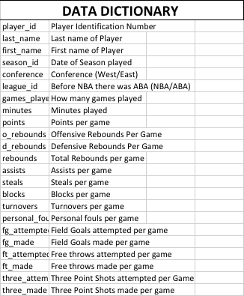
Potential Topic – NBA All Star Prediction
THE DATA
Attached to the right is a sample data dictionary
Again a huge bonus for this particular problem is that the data is readily available in CSV format, nearly every analyzable metric…
This also implies a sense of security that the data is very accurate because it is so accessible it can easily be compared with other databases...

Slide 7
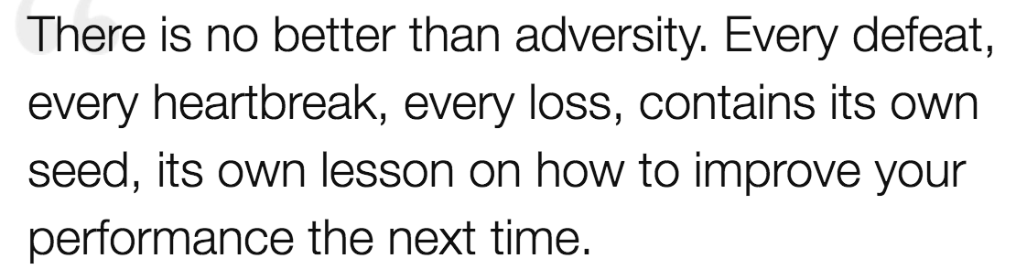
Potential Topic – NBA All Star Prediction
OUTCOMES
With a proper combination of statistical data and twitter sentiment analysis I believe that we will be able to successfully create a model (decision tree/k-nn/logit-regress/random forest) that will be able to determine who is most likely going to be an all – star in the coming year…
The model needs to be as complex as it needs to be, no less no more... As long as we are able to create a model that falls between the curve so we are not overfitting or underfitting we will be sucessfull...
If our project is unsucessfull, I think it is important to understand why it was unsuccesful and how we can improve in the future so we can avoid such mistakes..

