Slide 1
GA Capstone: Automated Stock Trading Agent
Will Arliss

Slide 2
Presentation
Define problem
Briefly discuss model type
Describe backtesting environment
Display results
Conclude findings

Slide 3
Problem Statement
Can an intelligent stock trading agent be trained in a backtesting simulation environment to learn how to profitably trade stocks and automate the process of portfolio management?
Reinforcement Learning AI techniques will be employed to train a Deep Q-Network on historical stock prices
The goal of the model is not to predict prices, but rather to predict quantities of shares to trade such that a long term profit will be achieved

Slide 4
Portfolio Management
“Portfolio management is the art and science of selecting and overseeing a group of investments that meet the long-term financial objectives and risk tolerance of a client, a company, or an institution.”
Investopedia
Source: https://www.investopedia.com/terms/p/portfoliomanagement.asp#:~:text=Portfolio%20management%20is%20the%20art,a%20company%2C%20or%20an%20institution.

Slide 5
Reinforcement Learning
{reward}
{next state}
Agent’
Environment
{next action}
action
next state
reward
Environment’
Agent
γ {next reward}

Slide 6
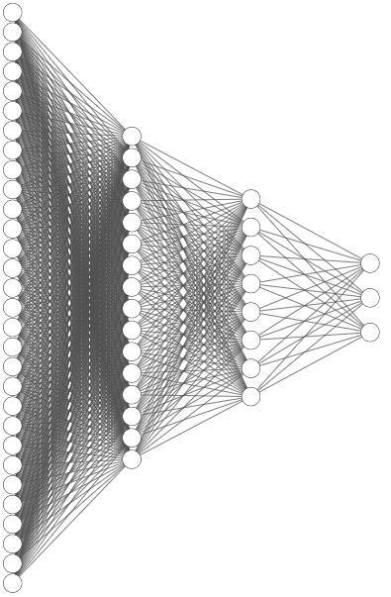
Deep Q-Network
270.67
274.52
269.3
272.42
18478500
270.95
276.64
265.7
266.15
24093800
270.06
271.39
262.64
266.61
18913900
275.51
279.16
267.03
268.09
24814700
275.77
278.48
271.35
273.72
22918800
988334.4
123.4498
10475.19
150
111.2489
 | Open | High | Low | Close | Volume
9/15/2020 | 270.670013 | 274.51999 | 269.299988 | 272.420013 | 18478500
9/14/2020 | 270.950012 | 276.64002 | 265.700012 | 266.149994 | 24093800
9/11/2020 | 270.059998 | 271.39002 | 262.640015 | 266.609985 | 18913900
9/10/2020 | 275.51001 | 279.16 | 267.029999 | 268.089996 | 24814700
9/9/2020 | 275.769989 | 278.48001 | 271.350006 | 273.720001 | 22918800
Q1 Expected reward from selling
Q2 Expected reward from holding
 | Net worth | Balance | Shares held | Date range | Shares value
9/15/2020 | 988334.37 | 123.4498 | 10475.1923 | 150 | 111.248851
Q3 Expected reward from buying
Environment state on 9/15/2020

Slide 7

Trading Environment
Backtesting is the process of simulating the performance of a particular strategy or model ex-post
A stock’s price history is broken into a training set and a testing set. At every episode of training, the model starts at a random point in the training set and executes trades until it has a negative balance or it reaches the train-test split point
The model receives feedback from the backtesting environment in the form of rewards
$r= \frac{{profit}_{m} − {profit}_{bh}}{{balance}_{0}}$

Slide 8
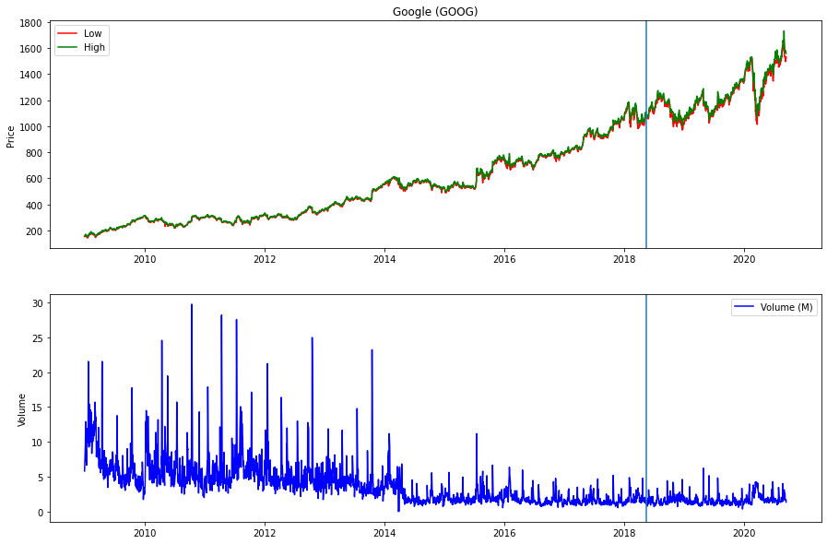
Training Data – Google
Data source: https://finance.yahoo.com/lookup/

Slide 9
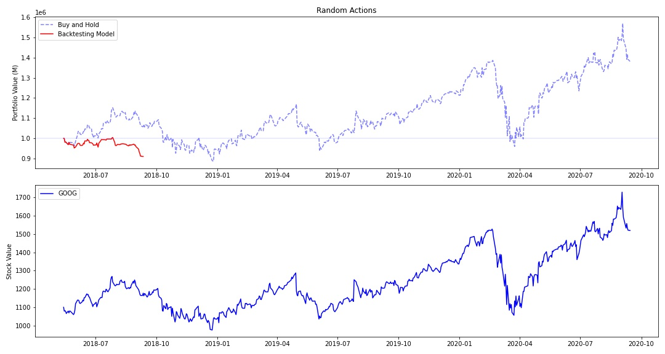
Google Backtesting – Random Agent

Slide 10
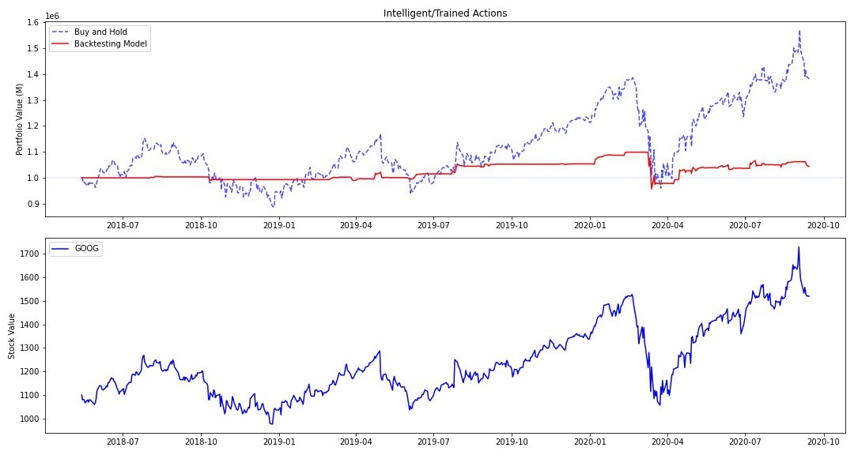
Google Backtesting – 100 Training Episodes

Slide 11
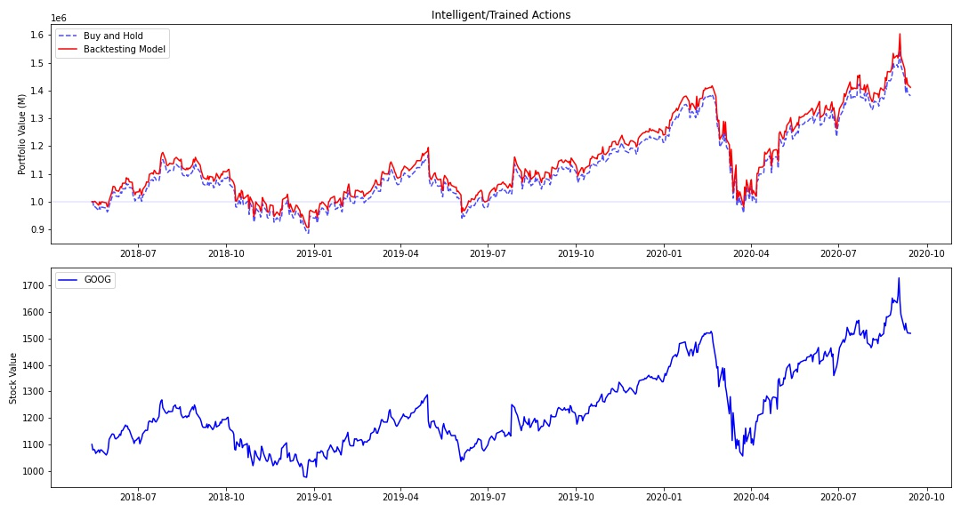
Google Backtesting – 2,500 Training Episodes

Slide 12
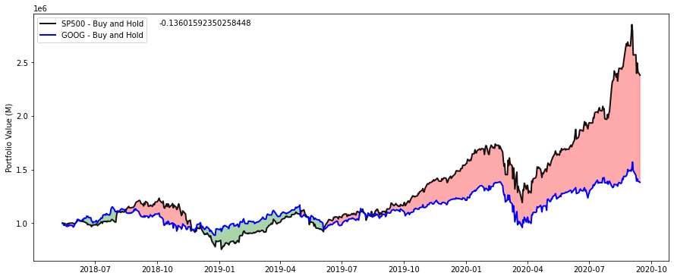
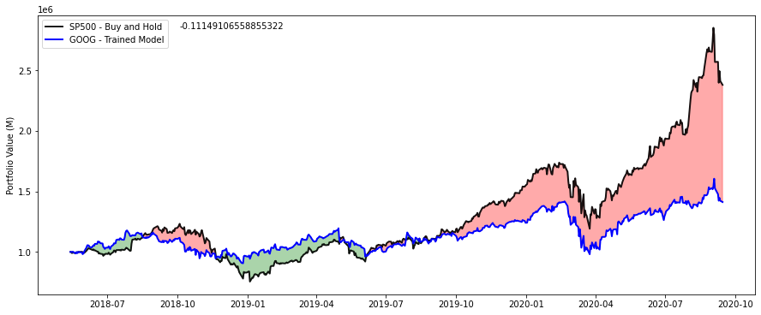
Google Backtesting – Summary
 | Buy and Hold | Trained Model | Difference
1 Year Return | 2.790% | 5.078% | 2.288%
2 Year Return | 22.522% | 25.249% | 2.727%
Lifetime Return | 38.084% | 41.157% | 3.073%
Lifetime Profit | $380,840.61 | $411,574.48 | $30,733.87
Against S&P 500 | -13.602% | -11.149% | 2.452%
Against S&P 500 | -$176,757.86 | -$151,961.93 | $24,795.93

Slide 13
Google Backtesting – Summary
 | Buy and Hold | Trained Model | Difference
1 Year Return | 2.790% | 5.078% | 2.288%
2 Year Return | 22.522% | 25.249% | 2.727%
Lifetime Return | 38.084% | 41.157% | 3.073%
Lifetime Profit | $380,840.61 | $411,574.48 | $30,733.87
Against S&P 500 | -13.602% | -11.149% | 2.452%
Against S&P 500 | -$176,757.86 | -$151,961.93 | $24,795.93

Slide 14
Google Backtesting – Summary
 | Buy and Hold | Trained Model | Difference
1 Year Return | 2.790% | 5.078% | 2.288%
2 Year Return | 22.522% | 25.249% | 2.727%
Lifetime Return | 38.084% | 41.157% | 3.073%
Lifetime Profit | $380,840.61 | $411,574.48 | $30,733.87
Against S&P 500 | -13.602% | -11.149% | 2.452%
Against S&P 500 | -$176,757.86 | -$151,961.93 | $24,795.93

Slide 15
Google Backtesting – Summary
 | Buy and Hold | Trained Model | Difference
1 Year Return | 2.790% | 5.078% | 2.288%
2 Year Return | 22.522% | 25.249% | 2.727%
Lifetime Return | 38.084% | 41.157% | 3.073%
Lifetime Profit | $380,840.61 | $411,574.48 | $30,733.87
Against S&P 500 | -13.602% | -11.149% | 2.452%
Against S&P 500 | -$176,757.86 | -$151,961.93 | $24,795.93

Slide 16
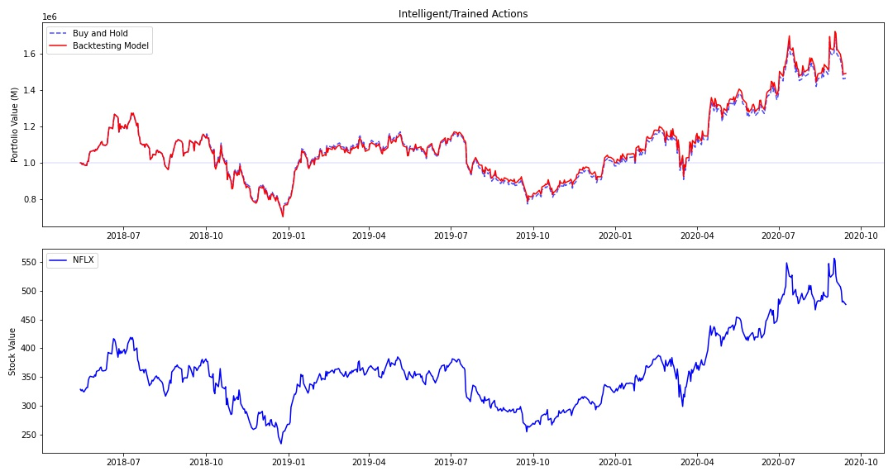
Netflix Backtesting

Slide 17
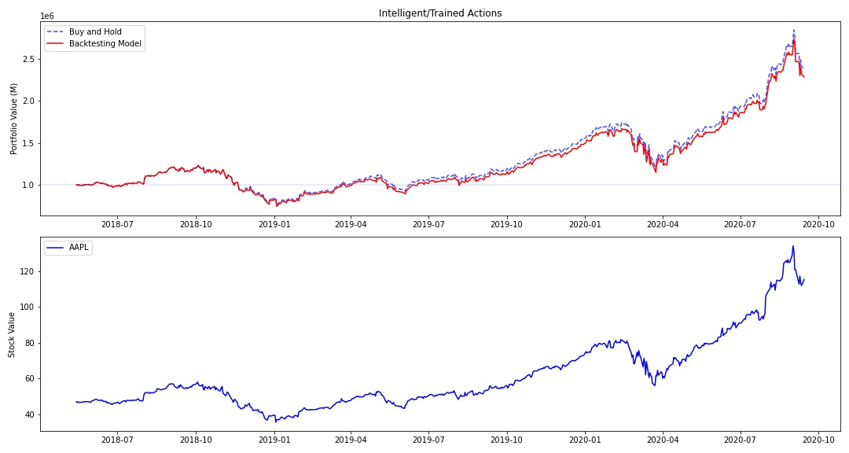
Apple Backtesting

Slide 18
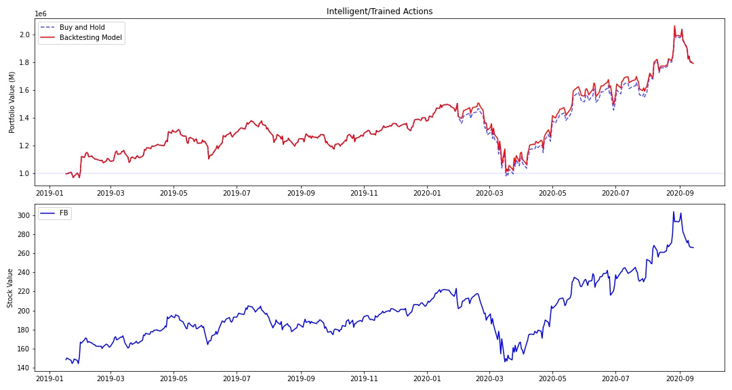
Facebook Backtesting

Slide 19
What does this mean
The agent learned the “buy and hold” strategy
One of the safest and most common investment strategies out there
Although not great from an outside perspective, the results are good for the composition of the model

Slide 20
Conclusions / Next Steps
Problem statement called for managing an entire portfolio, this agent/environment only handles one at a time
Although successful at managing one stock, more work is needed for managing a portfolio

Slide 21
Questions

