Slide 1
GA Capstone: Automated Stock Trading Agent
Semi-technical presentation
Will Arliss

Slide 2
Problem Statement
Can an intelligent stock trading agent be trained in a backtesting simulation environment to learn how to profitably trade stocks and automate the process of portfolio management?
Reinforcement Learning AI techniques will be employed to train a Deep Q-Network on historical stock prices
The goal of the model is not to predict prices, but rather to predict quantities of shares to trade such that a long term profit will be achieved

Slide 3
Portfolio Management

Slide 4
Reinforcement Learning
{reward}
{next state}
Agent’
Environment
{next action}
action
next state
reward
Environment’
Agent
γ {next reward}

Slide 5
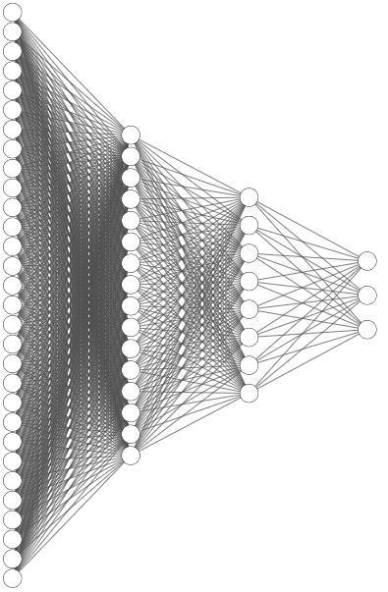
Deep Q-Network
270.67
274.52
269.3
272.42
18478500
270.95
276.64
265.7
266.15
24093800
270.06
271.39
262.64
266.61
18913900
275.51
279.16
267.03
268.09
24814700
275.77
278.48
271.35
273.72
22918800
988334.4
123.4498
10475.19
150
111.2489
 | Open | High | Low | Close | Volume
9/15/2020 | 270.670013 | 274.51999 | 269.299988 | 272.420013 | 18478500
9/14/2020 | 270.950012 | 276.64002 | 265.700012 | 266.149994 | 24093800
9/11/2020 | 270.059998 | 271.39002 | 262.640015 | 266.609985 | 18913900
9/10/2020 | 275.51001 | 279.16 | 267.029999 | 268.089996 | 24814700
9/9/2020 | 275.769989 | 278.48001 | 271.350006 | 273.720001 | 22918800
Q1 Expected reward from selling
Q2 Expected reward from holding
 | Net worth | Balance | Shares held | Date range | Shares value
9/15/2020 | 988334.37 | 123.4498 | 10475.1923 | 150 | 111.248851
Q3 Expected reward from buying
Environment state on 9/15/2020

Slide 6
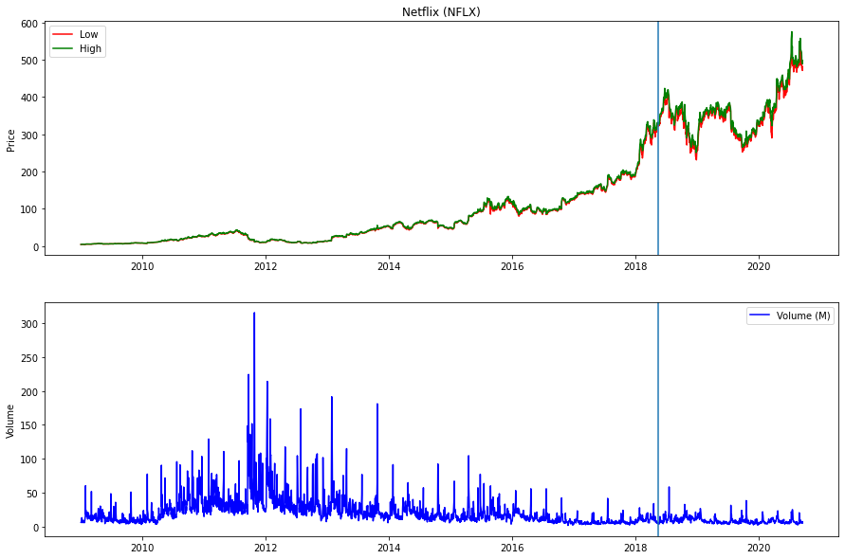
Training Data
Data source: https://finance.yahoo.com/lookup/

Slide 7
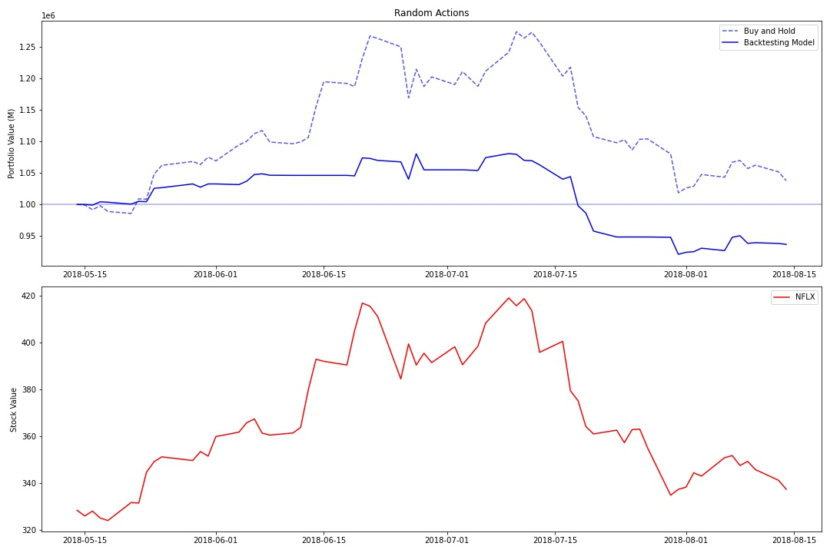
Random Backtesting - Portfolio

Slide 8
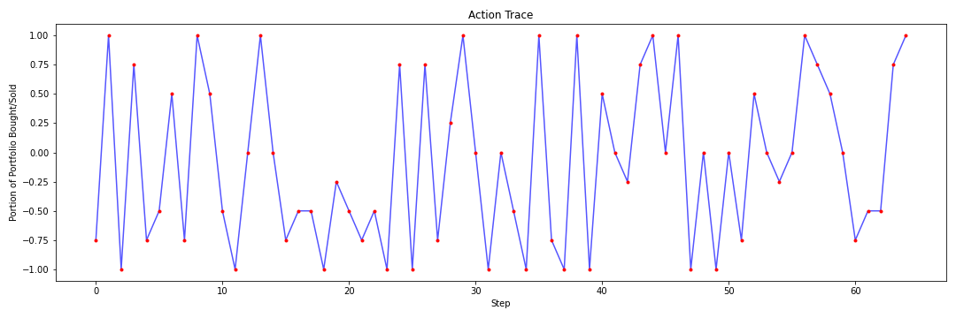
Random Backtesting – Actions

Slide 9
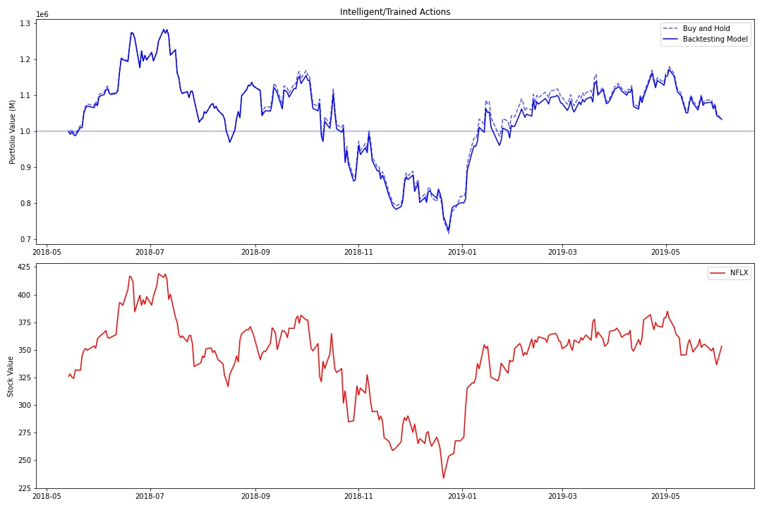
Trained Backtesting – Portfolio

Slide 10
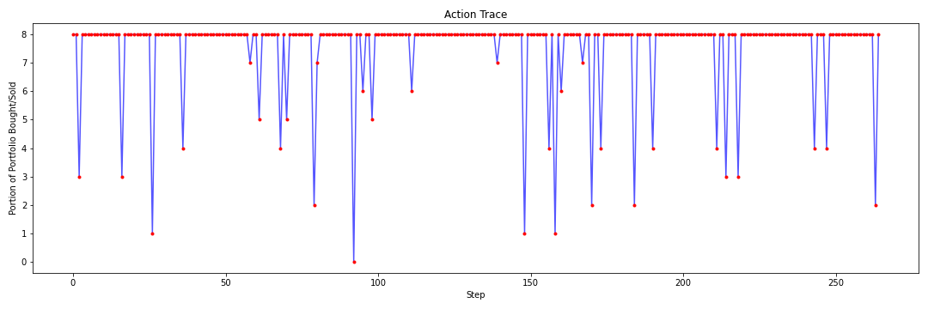
Trained Backtesting – Actions

Slide 11
What does this mean
The agent learned the “buy and hold” strategy

