Slide 1
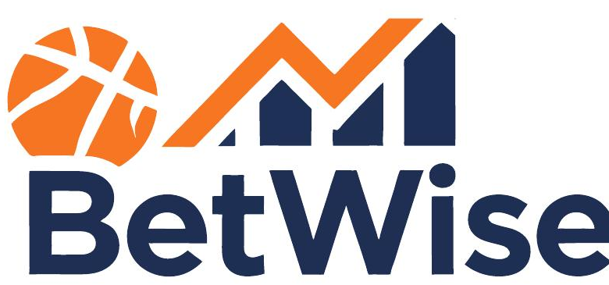
A sports betting strategy
backtesting platform.
Replacing guesswork with evidence.
April 30, 2026
Cate Anderson | William Armsworthy | Ryan Putka

Slide 2

The Sports Betting Market
The U.S. legal sports betting industry is at a record high — and it has never been more profitable for the house.
Market Overview
● Sports betting market size is at a record high, driven by strong growth in iGaming and mobile betting.
● Per the AGA (Feb 2026), Americans legally bet $166.94 billion on sports in 2025 — an 11% increase from 2024.
● The U.S. commercial gaming industry generated record-breaking revenue for a fourth consecutive year in 2024.
● Mobile and iGaming have permanently re-shaped the industry, expanding the bettor pool and entrenching the operators.
By the Numbers — 2025
Sector Trends
$166.9B
+11%
$
Mobile sportsbooks now account for the majority of all U.S. handle, with FanDuel and DraftKings dominating market share.
Total handle wagered
YoY handle growth
%
Player props and parlays have surged in popularity — and they carry the highest vig of any market type.
$16.96B
38
2025 betting revenue
States w/ legal betting
!
Bettor losses are climbing in lockstep with the boom — debt and problem gambling are both at record levels.

Slide 3
The House Always Wins
The math is rigged before tip-off — and only 4% of bettors ever beat it long-term.
How the Edge Works
The Toll on Bettors
● Every line carries a vig (vigorish) — the book’s built-in commission baked into every price you see.
4%
30%
● At standard -110 odds, the book locks in a ~4.54% margin regardless of outcome. You must win 52.38% of bets just to break even.
of 700,000 bettors turned long-term profit
carry debt attributed to gambling
● Without backtesting, bettors have no feedback loop — they can’t separate skill from variance or test ideas before risking real money.
52%
25%
● Sportsbooks bring historical data, quant models, and risk teams. Bettors bring opinions.
carry a credit card balance month-to-month
have missed a bill due to wagers
Bettors are bringing opinions to a fight where the house brings models. It is not a fair game.

Slide 4
Enter BetWise — Giving Bettors Their Edge Back
A platform to test betting strategies against years of real historical data — before risking a dollar.
What BetWise Does
Three Value Pillars
● Simulates user-defined betting strategies across past games, seasons, and conditions.
01
Test before you bet
Run any strategy against the historical record before any money is at risk.
● Surfaces performance, ROI, and consistency metrics for every backtest run.
02
See the truth in the data
ROI, hit rate, drawdown, and win streaks — the real numbers, not narratives.
● Lets users save and revisit strategies to compare approaches over time.
● Replaces guesswork with evidence — no more vibes-based wagering.
03
Build a library of edges
Save winning strategies and iterate on losing ones over time.
How a Strategy Becomes Evidence
Positioning
1
2
3
4
Without BetWise
With BetWise
× Hunches and narratives
× No record of past bets
× Strategies live in your head
× The book has all the data
✓ Test against real history
✓ Quantified ROI & hit rate
✓ Persistent strategy library
✓ Evidence-based decisions
Define
Backtest
Analyze
Save
Pick the rules
Run vs. history
Read the metrics
Add to library

Slide 5
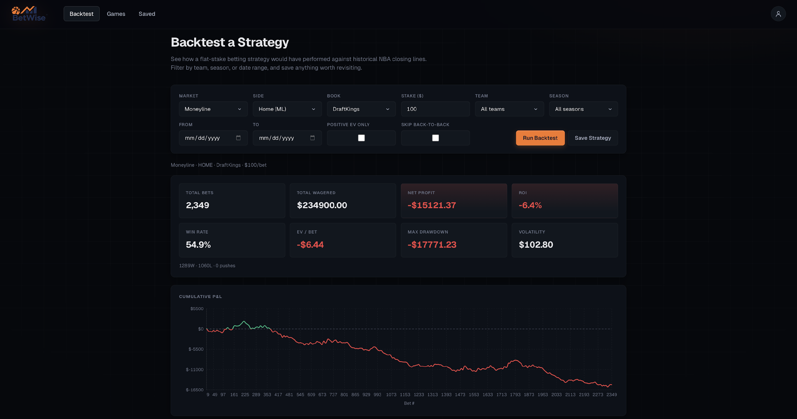
How It Works

Slide 6
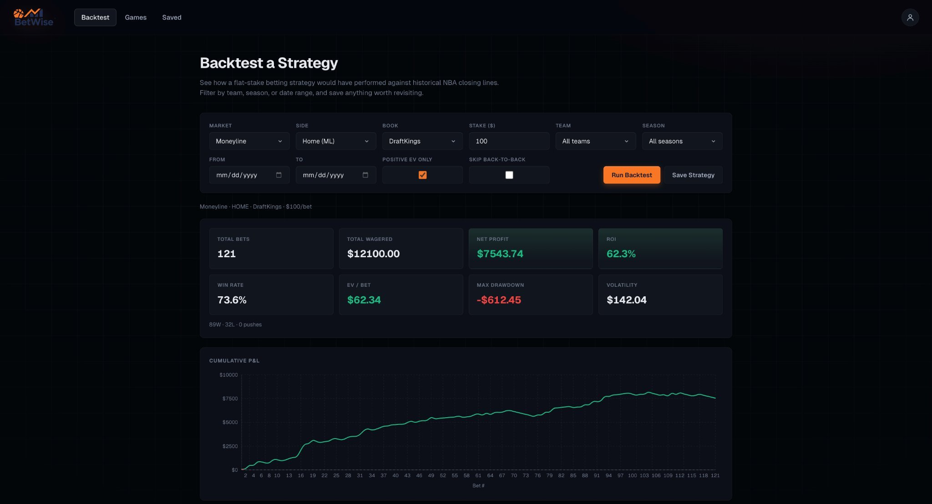
How It Works

Slide 7
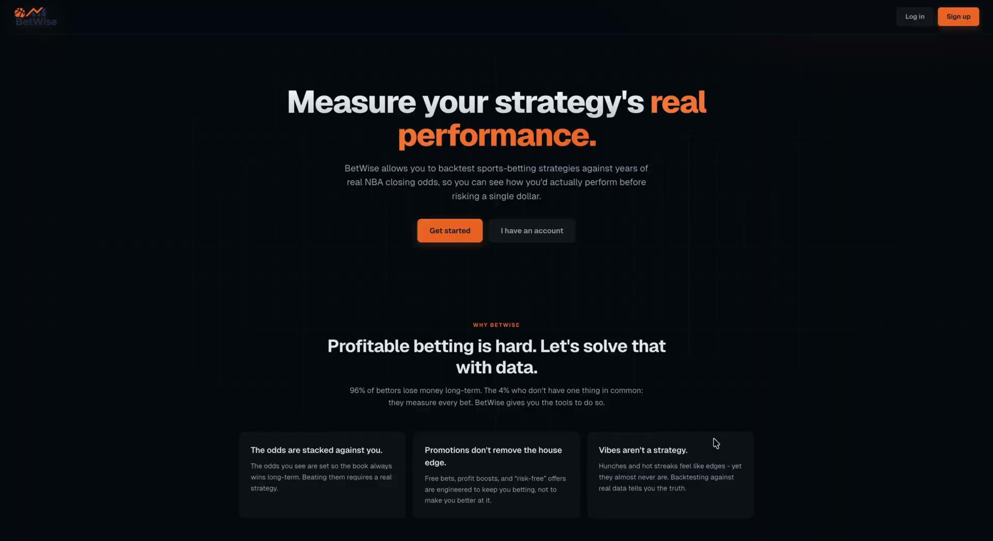
Video Demonstration

Slide 8
Room for Growth
Player Props
More Flexible Inputs
● Add player-level markets like points, rebounds, assists, etc.
● Combine filters: rest days, weather, travel, line movement.
● Backtest against per-game player box scores, not just team results.
● Bet-sizing options beyond flat units --> higher EV bets weighted more
● More lines means more chances for books to slip up --> more opportunity
● Natural language input
More Leagues & Markets
The Bottom Line
NBA
NFL
MLB
NFL
NFL
The house has the data.
NHL
NCAAF
NCAAB
BetWise puts it back in your hands.
EPL
UFC
PGA
Less vibes, more wins, one strategy at a time.

Slide 9
Citations
Applebaum, Josh. “Sports Betting Explained: Juice, House Edge & Expectations.” Casino.Org Blog, 28 Oct. 2025, www.casino.org/blog/sports-betting-house-edge/.
Garrison, Greg. “2025 Sports Betting and Debt Survey.” U.S. News & World Report, 23 July 2025, www.usnews.com/banking/articles/2025-sports-betting-and-debt-survey.
“State of the States 2025 - American Gaming Association.” American Gaming Association, 13 May 2025, www.americangaming.org/resources/state-of-the-states-2025/.
Surendran, Shwetha. “Sports Betting Hits Record $16.96 Billion in Revenue in 2025.” ESPN, ESPN Internet Ventures, 26 Feb. 2026, www.espn.com/espn/betting/story/_/id/48045855/sports-betting-hits-record-1696-billion-revenue-2025.

Slide 10
Thank You!

