Slide 1

San Antonio Region
OOH Current Holdings
59 contracted holdings · 40 in market now · prepared 8/28/2026 · H-E-B OOH Program

Slide 2
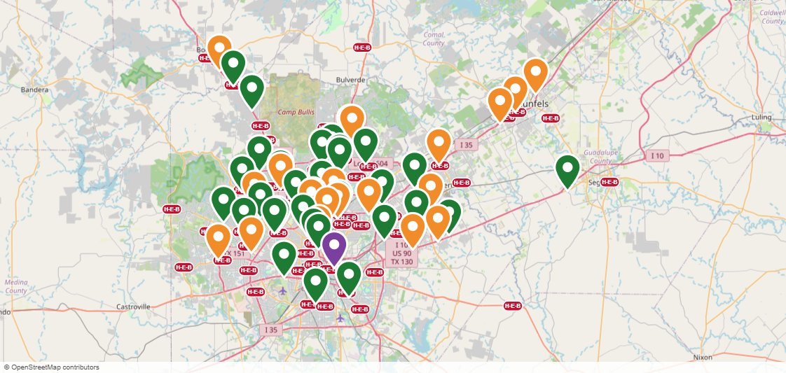
San Antonio Region OOH Current Holdings Map
Green pin = in market now · Orange pin = starting soon · Purple pin = Unique OOH (wallscapes / transit) · Purple dashes = Bus Routes · Red pills = H-E-B stores

Slide 3



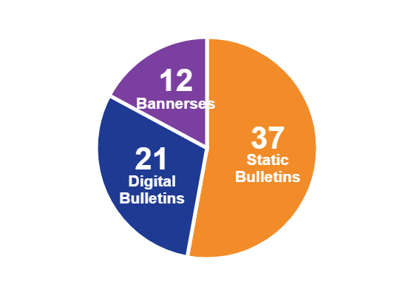

Costs & Impressions — San Antonio Region
$144,940
24,246,472
$1.49
PER PERIOD COMMITTED (IN-MARKET)
IMPRESSIONS / WEEK
EFFECTIVE CPM (4-WEEK)
$52,526
· 37 Static Bulletins
· 21 Digital Bulletins
· 12 Bannerses
59
FY26 BUDGET LEFT TO SPEND
CONTRACTED HOLDINGS · 40 IN MARKET · 19 STARTING SOON
FORMAT MIX
Full FY26 OOH budget: $1,037,000 · FY26 ends 11/1/2026 · program buys draw down what was left to spend ($433,374)

Slide 4
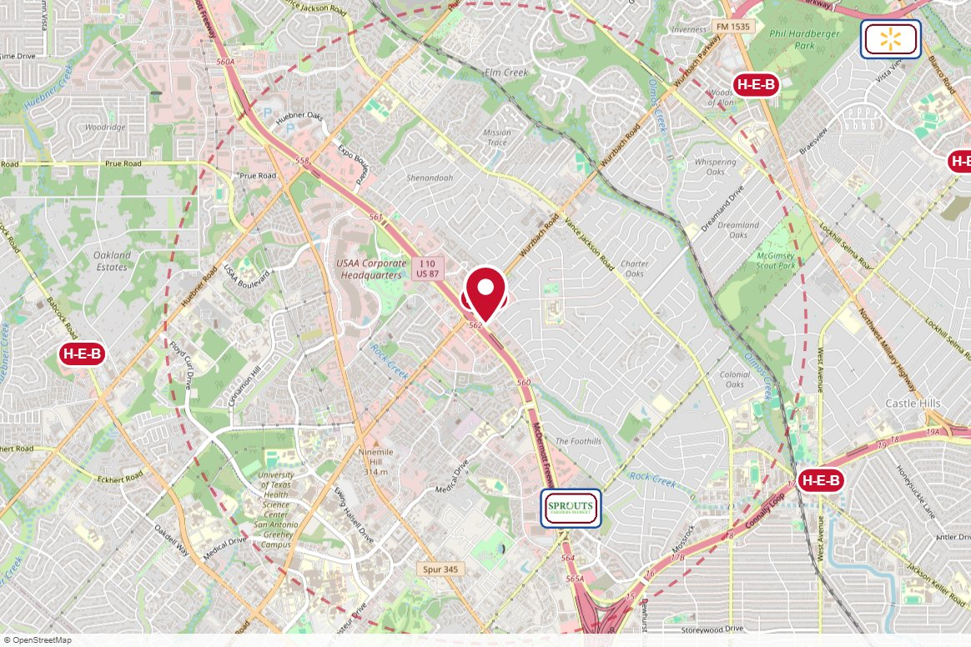
East Face Keller Custom Signs · Static
IN MARKET
no photo on file
PANEL INFO
Location: Double Sided Board (Colonnade) **10-year addendum effective 4/1/21** Total cost reflects PER year
Face: East
Size: 14' x 48'
Contract: 7/6/2026 → 3/31/2031 (Monthly)
Impressions: n/a
Nearest H-E-B: 0.2 mi — I10 and Wurzbach H-E-B
Investment: $5,566 / period
2-MILE AREA
red pin = this panel
red pills = H-E-B stores
company logos = blunting targets
dashed ring = 2-mile radius
San Antonio Region · H-E-B OOH Current Holdings · 8/28/2026

Slide 5
West Face Keller Custom Signs · Static
IN MARKET
no photo on file
PANEL INFO
Location: Double Sided Board (Colonnade) **10-year addendum effective 4/1/21** Total cost reflects PER year
Face: West
Size: 14' x 48'
Contract: 7/6/2026 → 3/31/2031 (Monthly)
Impressions: n/a
Nearest H-E-B: 0.2 mi — I10 and Wurzbach H-E-B
Investment: $5,566 / period
2-MILE AREA
red pin = this panel
red pills = H-E-B stores
company logos = blunting targets
dashed ring = 2-mile radius
San Antonio Region · H-E-B OOH Current Holdings · 8/28/2026

Slide 6
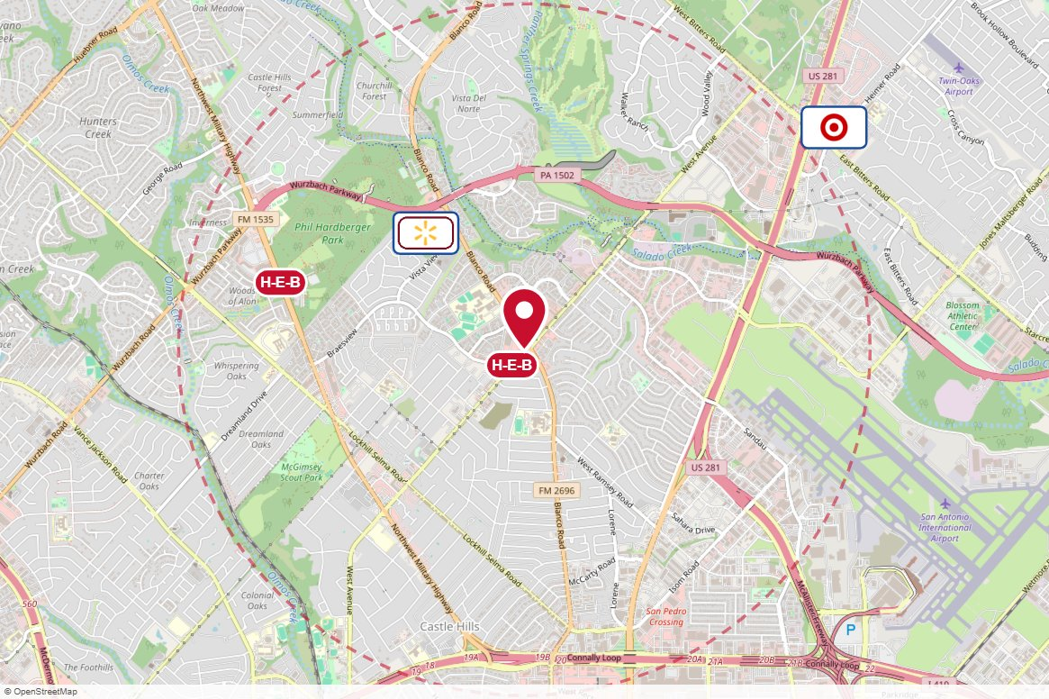
#4446 Clear Channel Outdoor · Static
IN MARKET
no photo on file
PANEL INFO
Location: West Ave 100' W/O Blanco NS
Face: East
Size: 10.5' x 36'
Contract: 7/6/2026 → 9/27/2026 (4-week)
Impressions: 234,667 / week
Nearest H-E-B: 0.1 mi — Blanco and West Ave H-E-B
Investment: $1,775 / period
2-MILE AREA
red pin = this panel
red pills = H-E-B stores
company logos = blunting targets
dashed ring = 2-mile radius
San Antonio Region · H-E-B OOH Current Holdings · 8/28/2026

Slide 7

#3428 Clear Channel Outdoor · Static
IN MARKET
no photo on file
PANEL INFO
Location: West Ave 100' S/O Blanco WS
Face: Southwest
Size: 10.5' x 36'
Contract: 7/6/2026 → 3/28/2027 (4-week)
Impressions: 84,337 / week
Nearest H-E-B: 0.1 mi — Blanco and West Ave H-E-B
Investment: $1,465 / period
2-MILE AREA
red pin = this panel
red pills = H-E-B stores
company logos = blunting targets
dashed ring = 2-mile radius
San Antonio Region · H-E-B OOH Current Holdings · 8/28/2026

Slide 8
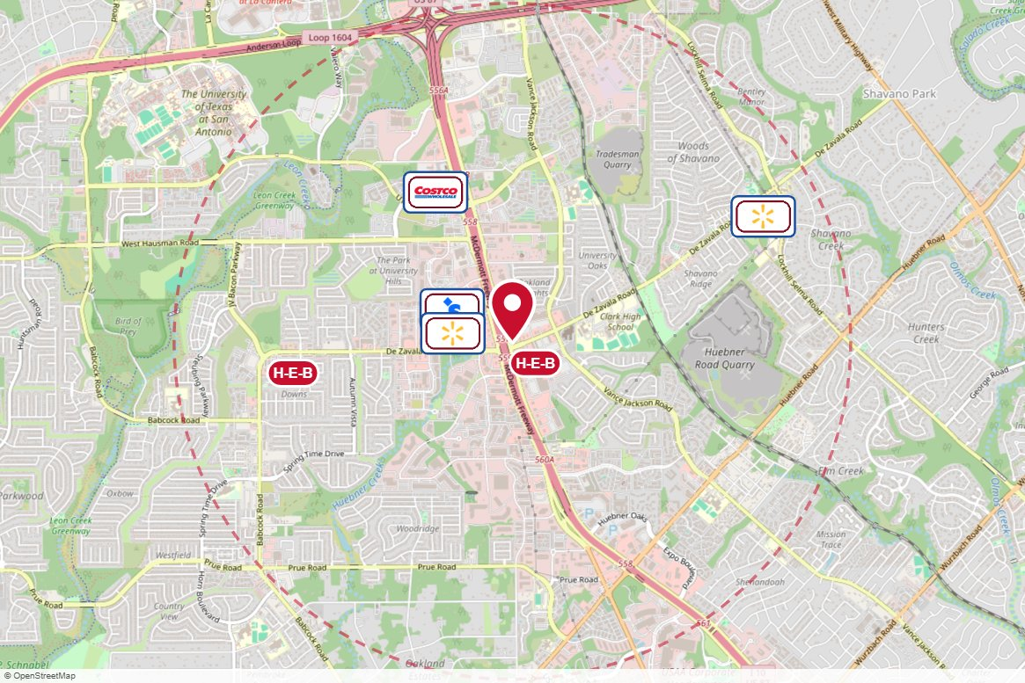
#4338 Clear Channel Outdoor · Static
IN MARKET
no photo on file
PANEL INFO
Location: I-10 NW 100ft n/o DeZavala ES
Face: North
Size: 20' x 60'
Contract: 7/6/2026 → 2/21/2027 (4-week)
Impressions: 601,051 / week
Nearest H-E-B: 0.2 mi — De Zavala H-E-B
Investment: $7,875 / period
2-MILE AREA
red pin = this panel
red pills = H-E-B stores
company logos = blunting targets
dashed ring = 2-mile radius
San Antonio Region · H-E-B OOH Current Holdings · 8/28/2026

Slide 9
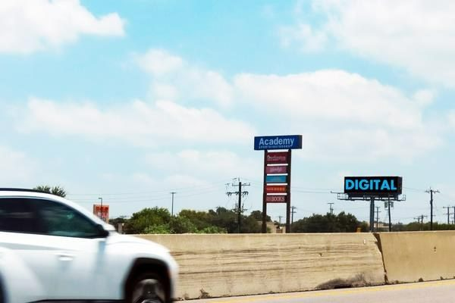
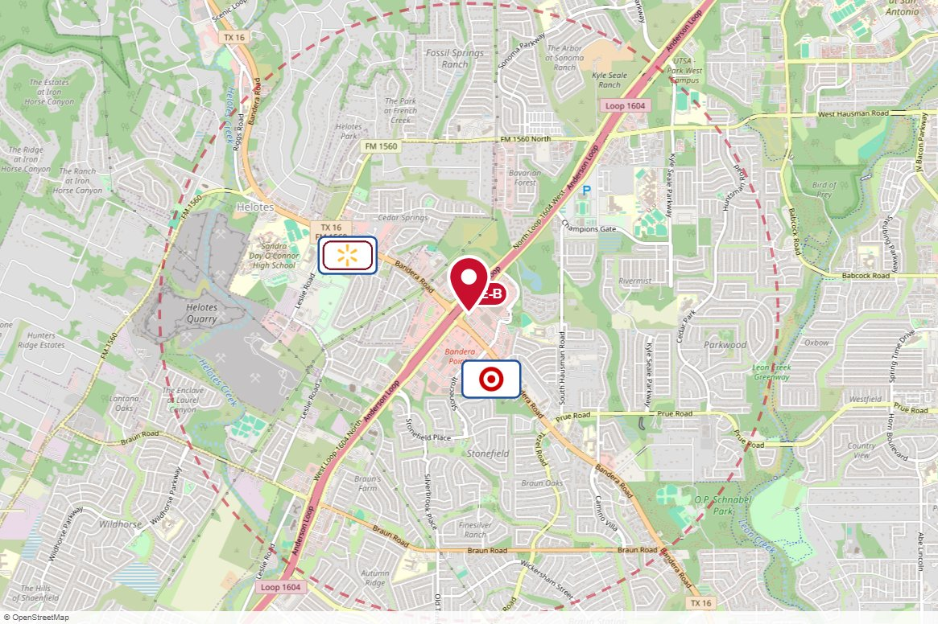
#4126 Clear Channel Outdoor · Digital
IN MARKET
PANEL INFO
Location: 1604 & Bandera
Face: East
Size: 10.5' x 36'
Contract: 4/13/2026 → 4/11/2027 (4-week)
Impressions: 86,239 / week
Nearest H-E-B: 0.2 mi — Bandera and 1604 H-E-B plus!
Investment: — / period
2-MILE AREA
red pin = this panel
red pills = H-E-B stores
company logos = blunting targets
dashed ring = 2-mile radius
San Antonio Region · H-E-B OOH Current Holdings · 8/28/2026

Slide 10
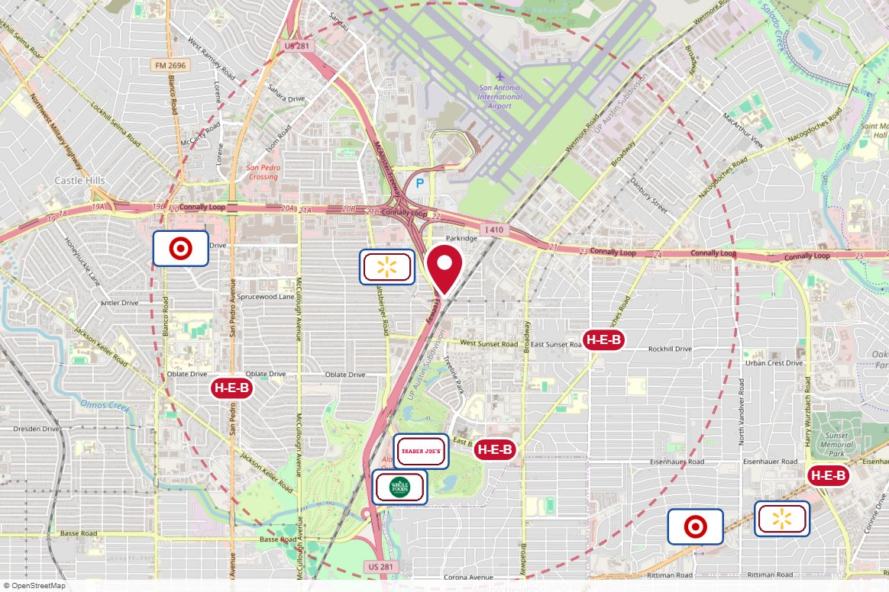
#02_6069O Outfront Media · Static
IN MARKET
no photo on file
PANEL INFO
Location: US 281 N .5M S/O Airport Blvd/Loop 410 ES F/N F/N
Face: North
Size: 14' x 48'
Contract: 7/6/2026 → 2/21/2027 (4-week)
Impressions: 432,834 / week
Nearest H-E-B: 1.1 mi — Lincoln Heights Market H-E-B
Investment: $7,137 / period
2-MILE AREA
red pin = this panel
red pills = H-E-B stores
company logos = blunting targets
dashed ring = 2-mile radius
San Antonio Region · H-E-B OOH Current Holdings · 8/28/2026

Slide 11
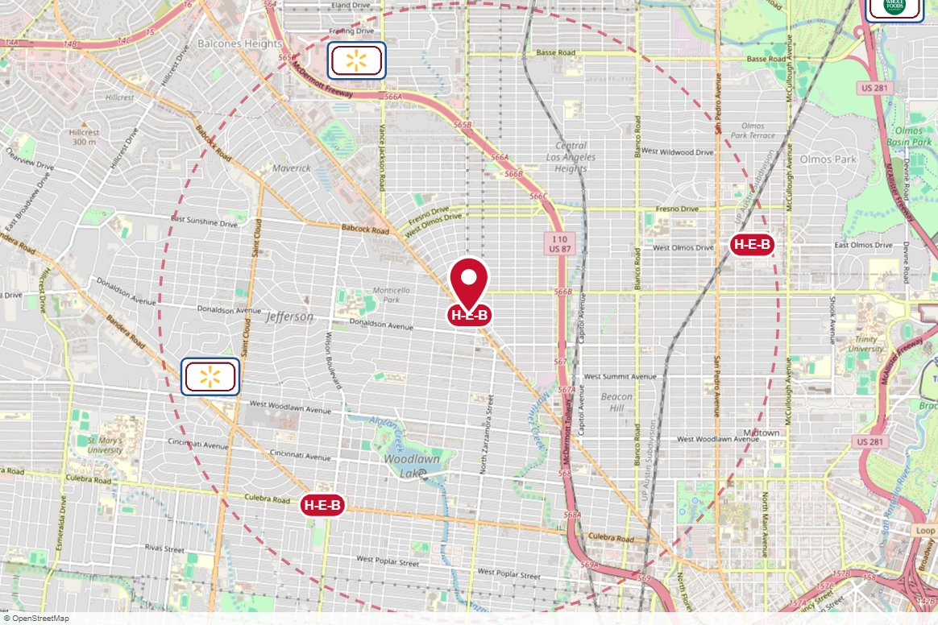
#2569 Clear Channel Outdoor · Static
IN MARKET
no photo on file
PANEL INFO
Location: Fredericksburg 15 ft S/ O West Av ES
Face: Southeast
Size: 12'3" x 24'6"
Contract: 11/1/2025 → 10/31/2030 (Monthly)
Impressions: 29,195 / week
Nearest H-E-B: 0 mi — Deco District H-E-B
Investment: — / period
2-MILE AREA
red pin = this panel
red pills = H-E-B stores
company logos = blunting targets
dashed ring = 2-mile radius
San Antonio Region · H-E-B OOH Current Holdings · 8/28/2026

Slide 12
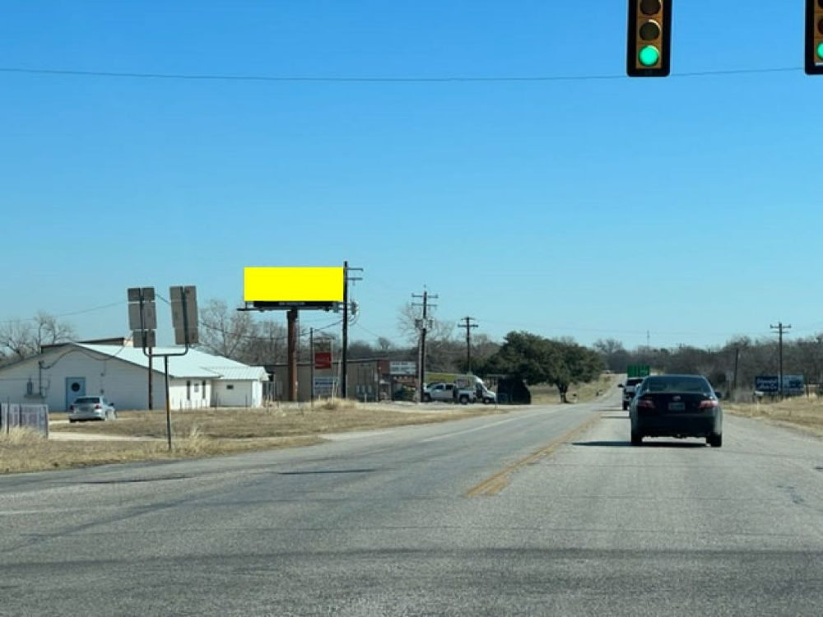
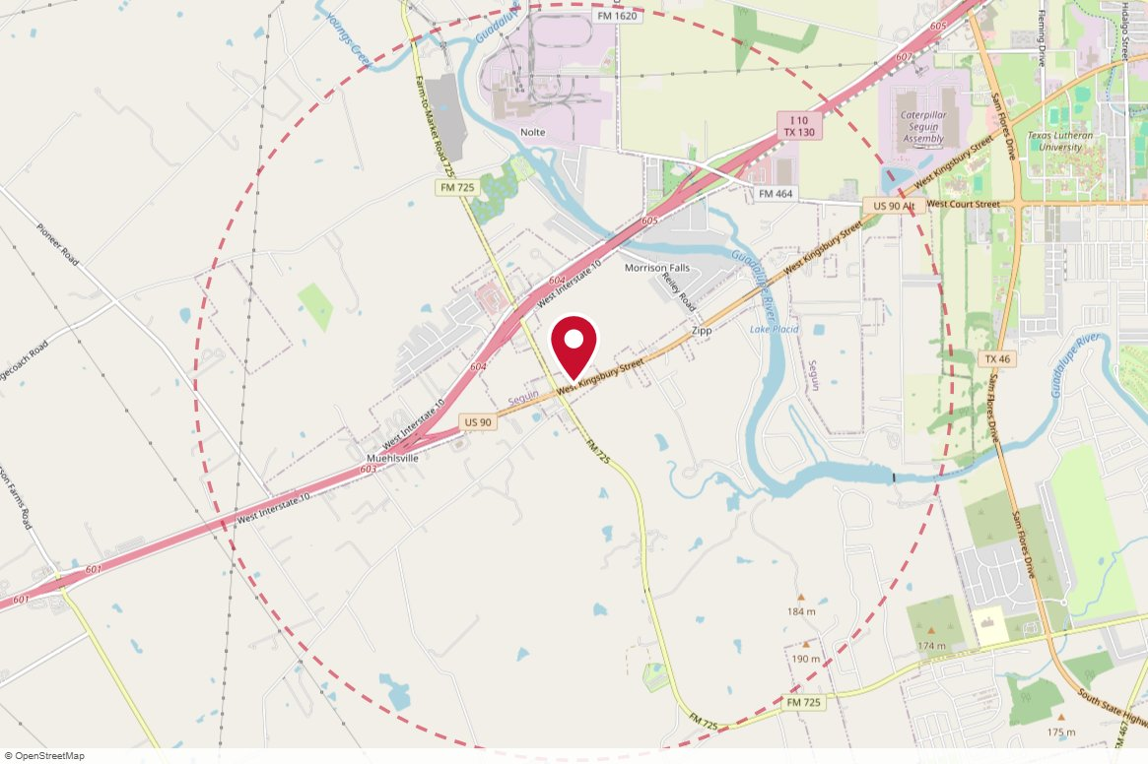
TX46B MH Outdoor Media · Static
IN MARKET
PANEL INFO
Location: N/S of Hwy 90 Bus., 600 feet E/o FM 725. Seguin, Texas N/S, W/F
Face: West · Read: Left
Size: 10' x 30'
Contract: 8/24/2026 → 10/4/2026 (4-week)
Impressions: 166,460 / week
Nearest H-E-B: 5 mi — Seguin H-E-B
Investment: $550 / period
2-MILE AREA
red pin = this panel
red pills = H-E-B stores
company logos = blunting targets
dashed ring = 2-mile radius
San Antonio Region · H-E-B OOH Current Holdings · 8/28/2026

Slide 13
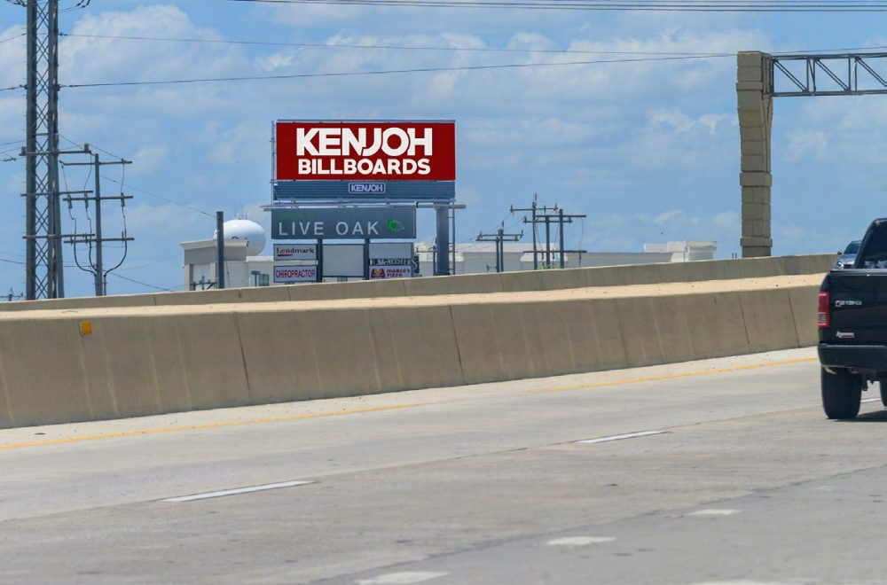
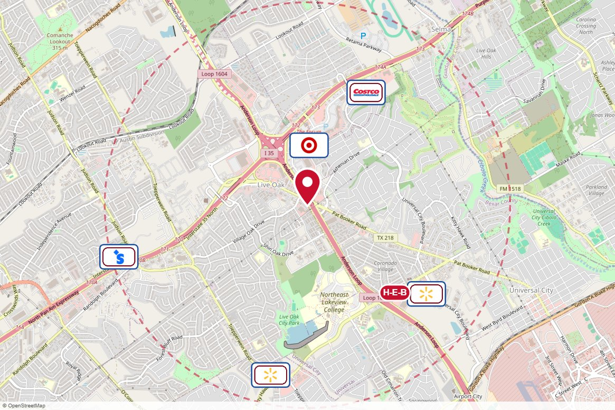
TX305S Kenjoh Outdoor · Digital
IN MARKET
PANEL INFO
Location: Loop 1604 W/L .6 Miles South of I-35
Face: South
Size: 11' x 36'
Contract: 8/24/2026 → 11/1/2026 (4-week)
Impressions: 68,098 / week
Nearest H-E-B: 1.2 mi — Kitty Hawk H-E-B
Investment: $1,250 / period
2-MILE AREA
red pin = this panel
red pills = H-E-B stores
company logos = blunting targets
dashed ring = 2-mile radius
San Antonio Region · H-E-B OOH Current Holdings · 8/28/2026

Slide 14
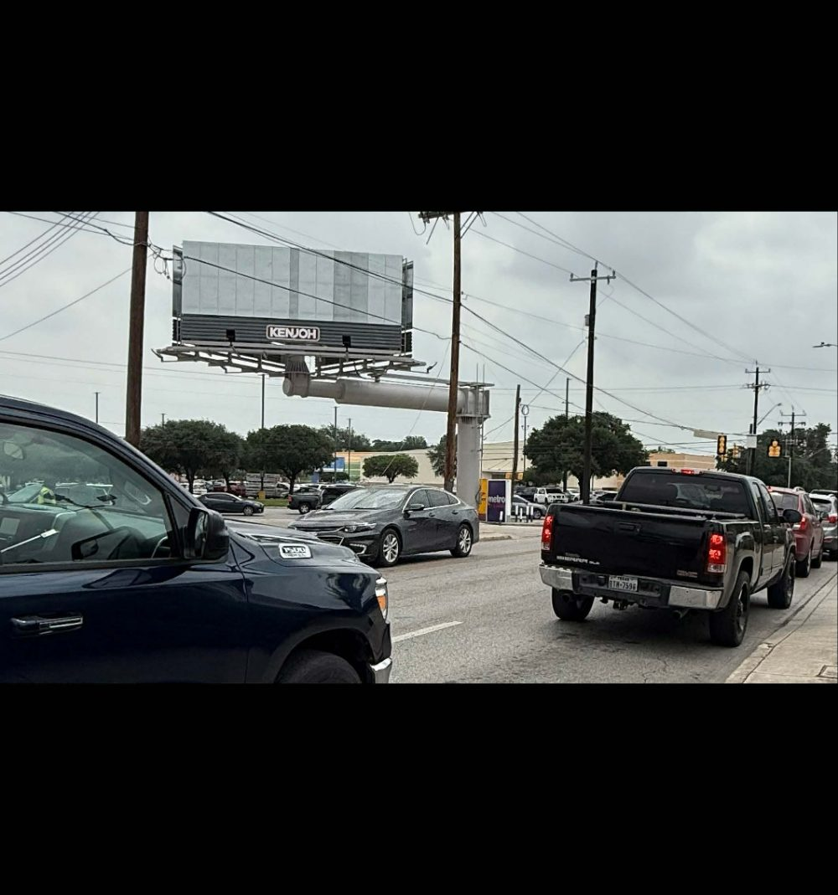
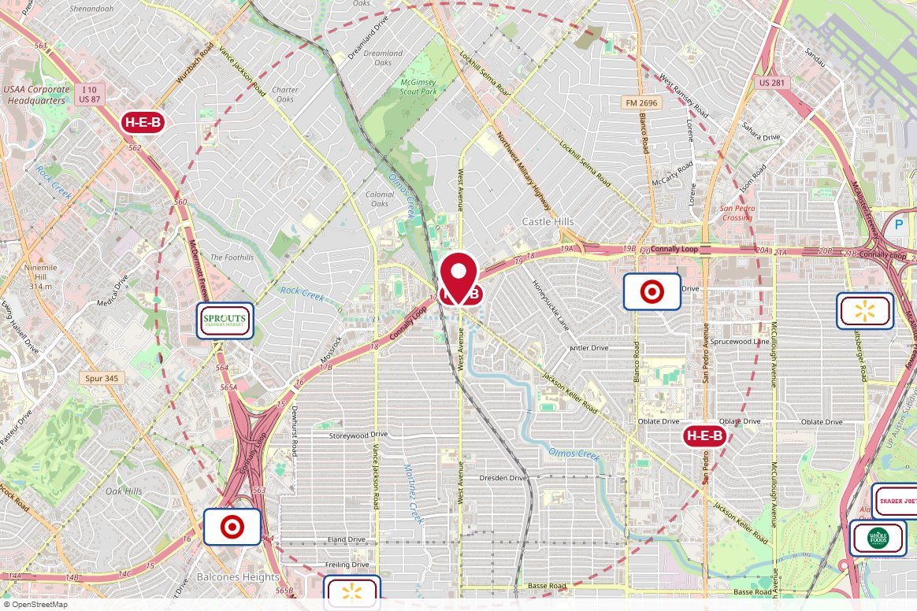
TX309W Kenjoh Outdoor · Static
IN MARKET
PANEL INFO
Location: West Avenue W/L at Jackson Keller Rd, West Face
Face: West
Size: 10' x 30'
Contract: 8/24/2026 → 8/22/2027 (4-week)
Impressions: 80,734 / week
Nearest H-E-B: 0.1 mi — West Ave and Jackson Keller H-E-B
Investment: $2,400 / period
2-MILE AREA
red pin = this panel
red pills = H-E-B stores
company logos = blunting targets
dashed ring = 2-mile radius
San Antonio Region · H-E-B OOH Current Holdings · 8/28/2026

Slide 15
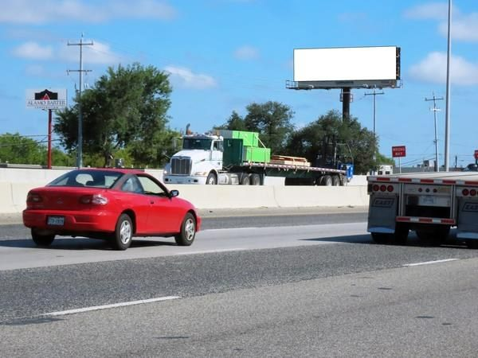
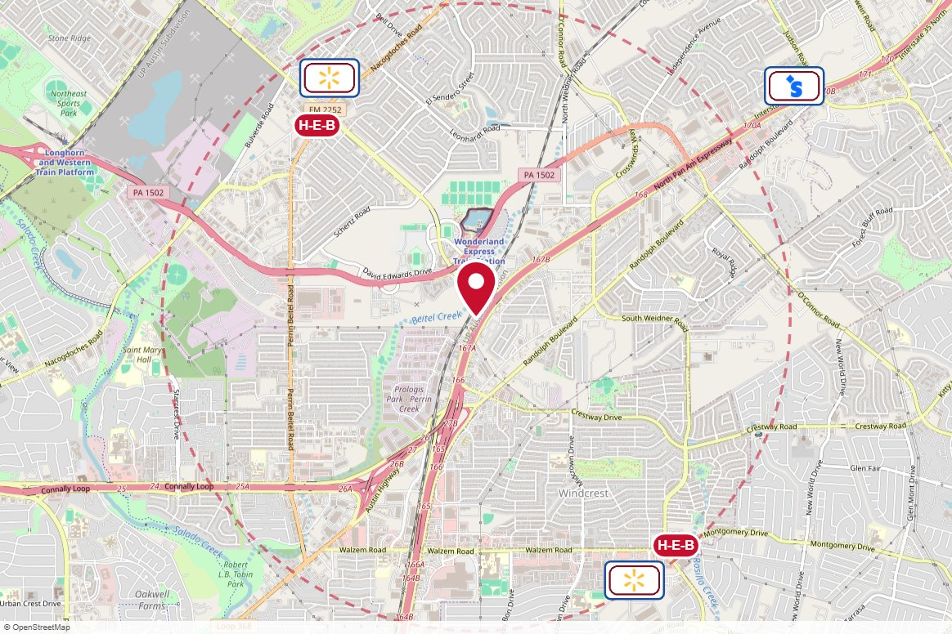
#004157 Clear Channel Outdoor · Static
IN MARKET
PANEL INFO
Location: I-35 N WS 0.9mi N/O Loop 410 F/S - 1
Face: South · Read: Left
Size: 14' x 48'
Contract: 8/24/2026 → 11/1/2026 (4-week)
Impressions: 685,058 / week
Nearest H-E-B: 1.6 mi — Perrin Beitel and Thousand Oaks H-E-B
Investment: $1,500 / period
2-MILE AREA
red pin = this panel
red pills = H-E-B stores
company logos = blunting targets
dashed ring = 2-mile radius
San Antonio Region · H-E-B OOH Current Holdings · 8/28/2026

Slide 16
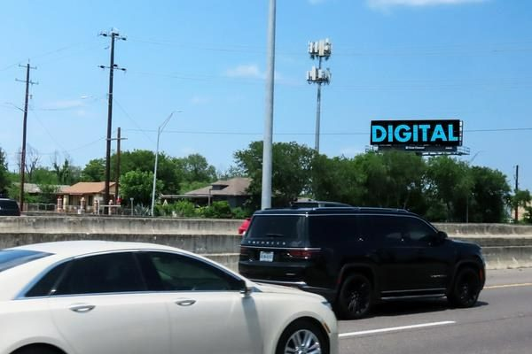
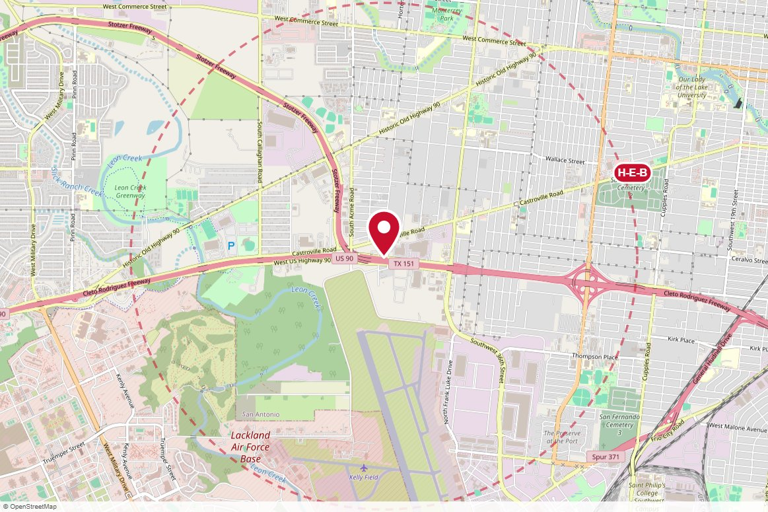
#004225 Clear Channel Outdoor · Digital
IN MARKET
PANEL INFO
Location: US 90 NS 0.2mi E/O Hwy 151 F/W - 1
Face: West · Read: Left
Size: 14' x 48'
Contract: 8/24/2026 → 11/1/2026 (4-week)
Impressions: 196,832 / week
Nearest H-E-B: 2.1 mi — Las Palmas H-E-B
Investment: $2,700 / period
2-MILE AREA
red pin = this panel
red pills = H-E-B stores
company logos = blunting targets
dashed ring = 2-mile radius
San Antonio Region · H-E-B OOH Current Holdings · 8/28/2026

Slide 17
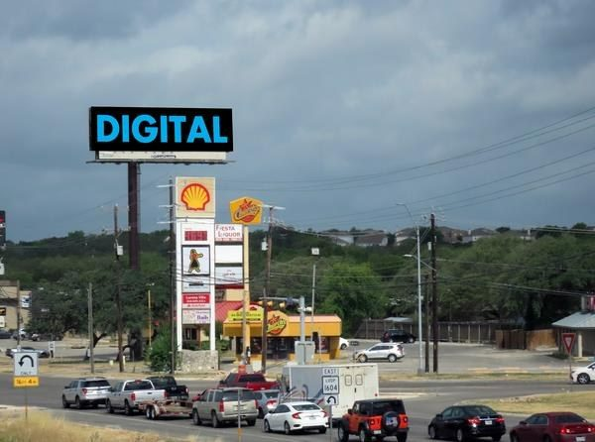
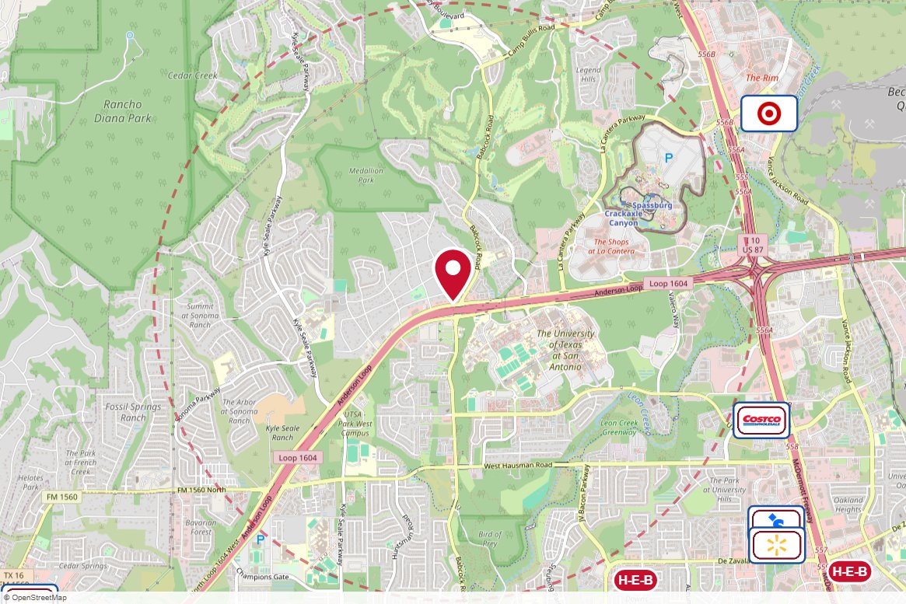
#004875 Clear Channel Outdoor · Digital
IN MARKET
PANEL INFO
Location: Loop 1604 NS 300ft W/O Babcock F/E - 2
Face: East · Read: Right
Size: 14' x 48'
Contract: 8/24/2026 → 11/1/2026 (4-week)
Impressions: 332,535 / week
Nearest H-E-B: 2.2 mi — College Park H-E-B
Investment: $3,313 / period
2-MILE AREA
red pin = this panel
red pills = H-E-B stores
company logos = blunting targets
dashed ring = 2-mile radius
San Antonio Region · H-E-B OOH Current Holdings · 8/28/2026

Slide 18
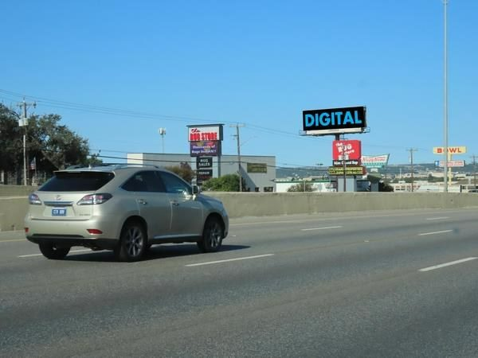
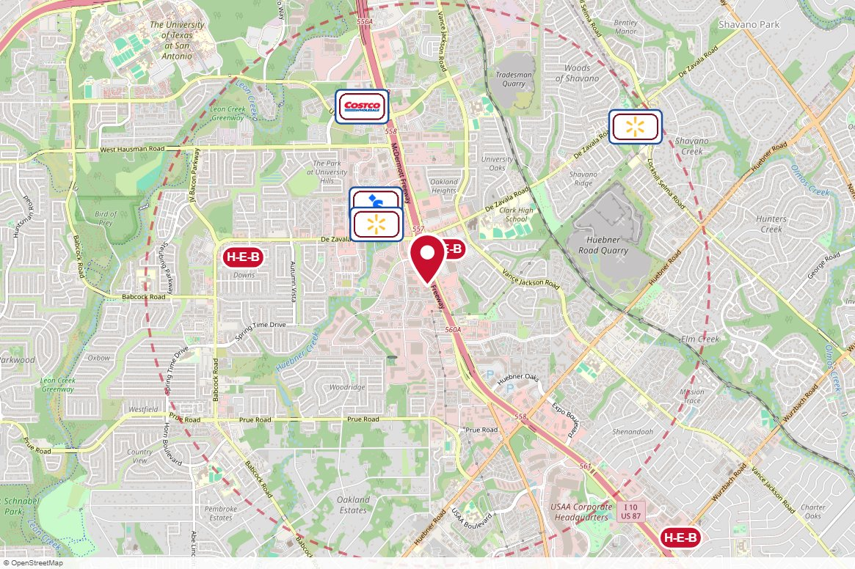
#005187 Clear Channel Outdoor · Digital
IN MARKET
PANEL INFO
Location: I-10 NW WS 0.3mi S/O DeZavala F/S - 1
Face: South · Read: Left
Size: 14' x 48'
Contract: 8/24/2026 → 9/13/2026 (4-week)
Impressions: 439,287 / week
Nearest H-E-B: 0.3 mi — De Zavala H-E-B
Investment: $3,313 / period
2-MILE AREA
red pin = this panel
red pills = H-E-B stores
company logos = blunting targets
dashed ring = 2-mile radius
San Antonio Region · H-E-B OOH Current Holdings · 8/28/2026

Slide 19
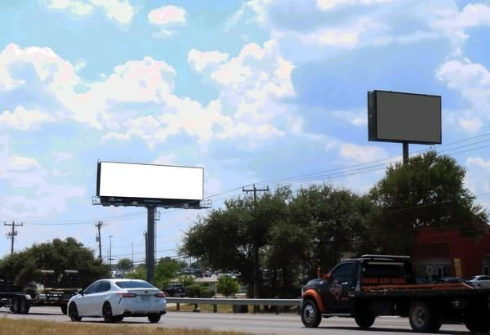
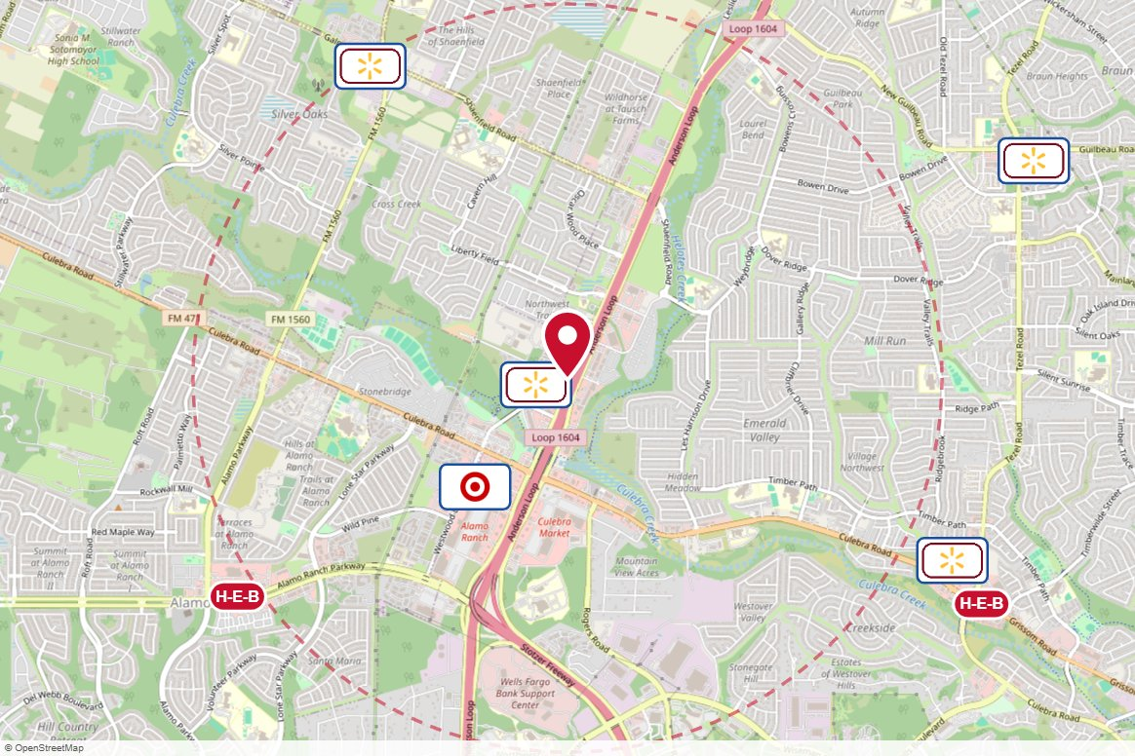
#005569 Clear Channel Outdoor · Static
IN MARKET
PANEL INFO
Location: Loop 1604 WS 0.9mi N/O Culebra F/N - 2
Face: North · Read: Right
Size: 14' x 48'
Contract: 8/24/2026 → 11/1/2026 (4-week)
Impressions: 279,692 / week
Nearest H-E-B: 2.1 mi — Alamo Ranch H-E-B
Investment: $5,500 / period
2-MILE AREA
red pin = this panel
red pills = H-E-B stores
company logos = blunting targets
dashed ring = 2-mile radius
San Antonio Region · H-E-B OOH Current Holdings · 8/28/2026

Slide 20
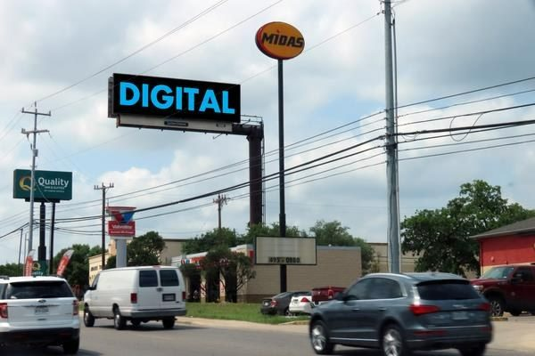
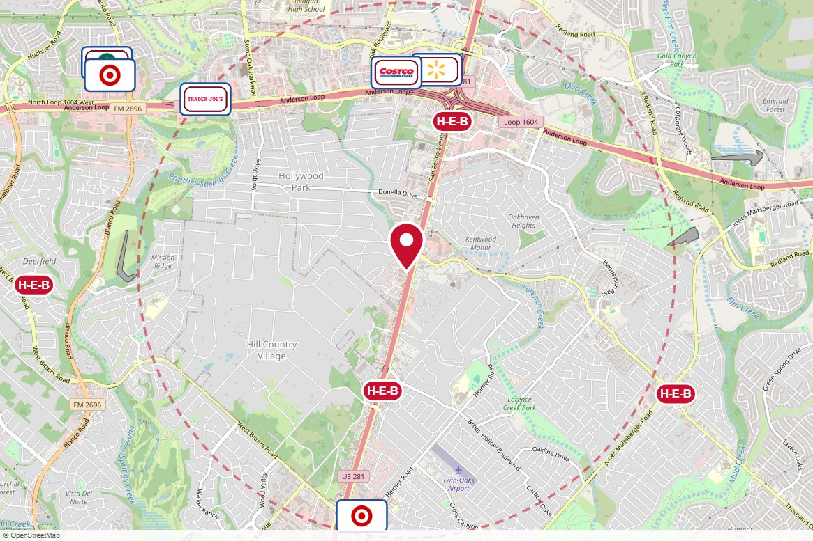
#010206 Clear Channel Outdoor · Digital
IN MARKET
PANEL INFO
Location: US281 N WS 700ft S/O Thousand Oaks F/N
Face: North · Read: Right
Size: 14' x 48'
Contract: 8/24/2026 → 11/1/2026 (4-week)
Impressions: 295,296 / week
Nearest H-E-B: 0.9 mi — Brook Hollow H-E-B
Investment: $3,313 / period
2-MILE AREA
red pin = this panel
red pills = H-E-B stores
company logos = blunting targets
dashed ring = 2-mile radius
San Antonio Region · H-E-B OOH Current Holdings · 8/28/2026

Slide 21
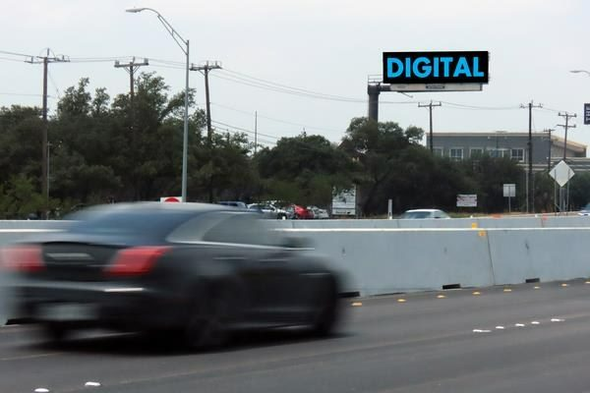
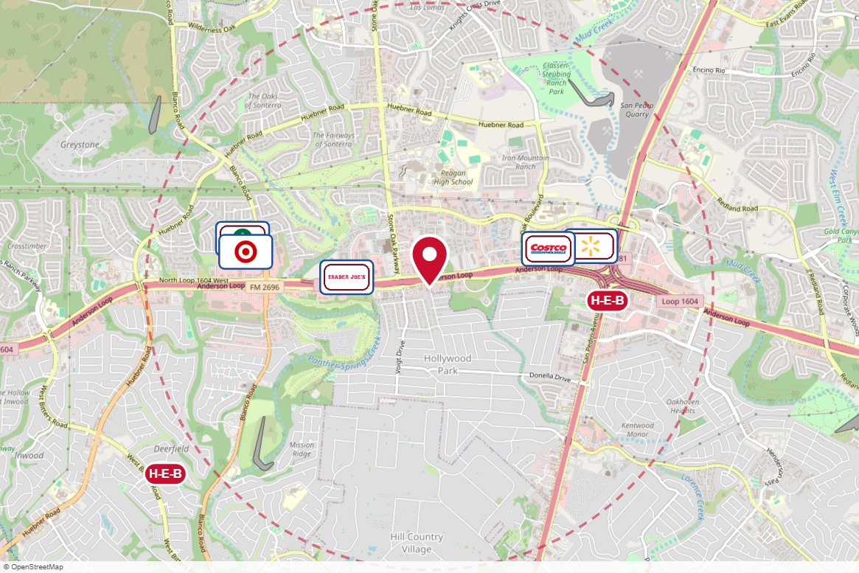
#010208 Clear Channel Outdoor · Digital
IN MARKET
PANEL INFO
Location: Loop1604 SS .2miles E/O Stone Oak Pkwy F/E
Face: East · Read: Left
Size: 14' x 48'
Contract: 8/24/2026 → 11/1/2026 (4-week)
Impressions: 321,050 / week
Nearest H-E-B: 1.2 mi — 281 and 1604 H-E-B
Investment: $2,200 / period
2-MILE AREA
red pin = this panel
red pills = H-E-B stores
company logos = blunting targets
dashed ring = 2-mile radius
San Antonio Region · H-E-B OOH Current Holdings · 8/28/2026

Slide 22
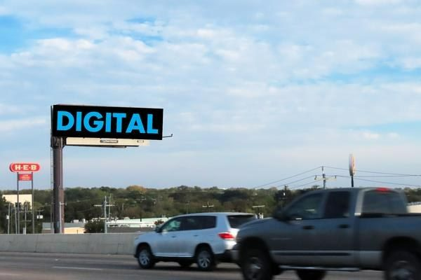
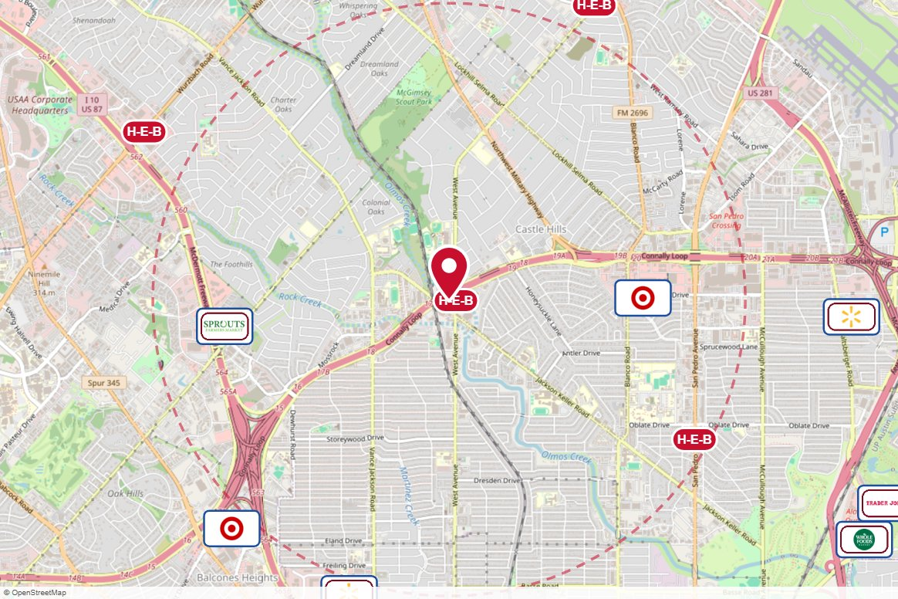
#010228 Clear Channel Outdoor · Digital
IN MARKET
PANEL INFO
Location: Loop 410 SS 150ft W/O West Ave F/W - 2
Face: West · Read: Right
Size: 14' x 48'
Contract: 8/24/2026 → 11/1/2026 (4-week)
Impressions: 900,124 / week
Nearest H-E-B: 0 mi — West Ave and Jackson Keller H-E-B
Investment: $3,313 / period
2-MILE AREA
red pin = this panel
red pills = H-E-B stores
company logos = blunting targets
dashed ring = 2-mile radius
San Antonio Region · H-E-B OOH Current Holdings · 8/28/2026

Slide 23
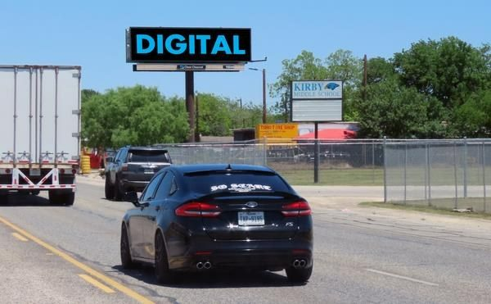
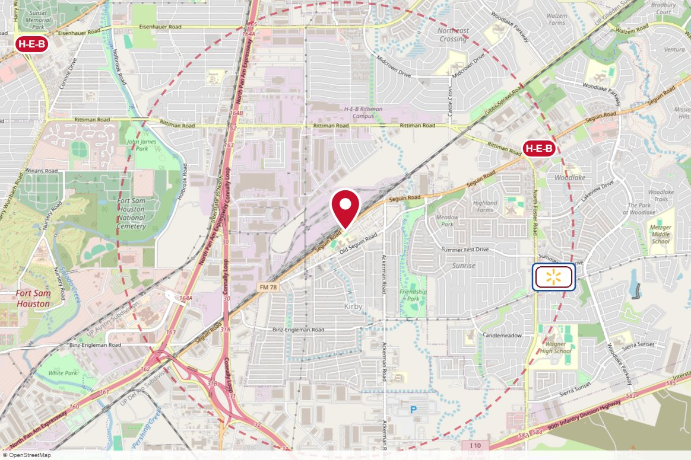
#010244 Clear Channel Outdoor · Digital
IN MARKET
PANEL INFO
Location: Hwy 78 SS 1.25mi E/O Loop 410 S F/SW - 2
Face: SW · Read: Right
Size: 10'6" x 36'
Contract: 8/24/2026 → 11/1/2026 (4-week)
Impressions: 44,059 / week
Nearest H-E-B: 1.8 mi — Foster Rd H-E-B
Investment: $800 / period
2-MILE AREA
red pin = this panel
red pills = H-E-B stores
company logos = blunting targets
dashed ring = 2-mile radius
San Antonio Region · H-E-B OOH Current Holdings · 8/28/2026

Slide 24
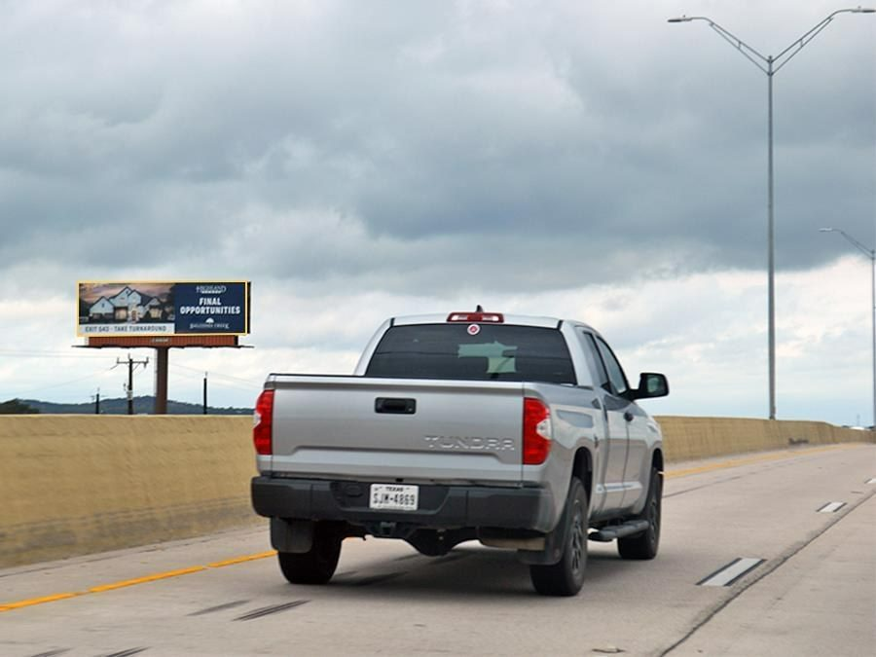
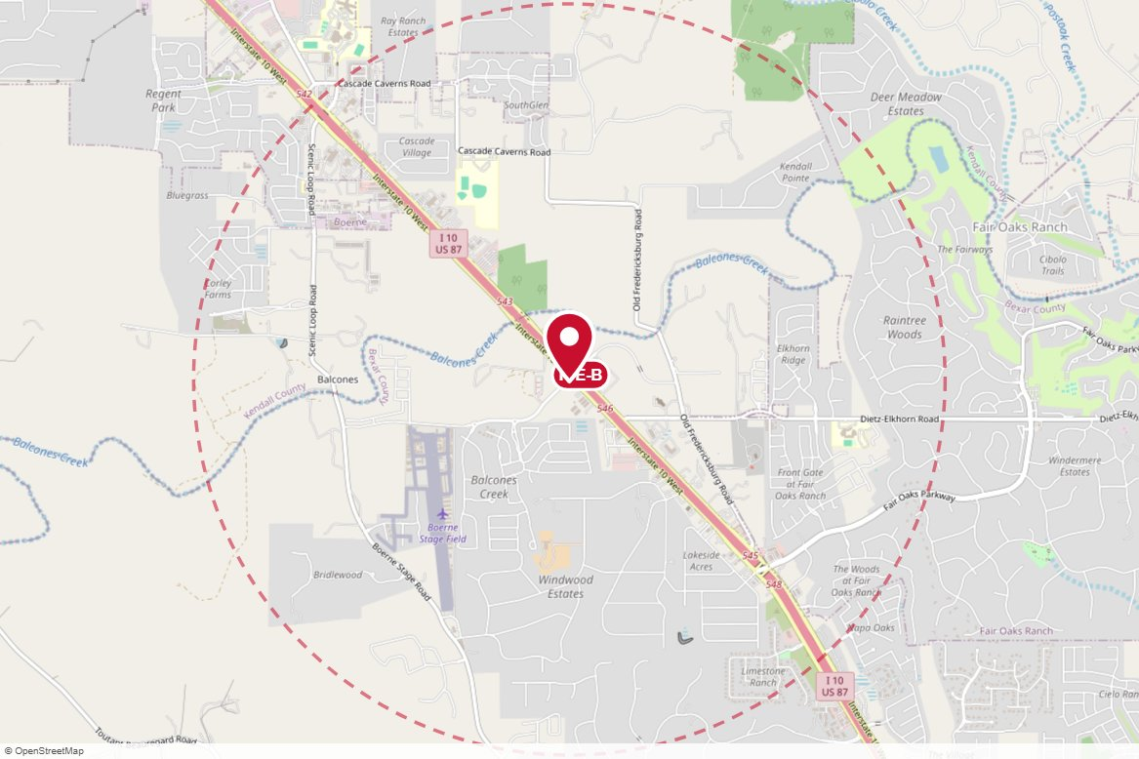
#1352 Lamar Advertising · Static
IN MARKET
PANEL INFO
Location: IH-10 W., 4/10 MI E/O MM 545
Face: South East · Read: Left
Size: 14' 0" x 48' 0"
Contract: 8/24/2026 → 11/15/2026 (4-week)
Impressions: 255,759 / week
Nearest H-E-B: 0.1 mi — Fair Oaks H-E-B
Investment: $4,050 / period
2-MILE AREA
red pin = this panel
red pills = H-E-B stores
company logos = blunting targets
dashed ring = 2-mile radius
San Antonio Region · H-E-B OOH Current Holdings · 8/28/2026

Slide 25
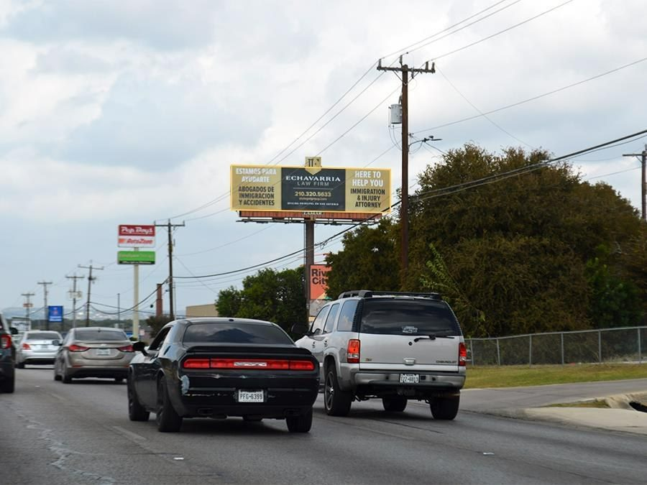
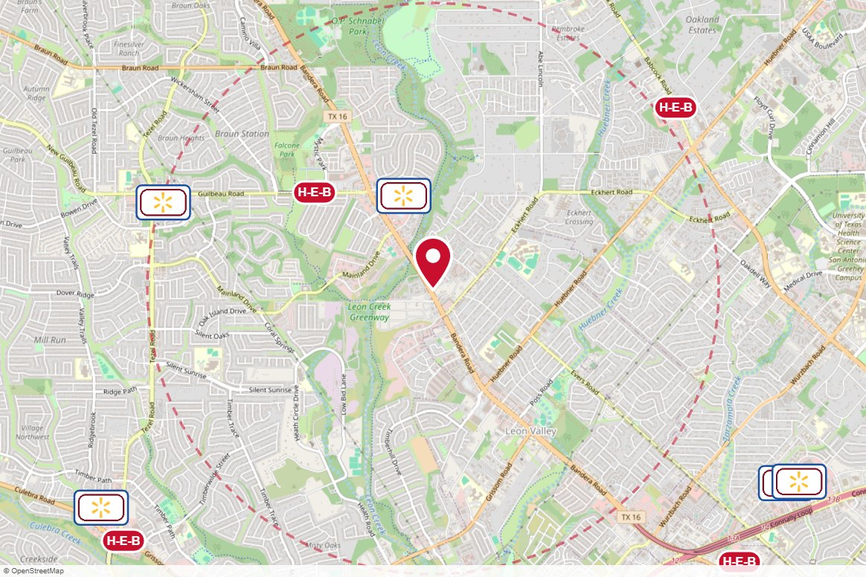
#1353 Lamar Advertising · Static
IN MARKET
PANEL INFO
Location: N/S BANDERA RD. 3.8 MI E/O LP 1604
Face: South East · Read: Right
Size: 10' 6" x 40' 0"
Contract: 8/24/2026 → 11/15/2026 (4-week)
Impressions: 406,505 / week
Nearest H-E-B: 1.1 mi — Bandera and Guilbeau H-E-B
Investment: $2,700 / period
2-MILE AREA
red pin = this panel
red pills = H-E-B stores
company logos = blunting targets
dashed ring = 2-mile radius
San Antonio Region · H-E-B OOH Current Holdings · 8/28/2026

Slide 26
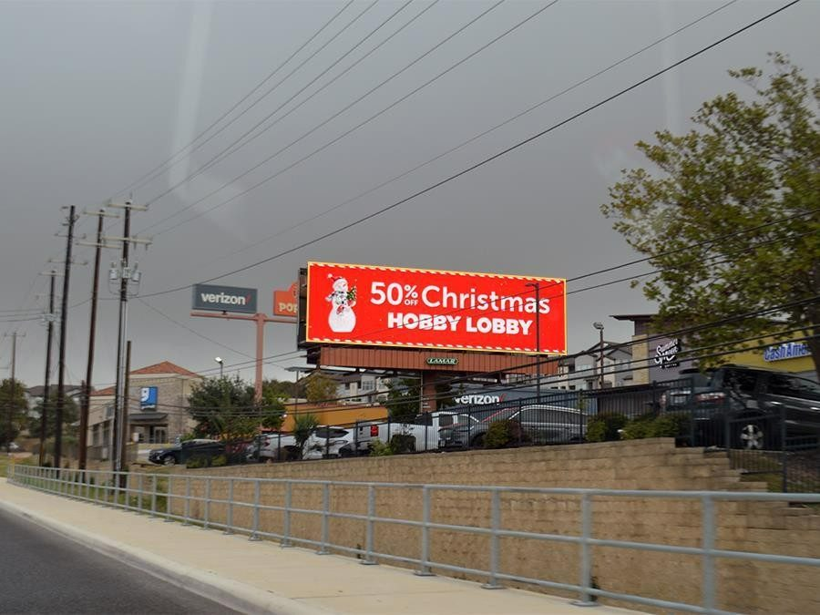
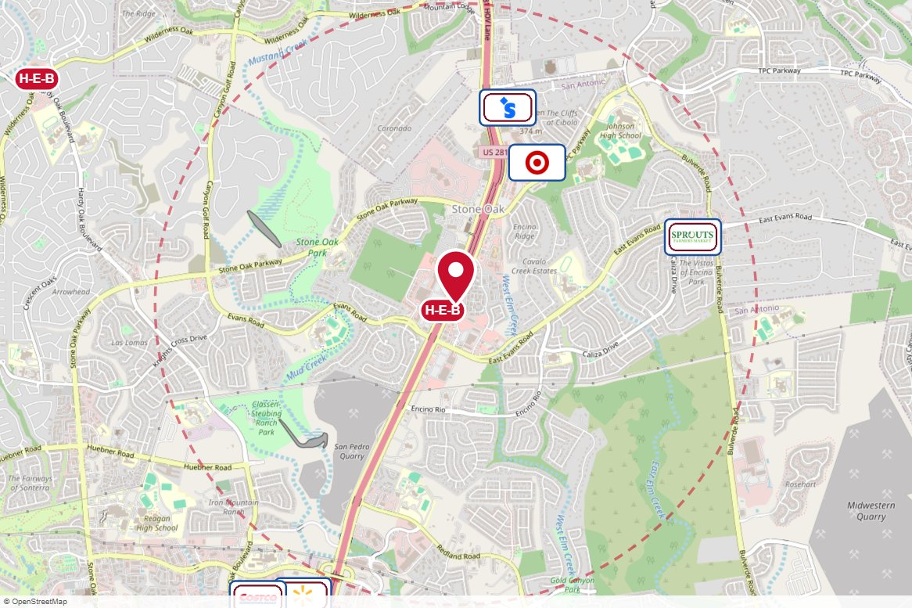
#40182 Lamar Advertising · Digital
IN MARKET
PANEL INFO
Location: E/S 281 1000'N/O EVANS RD.F/S
Face: South West · Read: Right
Size: 14' 0" x 48' 0"
Contract: 8/24/2026 → 11/15/2026 (4-week)
Impressions: 314,740 / week
Nearest H-E-B: 0.1 mi — 281 and Evans Road H-E-B plus!
Investment: $3,600 / period
2-MILE AREA
red pin = this panel
red pills = H-E-B stores
company logos = blunting targets
dashed ring = 2-mile radius
San Antonio Region · H-E-B OOH Current Holdings · 8/28/2026

Slide 27
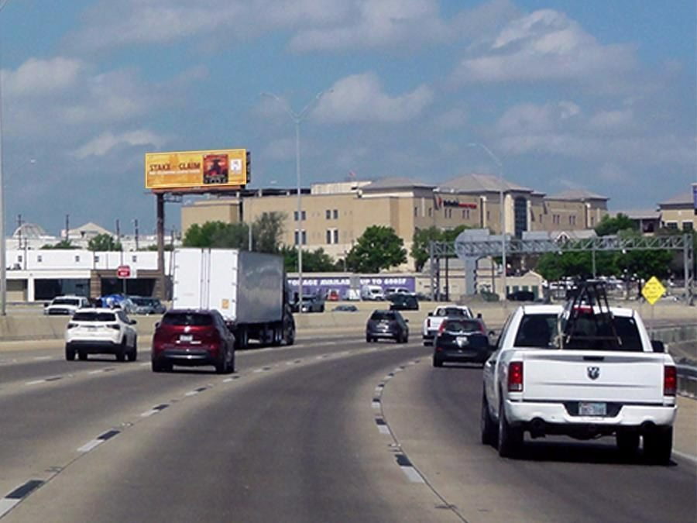
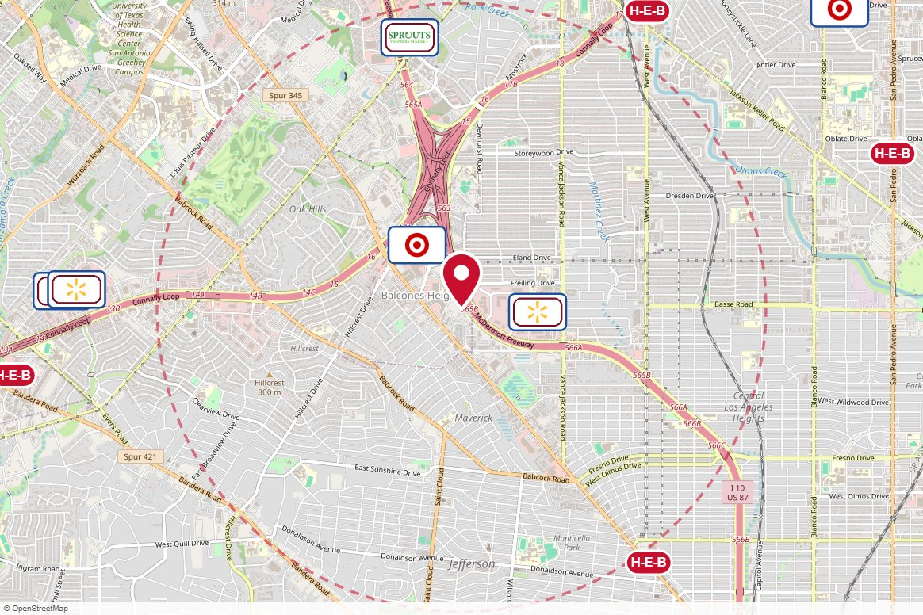
#40111 Lamar Advertising · Static
IN MARKET
PANEL INFO
Location: I-10-W/S @ BALCONES RD.
Face: South East · Read: Left
Size: 14' 0" x 48' 0"
Contract: 8/24/2026 → 11/15/2026 (4-week)
Impressions: 723,436 / week
Nearest H-E-B: 2.1 mi — Deco District H-E-B
Investment: $3,600 / period
2-MILE AREA
red pin = this panel
red pills = H-E-B stores
company logos = blunting targets
dashed ring = 2-mile radius
San Antonio Region · H-E-B OOH Current Holdings · 8/28/2026

Slide 28
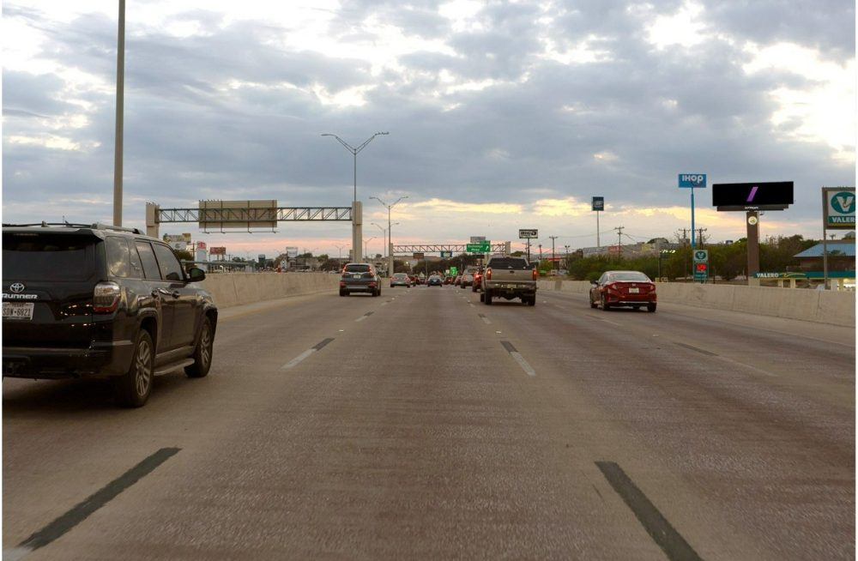
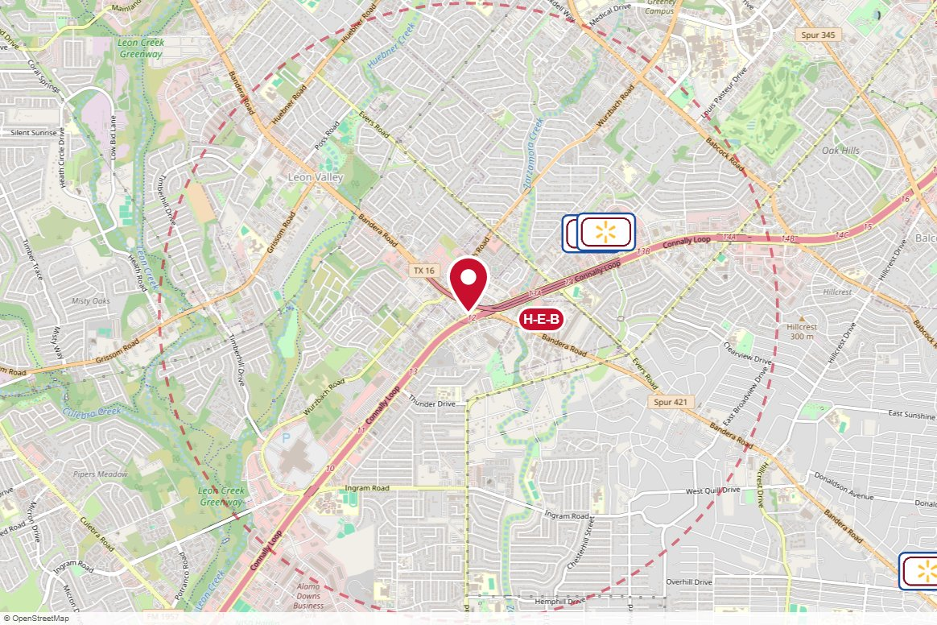
#2_1963F Outfront Media · Digital
IN MARKET
PANEL INFO
Location: NW Loop 410 W/O Bandera Rd. F/N F/N
Face: North
Size: 14'x48'
Contract: 8/24/2026 → 11/1/2026 (4-week)
Impressions: 1,522,800 / week
Nearest H-E-B: 0.5 mi — Marketplace H-E-B
Investment: $3,500 / period
2-MILE AREA
red pin = this panel
red pills = H-E-B stores
company logos = blunting targets
dashed ring = 2-mile radius
San Antonio Region · H-E-B OOH Current Holdings · 8/28/2026

Slide 29
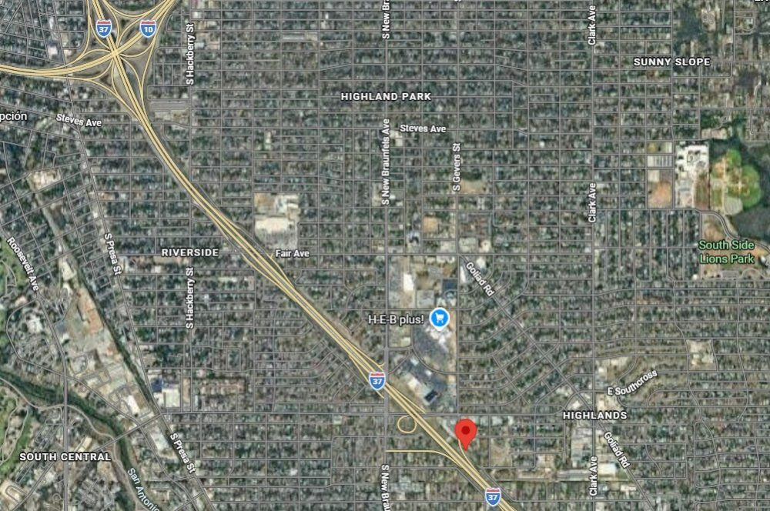
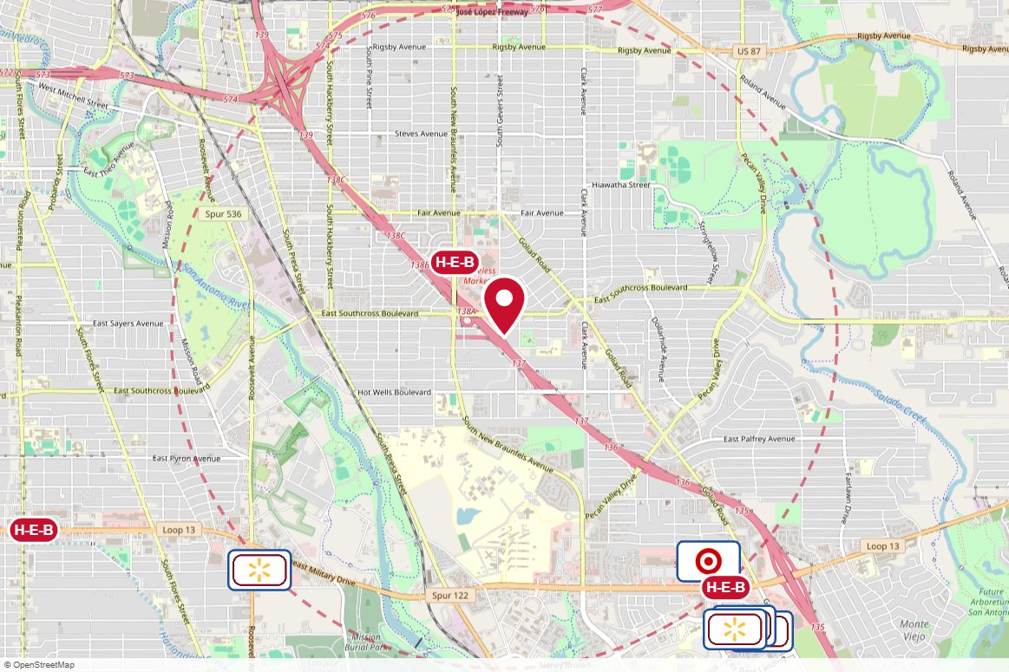
Board 2 Media Outdoor Displays · Static
IN MARKET
PANEL INFO
Location: ES IH-37, S/O Southcross - F/S (@ Gevers)
Face: South
Size: 14' x 48'
Contract: 8/25/2026 → 2/24/2027 (Monthly)
Impressions: n/a
Nearest H-E-B: 0.5 mi — McCreless Market H-E-B plus!
Investment: $1,500 / period
2-MILE AREA
red pin = this panel
red pills = H-E-B stores
company logos = blunting targets
dashed ring = 2-mile radius
San Antonio Region · H-E-B OOH Current Holdings · 8/28/2026

Slide 30
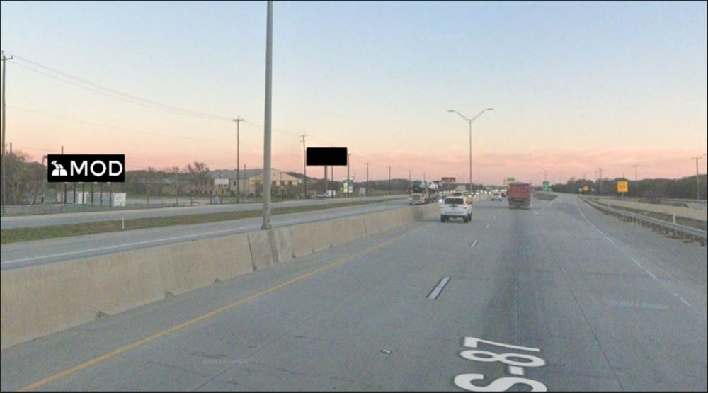
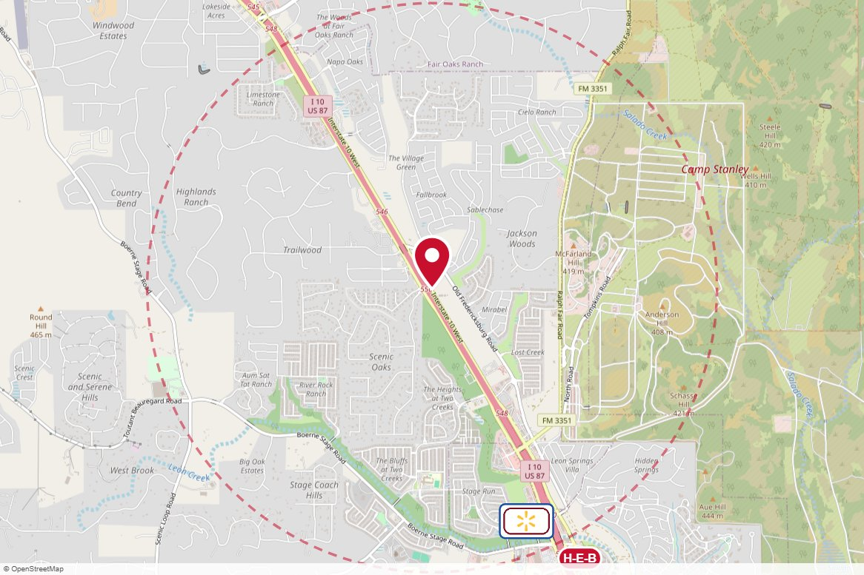
Board 6 FN Media Outdoor Displays · Static
IN MARKET
PANEL INFO
Location: ES I-10 W, S/O Old Fredericksburg Rd. - F/N
Face: North
Size: 12' x 36'
Contract: 8/25/2026 → 8/24/2027 (Monthly)
Impressions: n/a
Nearest H-E-B: 2.1 mi — Leon Springs H-E-B
Investment: $1,500 / period
2-MILE AREA
red pin = this panel
red pills = H-E-B stores
company logos = blunting targets
dashed ring = 2-mile radius
San Antonio Region · H-E-B OOH Current Holdings · 8/28/2026

Slide 31
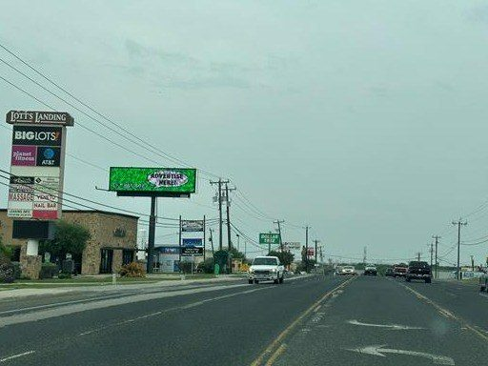
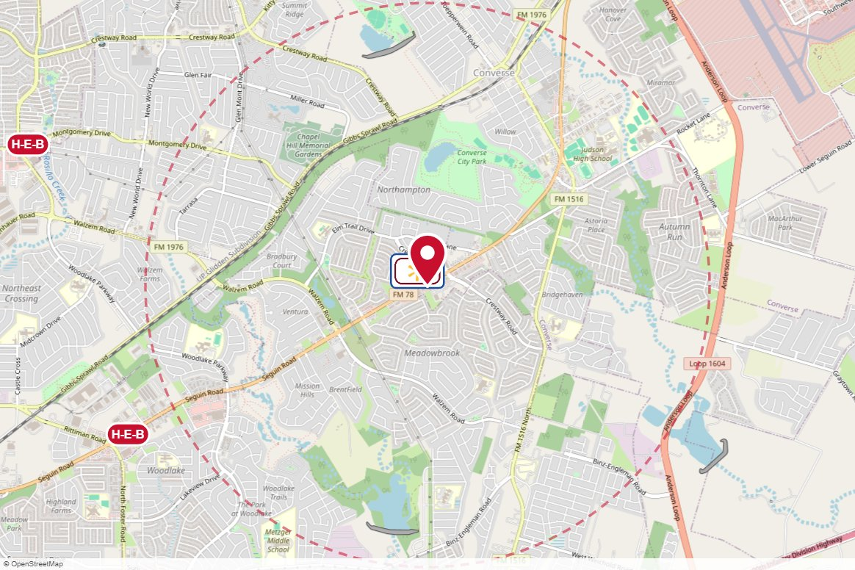
#54560.2 SignAd · Digital
IN MARKET
PANEL INFO
Location: FM 78/OLD SEGUIN RD/.7 MI E/O WALZEM RD/CONVERSE-LED-LH/WB
Face: East · Read: Left
Size: 10 ft x 36 ft
Contract: 8/24/2026 → 11/1/2026 (4-week)
Impressions: 24,119 / week
Nearest H-E-B: 2.4 mi — Foster Rd H-E-B
Investment: $1,000 / period
2-MILE AREA
red pin = this panel
red pills = H-E-B stores
company logos = blunting targets
dashed ring = 2-mile radius
San Antonio Region · H-E-B OOH Current Holdings · 8/28/2026

Slide 32
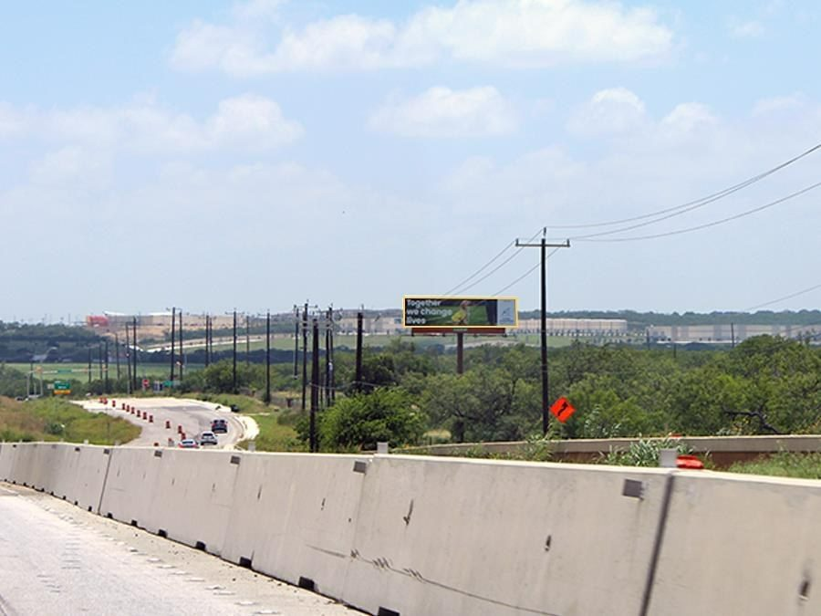

#1344 Lamar Advertising · Static
IN MARKET
PANEL INFO
Location: N/S I-10 1.8 MI E/O LOOP 1604
Face: East · Read: Right
Size: 10' 0" x 40' 0"
Contract: 8/24/2026 → 11/15/2026 (4-week)
Impressions: 169,587 / week
Nearest H-E-B: 5.7 mi — Kitty Hawk H-E-B
Investment: $2,250 / period
2-MILE AREA
red pin = this panel
red pills = H-E-B stores
company logos = blunting targets
dashed ring = 2-mile radius
San Antonio Region · H-E-B OOH Current Holdings · 8/28/2026

Slide 33


#004127 Clear Channel Outdoor · Digital
IN MARKET
PANEL INFO
Location: Loop 1604 SS 0.2mi E/O Bandera F/W - 2
Face: W · Read: Right
Size: 10'6" x 36'
Contract: 8/24/2026 → 11/1/2026 (4-week)
Impressions: 140,172 / week
Nearest H-E-B: 0.2 mi — Bandera and 1604 H-E-B plus!
Investment: $3,000 / period
2-MILE AREA
red pin = this panel
red pills = H-E-B stores
company logos = blunting targets
dashed ring = 2-mile radius
San Antonio Region · H-E-B OOH Current Holdings · 8/28/2026

Slide 34


#004364 Clear Channel Outdoor · Digital
IN MARKET
PANEL INFO
Location: US 281 N ES 0.2mi N/O Pasa Del Norte F/S - 2
Face: S · Read: Right
Size: 14' x 48'
Contract: 8/24/2026 → 11/1/2026 (4-week)
Impressions: 318,759 / week
Nearest H-E-B: 0.6 mi — Brook Hollow H-E-B
Investment: $1,400 / period
2-MILE AREA
red pin = this panel
red pills = H-E-B stores
company logos = blunting targets
dashed ring = 2-mile radius
San Antonio Region · H-E-B OOH Current Holdings · 8/28/2026

Slide 35


#004742 Clear Channel Outdoor · Static
IN MARKET
PANEL INFO
Location: Loop 1604 NS 0.3mi W/O Bulverde F/W - 1
Face: W · Read: Left
Size: 14' x 48'
Contract: 8/24/2026 → 11/1/2026 (4-week)
Impressions: 228,104 / week
Nearest H-E-B: 0.5 mi — Bulverde and 1604 H-E-B
Investment: $5,000 / period
2-MILE AREA
red pin = this panel
red pills = H-E-B stores
company logos = blunting targets
dashed ring = 2-mile radius
San Antonio Region · H-E-B OOH Current Holdings · 8/28/2026

Slide 36


#005540 Clear Channel Outdoor · Static
IN MARKET
PANEL INFO
Location: Blanco ES 0.5mi S/O Loop 1604 F/N - 1
Face: N · Read: Left
Size: 14' x 48'
Contract: 8/24/2026 → 11/1/2026 (4-week)
Impressions: 79,381 / week
Nearest H-E-B: 1 mi — Loop 1604 and Blanco Rd H-E-B plus!
Investment: $1,900 / period
2-MILE AREA
red pin = this panel
red pills = H-E-B stores
company logos = blunting targets
dashed ring = 2-mile radius
San Antonio Region · H-E-B OOH Current Holdings · 8/28/2026

Slide 37


#003442 Clear Channel Outdoor · Static
IN MARKET
PANEL INFO
Location: Grissom NS 500ft E/O Culebra F/E - 2
Face: E · Read: Right
Size: 14' x 48'
Contract: 8/24/2026 → 11/1/2026 (4-week)
Impressions: 104,481 / week
Nearest H-E-B: 0.2 mi — Grissom and Tezel H-E-B
Investment: $1,200 / period
2-MILE AREA
red pin = this panel
red pills = H-E-B stores
company logos = blunting targets
dashed ring = 2-mile radius
San Antonio Region · H-E-B OOH Current Holdings · 8/28/2026

Slide 38

#004413 Clear Channel Outdoor · Digital
IN MARKET
no photo on file
PANEL INFO
Location: I-35 S ES 0.3mi N/O SW Military F/N - 1
Face: North
Size: 14' x 48'
Contract: 8/24/2026 → 11/1/2026 (4-week)
Impressions: 156,948 / week
Nearest H-E-B: 0.8 mi — Zarzamora and Military H-E-B plus!
Investment: $3,313 / period
2-MILE AREA
red pin = this panel
red pills = H-E-B stores
company logos = blunting targets
dashed ring = 2-mile radius
San Antonio Region · H-E-B OOH Current Holdings · 8/28/2026

Slide 39

#004768 Clear Channel Outdoor · Digital
IN MARKET
no photo on file
PANEL INFO
Location: I-10 NW WS 500ft N/O Fredericksburg F/N - 2
Face: North
Size: 14' x 48'
Contract: 8/24/2026 → 11/1/2026 (4-week)
Impressions: 703,866 / week
Nearest H-E-B: 0.9 mi — Deco District H-E-B
Investment: $3,313 / period
2-MILE AREA
red pin = this panel
red pills = H-E-B stores
company logos = blunting targets
dashed ring = 2-mile radius
San Antonio Region · H-E-B OOH Current Holdings · 8/28/2026

Slide 40

#004778 Clear Channel Outdoor · Digital
IN MARKET
no photo on file
PANEL INFO
Location: Loop 410 NS 1000ft E/O Bandera F/E - 2
Face: East
Size: 14' x 48'
Contract: 8/24/2026 → 11/1/2026 (4-week)
Impressions: 1,025,010 / week
Nearest H-E-B: 0.2 mi — Marketplace H-E-B
Investment: $3,313 / period
2-MILE AREA
red pin = this panel
red pills = H-E-B stores
company logos = blunting targets
dashed ring = 2-mile radius
San Antonio Region · H-E-B OOH Current Holdings · 8/28/2026

Slide 41


#005185 Clear Channel Outdoor · Digital
IN MARKET
PANEL INFO
Location: McAllister Frwy WS 0.1mi N/O Sunset F/N - 2
Face: North
Size: 14' x 48'
Contract: 8/24/2026 → 11/1/2026 (4-week)
Impressions: 332,709 / week
Nearest H-E-B: 0.9 mi — Lincoln Heights Market H-E-B
Investment: $3,313 / period
2-MILE AREA
red pin = this panel
red pills = H-E-B stores
company logos = blunting targets
dashed ring = 2-mile radius
San Antonio Region · H-E-B OOH Current Holdings · 8/28/2026

Slide 42


#004664 Clear Channel Outdoor · Static
IN MARKET
PANEL INFO
Location: Loop 410 SS 50ft W/O Jackson Keller F/E - 1
Face: E · Read: Left
Size: 14' x 48'
Contract: 8/24/2026 → 11/1/2026 (4-week)
Impressions: 909,209 / week
Nearest H-E-B: 0.1 mi — West Ave and Jackson Keller H-E-B
Investment: $4,770 / period
2-MILE AREA
red pin = this panel
red pills = H-E-B stores
company logos = blunting targets
dashed ring = 2-mile radius
San Antonio Region · H-E-B OOH Current Holdings · 8/28/2026

Slide 43


#10201 Clear Channel Outdoor · Digital
STARTS SOON
PANEL INFO
Location: Loop 1604 E .7Mi S/O Highway 78 F/N
Face: North
Size: 14'' x 48''
Contract: 10/12/2026 → 11/29/2026 (4-week)
Impressions: 65,969 / week
Nearest H-E-B: 1.9 mi — Kitty Hawk H-E-B
Investment: $1,335 / period
2-MILE AREA
red pin = this panel
red pills = H-E-B stores
company logos = blunting targets
dashed ring = 2-mile radius
San Antonio Region · H-E-B OOH Current Holdings · 8/28/2026

Slide 44


#1680 Lamar Advertising · Static
STARTS SOON
PANEL INFO
Location: LOOP 1604 @ POTRANCO RD.
Face: South · Read: Left
Size: 14' 0" x 48' 0"
Contract: 9/28/2026 → 12/20/2026 (4-week)
Impressions: 62,485 / week
Nearest H-E-B: 0.5 mi — Potranco and 1604 H-E-B plus!
Investment: $3,600 / period
2-MILE AREA
red pin = this panel
red pills = H-E-B stores
company logos = blunting targets
dashed ring = 2-mile radius
San Antonio Region · H-E-B OOH Current Holdings · 8/28/2026

Slide 45


#40021 Lamar Advertising · Static
STARTS SOON
PANEL INFO
Location: E/S I-10 500' N/O Hildebrand
Face: North · Read: Left
Size: 14' 0" x 48' 0"
Contract: 9/28/2026 → 12/20/2026 (4-week)
Impressions: 849,571 / week
Nearest H-E-B: 0.7 mi — Deco District H-E-B
Investment: $3,600 / period
2-MILE AREA
red pin = this panel
red pills = H-E-B stores
company logos = blunting targets
dashed ring = 2-mile radius
San Antonio Region · H-E-B OOH Current Holdings · 8/28/2026

Slide 46


TX39A MH Outdoor Media · Static
STARTS SOON
PANEL INFO
Location: N/S of IH-10 East, .7 Miles E/o Loop 1604. Exit 587, E/F
Face: E/F · Read: Right
Size: 14'0x48'0
Contract: 1/11/2027 → 1/9/2028 (4-week)
Impressions: 1,536,325 / week
Nearest H-E-B: 4.7 mi — Foster Rd H-E-B
Investment: $1,200 / period
2-MILE AREA
red pin = this panel
red pills = H-E-B stores
company logos = blunting targets
dashed ring = 2-mile radius
San Antonio Region · H-E-B OOH Current Holdings · 8/28/2026

Slide 47


#44531 Lamar Advertising · Static
STARTS SOON
PANEL INFO
Location: S/SI-10 1.9 MI E/O SR 46
Face: East · Read: Left
Size: 10' 0" x 40' 0"
Contract: 10/19/2026 → 1/10/2027 (4-week)
Impressions: 296,736 / week
Nearest H-E-B: 2 mi — Boerne H-E-B plus!
Investment: $3,150 / period
2-MILE AREA
red pin = this panel
red pills = H-E-B stores
company logos = blunting targets
dashed ring = 2-mile radius
San Antonio Region · H-E-B OOH Current Holdings · 8/28/2026

Slide 48


#90391 Lamar Advertising · Static
STARTS SOON
PANEL INFO
Location: W/S I-35 S/O LOOP 337
Face: South West · Read: Left
Size: 14' 0" x 48' 0"
Contract: 8/31/2026 → 10/25/2026 (4-week)
Impressions: 461,327 / week
Nearest H-E-B: 1 mi — New Braunfels 3 H-E-B plus!
Investment: $4,050 / period
2-MILE AREA
red pin = this panel
red pills = H-E-B stores
company logos = blunting targets
dashed ring = 2-mile radius
San Antonio Region · H-E-B OOH Current Holdings · 8/28/2026

Slide 49


#40081 Lamar Advertising · Static
STARTS SOON
PANEL INFO
Location: E/S 281 1000' N/O EVANS RD.
Face: North · Read: Left
Size: 14' 0" x 48' 0"
Contract: 9/28/2026 → 12/20/2026 (4-week)
Impressions: 274,454 / week
Nearest H-E-B: 0.3 mi — 281 and Evans Road H-E-B plus!
Investment: $3,600 / period
2-MILE AREA
red pin = this panel
red pills = H-E-B stores
company logos = blunting targets
dashed ring = 2-mile radius
San Antonio Region · H-E-B OOH Current Holdings · 8/28/2026

Slide 50


#62 Gunnarson Outdoor Advertising · Static
STARTS SOON
PANEL INFO
Location: IH-35, South of Hwy 3009
Face: S · Read: Right
Size: 12' x 40'
Contract: 9/1/2026 → 10/31/2026 (Monthly)
Impressions: 420,000 / week
Nearest H-E-B: 0.3 mi — Schertz H-E-B plus!
Investment: $3,275 / period
2-MILE AREA
red pin = this panel
red pills = H-E-B stores
company logos = blunting targets
dashed ring = 2-mile radius
San Antonio Region · H-E-B OOH Current Holdings · 8/28/2026

Slide 51


#54 Gunnarson Outdoor Advertising · Static
STARTS SOON
PANEL INFO
Location: IH-35,Near Walnut Avenue
Face: N · Read: Right
Size: 14' x 48'
Contract: 9/1/2026 → 10/31/2026 (Monthly)
Impressions: 450,000 / week
Nearest H-E-B: 0.2 mi — New Braunfels H-E-B at Walnut
Investment: $4,275 / period
2-MILE AREA
red pin = this panel
red pills = H-E-B stores
company logos = blunting targets
dashed ring = 2-mile radius
San Antonio Region · H-E-B OOH Current Holdings · 8/28/2026

Slide 52


#74 Gunnarson Outdoor Advertising · Static
STARTS SOON
PANEL INFO
Location: IH-35,1/2 mile south of Hwy 306
Face: N · Read: CR
Size: 12' x 40'
Contract: 9/1/2026 → 10/31/2026 (Monthly)
Impressions: 400,000 / week
Nearest H-E-B: 3.1 mi — New Braunfels H-E-B at Walnut
Investment: $3,275 / period
2-MILE AREA
red pin = this panel
red pills = H-E-B stores
company logos = blunting targets
dashed ring = 2-mile radius
San Antonio Region · H-E-B OOH Current Holdings · 8/28/2026

Slide 53


#005437 Clear Channel Outdoor · Static
STARTS SOON
PANEL INFO
Location: I-10 E NS 1.5mi E/O Foster Rd F/E - 2
Face: E · Read: Right
Size: 14' x 48'
Contract: 10/5/2026 → 11/1/2026 (4-week)
Impressions: 207,445 / week
Nearest H-E-B: 2.5 mi — Foster Rd H-E-B
Investment: $2,000 / period
2-MILE AREA
red pin = this panel
red pills = H-E-B stores
company logos = blunting targets
dashed ring = 2-mile radius
San Antonio Region · H-E-B OOH Current Holdings · 8/28/2026

Slide 54


#004807 Clear Channel Outdoor · Static
STARTS SOON
PANEL INFO
Location: Bandera WS 0.3mi S/O Braun F/N - 2
Face: N · Read: Right
Size: 14' x 48'
Contract: 10/5/2026 → 11/1/2026 (4-week)
Impressions: 203,753 / week
Nearest H-E-B: 0.6 mi — Bandera and Guilbeau H-E-B
Investment: $2,000 / period
2-MILE AREA
red pin = this panel
red pills = H-E-B stores
company logos = blunting targets
dashed ring = 2-mile radius
San Antonio Region · H-E-B OOH Current Holdings · 8/28/2026

Slide 55


#005121 Clear Channel Outdoor · Static
STARTS SOON
PANEL INFO
Location: US 281 N ES 250ft S/O Isom F/SE - 2
Face: SE · Read: Right
Size: 14' x 48'
Contract: 10/5/2026 → 11/1/2026 (4-week)
Impressions: 492,997 / week
Nearest H-E-B: 1.7 mi — Blanco and West Ave H-E-B
Investment: $4,800 / period
2-MILE AREA
red pin = this panel
red pills = H-E-B stores
company logos = blunting targets
dashed ring = 2-mile radius
San Antonio Region · H-E-B OOH Current Holdings · 8/28/2026

Slide 56


#005403 Clear Channel Outdoor · Static
STARTS SOON
PANEL INFO
Location: Loop 410 SS 0.2mi W/O Jackson Keller F/W - 2
Face: W · Read: Right
Size: 14' x 48'
Contract: 9/14/2026 → 11/1/2026 (4-week)
Impressions: 1,034,308 / week
Nearest H-E-B: 0.3 mi — West Ave and Jackson Keller H-E-B
Investment: $4,500 / period
2-MILE AREA
red pin = this panel
red pills = H-E-B stores
company logos = blunting targets
dashed ring = 2-mile radius
San Antonio Region · H-E-B OOH Current Holdings · 8/28/2026

Slide 57


#005430 Clear Channel Outdoor · Static
STARTS SOON
PANEL INFO
Location: San Pedro ES 0.3mi N/O Jackson Keller F/S - 2
Face: S · Read: Right
Size: 14' x 48'
Contract: 9/28/2026 → 11/1/2026 (4-week)
Impressions: 131,668 / week
Nearest H-E-B: 0.2 mi — San Pedro and Oblate H-E-B
Investment: $2,800 / period
2-MILE AREA
red pin = this panel
red pills = H-E-B stores
company logos = blunting targets
dashed ring = 2-mile radius
San Antonio Region · H-E-B OOH Current Holdings · 8/28/2026

Slide 58


#005606 Clear Channel Outdoor · Static
STARTS SOON
PANEL INFO
Location: Potranco NS 0.2mi W/O W Military F/E - 2
Face: E · Read: Right
Size: 14' x 48'
Contract: 9/21/2026 → 11/1/2026 (4-week)
Impressions: 159,466 / week
Nearest H-E-B: 0.8 mi — Culebra and 1604 H-E-B
Investment: $2,000 / period
2-MILE AREA
red pin = this panel
red pills = H-E-B stores
company logos = blunting targets
dashed ring = 2-mile radius
San Antonio Region · H-E-B OOH Current Holdings · 8/28/2026

Slide 59
#005188 Clear Channel Outdoor · Digital
STARTS SOON
no photo on file
PANEL INFO
Location: I-10 NW WS 0.3mi S/O DeZavala F/N - 2
Face: North
Size: 14' x 48'
Contract: 9/14/2026 → 11/1/2026 (4-week)
Impressions: 1,095,078 / week
Nearest H-E-B: 0.3 mi — De Zavala H-E-B
Investment: $3,313 / period
2-MILE AREA
red pin = this panel
red pills = H-E-B stores
company logos = blunting targets
dashed ring = 2-mile radius
San Antonio Region · H-E-B OOH Current Holdings · 8/28/2026

Slide 60

#005184 Clear Channel Outdoor · Digital
STARTS SOON
PANEL INFO
Location: McAllister Frwy WS 0.1mi N/O Sunset F/S - 1
Face: S · Read: Left
Size: 14' x 48'
Contract: 9/7/2026 → 9/13/2026 (4-week)
Impressions: 419,410 / week
Nearest H-E-B: 0.9 mi — Lincoln Heights Market H-E-B
Investment: $3,313 / period
2-MILE AREA
red pin = this panel
red pills = H-E-B stores
company logos = blunting targets
dashed ring = 2-mile radius
San Antonio Region · H-E-B OOH Current Holdings · 8/28/2026

Slide 61

#004756 Clear Channel Outdoor · Static
STARTS SOON
no photo on file
PANEL INFO
Location: Loop 410 SS 0.4mi W/O Perrin Beitel F/E - 1
Face: E · Read: Left
Size: 14' x 48'
Contract: 9/14/2026 → 11/1/2026 (4-week)
Impressions: 543,631 / week
Nearest H-E-B: 1.7 mi — Austin Highway H-E-B
Investment: $2,340 / period
2-MILE AREA
red pin = this panel
red pills = H-E-B stores
company logos = blunting targets
dashed ring = 2-mile radius
San Antonio Region · H-E-B OOH Current Holdings · 8/28/2026

Slide 62


NT #1302 New Tradition · Place-Based - Banners
UNIQUE OOH
PANEL INFO
Location: San Antonio · San Antonio
Contract: 8/24/2026 → 11/1/2026 (4-week)
Impressions: 2,448,716 / week
Nearest H-E-B: 0.7 mi — South Flores Market H-E-B
Rate card: $38,561 / 4-week
Investment: $31,186 / period · $77,965 contract total
2-MILE AREA
red pin = this panel
red pills = H-E-B stores
company logos = blunting targets
dashed ring = 2-mile radius
San Antonio Region · H-E-B OOH Current Holdings · 8/28/2026

