Slide 1

Houston Region
OOH Current Holdings
3 contracted holdings · 1 in market now · prepared 8/18/2026 · H-E-B OOH Program

Slide 2



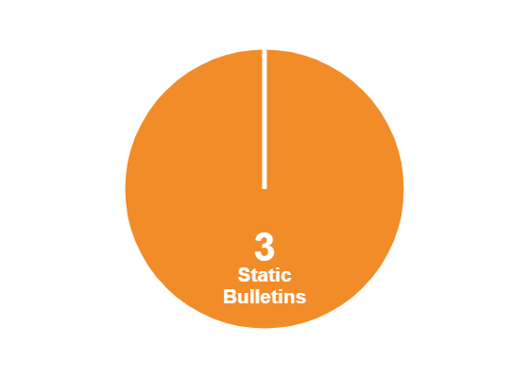

Costs & Impressions — Houston Region
$54,625
—
—
PER PERIOD COMMITTED (IN-MARKET)
IMPRESSIONS / WEEK
EFFECTIVE CPM (4-WEEK)
$682,203
· 3 Static Bulletins
3
FY26 BUDGET LEFT TO SPEND
CONTRACTED HOLDINGS · 1 IN MARKET · 2 STARTING SOON
FORMAT MIX
Full FY26 OOH budget: $1,005,000 · FY26 ends 11/1/2026 · program buys draw down what was left to spend ($782,146)

Slide 3
#14 Units (7/20-9/13) Clear Channel Outdoor · Static
IN MARKET
no photo on file
PANEL INFO
Location: Rotate every 8 weeks (7/20-9/13)
Size: 14' x 48'
Contract: 7/20/2026 → 9/13/2026 (4-week)
Impressions: n/a
Investment: $54,625 / period
Houston Region · H-E-B OOH Current Holdings · 8/18/2026

Slide 4
#14 Units (9/14-11/8) Clear Channel Outdoor · Static
STARTS SOON
no photo on file
PANEL INFO
Location: Rotate every 8 weeks (9/14-11/8)
Size: 14' x 48'
Contract: 9/14/2026 → 11/8/2026 (4-week)
Impressions: n/a
Investment: $54,625 / period
Houston Region · H-E-B OOH Current Holdings · 8/18/2026

Slide 5
#14 Units (11/9-1/3) Clear Channel Outdoor · Static
STARTS SOON
no photo on file
PANEL INFO
Location: Rotate every 8 weeks (11/9-1/3)
Size: 14' x 48'
Contract: 11/9/2026 → 12/27/2026 (4-week)
Impressions: n/a
Investment: $54,625 / period
Houston Region · H-E-B OOH Current Holdings · 8/18/2026

