Slide 1

Central Region
OOH Current Holdings
27 contracted holdings · 19 in market now · prepared 8/18/2026 · H-E-B OOH Program

Slide 2
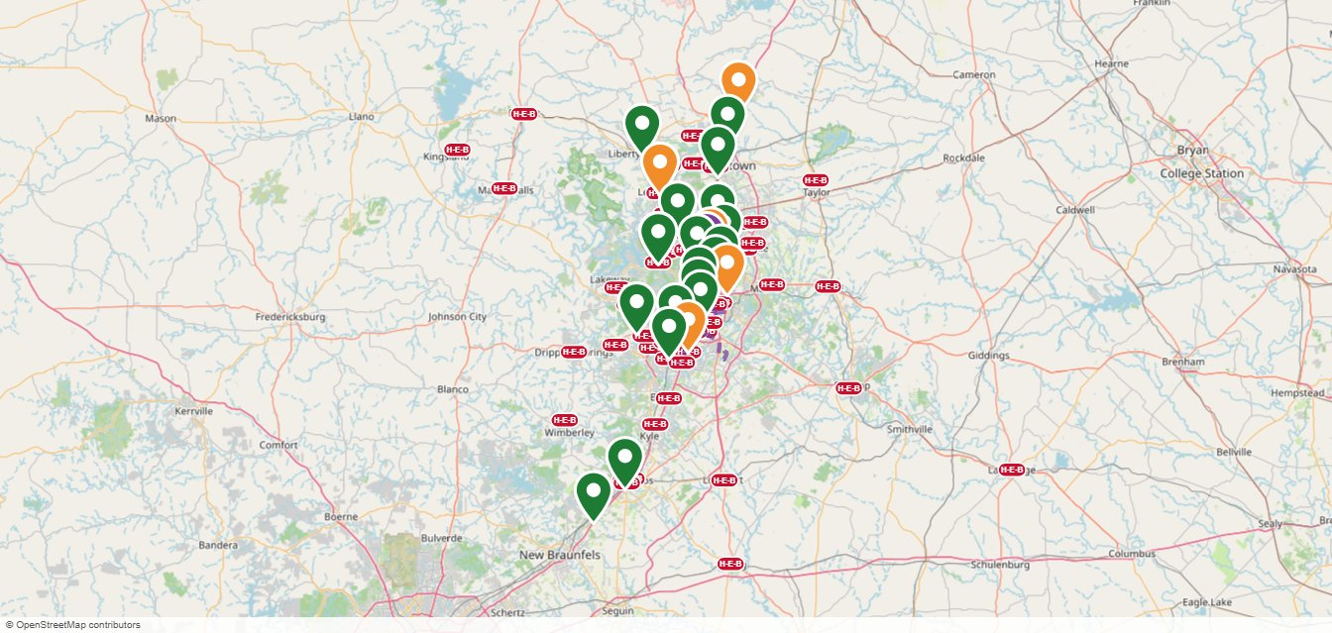
Central Region OOH Current Holdings Map
Green pin = in market now · Orange pin = starting soon · Purple pin = Unique OOH (wallscapes / transit) · Purple dashes = Bus Routes · Red pills = H-E-B stores

Slide 3



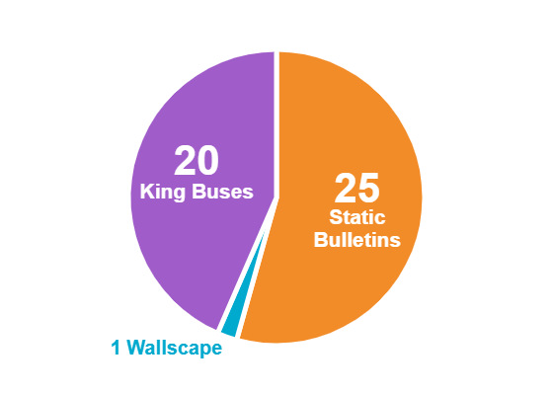

Costs & Impressions — Central Region
$110,699
12,714,412
$2.18
PER PERIOD COMMITTED (IN-MARKET)
IMPRESSIONS / WEEK
EFFECTIVE CPM (4-WEEK)
$72,109
· 25 Static Bulletins
· 1 Wallscape
· 20 King Buses
27
FY26 BUDGET LEFT TO SPEND
CONTRACTED HOLDINGS · 19 IN MARKET · 8 STARTING SOON
FORMAT MIX
Full FY26 OOH budget: $1,224,000 · FY26 ends 11/1/2026 · program buys draw down what was left to spend ($397,922)

Slide 4
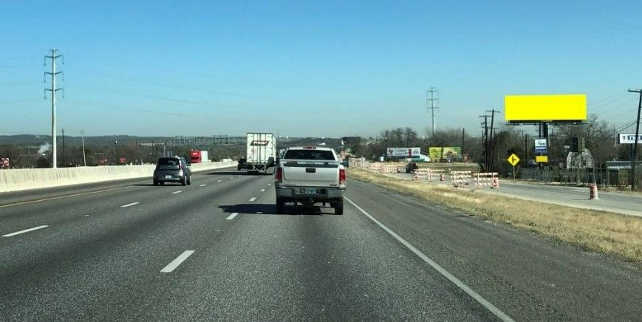
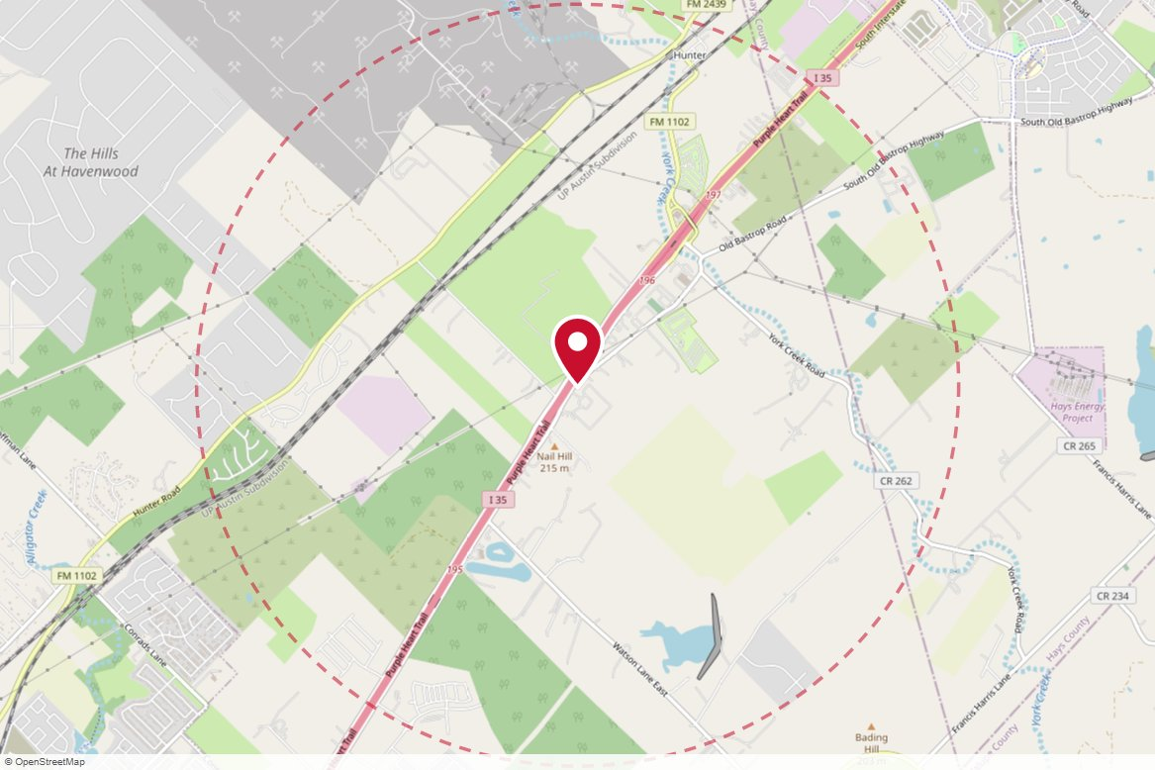
TX114A MH Outdoor Media · Static
IN MARKET
PANEL INFO
Location: E/S of IH-35, 250 feet S/o Old Bastrop Road. San Marcos, TX, S/F
Face: South · Read: Right
Size: 14' x 48'
Contract: 8/3/2026 → 11/29/2026 (4-week)
Impressions: 1,931,923 / week
Nearest H-E-B: 8.5 mi — San Marcos 3 (scheduled 10/7/26)
Investment: $2,819 / period
2-MILE AREA
red pin = this panel
red pills = H-E-B stores
company logos = blunting targets
dashed ring = 2-mile radius
Central Region · H-E-B OOH Current Holdings · 8/18/2026

Slide 5
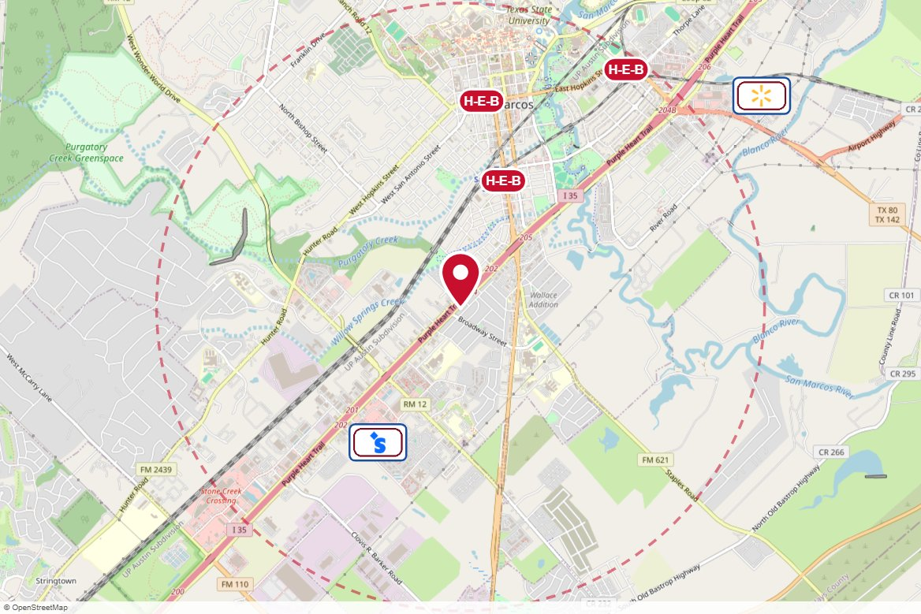
#189-3 The Reiss Group · Static
IN MARKET
no photo on file
PANEL INFO
Location: I-35 near Hwy 123 (MP 203.7), 408 Patricia Dr, San Marcos, TX
Size: 12'' x 40''
Contract: 8/3/2026 → 11/29/2026 (4-week)
Impressions: 367,525 / week
Nearest H-E-B: 0.9 mi — San Marcos 3 (scheduled 10/7/26)
Investment: $3,090 / period
2-MILE AREA
red pin = this panel
red pills = H-E-B stores
company logos = blunting targets
dashed ring = 2-mile radius
Central Region · H-E-B OOH Current Holdings · 8/18/2026

Slide 6
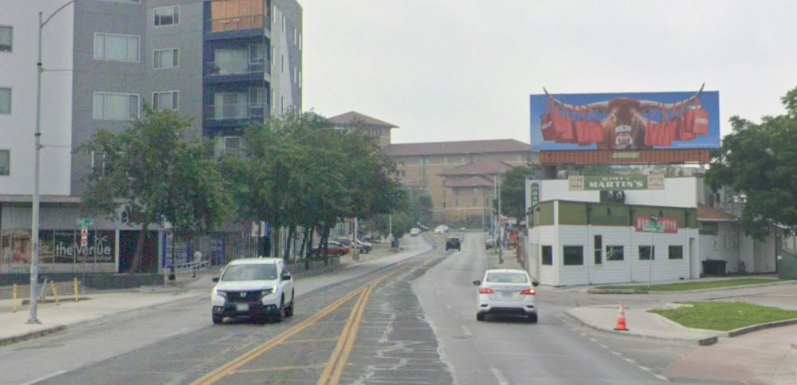
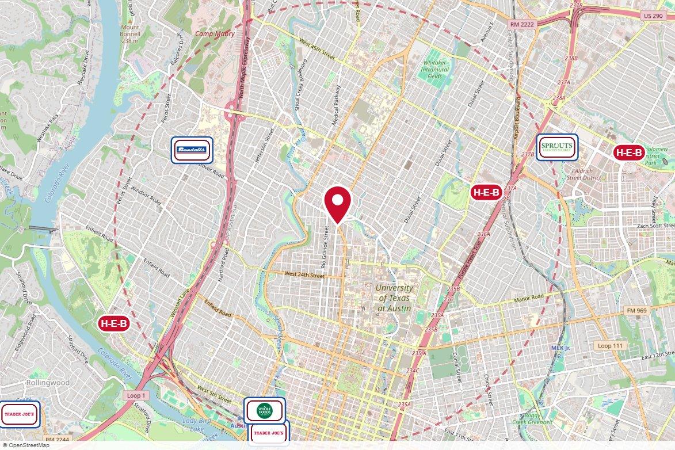
#71011 Lamar Advertising · Static
IN MARKET
PANEL INFO
Location: W/S GUADALUPE @ NUECES
Face: North · Read: Right
Size: 12' x 40'
Contract: 7/6/2026 → 1/24/2027 (4-week)
Impressions: 107,361 / week
Nearest H-E-B: 1.4 mi — Hancock Center H-E-B
Investment: $10,000 / period
2-MILE AREA
red pin = this panel
red pills = H-E-B stores
company logos = blunting targets
dashed ring = 2-mile radius
Central Region · H-E-B OOH Current Holdings · 8/18/2026

Slide 7
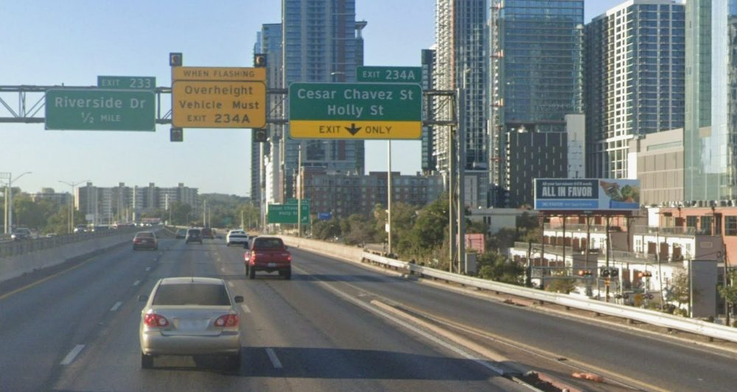
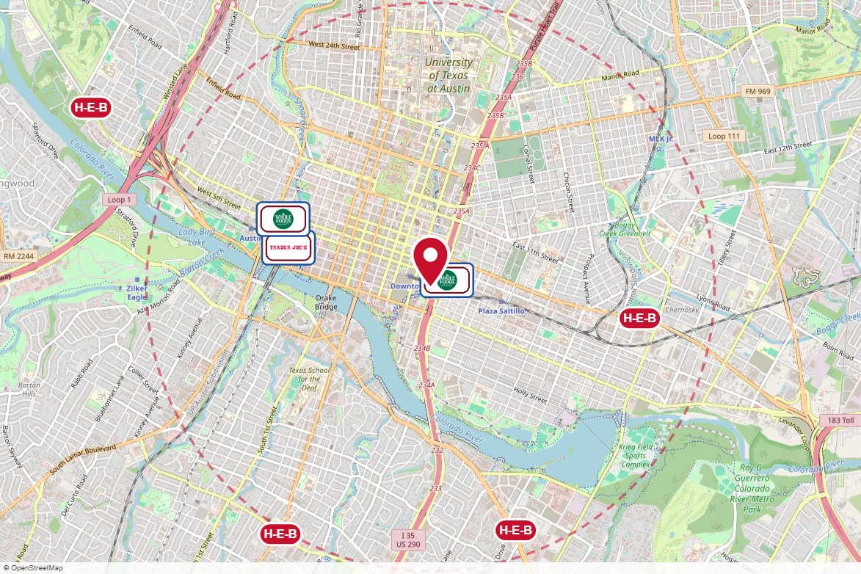
#352 Reagan Outdoor · Static
IN MARKET
PANEL INFO
Location: 306 I-35 N 0.18 mi N/O 1st St E (Loop 343) WS
Face: North
Size: 14' x 48'
Contract: 7/6/2026 → 11/29/2026 (4-week)
Impressions: 1,790,665 / week
Nearest H-E-B: 1.5 mi — 7th Street H-E-B
Investment: $20,735 / period
2-MILE AREA
red pin = this panel
red pills = H-E-B stores
company logos = blunting targets
dashed ring = 2-mile radius
Central Region · H-E-B OOH Current Holdings · 8/18/2026

Slide 8
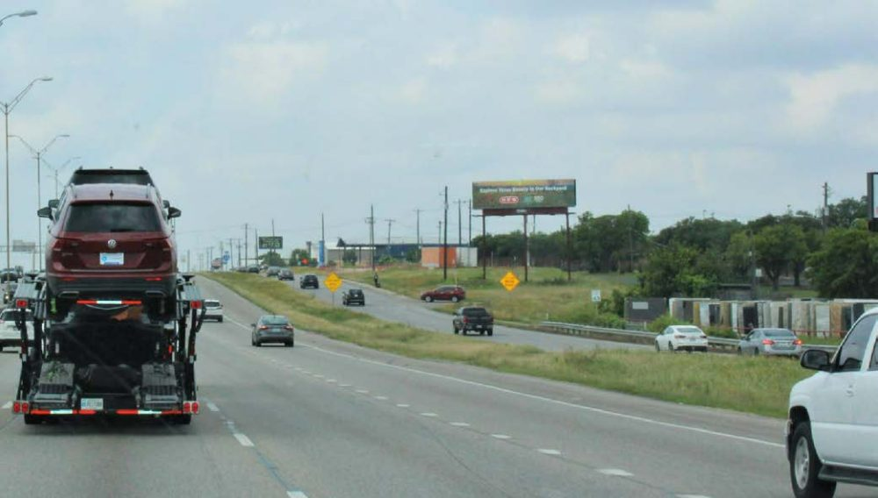
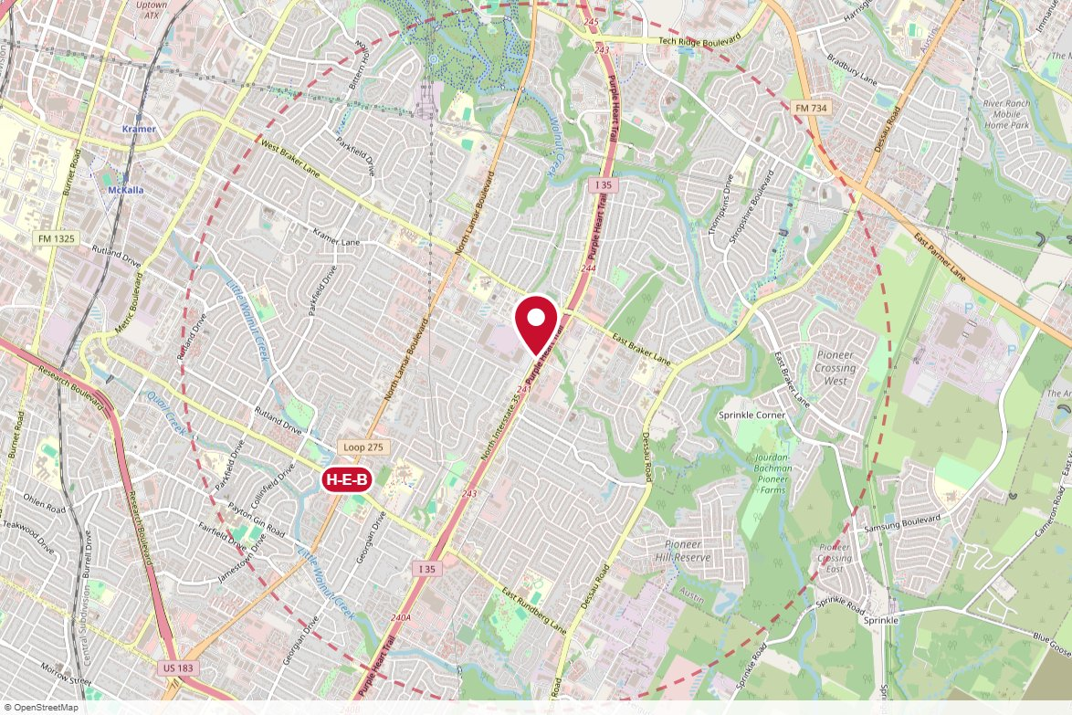
#134 Reagan Outdoor · Static
IN MARKET
PANEL INFO
Location: 10720 I-35 N 0.3 mi S/O Braker Ln E WS
Face: North · Read: Right
Size: 10' x 40'
Contract: 8/17/2026 → 12/27/2026 (4-week)
Impressions: 727,696 / week
Nearest H-E-B: 1.3 mi — Lamar and Rundberg H-E-B
Investment: $6,350 / period
2-MILE AREA
red pin = this panel
red pills = H-E-B stores
company logos = blunting targets
dashed ring = 2-mile radius
Central Region · H-E-B OOH Current Holdings · 8/18/2026

Slide 9
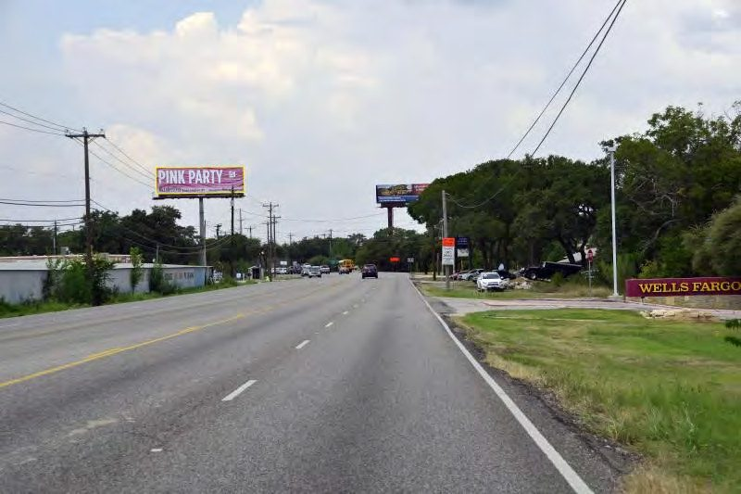
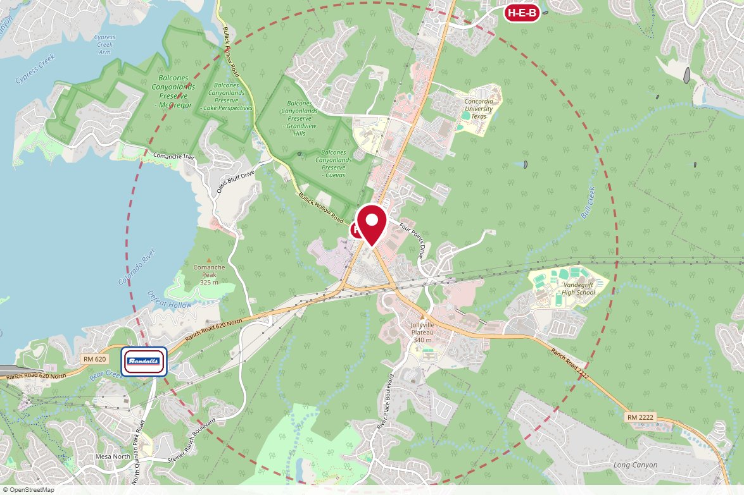
#9078 Reagan Outdoor · Static
IN MARKET
PANEL INFO
Location: RR 2222 500 ft E/O RR 620 SS
Face: East · Read: Left
Size: 14' x 48'
Contract: 8/17/2026 → 11/1/2026 (4-week)
Impressions: 125,286 / week
Nearest H-E-B: 0.1 mi — Four Points H-E-B
Investment: $3,750 / period
2-MILE AREA
red pin = this panel
red pills = H-E-B stores
company logos = blunting targets
dashed ring = 2-mile radius
Central Region · H-E-B OOH Current Holdings · 8/18/2026

Slide 10
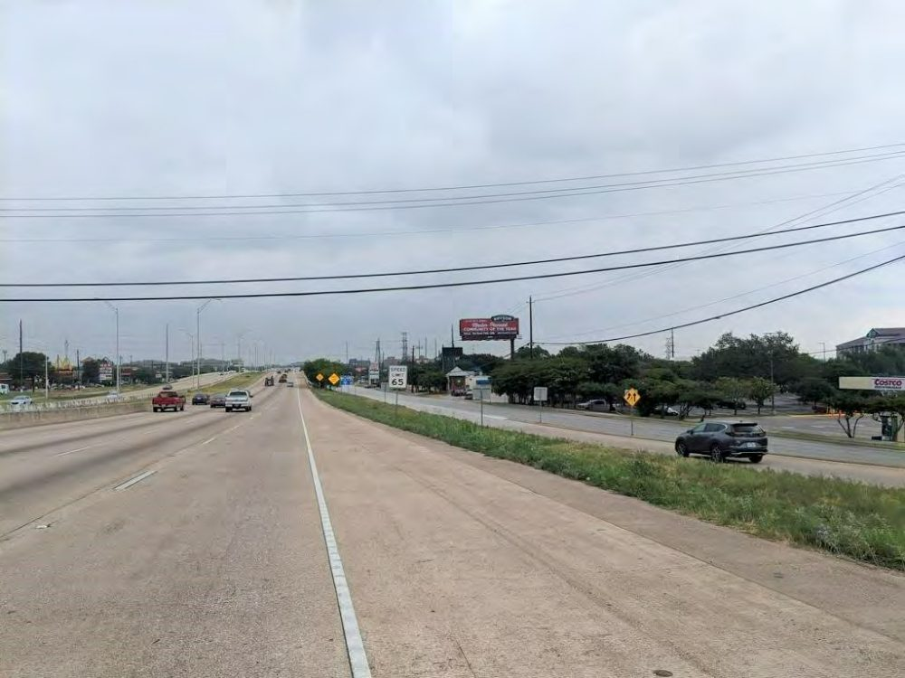
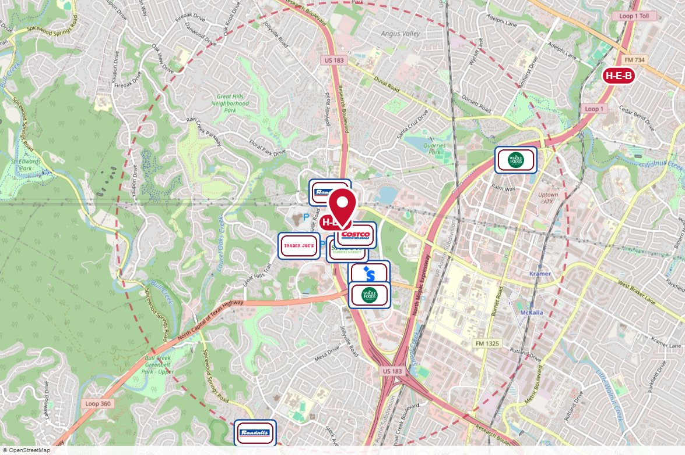
#9345 Reagan Outdoor · Static
IN MARKET
PANEL INFO
Location: 10611 Research Blvd (US 183) 0.2 mi S/O Braker Ln W ES
Face: South · Read: Right
Size: 14' x 48'
Contract: 8/17/2026 → 11/1/2026 (4-week)
Impressions: 722,818 / week
Nearest H-E-B: 0.1 mi — North Hills H-E-B
Investment: $12,925 / period
2-MILE AREA
red pin = this panel
red pills = H-E-B stores
company logos = blunting targets
dashed ring = 2-mile radius
Central Region · H-E-B OOH Current Holdings · 8/18/2026

Slide 11
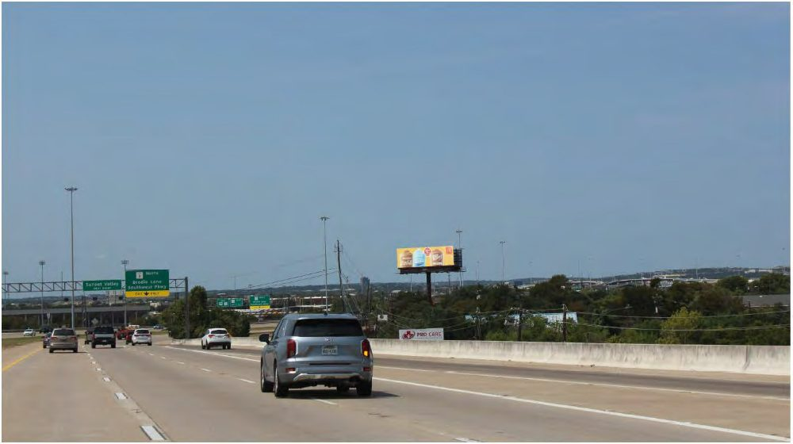
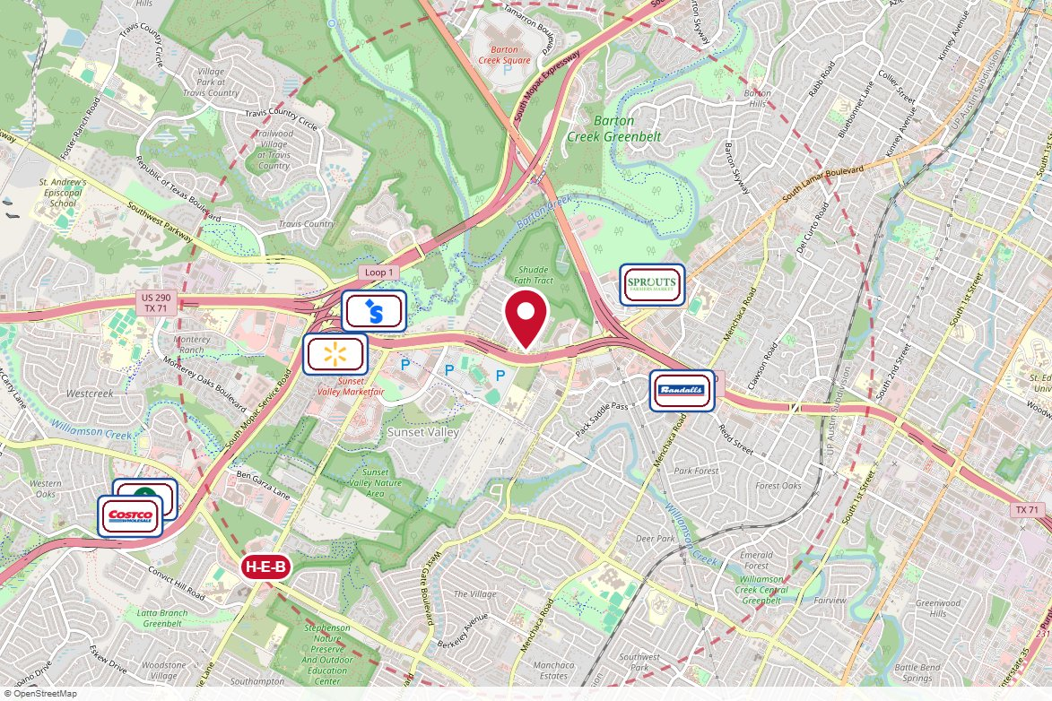
#9672 Reagan Outdoor · Static
IN MARKET
PANEL INFO
Location: Hwy 290 W 1370 ft W/O West Gate Blvd NS
Face: East · Read: Right
Size: 14' x 48'
Contract: 8/17/2026 → 11/1/2026 (4-week)
Impressions: 495,015 / week
Nearest H-E-B: 1.9 mi — Brodie Lane H-E-B
Investment: $8,450 / period
2-MILE AREA
red pin = this panel
red pills = H-E-B stores
company logos = blunting targets
dashed ring = 2-mile radius
Central Region · H-E-B OOH Current Holdings · 8/18/2026

Slide 12
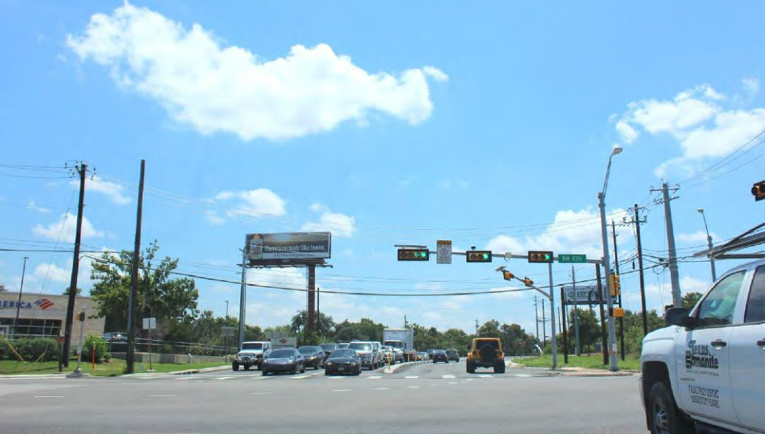
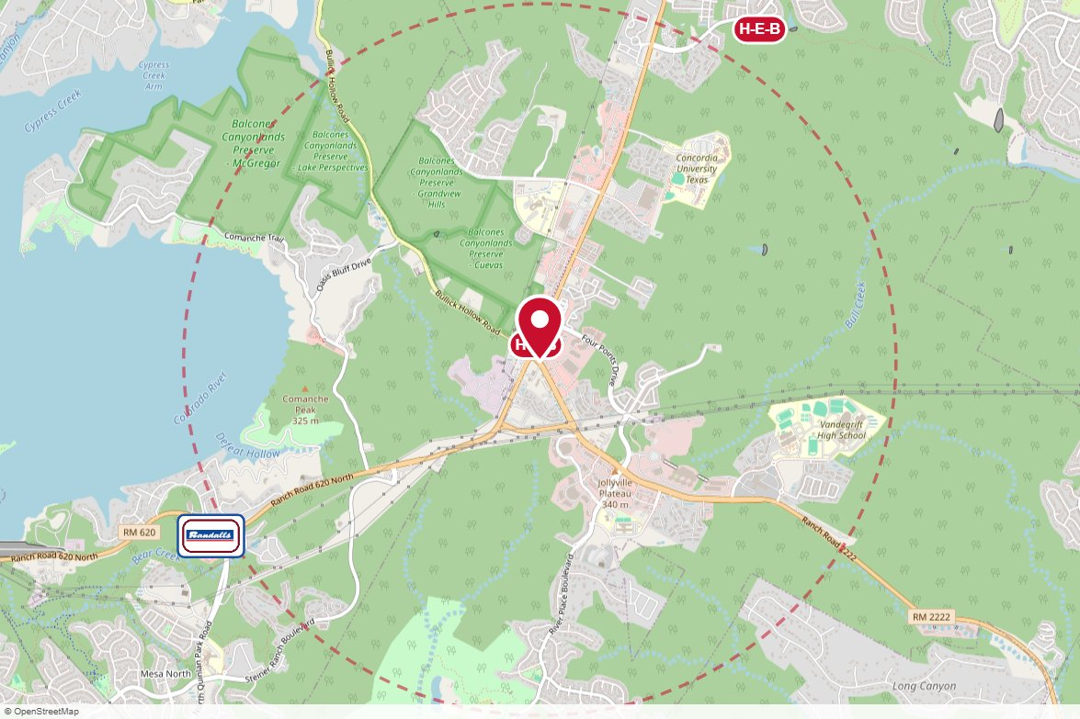
#504 Reagan Outdoor · Static
IN MARKET
PANEL INFO
Location: 11418 RR 2222 250 ft E/O FM 620 N NS
Face: West · Read: Left
Size: 14' x 48'
Contract: 8/17/2026 → 10/18/2026 (4-week)
Impressions: 341,814 / week
Nearest H-E-B: 0.1 mi — Four Points H-E-B
Investment: $5,830 / period
2-MILE AREA
red pin = this panel
red pills = H-E-B stores
company logos = blunting targets
dashed ring = 2-mile radius
Central Region · H-E-B OOH Current Holdings · 8/18/2026

Slide 13
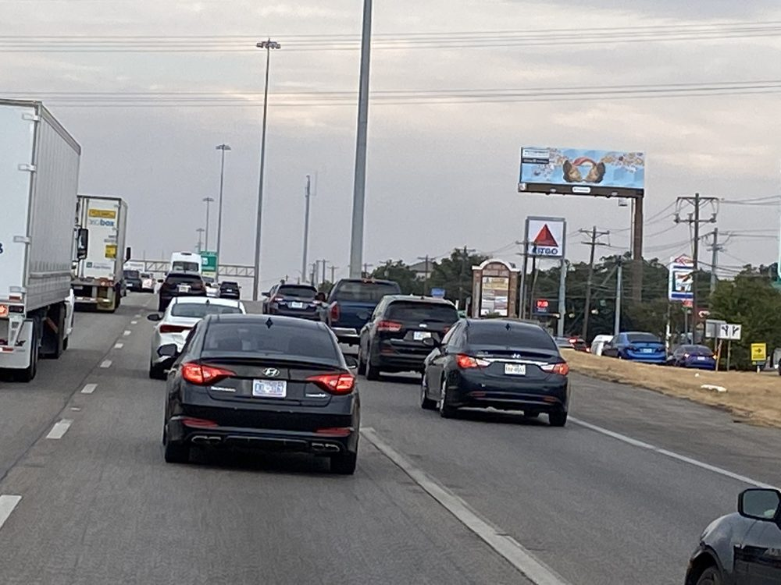
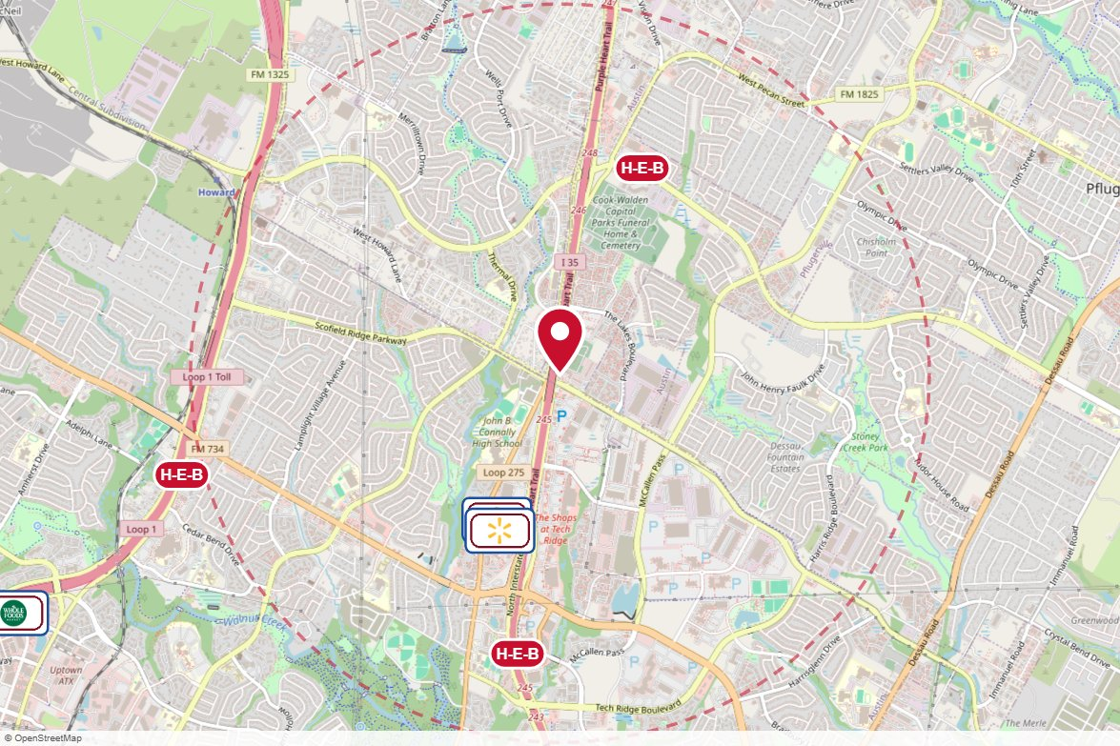
#01-011A-1 Media Choice · Static
IN MARKET
PANEL INFO
Location: 13709 1/2 N, 250' N/O Howard Ln, Austin, TX, 78753
Face: South · Read: Right
Size: 14' x 48'
Contract: 8/17/2026 → 11/1/2026 (4-week)
Impressions: 910,376 / week
Nearest H-E-B: 1.2 mi — Wells Branch H-E-B
Investment: $5,000 / period
2-MILE AREA
red pin = this panel
red pills = H-E-B stores
company logos = blunting targets
dashed ring = 2-mile radius
Central Region · H-E-B OOH Current Holdings · 8/18/2026

Slide 14
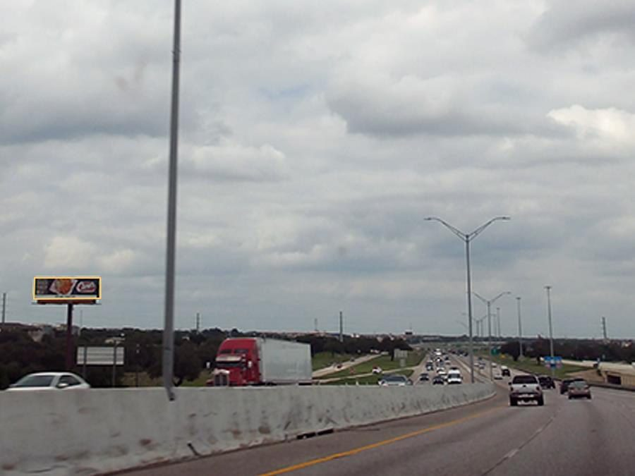
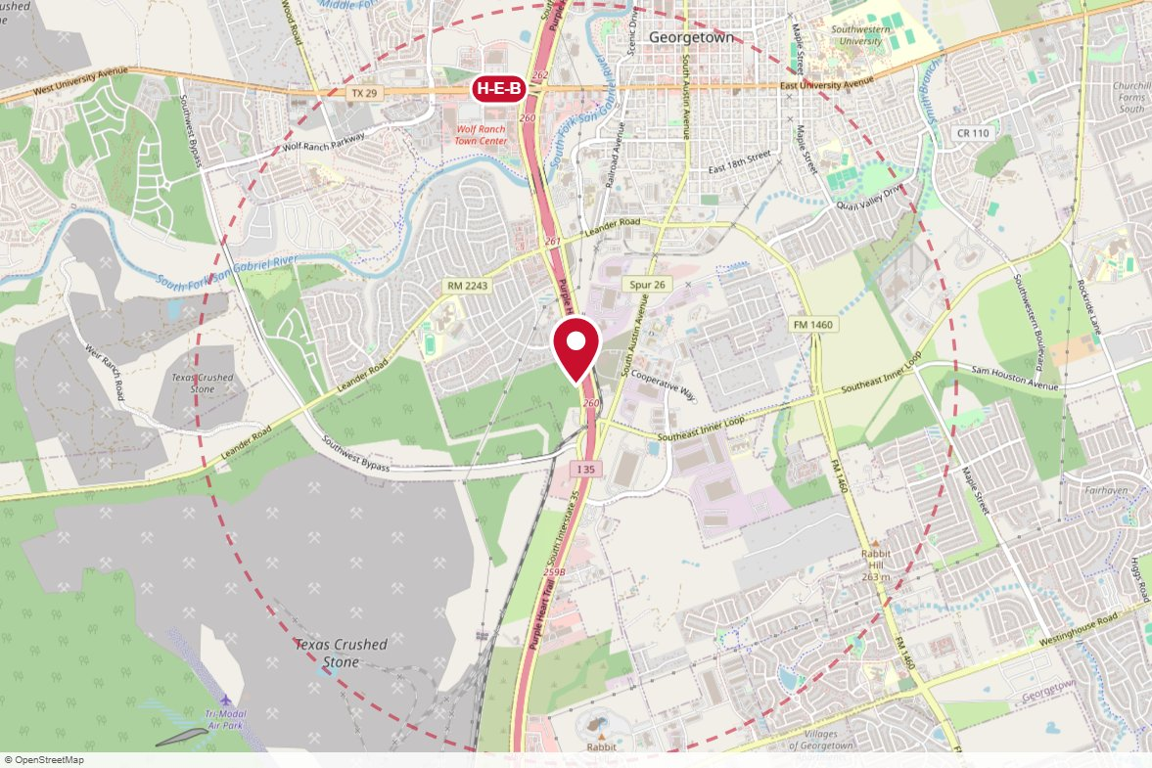
#1627 Lamar Advertising · Static
IN MARKET
PANEL INFO
Location: W/S IH-35 @ INNER SPACE
Face: South · Read: Left
Size: 14' x 48'
Contract: 8/17/2026 → 11/1/2026 (4-week)
Impressions: 475,190 / week
Nearest H-E-B: 1.6 mi — Wolf Lakes Village H-E-B
Investment: $5,850 / period
2-MILE AREA
red pin = this panel
red pills = H-E-B stores
company logos = blunting targets
dashed ring = 2-mile radius
Central Region · H-E-B OOH Current Holdings · 8/18/2026

Slide 15
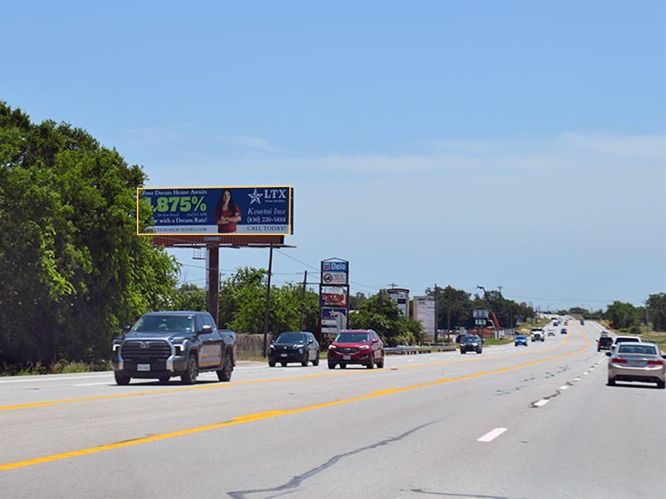
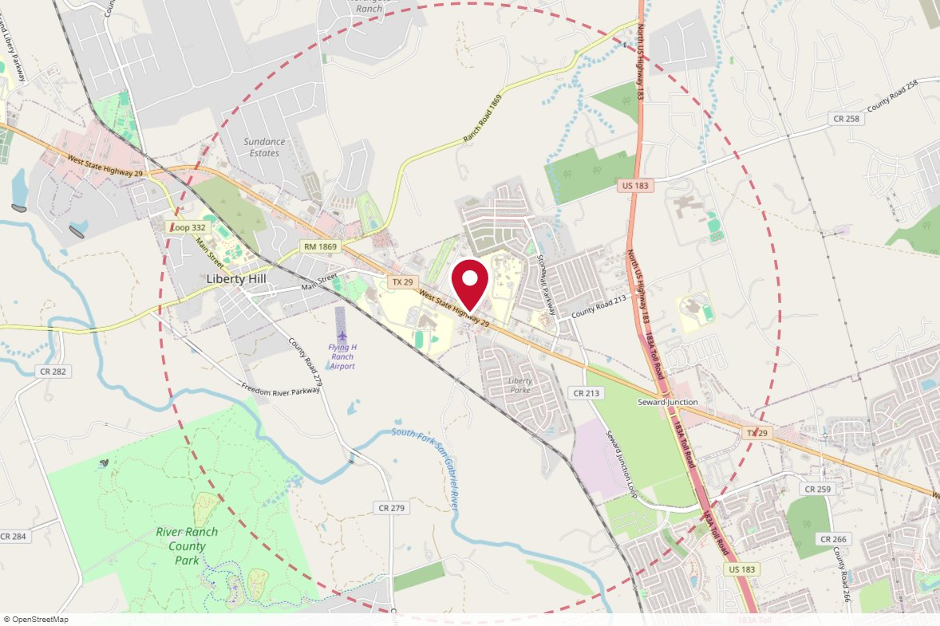
#25151 Lamar Advertising · Static
IN MARKET
PANEL INFO
Location: N/S SH 29 1.35 MI W/O US 183
Face: West · Read: Left
Size: 14' x 48'
Contract: 8/17/2026 → 11/1/2026 (4-week)
Impressions: 166,386 / week
Nearest H-E-B: 4.5 mi — H-E-B At Ronald Reagan Blvd
Investment: $2,700 / period
2-MILE AREA
red pin = this panel
red pills = H-E-B stores
company logos = blunting targets
dashed ring = 2-mile radius
Central Region · H-E-B OOH Current Holdings · 8/18/2026

Slide 16
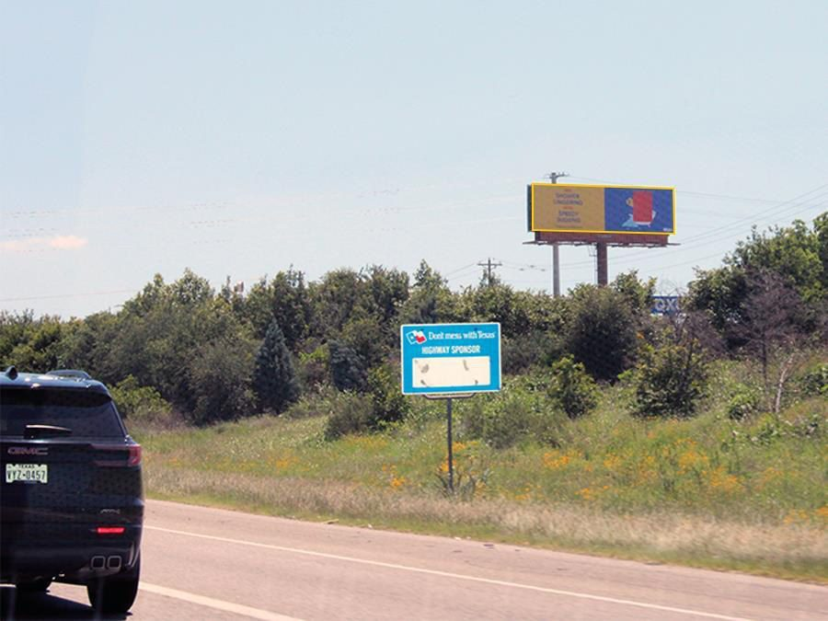
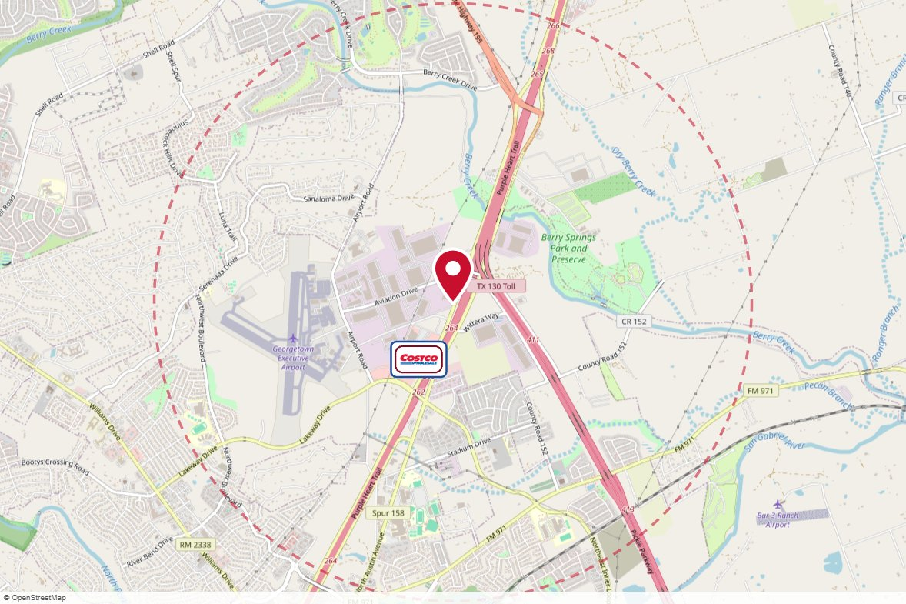
#1503 Lamar Advertising · Static
IN MARKET
PANEL INFO
Location: I-35 @ MM 265.2 IN GEORGETOWN
Face: North · Read: Right
Size: 14' x 48'
Contract: 8/17/2026 → 11/1/2026 (4-week)
Impressions: 407,496 / week
Nearest H-E-B: 4 mi — Wolf Lakes Village H-E-B
Investment: $4,050 / period
2-MILE AREA
red pin = this panel
red pills = H-E-B stores
company logos = blunting targets
dashed ring = 2-mile radius
Central Region · H-E-B OOH Current Holdings · 8/18/2026

Slide 17
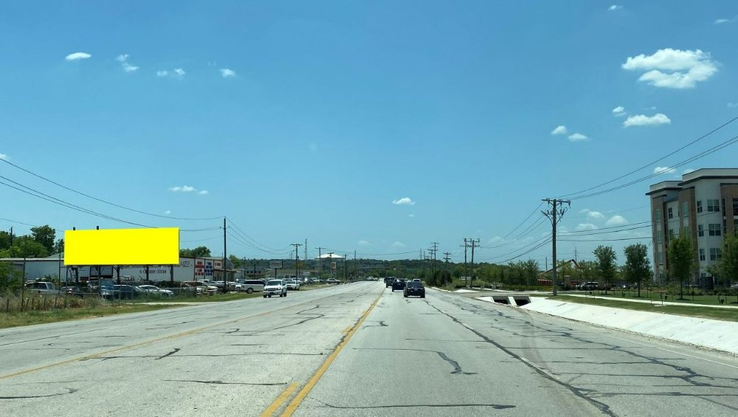
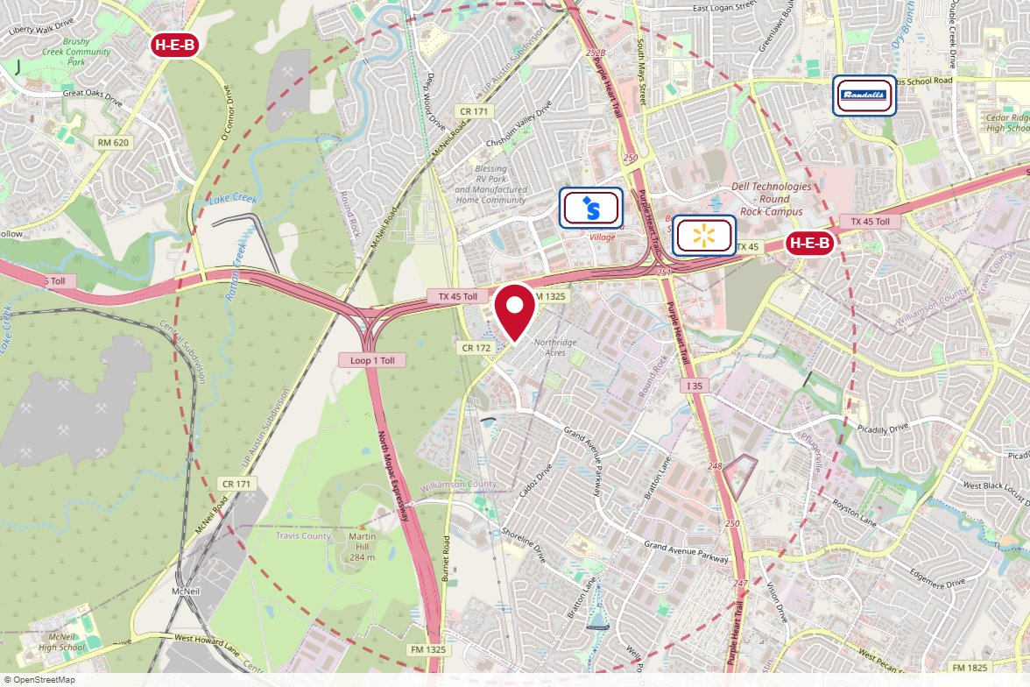
TX90B MH Outdoor Media · Static
IN MARKET
PANEL INFO
Location: E/S of FM 1325, 550 ft E/o CR 172, N/F
Face: North · Read: Left
Size: 12' x 40'
Contract: 8/17/2026 → 11/1/2026 (4-week)
Impressions: 353,822 / week
Nearest H-E-B: 1.8 mi — Louis Henna Blvd H-E-B
Investment: $700 / period
2-MILE AREA
red pin = this panel
red pills = H-E-B stores
company logos = blunting targets
dashed ring = 2-mile radius
Central Region · H-E-B OOH Current Holdings · 8/18/2026

Slide 18
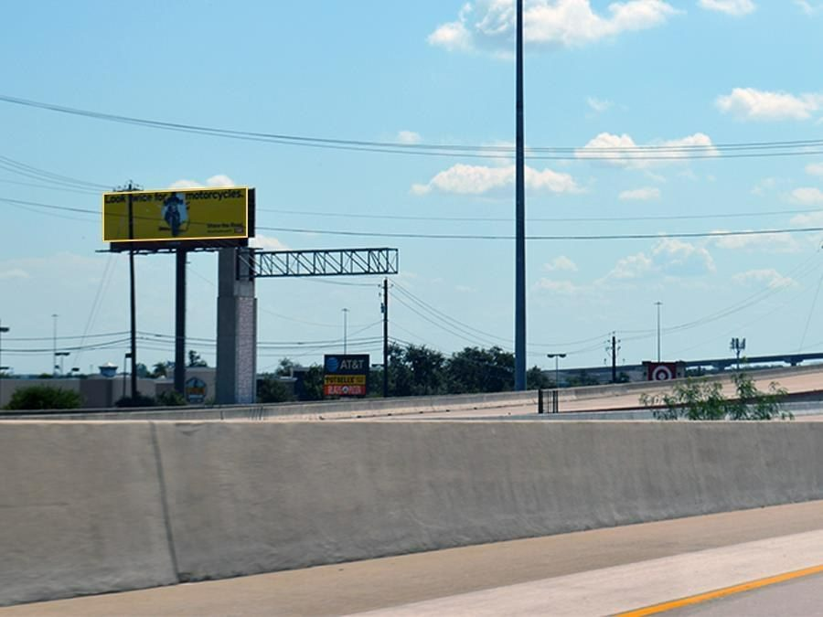
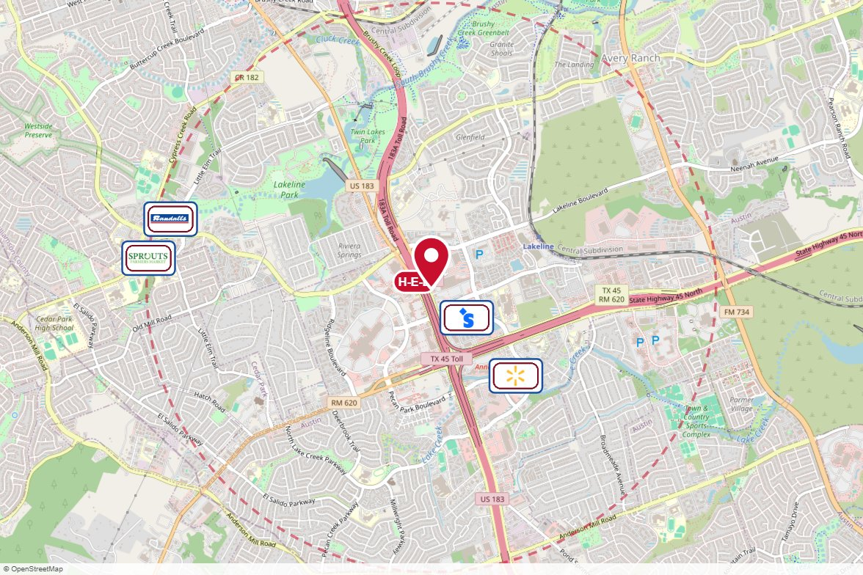
#1305 Lamar Advertising · Static
IN MARKET
PANEL INFO
Location: E/S US 183 N. 0.33 MI N/O RR 620
Face: North · Read: Left
Size: 14' 0" x 48' 0"
Contract: 8/17/2026 → 11/1/2026 (4-week)
Impressions: 230,021 / week
Nearest H-E-B: 0.1 mi — Lakeline H-E-B plus!
Investment: $4,050 / period
2-MILE AREA
red pin = this panel
red pills = H-E-B stores
company logos = blunting targets
dashed ring = 2-mile radius
Central Region · H-E-B OOH Current Holdings · 8/18/2026

Slide 19
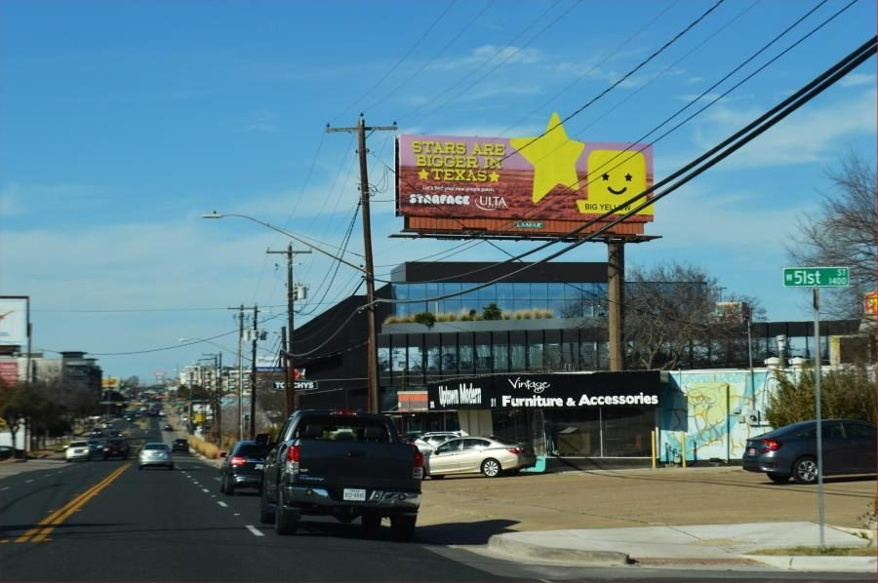
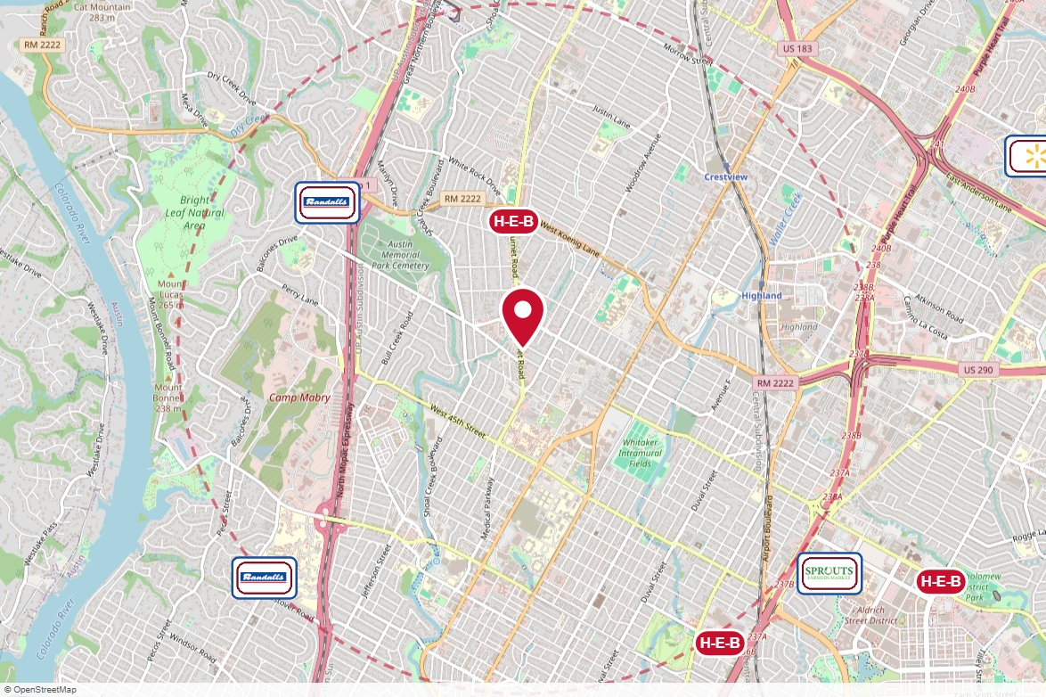
#1616 Lamar Advertising · Static
IN MARKET
PANEL INFO
Location: BURNET RD E/S S/O HANCOCK DR.
Face: South · Read: Right
Size: 14' 0" x 48' 0"
Contract: 8/17/2026 → 11/1/2026 (4-week)
Impressions: 82,848 / week
Nearest H-E-B: 0.7 mi — Burnet Rd H-E-B
Investment: $3,600 / period
2-MILE AREA
red pin = this panel
red pills = H-E-B stores
company logos = blunting targets
dashed ring = 2-mile radius
Central Region · H-E-B OOH Current Holdings · 8/18/2026

Slide 20
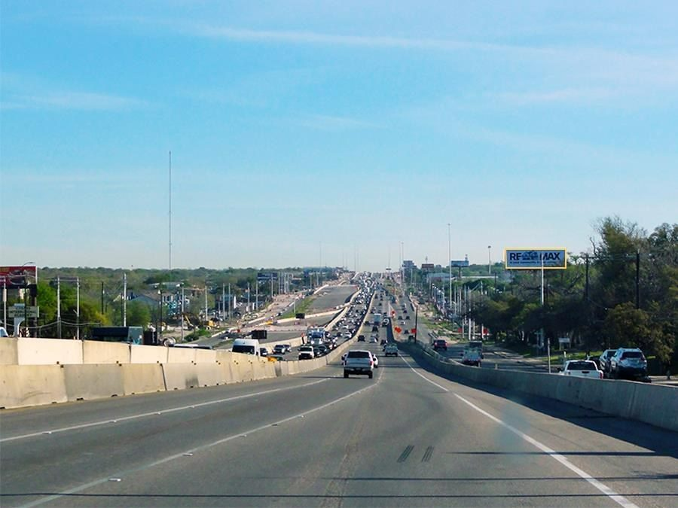
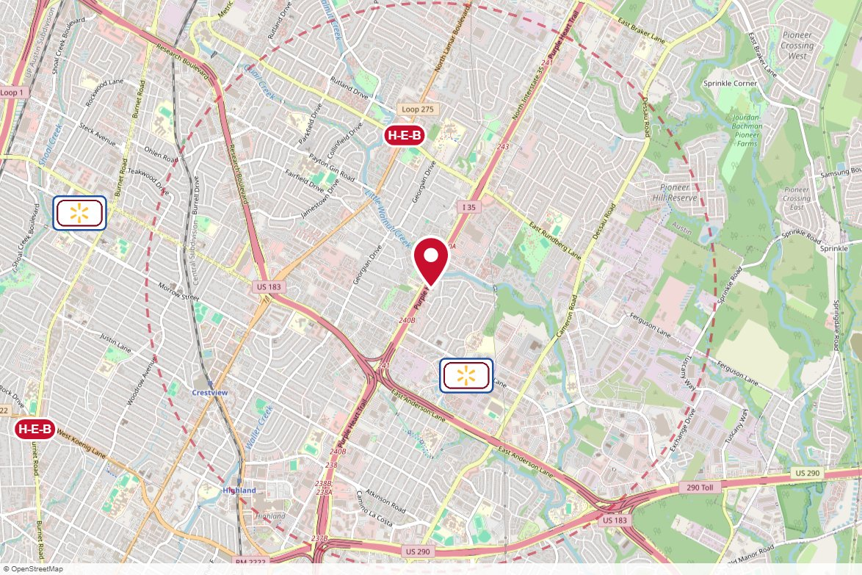
#1622 Lamar Advertising · Static
IN MARKET
PANEL INFO
Location: IH-35-E/S, 0.25 MI N/O HWY 183
Face: South · Read: Right
Size: 14' 0" x 48' 0"
Contract: 8/17/2026 → 11/1/2026 (4-week)
Impressions: 647,970 / week
Nearest H-E-B: 1.1 mi — Lamar and Rundberg H-E-B
Investment: $5,400 / period
2-MILE AREA
red pin = this panel
red pills = H-E-B stores
company logos = blunting targets
dashed ring = 2-mile radius
Central Region · H-E-B OOH Current Holdings · 8/18/2026

Slide 21
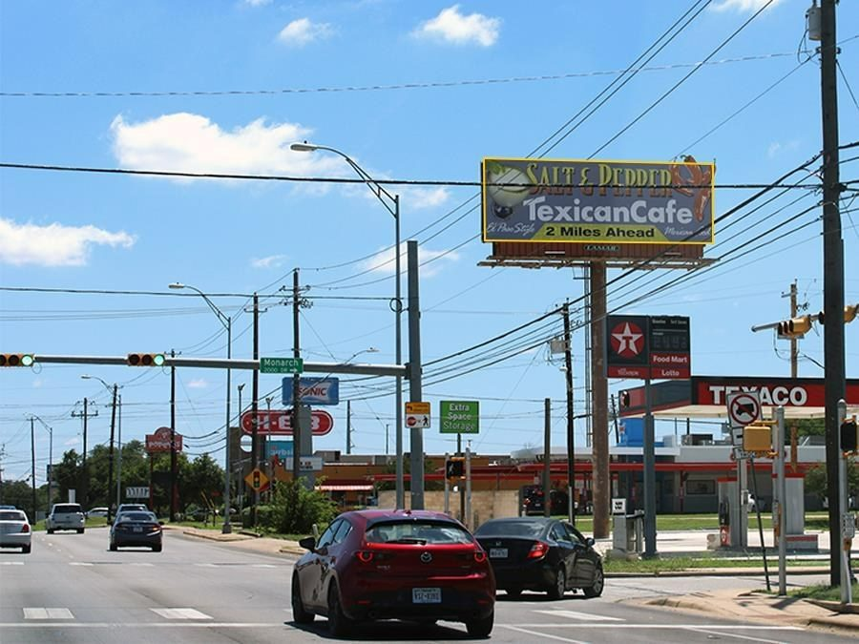
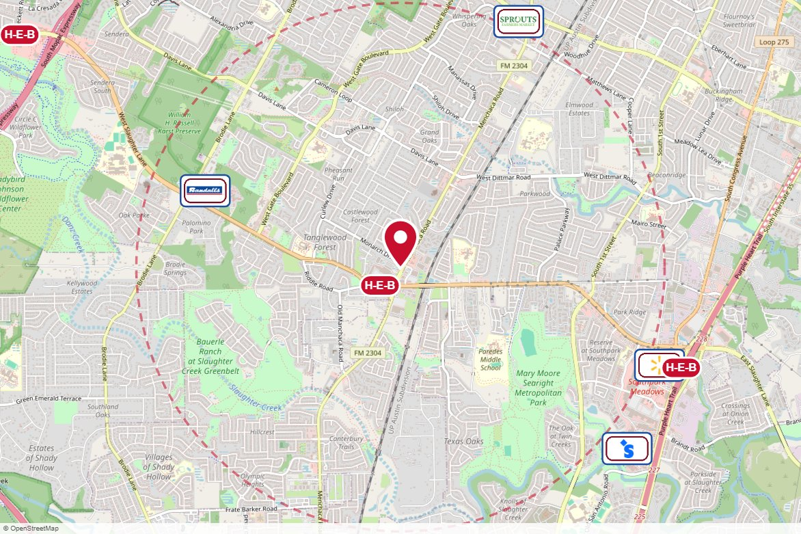
#1267 Lamar Advertising · Static
IN MARKET
PANEL INFO
Location: W/S MANCHACA 1000' N/O SLAUGHTER
Face: North · Read: Right
Size: 12' 0" x 36' 0"
Contract: 8/17/2026 → 11/1/2026 (4-week)
Impressions: 197,174 / week
Nearest H-E-B: 0.2 mi — Slaughter and Manchaca H-E-B
Investment: $3,150 / period
2-MILE AREA
red pin = this panel
red pills = H-E-B stores
company logos = blunting targets
dashed ring = 2-mile radius
Central Region · H-E-B OOH Current Holdings · 8/18/2026

Slide 22
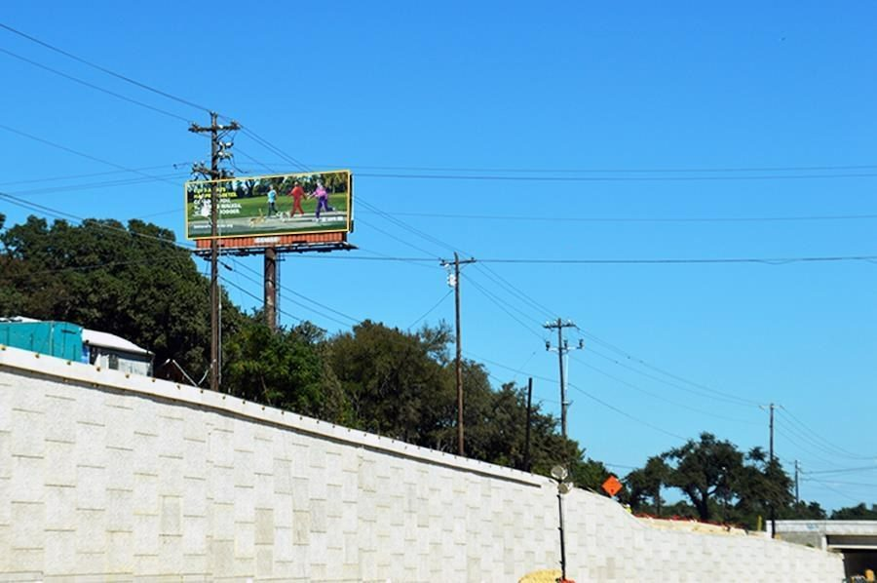
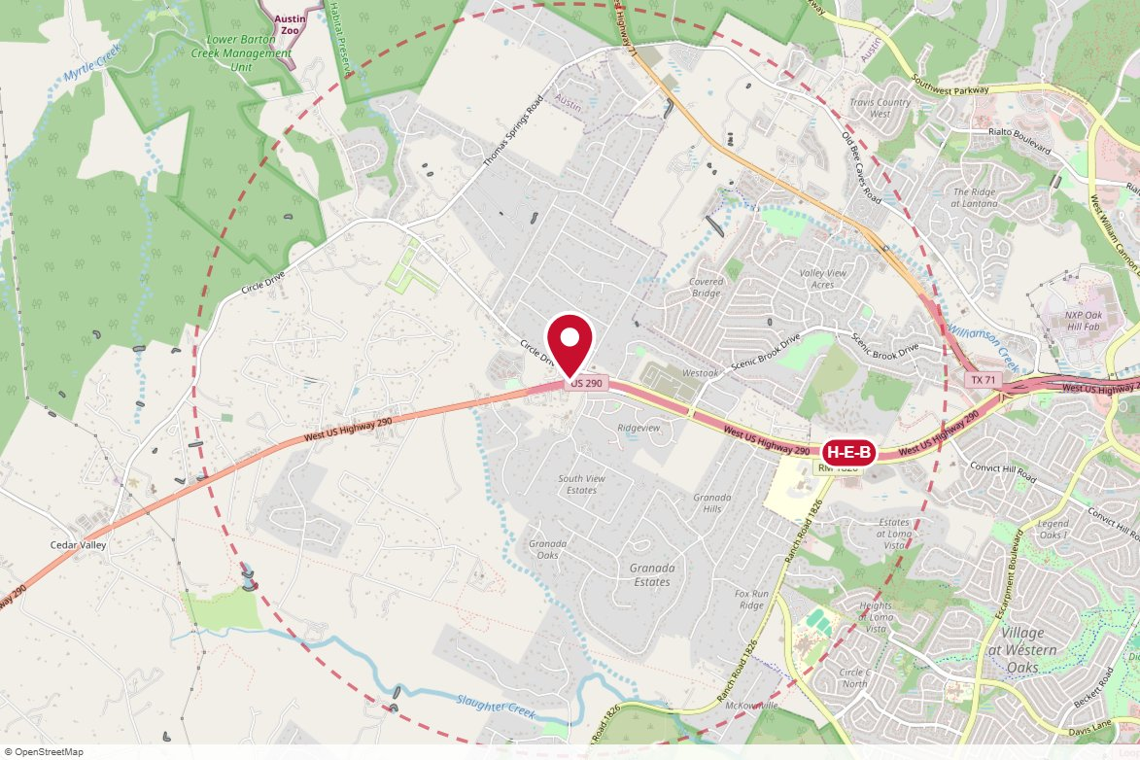
#1377 Lamar Advertising · Static
IN MARKET
PANEL INFO
Location: US 290 2.25 MI W/O HWY 71
Face: West · Read: Left
Size: 12' 0" x 36' 0"
Contract: 8/17/2026 → 11/1/2026 (4-week)
Impressions: 160,519 / week
Nearest H-E-B: 1.5 mi — Oak Hill H-E-B
Investment: $2,250 / period
2-MILE AREA
red pin = this panel
red pills = H-E-B stores
company logos = blunting targets
dashed ring = 2-mile radius
Central Region · H-E-B OOH Current Holdings · 8/18/2026

Slide 23
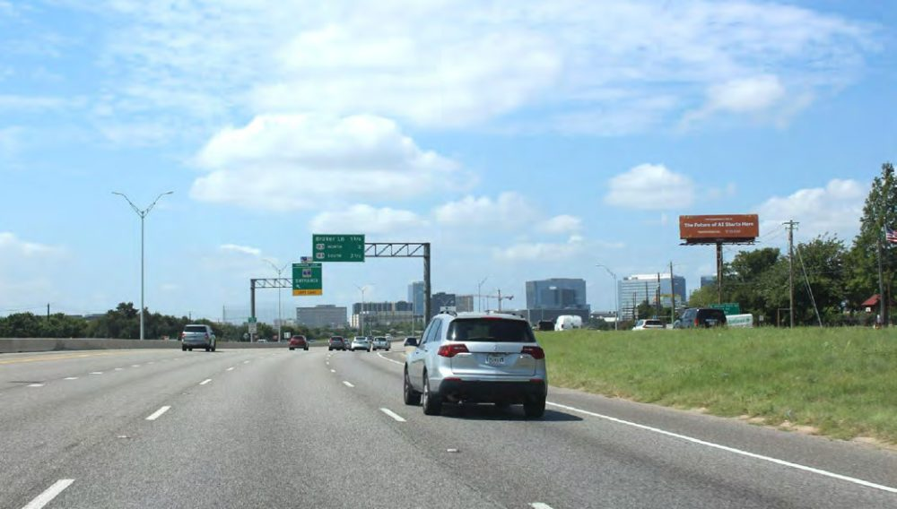
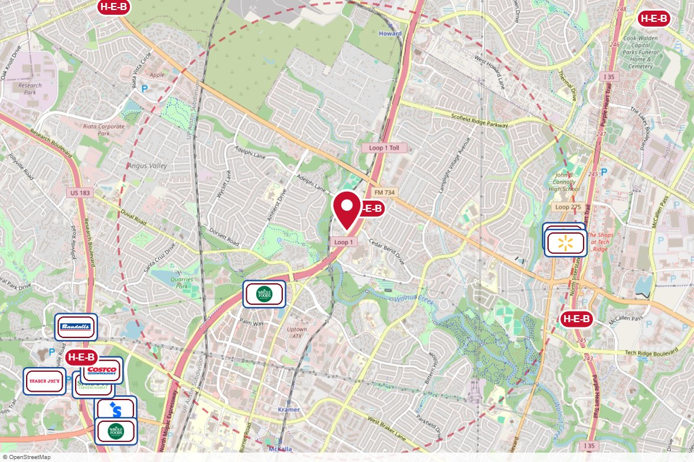
#9041 Reagan Outdoor · Static
STARTS SOON
PANEL INFO
Location: 12200 Mo-Pac Expy N (Loop 1) 0.5 mi S/O Parmer Ln W (SR 734) WS
Face: North · Read: Right
Size: 14' x 48'
Contract: 9/28/2026 → 11/1/2026 (4-week)
Impressions: 628,643 / week
Nearest H-E-B: 0.3 mi — Parmer and Mopac H-E-B
Investment: $20,350 / period
2-MILE AREA
red pin = this panel
red pills = H-E-B stores
company logos = blunting targets
dashed ring = 2-mile radius
Central Region · H-E-B OOH Current Holdings · 8/18/2026

Slide 24
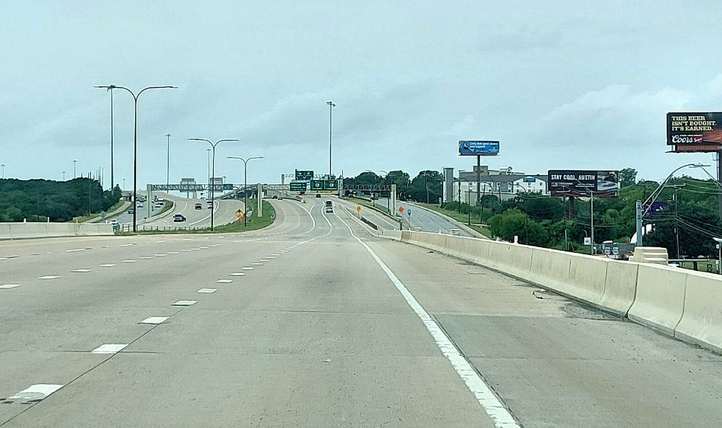
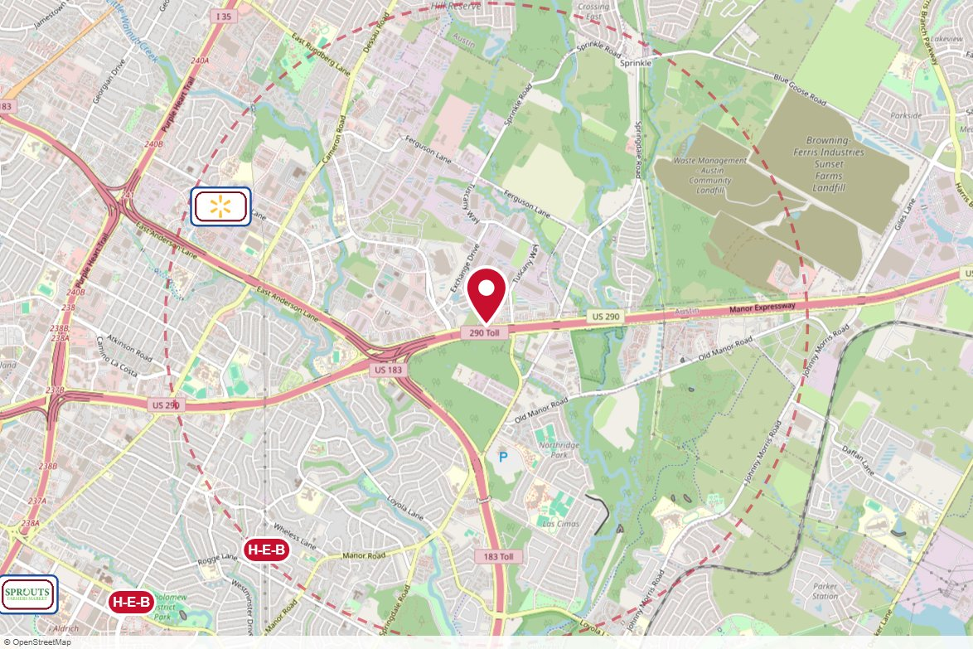
#9073 Reagan Outdoor · Static
STARTS SOON
PANEL INFO
Location: 8304 US 290 E 0.3 mi W/O Springdale Rd NS
Face: East · Read: Right
Size: 14' x 48'
Contract: 9/14/2026 → 11/1/2026 (4-week)
Impressions: 339,031 / week
Nearest H-E-B: 1.9 mi — Ed Bluestein H-E-B
Investment: $3,860 / period
2-MILE AREA
red pin = this panel
red pills = H-E-B stores
company logos = blunting targets
dashed ring = 2-mile radius
Central Region · H-E-B OOH Current Holdings · 8/18/2026

Slide 25
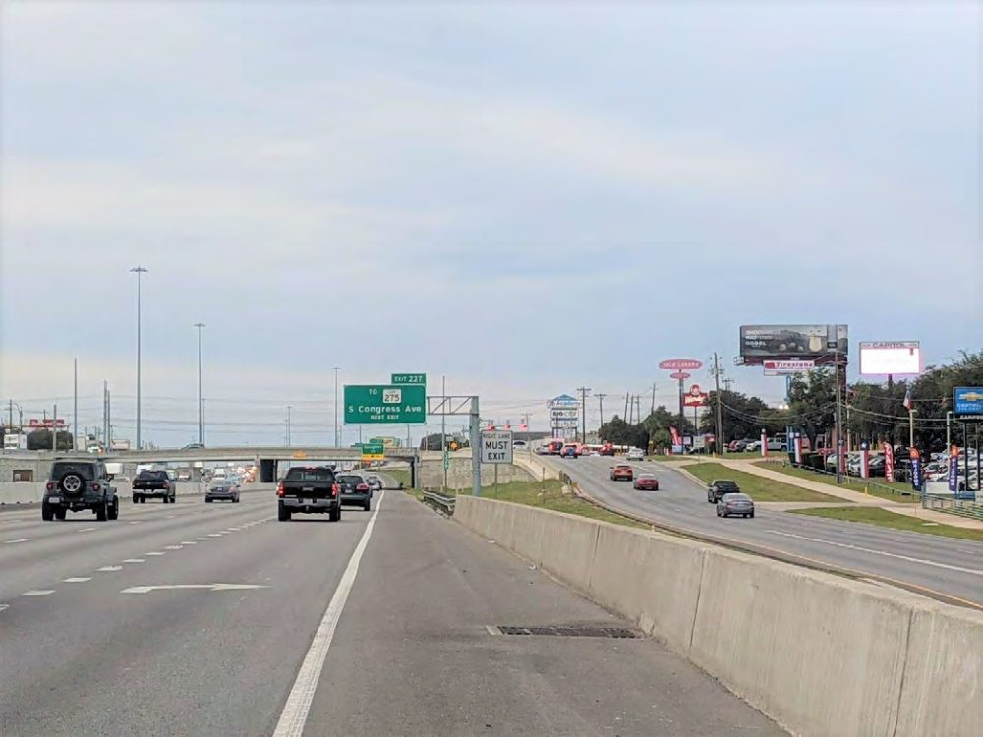
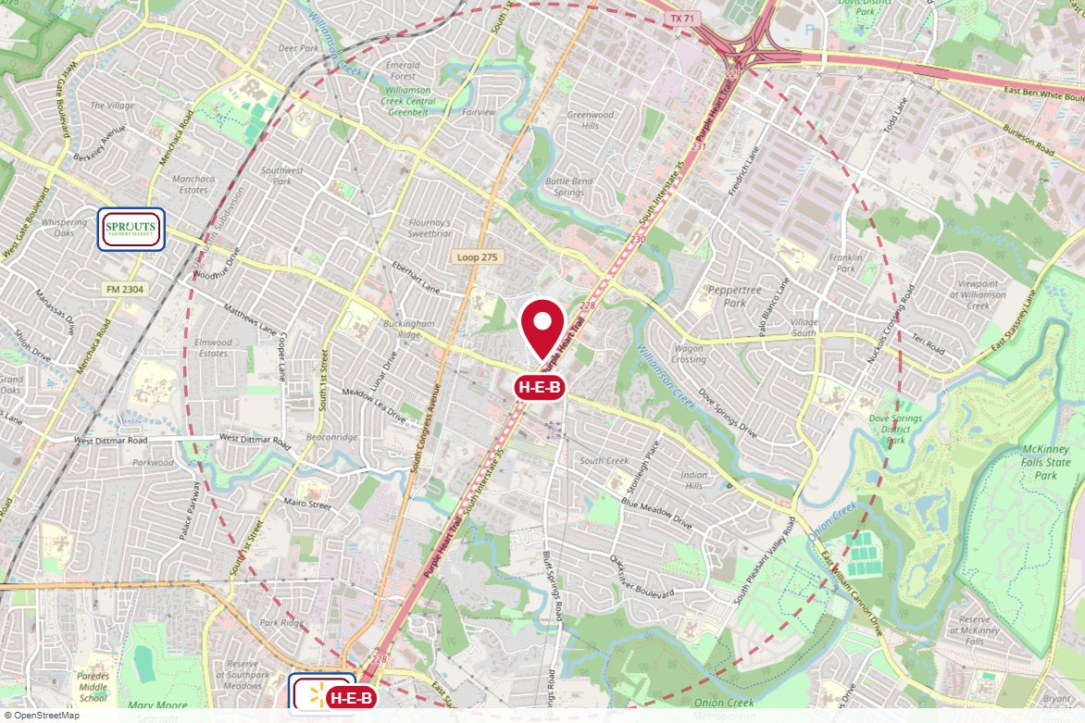
#9507 Reagan Outdoor · Static
STARTS SOON
PANEL INFO
Location: 6428 I-35 S 500 ft N/O William Cannon WS
Face: North · Read: Right
Size: 14' x 48'
Contract: 9/28/2026 → 12/20/2026 (4-week)
Impressions: 870,619 / week
Nearest H-E-B: 0.1 mi — I 35 and William Cannon H-E-B
Investment: $9,295 / period
2-MILE AREA
red pin = this panel
red pills = H-E-B stores
company logos = blunting targets
dashed ring = 2-mile radius
Central Region · H-E-B OOH Current Holdings · 8/18/2026

Slide 26
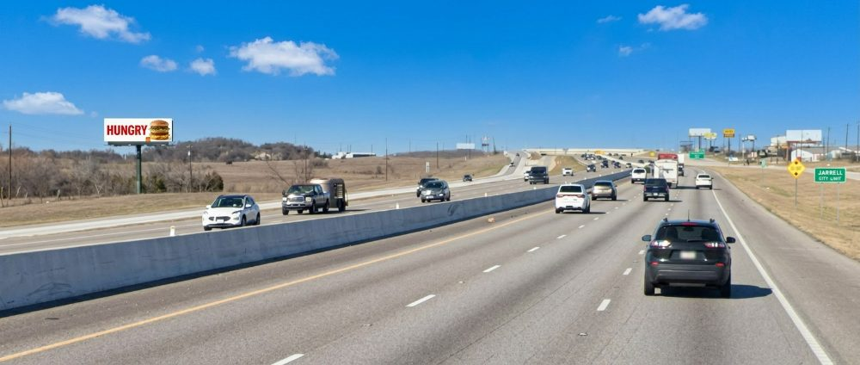
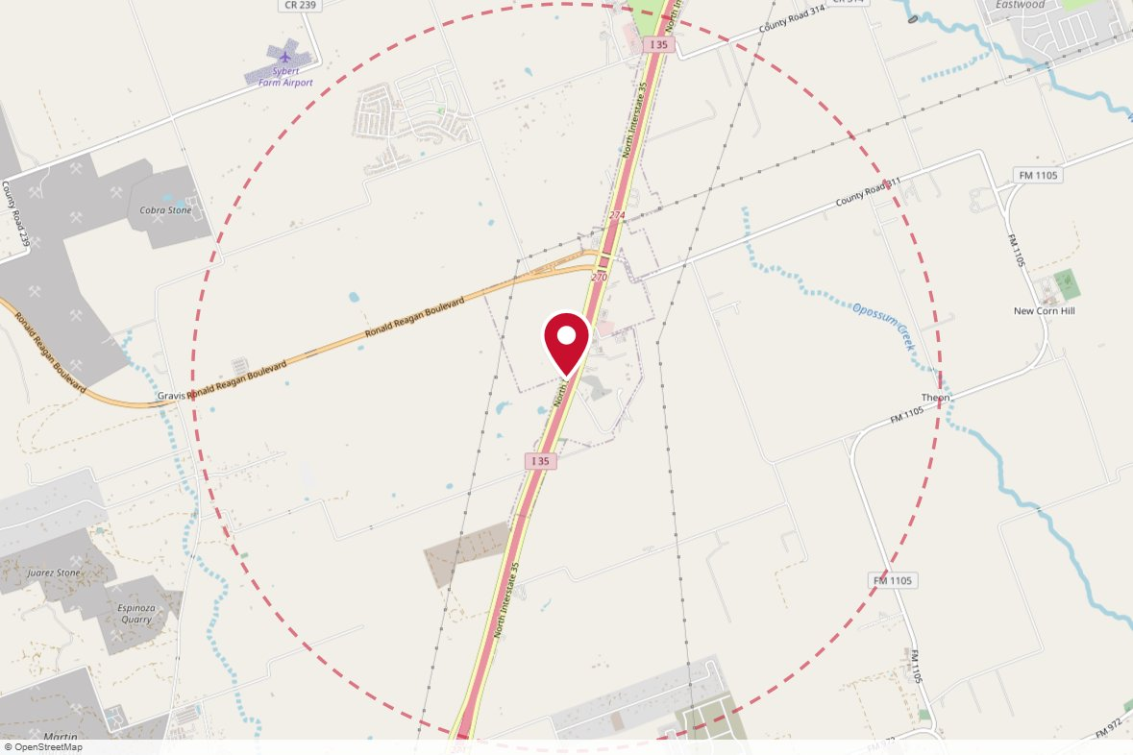
#203-8051L Theon Properties · Static
STARTS SOON
PANEL INFO
Location: IH-35 NB, 0.5 mi south of Ronald Reagan Blvd — SW corner IH-35 & Ronald Reagan ("Sign No. 2"), 8360 I-35 frontage, Georgetown/Jarrell line
Face: South · Read: Left
Size: 14x48
Contract: 10/1/2026 → 9/30/2028 (Monthly)
Impressions: 256,803 / week
Nearest H-E-B: 8.4 mi — Parmer Ranch H-E-B
Investment: $1,000 / period
2-MILE AREA
red pin = this panel
red pills = H-E-B stores
company logos = blunting targets
dashed ring = 2-mile radius
Central Region · H-E-B OOH Current Holdings · 8/18/2026

Slide 27
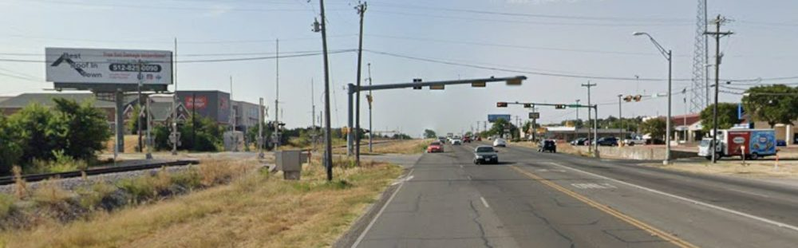
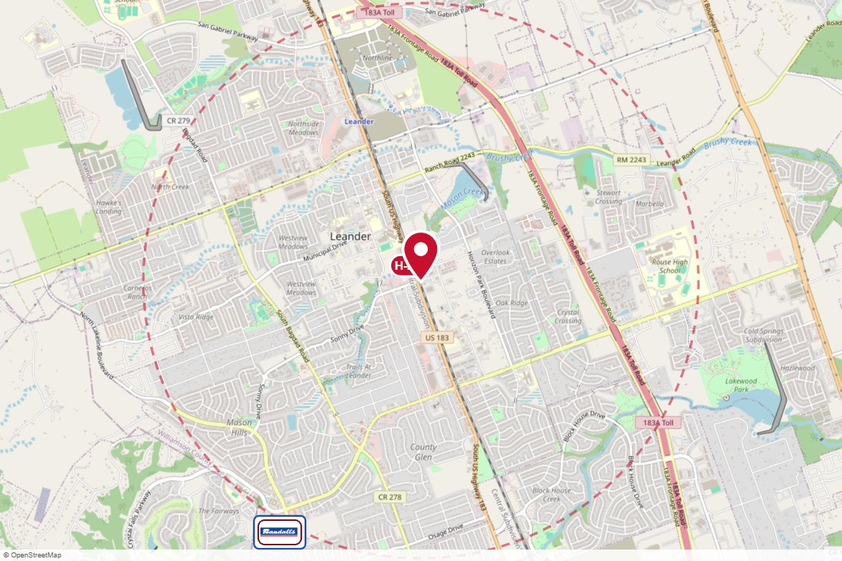
#207-101L Beseda Properties · Static
STARTS SOON
PANEL INFO
Location: US Hwy 183 SB @ East Sonny St — 709 Leander Dr / 101 E Sonny Dr, Leander
Face: North · Read: Left
Size: 14x48
Contract: 11/1/2026 → 10/31/2029 (monthly)
Impressions: 132,435 / week
Nearest H-E-B: 0.1 mi — Leander H-E-B plus!
Investment: $2,800 / period
2-MILE AREA
red pin = this panel
red pills = H-E-B stores
company logos = blunting targets
dashed ring = 2-mile radius
Central Region · H-E-B OOH Current Holdings · 8/18/2026

Slide 28
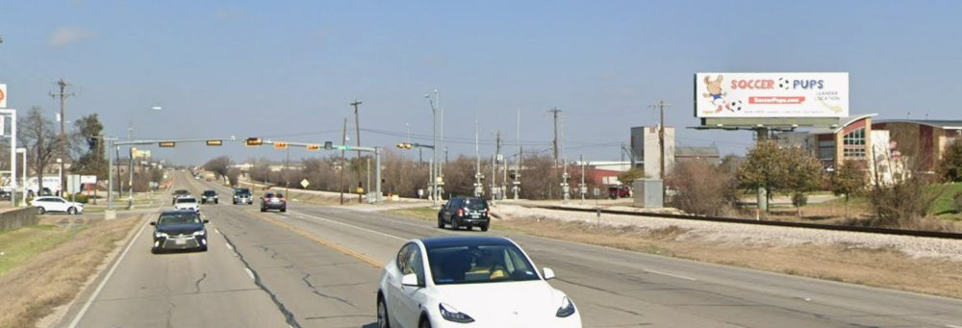
#207-101R Beseda Properties · Static
STARTS SOON
PANEL INFO
Location: US Hwy 183 NB @ East Sonny St — 709 Leander Dr / 101 E Sonny Dr, Leander
Face: South · Read: Right
Size: 14x48
Contract: 11/1/2026 → 10/31/2029 (monthly)
Impressions: 164,895 / week
Nearest H-E-B: 0.1 mi — Leander H-E-B plus!
Investment: $2,800 / period
2-MILE AREA
red pin = this panel
red pills = H-E-B stores
company logos = blunting targets
dashed ring = 2-mile radius
Central Region · H-E-B OOH Current Holdings · 8/18/2026

Slide 29


ATX.SP104 BIG Outdoor · Spectacular - Wallscape (Static)
UNIQUE OOH
PANEL INFO
Location: Austin · Austin
Contract: 10/19/2026 → 1/3/2027 (4-week) · 2.75 periods
Impressions: 80,081 / week
Nearest H-E-B: 1.3 mi — Parmer and Mopac H-E-B
Rate card: $25,300 / 4-week
Investment: $15,000 / period · $41,250 contract total
2-MILE AREA
red pin = this panel
red pills = H-E-B stores
company logos = blunting targets
dashed ring = 2-mile radius
Central Region · H-E-B OOH Current Holdings · 8/18/2026

Slide 30

ATX Bus King (20) Clear Channel Outdoor · Transit - Bus
UNIQUE OOH
PANEL INFO
Location: Austin · Austin metro
Contract: 8/24/2026 → 12/27/2026 (4-week) · 4.5 periods
Impressions: n/a
Rate card: $810 / 4-week
Investment: $13,400 / period · $60,300 contract total
Roams the CapMetro network — citywide Austin coverage (see Bus Routes on the region map)
Central Region · H-E-B OOH Current Holdings · 8/18/2026

