Slide 1

North West Region
OOH Current Holdings
63 contracted holdings · 56 in market now · prepared 9/15/2026 · H-E-B OOH Program

Slide 2
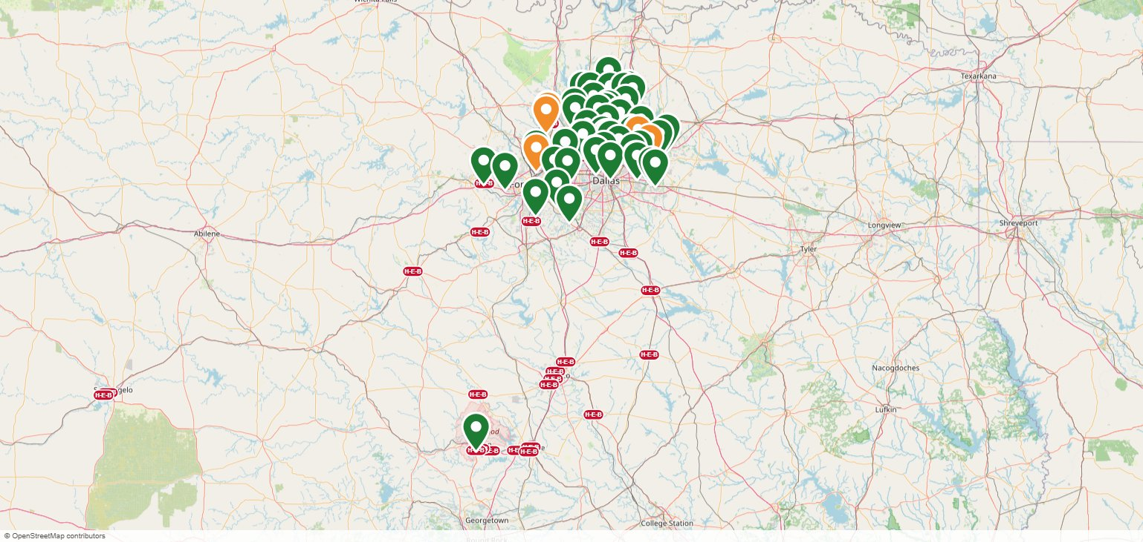
North West Region OOH Current Holdings Map
Green pin = in market now · Orange pin = starting soon · Purple pin = Unique OOH (wallscapes / transit) · Purple dashes = Bus Routes · Red pills = H-E-B stores

Slide 3



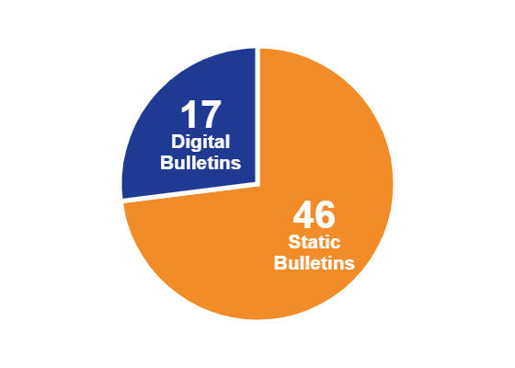

Costs & Impressions — North West Region
$450,045
22,878,502
$4.92
PER PERIOD COMMITTED (IN-MARKET)
IMPRESSIONS / WEEK
EFFECTIVE CPM (4-WEEK)
$274,992
· 46 Static Bulletins
· 17 Digital Bulletins
63
FY26 BUDGET LEFT TO SPEND
CONTRACTED HOLDINGS · 56 IN MARKET · 7 STARTING SOON
FORMAT MIX
Full FY26 OOH budget: $2,222,000 · FY26 ends 11/1/2026 · program buys draw down what was left to spend ($856,512)

Slide 4
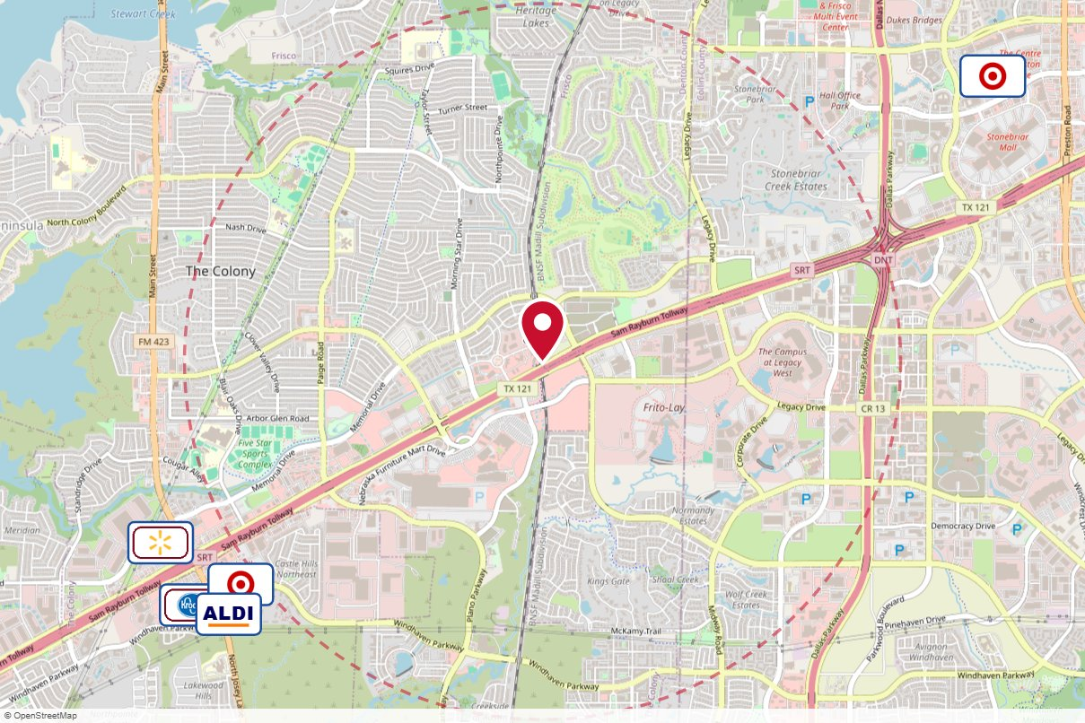
#5021 Clear Channel Outdoor · Static
IN MARKET
no photo on file
PANEL INFO
Location: Hwy 121 NS 0.2mi W/O Legacy Dr F/W - 1
Face: West
Size: 14'0"' x 48'0"'
Contract: 7/6/2026 → 3/28/2027 (4-week)
Impressions: 341,564 / week
Nearest H-E-B: 5.3 mi — H-E-B Plano
Investment: $13,080 / period
2-MILE AREA
red pin = this panel
red pills = H-E-B stores
company logos = blunting targets
dashed ring = 2-mile radius
North West Region · H-E-B OOH Current Holdings · 9/15/2026

Slide 5
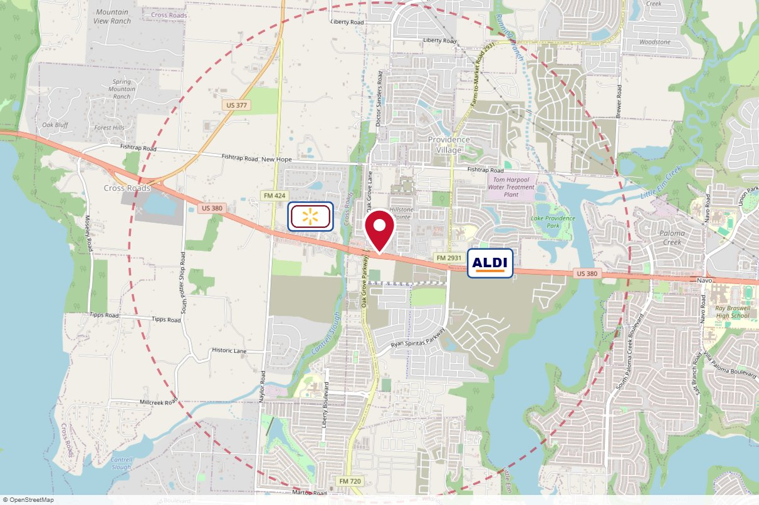
#058L The Reiss Group · Static
IN MARKET
no photo on file
PANEL INFO
Location: Hwy.380 EB, 1/10 mi east of FM 720
Face: West
Size: 14'' x 48''
Contract: 7/6/2026 → 12/27/2026 (4-week)
Impressions: 217,000 / week
Nearest H-E-B: 8.5 mi — Hwy 380 and FM 423 H-E-B
Investment: $2,300 / period
2-MILE AREA
red pin = this panel
red pills = H-E-B stores
company logos = blunting targets
dashed ring = 2-mile radius
North West Region · H-E-B OOH Current Holdings · 9/15/2026

Slide 6
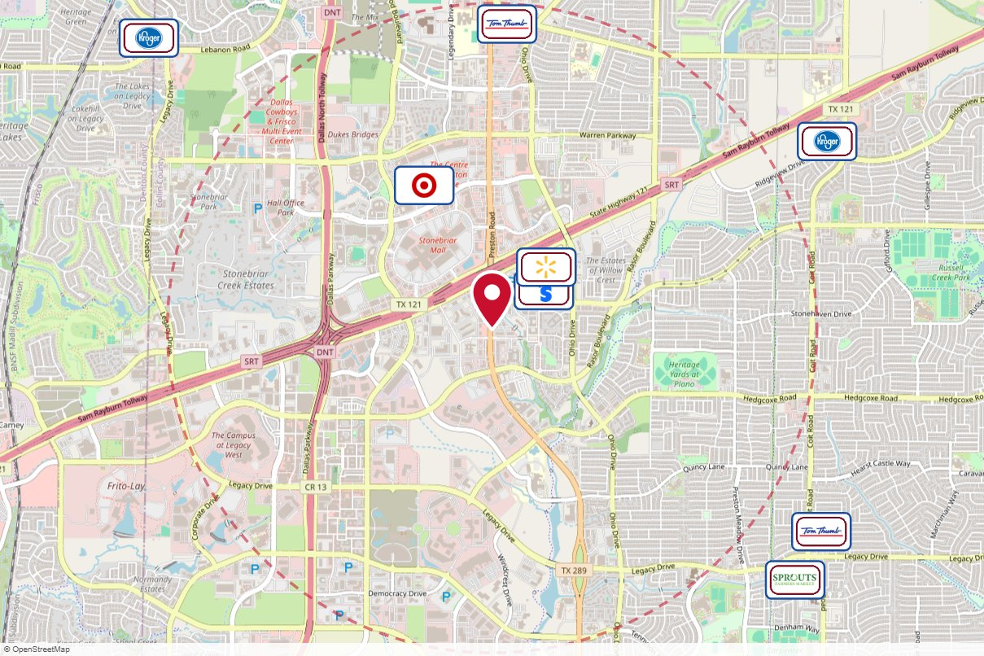
#1240R The Reiss Group · Static
IN MARKET
no photo on file
PANEL INFO
Location: Preston Rd. NB, just s/o Hwy 121
Face: South
Size: 12'' x 40''
Contract: 7/6/2026 → 12/27/2026 (4-week)
Impressions: 434,000 / week
Nearest H-E-B: 4.4 mi — H-E-B Plano
Investment: $8,600 / period
2-MILE AREA
red pin = this panel
red pills = H-E-B stores
company logos = blunting targets
dashed ring = 2-mile radius
North West Region · H-E-B OOH Current Holdings · 9/15/2026

Slide 7
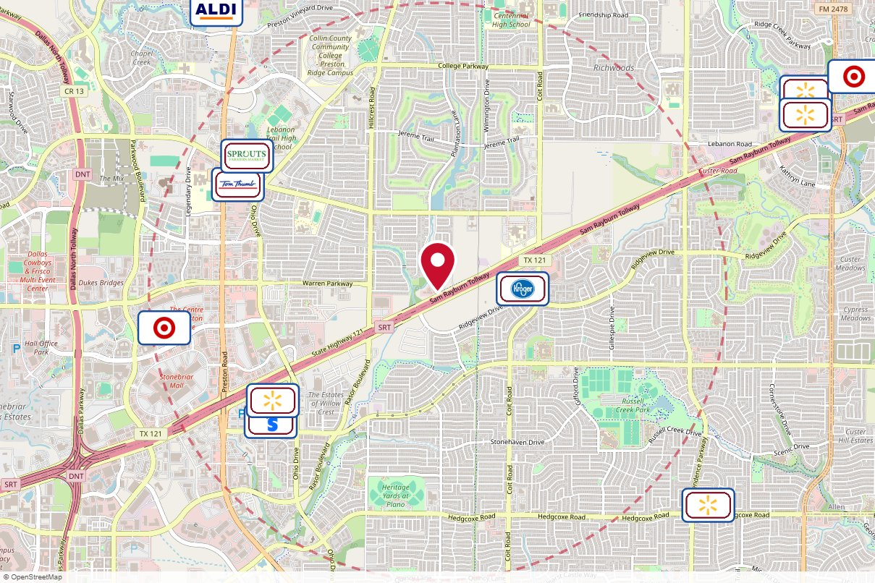
#6782 Clear Channel Outdoor · Static
IN MARKET
no photo on file
PANEL INFO
Location: SH 121 (Sam Rayburn Tollway) NS 0.56mi E/O Hillcrest Rd F/W - 1
Face: West
Size: 14'' x 48''
Contract: 7/6/2026 → 1/31/2027 (4-week)
Impressions: 298,768 / week
Nearest H-E-B: 5.4 mi — H-E-B Plano
Investment: $14,940 / period
2-MILE AREA
red pin = this panel
red pills = H-E-B stores
company logos = blunting targets
dashed ring = 2-mile radius
North West Region · H-E-B OOH Current Holdings · 9/15/2026

Slide 8
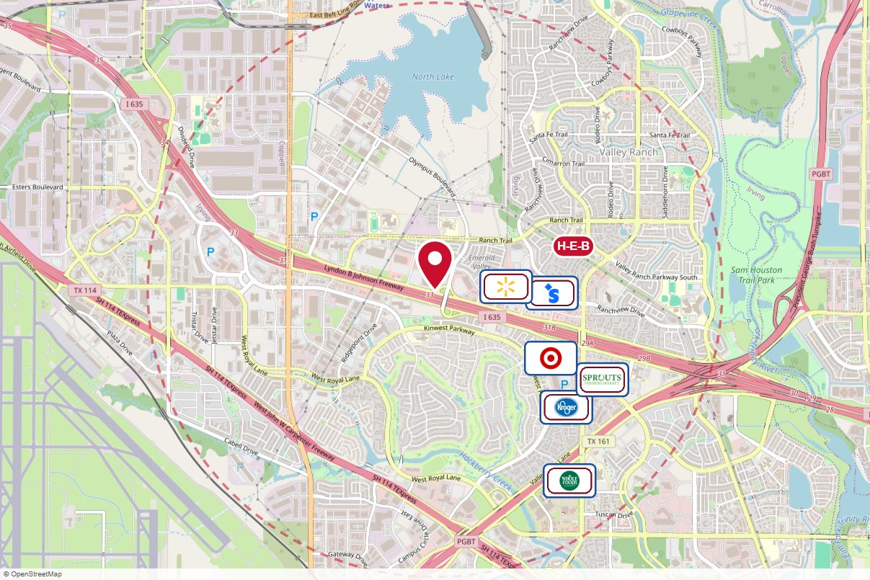
#1012B Media Eyes · Static
IN MARKET
no photo on file
PANEL INFO
Location: LBJ Frwy n/l 1 mi e/o Beltline Rd.
Face: West
Size: 12'' x 40''
Contract: 7/6/2026 → 12/27/2026 (4-week)
Impressions: 82,220 / week
Nearest H-E-B: 1 mi — Irving
Investment: $4,002 / period
2-MILE AREA
red pin = this panel
red pills = H-E-B stores
company logos = blunting targets
dashed ring = 2-mile radius
North West Region · H-E-B OOH Current Holdings · 9/15/2026

Slide 9
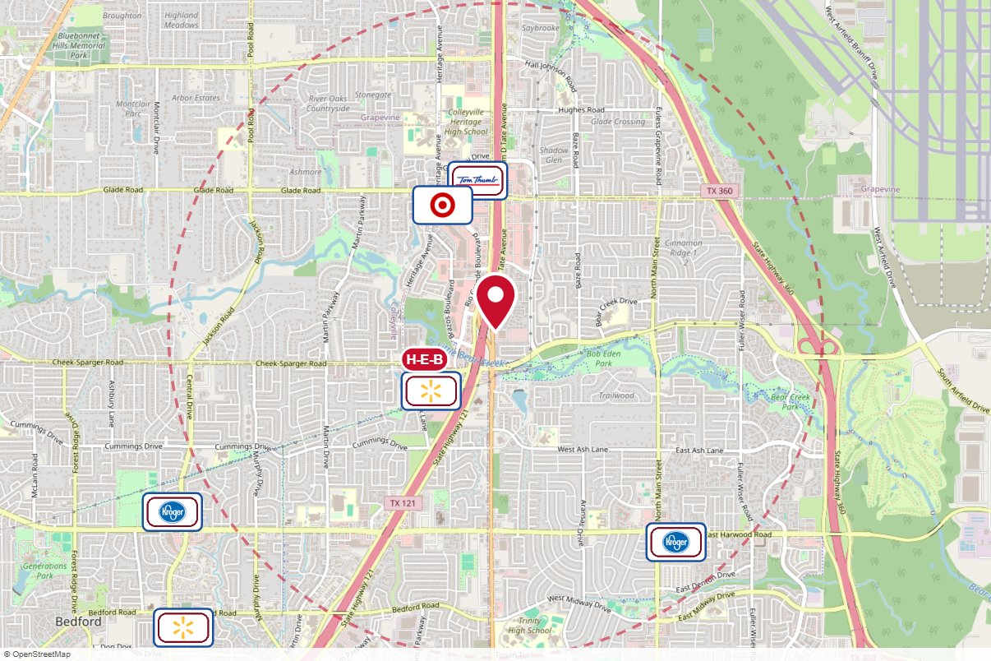
#2527 Lamar Advertising · Static
IN MARKET
no photo on file
PANEL INFO
Location: SH-121 N/O FM 157, E/S
Face: South · Read: Right
Size: 14'' x 48''
Contract: 7/6/2026 → 6/27/2027 (4-week)
Impressions: 220,168 / week
Nearest H-E-B: 0.5 mi — Mid Cities
Investment: $12,343 / period
2-MILE AREA
red pin = this panel
red pills = H-E-B stores
company logos = blunting targets
dashed ring = 2-mile radius
North West Region · H-E-B OOH Current Holdings · 9/15/2026

Slide 10
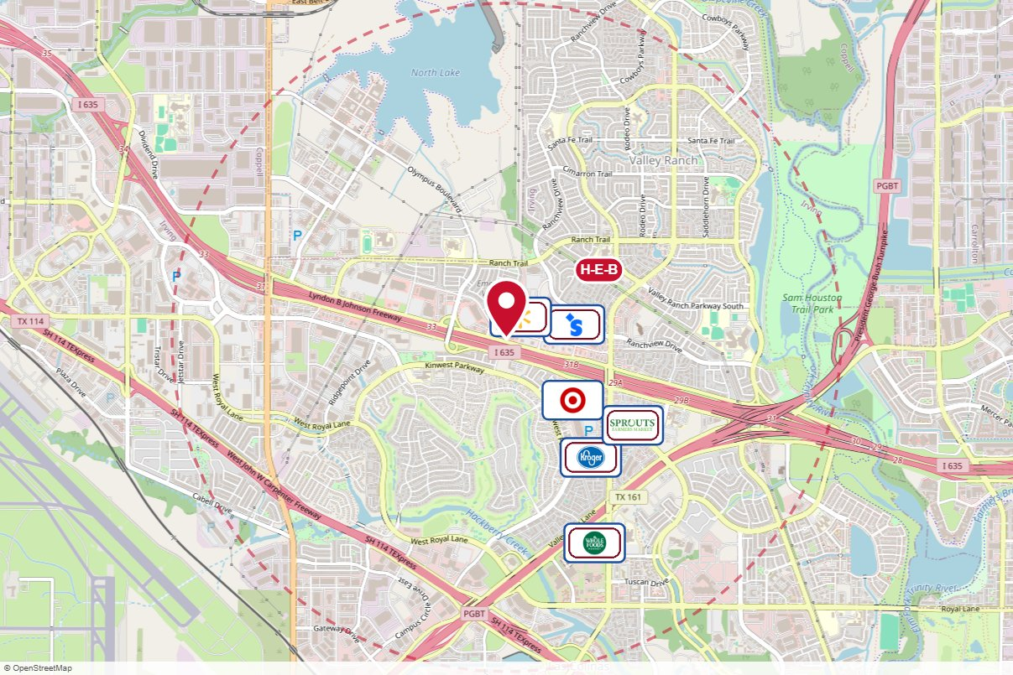
#1013A Media Eyes · Static
IN MARKET
no photo on file
PANEL INFO
Location: LBJ Frwy. (Interstate 635) n/l 0.7 mi. w/o N. MacArthur Blvd.
Face: East
Size: 12'' x 40''
Contract: 7/6/2026 → 8/29/2027 (4-week)
Impressions: 294,625 / week
Nearest H-E-B: 0.7 mi — Irving
Investment: $3,788 / period
2-MILE AREA
red pin = this panel
red pills = H-E-B stores
company logos = blunting targets
dashed ring = 2-mile radius
North West Region · H-E-B OOH Current Holdings · 9/15/2026

Slide 11
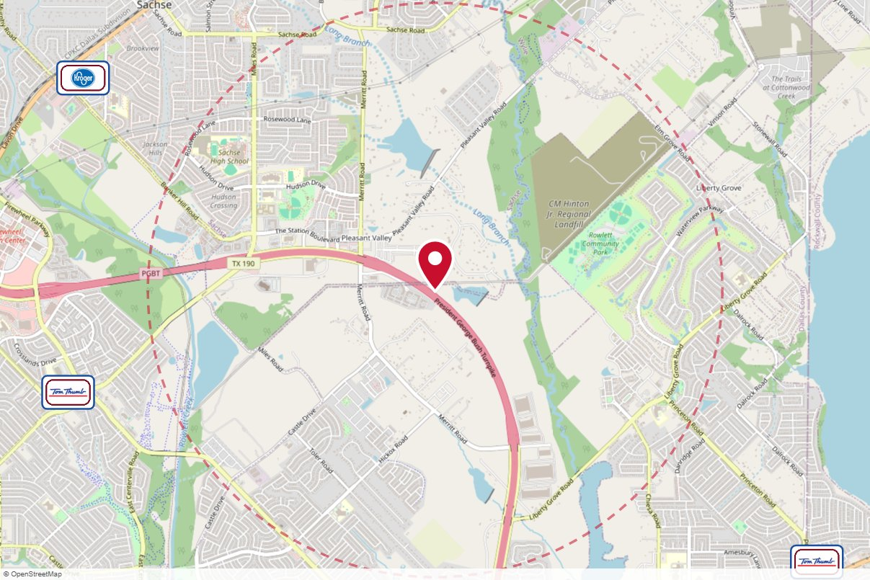
#78883 Clear Channel Outdoor · Static
IN MARKET
no photo on file
PANEL INFO
Location: Hwy 190 NS 0.5mi E/O Merritt Rd F/E - 1
Face: East
Size: 14' x 48'
Contract: 7/6/2026 → 5/23/2027 (4-week)
Impressions: 265,532 / week
Nearest H-E-B: 4.2 mi — Murphy (scheduled 7/22/2026)
Investment: $3,365 / period
2-MILE AREA
red pin = this panel
red pills = H-E-B stores
company logos = blunting targets
dashed ring = 2-mile radius
North West Region · H-E-B OOH Current Holdings · 9/15/2026

Slide 12
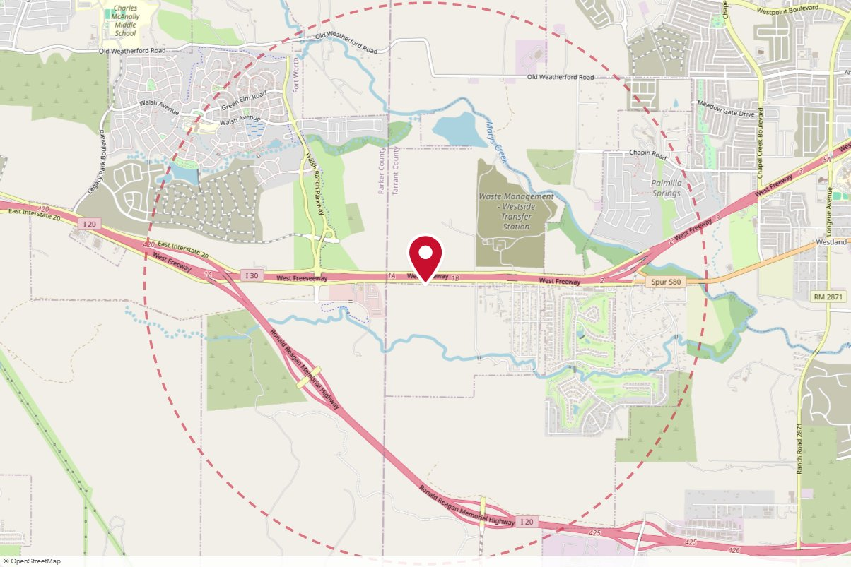
#78346 Clear Channel Outdoor · Static
IN MARKET
no photo on file
PANEL INFO
Location: West Fwy (I-30) SS 0.6mi W/O Linkcrest F/W - 2
Face: West
Size: 14'' x 48"'
Contract: 7/6/2026 → 5/23/2027 (4-week)
Impressions: 202,226 / week
Nearest H-E-B: 9.3 mi — Hudson Oaks H-E-B
Investment: $3,500 / period
2-MILE AREA
red pin = this panel
red pills = H-E-B stores
company logos = blunting targets
dashed ring = 2-mile radius
North West Region · H-E-B OOH Current Holdings · 9/15/2026

Slide 13
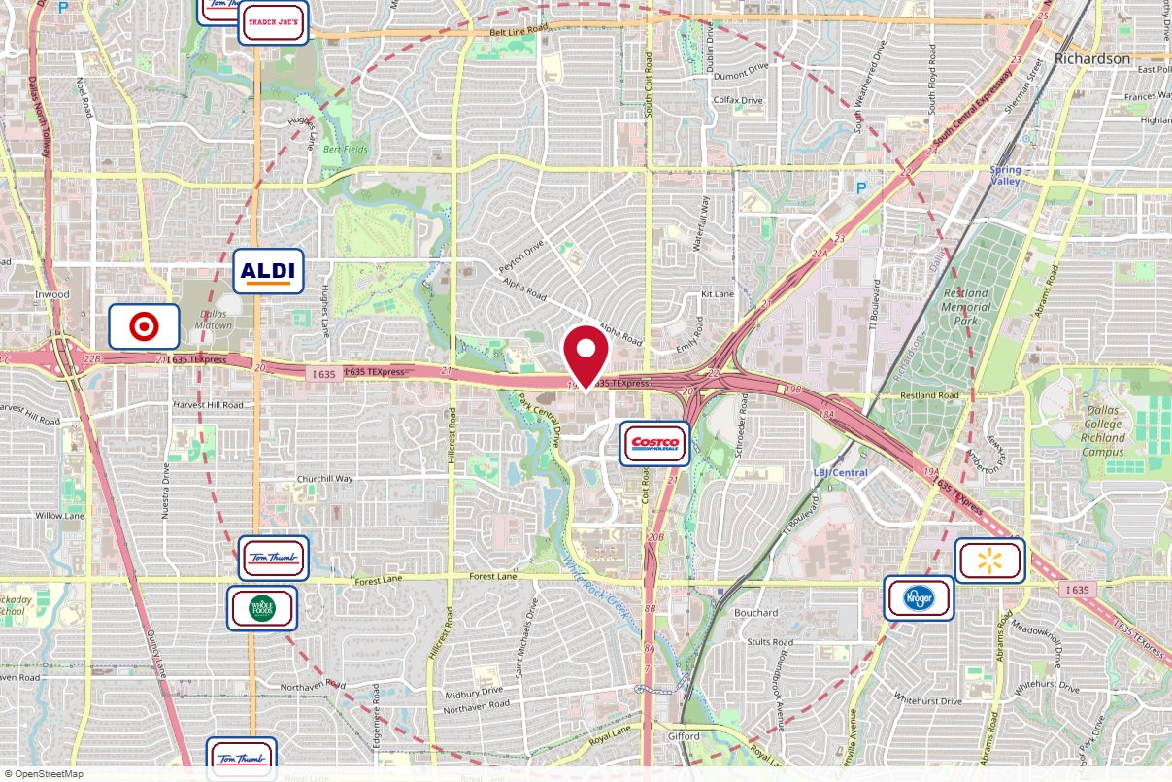
#635L J R Media Services · Static
IN MARKET
no photo on file
PANEL INFO
Location: I635 .4mi w/o Coit, .7mi w/o US75 (High 5)
Face: East
Size: 14' x 48'
Contract: 7/6/2026 → 5/23/2027 (4-week)
Impressions: 1,479,573 / week
Nearest H-E-B: 7.4 mi — H-E-B Plano
Investment: $5,000 / period
2-MILE AREA
red pin = this panel
red pills = H-E-B stores
company logos = blunting targets
dashed ring = 2-mile radius
North West Region · H-E-B OOH Current Holdings · 9/15/2026

Slide 14
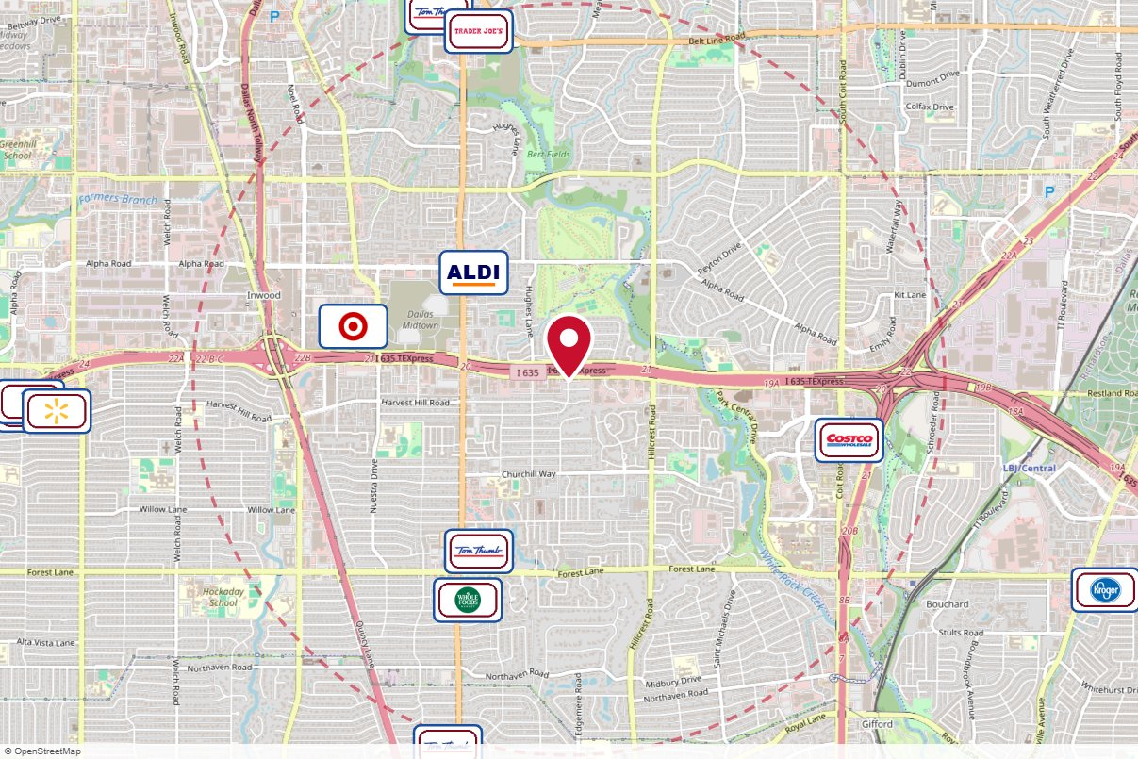
#2_7953O Outfront Media · Static
IN MARKET
no photo on file
PANEL INFO
Location: LBJ (635) .5 Mi W/O Hillcrest S/S F/W
Face: West
Size: 14'' x 48"'
Contract: 7/6/2026 → 5/23/2027 (4-week)
Impressions: 1,378,437 / week
Nearest H-E-B: 7.3 mi — H-E-B Plano
Investment: $12,600 / period
2-MILE AREA
red pin = this panel
red pills = H-E-B stores
company logos = blunting targets
dashed ring = 2-mile radius
North West Region · H-E-B OOH Current Holdings · 9/15/2026

Slide 15
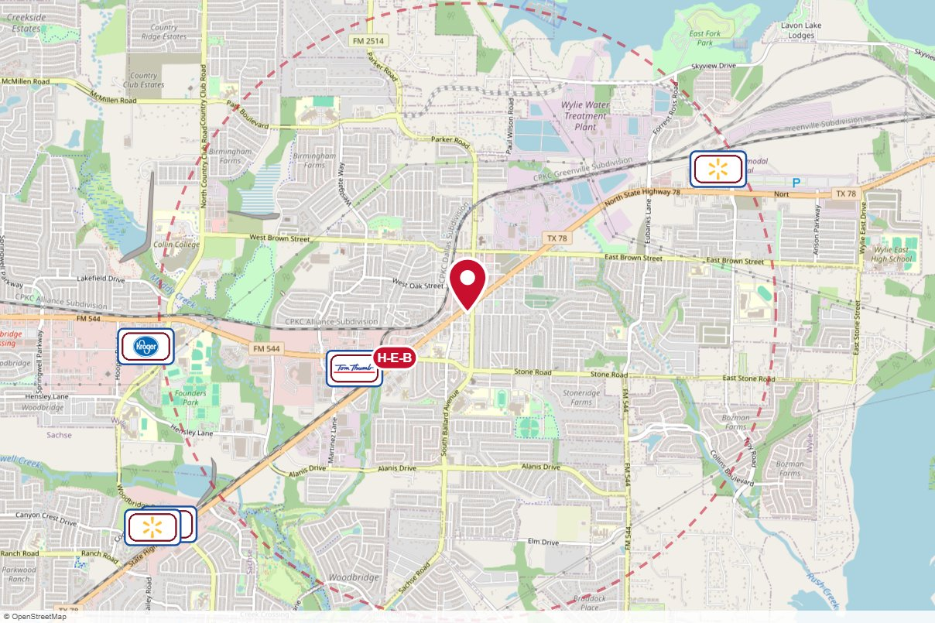
#003-390L The Reiss Group · Static
IN MARKET
no photo on file
PANEL INFO
Location: NE Corner of Hwy 78 SB & Ballard Ave.
Face: North
Size: 16' x 32'
Contract: 7/6/2026 → 5/23/2027 (4-week)
Impressions: 195,300 / week
Nearest H-E-B: 0.6 mi — Murphy (scheduled 7/22/2026)
Investment: $2,500 / period
2-MILE AREA
red pin = this panel
red pills = H-E-B stores
company logos = blunting targets
dashed ring = 2-mile radius
North West Region · H-E-B OOH Current Holdings · 9/15/2026

Slide 16
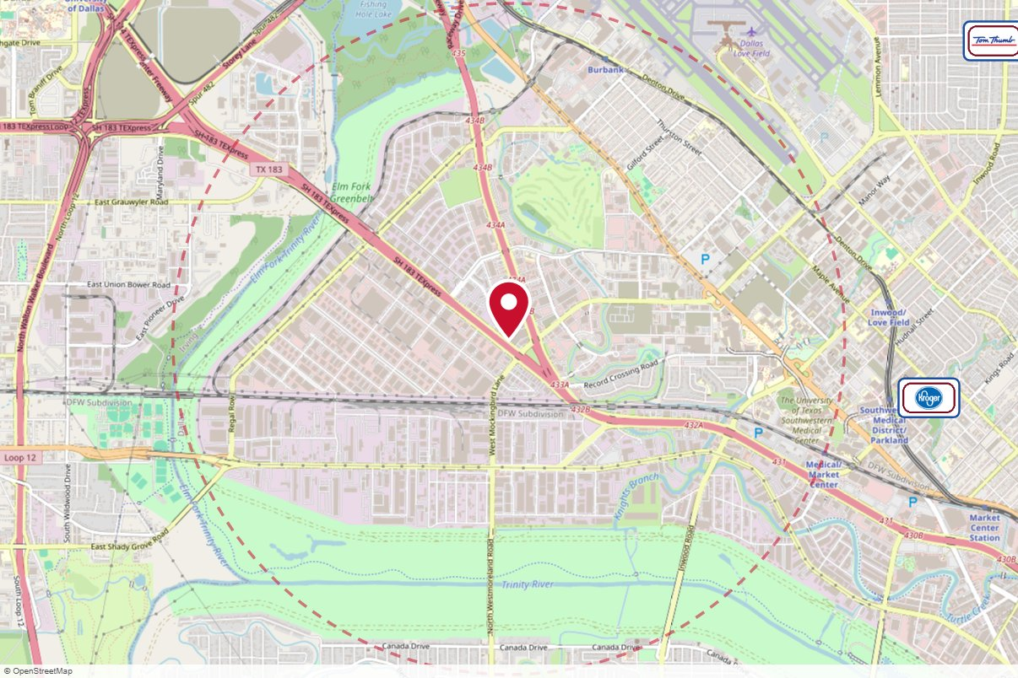
#10652 Lamar Advertising · Static
IN MARKET
no photo on file
PANEL INFO
Location: HWY 183 E/S .1 MI N/O MOCKINGBIRD LANE - 10652
Face: Southeast · Read: Right
Size: 14' x 48'
Contract: 6/8/2026 → 3/14/2027 (4-week)
Impressions: 582,320 / week
Nearest H-E-B: 8.9 mi — Irving
Investment: $6,568 / period
2-MILE AREA
red pin = this panel
red pills = H-E-B stores
company logos = blunting targets
dashed ring = 2-mile radius
North West Region · H-E-B OOH Current Holdings · 9/15/2026

Slide 17
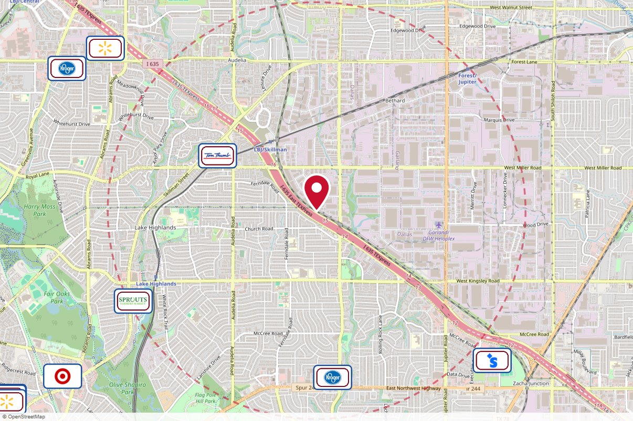
#2_7166O Outfront Media · Static
IN MARKET
no photo on file
PANEL INFO
Location: LBJ (635) .2Mi W/O Plano Road N/S F/E
Face: East
Size: 14'' x 48''
Contract: 6/8/2026 → 6/6/2027 (4-week)
Impressions: 546,436 / week
Nearest H-E-B: 10.9 mi — H-E-B Plano
Investment: $7,000 / period
2-MILE AREA
red pin = this panel
red pills = H-E-B stores
company logos = blunting targets
dashed ring = 2-mile radius
North West Region · H-E-B OOH Current Holdings · 9/15/2026

Slide 18
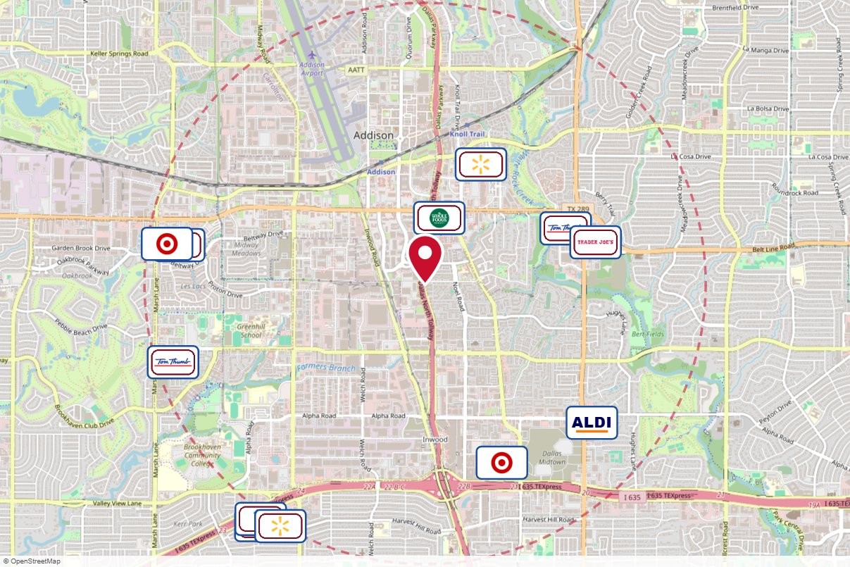
#2_7954O Outfront Media · Static
IN MARKET
no photo on file
PANEL INFO
Location: Dallas North Tollway S/O Beltline E/S F/S
Face: South
Size: 14'' x 48''
Contract: 6/8/2026 → 6/6/2027 (4-week)
Impressions: 639,308 / week
Nearest H-E-B: 6.1 mi — H-E-B Plano
Investment: $19,500 / period
2-MILE AREA
red pin = this panel
red pills = H-E-B stores
company logos = blunting targets
dashed ring = 2-mile radius
North West Region · H-E-B OOH Current Holdings · 9/15/2026

Slide 19
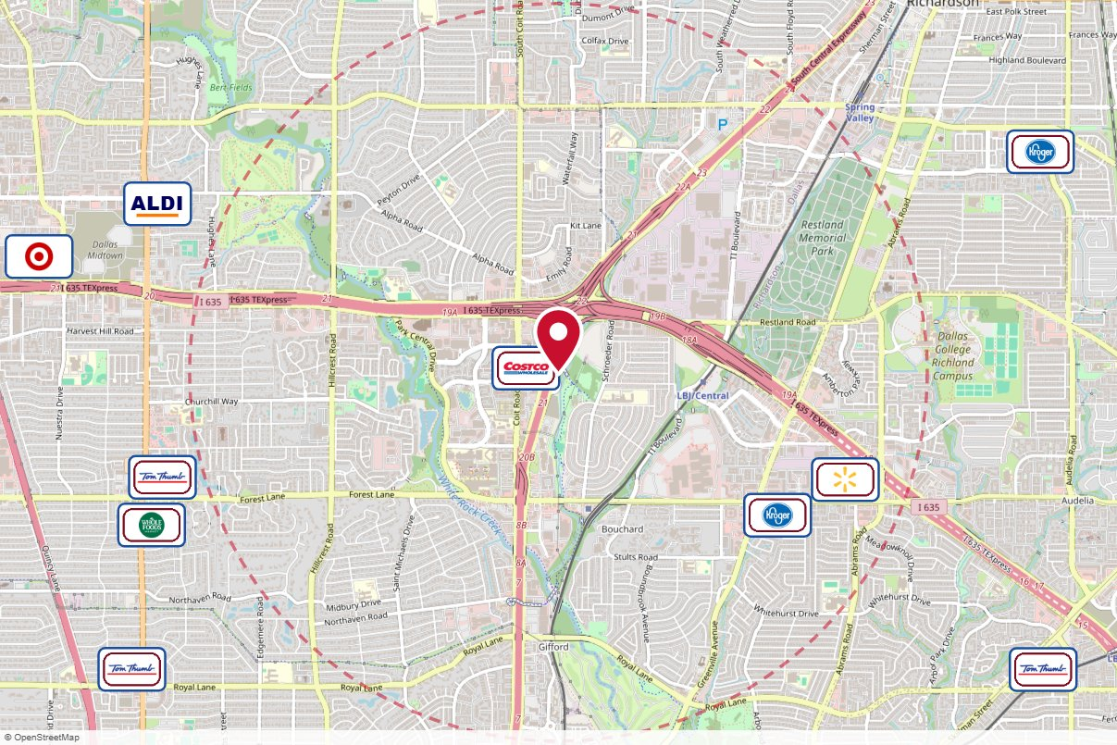
#2_7956O Outfront Media · Static
IN MARKET
no photo on file
PANEL INFO
Location: Central (75) S/O LBJ Frwy E/S F/S
Face: South
Size: 14'' x 48''
Contract: 6/8/2026 → 6/6/2027 (4-week)
Impressions: 911,767 / week
Nearest H-E-B: 7.8 mi — H-E-B Plano
Investment: $13,000 / period
2-MILE AREA
red pin = this panel
red pills = H-E-B stores
company logos = blunting targets
dashed ring = 2-mile radius
North West Region · H-E-B OOH Current Holdings · 9/15/2026

Slide 20
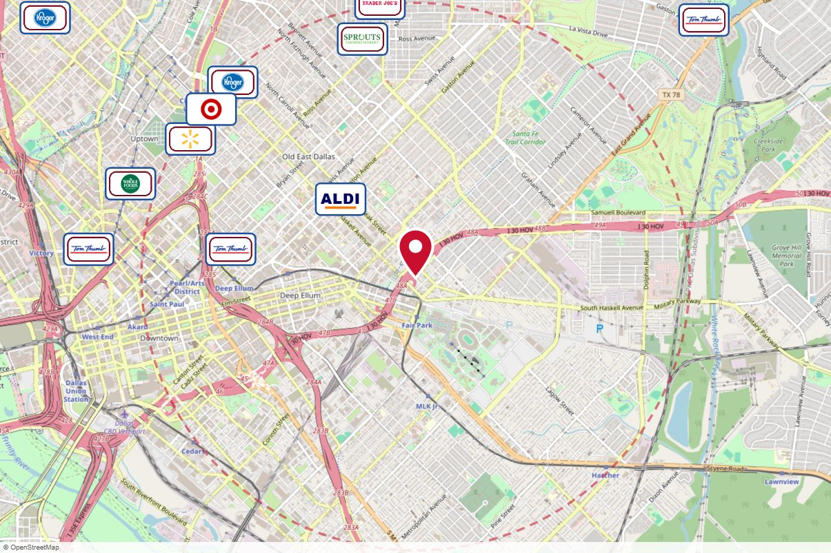
#2_8098O Outfront Media · Static
IN MARKET
no photo on file
PANEL INFO
Location: I-30 (E.R.L.T.) W/O Haskell S/S F/W
Face: West
Size: 14'' x 48''
Contract: 6/8/2026 → 6/6/2027 (4-week)
Impressions: 540,280 / week
Nearest H-E-B: 14.8 mi — Irving
Investment: $5,000 / period
2-MILE AREA
red pin = this panel
red pills = H-E-B stores
company logos = blunting targets
dashed ring = 2-mile radius
North West Region · H-E-B OOH Current Holdings · 9/15/2026

Slide 21
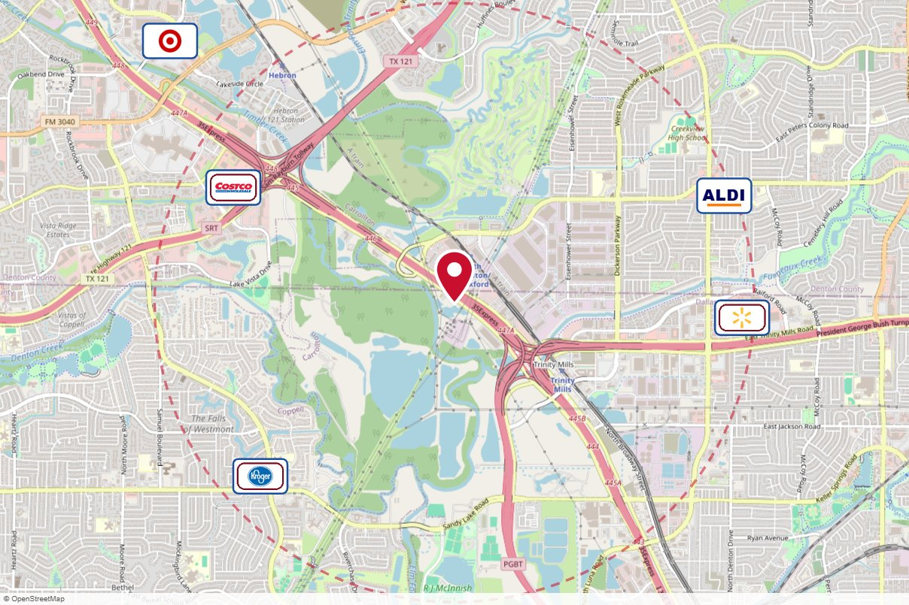
#2_8319O Outfront Media · Static
IN MARKET
no photo on file
PANEL INFO
Location: I-35E .7Mi N/O Trinity Mills W/S F/N
Face: North
Size: 14'' x 48''
Contract: 6/22/2026 → 6/20/2027 (4-week)
Impressions: 736,122 / week
Nearest H-E-B: 4.5 mi — Irving
Investment: $4,000 / period
2-MILE AREA
red pin = this panel
red pills = H-E-B stores
company logos = blunting targets
dashed ring = 2-mile radius
North West Region · H-E-B OOH Current Holdings · 9/15/2026

Slide 22
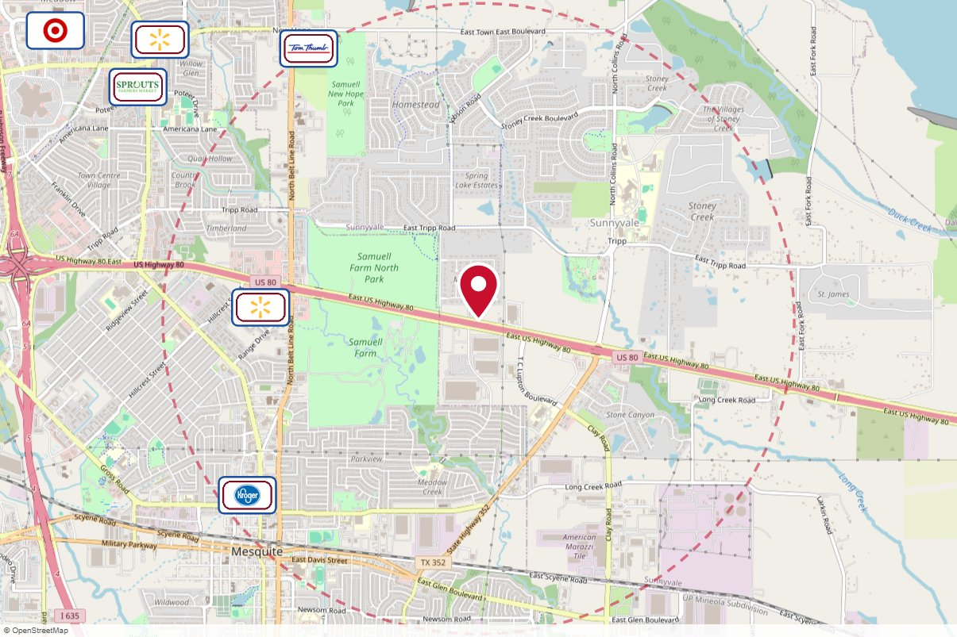
#4_7860O Outfront Media · Static
IN MARKET
no photo on file
PANEL INFO
Location: Hwy 80 1.50mi E/O Beltline N/S F/E
Face: East
Size: 10'' x 40''
Contract: 6/22/2026 → 6/20/2027 (4-week)
Impressions: 289,424 / week
Nearest H-E-B: 12 mi — Rockwall
Investment: $2,500 / period
2-MILE AREA
red pin = this panel
red pills = H-E-B stores
company logos = blunting targets
dashed ring = 2-mile radius
North West Region · H-E-B OOH Current Holdings · 9/15/2026

Slide 23
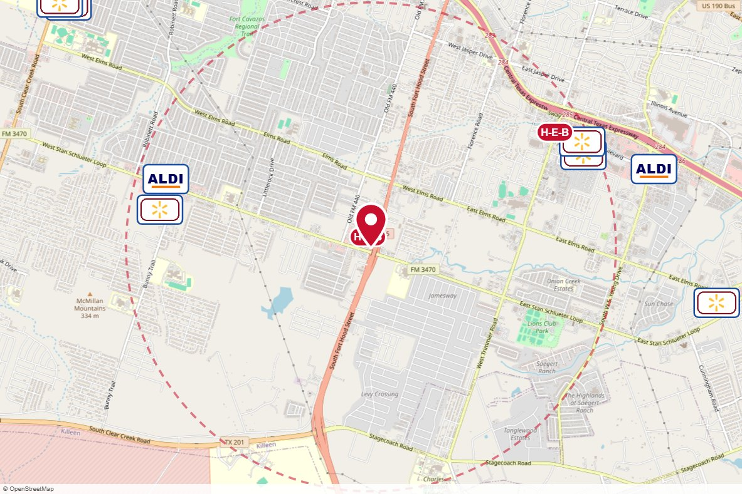
#2465 Lamar Advertising · Static
IN MARKET
no photo on file
PANEL INFO
Location: W/S FM 195 AT STAN SCHL LP F/S
Face: South
Size: 14'' x 48''
Contract: 6/22/2026 → 6/17/2029 (4-week)
Impressions: 57,009 / week
Nearest H-E-B: 0.1 mi — Fort Hood Stan Schlueter H-E-B
Investment: $1,250 / period
2-MILE AREA
red pin = this panel
red pills = H-E-B stores
company logos = blunting targets
dashed ring = 2-mile radius
North West Region · H-E-B OOH Current Holdings · 9/15/2026

Slide 24
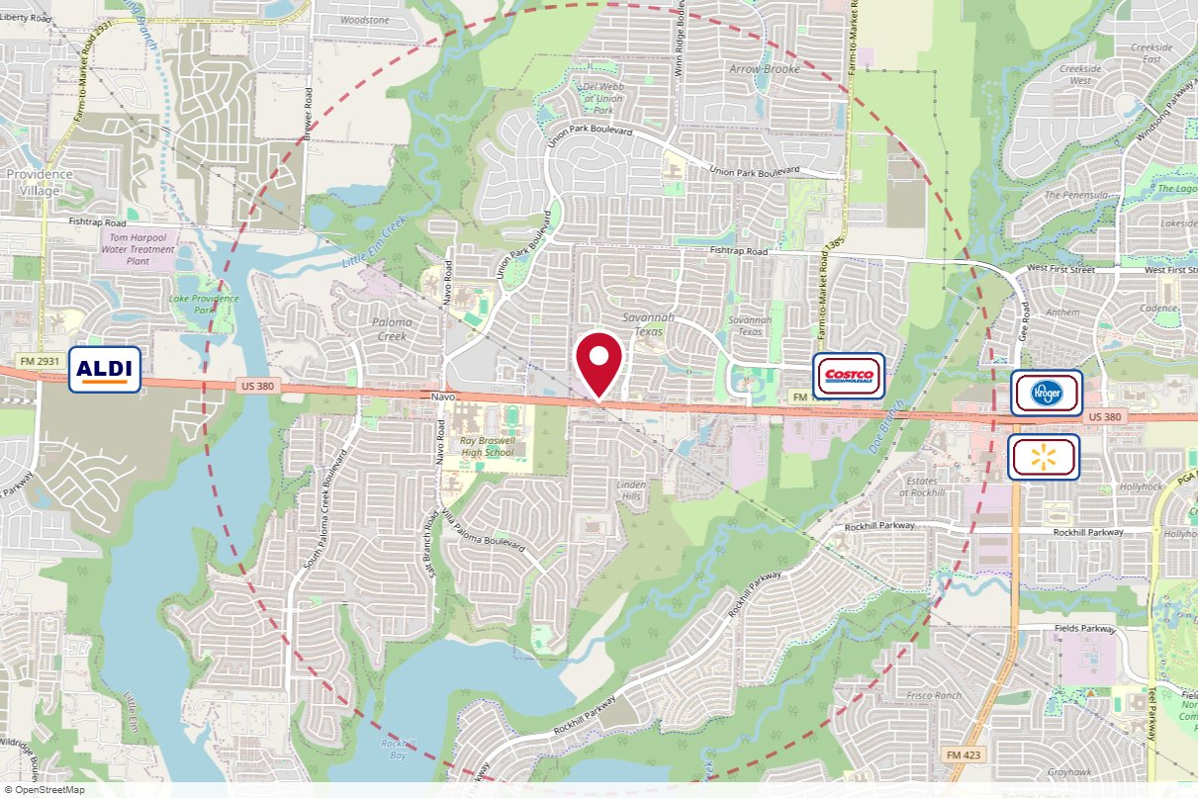
#78898 Clear Channel Outdoor · Static
IN MARKET
no photo on file
PANEL INFO
Location: Hwy 380 NS 0.1mi W/O Magnolia Blvd F/E - 2
Face: East
Size: 14'' x 48''
Contract: 6/22/2026 → 6/20/2027 (4-week)
Impressions: 174,776 / week
Nearest H-E-B: 5.2 mi — Hwy 380 and FM 423 H-E-B
Investment: $3,540 / period
2-MILE AREA
red pin = this panel
red pills = H-E-B stores
company logos = blunting targets
dashed ring = 2-mile radius
North West Region · H-E-B OOH Current Holdings · 9/15/2026

Slide 25
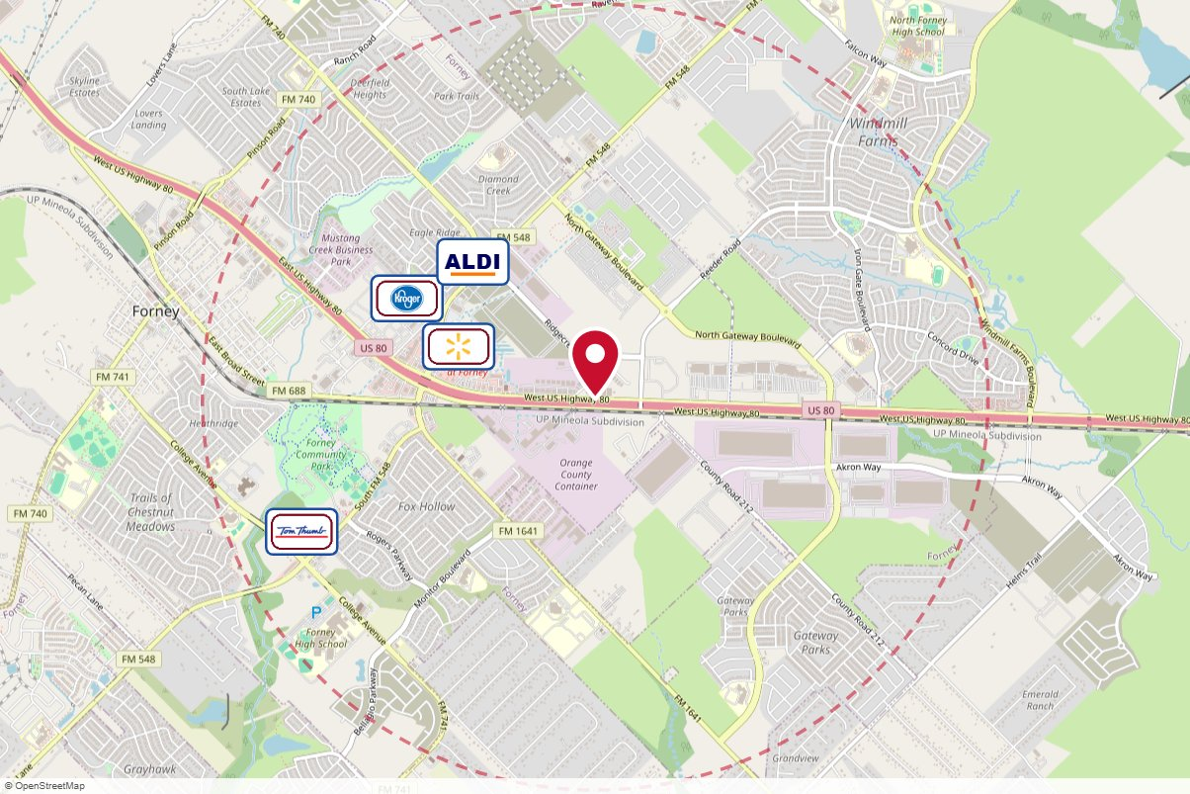
TX-180244 (234) Adkom (Arrington) · Static
IN MARKET
no photo on file
PANEL INFO
Location: Hwy 80 562 feet E/O Reeder Rd
Size: 10'' x 40''
Contract: 7/13/2026 → 10/4/2026 (4-week)
Impressions: 167,360 / week
Nearest H-E-B: 11.9 mi — Rockwall
Investment: $5,577 / period
2-MILE AREA
red pin = this panel
red pills = H-E-B stores
company logos = blunting targets
dashed ring = 2-mile radius
North West Region · H-E-B OOH Current Holdings · 9/15/2026

Slide 26
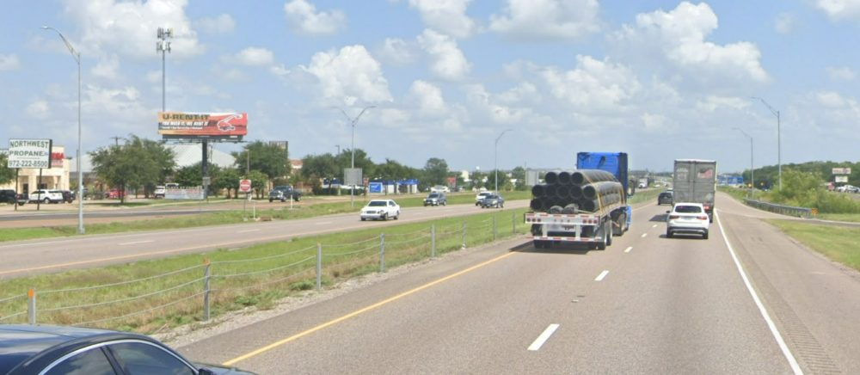
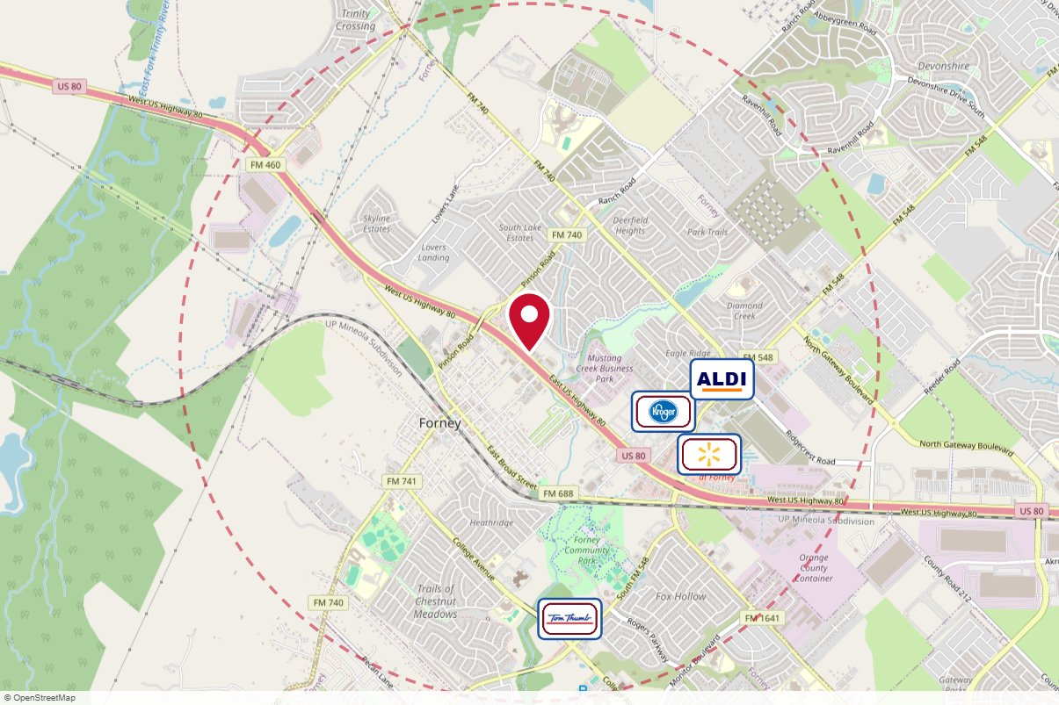
#6212 Clear Channel Outdoor · Static
IN MARKET
PANEL INFO
Location: Hwy 80 NS 0.3mi E/O FM 740 F/W - 1
Face: West
Size: 10'' x 40''
Contract: 7/6/2026 → 7/4/2027 (4-week)
Impressions: 140,145 / week
Nearest H-E-B: 11.2 mi — Rockwall
Investment: $2,000 / period
2-MILE AREA
red pin = this panel
red pills = H-E-B stores
company logos = blunting targets
dashed ring = 2-mile radius
North West Region · H-E-B OOH Current Holdings · 9/15/2026

Slide 27
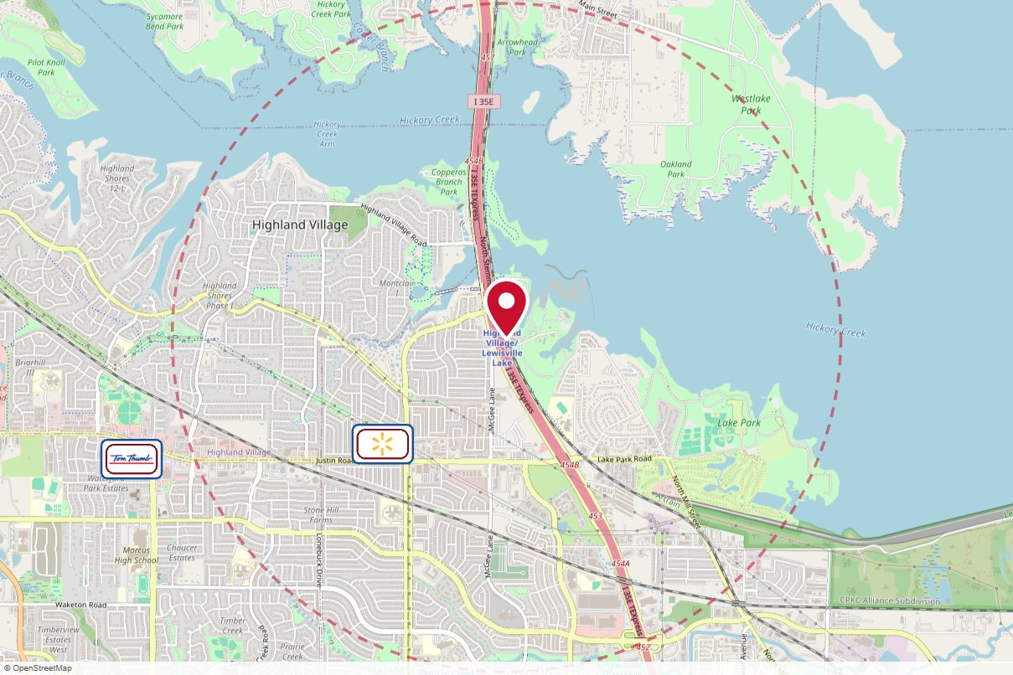
#2_7859O Outfront Media · Static
IN MARKET
no photo on file
PANEL INFO
Location: I-35E 285' N/O Highland Village Road E/S F/S **Flagman Unit - No Sharp Installs / Take-Downs**
Face: South
Size: 14'' x 48"'
Contract: 7/13/2026 → 7/11/2027 (4-week)
Impressions: 503,687 / week
Nearest H-E-B: 11.5 mi — Irving
Investment: $4,050 / period
2-MILE AREA
red pin = this panel
red pills = H-E-B stores
company logos = blunting targets
dashed ring = 2-mile radius
North West Region · H-E-B OOH Current Holdings · 9/15/2026

Slide 28
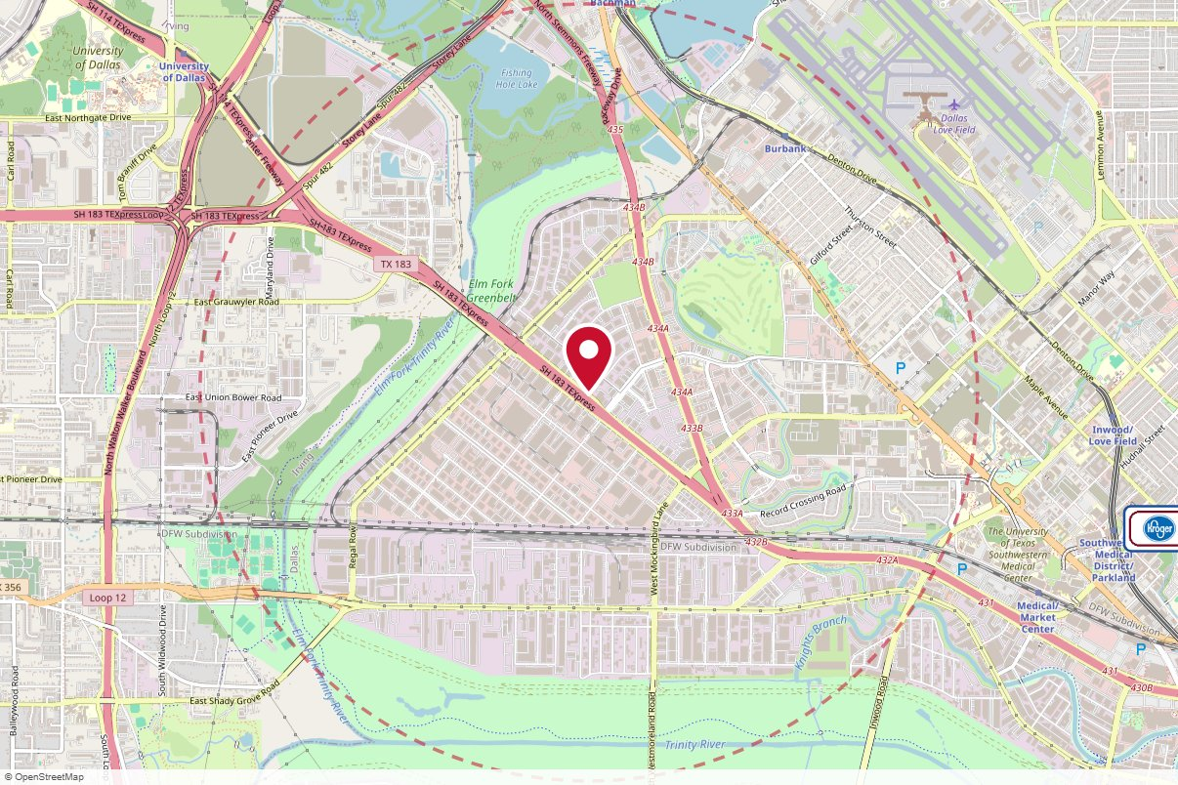
#2_7904O Outfront Media · Static
IN MARKET
no photo on file
PANEL INFO
Location: 3.7Mi N/O Mockingbird Lane E/S F/S
Face: South
Size: 14'' x 48''
Contract: 7/13/2026 → 7/11/2027 (4-week)
Impressions: 585,813 / week
Nearest H-E-B: 8.4 mi — Irving
Investment: $5,500 / period
2-MILE AREA
red pin = this panel
red pills = H-E-B stores
company logos = blunting targets
dashed ring = 2-mile radius
North West Region · H-E-B OOH Current Holdings · 9/15/2026

Slide 29
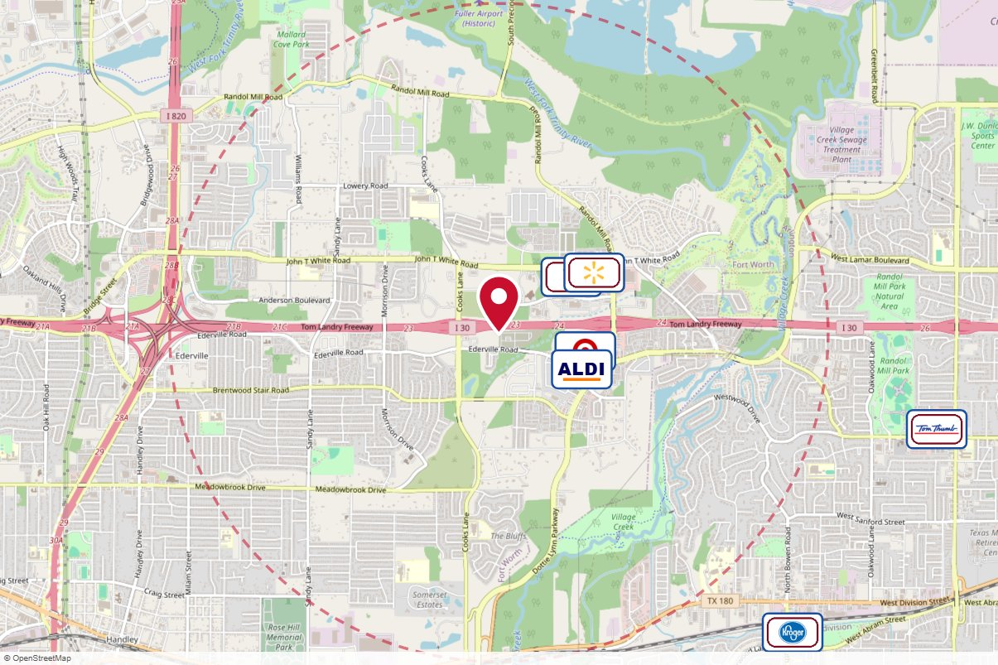
#2023 Lamar Advertising · Static
IN MARKET
no photo on file
PANEL INFO
Location: I-30 .5 MI E/O COOKS LN S/S - 2023
Face: West · Read: Right
Size: 14' x 48'
Contract: 7/20/2026 → 3/28/2027 (4-week)
Impressions: 603,686 / week
Nearest H-E-B: 8.5 mi — Mid Cities
Investment: $4,599 / period
2-MILE AREA
red pin = this panel
red pills = H-E-B stores
company logos = blunting targets
dashed ring = 2-mile radius
North West Region · H-E-B OOH Current Holdings · 9/15/2026

Slide 30
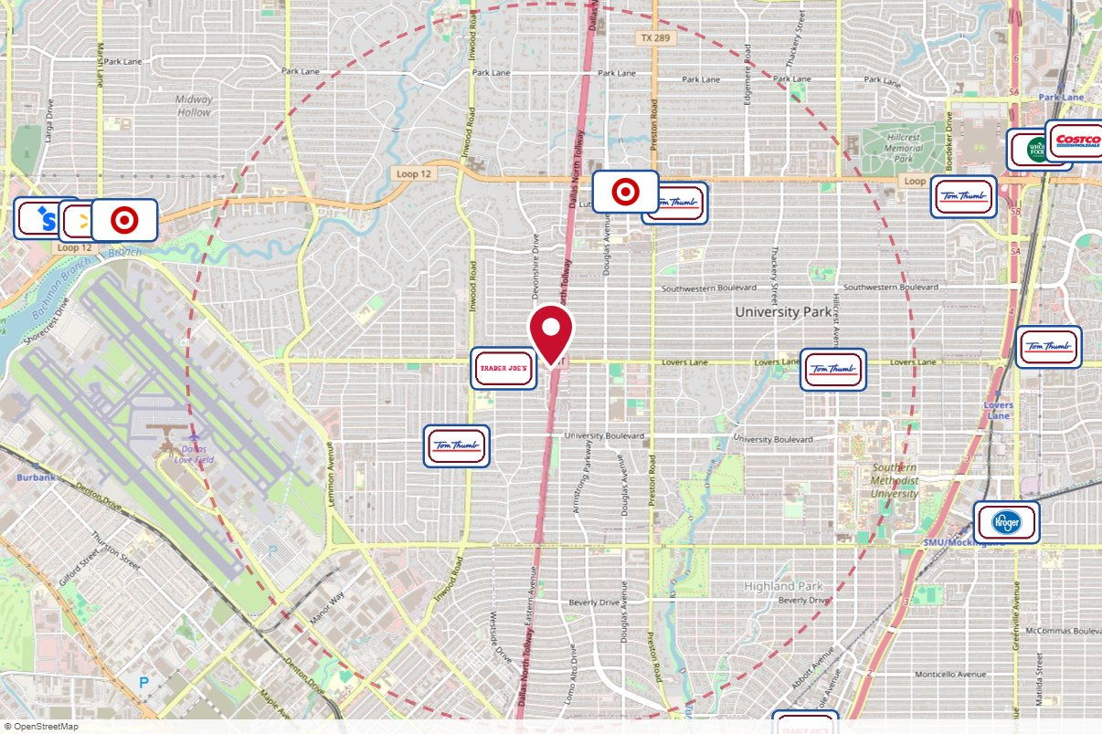
#2_8432O Outfront Media · Static
IN MARKET
no photo on file
PANEL INFO
Location: D.N. Tollway S/O Lovers Lane W/S F/S
Face: South
Size: 14'' x 48''
Contract: 7/20/2026 → 7/18/2027 (4-week)
Impressions: 442,450 / week
Nearest H-E-B: 9.9 mi — Irving
Investment: $18,000 / period
2-MILE AREA
red pin = this panel
red pills = H-E-B stores
company logos = blunting targets
dashed ring = 2-mile radius
North West Region · H-E-B OOH Current Holdings · 9/15/2026

Slide 31
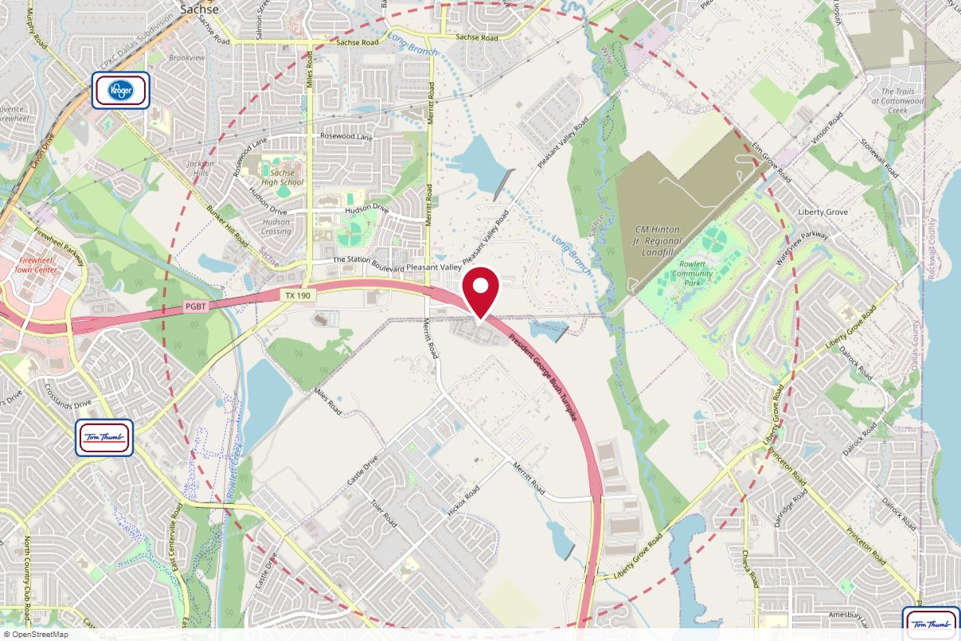
#78991 Clear Channel Outdoor · Static
IN MARKET
no photo on file
PANEL INFO
Location: Hwy 190 SS 0.3mi E/O Merritt Rd F/E - 1
Face: East
Size: 14' x 48'
Contract: 7/20/2026 → 7/18/2027 (4-week)
Impressions: 151,134 / week
Nearest H-E-B: 4.2 mi — Murphy (scheduled 7/22/2026)
Investment: $3,000 / period
2-MILE AREA
red pin = this panel
red pills = H-E-B stores
company logos = blunting targets
dashed ring = 2-mile radius
North West Region · H-E-B OOH Current Holdings · 9/15/2026

Slide 32
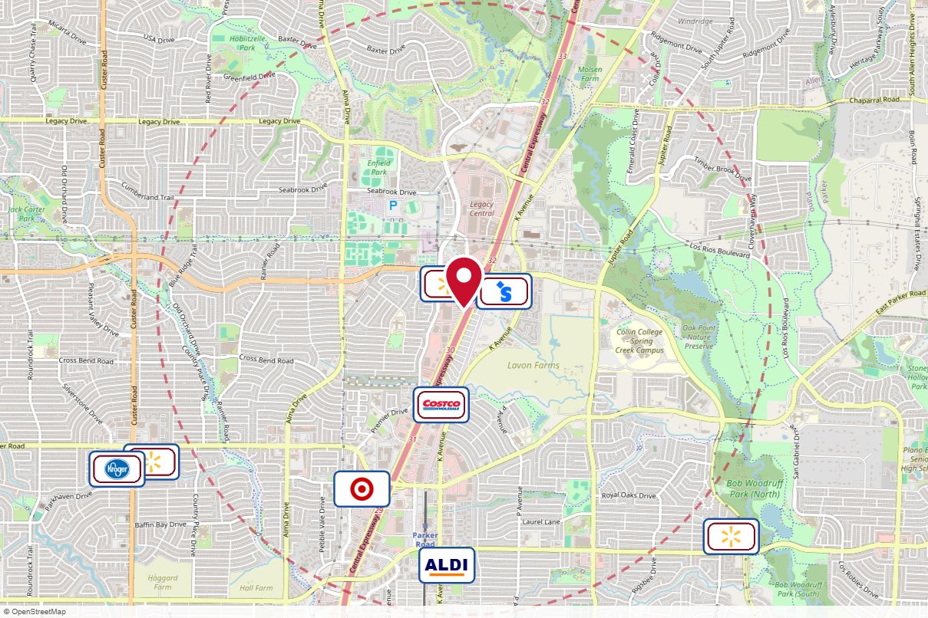
#3_3009O Outfront Media · Static
IN MARKET
no photo on file
PANEL INFO
Location: Central (75) 1000' N/O Parker Road W/S F/S
Face: South
Size: 10'' x 30''
Contract: 8/10/2026 → 8/8/2027 (4-week)
Impressions: 444,000 / week
Nearest H-E-B: 4.9 mi — Allen H-E-B
Investment: $6,500 / period
2-MILE AREA
red pin = this panel
red pills = H-E-B stores
company logos = blunting targets
dashed ring = 2-mile radius
North West Region · H-E-B OOH Current Holdings · 9/15/2026

Slide 33
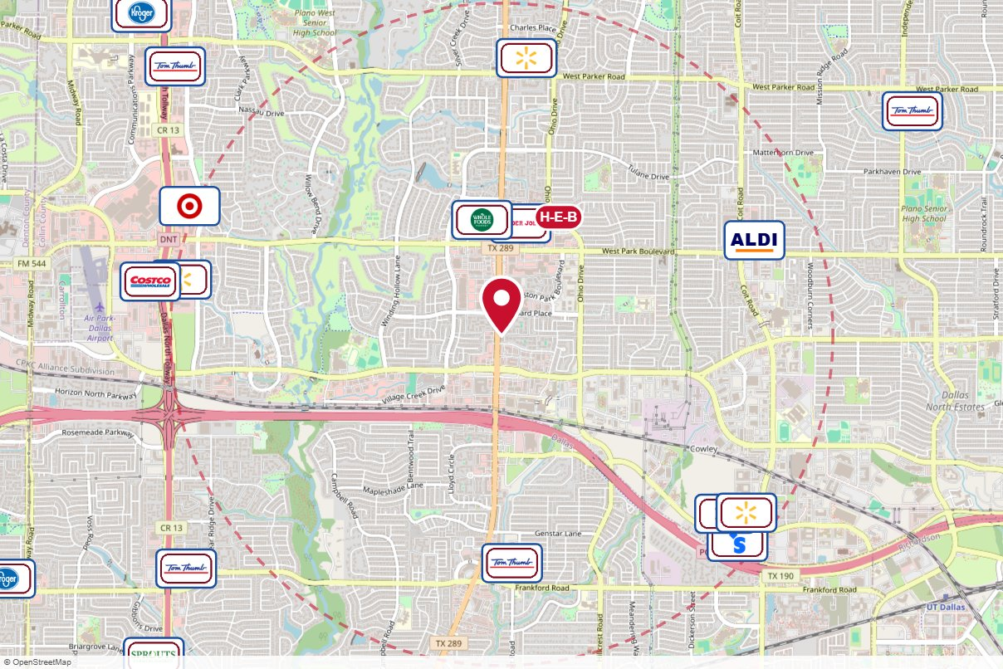
#4_8541O Outfront Media · Static
IN MARKET
no photo on file
PANEL INFO
Location: Preston .25Mi S/O Old Shephard Road E/S F/S
Face: South
Size: 10'' x 40''
Contract: 8/10/2026 → 8/8/2027 (4-week)
Impressions: 291,803 / week
Nearest H-E-B: 0.8 mi — H-E-B Plano
Investment: $4,000 / period
2-MILE AREA
red pin = this panel
red pills = H-E-B stores
company logos = blunting targets
dashed ring = 2-mile radius
North West Region · H-E-B OOH Current Holdings · 9/15/2026

Slide 34
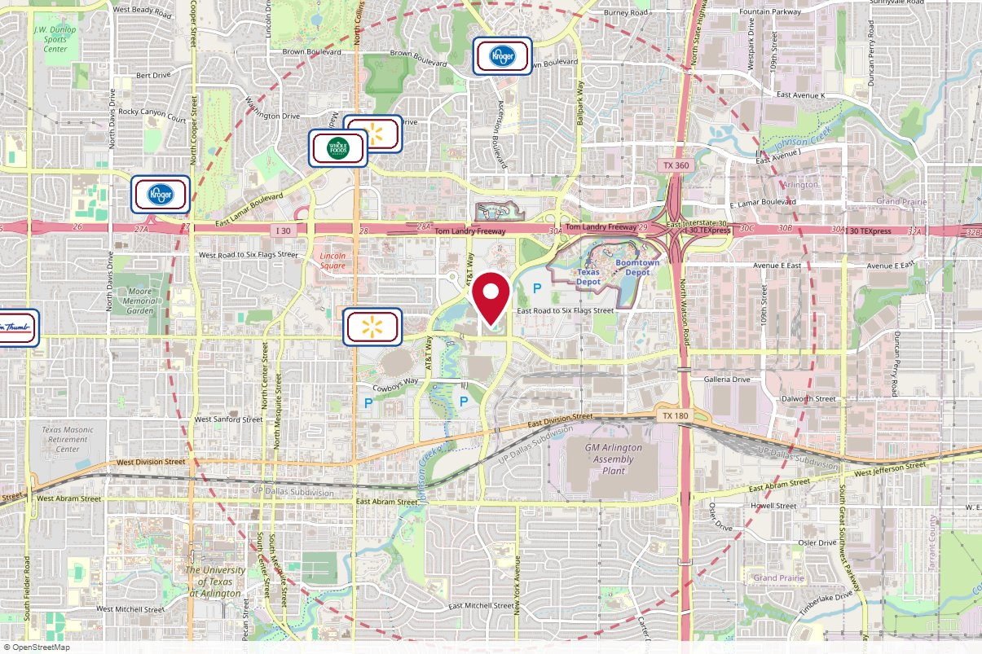
Choctaw Stadium Rev Entertainment · Other
IN MARKET
no photo on file
PANEL INFO
Contract: 8/24/2026 → 10/18/2026 (4-week)
Impressions: n/a
Nearest H-E-B: 8.1 mi — Mid Cities
Investment: $175,000 / period
2-MILE AREA
red pin = this panel
red pills = H-E-B stores
company logos = blunting targets
dashed ring = 2-mile radius
North West Region · H-E-B OOH Current Holdings · 9/15/2026

Slide 35
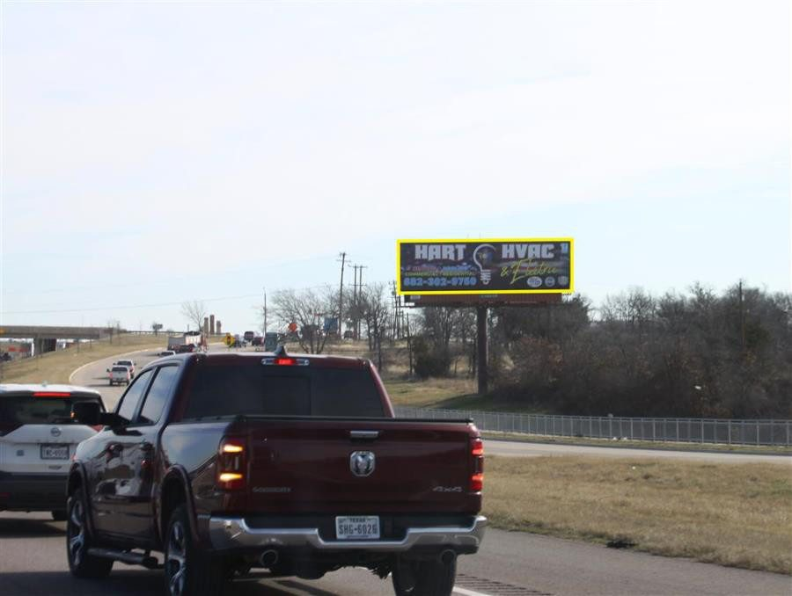
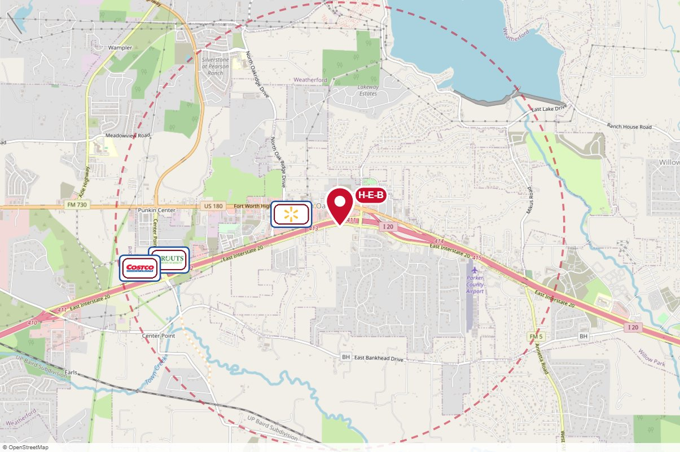
#2433 Lamar Advertising · Static
IN MARKET
PANEL INFO
Location: I-20 @ Lake Shore Dr, Exit 413, S/S
Face: West · Read: Right
Size: 14' x 48'
Contract: 8/10/2026 → 4/18/2027 (4-week)
Impressions: 294,900 / week
Nearest H-E-B: 0.4 mi — Hudson Oaks H-E-B
Investment: $3,749 / period
2-MILE AREA
red pin = this panel
red pills = H-E-B stores
company logos = blunting targets
dashed ring = 2-mile radius
North West Region · H-E-B OOH Current Holdings · 9/15/2026

Slide 36
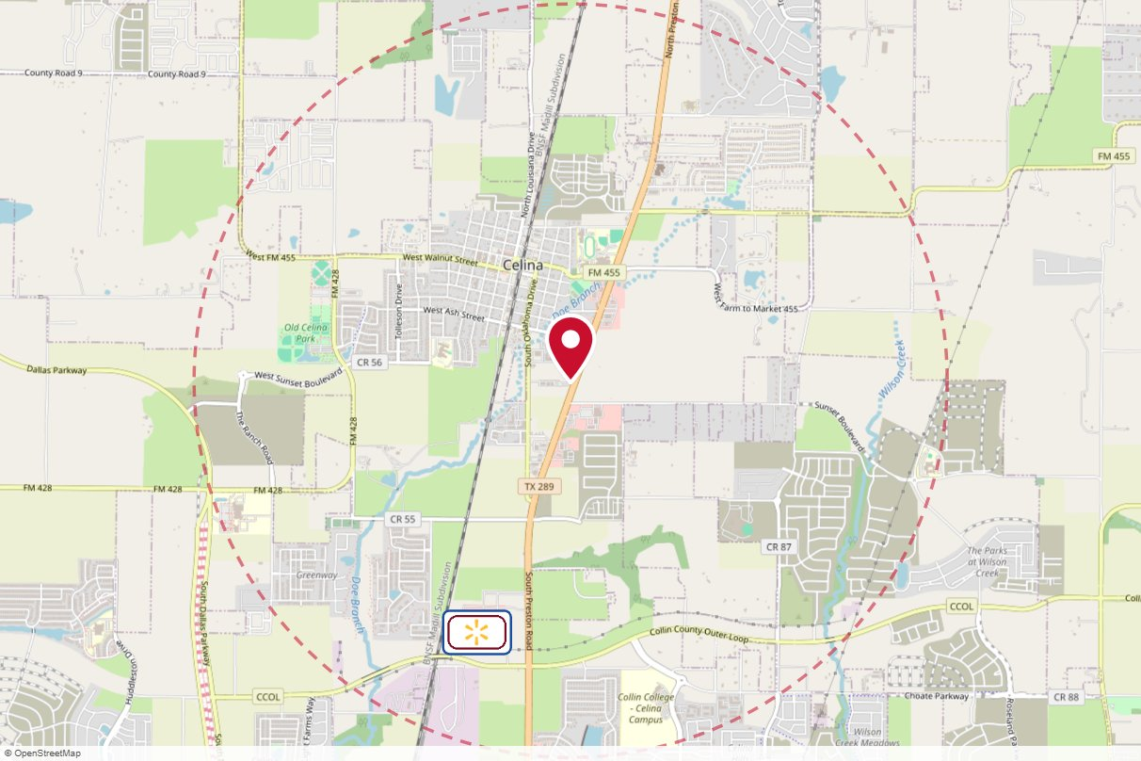
#290R The Reiss Group · Static
IN MARKET
no photo on file
PANEL INFO
Location: Preston Rd.SB @Celina Storage
Face: North
Size: 10' ' x 30''
Contract: 7/6/2026 → 6/13/2027 (4-week)
Impressions: 105,300 / week
Nearest H-E-B: 7.2 mi — Hwy 380 and FM 423 H-E-B
Investment: $2,900 / period
2-MILE AREA
red pin = this panel
red pills = H-E-B stores
company logos = blunting targets
dashed ring = 2-mile radius
North West Region · H-E-B OOH Current Holdings · 9/15/2026

Slide 37
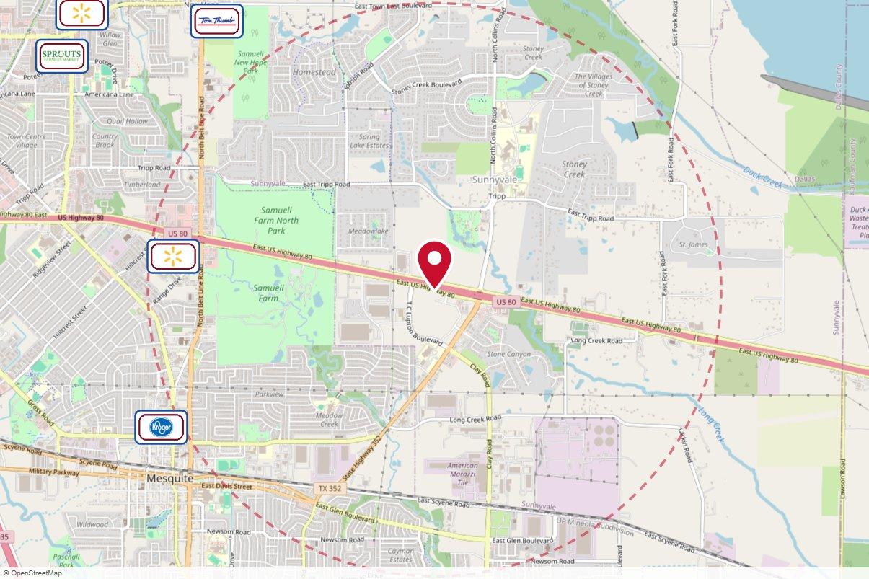
#445R The Reiss Group · Static
IN MARKET
no photo on file
PANEL INFO
Location: US 80 EB, next to Collins Rd. exit
Face: West
Size: 10'' x 40''
Contract: 7/6/2026 → 6/27/2027 (4-week)
Impressions: 217,000 / week
Nearest H-E-B: 11.8 mi — Rockwall
Investment: $2,200 / period
2-MILE AREA
red pin = this panel
red pills = H-E-B stores
company logos = blunting targets
dashed ring = 2-mile radius
North West Region · H-E-B OOH Current Holdings · 9/15/2026

Slide 38
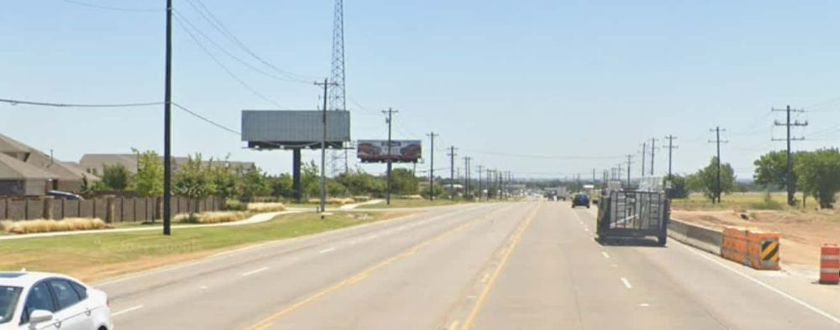
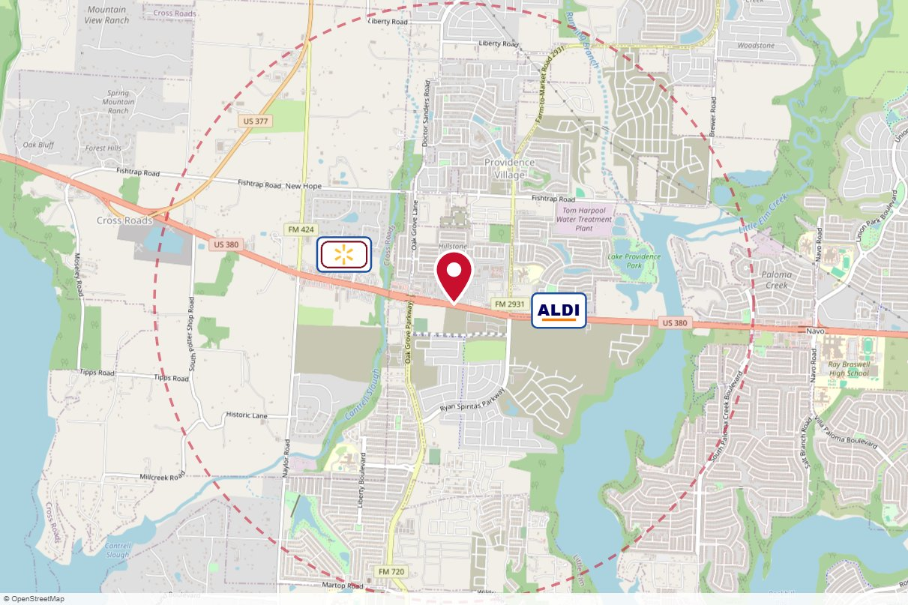
#003-057L The Reiss Group · Static
IN MARKET
PANEL INFO
Location: 4101 Hillstone Pointe Boulevard — Hwy.380 EB,.3/10 mi east of FM 720
Face: West · Read: Left
Size: 14x48
Contract: 8/10/2026 → 12/27/2026 (4-week)
Impressions: 217,000 / week
Nearest H-E-B: 8.3 mi — Hwy 380 and FM 423 H-E-B
Investment: $2,400 / period
2-MILE AREA
red pin = this panel
red pills = H-E-B stores
company logos = blunting targets
dashed ring = 2-mile radius
North West Region · H-E-B OOH Current Holdings · 9/15/2026

Slide 39
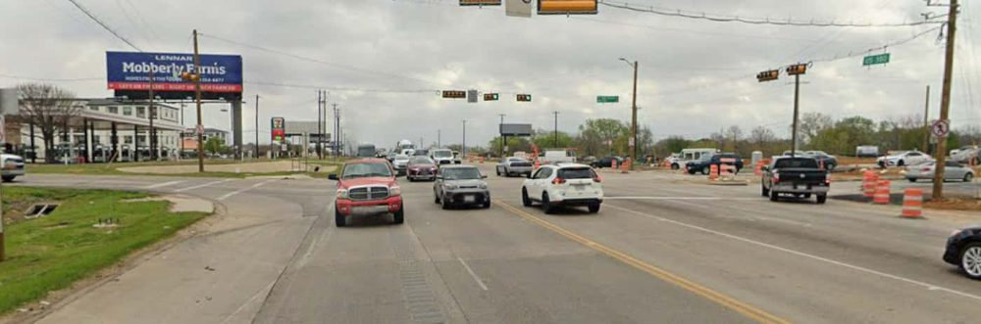
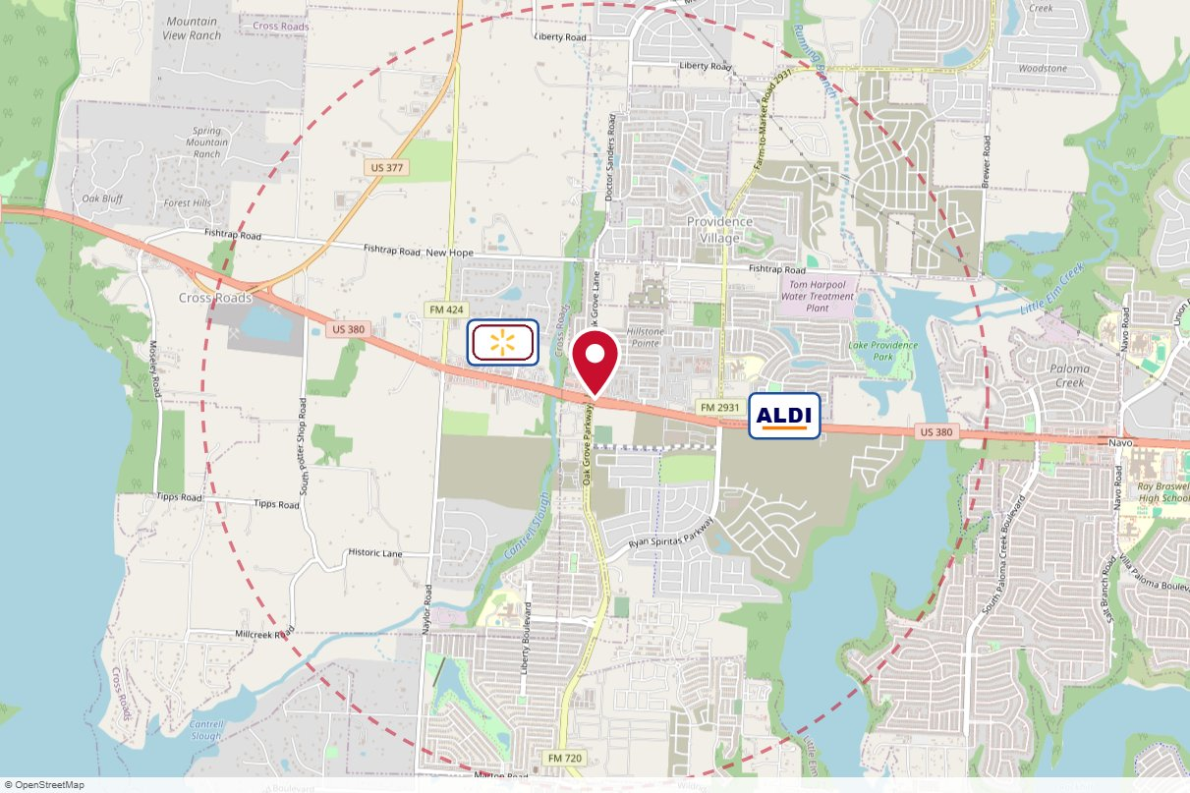
#003-055L The Reiss Group · Static
IN MARKET
PANEL INFO
Location: 26401 East University Drive — NE Corner of Hwy 380 EB & FM 720
Face: West · Read: Left
Size: 14' x 48'
Contract: 8/10/2026 → 12/27/2026 (4-week)
Impressions: 217,000 / week
Nearest H-E-B: 8.6 mi — Hwy 380 and FM 423 H-E-B
Investment: $2,500 / period
2-MILE AREA
red pin = this panel
red pills = H-E-B stores
company logos = blunting targets
dashed ring = 2-mile radius
North West Region · H-E-B OOH Current Holdings · 9/15/2026

Slide 40
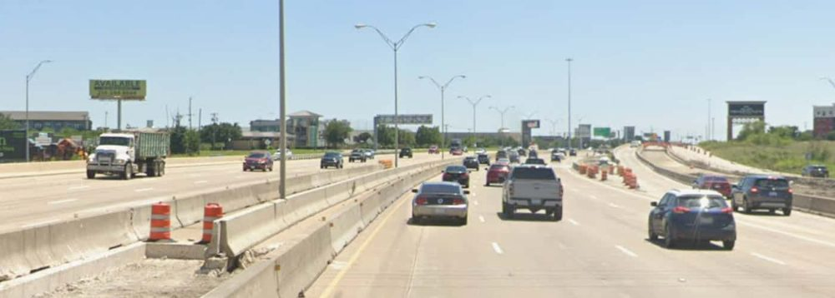
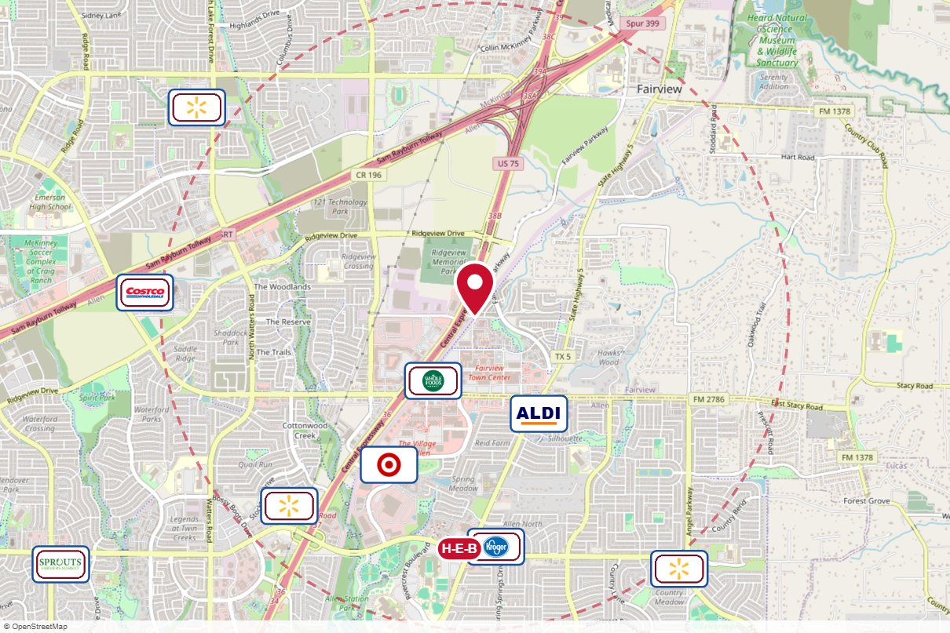
#003-009L The Reiss Group · Static
IN MARKET
PANEL INFO
Location: 6108 South US Highway 75 South — US 75 SB, 1.5 mi. S of 121 Toll at Boy Scout Council
Face: North · Read: Left
Size: 14x48
Contract: 8/10/2026 → 11/1/2026 (4-week)
Impressions: 781,200 / week
Nearest H-E-B: 1.5 mi — Allen H-E-B
Investment: $5,800 / period
2-MILE AREA
red pin = this panel
red pills = H-E-B stores
company logos = blunting targets
dashed ring = 2-mile radius
North West Region · H-E-B OOH Current Holdings · 9/15/2026

Slide 41
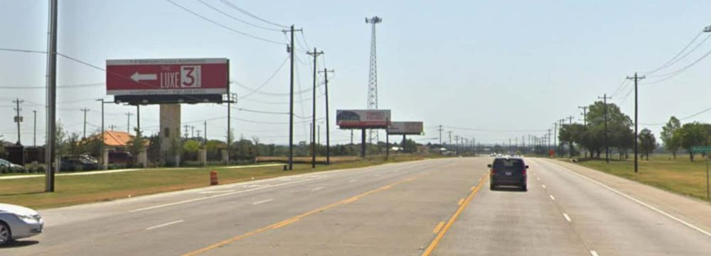
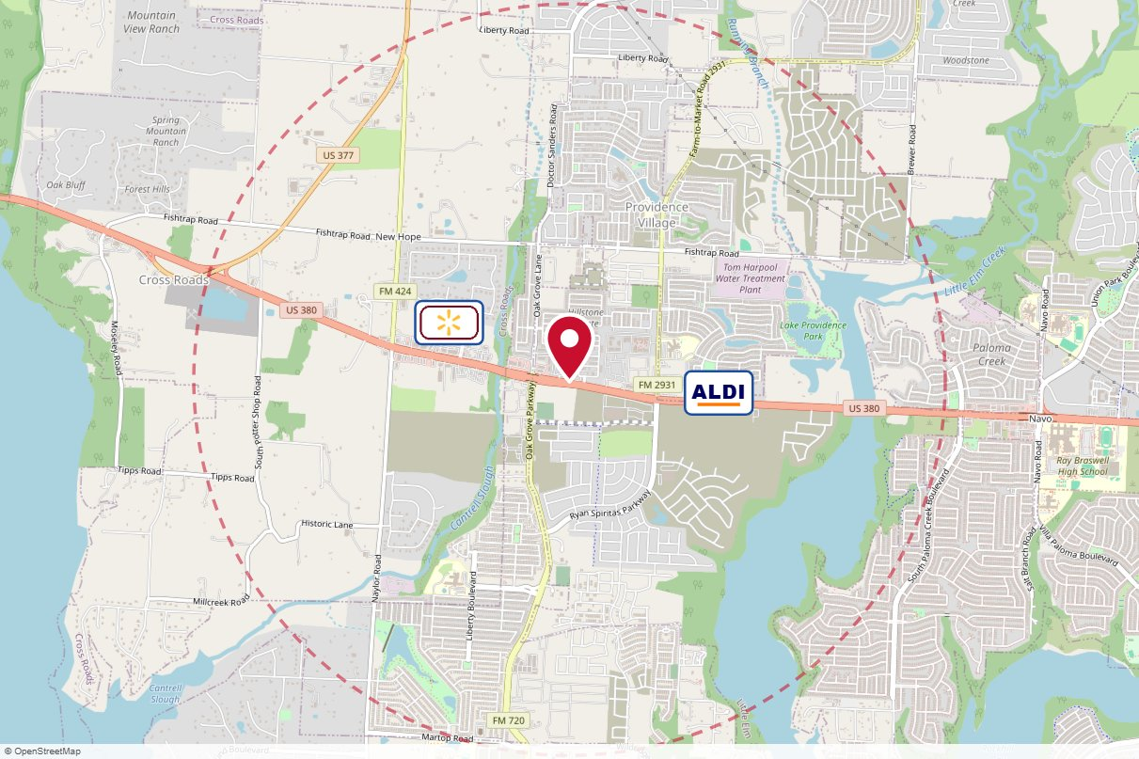
#003-056L The Reiss Group · Static
IN MARKET
PANEL INFO
Location: 4201 Carnelian Road — Hwy.380 EB,2/10 mile east of FM 720
Face: West · Read: Left
Size: 14x48
Contract: 8/10/2026 → 12/27/2026 (4-week)
Impressions: 217,000 / week
Nearest H-E-B: 8.4 mi — Hwy 380 and FM 423 H-E-B
Investment: $2,400 / period
2-MILE AREA
red pin = this panel
red pills = H-E-B stores
company logos = blunting targets
dashed ring = 2-mile radius
North West Region · H-E-B OOH Current Holdings · 9/15/2026

Slide 42
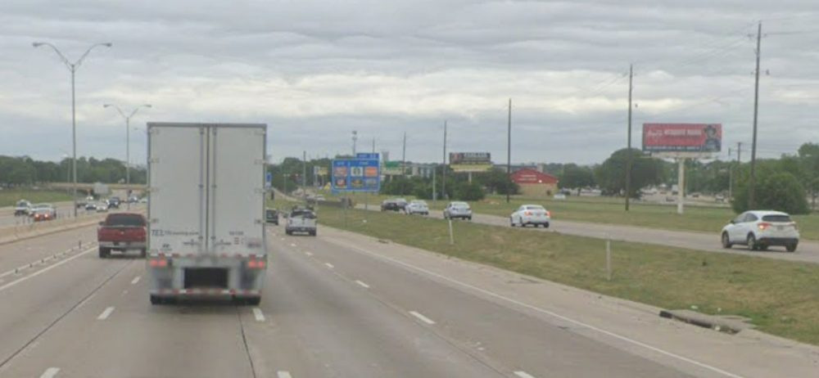
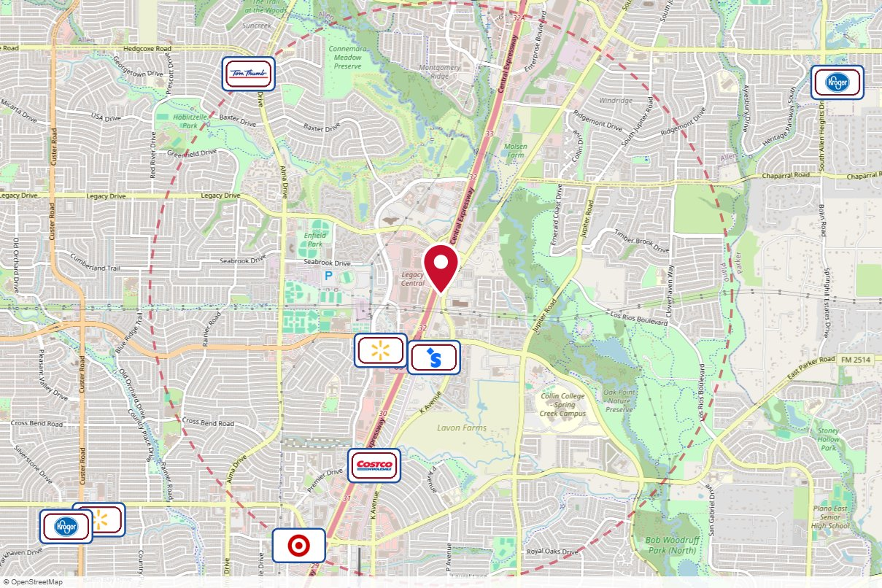
#008-0507A The Reiss Group · Static
IN MARKET
PANEL INFO
Location: 6428 K Avenue — US 75 NB, 3/10 mi. N. of Spring Creek Pkwy
Face: South · Read: Right
Size: 10x30
Contract: 8/10/2026 → 11/1/2026 (4-week)
Impressions: 421,200 / week
Nearest H-E-B: 4.3 mi — Allen H-E-B
Investment: $2,500 / period
2-MILE AREA
red pin = this panel
red pills = H-E-B stores
company logos = blunting targets
dashed ring = 2-mile radius
North West Region · H-E-B OOH Current Holdings · 9/15/2026

Slide 43
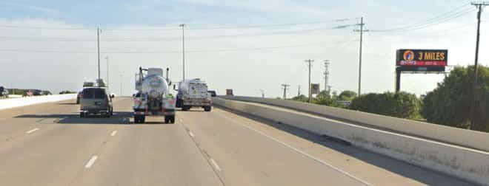
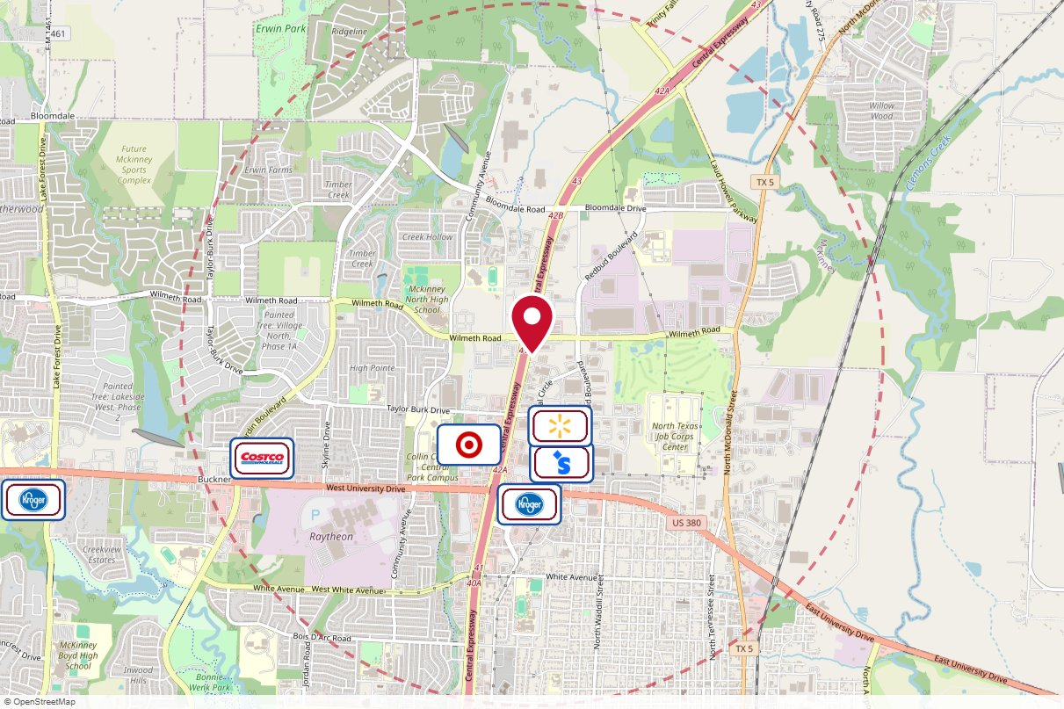
#003-316RD-1 The Reiss Group · Digital
IN MARKET
PANEL INFO
Location: 2698 North Central Expressway — US 75 NB at Wilmeth Rd Digital
Face: South · Read: Right
Size: 10x30
Contract: 8/10/2026 → 11/1/2026 (4-week)
Impressions: 421,200 / week
Nearest H-E-B: 7.8 mi — Allen H-E-B
Investment: $2,900 / period
2-MILE AREA
red pin = this panel
red pills = H-E-B stores
company logos = blunting targets
dashed ring = 2-mile radius
North West Region · H-E-B OOH Current Holdings · 9/15/2026

Slide 44


#254-19023R Burks Ad World LLC · Static
IN MARKET
PANEL INFO
Location: 2505 Interstate 30 Frontage Road — I-30 WB @ Rochelle Road
Face: East · Read: Right
Size: 14x48
Contract: 9/1/2026 → 8/31/2029 (Monthly)
Impressions: 327,563 / week
Nearest H-E-B: 2 mi — Rockwall
Investment: $2,500 / period
2-MILE AREA
red pin = this panel
red pills = H-E-B stores
company logos = blunting targets
dashed ring = 2-mile radius
North West Region · H-E-B OOH Current Holdings · 9/15/2026

Slide 45


#216-6001A Firewheel Outdoor · Digital
IN MARKET
PANEL INFO
Location: 2698 North George Bush Highway — Firewheel Town Center - President Geo. Bush Tollway (Hwy. 190) n/l
1 mi. e/o Hwy. 78 (Lavon Dr.)
Garland Texas (East Face and West Face)
Face: East · Read: Right
Size: 12’6”x42’
Contract: 8/10/2026 → 11/1/2026 (4-week)
Impressions: 18,452 / week
Nearest H-E-B: 5.2 mi — Murphy (scheduled 7/22/2026)
Investment: $2,350 / period
2-MILE AREA
red pin = this panel
red pills = H-E-B stores
company logos = blunting targets
dashed ring = 2-mile radius
North West Region · H-E-B OOH Current Holdings · 9/15/2026

Slide 46


#216-6002A Firewheel Outdoor · Digital
IN MARKET
PANEL INFO
Location: 9 Town Center Boulevard — Firewheel Town Center-Hwy. 78 (Lavon Dr.) e/l .2 mi. n/o
President Geo. Bush Tollway (Hwy. 190)
Garland Texas (North Face and West Face)
Face: South · Read: Right
Size: 12’6”x42’
Contract: 8/10/2026 → 11/1/2026 (4-week)
Impressions: 165,235 / week
Nearest H-E-B: 5.5 mi — Murphy (scheduled 7/22/2026)
Investment: $2,700 / period
2-MILE AREA
red pin = this panel
red pills = H-E-B stores
company logos = blunting targets
dashed ring = 2-mile radius
North West Region · H-E-B OOH Current Holdings · 9/15/2026

Slide 47


#002-648RD BB Outdoor · Digital
IN MARKET
PANEL INFO
Location: 648 West Interstate 30 — I-30 EB, W of Beltline Rd
Face: West · Read: Right
Size: 14x48
Contract: 8/10/2026 → 11/1/2026 (4-week)
Impressions: 729,120 / week
Nearest H-E-B: 10.9 mi — Rockwall
Investment: $2,500 / period
2-MILE AREA
red pin = this panel
red pills = H-E-B stores
company logos = blunting targets
dashed ring = 2-mile radius
North West Region · H-E-B OOH Current Holdings · 9/15/2026

Slide 48


#002-1459L BB Outdoor · Digital
IN MARKET
PANEL INFO
Location: 1459 Interstate 30 — I-30 WB, on Southside of the Hwy, in Royce City
Face: East · Read: Left
Size: 14x48
Contract: 8/10/2026 → 11/1/2026 (4-week)
Impressions: 434,000 / week
Nearest H-E-B: 5.9 mi — Rockwall
Investment: $1,000 / period
2-MILE AREA
red pin = this panel
red pills = H-E-B stores
company logos = blunting targets
dashed ring = 2-mile radius
North West Region · H-E-B OOH Current Holdings · 9/15/2026

Slide 49


#002-1298R BB Outdoor · Static
IN MARKET
PANEL INFO
Location: 1280 East Interstate 30 — I-30 EB, E of Lake Hubbard Pkwy
Face: West · Read: Right
Size: 14x48
Contract: 9/8/2026 → 9/6/2027 (4-week)
Impressions: 690,060 / week
Nearest H-E-B: 7.7 mi — Rockwall
Investment: $4,000 / period
2-MILE AREA
red pin = this panel
red pills = H-E-B stores
company logos = blunting targets
dashed ring = 2-mile radius
North West Region · H-E-B OOH Current Holdings · 9/15/2026

Slide 50


#003-AD Arrington Outdoor · Digital
IN MARKET
PANEL INFO
Location: IH 35 E Apx 1 miles north of Lake Lewisville
Face: South · Read: Right
Size: 14x48
Contract: 8/10/2026 → 11/1/2026 (4-week)
Impressions: 343,066 / week
Nearest H-E-B: 10.8 mi — Robson Ranch (1/20/27)
Investment: $3,500 / period
2-MILE AREA
red pin = this panel
red pills = H-E-B stores
company logos = blunting targets
dashed ring = 2-mile radius
North West Region · H-E-B OOH Current Holdings · 9/15/2026

Slide 51


#126-B Arrington Outdoor · Static
IN MARKET
PANEL INFO
Location: US 380 .5 miles east of Hwy 5
Face: East · Read: Left
Size: 12x24
Contract: 9/14/2026 → 9/12/2027 (4-week)
Impressions: 81,316 / week
Nearest H-E-B: 6.9 mi — Allen H-E-B
Investment: $1,200 / period
2-MILE AREA
red pin = this panel
red pills = H-E-B stores
company logos = blunting targets
dashed ring = 2-mile radius
North West Region · H-E-B OOH Current Holdings · 9/15/2026

Slide 52


#117-AD Arrington Outdoor · Digital
IN MARKET
PANEL INFO
Location: FM 423 n/o Main St. (Frisco & Little Elm)
Face: North
Size: 14' x 48'
Contract: 8/10/2026 → 11/1/2026 (4-week)
Impressions: 71,875 / week
Nearest H-E-B: 5.7 mi — Hwy 380 and FM 423 H-E-B
Investment: $2,800 / period
2-MILE AREA
red pin = this panel
red pills = H-E-B stores
company logos = blunting targets
dashed ring = 2-mile radius
North West Region · H-E-B OOH Current Holdings · 9/15/2026

Slide 53

#117-BD Arrington Outdoor · Digital
IN MARKET
PANEL INFO
Location: FM 423 n/o Main St. (Frisco & Little Elm)
Face: South
Size: 14' x 48'
Contract: 8/10/2026 → 11/1/2026 (4-week)
Impressions: 62,793 / week
Nearest H-E-B: 5.7 mi — Hwy 380 and FM 423 H-E-B
Investment: $2,250 / period
2-MILE AREA
red pin = this panel
red pills = H-E-B stores
company logos = blunting targets
dashed ring = 2-mile radius
North West Region · H-E-B OOH Current Holdings · 9/15/2026

Slide 54


#133A Primary Media · Digital
IN MARKET
PANEL INFO
Location: WB/RHR US 380 @ Hardin Blvd (adjacent Costco & 380 Crossing)
Face: East · Read: Right
Size: 10' x 30'
Contract: 8/3/2026 → 10/25/2026 (4-week)
Impressions: 1,349,696 / week
Nearest H-E-B: 7.1 mi — Allen H-E-B
Investment: $3,650 / period
2-MILE AREA
red pin = this panel
red pills = H-E-B stores
company logos = blunting targets
dashed ring = 2-mile radius
North West Region · H-E-B OOH Current Holdings · 9/15/2026

Slide 55


#800A Primary Media · Digital
IN MARKET
PANEL INFO
Location: US 380 at Coit Rd — "front door of McKinney"
Face: West · Read: Right
Size: 14' x 48'
Contract: 8/3/2026 → 10/25/2026 (4-week)
Impressions: 760,443 / week
Nearest H-E-B: 3.4 mi — Hwy 380 and FM 423 H-E-B
Investment: $4,650 / period
2-MILE AREA
red pin = this panel
red pills = H-E-B stores
company logos = blunting targets
dashed ring = 2-mile radius
North West Region · H-E-B OOH Current Holdings · 9/15/2026

Slide 56


#114 Lamar Advertising · Digital
IN MARKET
PANEL INFO
Location: HWY 287, E/S, 1.5 MI N/O FM 157, N/F (between I-20 and SH-360)
Face: Northwest
Size: 14' x 48'
Contract: 8/10/2026 → 11/1/2026 (4-week)
Impressions: 137,437 / week
Nearest H-E-B: 12.7 mi — Burleson H-E-B plus!
Investment: $2,895 / period
2-MILE AREA
red pin = this panel
red pills = H-E-B stores
company logos = blunting targets
dashed ring = 2-mile radius
North West Region · H-E-B OOH Current Holdings · 9/15/2026

Slide 57


#078905 Clear Channel Outdoor · Digital
IN MARKET
PANEL INFO
Location: Hwy 287 ES 1mi S/O Hwy 360 F/S - 1
Face: South · Read: Right
Size: 14' x 48'
Contract: 8/10/2026 → 11/1/2026 (4-week)
Impressions: 82,742 / week
Nearest H-E-B: 15.4 mi — Waxahachie H-E-B
Investment: $2,300 / period
2-MILE AREA
red pin = this panel
red pills = H-E-B stores
company logos = blunting targets
dashed ring = 2-mile radius
North West Region · H-E-B OOH Current Holdings · 9/15/2026

Slide 58


#040-1212L The Reiss Group · Static
IN MARKET
PANEL INFO
Location: 6503 North Freeway — I-35W NB at Western Center Blvd (west side of 35W)
Face: South · Read: Left
Size: 14x48
Contract: 8/10/2026 → 11/1/2026 (4-week)
Impressions: 263,082 / week
Nearest H-E-B: 3.8 mi — Alliance H-E-B
Investment: $5,800 / period
2-MILE AREA
red pin = this panel
red pills = H-E-B stores
company logos = blunting targets
dashed ring = 2-mile radius
North West Region · H-E-B OOH Current Holdings · 9/15/2026

Slide 59


#006447 Clear Channel Outdoor · Digital
IN MARKET
PANEL INFO
Location: South Fwy (I-35W) ES 0.38mi S/O Alsbury Rd F/N - 1
Face: North · Read: Left
Size: 14' x 48'
Contract: 8/10/2026 → 11/1/2026 (4-week)
Impressions: 203,116 / week
Nearest H-E-B: 3.1 mi — Burleson H-E-B plus!
Investment: $2,000 / period
2-MILE AREA
red pin = this panel
red pills = H-E-B stores
company logos = blunting targets
dashed ring = 2-mile radius
North West Region · H-E-B OOH Current Holdings · 9/15/2026

Slide 60

#181-119 The Reiss Group · Digital
STARTS SOON
no photo on file
PANEL INFO
Location: I-35W W/L .5mi N/O FM 1171, Northlake, Denton County, TX
Face: West
Size: 14'' x 48''
Contract: 11/2/2026 → 1/10/2027 (4-week)
Impressions: 120,067 / week
Nearest H-E-B: 4.3 mi — Robson Ranch (1/20/27)
Investment: $3,293 / period
2-MILE AREA
red pin = this panel
red pills = H-E-B stores
company logos = blunting targets
dashed ring = 2-mile radius
North West Region · H-E-B OOH Current Holdings · 9/15/2026

Slide 61

#006-78728 The Reiss Group · Digital
STARTS SOON
no photo on file
PANEL INFO
Location: I-35W WS 500ft S/O FM 407 F/S - 1, Corral City, Denton County, TX
Face: South
Size: 14'' x 48''
Contract: 11/2/2026 → 1/10/2027 (4-week)
Impressions: 63,570 / week
Nearest H-E-B: 2.3 mi — Robson Ranch (1/20/27)
Investment: $2,400 / period
2-MILE AREA
red pin = this panel
red pills = H-E-B stores
company logos = blunting targets
dashed ring = 2-mile radius
North West Region · H-E-B OOH Current Holdings · 9/15/2026

Slide 62

#006-78074 The Reiss Group · Digital
STARTS SOON
no photo on file
PANEL INFO
Location: I-35W WS 0.4mi S/O FM 407, Corral City, Denton County, TX
Face: West
Size: 14'' x 48''
Contract: 11/2/2026 → 1/10/2027 (4-week)
Impressions: 95,992 / week
Nearest H-E-B: 2.6 mi — Robson Ranch (1/20/27)
Investment: $2,400 / period
2-MILE AREA
red pin = this panel
red pills = H-E-B stores
company logos = blunting targets
dashed ring = 2-mile radius
North West Region · H-E-B OOH Current Holdings · 9/15/2026

Slide 63

#78987 Clear Channel Outdoor · Static
STARTS SOON
no photo on file
PANEL INFO
Location: Hwy 190 SS 0.4mi E/O Merritt Rd F/E - 1
Face: East
Size: 14'' x 48''
Contract: 11/9/2026 → 11/7/2027 (4-week)
Impressions: 154,270 / week
Nearest H-E-B: 4.2 mi — Murphy (scheduled 7/22/2026)
Investment: $3,000 / period
2-MILE AREA
red pin = this panel
red pills = H-E-B stores
company logos = blunting targets
dashed ring = 2-mile radius
North West Region · H-E-B OOH Current Holdings · 9/15/2026

Slide 64

#2_7891O Outfront Media · Static
STARTS SOON
no photo on file
PANEL INFO
Location: I-35W S/O Loop 820 W/S F/N
Face: North
Size: 14'' x 48"'
Contract: 11/23/2026 → 11/21/2027 (4-week)
Impressions: 441,111 / week
Nearest H-E-B: 5.5 mi — Alliance H-E-B
Investment: $5,850 / period
2-MILE AREA
red pin = this panel
red pills = H-E-B stores
company logos = blunting targets
dashed ring = 2-mile radius
North West Region · H-E-B OOH Current Holdings · 9/15/2026

Slide 65

#78885 Clear Channel Outdoor · Static
STARTS SOON
no photo on file
PANEL INFO
Location: Hwy 190 NS 0.6mi E/O Merritt Rd F/E - 1
Face: East
Size: 14'' x 48"'
Contract: 1/4/2027 → 1/2/2028 (4-week)
Impressions: 174,763 / week
Nearest H-E-B: 4.2 mi — Murphy (scheduled 7/22/2026)
Investment: $3,000 / period
2-MILE AREA
red pin = this panel
red pills = H-E-B stores
company logos = blunting targets
dashed ring = 2-mile radius
North West Region · H-E-B OOH Current Holdings · 9/15/2026

Slide 66


#002-1125RD BB Outdoor · Digital
STARTS SOON
PANEL INFO
Location: 2610 Sunset Ridge Drive — I-30 EB @ Ridge Rd.
Face: West · Read: Right
Size: 14x48
Contract: 9/18/2026 → 11/1/2026 (4-week)
Impressions: n/a
Nearest H-E-B: 2.8 mi — Rockwall
Investment: $4,000 / period
2-MILE AREA
red pin = this panel
red pills = H-E-B stores
company logos = blunting targets
dashed ring = 2-mile radius
North West Region · H-E-B OOH Current Holdings · 9/15/2026

