Slide 1
How is the similarity between Taipei and Kaohsiung?

Slide 2
Background
Taipei and Kaohsiung are both well-known cities in Taiwan
But do we know how similar are those two cities?
Based on the diversity of point of interests, population to compare those two cities and figure out if those two cities are similar or have huge differences.

Slide 3
Data acquisition and cleaning
List of Taiwan district overall latitude and longitude
Description: Information of Taiwan's overall latitude and longitude
URL:https://data.gov.tw/dataset/25489
Taipei government data
Description: Taipei Government Dataset
URL : https://ca.gov.taipei/News_Content.aspx?n=8693DC9620A1AABF&sms=D19E9582624D83CB&s=EE7D5719108F4026
Kaohsiung government data
Description: Kaohsiung Government Dataset
URL : http://cabu.kcg.gov.tw/Stat/StatRpts/StatRpt1.aspx
Foursquare API
Description: Retrieve the point of interests information.
URL:https://developer.foursquare.com/docs/api/venues/details

Slide 4
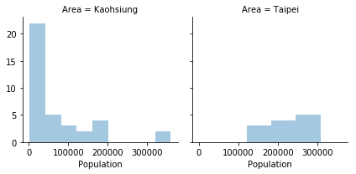
Using population as feature

Slide 5
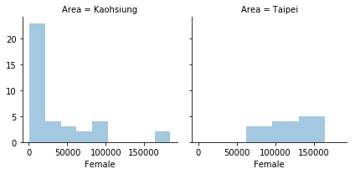
Using female as feature

Slide 6
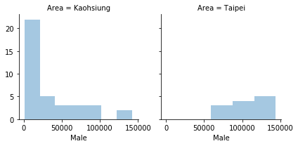
Using male as feature

Slide 7
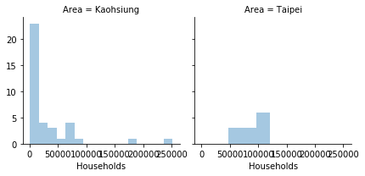
Using hoseholds as feature

Slide 8
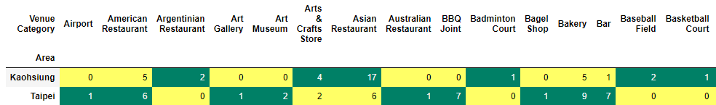
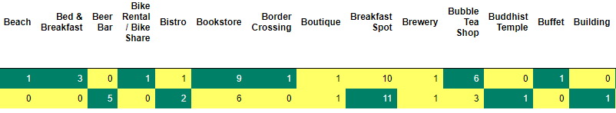
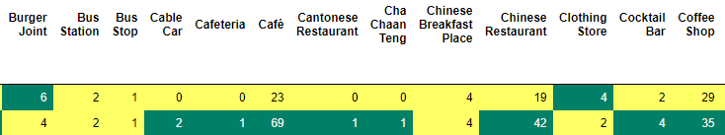
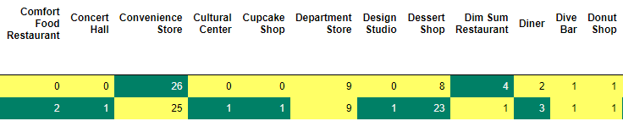
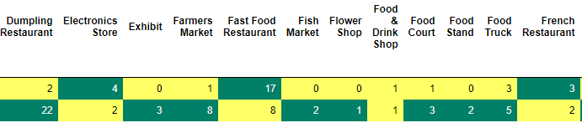
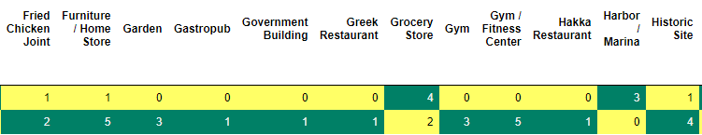
Using venues category as feature

Slide 9
Conclusion
According to the comparison of population, female, male, venues categories. The population and related data distribute to over all district.
We can say that districts in Taipei does not have huge gap. but in the other site. Kaohsiung have gap between districts and this is major difference between those two cities.

