Slide 1

CASE STUDY · DATA & GROWTH ENGINEER
Dental Bright → Norway
Three Google Search campaigns to €1k/day at 1.5× ROAS
€63k
2,993
2.72×
€59
NL spend analyzed
unique search terms
current NL ROAS
blended AOV
Danil Sysenko · April 2026
Notes:
1

Slide 2
TL;DR
€14.4k over four weeks → €24.9k revenue. 1.74× blended, W2 dips before it scales.
01
02
03
Problem-Aware
Solution-Aware
DSA Discovery
30% of budget · 2.87× NL benchmark
55% of budget · 3.09× NL benchmark
15% of budget · ~1.8× NL benchmark
Symptom queries: bad breath, tartar, gum issues. Cheapest CPC, hottest intent.
Category queries: tannpulver, tannpleie, tannstein fjerning. Volume + highest ROAS.
Dynamic Search Ads on landing pages. Finds NO-specific queries our translation misses.
Path to target
Week 1
Week 2
Week 3
Week 4
€150/day
€300/day
€600/day
€1000/day
ROAS 1.50×
ROAS 1.42×
ROAS 1.73×
ROAS 1.87×
Built in a weekend without a Norwegian speaker to verify keywords. Campaign 3 (DSA) exists partly to catch what my translation misses.
Dental Bright → Norway · Danil Sysenko · April 2026
2 / 8
Notes:
2

Slide 3
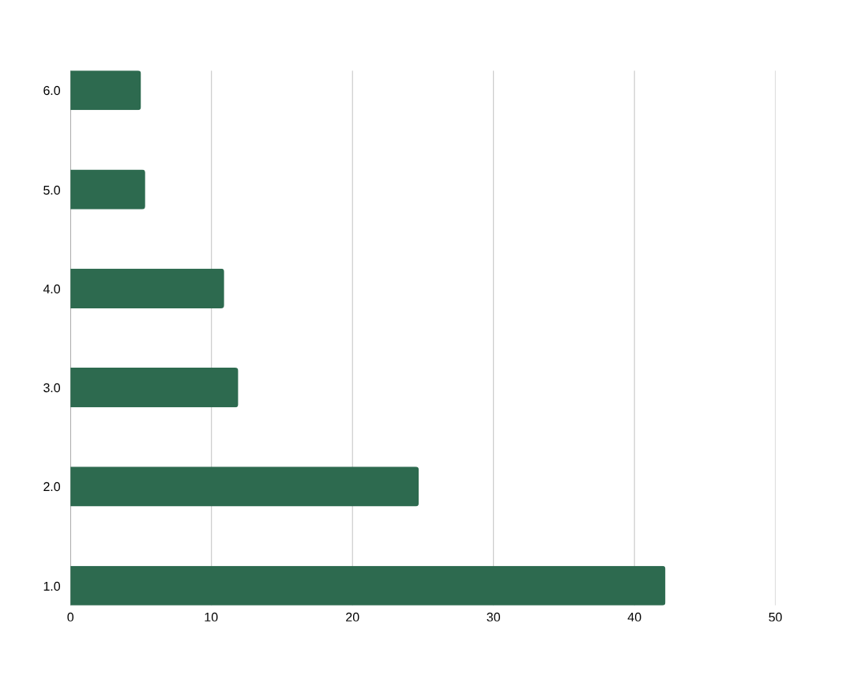
What the NL data says
I grouped 2,993 search terms into 6 intent clusters. Two drive three-quarters of revenue.
Spend share and ROAS by cluster
Cluster performance (6 months, NL)
Cluster | Spend | Revenue | ROAS | CPC | CVR
Solution-Aware | €26,636 | €82,282 | 3.09× | €1.22 | 6.5%
Problem-Aware | €15,596 | €44,730 | 2.87× | €0.94 | 4.8%
Other | €7,535 | €15,465 | 2.05× | €1.67 | 5.5%
Broad dog | €6,881 | €15,087 | 2.19× | €1.54 | 5.4%
Branded (Beemzy) | €3,366 | €8,424 | 2.50× | €1.37 | 5.2%
Competitor | €3,134 | €5,564 | 1.78× | €1.86 | 5.3%
Key insight. Solution + Problem = 67% of NL spend, 74% of NL revenue. Competitor has the worst ROAS (1.78×) — expected to be worse in NO without brand trust. Branded won't exist in NO yet.
Dental Bright → Norway · Danil Sysenko · April 2026
3 / 8
Notes:
3

Slide 4


Norway: market and unit economics
Explicit assumptions — every number is adjustable with Week 1 real data.
Market context
Unit economics (NO vs NL baseline)
POPULATION
CPC
CVR
5.55M
~20% dog-owning households → ~560k dogs
€1.45
4.20%
LANGUAGE
NL €1.22 +20%
NL 5.66% −25%
Bokmål
~90% of searches; Nynorsk covered via broad match
Cold market, Nordic auction density
No brand trust yet; improves W3-4
TOP PET E-TAIL
AOV
Target ROAS
zooplus.no
then musti.no, buddy.no, dyrelege.no
€62.00
1.50×
COMPETITOR DENSITY
NL €58.83 +5%
NL 2.72× min
Low–Medium
Plaque Off, DentaLife present; natural powder = white space
Nordic price index uplift
Brief target; model lands at 1.81×
Break-even check. At €1k/day and CPC €1.45, we need CVR ≥ 3.5% to hit 1.5× ROAS. Baseline assumes 4.2%. Safety buffer holds even if NO CVR is 40% below NL.
Dental Bright → Norway · Danil Sysenko · April 2026
4 / 8
Notes:
4

Slide 5
CAMPAIGNS 1 & 2
Where the revenue lives
85% of the budget. Both clusters did the heavy lifting in NL — there's no reason Norway should be different.
01
02
Problem-Aware
Solution-Aware
They don't know tannpulver exists. They just know the dog stinks.
They know they want a dental product. Bigger volume, higher CVR, slightly more expensive clicks.
30% · €300/day · NL: CPC €0.94 · CVR 4.8% · ROAS 2.87×
55% · €550/day · NL: CPC €1.22 · CVR 6.5% · ROAS 3.09×
hund dårlig ånde bad breath dog
tannstein hund tartar dog
fjerne tannstein hund remove tartar dog
hund stinker fra munnen dog smells from mouth
betennelse tannkjøtt hund gum inflammation dog
hund gule tenner yellow teeth dog
tannpulver hund tooth powder dog
dental pulver hund dental powder dog
beste tannpulver hund best tooth powder dog
tannpleie hund dental care dog
tannrens hund teeth cleaning dog
anti plakk hund anti plaque dog
STRUCTURE Phrase match. 3 ad groups: breath / tartar / gums.
AD COPY First angle I'd test: "Hunden din stinker fra munnen? Naturlig pulver — ryddig ånde på 14 dager." (A/B against 3 variations)
KILL / SCALE Pause ad group after €200 spend if ROAS < 1.0×
STRUCTURE Phrase match. 3 ad groups: powder / paste-brush / general care.
AD COPY First angle: "Tannpulver for hund — 4.6/5 fra 12 000 anmeldelser. Prøv i 30 dager risikofritt." (trust + risk reversal)
KILL / SCALE tROAS 2.0× from Day 7 · Kill terms under 1.2× ROAS
Landing page for both: /no/dental-bright with Bokmål copy + Trustpilot widget above the fold before launch.
Dental Bright → Norway · Danil Sysenko · April 2026
5 / 8
Notes:
5

Slide 6
CAMPAIGN 3
DSA: the unknown-unknowns bet
Why this campaign exists.
My Norwegian comes from 4 hours with Google Translate this weekend. If the dominant NO query is actually "tannrens" and I bid on "tannpulver", Campaigns 1 and 2 quietly underperform for 3 weeks before anyone notices.
DSA lets Google crawl /no/dental-bright and match queries against the page content. It surfaces the real NO language within 7–10 days. We then promote winners to phrase match and add losers to the negatives list.
It's a 15% budget allocation that de-risks the other 85%.
SPEC
Budget
15% · €150/day, capped
Type
Dynamic Search Ads — no manual keywords
Targets
/no/ homepage
/no/dental-bright PDP
/no/blog/dental-care
Account-level negatives
gratis, diy, katt, hest, veterinær, valp trening (+ 8 more)
Ad copy
Google auto-writes headline from page content. Description: "Naturlig tannpulver. 4.6/5."
Dental Bright → Norway · Danil Sysenko · April 2026
6 / 8
Notes:
6

Slide 7
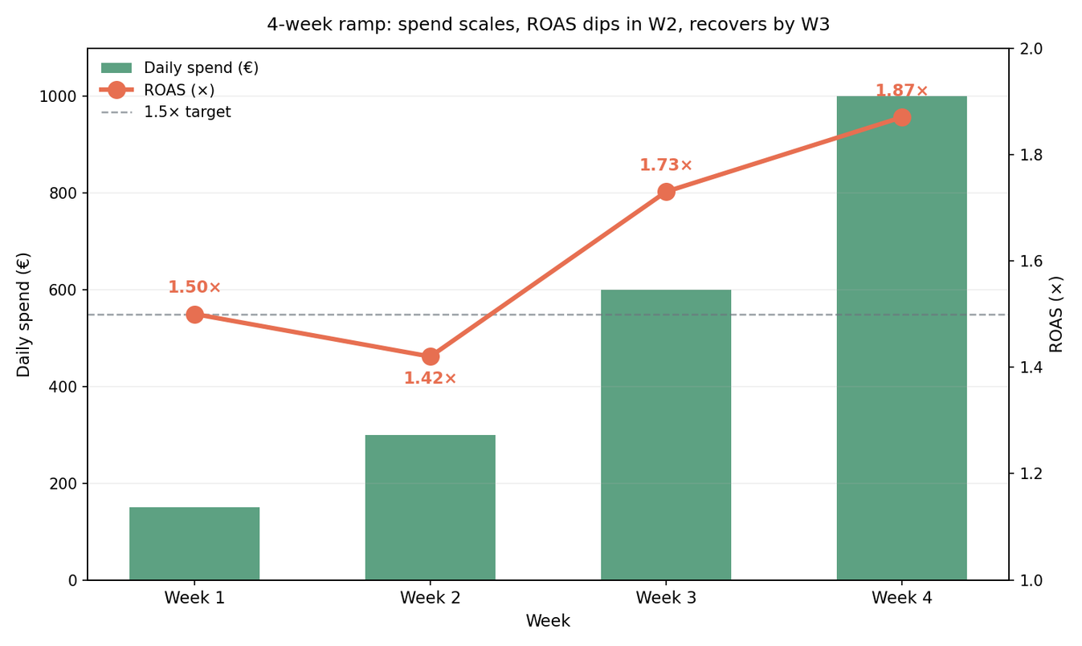
4-week ramp to €1k/day
€14,350 spend, €24,913 revenue, blended 1.74×. The dip in Week 2 is the plan, not a risk.
Week-by-week
Week | Spend | Rev. | ROAS
W1 | €1,050 | €1,575 | 1.50×
W2 | €2,100 | €2,982 | 1.42×
W3 | €4,200 | €7,266 | 1.73×
W4 | €7,000 | €13,090 | 1.87×
Total | €14,350 | €24,913 | 1.74×
WHY W2 DIPS
W1 runs tight on the 12 highest-intent keywords. W2 we double spend and add long-tail variants to learn — mix shifts toward lower-CVR terms, so ROAS dips even as revenue grows. In W3 we cut what didn't work. Without the dip there's no signal.
Break-even sits at CVR 3.5%. Baseline assumes 4.2% (a 25% haircut vs NL). Even if NO CVR lands 40% below NL we still clear the 1.5× target — which is why the plan starts at €150/day, not €1,000.
Dental Bright → Norway · Danil Sysenko · April 2026
7 / 8
Notes:
7

Slide 8


What could kill this, and what I'd build first
Three risks I can name. One automation I'd commit to in Week 1. The rest waits until data earns it.
Three things that break it
The one thing I'd build in Week 1
CVR drops below 3.5%
Daily pacing & ROAS Slack bot
Landing page isn't localized well enough, or NO users don't trust an unknown brand. Fix: Trustpilot widget above the fold Day 1, first-purchase 20% off in checkout.
Python + Google Ads API + Slack webhook. At 09:00 it posts yesterday's spend, revenue, orders and ROAS broken out by campaign. Red if any campaign is <1.3× ROAS or pacing ±20% off budget. One screenshot per day that replaces a spreadsheet check.
Build time: 1 evening. Saves 15 min/day. Pays for itself Week 1.
CPC inflates above €1.80
Nordic auction heats up, or broad match leaks budget. Fix: strict phrase match from Day 1, tROAS bidding from Day 7 once we have ≥15 conversions for the algo to learn on.
WHY NOT A LIST OF FIVE MORE
NO search volume caps the plan at €600/day
Search-term harvesting, feed generation, translation pipelines — I have ideas, but automating things I don't have data for yet is how teams build shelfware. These come in Week 4+ once I know what the real failure modes look like.
Norway is 5.5M people. If demand is thinner than I modeled, we hit a ceiling. Fix: Sweden and Denmark next — same pipeline, similar dental-care habits, 3× the combined population.
Full notebook, data, and this deck: github.com/willbebettertoday/dogsuppy-no-case-study
Dental Bright → Norway · Danil Sysenko · April 2026
8 / 8
Notes:
8

