Slide 1
Photos for Lakeline Article

Slide 2
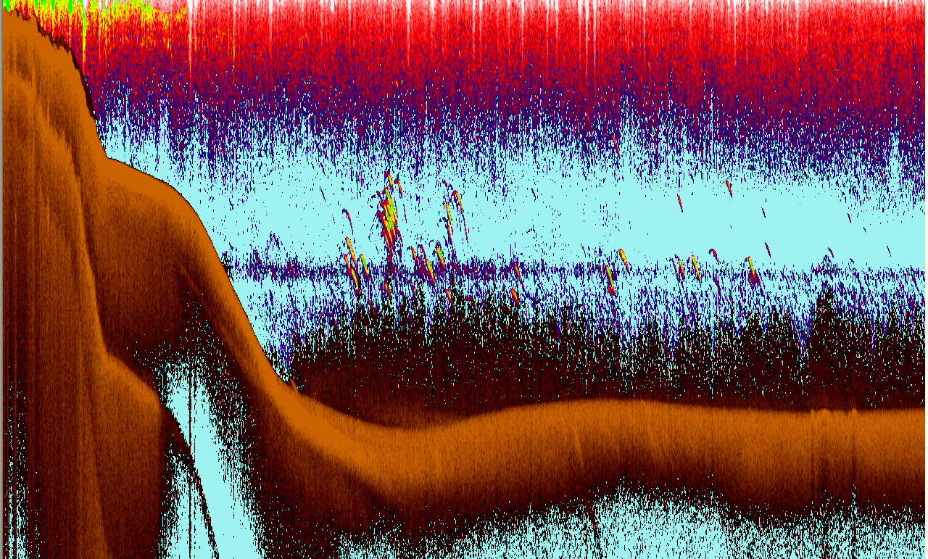
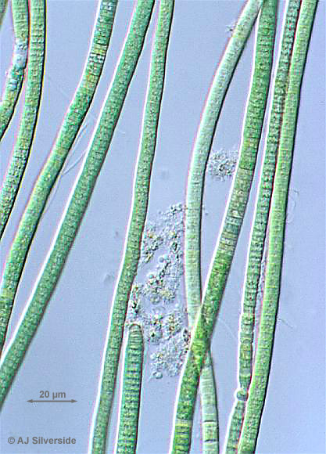
Mirror Lake (NH)
Oscillatoria

Slide 3
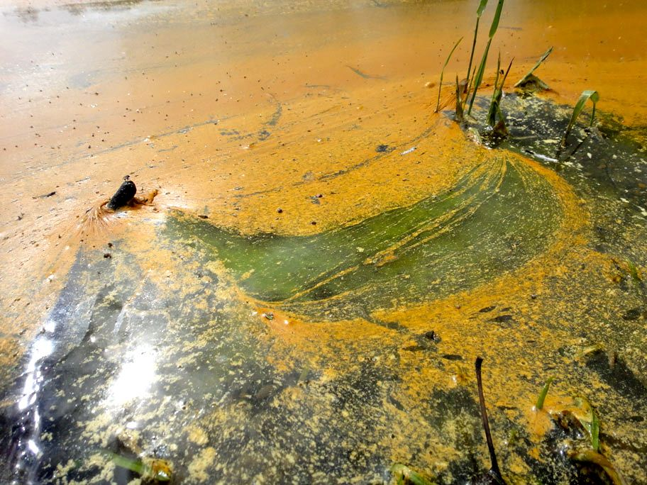
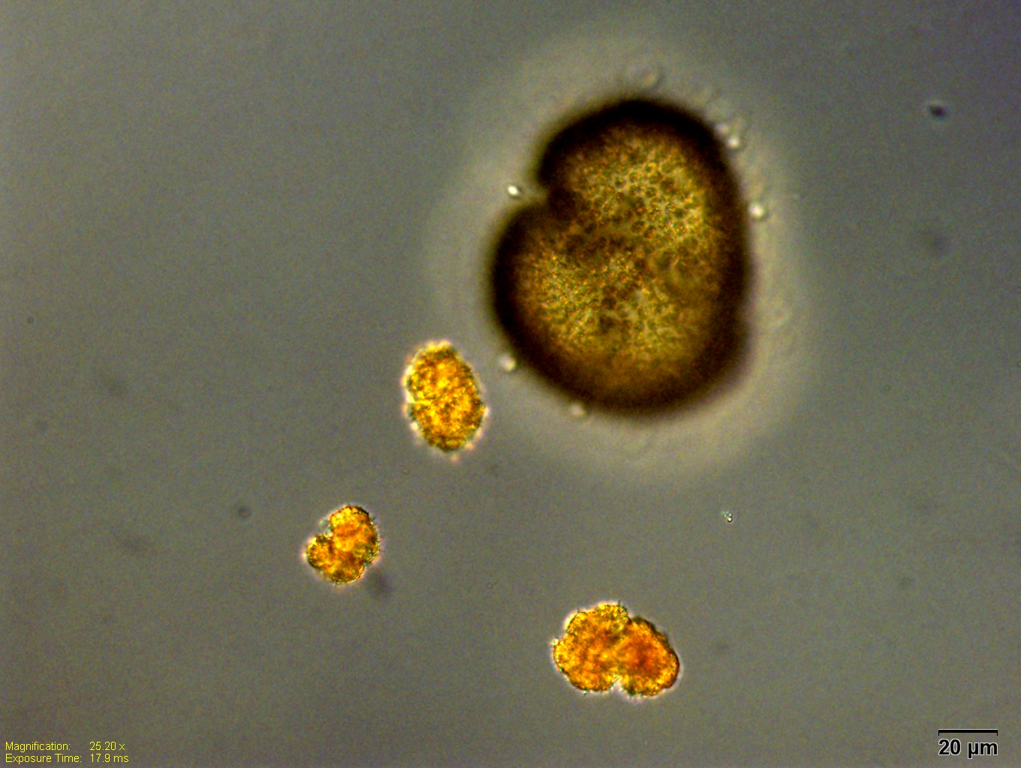
Woronichinia
Why do cyanobacteria accumulate at the surface?
Botryococcus
Notes:
Non-flagellated compact colony with cells embedded in a wax-like substance that tends to hide cellular organelles from view, often masking chlorophyll with orange-red carotinoid pigments. Thin filaments connect the cells. The cell body is 6 to 10 μm long, and 3 to 6 μm wide.
Similar genera:
Habitat:
Mostly found in freshwater environments. Inland, shallow and oxygenated freshwater lakes, ponds, pools or slow moving waters plus ditches, bogs. They grow in oligotrophic lakes but prefer a eutrophic environment with a slightly acidic pH level. The salinity of the lakes they inhibit is usually less than 5%. Oil and wax production decreases buoyancy, occasionally causing floatation of large masses on the surface of lakes.
Toxicity:
Cell-free extract from eutrophic Liyu Lake (eastern Taiwan) was found to be toxic to several species of phytoplankton and zooplankton. During blooms of Botryococcus braunii the relative dominance of 20 phytoplankton species isolated from Liyu Lake and cultered, was inversely related to their susceptibility to the extract, suggesting that B. braunii influences the phytoplankton community composition. Among zooplankton, copepods were more susceptible to the extract than cladocerans.
The cell-free extract of several phytoplankton species contained four fatty acids (a-linoleic, linoleic, palmitic, and oleic), with much more oleic acid in B. braunii..Of these, a-linoleic acid was most toxic to both phytoplankton and zooplankton species tested (Chiang et al. 2004).
The alkaline pH (8-9) of Liyu Lake during B. braunii blooms is thought to have enhanced the toxicity of the cell-free fatty acids (Ibid 2004).

