Slide 1
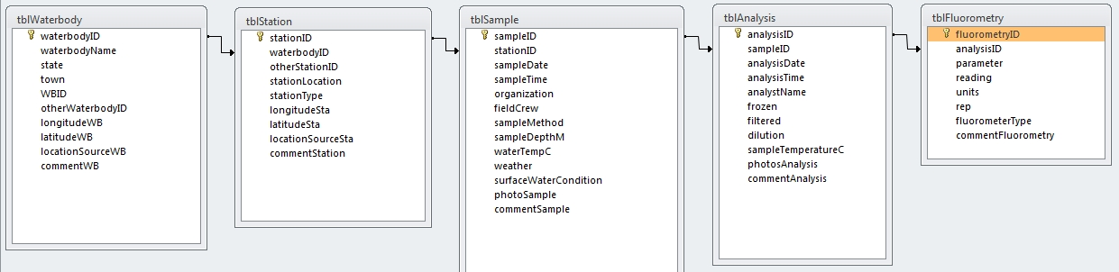
MS Access Database: cyanoMon.mdb
https://github.com/willbmisled/Reg1Cyano/blob/master/Access/CyanoMonDocumentation.md

Slide 2
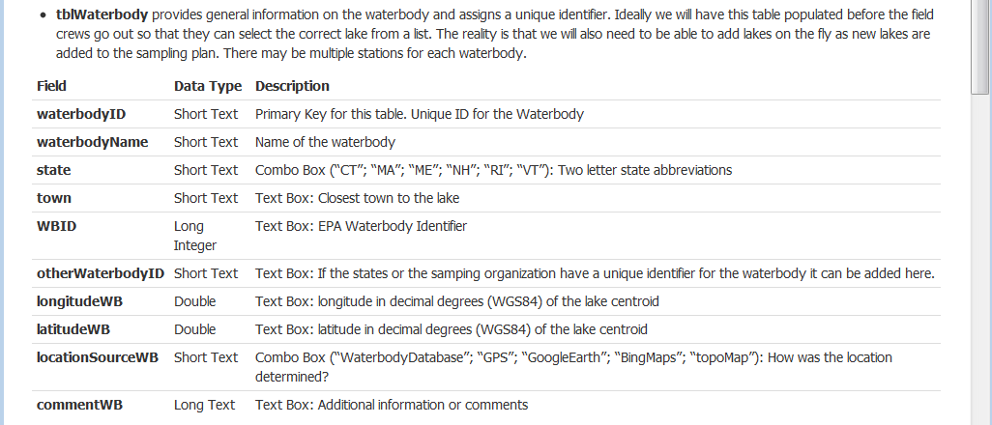
MS Access Database: cyanoMon.mdb
https://github.com/willbmisled/Reg1Cyano/blob/master/Access/CyanoMonDocumentation.md

Slide 3
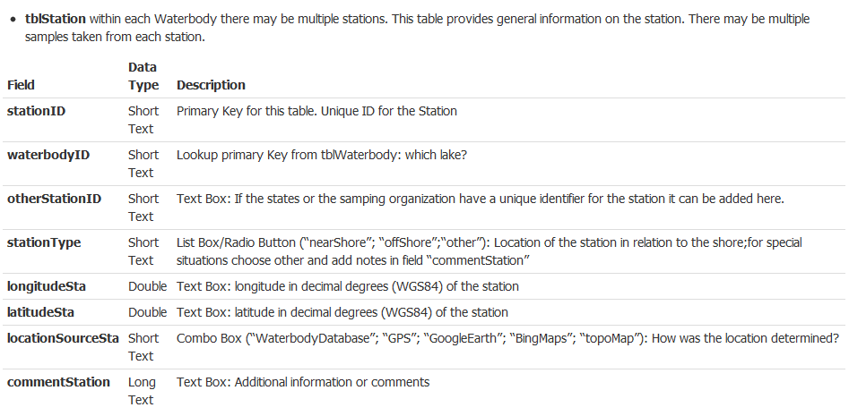
MS Access Database: cyanoMon.mdb
https://github.com/willbmisled/Reg1Cyano/blob/master/Access/CyanoMonDocumentation.md

Slide 4
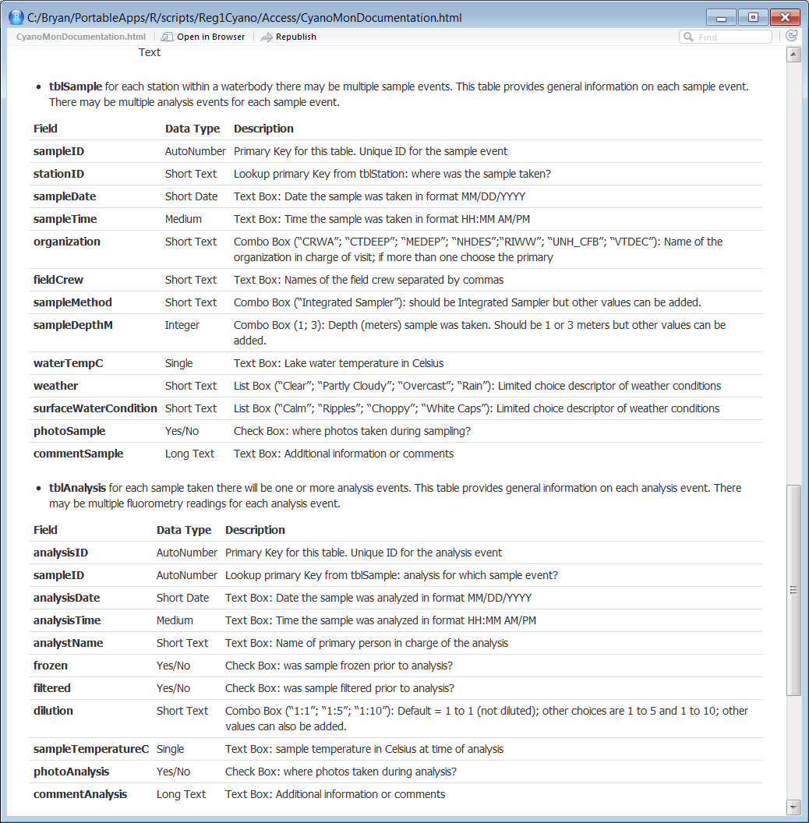
MS Access Database: cyanoMon.mdb
https://github.com/willbmisled/Reg1Cyano/blob/master/Access/CyanoMonDocumentation.md

Slide 5
MS Access Database: cyanoMon.mdb
https://github.com/willbmisled/Reg1Cyano/blob/master/Access/CyanoMonDocumentation.md

Slide 6
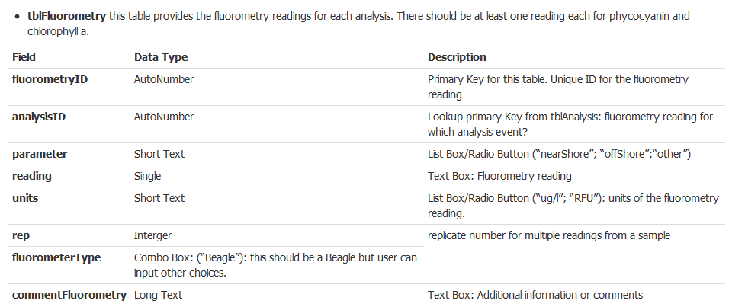
MS Access Database: cyanoMon.mdb
https://github.com/willbmisled/Reg1Cyano/blob/master/Access/CyanoMonDocumentation.md

Slide 7
Discussion topics:
RFU or ug/l
Locations
Spelling, capitalization, & abbreviations
UDIDs
waterbodyID
stationID
Required fields
Replicates

Slide 8
Data Entry Options:
Excel Spreadsheet
Pros: easy, available
Cons: extra typing, more errors, a multitude of sins
MS Access Database
Pros: user interface, QA/QC, validation, less repeated information
Cons: software availability, training
Webform
Pros: same as MS Access + accessibility & rapid updating
Cons: training, hosting, development
Phone App
Pros: rapid entry and delivery of data, validation possible
Cons: same phone must go to the field, repeated information, updates difficult

