Slide 1
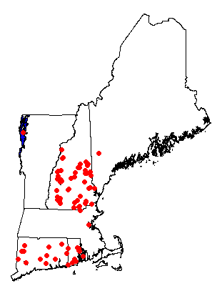
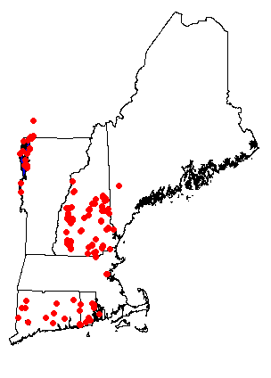
Cyano Monitoring 2014
75 Waterbodies
227 Locations

Slide 2
Number of Observations
4728 observations
1035 for Beagle/Unfrozen/Unfiltered

