Slide 1
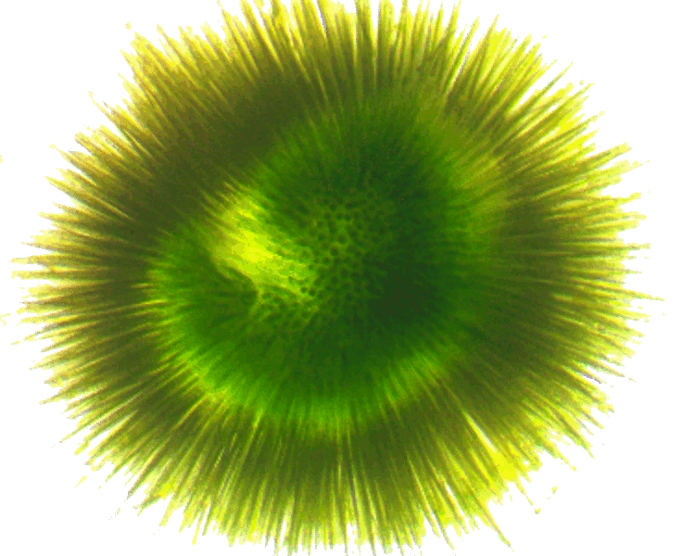
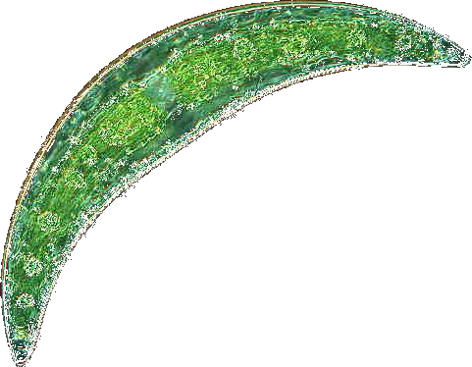


Phytoplankton community composition and cyanotoxin detection among lakes included in the 2007 National Lake Assessment
chla_cat
Betty J. Kreakie¹ , W. Bryan Milstead¹, Jeffrey W. Hollister¹, Elizabeth D. Hilborn¹, & Keith A. Loftin²
Ecological Society of America
August 2017
¹U.S. Environmental Protection Agency
²U.S. Geological Service

Slide 2
Intro slide on cyano toxin problems

Slide 3
Questions:
Are there identifiable phytoplankton community types across the coterminous United States?
Is cyanotoxin detectability influenced by phytoplankton community type?
What are the environmental or biotic determinants of community type?

Slide 4
Methods - Data
Data from the 2007 National Lake Assessment.
1148 lakes with complete physical, chemical and biological data selected for analysis.
Genus level phytoplankton abundances analyzed by non-metric multidimensional scaling (NMDS) [R::vegan:: metaMDS; K=4; N=10,000]

Slide 5
Methods - Analysis
Genus level phytoplankton abundances analyzed by non-metric multidimensional scaling (NMDS) [R::vegan:: metaMDS; K=4; N=10,000]
Cluster analysis used to define lake groupings
Association between lake groupings and environmental gradient data investigated with vegan::envfit and random forest analysis
Indicator species analysis with random forest and labdsv::indval

Slide 6
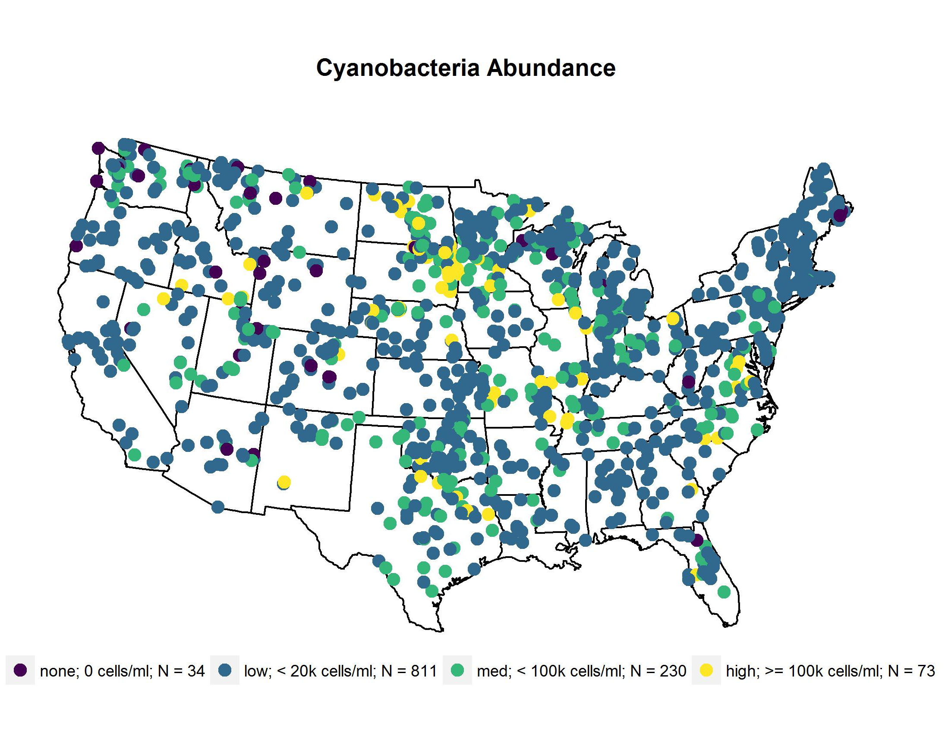
Sample Sites

Slide 7
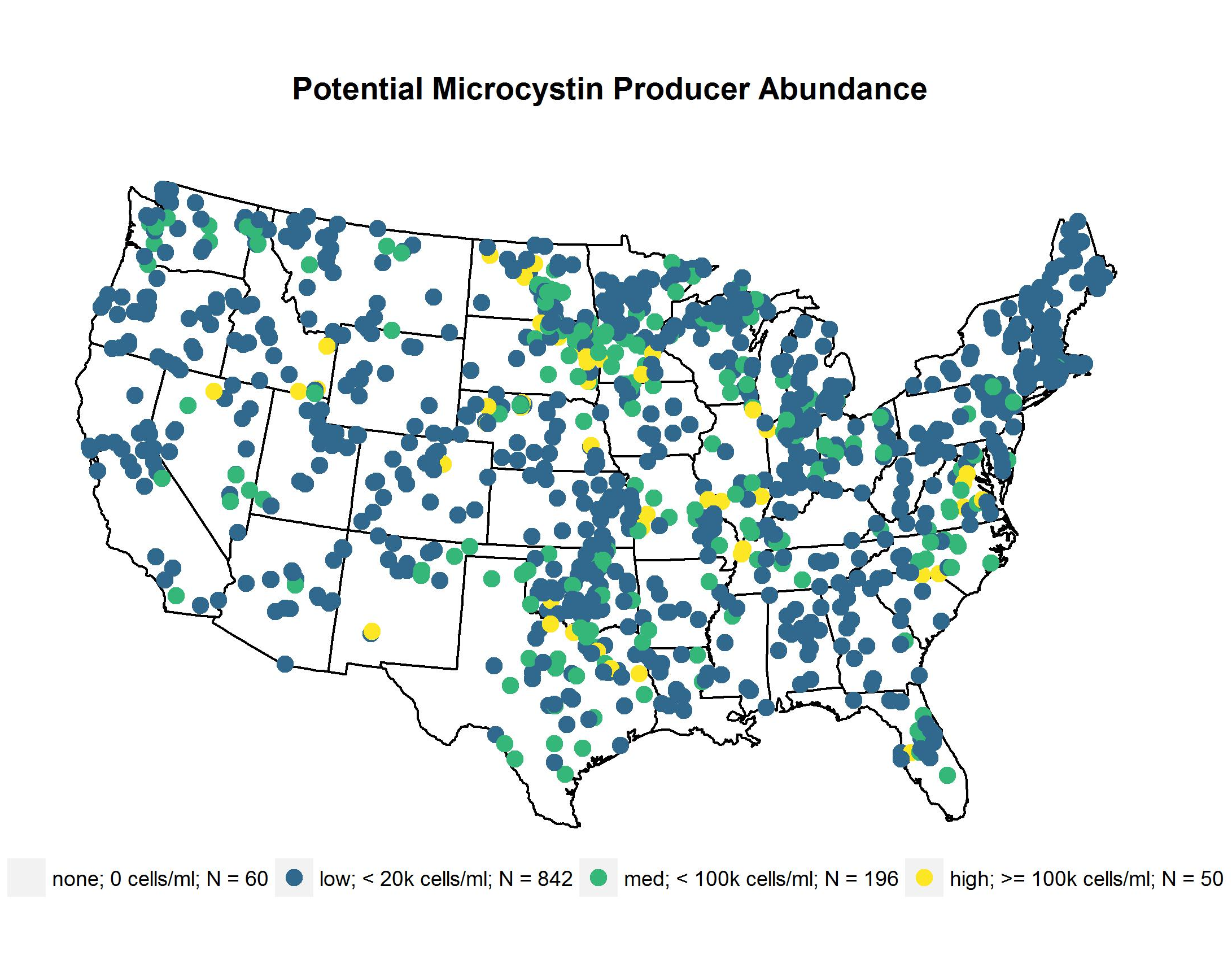
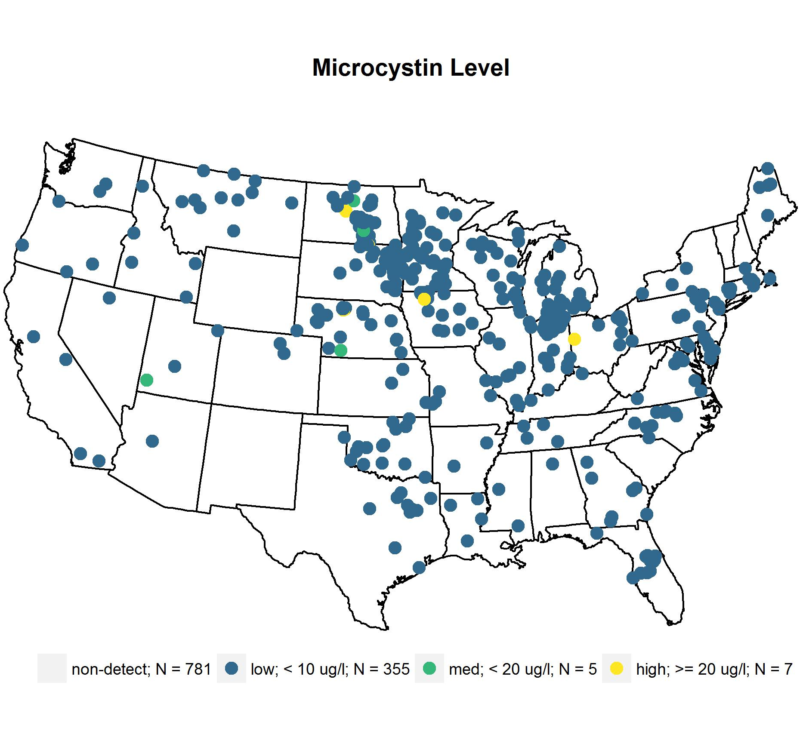
 | Lakes | cells/ml
genus | n | median | mean | max
Anabaena + Dolichospermum | 643 | 312 | 3461 | 13539
Anabaenopsis | 137 | 188 | 1170 | 3536
Aphanocapsa | 397 | 110 | 13406 | 158052
Coelosphaerium | 166 | 891 | 6094 | 36273
Leptolyngbya | 143 | 1062 | 3271 | 8121
Limnothrix | 80 | 676 | 13383 | 51263
Lyngbya | 268 | 174 | 1853 | 5620
Microcystis | 661 | 2953 | 27974 | 204147
 | Lakes | cells/ml
genus | n | median | mean | max
Oscillatoria + Phormidium + Planktothrix | 521 | 239 | 2929 | 14601
Planktolyngbya | 93 | 305 | 1714 | 5530
Pseudanabaena | 106 | 323 | 1802 | 6861
Snowella | 26 | 703 | 2030 | 5357
Synechococcus | 283 | 201 | 407 | 591
Synechocystis | 187 | 490 | 2421 | 8951

Slide 8

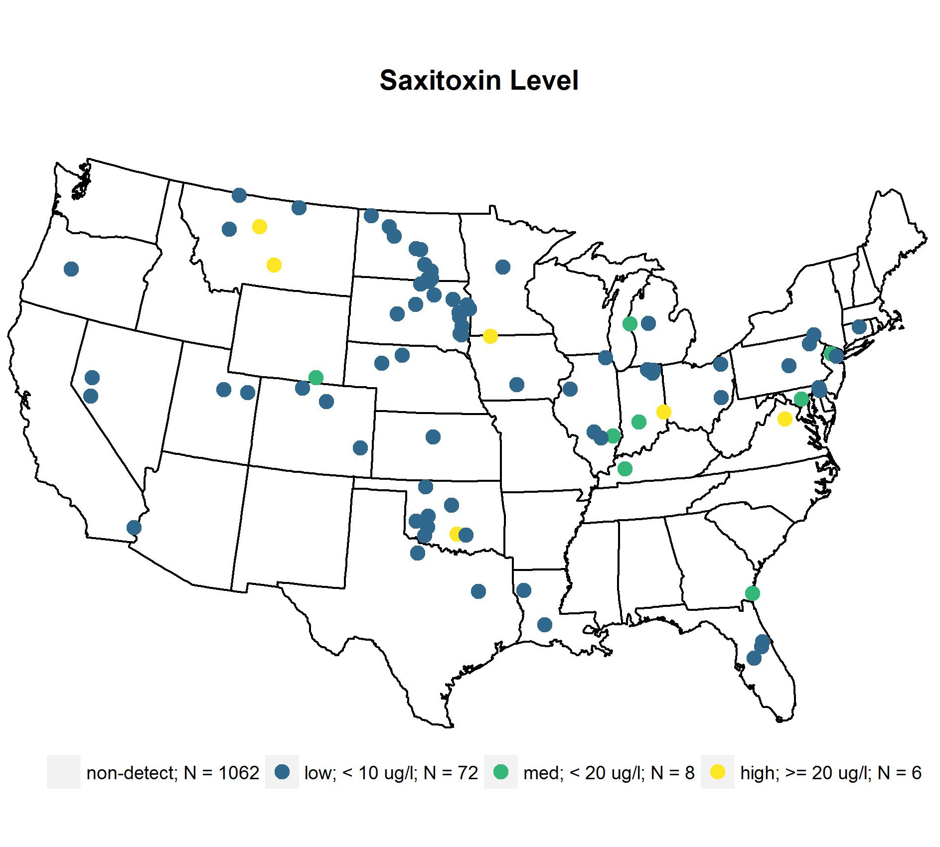
 | Lakes | cells/ml
genus | n | median | mean | max
Anabaena + Dolichospermum | 643 | 312 | 3461 | 13539
Aphanizomenon | 318 | 740 | 8527 | 25923
Cylindrospermopsis | 47 | 438 | 2481 | 5268
Lyngbya | 268 | 174 | 1853 | 5620
Oscillatoria + Phormidium + Planktothrix | 521 | 239 | 2929 | 14601
Planktolyngbya | 93 | 305 | 1714 | 5530

Slide 9

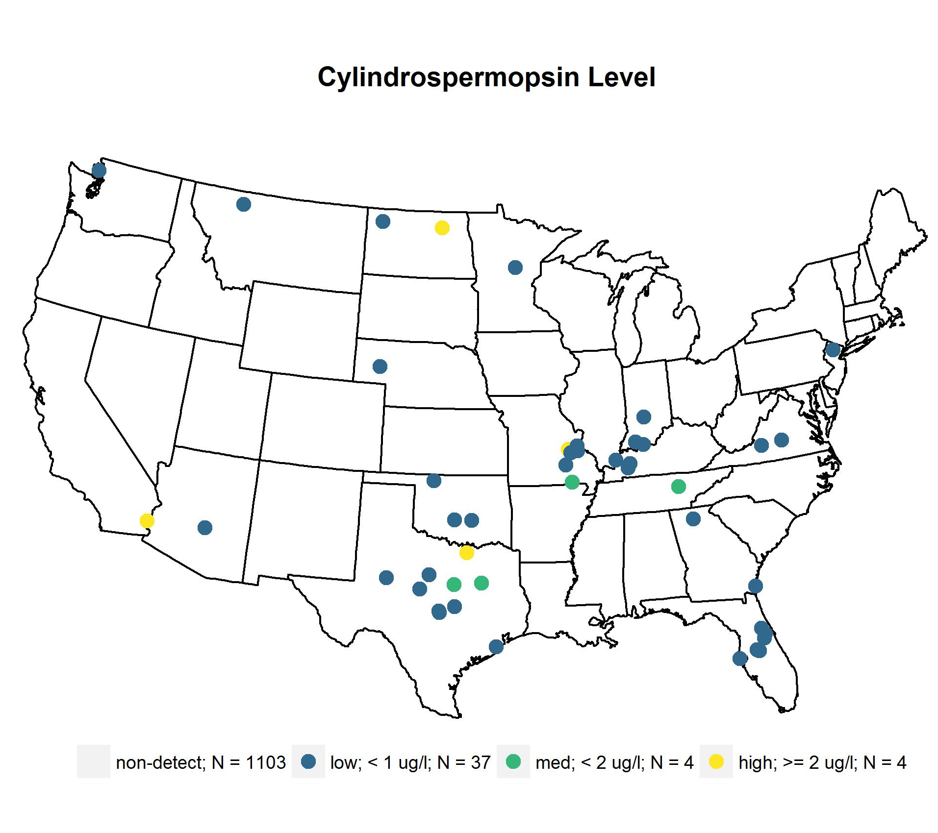
 | Lakes | cells/ml
genus | n | median | mean | max
Anabaena + Dolichospermum | 643 | 312 | 3461 | 13539
Aphanizomenon | 318 | 740 | 8527 | 25923
Cylindrospermopsis | 47 | 438 | 2481 | 5268
Lyngbya | 268 | 174 | 1853 | 5620
Raphidiopsis | 134 | 74 | 1328 | 7030

Slide 10
Table of phyto taxonomy
Question: are there patterns of community type

Slide 11
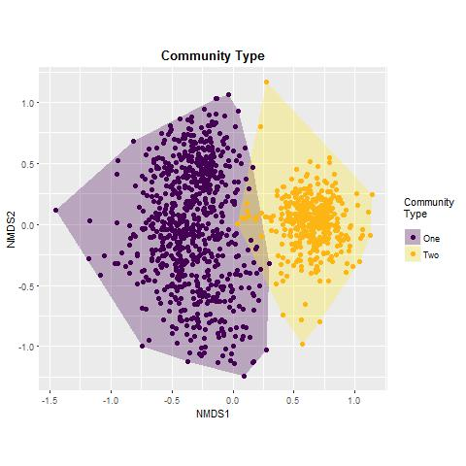
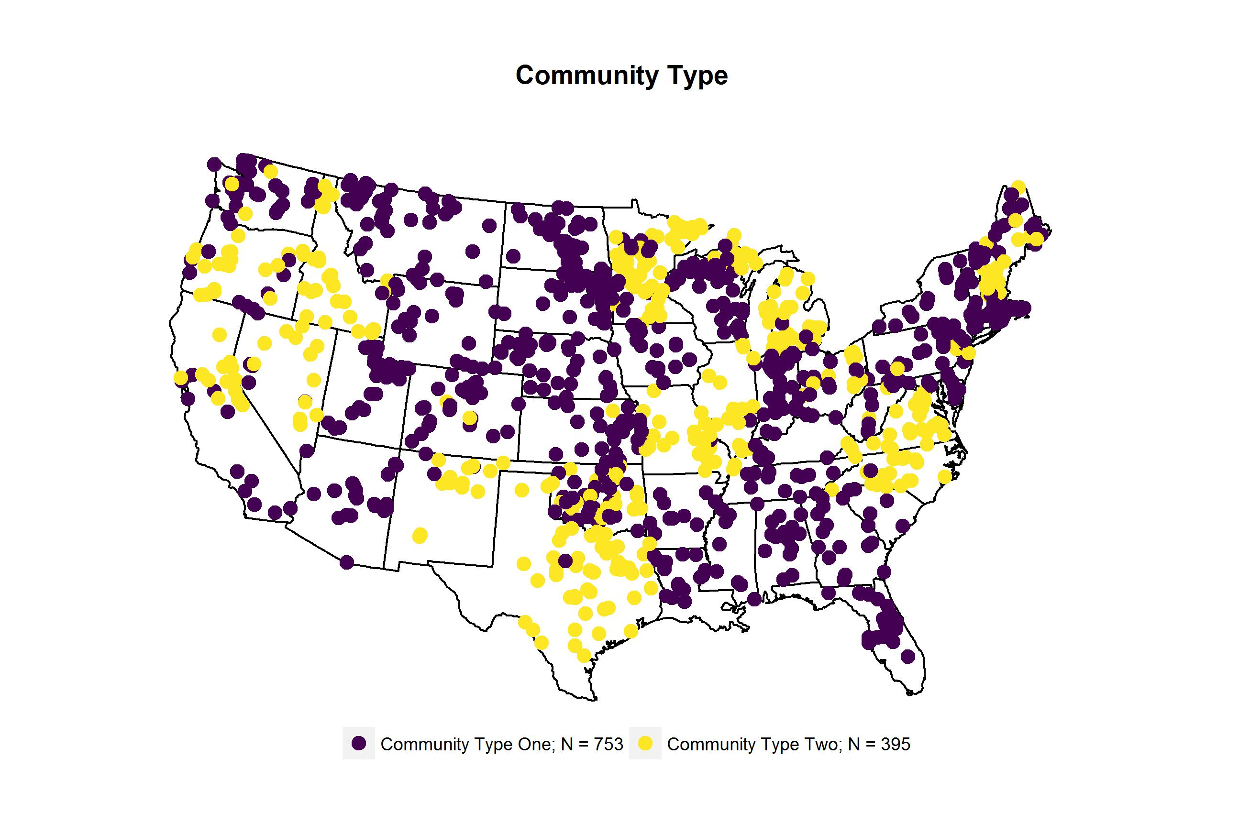
Call:
metaMDS(comm = phyto07[, -1], k = 4, trymax = 10000)
global Multidimensional Scaling using monoMDS
Data: wisconsin(sqrt(phyto07[, -1]))
Distance: bray
Dimensions: 4
Stress: 0.178225
Stress type 1, weak ties
No convergent solutions - best solution after 10000 tries
Scaling: centring, PC rotation, halfchange scaling
Species: expanded scores based on ‘wisconsin(sqrt(phyto07[, -1]))’

Slide 12
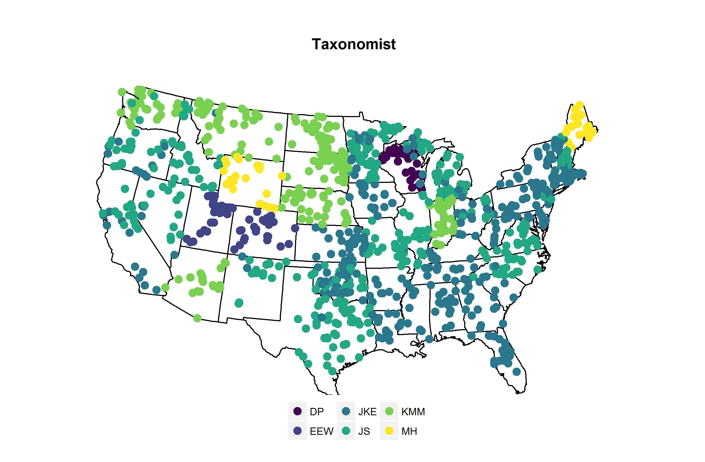

Slide 13
Question: relationship btw community type and cyano abund/toxin

Slide 14
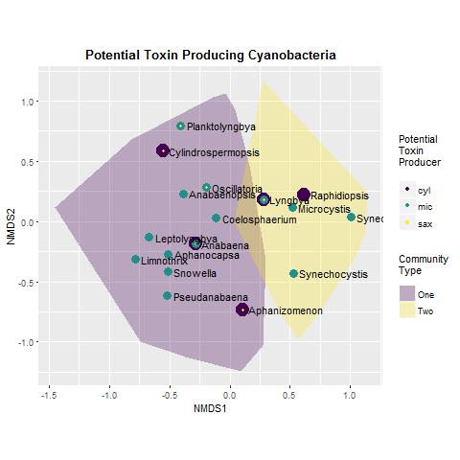
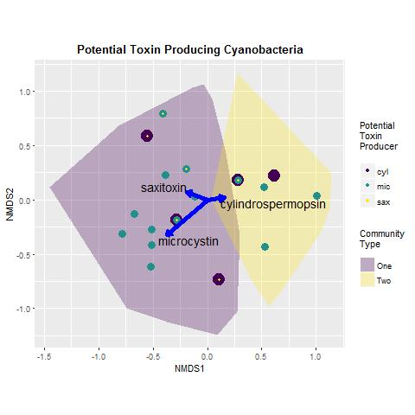

Slide 15
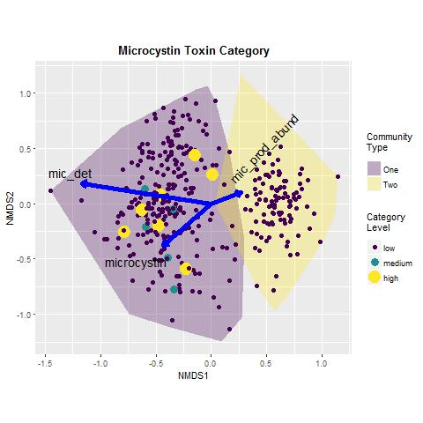
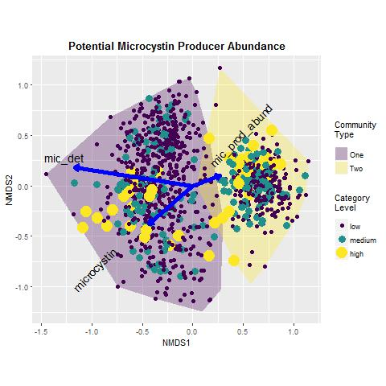

Slide 16
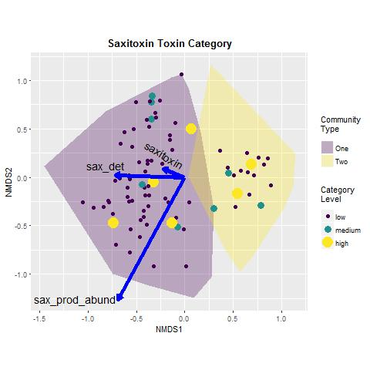
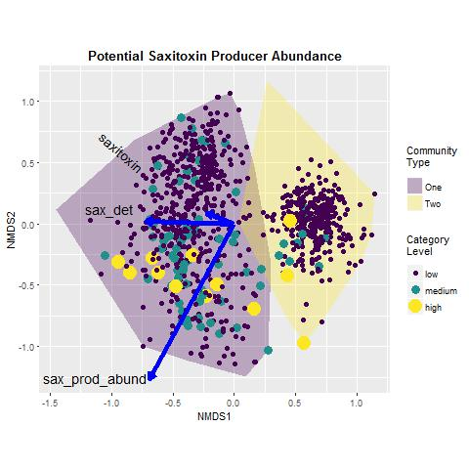

Slide 17
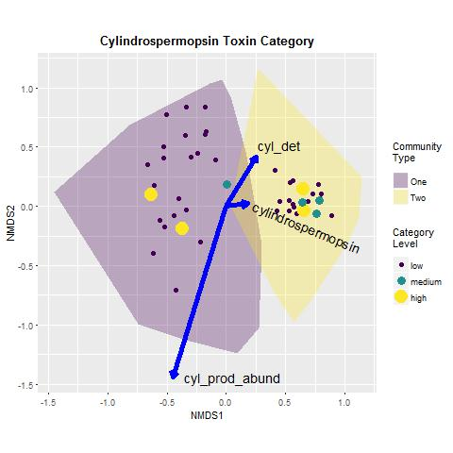
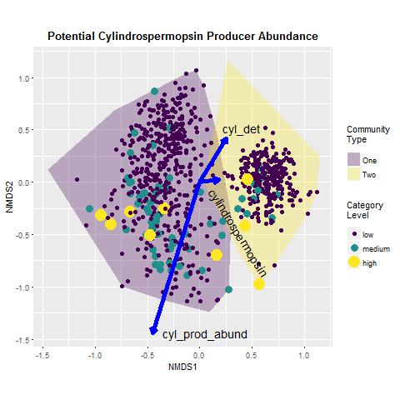

Slide 18
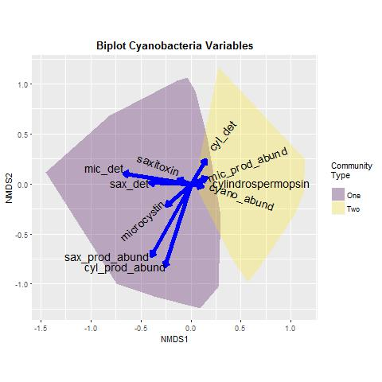
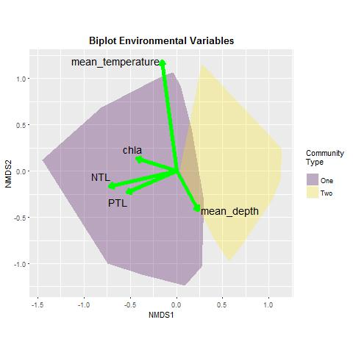

Slide 19
group | indval | pvalue | freq | genus | cylindrospermopsin | microcystin | saxitoxin
1 | 0.521674761 | 0.001 | 643 | Anabaena | 1 | 1 | 1
1 | 0.514897393 | 0.001 | 397 | Aphanocapsa | NA | 1 | NA
1 | 0.40712053 | 0.001 | 521 | Oscillatoria | NA | 1 | 1
1 | 0.189907039 | 0.001 | 143 | Leptolyngbya | NA | 1 | NA
1 | 0.139408217 | 0.001 | 106 | Pseudanabaena | NA | 1 | NA
1 | 0.119105861 | 0.001 | 93 | Planktolyngbya | NA | 1 | 1
1 | 0.1062417 | 0.001 | 80 | Limnothrix | NA | 1 | NA
1 | 0.100417575 | 0.037 | 137 | Anabaenopsis | NA | 1 | NA
1 | 0.056535915 | 0.001 | 47 | Cylindrospermopsis | 1 | NA | 1
1 | 0.047789607 | 0.004 | 37 | Cylindrospermum | NA | NA | NA
1 | 0.031690782 | 0.011 | 26 | Snowella | NA | 1 | NA
2 | 0.705886976 | 0.001 | 661 | Microcystis | NA | 1 | NA
2 | 0.572823241 | 0.001 | 283 | Synechococcus | NA | 1 | NA
2 | 0.292160739 | 0.001 | 268 | Lyngbya | 1 | 1 | 1
2 | 0.232324532 | 0.002 | 318 | Aphanizomenon | 1 | NA | 1
2 | 0.221506068 | 0.001 | 187 | Synechocystis | NA | 1 | NA
2 | 0.192341441 | 0.001 | 134 | Raphidiopsis | 1 | NA | NA

Slide 20
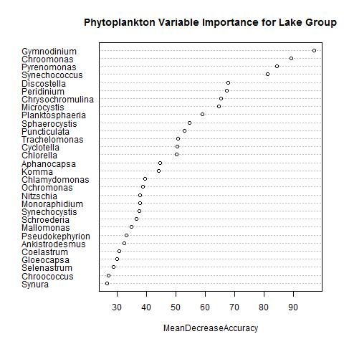
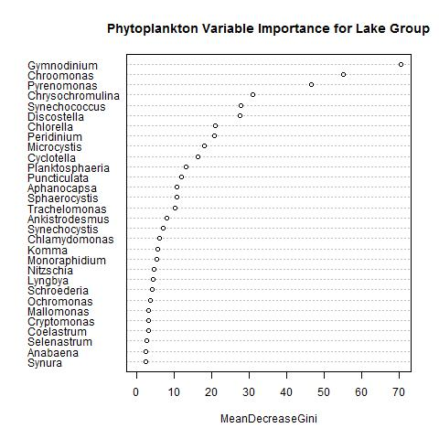
Call:
randomForest(x = phyto07[, -1], y = lake_group1, ntree = 10000, importance = TRUE, proximity = TRUE)
Type of random forest: classification Number of trees: 10000
No. of variables tried at each split: 15
OOB estimate of error rate: 1.48%
Confusion matrix:
one two class.error
one 753 0 0.00000000
two 17 378 0.04303797

Slide 21
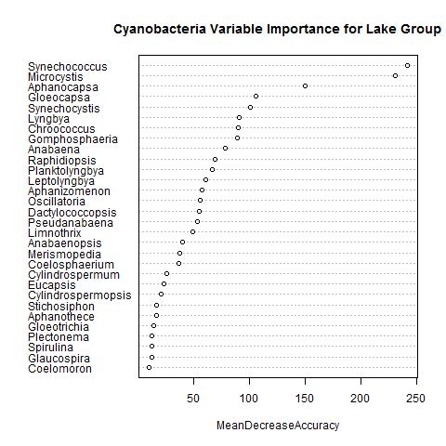
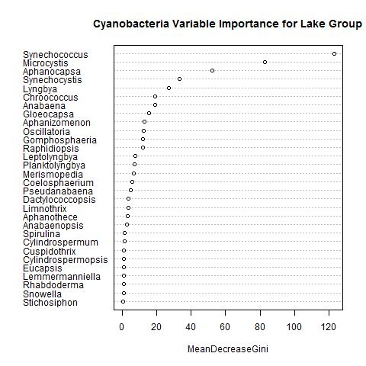
Call: randomForest(x = cyano07[, -1], y = lake_group1, ntree = 10000, importance = TRUE, proximity = TRUE)
Type of random forest: classification Number of trees: 10000
No. of variables tried at each split: 7
OOB estimate of error rate: 4.75%
Confusion matrix:
one two class.error
one 707 18 0.02482759
two 35 355 0.08974359

Slide 22
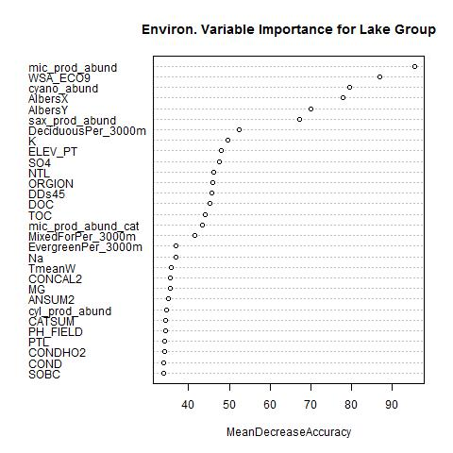
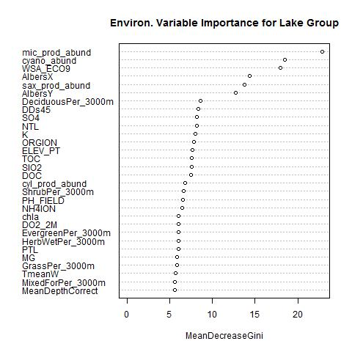
Call: randomForest(x = predictors, y = lake_group, ntree = 10000, importance = TRUE, proximity = TRUE)
Type of random forest: classification Number of trees: 10000
No. of variables tried at each split: 9
OOB estimate of error rate: 16.62%
Confusion matrix:
one two class.error
one 649 36 0.05255474
two 138 224 0.38121547

Slide 24
Abstract #68612
Phytoplankton community composition and cyanotoxin detection among lakes included in the 2007 National Lake Assessment
Betty J. Kreakie, Office of Research and Development, US Environmental Protection Agency, Narragansett, RI, W. Bryan Milstead, U.S. Environmental Protection Agency, Narragansett, RI,
Jeffrey W. Hollister, Atlantic Ecology Division, US Environmental Protection Agency, Narragansett, RI, Elizabeth D. Hilborn, US Environmental Protection Agency and
Keith A. Loftin, Organic Geochemistry Research Laboratory, U.S. Geological Survey, Lawrence, KS
Abstract Text:
Background/Question/Methods
Cyanobacteria are ubiquitous in aquatic environments and typically present no health concerns. Yet when conditions are suitable, cyanobacteria can proliferate rapidly and form blooms.
Since many cyanobacteria have the potential to produce cyanotoxins, these blooms can lead to human health concerns. We hypothesized that toxic cyanobacteria blooms may alter the composition
of the entire phytoplankton community. If true, then we expected to find recognizable patterns in phytoplankton community structure among water samples from lakes with detectable levels of cyanotoxins.
Our main goal was to determine if there were continental-scale patterns of phytoplankton community composition across the United States that were associated with the occurrence of detectable
levels of three cyanotoxins: microcystins, cylindrospermopsin, and saxitoxins. We analyzed landscape composition, along with phytoplankton counts, and physico-chemical monitoring data collected from
1000+ lakes during the 2007 National Lake Assessment. We used nonmetric multidimensional scaling (NMS) to reduce the dimensionality of the phytoplankton abundance data and elucidate any dominant
patterns in community composition. Cluster analysis was then used to delineate boundaries between distinct community types within the NMS space. Finally, a statistical tests were used to explore relationship
between community composition and environmental factors (including water quality measures, land use variables, and cyanotoxin detection).
Results/Conclusions
Our final NMS configuration of four dimensions had a 0.178 stress value (NMS measure of model fit that ranges from 1 (poorly fit) to 0 (perfect fit)). There were three distinct clusters within the first two
dimensions and these explained the strongest variance in community composition. Statistically significant gradients of microcystin and saxotoxin detections occurred predominately along the first NMS
dimension. A cylindrospermopsin detection gradient was evident along the second dimension. Evaluation of indicator species among clusters revealed that potential toxin-producing cyanobacteria were
present, but did not dominate community composition in clusters associated with toxin detections. Despite these relationships, random forest based classification revealed that geography, elevation,
phytoplankton abundance, and landscape variables were stronger predictors of phytoplankton community cluster types. In conclusion, the phytoplankton community types across the conterminous US
have a robust spatial pattern but only weak support for the hypothesis that community structure is dominated by cyanobacteria or associated with detectable cyanotoxins.
Topic Selection:
Aquatic Ecology: Lakes And Ponds
Slot:
COS 73: Wednesday, August 9, 2017: 8:00 AM-11:30 AM
Scheduled Time:
11:10 AM
Final Paper Number:
10

Slide 25
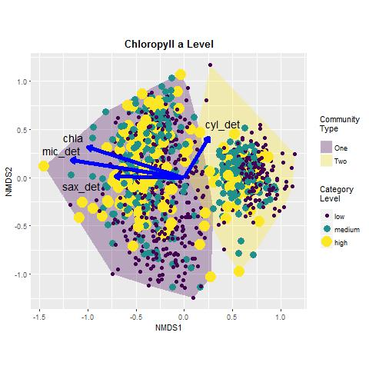
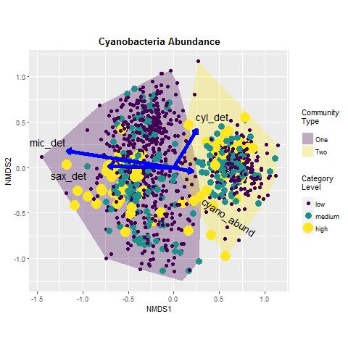

Slide 26
