Slide 1
IPT · GROUP 10
UDOMGo
A Smart Campus Assistant for University of Dodoma Students
Mobile App Development · IPT Course
COURSE
DATE
Mobile app development
23/09/2026
Notes:
Title slide. Fill in course name, lecturer/supervisor, and presentation date before presenting. Say: 'Good [morning], we are Group 10 presenting UDOMGo, an Android campus assistant app built for University of Dodoma students, for our IPT mobile app development project.'

Slide 2
OUR TEAM
Group 10 Members
Every member's contribution to the design, development, and testing of UDOMGo.
# | Full Name | Registration Number
1 | [Full Name] | [Registration No.]
2 | [Full Name] | [Registration No.]
3 | [Full Name] | [Registration No.]
4 | [Full Name] | [Registration No.]
5 | [Full Name] | [Registration No.]
6 | [Full Name] | [Registration No.]
UDOMGo — IPT Group 10
2
Notes:
Replace every placeholder row with each group member's full name and registration number before presenting.

Slide 3
INTRODUCTION
Background to the Project
University of Dodoma (UDOM) students juggle timetables, professor office hours, exam dates, fees, hostel and transport information scattered across notice boards, offices and word of mouth.
Finding a specific building, office or service on a large campus is slow for new and continuing students alike.
Getting a quick, reliable answer to a simple campus question ("Where is the CIVE office?", "When is the next exam?") often means physically asking around.
1
Scattered Information
Timetables, FAQs and contacts live in different offices, not one place.
2
Hard to Navigate
A large campus is difficult to find your way around, especially for new students.
3
Slow to Get Answers
Simple questions require asking staff in person, taking time out of the day.
UDOMGo — IPT Group 10
3
Notes:
Set up the motivation: students face scattered info, a large hard-to-navigate campus, and slow answers to routine questions — this is the gap UDOMGo fills.

Slide 4
THE CHALLENGE
Problem Statement & Objectives
Problem: UDOM students lack a single, mobile, always-available way to get accurate campus information and find their way around — forcing them to rely on scattered, offline sources.
OUR OBJECTIVES
1
2
3
4
5
Centralize Information
AI-Assisted Q&A
Work Offline Too
Campus Navigation
Secure Accounts
Bring timetables, professors, FAQs, calendar, fees and contacts into one app.
Let students ask questions in plain language and get grounded answers.
Fall back to a local rule-based engine when there is no internet connection.
Help students find buildings and get walking directions on an interactive map.
Give every student their own login and a personalised, college-aware experience.
UDOMGo — IPT Group 10
4
Notes:
State the problem in one breath, then walk through the 5 objective cards left to right.

Slide 5

OUR SOLUTION
pick your college
UDOMGo — App Overview
ask the AI assistant
UDOMGo is a native Android app that puts UDOM's campus knowledge and navigation in every student's pocket.
After a simple login, students pick their college and land in a 5-tab home: Home, Chat, Map, Guide and Services.
A built-in AI assistant (Google Gemini, with an offline fallback) answers questions using a local knowledge base — no need to leave the app or ask around campus.
An interactive campus map gives walking directions between buildings, powered by MapLibre and OpenStreetMap routing.
find & navigate campus
campus-life tips
All in one place
UDOMGo — IPT Group 10
5
Notes:
High-level app pitch. The phone graphic on the right previews the 5-tab structure covered in detail on the next slide.

Slide 6
WHAT IT DOES
Key Features
A
H
C
Login & Register
Home — College Selection
Chat — AI Assistant
Local SQLite-backed accounts (email + password) with a demo account and a "forgot password" helper.
Pick your college/school (CIVE, CoBE, CoED, CHSS, CNMS, CoESE, SoL, SoMD, SoNPH, IDS, CI) to personalise content.
Ask about timetables, professors, exams, fees & more. Online: Gemini AI with tool-calling. Offline: local keyword-matching fallback.
M
G
S
Map — Campus Navigation
Guide — Campus Tips
Services — Profile
Interactive MapLibre map of ~26 campus locations with search and walking-route directions (OSRM/OpenStreetMap).
Static, always-available guidance on hostels, library, transport, health and campus life.
View your profile, change password, and log out securely.
UDOMGo — IPT Group 10
6
Notes:
Walk through the 6 feature cards — these map directly to the app's Activities and Fragments shown in the next Android-structure slide.

Slide 7
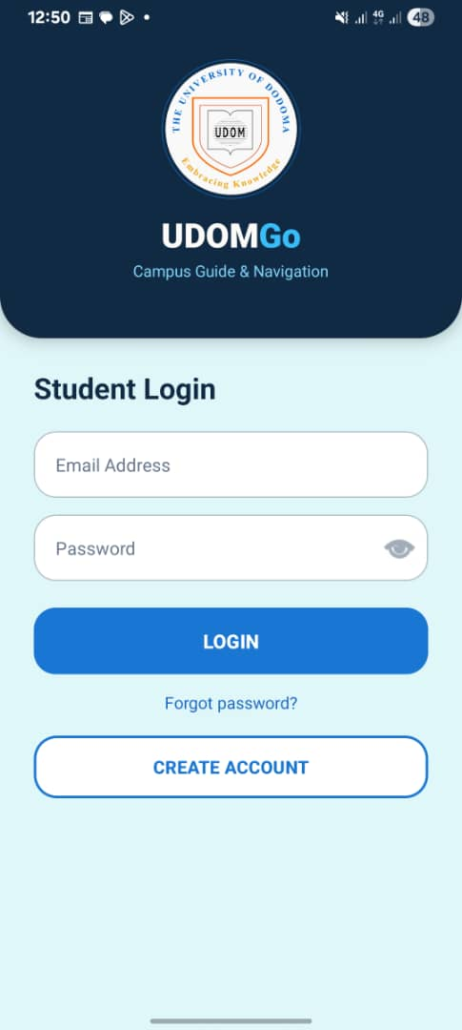
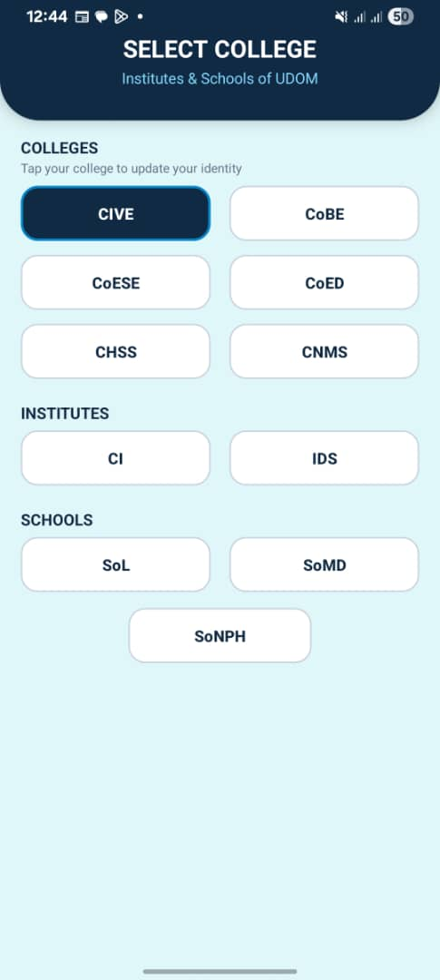
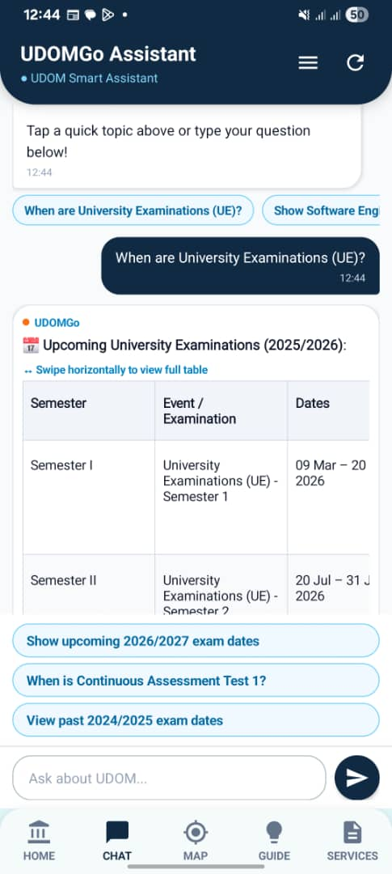
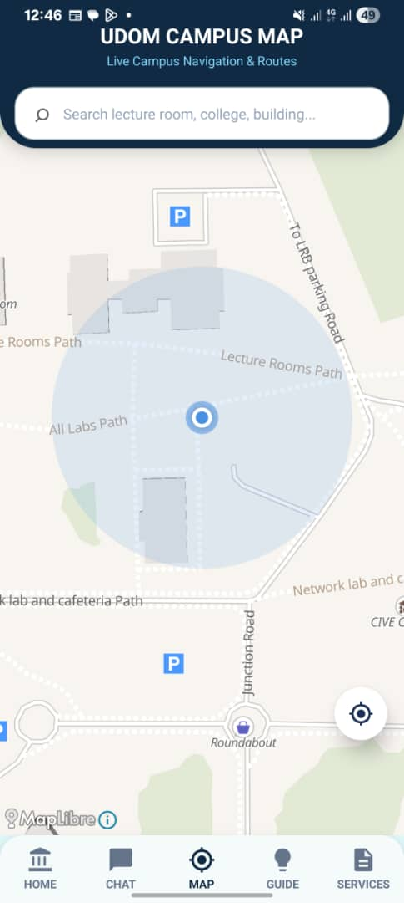
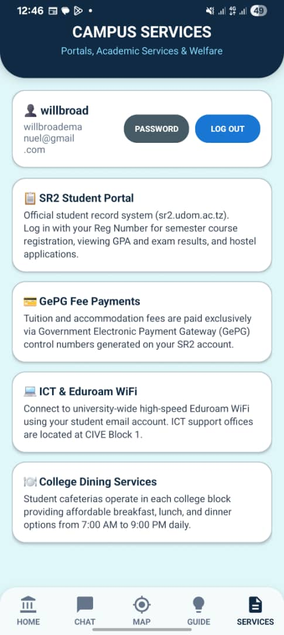
App Screens
WALKTHROUGH
Login
Home — Colleges
Chat — AI Assistant
Map — Directions
Services — Profile
UDOMGo — IPT Group 10
16
Notes:
Placeholder slide — paste real screenshots (phone or emulator) into each dashed box before presenting; delete the placeholder icon/text once an image is added.

Slide 8
USER FLOW
User Flow — App Navigation
Logged in
already?
Splash Screen
(MainActivity)
Yes
Home Shell
(HomeActivity)
Bottom Nav Bar
Home
Chat
No
Map
Do you have an account
No
Guide
Login Screen
Yes
Create account
auto-login
Services
HomeActivity swaps these 5 Fragments in and out of one fragmentContainer via FragmentManager
tap
Logout
UDOMGo — IPT Group 10
14
Notes:
Splash checks the saved session; unauthenticated users go through Login (Register auto-logs in too), authenticated users land straight on the Home shell, which hosts the 5 tabs. Logging out from Services clears the session and returns to Login (not drawn as a long arrow, to keep the diagram legible).

Slide 9
USE CASES
Use Case Diagram — Actor: Student
UDOMGo System
Register Account
Login
Select College
Ask AI Assistant
View Campus Map
Get Walking Directions
Browse Campus Guide
Change Password
Logout
Student
UDOMGo — IPT Group 10
10
Student performs every use case shown; lines are simplified to the 3 entry points for legibility.
Notes:
One actor (Student) drives all 9 use cases. Login/Register are prerequisites; the other 7 use cases happen after authentication, inside the 5-tab home.

Slide 10
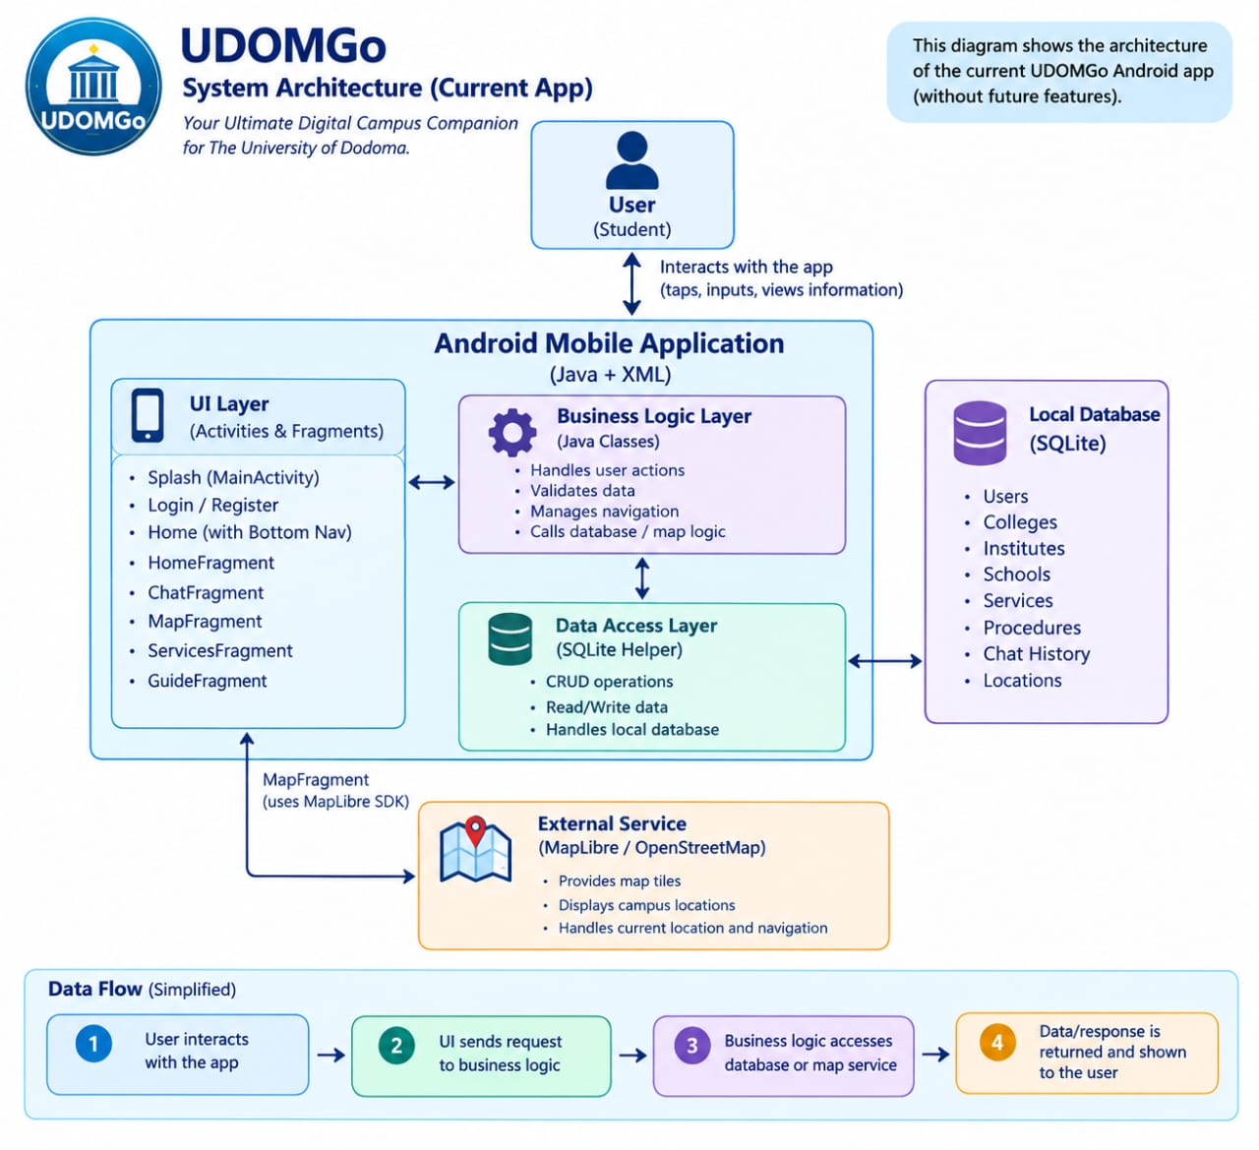

Slide 11
HOW IT'S BUILT
Tech Stack & Tools
Language & SDK
Data Layer
Java · Android SDK — minSdk 24, targetSdk 36
SQLite via SQLiteOpenHelper (raw, no Room) — 10 tables, schema v1→v9
AI Integration
Maps & Navigation
Google Gemini API via OkHttp, with function/tool-calling for DB queries
MapLibre Android SDK · OpenFreeMap tiles · OSRM walking-route API
Chat Rendering
Session/Settings
Markwon (Markdown + tables) for rich AI responses in chat bubbles
SharedPreferences (UserPreferences) for login session & college choice
Networking
Build Config
OkHttp 4.12.0 for all REST calls to the Gemini API
Gradle (Kotlin DSL) — API key injected from local.properties, kept out of git
UDOMGo — IPT Group 10
7
Notes:
No Room, no Retrofit, no Firebase — deliberately simple, raw SQLiteOpenHelper + OkHttp, which is worth mentioning if asked why.

Slide 12
WHAT WE LEARNT, APPLIED
Android Project Structure — Components We Used
M
Manifest
A
Activities & Fragments
AndroidManifest.xml
UI building blocks
Declares 4 Activities — MainActivity (LAUNCHER), LoginActivity, RegisterActivity, HomeActivity
Requests INTERNET, ACCESS_NETWORK_STATE, ACCESS_COARSE/FINE_LOCATION permissions
Sets the app theme and windowSoftInputMode="adjustResize" on every screen
4 Activities = full screens / entry points (splash, login, register, main shell)
5 Fragments — Home, Chat, Map, Guide, Services — swapped inside HomeActivity's single container
Done with plain FragmentManager.replace()+commit() — no Navigation-graph XML used
r
res/ Folders
J
Java Packages
Resources
com.example.udomgo
layout/ — 9 XML screens, one per Activity/Fragment
drawable/ — icons (ic_history, ic_menu), backgrounds (followup_pill_bg), images (udom_logo)
values/ — strings.xml, themes.xml, colors.xml
UI layer: Activities + Fragments
Data layer: DatabaseHelper (SQLite)
Settings/session layer: UserPreferences (SharedPreferences)
Integration layer: AiService (Gemini/OkHttp) + MapLocation model
UDOMGo — IPT Group 10
8
Notes:
This slide exists to show the examiner we understand the Android building blocks taught in the course (Manifest, Activities vs Fragments, res/ structure, package layering) — not just what the app does.

Slide 13
A DELIBERATE DISTINCTION
Android "Service" Component vs. Our ServicesFragment
✕
Android Service Component
S
Our ServicesFragment
(course concept — not used in UDOMGo)
(just a screen name — a UI Fragment)
The Service / IntentService class taught in class runs long-lived work in the background, independent of any UI screen.
UDOMGo has no background Service — there is no need for work that must keep running after a screen closes.
ServicesFragment is one of our 5 tabs — a normal UI screen for profile, change-password and logout.
It is not an Android Service class; the name describes "account services" for the student, not a background component.
So where does background work happen? Network calls to the Gemini AI run asynchronously through OkHttp's call queue, off the main UI thread — a valid, lightweight alternative to a Service for short-lived request/response work like a chat reply.
UDOMGo — IPT Group 10
9
Notes:
Important clarifying slide: shows we know the difference between the Android Service component from the syllabus and our own ServicesFragment naming, and can explain how background/network work is actually handled (OkHttp async calls, not a Service).

Slide 14
USE CASES IN DETAIL
Use Case Descriptions
Use Case | Precondition | Main Flow | Postcondition
Login | Student has a registered account | Enter email & password → app validates against SQLite → session saved | Student lands on Home shell, logged in
Ask AI Assistant | Student is logged in, on Chat tab | Type/tap a question → online: Gemini + tool-calling, or offline: local keyword match → answer rendered | Answer shown with follow-up suggestions; saved to chat history
Get Walking Directions | Student is on the Map tab | Search/select a destination → app calculates route via OSRM → route drawn on map | Distance & route shown; student can start navigating
Change Password | Student is logged in, on Services tab | Open change-password dialog → enter current & new password → confirm | Password updated in SQLite; student can log in with new password
UDOMGo — IPT Group 10
11
Notes:
Four representative use cases described in detail — enough depth for Q&A without cluttering the slide with all nine.

Slide 15
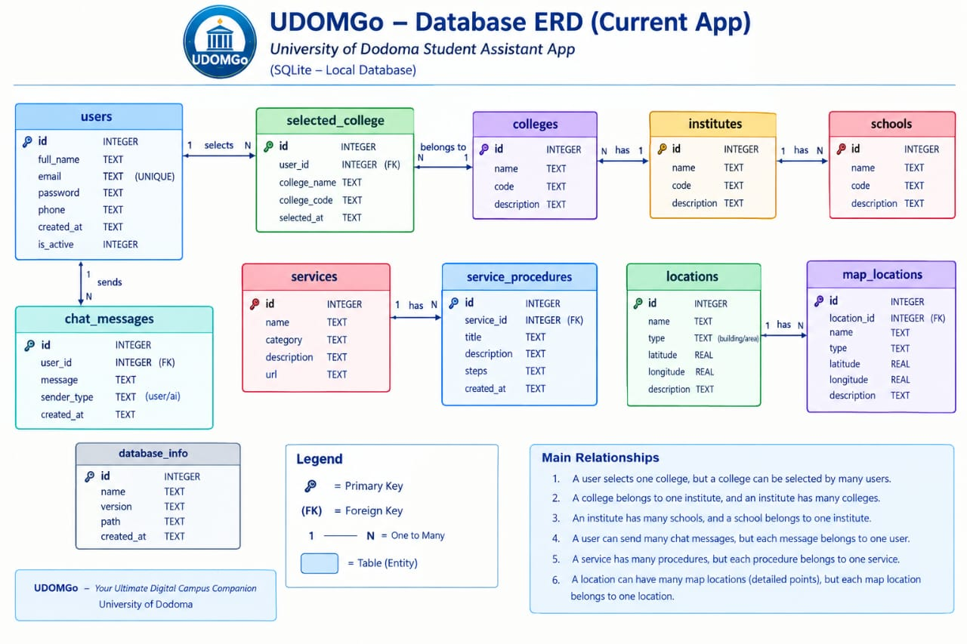
Notes:
10 tables total. Only one real foreign key exists in the schema (chat_history.user_email -> users.email, cascade delete). Everything else is a logical/soft link via shared text values like college code or programme+year+semester — explained on the next slide.

Slide 16
DATA DESIGN
ERD — Key Relationships Explained
1
The one hard foreign key
2
The "college code" hub
chat_history.user_email → users.email, ON DELETE CASCADE. Deleting a user automatically clears their chat history — a real, enforced 1-to-many relationship.
users, professors, student_leaders, campus_contacts, campus_locations and campus_faqs all share the same college vocabulary (CIVE, CoBE, CoED, …). They are logically linked by matching text, not a formal FK — a deliberate simplification for a single-app SQLite schema.
3
Programme, year & semester
4
A safety boundary: executeReadOnlySql()
courses and timetables both key off programme + year_of_study + semester, letting the app join a course to its scheduled sessions without a dedicated join table.
The AI assistant only reaches the database through a sandboxed read-only query method — it blocks INSERT/UPDATE/DELETE/DROP and explicitly refuses to touch users or chat_history, protecting student privacy even though the model can write its own SQL.
UDOMGo — IPT Group 10
13
Notes:
Good place to pause for questions about database design trade-offs — why soft links instead of formal FKs, and how the AI is kept from reading private tables.

Slide 17
USER FLOW
User Flow — Asking the AI Assistant
Student sends a message
(or taps a suggestion chip)
Saved to chat_history (SQLite)
Network available
& API key configured?
Yes
No
ONLINE — Gemini AI
with tool-calling
OFFLINE — local keyword
match against SQLite
Optional: read-only SQL
via queryDatabase() tool
Render Markdown answer in chat + follow-up suggestion pills
UDOMGo — IPT Group 10
15
Notes:
Every message is saved locally first. The app then picks online (Gemini, which can call back into SQLite through a sandboxed read-only tool) or offline (pure local keyword matching) automatically, and both paths converge on the same rendered chat bubble with follow-up suggestions.

Slide 18
LOOKING BACK, LOOKING AHEAD
Challenges & Future Work
Challenges Faced
Future Work
Designing a reliable offline fallback so the AI assistant still answers useful questions with no internet.
Integrating MapLibre + OpenFreeMap tiles + OSRM routing for accurate walking directions on campus.
Evolving the SQLite schema safely across 9 versions (v1 → v9) as new tables/features were added.
Keeping the AI assistant safe: sandboxing it to read-only queries and blocking access to private tables.
Push notifications for exam dates, timetable changes and academic-calendar events.
A real backend (e.g. Firebase) to sync accounts and chat history across devices.
Expand seeded reference data to cover every college/school, not just BSc Software Engineering.
Add exam and deadline reminders directly inside the Chat and Guide tabs.
UDOMGo — IPT Group 10
17
Notes:
Honest reflection: what was hard, and where the app could go next if development continued beyond this course.

Slide 19
IN SUMMARY
UDOMGo puts UDOM's campus
in every student's pocket.
One app for accounts, campus knowledge, AI-assisted Q&A, and navigation.
Works online with Gemini AI, and still answers offline from local data.
Built with a clear separation of UI, data and integration layers.
Thank You
UDOMGo · IPT Group 10 · [Course Name]
UDOMGo — IPT Group 10
18
Notes:
Close with the one-line pitch, invite questions. Good moment to open the app live if a device/emulator is available.

