Slide 1
Introduction to GitHub
October 2022

Slide 2
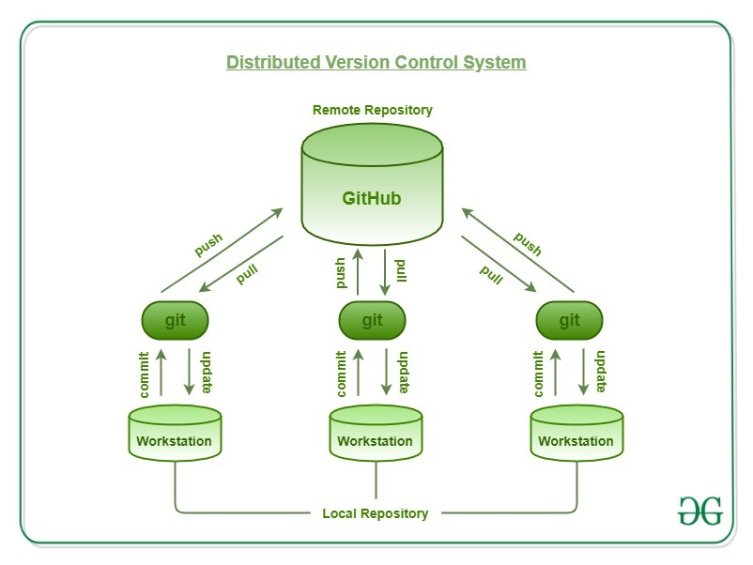
What is GitHub?
Git was designed and developed in 2005 on the Linux kernel, which is know for being free, open source, multitasking and distributed. It shares these qualities with Git
Git is an open-source, distributed, Version Control System
Seamlessly tracking changes and versions, branches allow versions to be stored without clutter
Contributions from multiple users, pulling content from and pushing content to the remote repository
Distributed
Use your system (local repository) and remotes (GitHub).
Open-Source
Source code can be inspected by anyone on the remote (GitHub)
Would have implications for what Git can be used for (Non-sensitive)
GitHub and GitBash
GitHub is an online repository which acts as your remote. This is accessible across teams, and can be duplicated into a ‘local’ folder, which acts as a personal repository
Git Bash on UDAL – Local repository, linked to GitHub via push commands, can pull from ‘remote’. Makes changes accessible to all working in a remote repository
Strong admin and team management

Slide 3
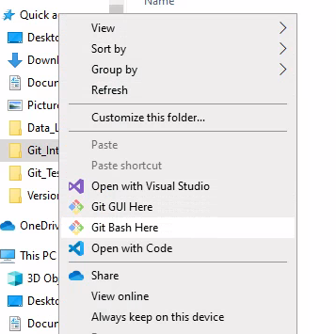
An Introduction to Git
Choose a repository -> A local folder in which you are going to work
Right-click, Git Bash here
git init -> Initialise this repository as a .Git area
git config –global user.name “user name” -> Set a username for your repository (try to match GitHub username)
git config –global user.email “username@nhs.net” -> Set a user email
Both the username and email mean that when checking the version control log (git log), users can see who has made the changes and have a means of contacting them
Add files to your repository
git status -> This will tell you what files are untracked, and need to be added to the git repository
git add . -> Add these files to be tracked. These are not yet committed to the repository, so no real changes are made
git commit –m “First changes made” -> These changes are committed to the repository. It is best to add a message, so that collaborators can see what changes you have made, and for what reason. This is a very good feature. To see these changes, use git log

Slide 4
Connecting to GitHub
Create a ‘remote’ repository
Create a GitHub account on GitHub
Click ‘create a new repository’
Name it consistently with your local file
You can add a README.md which explains to outside users what the project is (usually HTML). Licences can also be added which control what users can/can’t do with code. Would be helpful to establish what others use within NHSE
Connect ‘remote’ to ‘local’ repository
Using GitBash -> git remote add origin <link to GitHub repo>
Push your files to the remote repo
git push –u origin master -> here, Master is the name of the main branch, and origin is the remote repo. If you were operating on a different branch, you would use that name, e.g. –u origin branch_1
Check GitHub to see if the changes have been made, and are up to date

Slide 5
Using Branches
Branches are an independent line of development, away from the main branch
Files are identical to the main branch, but adding and committing new files, or changes, do not automatically affect the main branch
The latest edited branch can be merged with the master branch, meaning that the master always contains production quality code
Name branches v1, v1.1 etc. as change are made, which keeps a log of all changes made
git checkout –b edit_branch -> Creating a new branch ‘edit_branch’ and moving to that branch
Here we can make the required changes that can be proposed, but not necessarily merged to the main branch
git checkout master would move you back to the main branch
Switching between branches allows you to compare the versions and assess the changes made. This means that further alterations can be made before the branches are merged, and the master then contains the latest version

Slide 6
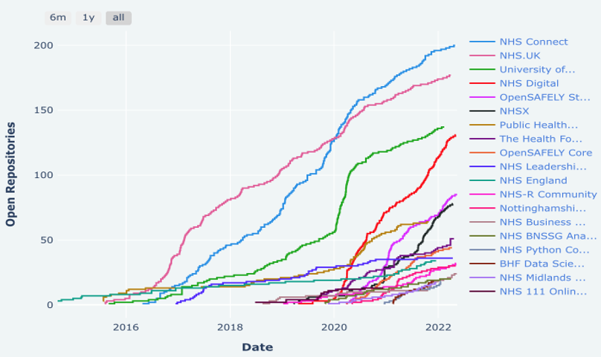
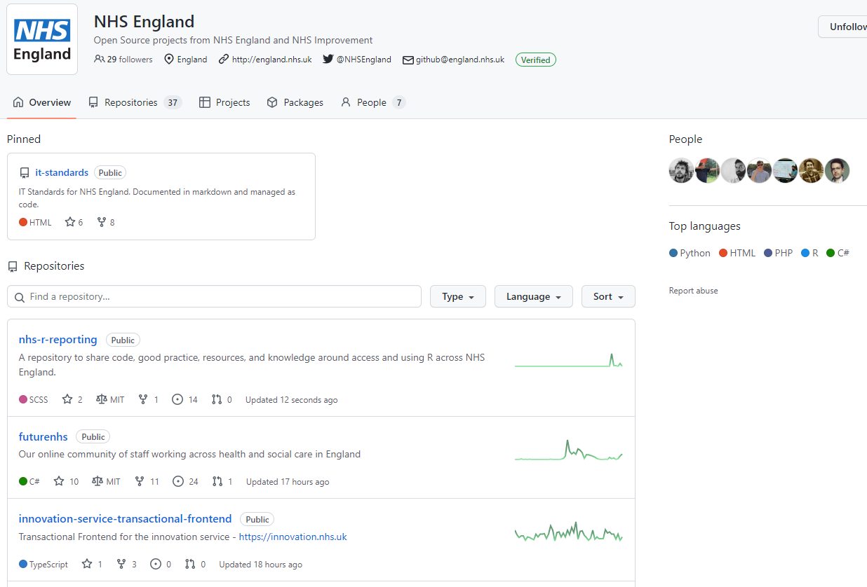
Learning From Others
GitHub is already used widely within the NHS for code/file based storage and collaboration
Above is the adoption of open-source in healthcare, and the NHS GitHub organisation
NHS England (github.com)
Mental Health & Dementia Analytical Team
Online, open-access repository to upload SQL files rather than losing them in emails/SharePoint, working collaboratively within the team or across teams
Benefits: Easily track changes to code, simple to share due to open-access, and transparent, so improves confidence in own published analysis
A&E Admissions Forecasting Tool
Describes the Master branch as the ‘single source of truth’
Using a few different repositories for different areas of a project

Slide 7
Why is this applicable to AIF?
Version Control -> Version Control can be something that is difficult/time consuming to complete
There are often small changes that may seem meaningless to record
There can be large changes that change the landscape of a file
Branching allows small and large changes to be tracked, and files to be archived without clutter
Collaborative Working -> The team often works on large R scripts / SQL queries etc. that may constantly change over the process of producing a product
Multiple colleagues can access scripts, make changes, push them to the remote, and pull the changes that others have made
These changes can be reviewed centrally, and commits and merges can be made where we are confident that change is necessary
This would be useful for projects (such as PLICS) where the R code will likely become much larger and more complex, and more people will work on it
Transparency -> This nature of version control allows the steps of change for production documents to be followed easily, if an appropriate naming system is adopted
The –m messaging feature allows colleagues to label their changes, e.g. ‘column added for MFF values’ e.g.

Slide 8
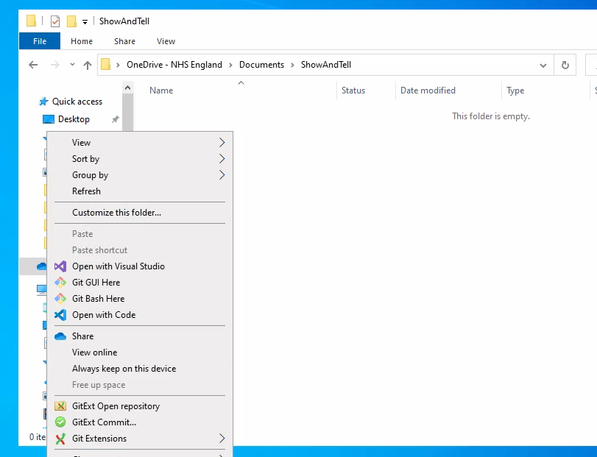
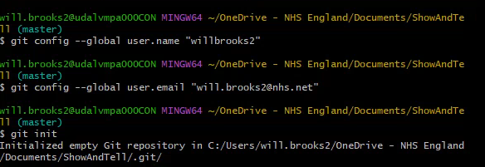

Visual Run: Initialisation
1. Creating Local Repository
2. Initialising Repository and Creating global User name/email

Slide 9
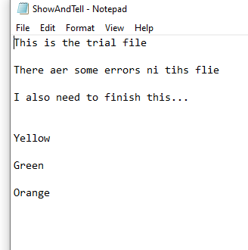
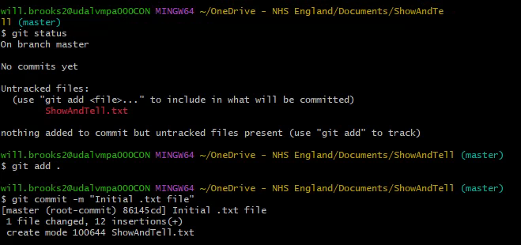
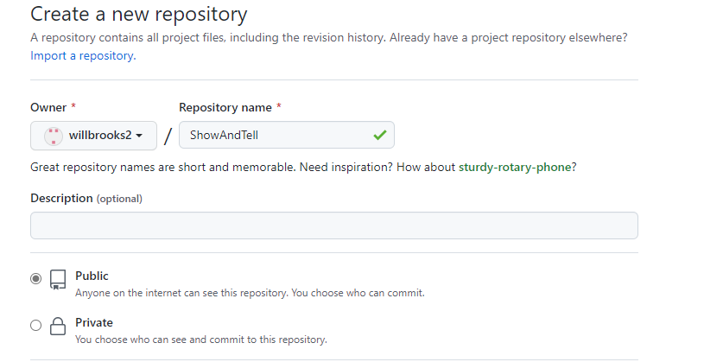
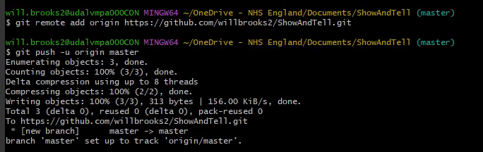
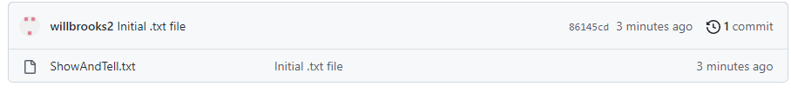
Visual Run: Adding Files and Remote
3. Create first file for repository
4. Check status, add and commit file with message
5. Create ‘remote’ repo on GitHub
6. Connect local and remote repos, push files
7. Check GitHub to see files and branches

Slide 10
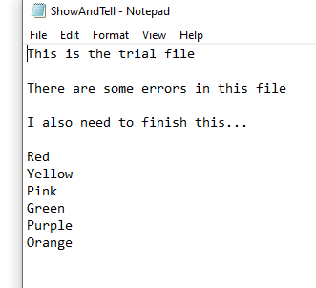
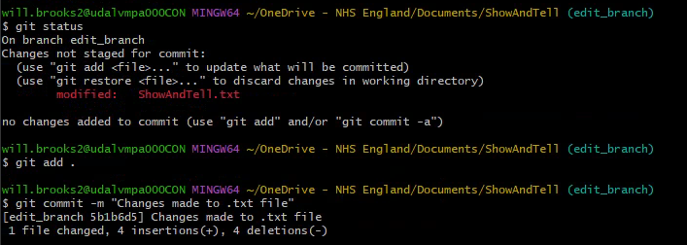
Visual Run: Creating Branches
8. Create and move to new branch
9. Edit file within the new branch and save
10. Check status, add changes and commit with message

Slide 11
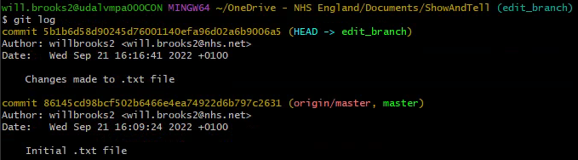
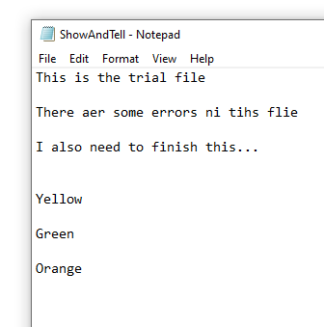
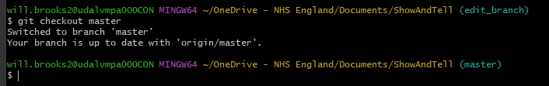
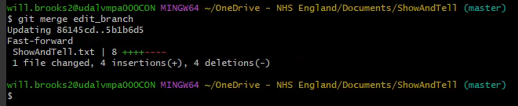
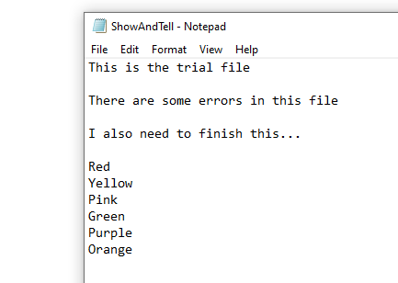
Visual Run: Merging
11. Check log to see commits
12. Move back to Master branch, see that the file is ‘as was’
13. Merge Master with edit_branch, updating the initial file with the changes on-branch

Slide 12
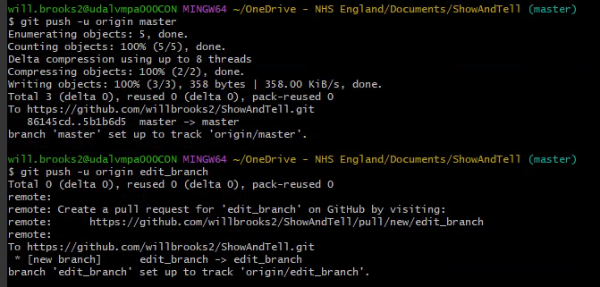
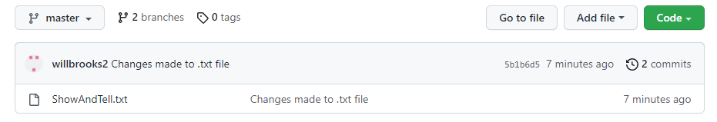
Visual Run: Pushing to Remote
14. Push these changes, from both branches, to the remote repo
15. Check the changes have been made

