Slide 1

Web ML Platform
Will Reed

Slide 2
Project Description
Web based app coded in JavaScript
01
Account creation and sign in
02
Data upload (.txt .csv and .xlsx)
03
6 machine learning models to train
04
Save data for later
05

Slide 3
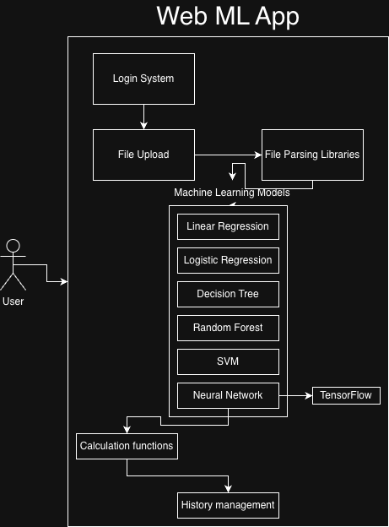
Functions Implemented
Sign in functions
Data uploading (PapaParse and XLSX)
Machine learning models
Metrics and visualization
History management

Slide 4
Functional Details
Monolithic application
Docker Composed
Locally stored data
TensorFlow, PapaParse, XLSX and Chart modules

Slide 5
Highlighted Features
Supports multiple file types
Manually implemented ML models
Locally stored history

Slide 6

Discussion
Web Development
AI Assisted Development
Machine Learning

Slide 7
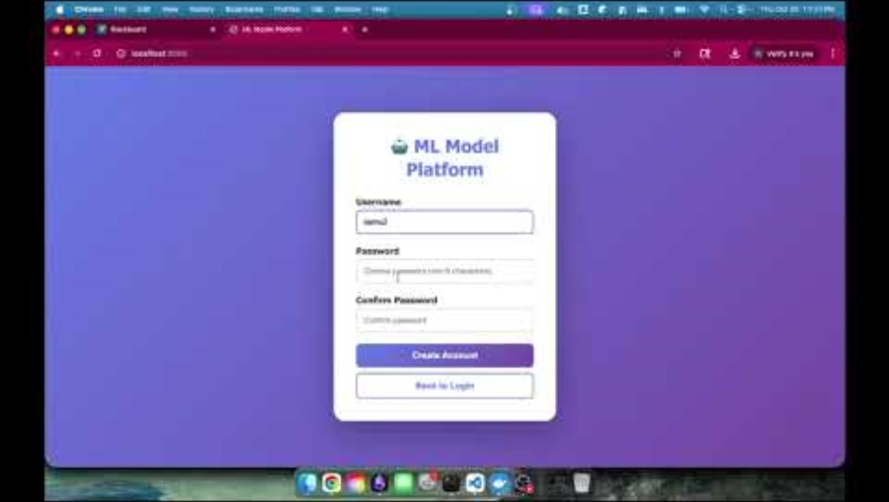
Demo

Slide 8
In Conclusion...

