Slide 1
FP&A AI Dashboard – Executive Pack
Automated Variance • Forecast • AI Summary

Slide 2
Executive Summary
**Executive Summary for 2024-12**
In December 2024, actual revenue reached $467,977, falling short of the budgeted amount of $478,620, resulting in a variance of -$10,643 (-2.22%). The gross margin percentage stood at 53.75%. Notably, the R&D and Sales departments reported unfavorable variances of -2.22% and -2.39%, respectively, while Marketing and Operations showed favorable variances of -2.62% and -2.43%. Looking ahead, the average projected revenue for the next three months is approximately $442,053, with Marketing showing significant upside potential (+25.6%) and R&D facing considerable downside risk (-51.5%).
**Actionable Next Steps:**
1. Conduct a detailed review of R&D expenditures to identify cost-saving opportunities and mitigate the projected downside risk.
2. Leverage Marketing's positive performance to enhance promotional strategies and drive revenue growth in the upcoming quarter.

Slide 3
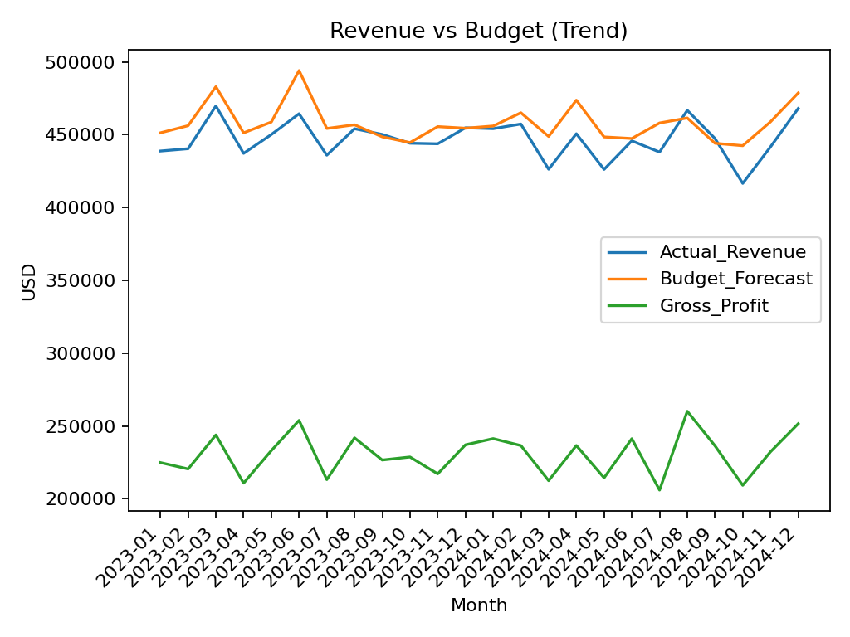
Revenue vs Budget (Trend)

Slide 4
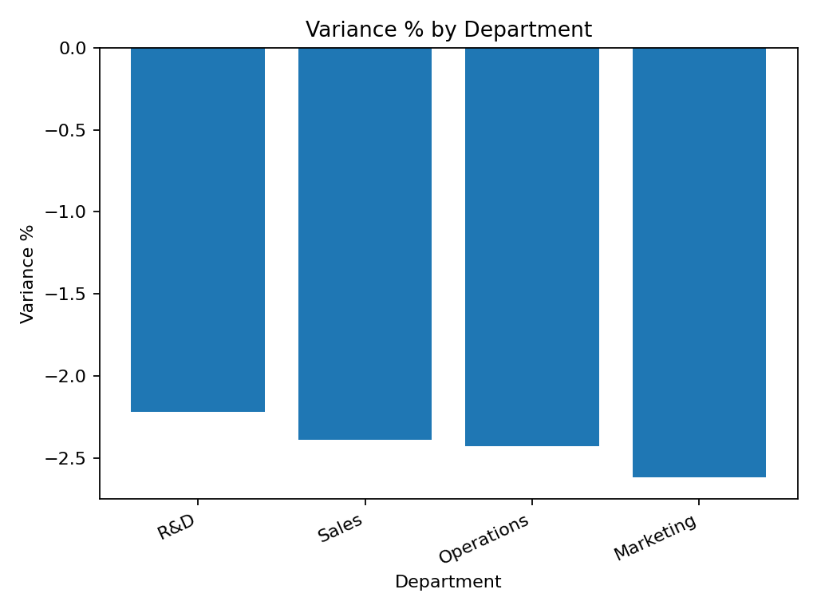
Variance % by Department

Slide 5
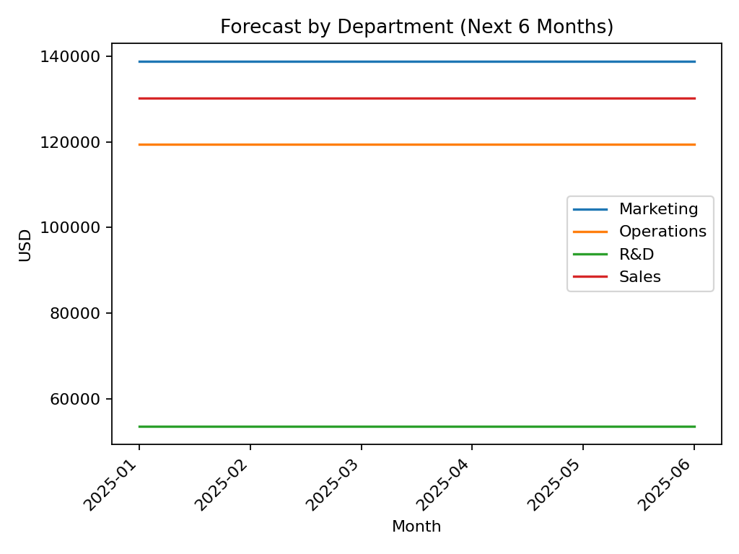
Forecast by Department (6 mo.)

