Slide 1
Modeling Coffee Reviews
Will Rodman
Final Project
MATH-6040 Linear Models

Slide 2
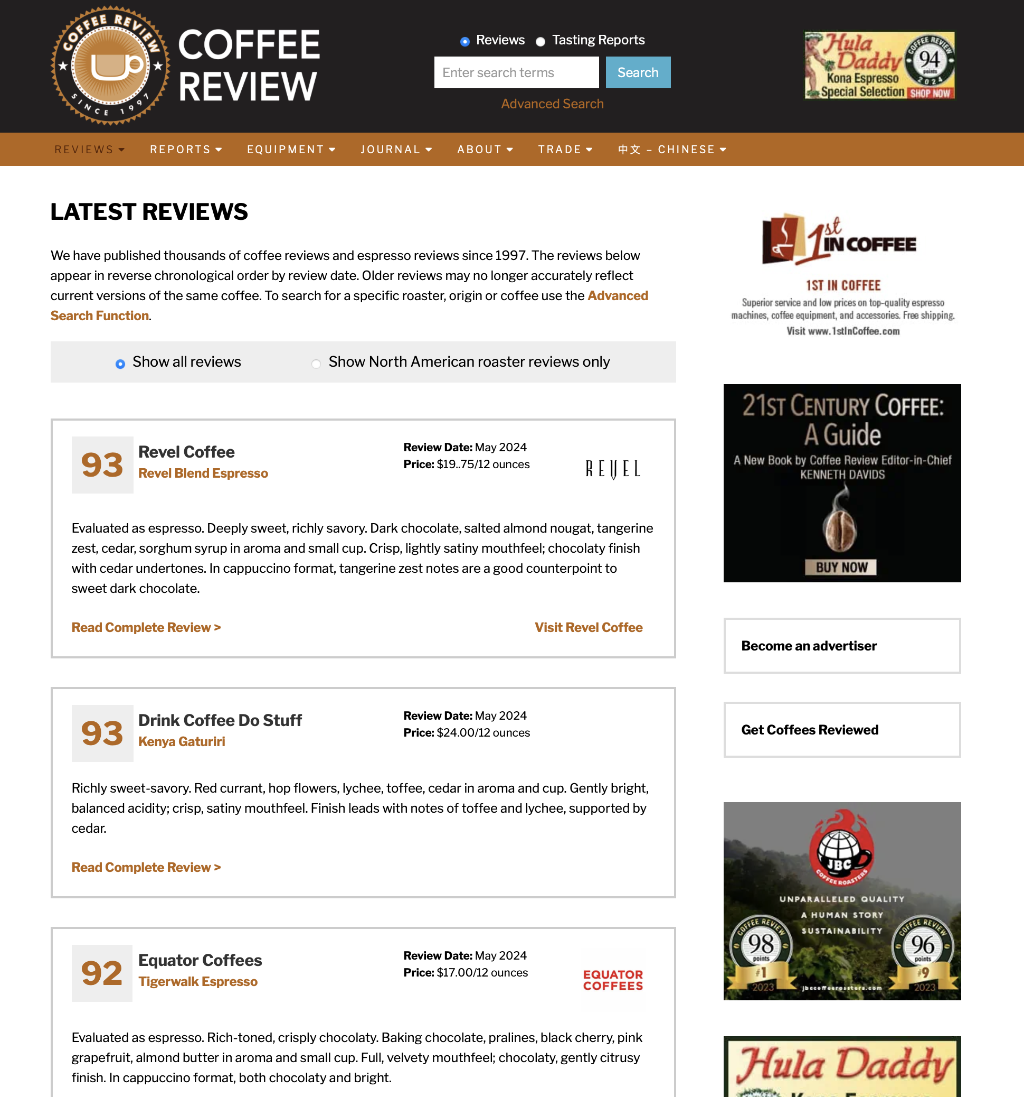
Project Summary
Modeled a dataset sourced from Kaggle.com.
The dataset consists of web-scraped coffee bean reviews from CoffeeReview.com.
The goal was to develop a linear model that predicts users' coffee bean ratings.
Individual coffee bean review.
Figure 1: coffeereview.com reviews webpage.

Slide 3
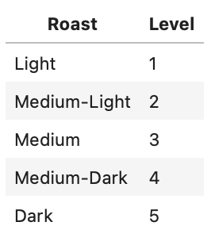
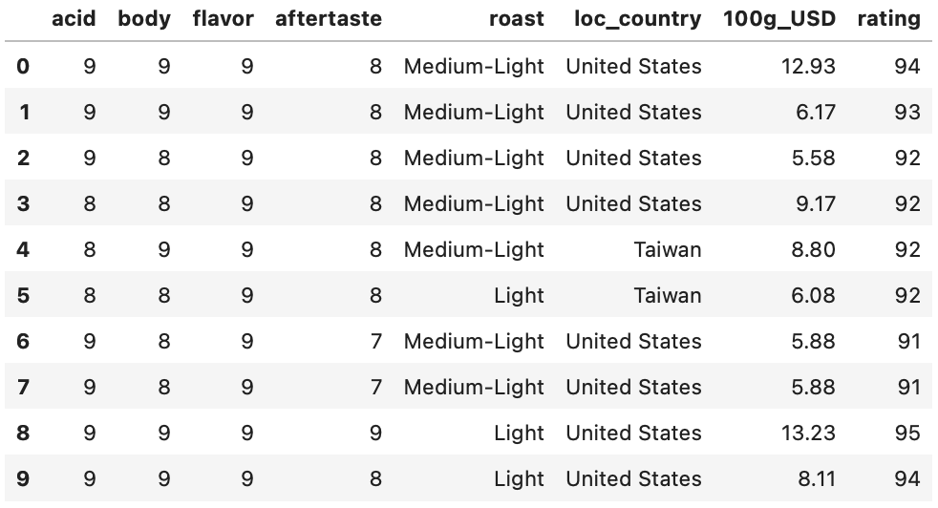
Metadata
Number of Reviews: 1779
Feature Descriptions:
acid: Acidity level from 1 - 10.
body: Body characteristic from 1 - 10.
flavor: Strength of flavor from 1 - 10.
aftertaste: Aftertaste persistence from 1 - 10.
roast: Level of roast.
loc_country: Location of a users rating.
100g_USD: Price per 100 grams in USD.
rating: Overall rating from 1 - 100.
Figure 2: Dataset heading after data cleaning.
Individual coffee bean review.

Slide 4
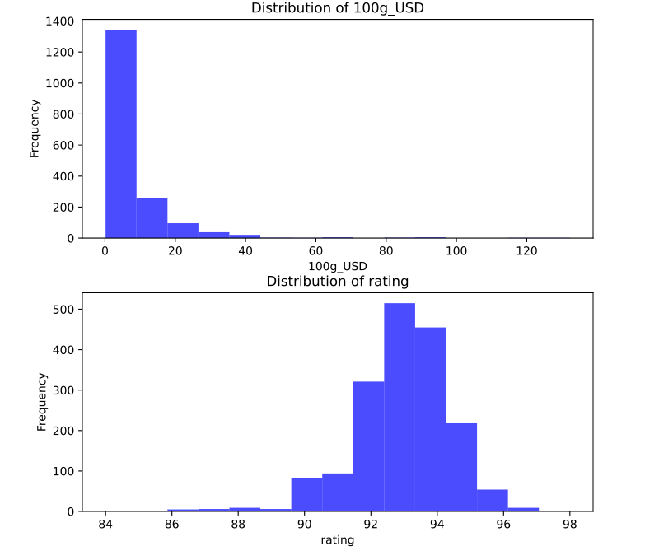
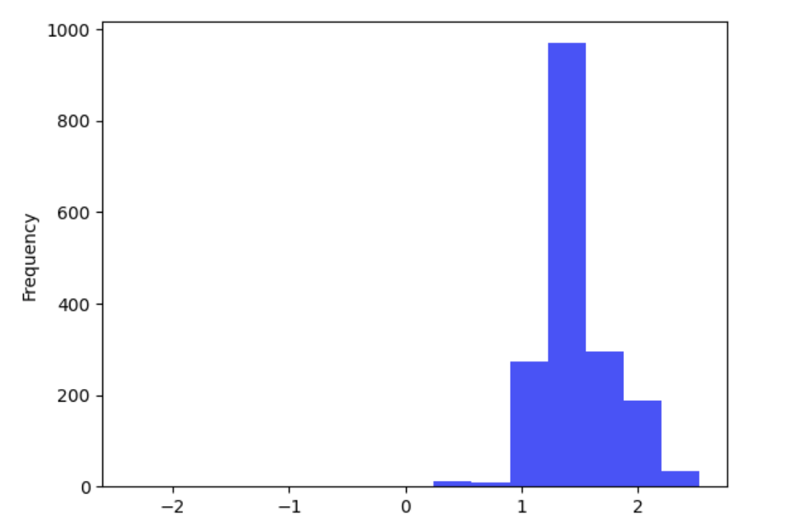
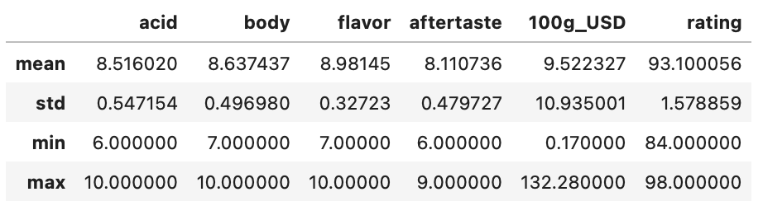

Numerical Distributions
Box-Cox Transformation
$$λ≈−0.3$$
Figure 4: Distribution price after transformation.
The distributions do not cover the entire range of scores.
Figure 3: Distributions of price and rating values.
Figure 5: Distribution statistics.

Slide 5
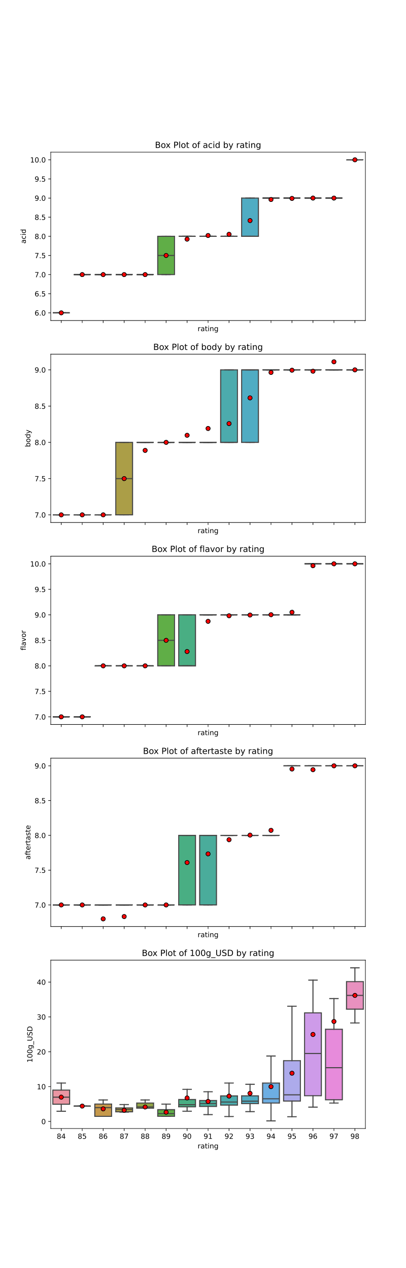
Numerical Distributions
Caused by uniform distribution.
Exponential relationship relationship between price and rating.
Figure 6: Box plot distribution of aftertaste by rating.
Figure 7: Box plot distribution of price by rating.

Slide 6
Categorical Features
Number of roast Observations by Category:
Top 5 location Observations by Category:
Category | Observations
Medium-Light | 1304
Light | 280
Medium | 175
Medium-Dark | 16
Dark | 4
Category | Observations
United States | 1210
Taiwan | 402
Hawaii | 82
Guatemala | 27
Canada | 21
73% of data.
68% of data.
* 17 total location categories.

Slide 7
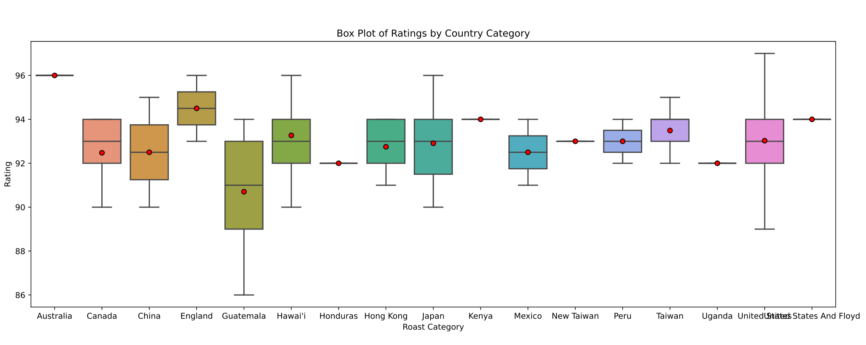
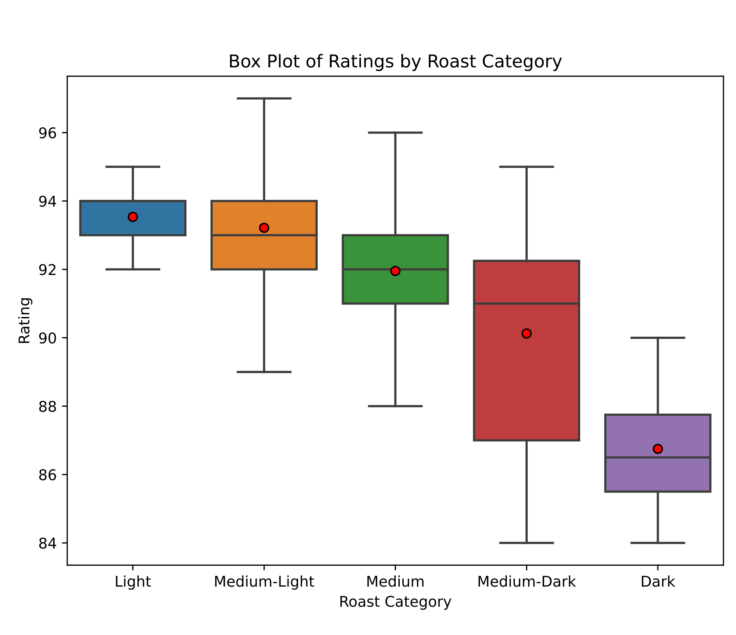
Categorical Features
No significant variance in the averages by location.
Average rating decreases as the level of roast increases.
Figure 8: Box plot distribution of rating by location.
Figure 9: Box plot distribution of rating by roast.

Slide 8
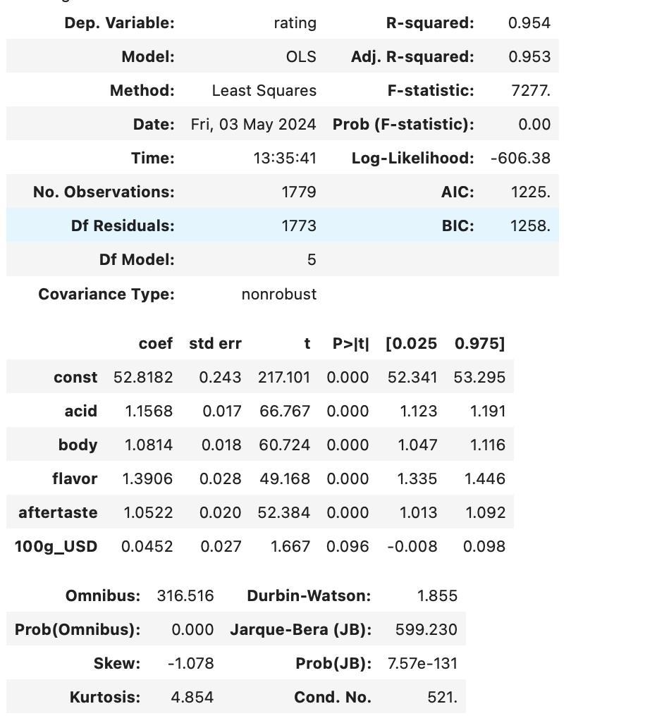
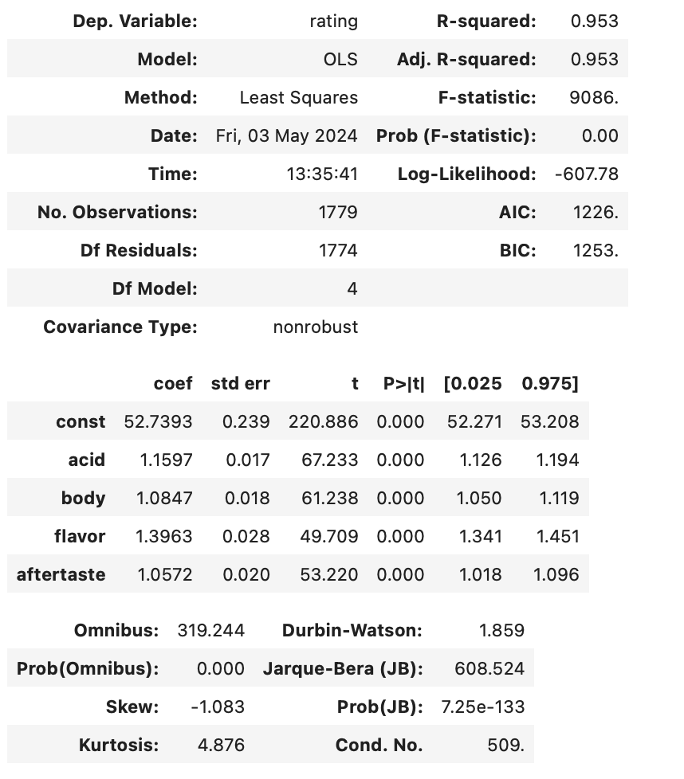

Models
1) Regression including all numerical features:
2) Regression excluding the price feature:
$$0.096>α=0.05$$

Slide 9
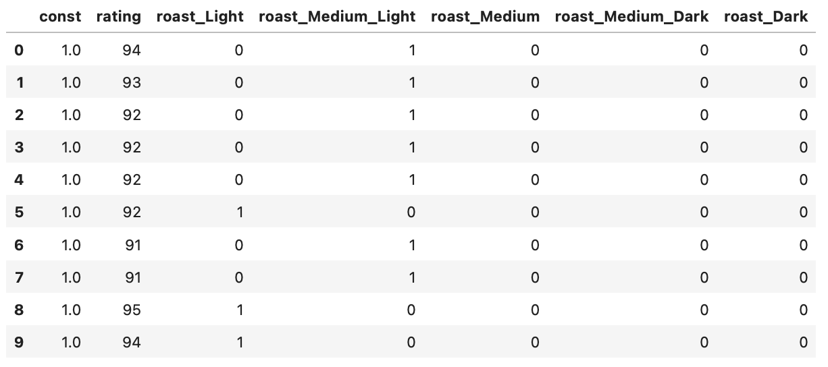
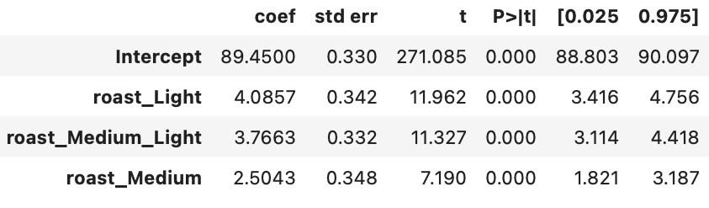
Models
Design Matrix for Roast:
3) Analysis of Light Light/Medium and Medium Roasts:

Slide 10
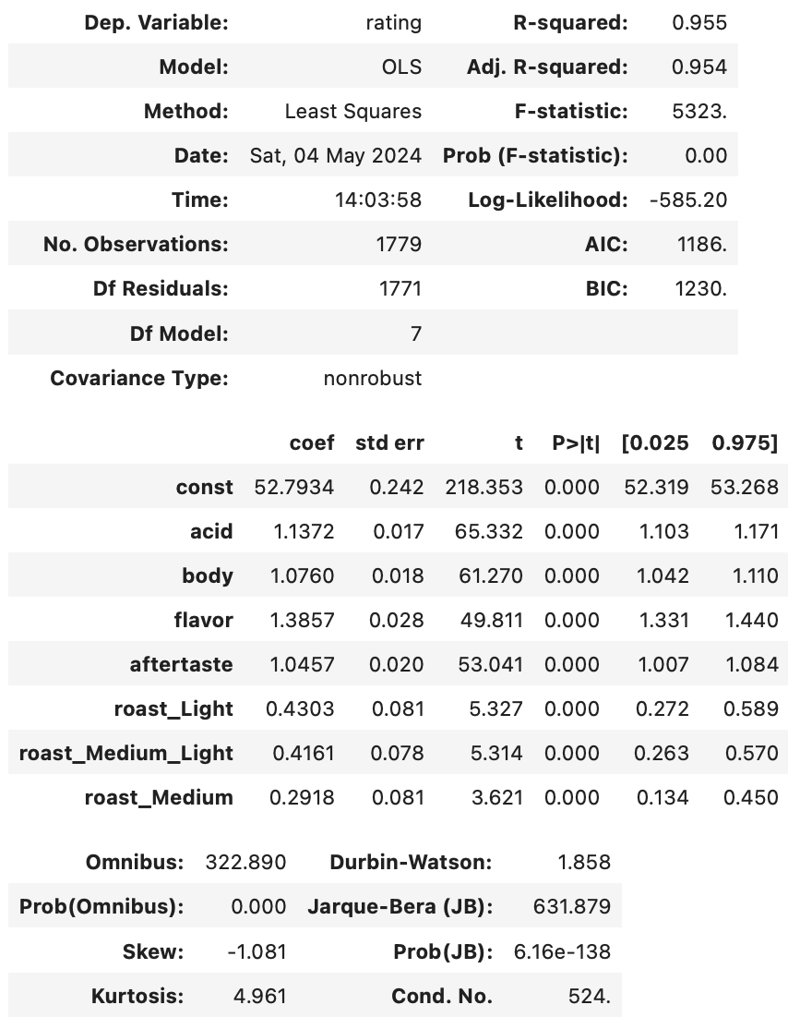
Models
4) Combining Categorical and Numerical Features:
R-squared of 95%.
All coefficients are positive.
Improvement in Log Likelihoods:
Model 1: -606.38
Model 2: -607.78
Model 4: -585.20

