Slide 1

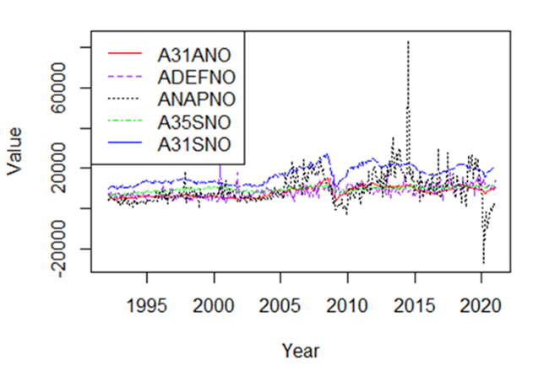
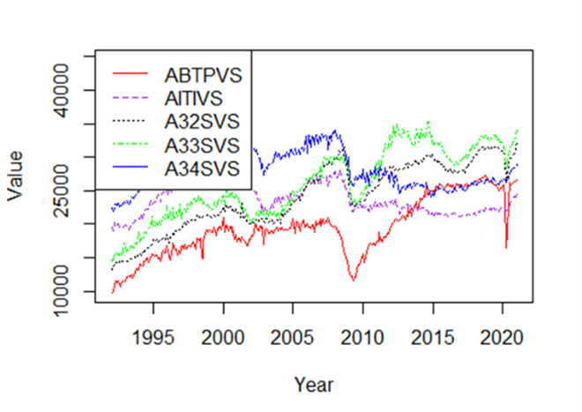
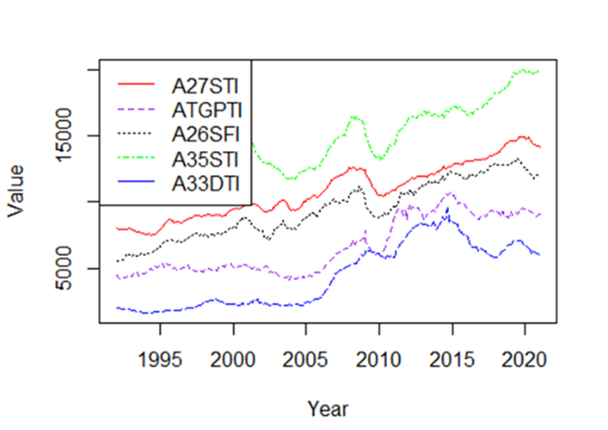
A Time Series Analysis of US Industries from 1992 – 2021
Will Davis, Tricia Dudley, and Olivia Sylvester, Department of Mathematical Sciences, SUNY Fredonia
Mentored by Dr. Lan Cheng (SUNY Fredonia) and Dr. Jim Livsey (United States Census Bureau)
Abstract
In the modern world, business decisions are being made with more and more emphasis on insights from data. The United States Census Bureau has compiled decades of economic data from hundreds of domestic industries to track trends in the US economy. In this study, we attempt to analyze this vast amount of data by through the use time series graphs and various methods of data clustering. This process included designing and implementing an algorithm that combs through these large datasets and reconfigures them based on statistical measures such as the mean, median, and standard deviations of the various measurements included in the data. The results of this statistical analysis are then displayed as time series, clustered by their similarity in our selected statistical measures.
Clustering Methodology
Clustering, the process of grouping similar sets of data based on certain similarities and criteria, is used to both cut down on the amount of data being worked with as well as serving as a means of analyzing said data [4]. We have chosen to cluster based upon three statistical measures: mean, median, and standard deviation. Many different R coding packages were used, including a package called “matrixStats.” From this package, the function “colMeans” was used to find the mean value for each industry column of the data frames. The industry means were then converted into a list and added as a new row to the bottom of their respective data frames. The columns of each data frame were then rearranged according to these mean values in ascending order. Additionally, the industries were separated into data classified as “adjusted” and “unadjusted”. “Adjusted” data is data that has been altered to lessen the effects of seasonal spikes and drops in economic behavior. “Unadjusted” data is raw data without any alterations. Next, a function was written to plot each industry column as a time series from the sorted data frames, clustering the industries into groups of five. Axis titles, a legend, different line types, and different colors were added to each cluster graphing to make the plots both easier to understand and nicer to look at. The same methodology was utilized for clustering by the median and standard deviation. It is important to note that there were instances where values were missing in many industries across the data sets used in this study. The code was written to include only the values that were ascertained. As such, the actual number of values used to calculate each statistical measure will vary.
Cluster Examples
Figure I: This cluster is from the New Orders data set and includes the following industries in the order of the list in the legend, clustered by their mean value: Iron and Steel Mills and Ferroalloy and Steel Product Manufacturing from Purchased Steel, Defense Capital Goods, Nondefense Aircraft and Parts, Electrical Equipment, Appliances, and Components, Primary Metals.
Figure II: This cluster is from the Shipments data set and includes the following industries in the order of the list in the legend, clustered by their median value: Motor Vehicle Bodies, Trailers, and Parts, Information Technology Industries, Fabricated Metal Products, Machinery, Computer and Electronics Products.
Figure III: This cluster is from the Total Inventories data set and includes the following industries in the order of the list in the legend, clustered by their standard deviation value: Nonmetallic Mineral Products, Turbines, Generators, and Other Power Transmission Equipment, Plastic and Rubber Products, Electrical, Equipment (Finished Goods Inventories), Appliances, and Components, Mining and Oil and Gas Field Machinery Manufacturing.
Introduction
The data being used in this project comes from the United States Census Bureau, our sponsor, specifically historical data on US industries. There are 6 different sets of data, each with a different economic measure, for the over 80 industries for which information is available. These measurement categories are as follows: Shipments, New Orders, Unfilled Orders, Total Inventories, Inventories to Shipments, and Unfilled Orders to Shipments [2]. The task at hand is to compare these industries based on their recorded values for these varying measures from 1992 to 2021, and to attempt to observe any previously unknown similarities between industries.
Future Work
While our clustering led to a more direct evaluation of the industries included in our data, one may argue that the amount of time series clusters that were created in this study may still lead to a large amount of time necessary to ascertain the usefulness of a given cluster. Our solution has not been implemented here but would involve fitting a linear regression model to each cluster and calculating an R-Squared statistic to examine the variability of each model created. We would then filter out clusters that do not meet our minimum variability requirements, which could be determined by a client for example, leaving us with only a few truly optimal clusters. These “optimal clusters” would be selected by the algorithm, eliminating the necessity of manual selection at the end of our clustering process.
References
[1] “Hayes, A. (2022, February 8). Understanding time series. Investopedia. Retrieved March 24, 2022, from https://www.investopedia.com/terms/t/timeseries.asp”
[2] “US Census Bureau: Adriana Stoica (M3 Section Chief). (2009, September 30). US Census Bureau Manufacturer' shipments, inventories, and orders main page. United States Census Bureau. Retrieved March 29, 2022, from https://www.census.gov/manufacturing/m3/historical_data/index.html”
[3] “Data wrangling: What it is & why it's important. Business Insights Blog. (2021, January 19). Retrieved March 29, 2022, from https://online.hbs.edu/blog/post/data-wrangling”
[4] “What is clustering? NVIDIA Data Science Glossary. (n.d.). Retrieved March 31, 2022, from https://www.nvidia.com/en-us/glossary/data-science/clustering/”
Wrangling
To analyze and work with the data, it is necessary to wrangle it. In other words, we need to format the data to be easily manipulated in the software program we are using for this project, RStudio. First, we downloaded all six data sets as excel sheets from the United States Census Bureau’s historical data archive. Second, as the industry names and methods of measurement are classified based on a unique ID code, we created an array that stores each ID code as an element and initialized a data frame to store the finalized wrangled data. Then, we used the industry ID array to filter data specific to each unique industry. Next, we stored the filtered data in the initialized table with each industry as a column, and data listed underneath. After that, we converted the type of data to numeric for each column. Last, a final column was added to include dates for each data entry, concluding the data wrangling process.
Conclusion
We consider the methods of clustering we employed to be successful. There were many clusters that are not included here, as they did not present any useful information about the industries they contained. This is to be expected, as not all industries will have hidden connections waiting to be found. Still, we did find some clusters that showed us the characteristics we were looking for and allowed us to make inferences about those connections. While the methods we employed in this study were rudimentary, there are more advanced methods of clustering being developed every day to find even more deeply hidden connections across the vastness of our national economy. As the efficiency of these algorithms increases, the ability to make effective business and economic policy decisions increases as well. These decisions and their consequences will allow us to strengthen our economy across all industries and build toward a better tomorrow.
Acknowledgements
PIC Math is a program of the Mathematical Association of America (MAA) and the Society
for Industrial and Applied Mathematics (SIAM). Support is provided by the National Science Foundation (NSF grant DMS-1722275).
Thank you to the SUNY Fredonia Department of Mathematical Sciences, Dr. Lan Cheng, and Dr. Jim Livsey for their continual support and contributions to this study!

