Slide 1
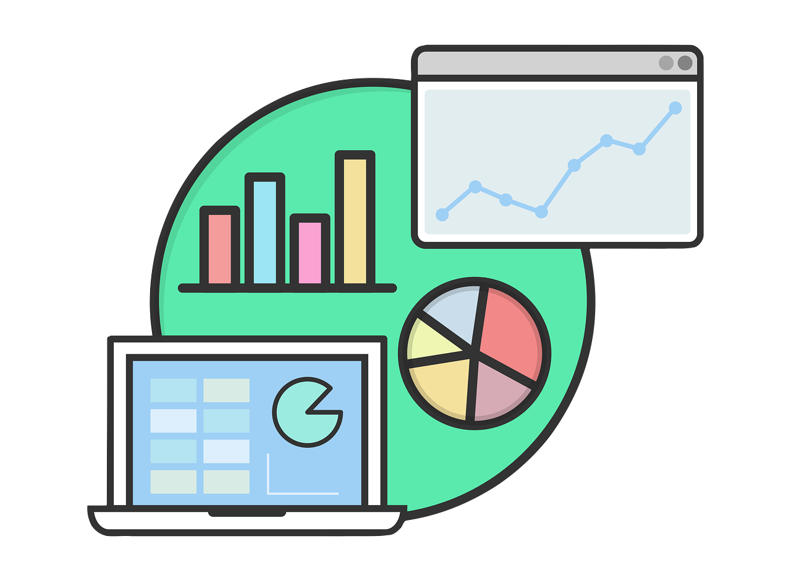


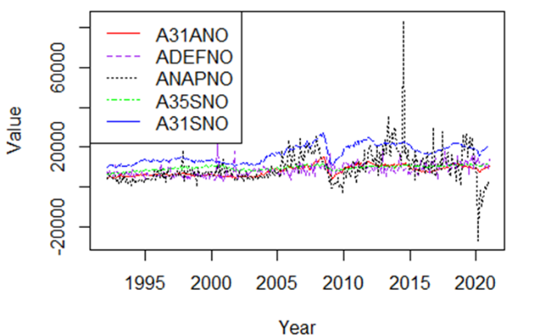
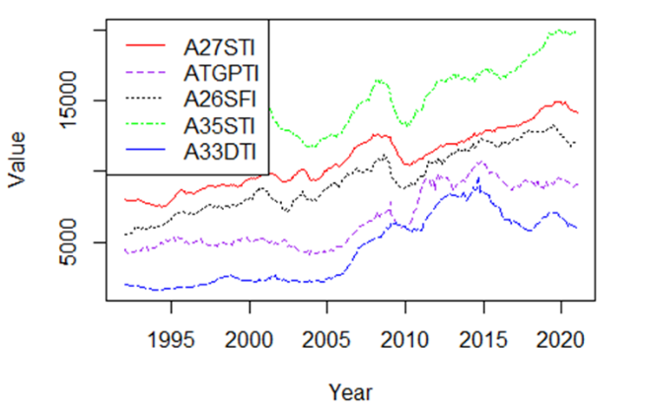
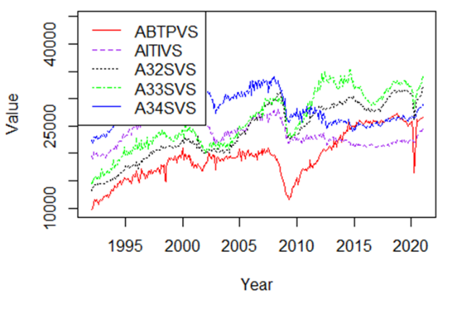
A Time Series Analysis of US Industries from 1992 - 2021
Will Davis, Tricia Dudley, and Olivia Sylvester
SUNY Fredonia, mentored by Dr. Lan Cheng and Dr. Jim Livsey
Abstract
Wrangling
Mean
Standard Deviation
What is a time series and what is the process of creating one? Given over 20 years of data from the US Census Bureau, from over 80 industries, we attempt to analyze thousands of data sets using time series graphs and various methods of clustering. This daunting project follows a step-by-step process, by creating an algorithm that both analyzes large sets of data and can combine them based on common characteristics such as mean, median, and standard deviation. The results of the computational analysis are finally displayed in a set of time series graphs that can be understood and analyzed by the average person.
In order to analyze and work with the data, it is necessary to wrangle it. “Data Wrangling refers to a variety of processes designed to transform raw data into more readily used formats.” [3] In other words, we need to format the data to be compatible in the software program we are using for this project, R-Studio. First, we downloaded all six excel sheets. Second, since the industry names and methods of measurement are classified based on a unique ID code, we created an array that stores and translates the ID for each industry and initialized a data frame to store wrangled data. Then, we used the industry ID array to filter data specific to each industry. Next, we filled in the initialized table with each industry as a column, and data listed underneath. After that, we converted the type of data to numeric for each column. Last, a final column was added to include dates for each data entry. .
This is an example of cluster determined by the mean value of each industry. This cluster is from the New Orders data set and includes the following industries in the order of the list in the legend, clustered by their mean value: Iron and Steel Mills and Ferroalloy and Steel Product Manufacturing from Purchased Steel, Defense Capital Goods, Nondefense Aircraft and Parts, Electrical Equipment, Appliances, and Components, Primary Metals.
This is an example of cluster determined by the standard deviation value of each industry. This cluster is from the Total Inventories data set and includes the following industries in the order of the list in the legend, clustered by their standard deviation value: Nonmetallic Mineral Products, Turbines, Generators, and Other Power Transmission Equipment, Plastic and Rubber Products, Electrical, Equipment (Finished Goods Inventories), Appliances, and Components, Mining and Oil and Gas Field Machinery Manufacturing.
What Is a Time Series?
A time series can be defined as “a sequence of data points that occur in successive order over some period. A time series allows one to see what factors influence certain variables from period to period.” [1] Visualizing data in this way allows for comparison of multiple data sets, or even combining their time series in specific ways, in order to work with a smaller number of data sets, the methods of which will be further discussed. Time series are often utilized in financial environments, such as stock markets, businesses, and even entire industries, which is the subject of analysis for this project. The data sets being used in this project comes from the United States Census Bureau, specifically their data on US industries. There are 6 different sets of data, each with a different way of measuring the over 80 industries to which information is available. These measurement categories are as follows: Shipments, New Orders, Unfilled Orders, Total Inventories, Inventories to Shipments, and Unfilled Orders to Shipments [2]. The task at hand is to compare these industries based on their performance from 1992 to 2021 to observe any previously unknown similarities.
Clustering
Median
Clustering is the process of grouping similar sets of data based on certain similarities and criteria determined by the person analyzing the data. It is used to both cut down on the amount of data being worked with, while also serving as a means of analyzing said data [4]. Clustering is almost always done using an algorithm due to the data sets being too vast and numerous for it to be done by hand. For this project, the R package called “matrixStats” was used to find the mean, median, and standard deviation of each industry, the criteria we have decided to base our clustering on.
Conclusion
To conclude, we consider the methods of clustering we employed to be successful. There were many clusters that we did not include in this report, as they did not present any useful information about the industries they contained. This is to be expected, as not all industries will have hidden connections waiting to be found. Still, we did find some clusters that were able to show us the characteristics we were looking for and allowed us to make inferences about those connections. While the methods we employed in this study were rudimentary, there are more and more advanced methods of clustering being developed every day to find even more deeply hidden connections across the vastness of our national economy. As the efficiency of these algorithms increases, the ability to make effective business and economic policy decisions increases as well. These decisions and their consequences will allow us to strengthen our economy across all industries and build toward a better tomorrow.
Acknowledgements
This is an example of cluster determined by the median value of each industry. This cluster is from the Shipments data set and includes the following industries in the order of the list in the legend, clustered by their median value: Motor Vehicle Bodies, Trailers, and Parts, Information Technology Industries, Fabricated Metal Products, Machinery, Computer and Electronics Products.
Project was facilitated by MAA (Mathematical Association of America) as a part of their PIC Math class initiative., and in individual collaboration with Dr. Livesey

