Slide 1

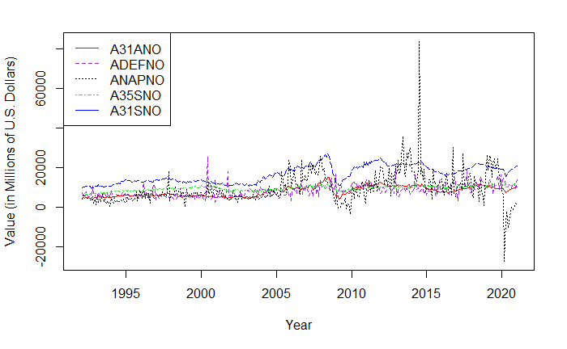
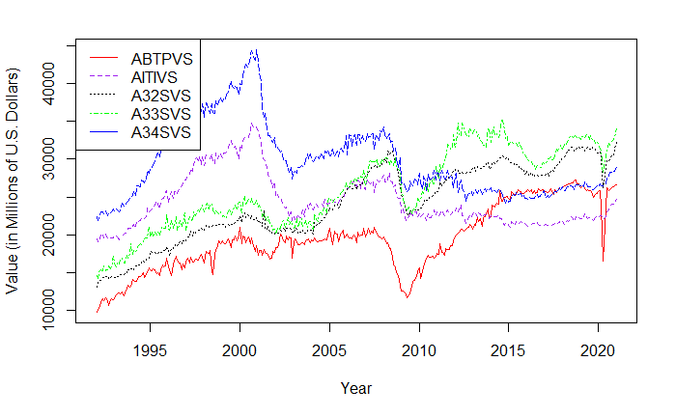
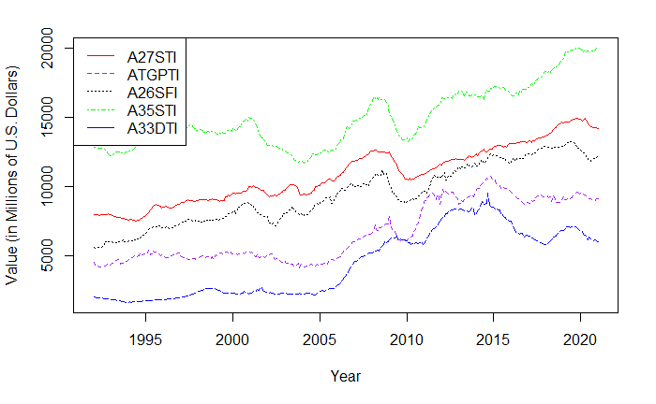


Time Series Clustering Using U.S. Industry Data
Will Davis, Tricia Dudley, and Olivia Sylvester, Department of Mathematical Sciences, SUNY Fredonia
Mentored by Dr. Lan Cheng (SUNY Fredonia) and Dr. Jim Livsey (United States Census Bureau)
Abstract
The United States Census Bureau has compiled decades of economic data from hundreds of domestic industries. In this study, we attempt to analyze this vast amount of data using time series graphs and various methods of data clustering. This process includes designing and implementing an algorithm that combs through our various datasets. The data is then reconfigured based on statistical measures such as the mean, median, and standard deviation. As a result, we determine time series clusters based upon their similarities with the selected statistical measures.
Introduction
In the modern world, business decisions are being made with more and more emphasis on insights from data. The data used in this project comes from the United States Census Bureau archives, specifically historical data on US industries. There are 6 different sets of data for over 150 industries, each with a different economic measure. These measurement categories are as follows: Shipments, New Orders, Unfilled Orders, Total Inventories, Inventories to Shipments, and Unfilled Orders to Shipments. Our task is to compare industry data from 1992 to 2021 based upon different statistical measures, and then attempt to discern any potential correlations among multiple industries.
Cluster Examples
Figure I: This cluster is from the New Orders data set and includes the following industries in the order of the list in the legend, clustered by their mean value:
Iron and Steel Mills and Ferroalloy and Steel Product Manufacturing from Purchased Steel
Defense Capital Goods
Nondefense Aircraft and Parts
Electrical Equipment, Appliances, and Components
Primary Metals.
Figure II: This cluster is from the Shipments data set and includes the following industries in the order of the list in the legend, clustered by their median value:
Motor Vehicle Bodies, Trailers, and Parts
Information Technology Industries
Fabricated Metal Products
Machinery
Computer and Electronics Products.
Figure III: This cluster is from the Total Inventories data set and includes the following industries in the order of the list in the legend, clustered by their standard deviation value:
Nonmetallic Mineral Products
Turbines, Generators, and Other Power Transmission Equipment
Plastic and Rubber Products
Electrical Equipment, Appliances, and Components
Mining and Oil and Gas Field Machinery Manufacturing.
Data Wrangling
To analyze and work with the data, it is necessary to wrangle it. In other words, we need to format the data so that it can be easily manipulated in RStudio, the statistical software we use for this project. The steps are as follows:
We download all six data sets as Excel sheets from the U.S. Census Bureau’s historical data archive.
We create an array to store each unique industry ID code as an element.
We initialize a data frame to store the wrangled data. Then, we use the industry ID array to filter data specific to each unique industry.
We store the filtered data in the initialized table with each industry as a column, and data listed underneath.
We convert the type of data to “numeric” for each column.
A final column is added to include dates for each data entry.
Clustering Methodology
Clustering, the process of grouping similar sets of data based on certain similarities and criteria, is used to both cut down on the amount of data being worked with as well as serving as a means of analyzing said data. We have chosen to cluster based upon three statistical measures: mean, median, and standard deviation. Many different R coding packages were used, including “matrixStats.” From this package, the function “colMeans” was used to find the mean value for each industry in their respective data frames. The means were then converted into a list and added as a new row to the bottom of their data frames. The columns of each data frame were then rearranged according to these mean values in ascending order. Additionally, the industries were separated into data classified as “adjusted” and “unadjusted”. “Adjusted” data is data that has been altered to lessen the effects of seasonal spikes and drops in economic behavior. “Unadjusted” data is raw data without any alterations. Next, a function was written to plot each column as a time series from the sorted data frames, clustering these time series into groups of five. Axis titles, a legend, different line types, and different colors were added to each cluster graphing to make the plots both easier to understand and more informative. The same methodology was utilized for clustering by the median and standard deviation. It is important to note that there were instances where values were missing in many industries across the data sets used in this study. Our code was written to disregard any missing values in the data. As such, the actual number of values used to calculate each statistical measure will vary.
Conclusion
We produced 2,136 time series clusters, half for “adjusted” data and half for “unadjusted” data. This included an equivalent number of clusters determined by mean value, median value, and standard deviation value for both sets of data, respectively. These clusters varied drastically in their depiction of time series that had similar statistical measures. Some clusters included time series with similar data points in terms of value at a given time, but a dissimilar overall shape. Other clusters include time series with a similar overall shape, but values that were relatively far apart. One interesting result was a pattern of clusters that included time series with the largest mean, median, and standard deviation values in each data set. It was determined from these clusters that each data set included “industries” that were cumulative measurements across many industries included in the data. While this methodology led to some useful results, it could be improved.
Future Work
Our clustering method requires manual evaluation of time series clusters that are created. An algorithm to automate the selection of the “best” clusters would eliminate this issue. We will fit a linear regression to each cluster, allowing each model to be evaluated against another. Then we will determine the usefulness of a given model by calculating and comparing R-Squared values for all models.
We will seek more powerful statistical measurements to analyze the data and create even more powerful time series clusters.
We only clustered time series in groups of five, there may be a more optimal number of time series to include for efficiency and evaluative purposes. Some experimentation with cluster size is necessary.
Acknowledgements
PIC Math is a program of the Mathematical Association of America (MAA) and the Society for Industrial and Applied Mathematics (SIAM). Support is provided by the National Science Foundation (NSF grant DMS-1722275).
Thank you to the SUNY Fredonia Department of Mathematical Sciences, Dr. Lan Cheng, and Dr. Jim Livsey (our industrial liaison) for their continual support and contributions to this study!
*Disclaimer: This report is released to inform interested parties of research and to encourage discussion. The views expressed on statistical issues are those of the authors and not those of the U.S. Census Bureau.*
References
“US Census Bureau: Adriana Stoica (M3 Section Chief). (2009, September 30). US Census Bureau Manufacturer' shipments, inventories, and orders main page. United States Census Bureau. Retrieved March 29, 2022, from
https://www.census.gov/manufacturing/m3/historical_data/index.html”
“Data wrangling: What it is & why it's important. Business Insights Blog. (2021, January 19). Retrieved March 29, 2022, from https://online.hbs.edu/blog/post/data-wrangling”
“What is clustering? NVIDIA Data Science Glossary. (n.d.). Retrieved March 31, 2022, from https://www.nvidia.com/en-us/glossary/data-science/clustering/”

