Slide 1
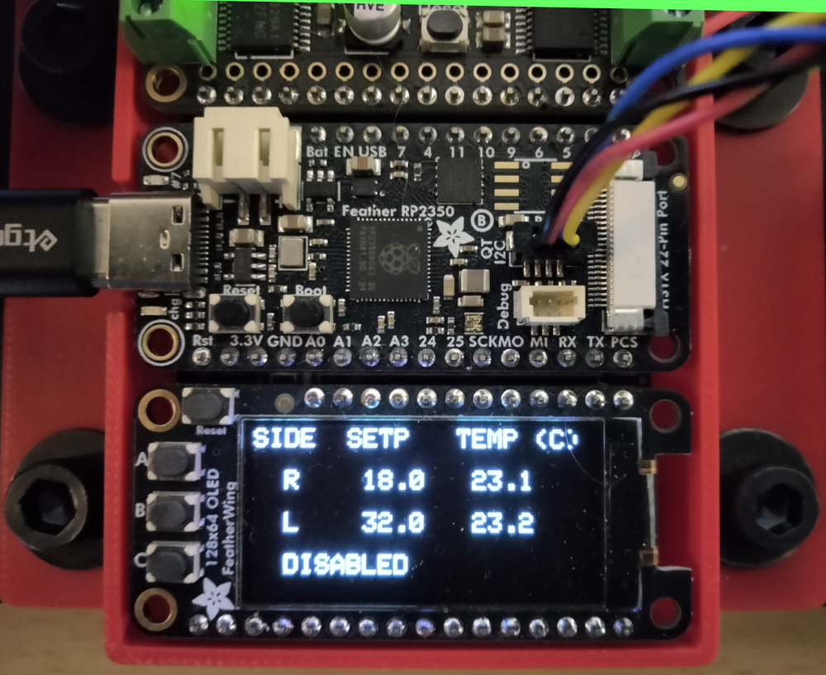
adjust left set-point
adjust right set-point
toggle enabled/disabled

