Slide 1

Crime Rate Analysis and Prediction
Willem Atack
STA2101

Slide 2
Problem Introduction
Reduction of crime equates to safe communities with increased well-being, health and economic output
Research Questions:
What are the most statistically significant predictors of crime, and do these differ for violent and non-violent crime?
How can we optimize crime prediction? Compare traditional regression techniques with tree-based machine learning algorithms.
Notes:
Obviously, reducing crime in our communities is a way to increase quality of life. Reduction of crime creates safe communities with increased health and economic output.
It is well known that factors like education and income affect crime rates, but communities have limited resources to allocate to crime prevention, so understanding the most statistically significant factors is vital.
For this project, I used a dataset containing demographic and environmental data for over 2000 communities, and their associated violent and non-violent crime rates
Using this dataset, there are two research questions I’d like to answer.
First, I investigated what the most statistically significant predictors of crime for each crime type, and whether these differ.
Secondly, of course populations and demographics evolve over time. So, it would be useful to build a predictive model which generalizes well to unseen data. Then, as demographics shift, we can adapt our crime rate projections to effectively adapt reduction strategies. In this analysis I compare the predictive power of traditional statistical methods with tree-based machine learning algorithms.

Slide 3
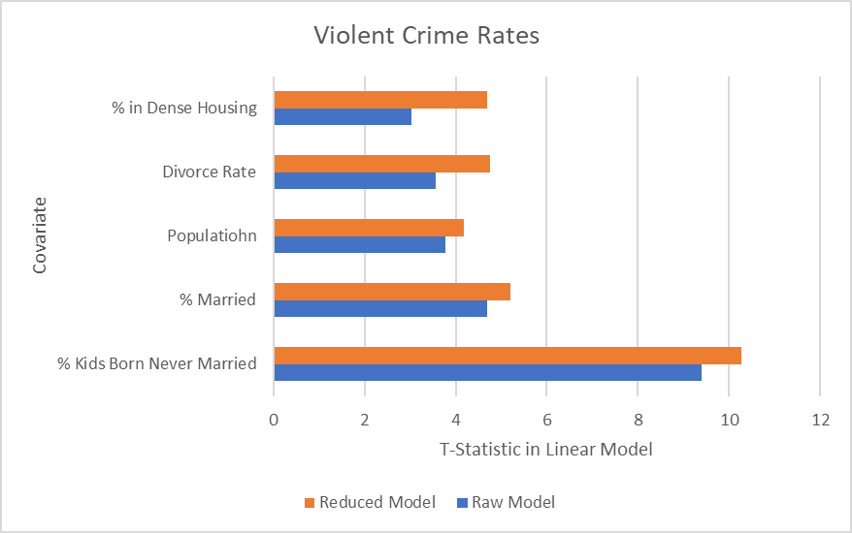
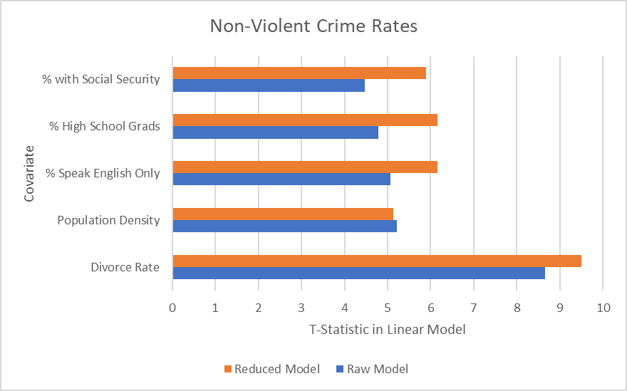
Estimating Feature Importance – Linear Models
Methods Used:
- Bootstrapping to estimate covariate t-statistics.
- AIC, BIC, LASSO, correlation matrix to select feature set in reduced model
Notes:
The first method I used to estimate feature importance was using t-statistics when fitting a linear model to the data. Note that all data was standardized so that these statistics could be compared.
When experimenting with the data, the first thing I noticed is that when fitting a linear model on different samples of the dataset, the coefficient estimates varied widely. To enhance the stability of results so that better comparisons could be made, I used non-parametric bootstrapping when computing feature significance statistics.
I originally computed the t-statistics when fitting all 45 features to the response variables. However, with so many features it was likely there was a lot of co-linearity and redundancy in this data, so I simplified the model to improve inference and also prediction potential.
This model selection was done using a mix of criterion methods, LASSO regression and an analysis of the correlation matrix. To compare the resulting feature set from these methods, I used ANOVA to compare the F-score between models. Ultimately, I simplified the model to consider 19 covariates with minimal information loss, as given by a very low F-statistic. This was repeated for both violent, and non-violent crime.
Once the refined model was built, the feature importance was re-computed. To ensure that the most significant features are stable, I compared the most significant features in the original model and simplified model, and found that they were identical, showing these results are stable. The top five most significant features are shown on screen.

Slide 4
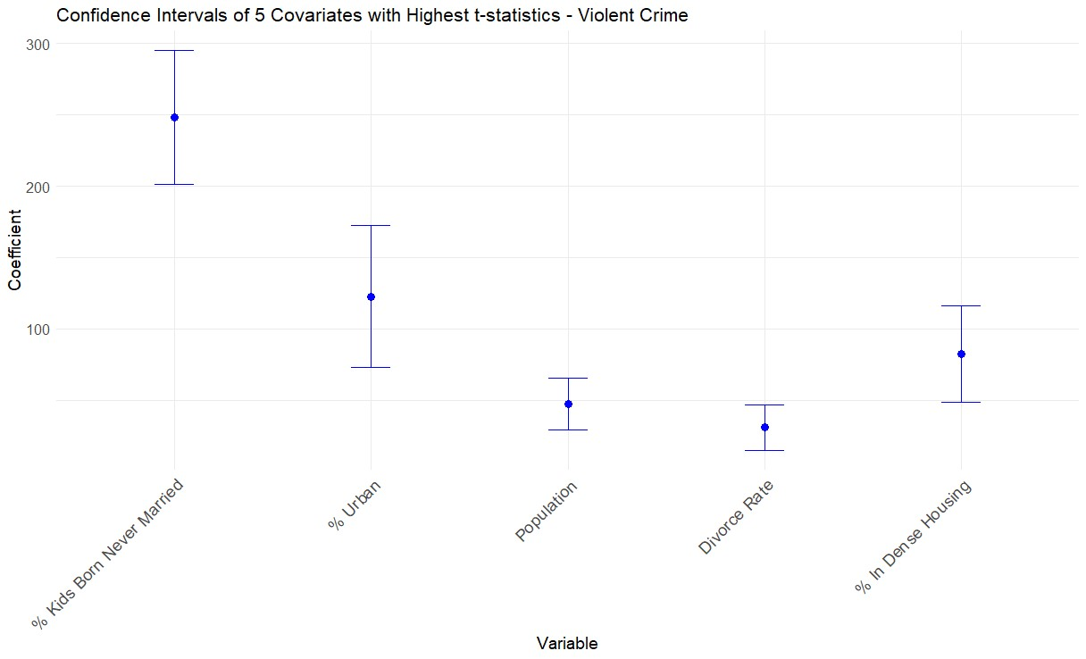
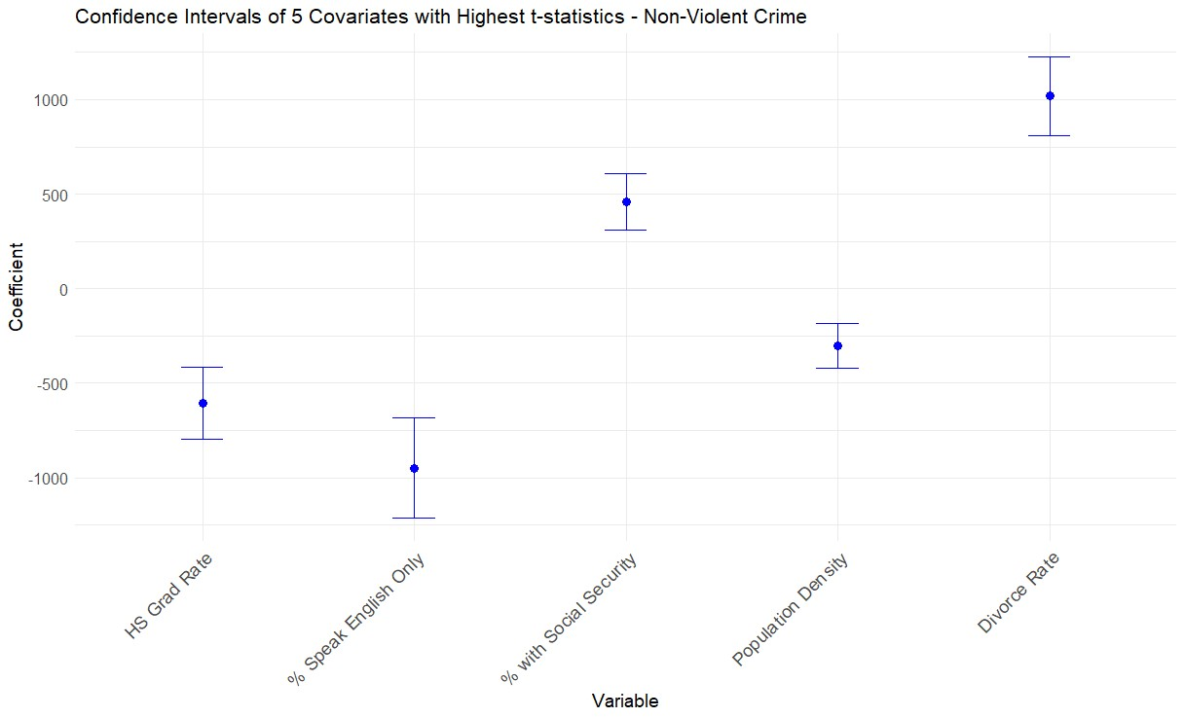
Confidence Intervals
Notes:
The confidence intervals for the 5 most statistically significant features for both violent and non-violent crime are shown here, and we can see that none of the confidence intervals include zero.
Between these graphs, we see that the most significant covariates for violent and non-violent crime are different. While both crime types correlate with family structure variables like divorce rate, we see low education correlates with non-violent crime (on the right), and urban centers with high housing density and population correlates with violent crime (on the left).

Slide 5
Feature Importance – Random Forest Models
Violent Crime Feature Importance (GINI scores) | 189349398
% Kids Born Never Married Parents | 189349398
% Kids with 2 Parents | 170680512
Divorce Rate | 85377234
% with Investment Income | 54694298
% Living in Dense Housing | 45682006
Non-Violent Crime Feature Importance (GINI scores) | 4.290619
% Kids with 2 parents | 3043941318
Median Income | 2438294055
Divorce Rate | 1962141442
% Kids Born Never Married Parents | 1112921798
Poverty Rate | 995314716
Notes:
Since, the aforementioned methods all assume a linear relationship between the covariates and response, I was curious to see if the statistically significant predictors remained the same when we removed this asusumption and used Random Forest to generate feature importance. While there was some overlap, using a different model type did result in some different features which ranked as most significant. This shows that the most significant features in the dataset depends on model choice.

Slide 6
Prediction
MSE values represent about 30% error from mean values
When using traditional linear statistical methods, we benefitted from using the simplified dataset, and penalized regression, as it enabled better generalization to unseen data.
We got the best predictive performance when using tree-based methods on the full dataset, namely with Light-GBM, which uses boosting.
Notes:
Moving on to the prediction aspect of the project, I compared the results of traditional methods, such as LASSO, Ridge Regression and ElasticNet regression to tree-based fine-tuned machine learning algorithms, like random forest, LightGBM and XGBoost. In all prediction, 10-fold cross validation was used, since it was found that prediction error varied greatly based on the training data split.
The results are shown on the slide:
- When using traditional linear statistical methods, we benefitted from using the simplified dataset, and penalized regression, as it enabled better generalization to unseen data.
- The best predictive performance in both cases was with Light-GBM. Since this method uses extra mechanisms to prevent overfitting and improve performance, such as boosting, the additional data in the raw model did not cause overfitting and instead helped predictive accuracy. This allows us to conclude that with this dataset, feature selection is more important when using linear regression techniques.

