Slide 1
Features (X)
target (y)
DATA
observations

Slide 2
Features (X)
target (y)
DATA
training
observations
inference
DATA

Slide 3
1D
2D
3D
4D
?

Slide 4
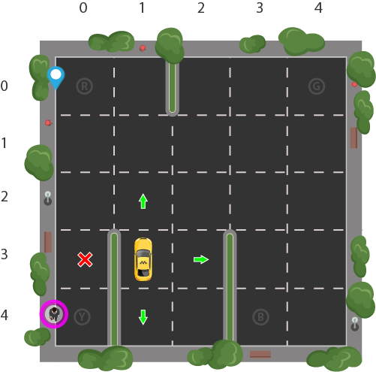


Slide 5
Input
Features & target
Supervised learning
Mapping
Features
Unsupervised learning
Groups
States & actions
Reinforcement learning
Action
Error
Reward
Output

Slide 6
Machine learning
Unsupervised Learning
Reinforcement Learning
Supervised Learning
Classification
Regression
Clustering
Dimensionality reduction
identity fraud detection
image classification
customer retention
population growth prediction
estimating life expectancy
market forecasting
Customer segmentation
targeted marketing
recommender systems
big data visualisation
structure discovery
feature elicitation
game AI
skill acquisition
learning tasks
robot navigation
real-time decisions
meaningful compression
weather forecasting
advertising popularity prediction
diagnostics

