Slide 1
Setting up Project in IntelliJ
CSCI 3155

Slide 2
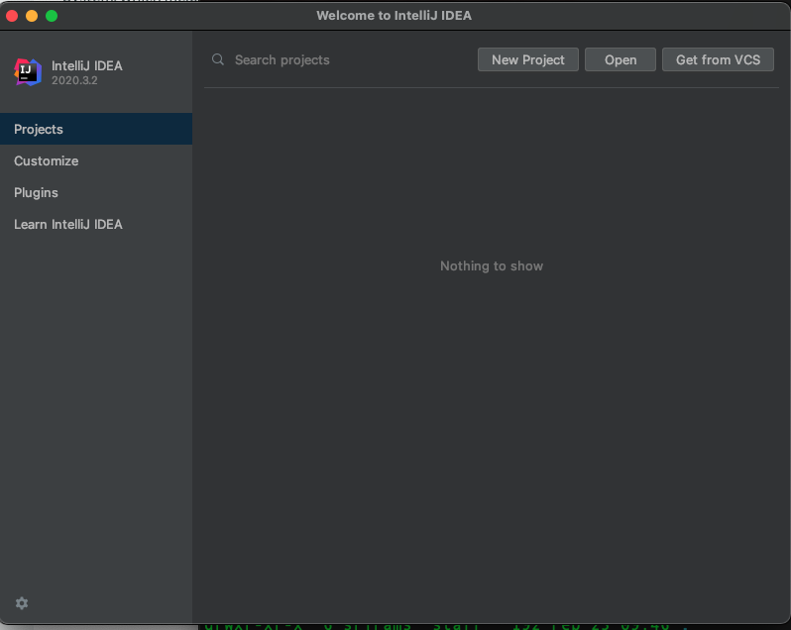
Open IntelliJ IDEA
Click on New Project

Slide 3
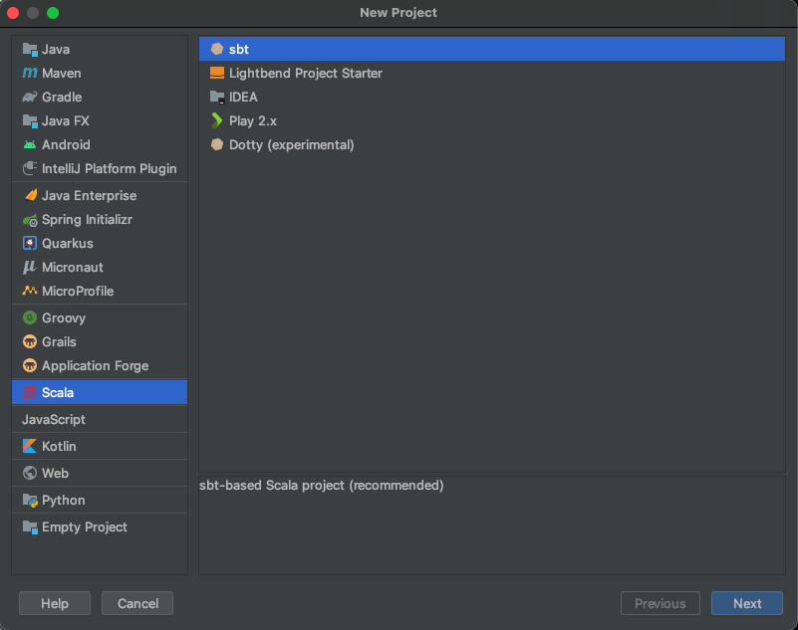
Choose a Scala/SBT project

Slide 4
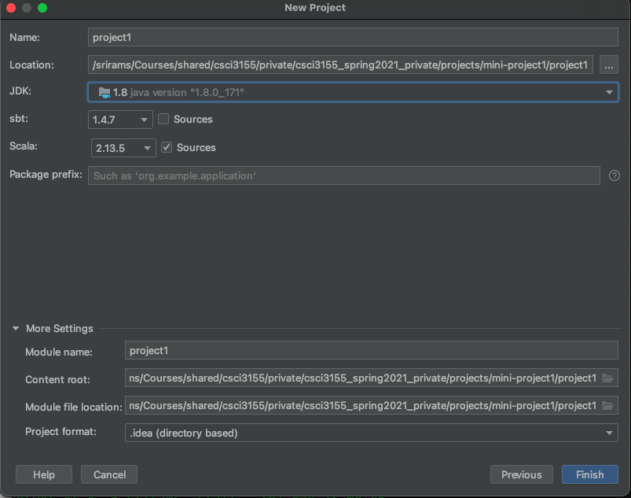
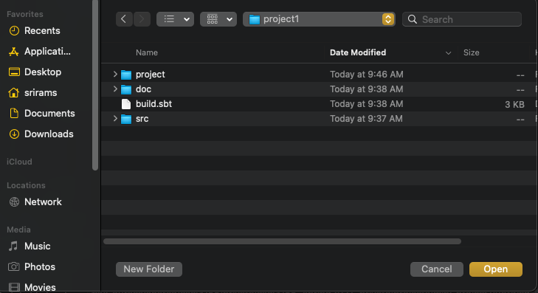
Important: Java version may
matter. We are not sure about
compatibility. Suggested: JDK 1.8 or JDK 1.13
Important: Make sure that
the directory you choose has
the build.sbt file in it.

Slide 5
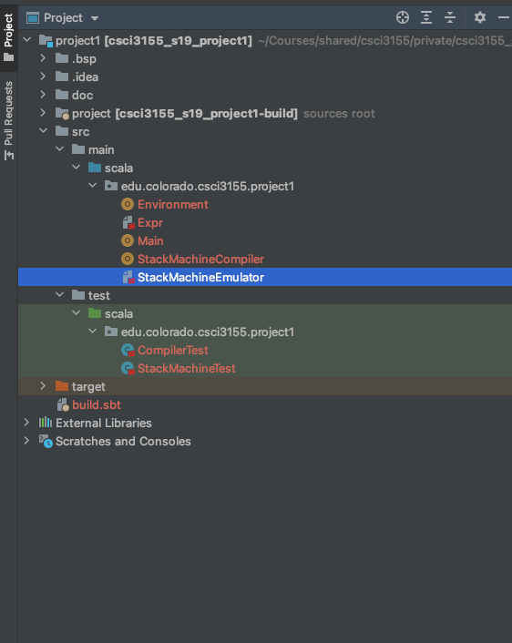
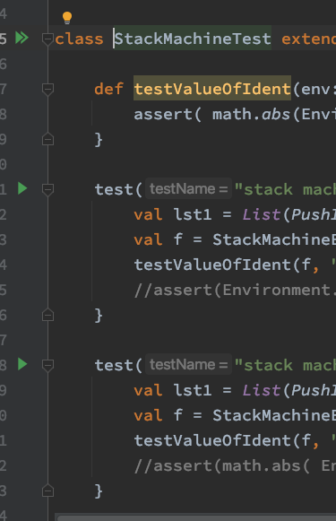
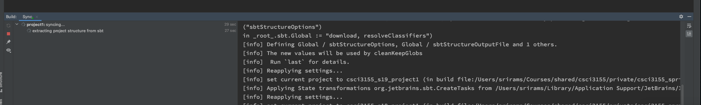
Click on project tab to examine
the directory structure
Open file StackMachineTest under “test”
If you see green arrows, you can click on them to run
tests.
Same for CompilerTest
Look under directory src/
Look under directory test/
It may take 2-3 minutes to load. But should not take much more than that.

Slide 6
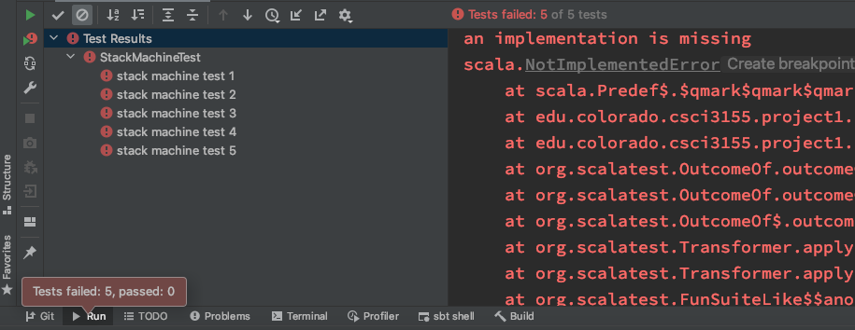
You would expect to fail all the tests starting out.
it will complain about :

Slide 7
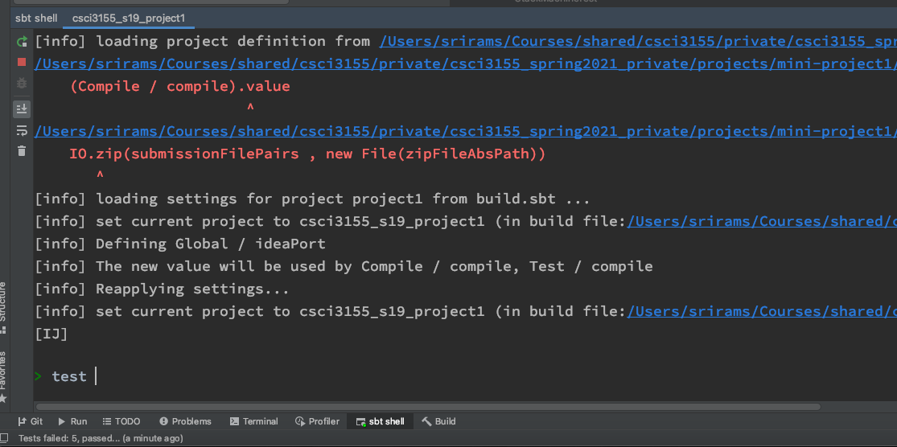
If green arrow does not appear automatically?
type “test” at the prompt.
Click on this little tab at the bottom “sbt shell”
Wait for 2-3 minutes to load
You will see a prompt “>”

Slide 8
Common Issues
Java version is incompatible (Not JDK 1.8 or JDK 1.11)
You will get an error that says something like “Package URI not valid”.
Top-Level does not have build.sbt
You will not be able to load the project or get the SBT shell to appear.

Slide 9
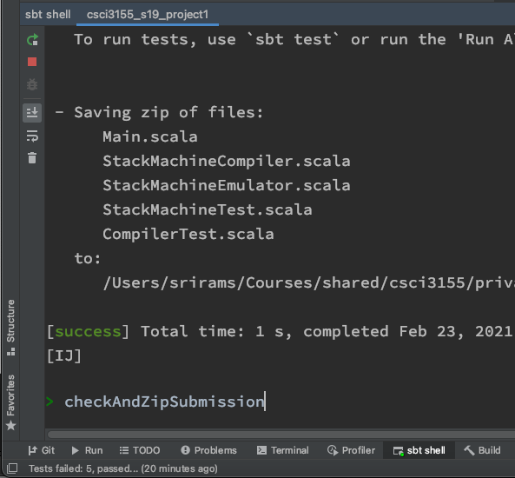
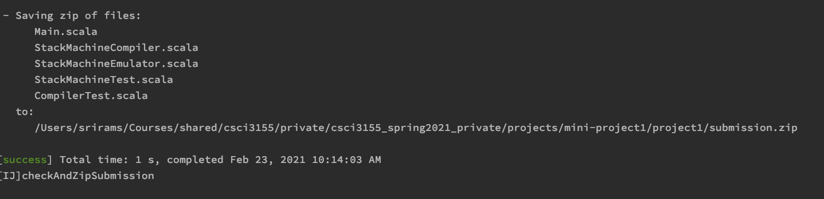
Submitting the Project
Type “checkAndZipSubmission” (case sensitive)
open SBT Shell
Upload submission.zip to canvas

