Slide 1

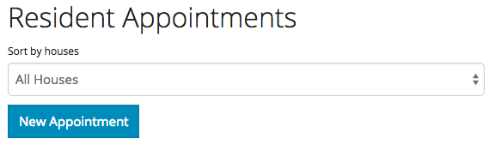
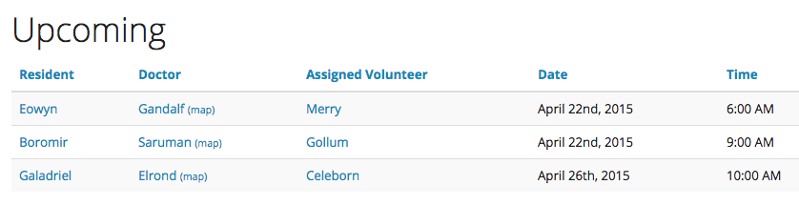
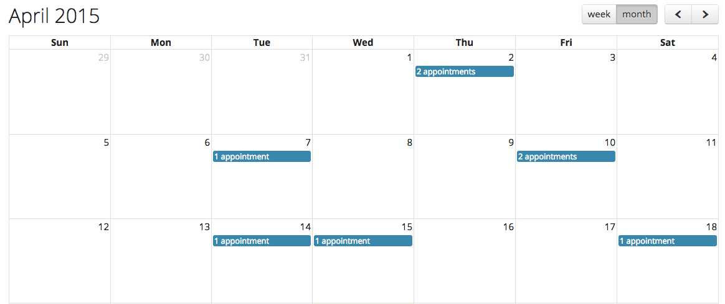
Our system allows volunteers and administrators to create, manage, and report medical appointments and car reservations for over fifty residents

