Slide 1

COWBOY
CAFE
Good coffee.
A place to stay awhile.
STELLENBOSCH · PROPOSED 2027 OPENING
Investment concept | 7 September 2026
Design visualisation; site not yet secured
Notes:
An urban Western cafe: concrete, warm timber and leather, with restrained Western cues. Concept render generated for this proposal, not an architect’s layout or photo of Ground Gym.
Sources accessed 7 September 2026:
Financial figures: issued Excel model, Expected case unless stated. Forward estimates, not actual trading results.

Slide 2
COWBOY CAFE / 01 / INVESTMENT THESIS
A distinctive café. A demanding funding test.
The expected case supports operations. It does not yet establish financeability.
R1.09m
94 / day
R196k each
Initial company funding, including VAT, fit-out and R200k opening cash.
Whole transactions needed for operating break-even at the proposed menu mix.
Gap above the R350k personal-loan benchmark, before affordability checks.
STELLENBOSCH · INVESTMENT DECISION · 07 SEP 2026
02
Notes:
Initial funding R1,091,740.25; founders each R545,820.125. Gap R195,820.125 each. Operating break-even 93.34, rounded up to94; excludes interest, principal and owner remuneration. Recommendation: conditional development, no lease commitment until funding and demand evidence.
Sources accessed 7 September 2026:
https://www.absa.co.za/personal/loans/for-myself/personal-loan/
Financial figures: issued Excel model, Expected case unless stated. Forward estimates, not actual trading results.

Slide 3
COWBOY CAFE / 02 / POSITIONING
An everyday ritual with a memorable identity.
Premium to franchise coffee; approachable enough for repeat student and working-day visits.
The customer
The experience
The distinction
Students and young professionals first. Gym visitors provide an additional route to repeat visits.
Fast counter ordering, thoughtful drinks and a compact, comfortable place to work or meet.
Indigo denim cups, cream cowboy artwork and a warm modern Western material palette.
STELLENBOSCH · INVESTMENT DECISION · 07 SEP 2026
03
Notes:
Target segments and positioning reflect founder brief. No exclusivity, gym partnership or customer conversion is assumed. Validate willingness to pay in intercepts and a pop-up.
Sources accessed 7 September 2026:
Financial figures: issued Excel model, Expected case unless stated. Forward estimates, not actual trading results.

Slide 4
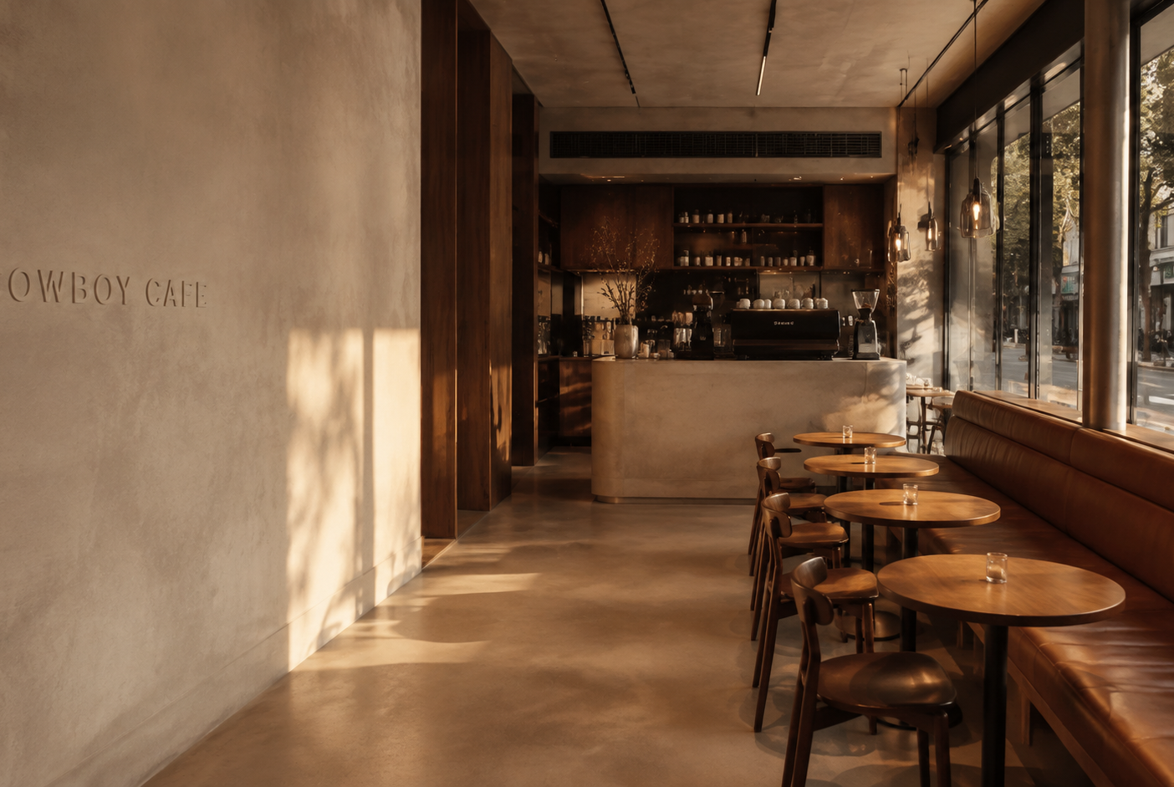
COWBOY CAFE / 03 / THE SPACE
A small footprint, fully considered from day one.
50 m² planning footprint
14 seats · 80% takeaway assumption
Street-facing entrance and visible counter. Small tables, leather seating, concrete finishes and warm wood.
Shared gym bathrooms depend on written access and health approval.
STELLENBOSCH · INVESTMENT DECISION · 07 SEP 2026
04
Notes:
45–60m² target range, 50m² base. Allow 22m² seating,14m² service/prep,6m² storage/wash and8m² circulation, subject to design and accessibility checks. Ground Gym adjacency and property are unconfirmed.
Sources accessed 7 September 2026:
https://capewinelands.gov.za/download/application-for-a-certificate-of-acceptability-for-a-food-premises-in-terms-of-regulation-32-of-r-638-of-22-june-2018/
Financial figures: issued Excel model, Expected case unless stated. Forward estimates, not actual trading results.

Slide 5
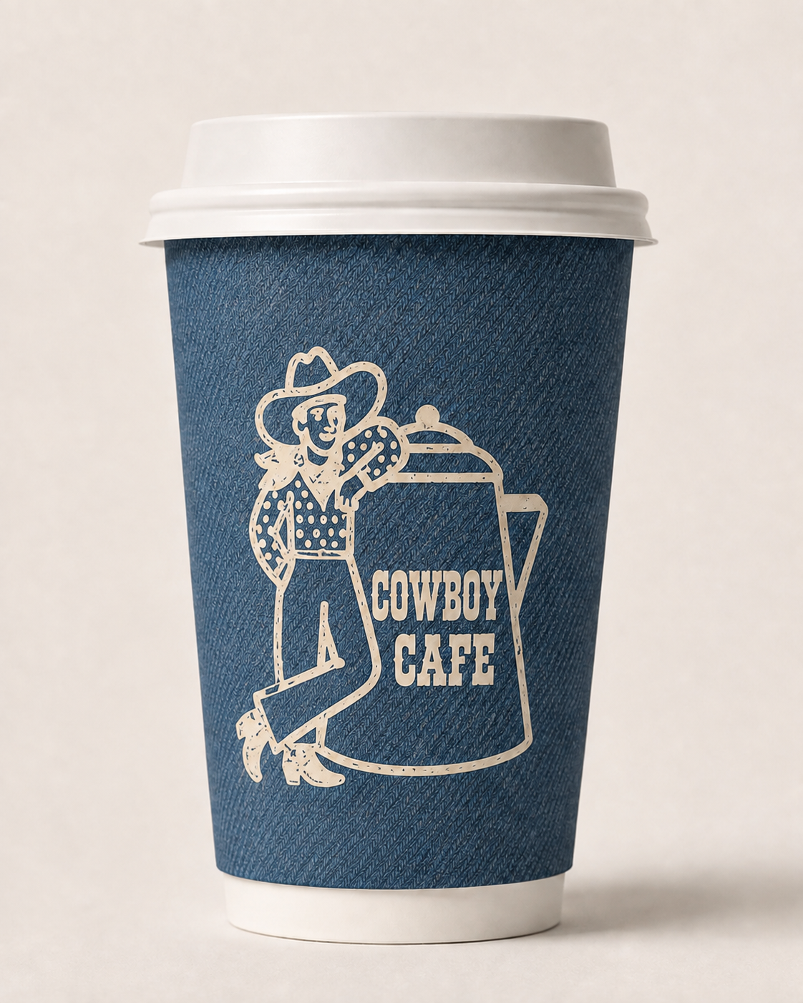
COWBOY CAFE / 04 / BRAND IN THE STREET
The takeaway cup carries the brand.
Indigo denim.
Cream cowboy artwork.
R5.20
Hot cup + lid allowance
including VAT
A softened woven print gives the cup texture while keeping the illustration prominent.
At 80% takeaway, packaging is a recurring product cost. Obtain a quote for the denim print, minimum order and lead time.
STELLENBOSCH · INVESTMENT DECISION · 07 SEP 2026
05
Notes:
Custom cup benchmark R4.50 per250ml double wall plus approximate lid cost. Base hot cup/lid5.20. Cold3.50 allowance. No proven advertising return attributed to branded cups. Approved denim cup concept with cream cowboy and coffee-pot artwork. R5.20 is an unchanged benchmark allowance, not a quote for this design. Artwork requires production preparation and a physical print proof.
Sources accessed 7 September 2026:
https://www.papercupsa.co.za/product-category/customized-cups/
https://www.tevaint.co.za/
Financial figures: issued Excel model, Expected case unless stated. Forward estimates, not actual trading results.

Slide 6
COWBOY CAFE / 05 / MENU
A focused opening menu protects execution.
One standard recipe per item; pastries delivered daily and warmed to order.
Proposed item | Cowboy price | Plato reference
Cappuccino / latte | R42 | R39 small
Flat white | R44 | R42
Iced latte | R50 | R48 medium
Matcha / iced matcha | R55 / R60 | R56 / R56 medium
Delivered pastry | R40 | Quote and taste-test
STELLENBOSCH · INVESTMENT DECISION · 07 SEP 2026
06
Notes:
Retail prices includeVAT. Espresso28 Americano35; alternative milk surcharge10. Plato June2026 menu, size comparability not exact. Matcha and pastry procurement targets unquoted. Initial range excludes kitchen, sandwiches and delivery platforms.
Sources accessed 7 September 2026:
https://plato.coffee/pages/our-menu
https://www.matchamove.com/pages/wholesale
Financial figures: issued Excel model, Expected case unless stated. Forward estimates, not actual trading results.

Slide 7
COWBOY CAFE / 06 / UNIT ECONOMICS
R53.93 at the till yields R25.89 contribution.
Expected mix: one drink per transaction, with one pastry on 25% of orders.
Per average transaction | Rand
Till receipt, including VAT | 53.93
Net revenue | 46.90
Ingredients, packaging and wastage | (19.82)
Gross profit · 57.7% | 27.07
Card fees | (1.18)
Contribution to fixed costs | 25.89
STELLENBOSCH · INVESTMENT DECISION · 07 SEP 2026
07
Notes:
Linked to Menu economics D22:D28. GP includes packaging and waste, excludes staff and card fees. 5% beverage and12% pastry waste. Higher pastry attachment raises absolute contribution but dilutesGPmargin. Rounded rows may differ byR0.01.
Sources accessed 7 September 2026:
https://capecoffeebeans.co.za/collections/wholesale-coffee-beans
https://www.papercupsa.co.za/product-category/customized-cups/
Financial figures: issued Excel model, Expected case unless stated. Forward estimates, not actual trading results.

Slide 8
COWBOY CAFE / 07 / OPERATIONS
Three employees can work—with deliberate cover.
Founders manage the business; the base case does not rely on their routine barista shifts.
R34.5k / month
120 staff hours
43 overlap hours
Payroll with Sunday and holiday premiums, relief, employer UIF and provisional benefits.
Weekly planning capacity versus 70 trading hours and 7 opening/closing hours.
For peaks and breaks. Quiet periods require one-person operation; relief still needs booking.
STELLENBOSCH · INVESTMENT DECISION · 07 SEP 2026
08
Notes:
Lead11,500 secondbarista9,000 allrounder8,000. Total34,460.50/month. 7–17 daily;40paid hours average each; actual roster must meet rest and break requirements. Wage benchmark30.23/hr effectiveMarch2026;2027 and bargaining council terms pending. Higher sales may need more cover.
Sources accessed 7 September 2026:
https://www.labour.gov.za/Media-Desk/Media-Statements/Pages/Minister-of-Employment-and-Labour%2C-Meth-increases-the-statutory-National-Minimum-Wage-to-R30%2C23-per-hour.aspx
https://www.westerncape.gov.za/basic-conditions-employment-act
Financial figures: issued Excel model, Expected case unless stated. Forward estimates, not actual trading results.

Slide 9
COWBOY CAFE / 08 / CAPITAL
Build the whole experience. Price the shell risk.
Company funding envelope: R864k low · R1.092m base · R1.461m high.
Use of funds · base case | R000
Capital expenditure incl. 15% contingency | 734
Pre-opening expenses | 103
Refundable lease deposit | 40
Initial inventory | 15
Opening cash reserve | 200
Total initial funding | 1,092
STELLENBOSCH · INVESTMENT DECISION · 07 SEP 2026
09
Notes:
Gross cash amounts includeVATwhere applicable. Base capital638,035+95,705contingency=733,740. Training12k legal25k preopenpayroll/launch20k rent46k. Low/high varycapital only; not probabilistic confidence intervals. Potential106,297VATrefund assumed month3, not deducted from initial funding.
Sources accessed 7 September 2026:
https://www.bunacoffee.co.za/pages/rent-to-own-commercial-coffee-machine-bundles
https://www.theneighborhoodbarista.com/services
Financial figures: issued Excel model, Expected case unless stated. Forward estimates, not actual trading results.

Slide 10
COWBOY CAFE / 09 / DEMAND SCENARIOS
Volume makes the difference.
These are decision scenarios, not observed turnover at nearby cafés.
Year 1 · R000 unless stated | Conservative | Expected | Optimistic
Mature transactions / day | 80 | 130 | 180
Net turnover | 1,140 | 2,034 | 3,083
Gross profit | 672 | 1,174 | 1,746
Operating expenses | 911 | 933 | 960
EBITDA | (239) | 241 | 787
No owner salaries. VAT registered. Ordinary company tax baseline. Ramp and seasonal factors included.
STELLENBOSCH · INVESTMENT DECISION · 07 SEP 2026
10
Notes:
Static snapshot produced by sequentially recalculating the same live Excel selector. Year1 average realized transactions is lower than mature input because of launchramp. Conservative/Expected/Optimistic pastry attachment18/25/32%, growth2/6/10%. No empirical turnover benchmark available.
Sources accessed 7 September 2026:
Financial figures: issued Excel model, Expected case unless stated. Forward estimates, not actual trading results.

Slide 11
COWBOY CAFE / 10 / PROFIT TRAJECTORY
The expected case grows into its cost base.
Net turnover and EBITDA over the first three planning years, R000.
STELLENBOSCH · INVESTMENT DECISION · 07 SEP 2026
11
Notes:
Model Overview22/25: netturnover2033969/2481871/2754166 EBITDA240903/436189/531277. Growth assumes6%volume5%price with5%cost8%rent. Firstpositive monthlyEBITDAMarch2027 (month3) underJanplaceholder. No guarantee of timing.
Sources accessed 7 September 2026:
Financial figures: issued Excel model, Expected case unless stated. Forward estimates, not actual trading results.

Slide 12
COWBOY CAFE / 11 / FINANCING
Company profit is not personal debt-service cash.
Personal borrowing at 18%; company lending at 8%. The founders fund the spread.
Expected case · each founder | Amount
Initial advance to the company | R545,820
Opening bank payment incl. estimated fees / cover | R16,385 / month
Peak cumulative outside cash contribution, 36 months | R101,146
Company loan still receivable at month 36 | R110,900
Personal bank debt still outstanding at month 36 | R277,626
STELLENBOSCH · INVESTMENT DECISION · 07 SEP 2026
12
Notes:
60monthloanillustration,69fee/person/month,creditlife4.50per1000openingbalance/month allowance,1207.50initiation/person,2monthpreopeninginterestcarry. Peakcashcontribution includespreopenandoperatingshortfalls, excludespersonaltax. Bankcap350k/personmeans fullborrowing not established. Founderloans notequity; noassumption companycashafterrepayment belongs tofounders.
Sources accessed 7 September 2026:
https://www.absa.co.za/personal/loans/for-myself/personal-loan/
https://www.sars.gov.za/legal-pub-irt-03-interest-rates-table-3/
Financial figures: issued Excel model, Expected case unless stated. Forward estimates, not actual trading results.

Slide 13
COWBOY CAFE / 12 / DOWNSIDE
At 80 transactions a day, the model needs rescue cash.
R239k loss
R265k extra
R726k each
Year 1 EBITDA before depreciation, interest and tax in the conservative case.
Company funding needed over 36 months, beyond the initial R200k cash reserve.
Peak outside cash need over 36 months, including personal servicing and half the extra funding.
STELLENBOSCH · INVESTMENT DECISION · 07 SEP 2026
13
Notes:
Exactconservativeextra264550.88;peak725593.18each. Extra equity row is an UNFUNDED requirement and could changeownership/taxeligibility. No downside bailout facility assumed. Optimistic capacity and staffing need validation, not simply a fixedcost extrapolation.
Sources accessed 7 September 2026:
Financial figures: issued Excel model, Expected case unless stated. Forward estimates, not actual trading results.

Slide 14
COWBOY CAFE / 13 / OWNERSHIP & TAX
Keep the investment case independent of tax approval.
Inge’s sole shareholding and a nominal buyback are proposed, not cleared.
Governance
Economic rights
Model treatment
Board-led operations and distributions, subject to the Companies Act and a properly drafted MOI.
A nominal buyback cannot simply be assumed to remove Inge’s rights or create a tax-neutral exit.
Ordinary company tax is the default. Turnover tax is a conditional selector pending written advice.
STELLENBOSCH · INVESTMENT DECISION · 07 SEP 2026
14
Notes:
Mandatory shareholder rights/director removal/protections cannot be contracted away indiscriminately. ReviewMOI transferrestrictions rightoffirstoffer valuation buybackfunding and beneficialownership. Companycannotbuyallsharesandleavenoneissued;replacementissuance sequencing requirescounsel. STT CGT dividendanddonations possible. Expectednetturnoverexceeds2.3m inyear2;optimisticyear1. TTcanpaytaxwhilelossmaking. BPR340notgeneralclearance.
Sources accessed 7 September 2026:
https://www.sars.gov.za/tax-rates/turnover-tax/
https://www.sars.gov.za/types-of-tax/turnover-tax/quick-test-for-individuals-and-companies/
https://www.saflii.org/za/legis/consol_act/ca2008107/index.html
https://www.cipc.co.za/?page_id=16055
Financial figures: issued Excel model, Expected case unless stated. Forward estimates, not actual trading results.

Slide 15
COWBOY CAFE / 14 / PRE-LEASE DECISIONS
Four gates before capital is committed.
Gate | Evidence required | Owner
Demand | 7-day counts + paid pop-up support 130/day | Willem
Site and costs | Written access, approvals, fixed fit-out quotes | Willem
Funding | Approved facilities + personal cash runway | Marius
Legal and tax | Written opinion on ownership, loans and exit | Marius + advisers
STELLENBOSCH · INVESTMENT DECISION · 07 SEP 2026
15
Notes:
130/day is base underwriting target, not statistical cut-off. Proposed 4week validation followed by8–12week site/fitout window subjecttoapprovals. Rentbase20kexVAT pluscharges2k; sensitivity16–26k. Donotsignunconditionalleasependinggates.
Sources accessed 7 September 2026:
https://www.ahproperty.co.za/results/retail/to-let/stellenbosch/stellenbosch-central/retail/250371/
Financial figures: issued Excel model, Expected case unless stated. Forward estimates, not actual trading results.

Slide 16
COWBOY CAFE / 15 / THE DECISION
Develop the concept.
Validate the address. Secure the funding.
Proceed to measured site diligence and supplier quotations.
Commit to opening only when the demand case and personal funding plan survive the downside test.
COWBOY CAFE
STELLENBOSCH · INVESTMENT DECISION · 07 SEP 2026
16
Notes:
Investmentrecommendation: conditionaldevelopment, notunconditionalgo. SupportingWordbusinessplancontains detailedoperatingandlegalbrief;Excelcontainsthelive36monthforecastandinputregister. Deckfiguresremainissued7September2026snapshot.
Sources accessed 7 September 2026:
Financial figures: issued Excel model, Expected case unless stated. Forward estimates, not actual trading results.

