Slide 1

Host-Based Anomaly Detection
with Extended BPF
William Findlay
Supervisor: Dr. Anil Somayaji
April 10th, 2020

Slide 2
Research Questions
Can we write IDS software in eBPF?
  Spoiler: Yes.
How does eBPF compare with kernel-based IDS implementations?
How far can we take this?
  I have some thoughts on this (later)

Slide 3
Why eBPF?
Good performance*
  Keep up with kernel-based implementation
Broad scope
  Trace userspace, kernelspace, hardware, sockets,
  packets (incl. before kernel networking stack!)
Low opportunity cost
  No custom kernel required
  Forward compatibility
Production-safe
  No kernels were harmed in the making of this software
*we will revisit this soon!

Slide 4
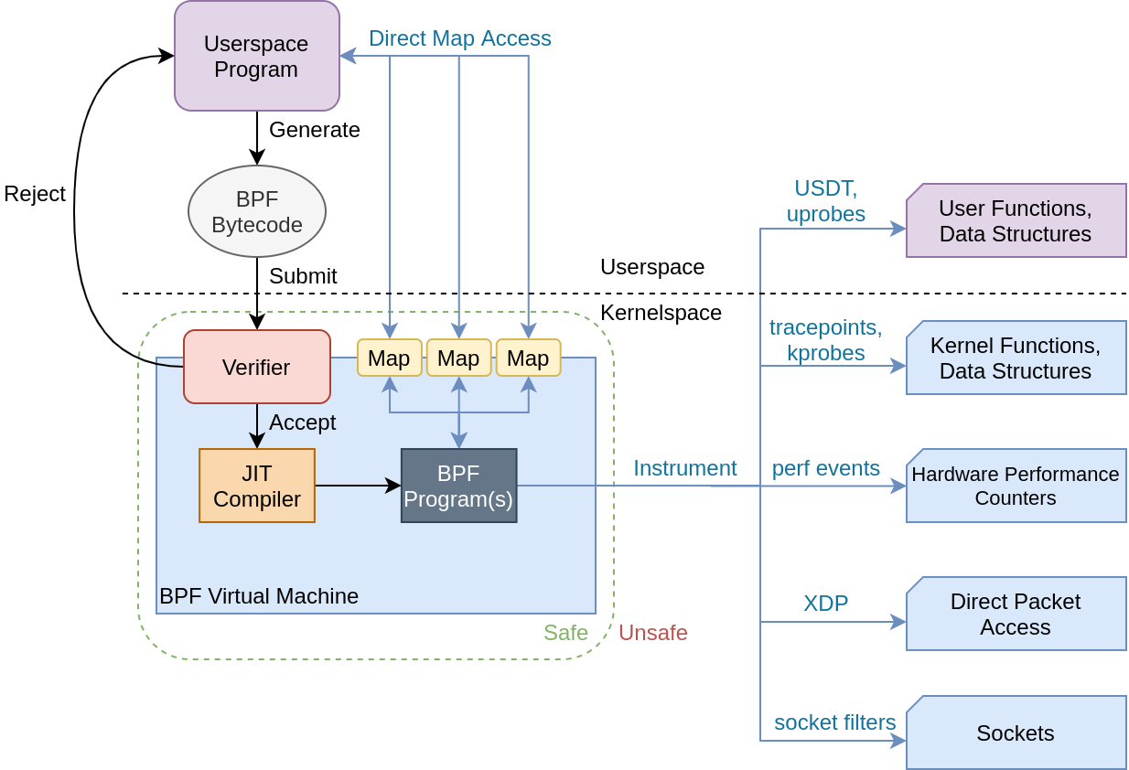
What is eBPF?
Figure 1: eBPF architecture in a nutshell.

Slide 5
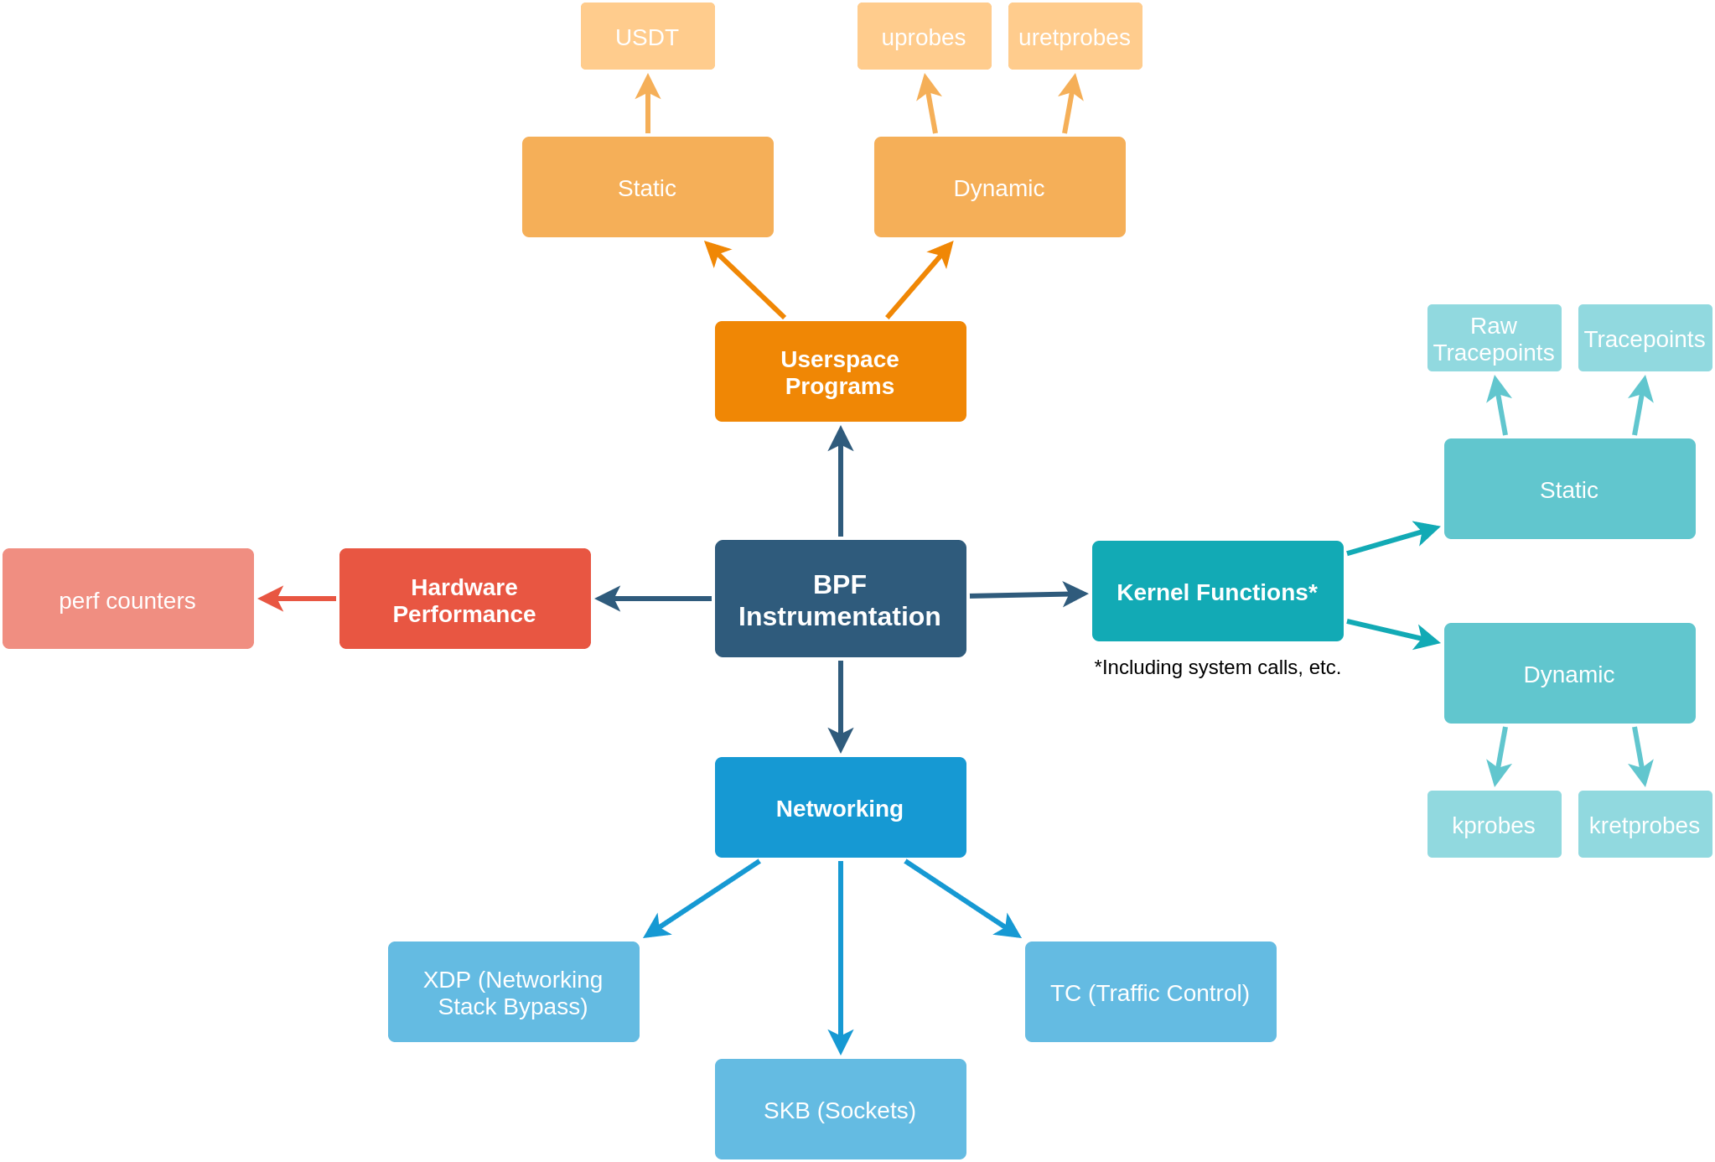
What is eBPF?
Figure 2: BPF program types and use cases.

Slide 6
What is eBPF?
Figure 2: BPF program types and use cases.

Slide 7
Tracepoints vs Kprobes
Tracepoints
  Stable API
  Limited number of these
    (getting better)
    (1,872 of them on Linux 5.5)
Kprobes
  Unstable API
  But, can trace (almost) any kernel function
TRACEPOINT_PROBE(raw_syscalls, sys_enter)
kprobe__get_signal(...)
All syscall entrypoints
All signal handler
invocations
tl;dr? Use tracepoints when you can, kprobes otherwise

Slide 8
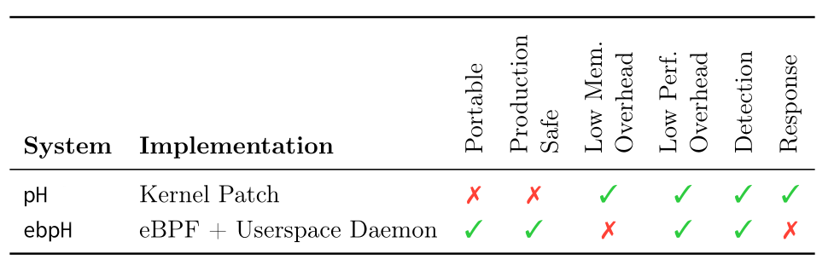
Back to the Future
ebpH
  “Extended BPF + Process Homeostasis”
  20 year old technology...
  Re-written using modern technology
Table 1: Comparing ebpH and pH.

Slide 9
Back to the Future
ebpH
  “Extended BPF + Process Homeostasis”
  20 year old technology...
  Re-written using modern technology
Table 1: Comparing ebpH and pH.

Slide 10
Back to the Future
ebpH
  “Extended BPF + Process Homeostasis”
  20 year old technology...
  Re-written using modern technology
Table 1: Comparing ebpH and pH.

Slide 11
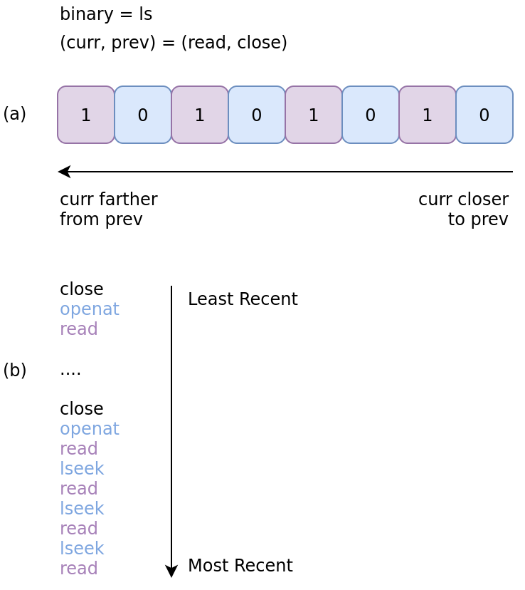
ebpH in Detail
Same idea as pH:
Trace all system calls
Build a profile of lookahead pairs from system calls
Gather enough data → Normal profile
Flag new lookahead pairs as anomalies
Figure 3: Example (read, close) lookahead pair from ls.

Slide 12
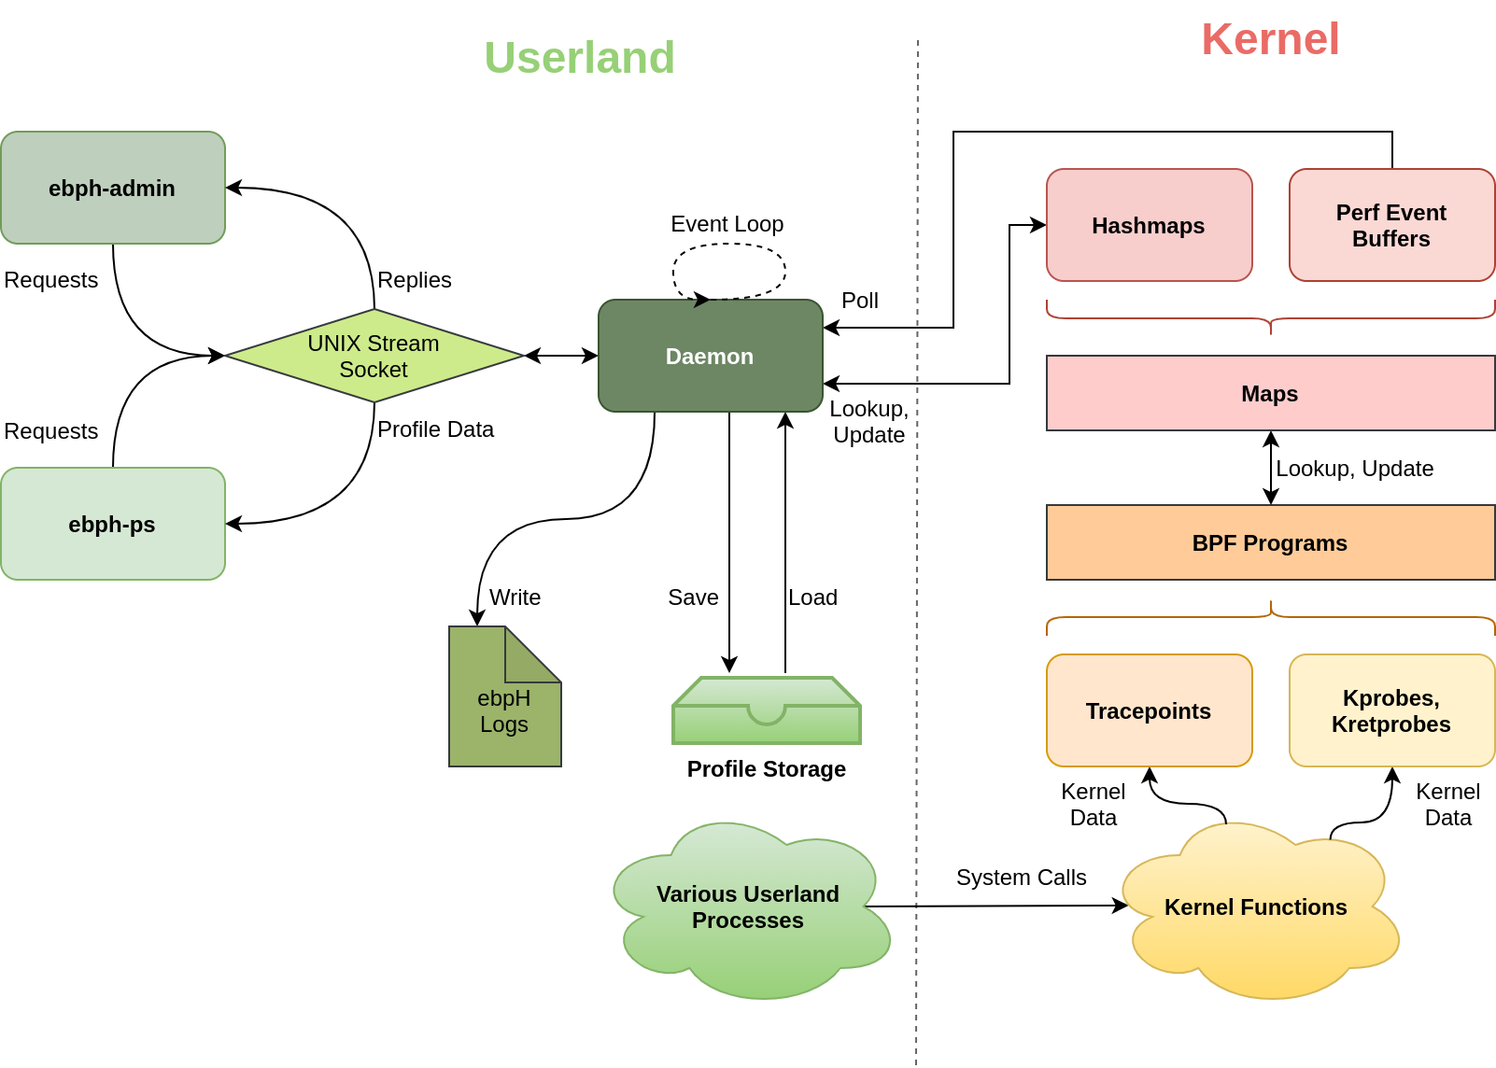
ebpH in Detail
Figure 4: ebpH architecture in a nutshell.

Slide 13
Performance Analysis
Benchmarks
  lmbench OS suite (micro)
    System call overhead
    Process creation overhead
    IPC overhead (signals, UDS, pipes)
  x11perf (micro)
    Syscall-heavy application overhead
  bpfbench (macro, ad-hoc)
    Real world system call overhead
Feedback welcome here

Slide 14
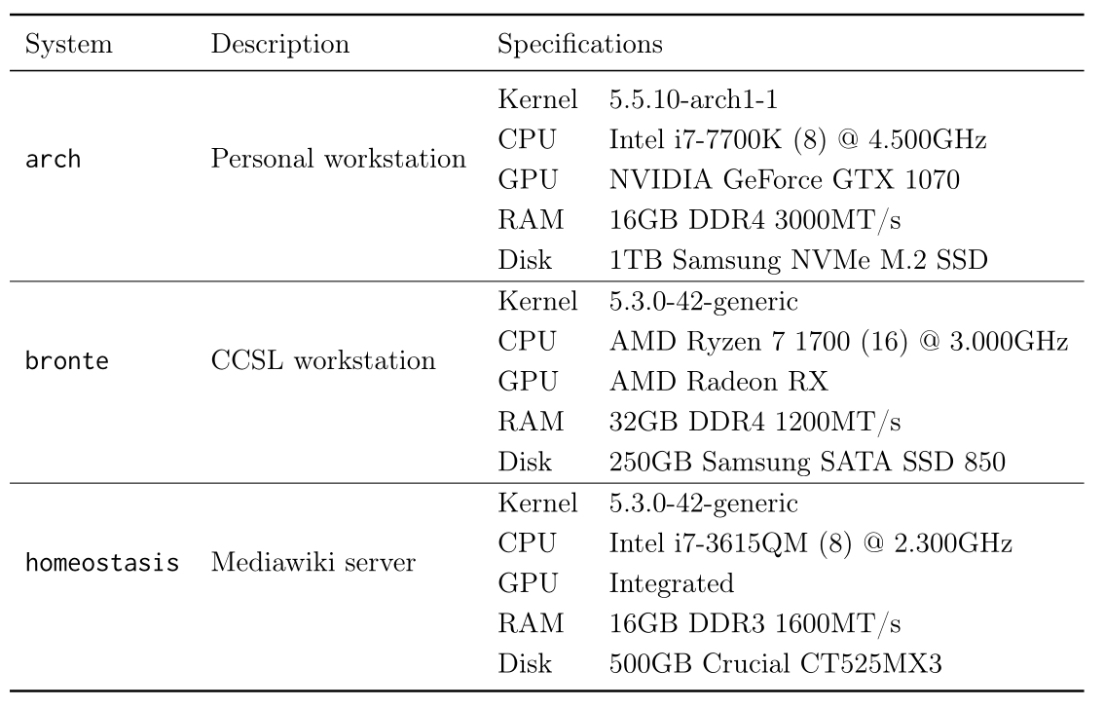
Performance Analysis
Table 2: Systems used for benchmarking tests.

Slide 15
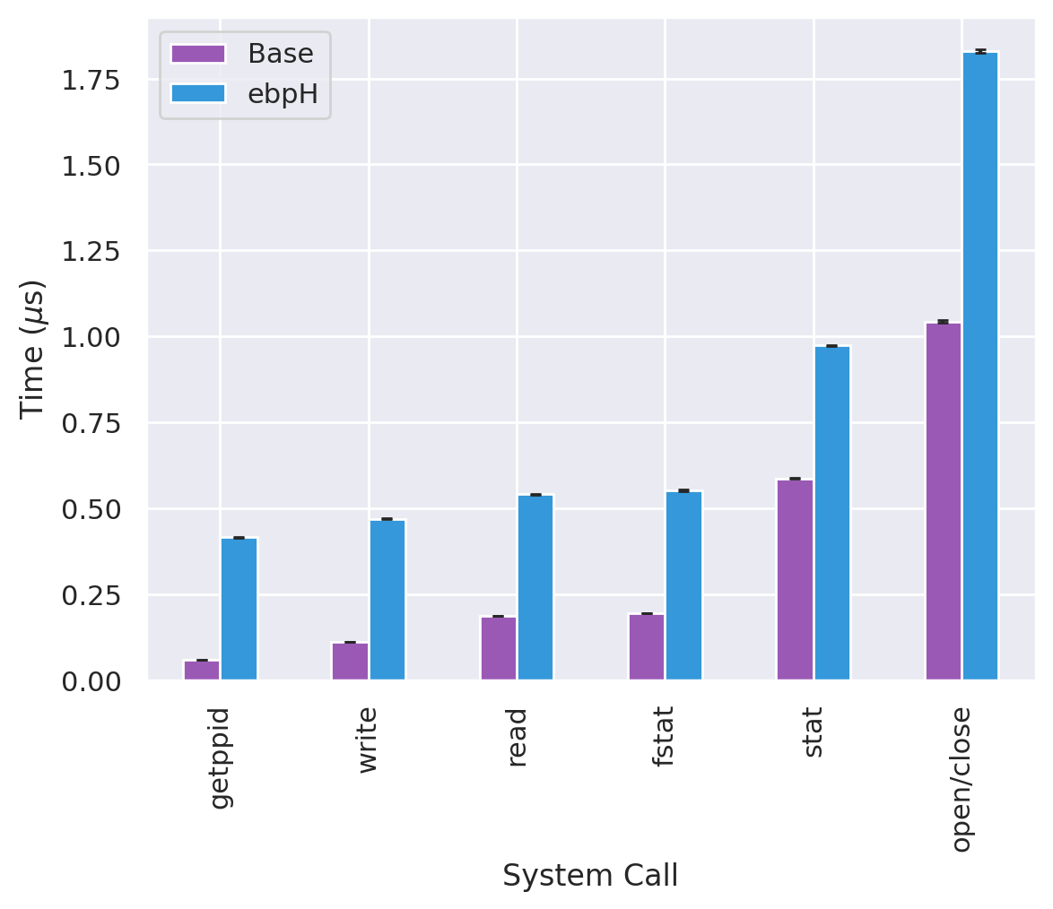
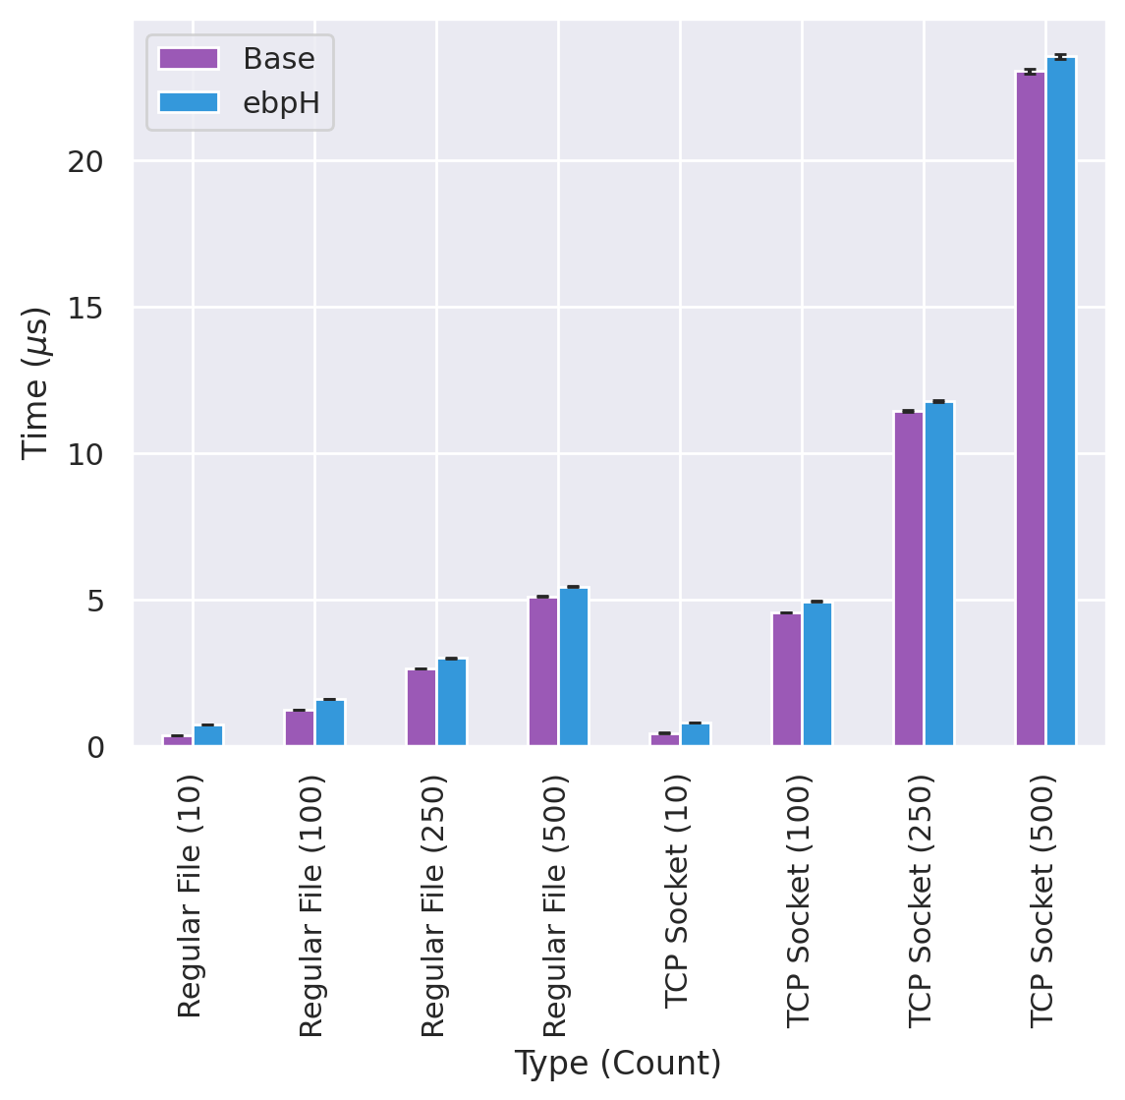
lmbench: System Calls
Figure 5: Various system call overheads.
Figure 6: select(2) (blocking) system call overhead.
*All error bars show standard error

Slide 16
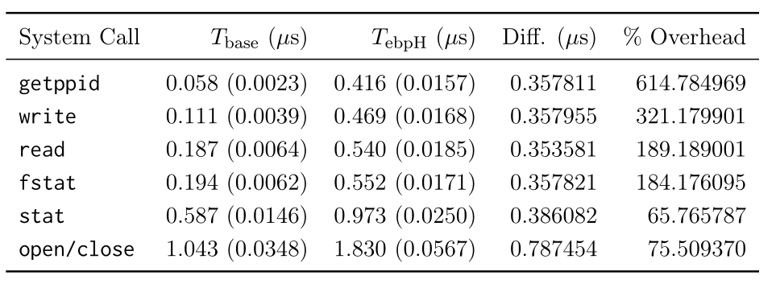
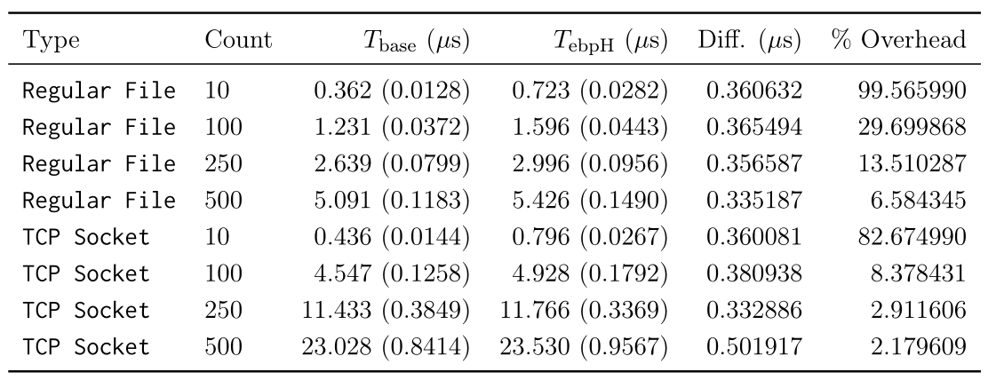
lmbench: System Calls
Table 3: Various system call overheads.
Table 4: select(2) (blocking) overhead.
*Standard deviations in parentheses

Slide 17
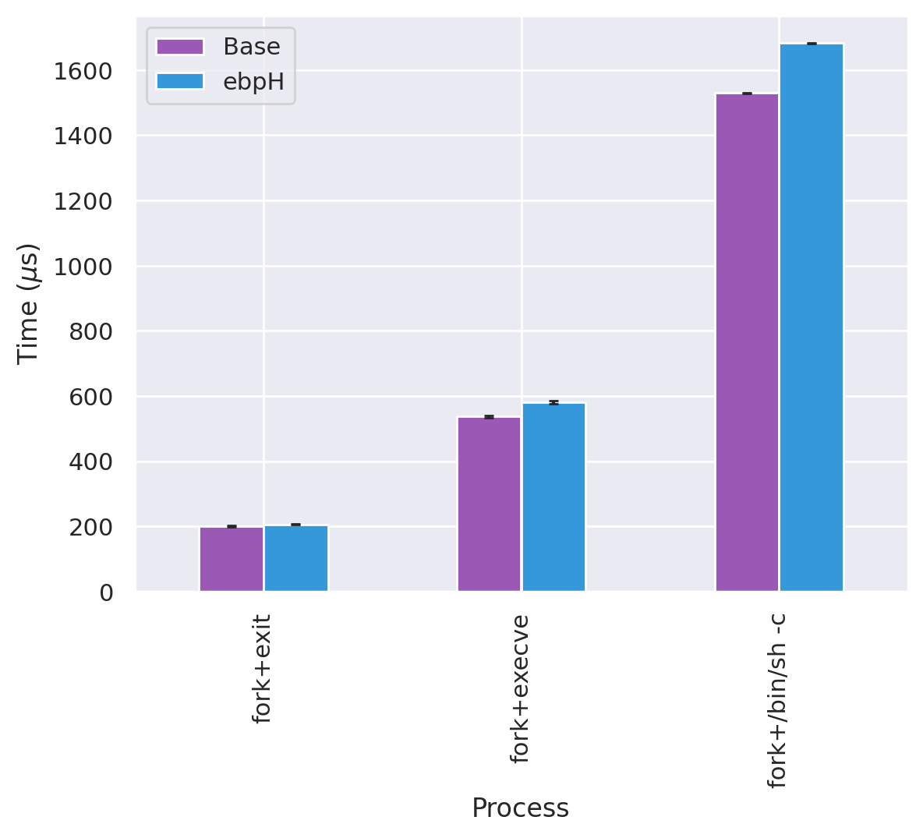
lmbench: Process Creation
Figure 7: Process creation overhead.
*All error bars show standard error

Slide 18
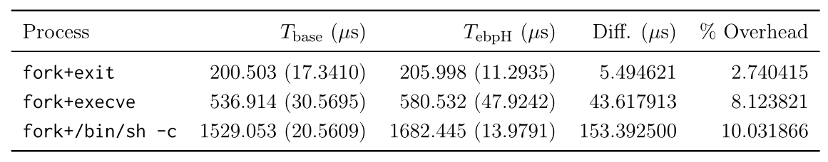
lmbench: Process Creation
Table 5: Process creation overhead.
*Standard deviations in parentheses

Slide 19
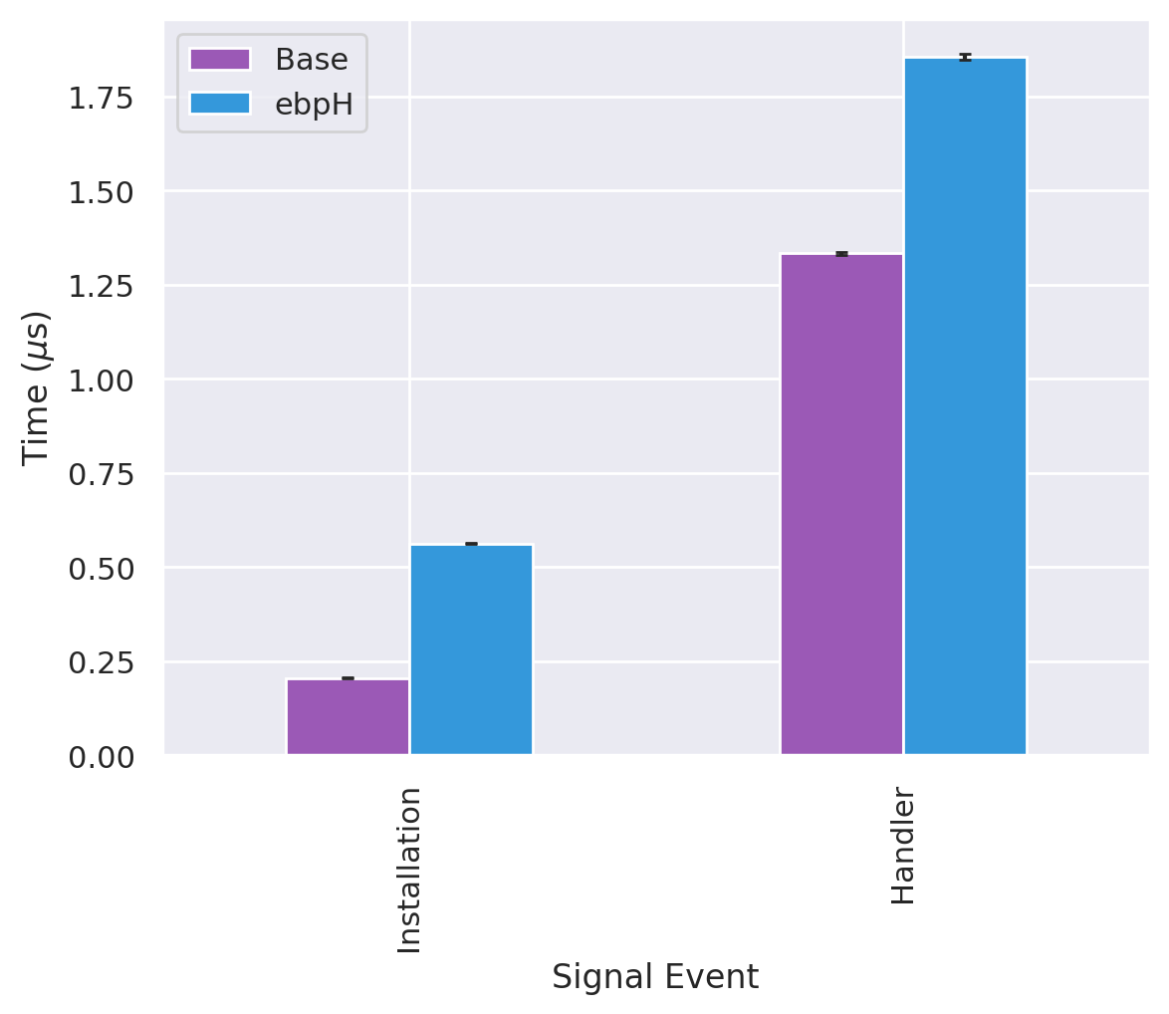
lmbench: Signal Handlers
Figure 8: Signal handler creation and invocation overheads.
*All error bars show standard error

Slide 20
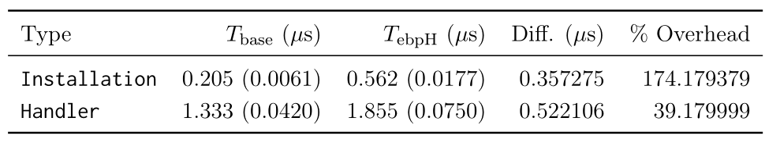
lmbench: Signal Handlers
Table 6: Signal handler creation and invocation overheads.
*Standard deviations in parentheses

Slide 21
lmbench: Signal Handlers
This is just a short system call!
(rt_sigaction(2))
Table 6: Signal handler creation and invocation overheads.
*Standard deviations in parentheses

Slide 22
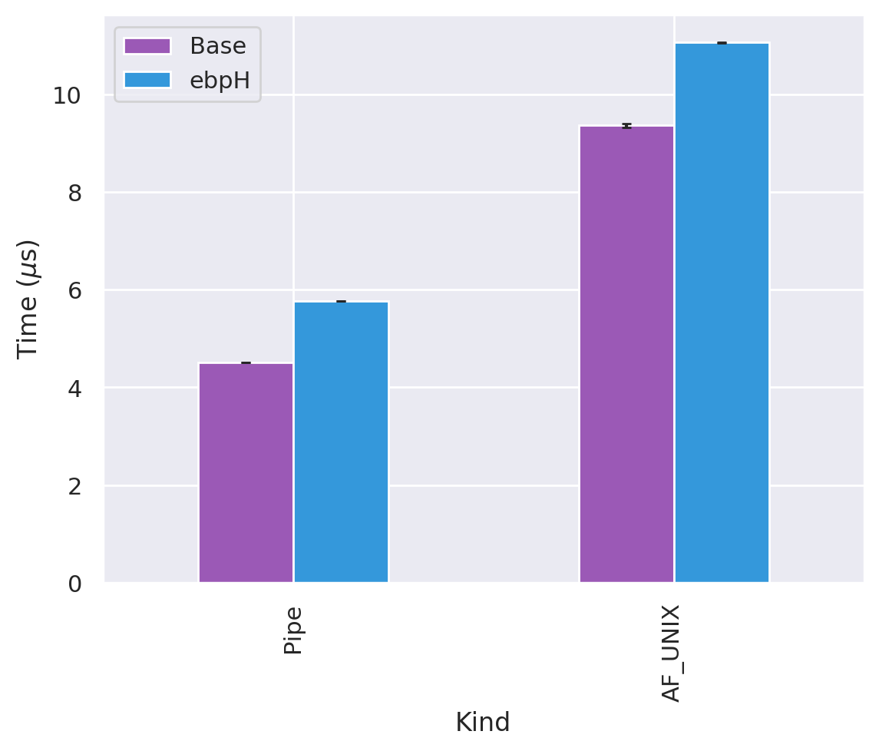
lmbench: UDS, Pipes
Figure 9: IPC (UDS and pipes) overheads.
*All error bars show standard error

Slide 23
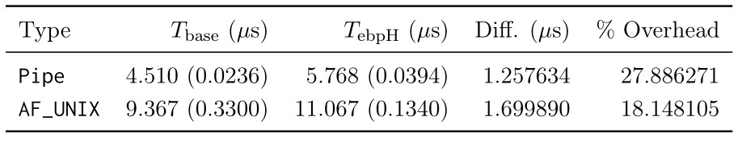
lmbench: UDS, Pipes
Table 7: IPC (UDS and pipes) overheads.
*Standard deviations in parentheses

Slide 24
x11perf

Slide 25
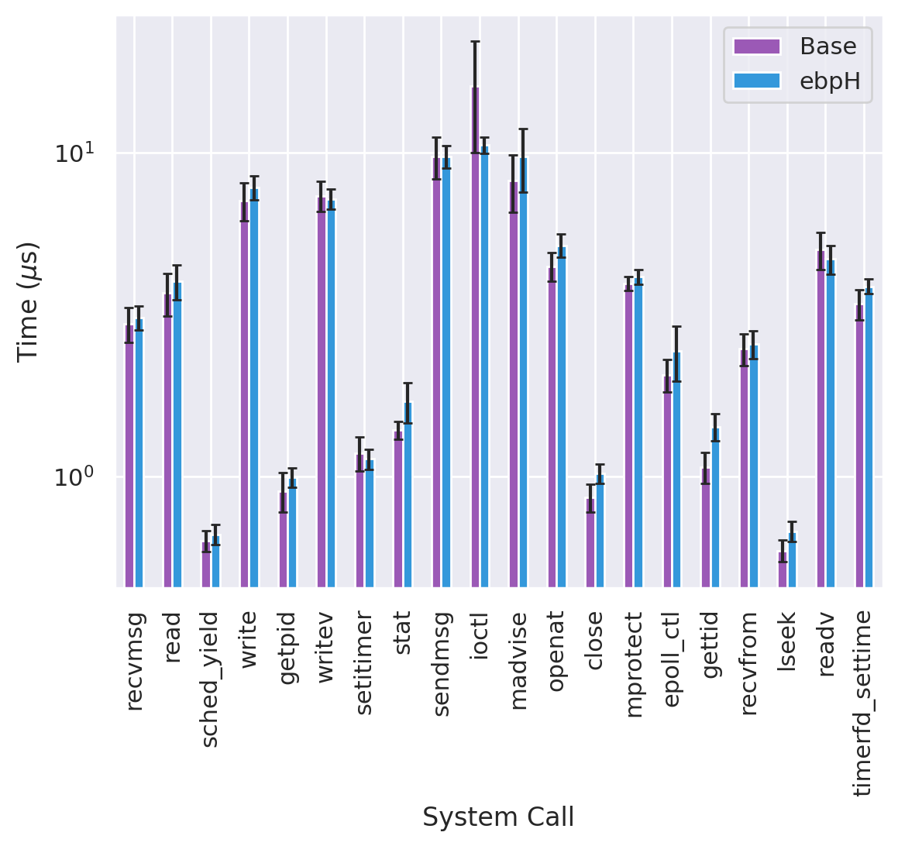
bpfbench: arch
*All error bars show standard error
**Time scale is logarithmic

Slide 26
bpfbench: arch
*Standard deviations in parentheses

Slide 27
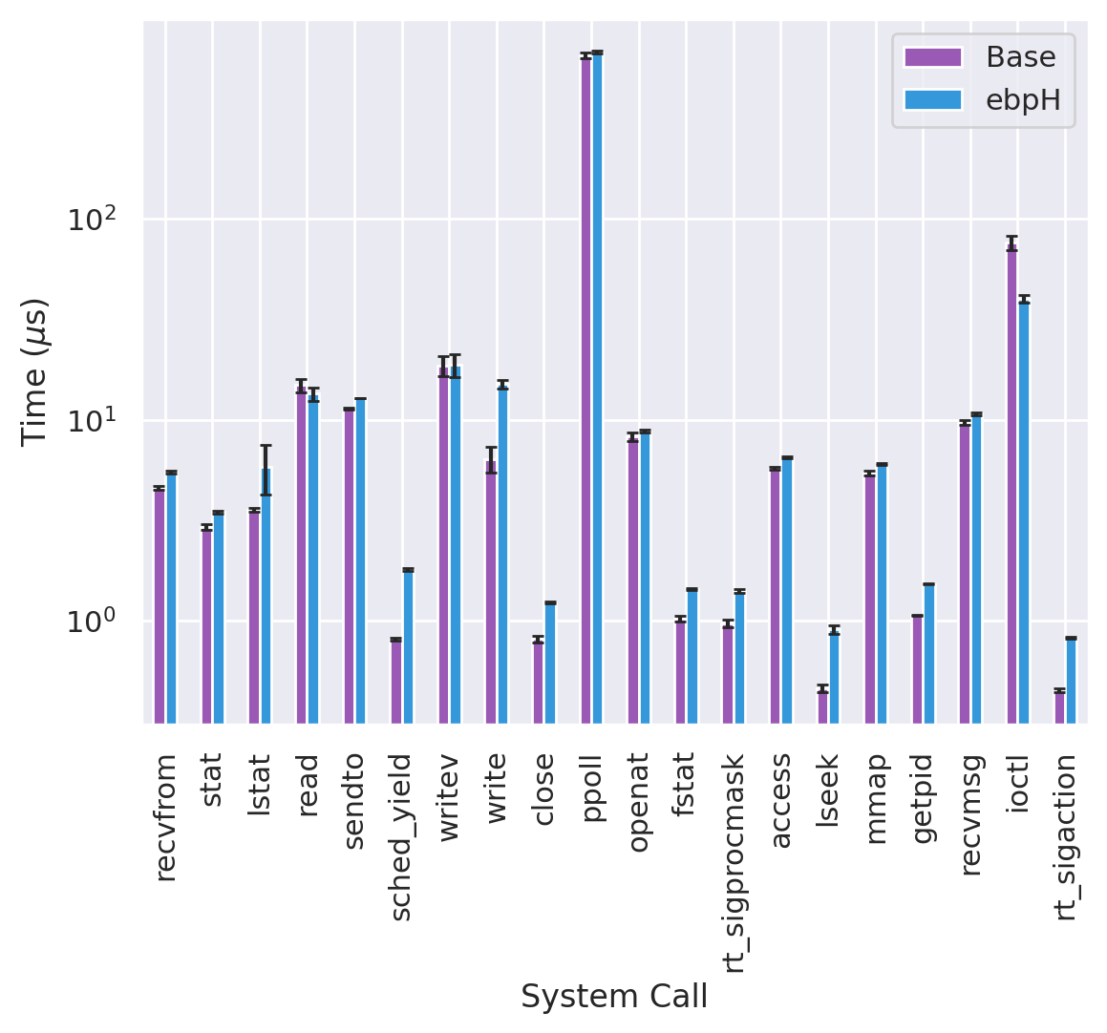
bpfbench: homeostasis
*All error bars show standard error
**Time scale is logarithmic

Slide 28
bpfbench: homeostasis
*Standard deviations in parentheses

Slide 29
bpfbench: bronte
*All error bars show standard error
**Time scale is logarithmic

Slide 30
bpfbench: bronte
*Standard deviations in parentheses

Slide 31
Cool New(ish) eBPF Features
bpf_signal
  Real-time signals from kernelspace (instantaneous)
  SIGKILL, SIGSTOP, SIGCONT… you name it
  Linux 5.3
bpf_signal_thread
  Like bpf_signal but target a specific thread
  Linux 5.5
bpf_override_return
  Targeted error injection
  Whitelisted kernel functions only :(
  Linux 4.16

Slide 32
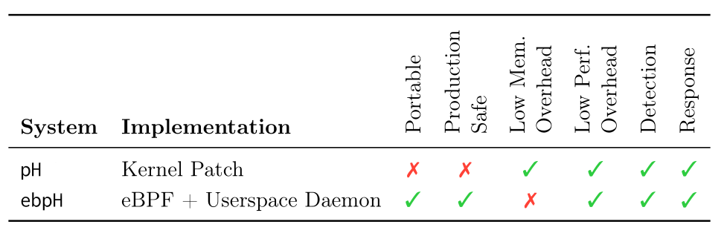
Future Work: Responding to Attacks
Add system call delays
  bpf_signal → send SIGSTOP and SIGCONT for delays
Add execve abortion
  bpf_override_return → target execve implementation
Recall this table:

Slide 33

Future Work: Saving on Memory Overhead
Current map allocation is too granular
  One big map for profiles, one big map for processes
Solution: use new map types
  LRU_HASH → smaller map, discard least recently used entries
  HASH_OF_MAPS →nested maps for lookahead pairs (sparse array )
Recall this table:

Slide 34
Conclusion
ebpH:
  is as fast as the original implementation.
  supports most of the original functionality.
  can be made even better, using new eBPF features.
Future of ebpH?
  Ecosystem of BPF programs
  All talking to each other, sharing information about diff. parts of system
  Beyond just system call tracing
Future of eBPF in OS security?
  We are going to be seeing a lot more of this.
  eBPF keeps getting better and better.
  Replacing many in-kernel implementations with something safer,
  with less opportunity cost.

Slide 35
Some Links
https://github.com/iovisor/bcc
https://github.com/willfindlay/honors-thesis
https://github.com/willfindlay/ebph
PRs welcome!
Thank you!

