Slide 1
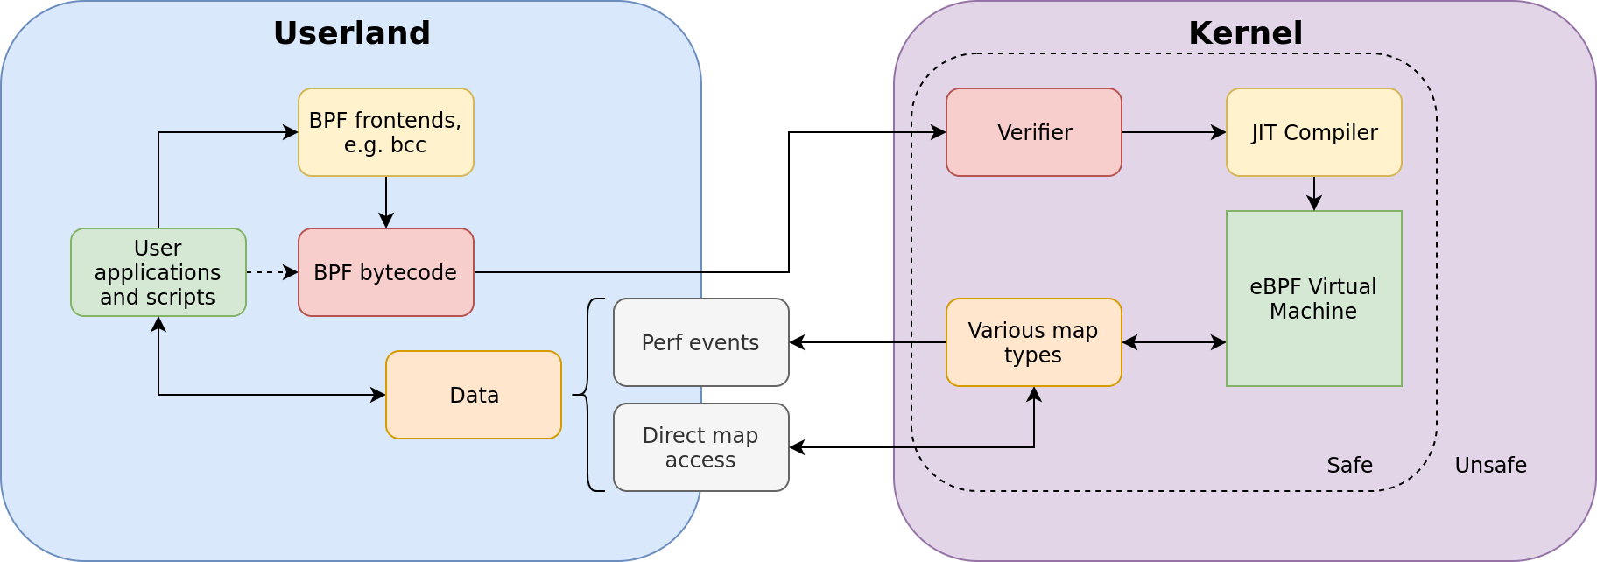

Extended BPF for Intrusion Detection Implementations
 William Findlay
 Carleton University
ebpH is an intrusion detection system that instruments eBPF system call tracepoints to establish
behavioral profiles.
It is fast, safe, and effective at
detecting anomalies
in process behavior.
What is eBPF?
Observability subsystem for the Linux kernel (Figure 1)
Specialized bytecode runs in a kernelspace virtual machine
Allows limited user-specified code to be run in kernelspace
This code is guaranteed to be safe due to a verification process before loading
BPF programs can observe:
  Kernel functions and data structures
  Hardware performance counters
  User functions
Figure 1: Topology of eBPF with respect to userland and the kernel. Note the bidirectional nature of dataflow between userspace and kernelspace provided by maps.
Heading
Point
Point
Point
Heading
Point
Point
Point
github.com/willfindlay/ebph

