Slide 1
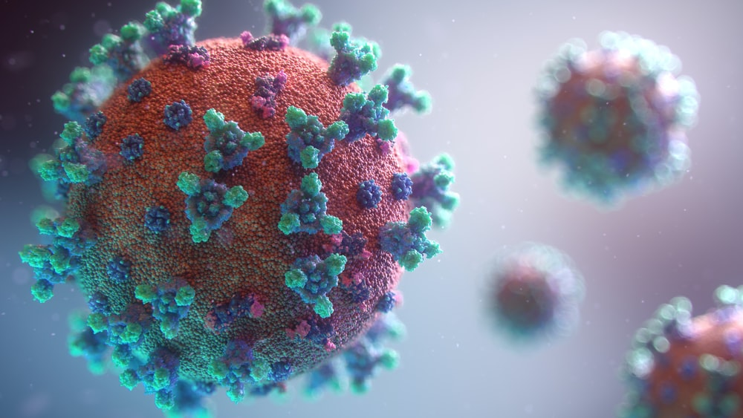
Inference of R in heterogeneous epidemics .

Slide 2


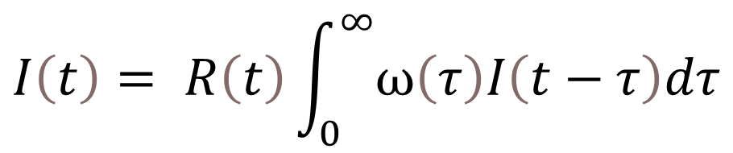
A commonly used method to infer the reproduction number is the renewal equation
$$I\left(t\right)= R\left(t\right)\int_{0}^{∞}{ω\left(τ\right)I\left(t−τ\right)dτ}$$
Reproduction number
Generation interval
GI
GI
Key
Infected
Recovered
Infection event
Onset of symptoms
SI
SI
Notes:
Commonly used method to infer the reproduction number is the renewal equation (which you can see here)
The renewal links the incidence at time t to the historic infection incidence, the generation time distribution and the instantaneous reproduction number
The integral is essentially the infectiousness of the population weighted on the time of infection, normalized by how many infections we expect
Homogeneous approach: assumes all infected individuals have the same reproduction number and infectious profile over time

Slide 3


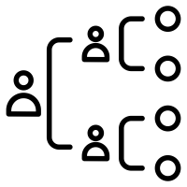



Heterogeneity in infectious profile may result from biological and behavioral differences
Viral load
Viral shedding
Contact rates
Symptomatic vs
asymptomatic
Isolation vs
Non-isolation
Vaccinated vs
Non-vaccinated
Notes:
Can think about what underlies the generation time distribution
There are various sources of heterogeneity missed by the generation time distribution, including…
This heterogeneity is missed when measuring the generation time distribution
GT dist is often found from measuring onset of symptoms
typical of symptomatic -> symptomatic transmission only;
early in the outbreak self-isolation may not be common and no vaccines
We derive a multi-type equivalent of the renewal equation which accounts for heterogeneity in infectious profiles, and explore how much the R differs from a “naïve” R derived from a single-type branching process

Slide 4
The generation time distribution we have misses this heterogeneity
Generation interval
Fitting a generation time distribution to infector-infectee relationships where the time of infection of the index case and infection of the secondary case are unambiguously known
Estimating via the serial interval distribution (the time between symptom onset in a case and symptom onset of their infector)
GI
GI
Key
Infected
Recovered
Infection event
Onset of symptoms
SI
SI
Notes:
This is done either by assuming the generation time distribution and serial interval distribution are equivalent, or by convolution with the incubation period distribution (the time from infection to onset of symptoms). The optimal approach will depend upon the joint relationship of the infectious distribution and the incubation period (9).
Both approaches are only applicable to symptomatic individuals

Slide 5
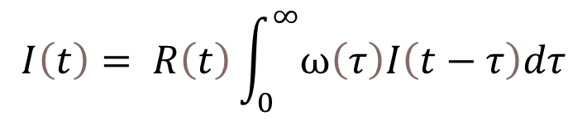
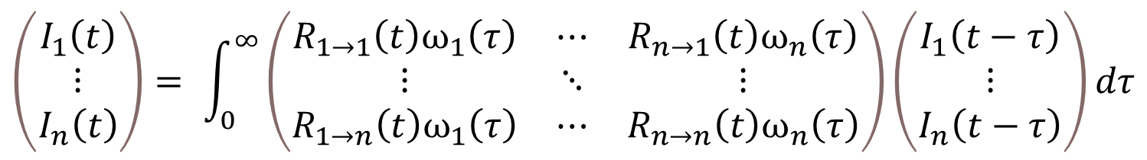
We can consider a multi-dimensional equivalent to the renewal equation
$$I\left(t\right)= R\left(t\right)\int_{0}^{∞}{ω\left(τ\right)I\left(t−τ\right)dτ}$$
$$\left(\begin{matrix}I_{1}\left(t\right) \\ ⋮ \\ I_{n}\left(t\right)\end{matrix}\right)= \int_{0}^{∞}{\left(\begin{matrix}R_{1→1}\left(t\right)ω_{1}\left(τ\right) & ⋯ & R_{n→1}\left(t\right)ω_{n}\left(τ\right) \\ ⋮ & ⋱ & ⋮ \\ R_{1→n}\left(t\right)ω_{1}\left(τ\right) & ⋯ & R_{n→n}\left(t\right)ω_{n}\left(τ\right)\end{matrix}\right)}\left(\begin{matrix}I_{1}\left(t−τ\right) \\ ⋮ \\ I_{n}\left(t−τ\right)\end{matrix}\right)dτ$$
Notes:
Explain the equation

Slide 6
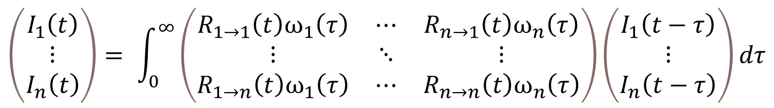
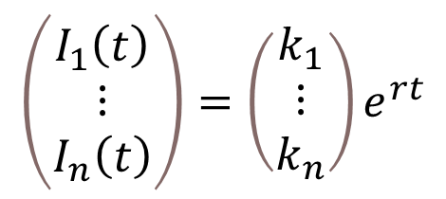
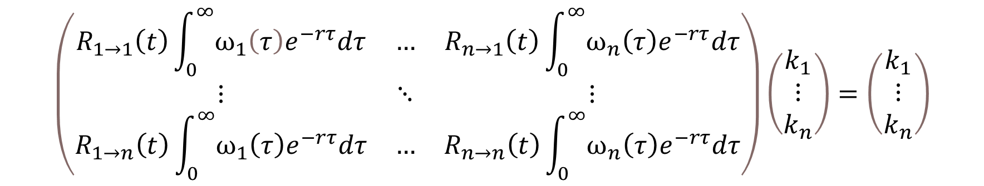
The solution is exponential, yielding an eigenvalue equation
$$\left(\begin{matrix}I_{1}\left(t\right) \\ ⋮ \\ I_{n}\left(t\right)\end{matrix}\right)= \int_{0}^{∞}{\left(\begin{matrix}R_{1→1}\left(t\right)ω_{1}\left(τ\right) & ⋯ & R_{n→1}\left(t\right)ω_{n}\left(τ\right) \\ ⋮ & ⋱ & ⋮ \\ R_{1→n}\left(t\right)ω_{1}\left(τ\right) & ⋯ & R_{n→n}\left(t\right)ω_{n}\left(τ\right)\end{matrix}\right)}\left(\begin{matrix}I_{1}\left(t−τ\right) \\ ⋮ \\ I_{n}\left(t−τ\right)\end{matrix}\right)dτ$$
$$\left(\begin{matrix}I_{1}\left(t\right) \\ ⋮ \\ I_{n}\left(t\right)\end{matrix}\right)=\left(\begin{matrix}k_{1} \\ \begin{matrix}⋮ \\ k_{n}\end{matrix}\end{matrix}\right)e^{rt}$$
$$\left(\begin{matrix}R_{1→1}\left(t\right)\int_{0}^{∞}{ω_{1}\left(τ\right)e^{−rτ}dτ} & … & R_{n→1}\left(t\right)\int_{0}^{∞}{ω_{n}\left(τ\right)e^{−rτ}dτ} \\ ⋮ & ⋱ & ⋮ \\ R_{1→n}\left(t\right)\int_{0}^{∞}{ω_{1}\left(τ\right)e^{−rτ}dτ} & … & R_{n→n}\left(t\right)\int_{0}^{∞}{ω_{n}\left(τ\right)e^{−rτ}dτ}\end{matrix}\right)\left(\begin{matrix}k_{1} \\ \begin{matrix}⋮ \\ k_{n}\end{matrix}\end{matrix}\right)=\left(\begin{matrix}k_{1} \\ \begin{matrix}⋮ \\ k_{n}\end{matrix}\end{matrix}\right)$$
Notes:
The solution will be exponential. Making this substitution and subsuming the integral into the matrix yields an eigenvalue equation

Slide 7
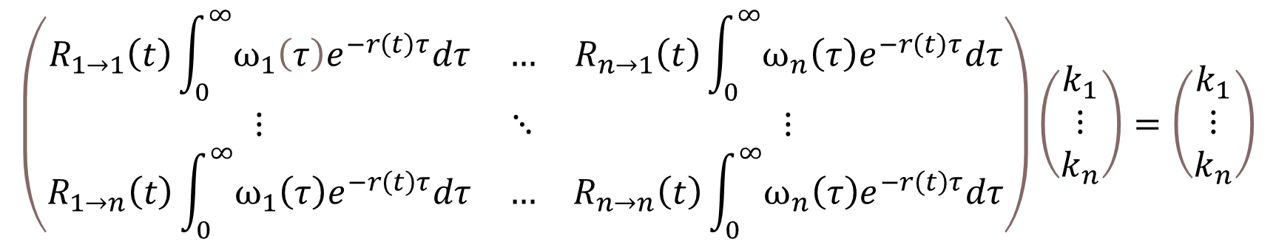
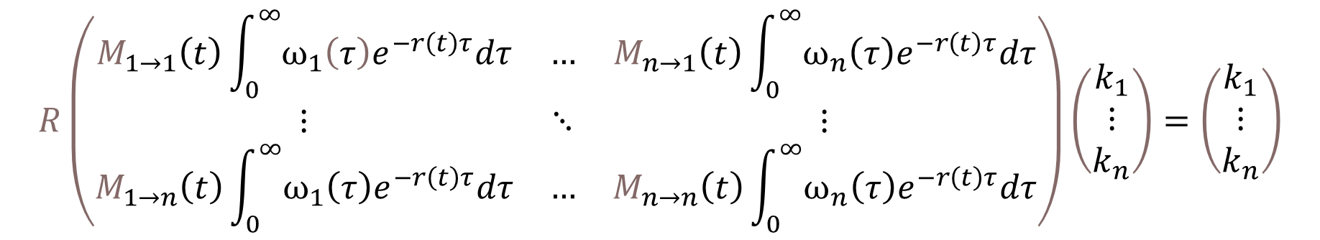
We can factorise out the reproduction number R leaving a relative risk matrix M
$$\left(\begin{matrix}R_{1→1}\left(t\right)\int_{0}^{∞}{ω_{1}\left(τ\right)e^{−r\left(t\right)τ}dτ} & … & R_{n→1}\left(t\right)\int_{0}^{∞}{ω_{n}\left(τ\right)e^{−r\left(t\right)τ}dτ} \\ ⋮ & ⋱ & ⋮ \\ R_{1→n}\left(t\right)\int_{0}^{∞}{ω_{1}\left(τ\right)e^{−r\left(t\right)τ}dτ} & … & R_{n→n}\left(t\right)\int_{0}^{∞}{ω_{n}\left(τ\right)e^{−r\left(t\right)τ}dτ}\end{matrix}\right)\left(\begin{matrix}k_{1} \\ \begin{matrix}⋮ \\ k_{n}\end{matrix}\end{matrix}\right)=\left(\begin{matrix}k_{1} \\ \begin{matrix}⋮ \\ k_{n}\end{matrix}\end{matrix}\right)$$
$$R\left(\begin{matrix}M_{1→1}\left(t\right)\int_{0}^{∞}{ω_{1}\left(τ\right)e^{−r\left(t\right)τ}dτ} & … & M_{n→1}\left(t\right)\int_{0}^{∞}{ω_{n}\left(τ\right)e^{−r\left(t\right)τ}dτ} \\ ⋮ & ⋱ & ⋮ \\ M_{1→n}\left(t\right)\int_{0}^{∞}{ω_{1}\left(τ\right)e^{−r\left(t\right)τ}dτ} & … & M_{n→n}\left(t\right)\int_{0}^{∞}{ω_{n}\left(τ\right)e^{−r\left(t\right)τ}dτ}\end{matrix}\right)\left(\begin{matrix}k_{1} \\ \begin{matrix}⋮ \\ k_{n}\end{matrix}\end{matrix}\right)=\left(\begin{matrix}k_{1} \\ \begin{matrix}⋮ \\ k_{n}\end{matrix}\end{matrix}\right)$$
Notes:
The reproduction number will be the dominant eigen value of the R matrix. Given eigenvalues scale linearly when multiplied by a scalar, we can factorise the reproduction number out, leaving a ‘relative risk matrix’ M (normalized such that it’s eigenvalue is 1)

Slide 8
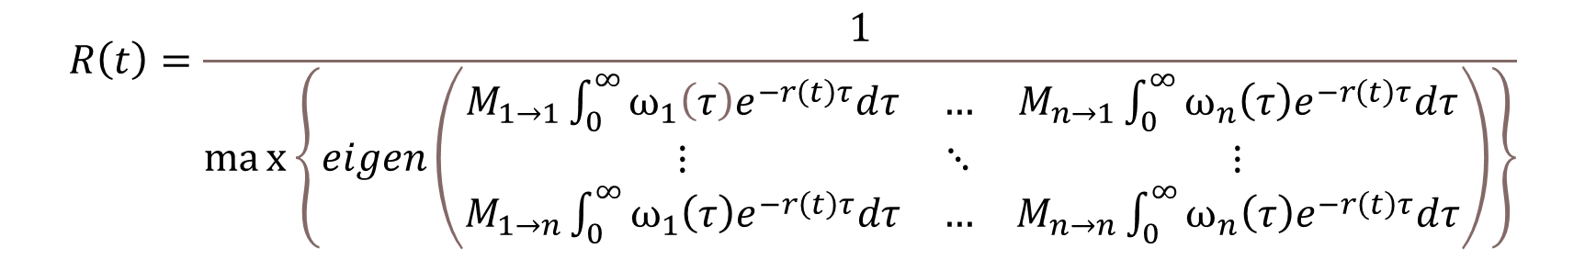
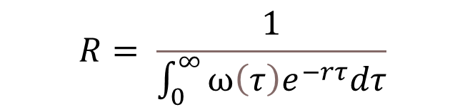

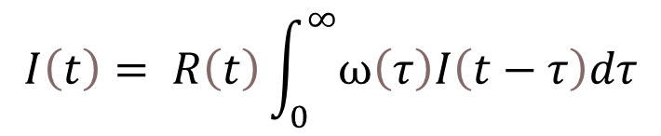
This leaves us with a multi-dimensional equation for R
$$R\left(t\right)=\frac{1}{max\left\{eigen\left(\begin{matrix}M_{1→1}\int_{0}^{∞}{ω_{1}\left(τ\right)e^{−r\left(t\right)τ}dτ} & … & M_{n→1}\int_{0}^{∞}{ω_{n}\left(τ\right)e^{−r\left(t\right)τ}dτ} \\ ⋮ & ⋱ & ⋮ \\ M_{1→n}\int_{0}^{∞}{ω_{1}\left(τ\right)e^{−r\left(t\right)τ}dτ} & … & M_{n→n}\int_{0}^{∞}{ω_{n}\left(τ\right)e^{−r\left(t\right)τ}dτ}\end{matrix}\right)\right\}}$$
$$I\left(t\right)=ke^{rt}$$
$$I\left(t\right)= R\left(t\right)\int_{0}^{∞}{ω\left(τ\right)I\left(t−τ\right)dτ}$$
$$R= \frac{1}{\int_{0}^{∞}{ω\left(τ\right)e^{−rτ}dτ}}$$
Notes:
Recognising the former as an eigenvalue equation, we can rewrite R for a multi-type branching process as

Slide 9
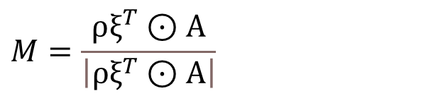
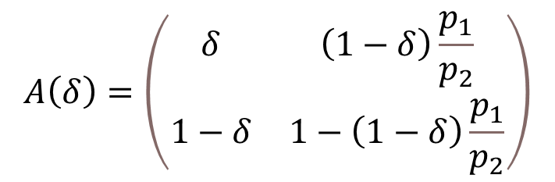
We parameterize the relative risk matrix M and the assortativity matrix as follows
Relative risk matrix parameterization
Assortativity parameterization
$$A\left(δ\right)=\left(\begin{matrix}δ & \left(1−δ\right)\frac{p_{1}}{p_{2}} \\ 1−δ & 1−\left(1−δ\right)\frac{p_{1}}{p_{2}}\end{matrix}\right)$$
$$M=\frac{ρξ^{T}⊙A}{\left|ρξ^{T}⊙A\right|}$$
Notes:
Relative risk depends upon relative infectiousness and relative susceptibility
Rho is a vector of each group’s infectiousness, Eta is a vector of each groups susceptibility
A is the assortativity matrix – what proportion of each groups contacts are with each other group
Assortativity was parameterized using an approach previously used to model HIV transmission within and between groups. At the extremes thereall mixing is within group (totally assortative) or all of the smaller group’s mixing is with the larger group

Slide 10
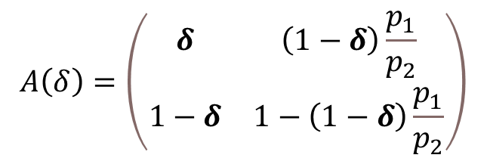
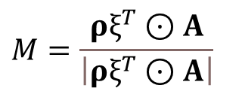
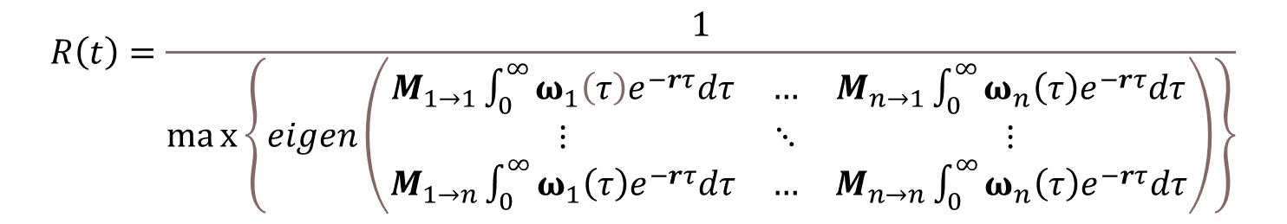
We explore variation in four variables
We compare the inferred R from the multi-type process differs from the inferred R in the single-type process as we change the:
Epidemic growth rate (r)
Relative infectiousness of each group (ρ)
Generation time distribution (ω)
Assortativity of mixing (δ)
$$A\left(δ\right)=\left(\begin{matrix}δ & \left(1−δ\right)\frac{p_{1}}{p_{2}} \\ 1−δ & 1−\left(1−δ\right)\frac{p_{1}}{p_{2}}\end{matrix}\right)$$
$$M=\frac{ρξ^{T}⊙A}{\left|ρξ^{T}⊙A\right|}$$
$$R\left(t\right)=\frac{1}{max\left\{eigen\left(\begin{matrix}M_{1→1}\int_{0}^{∞}{ω_{1}\left(τ\right)e^{−rτ}dτ} & … & M_{n→1}\int_{0}^{∞}{ω_{n}\left(τ\right)e^{−rτ}dτ} \\ ⋮ & ⋱ & ⋮ \\ M_{1→n}\int_{0}^{∞}{ω_{1}\left(τ\right)e^{−rτ}dτ} & … & M_{n→n}\int_{0}^{∞}{ω_{n}\left(τ\right)e^{−rτ}dτ}\end{matrix}\right)\right\}}$$

Slide 11
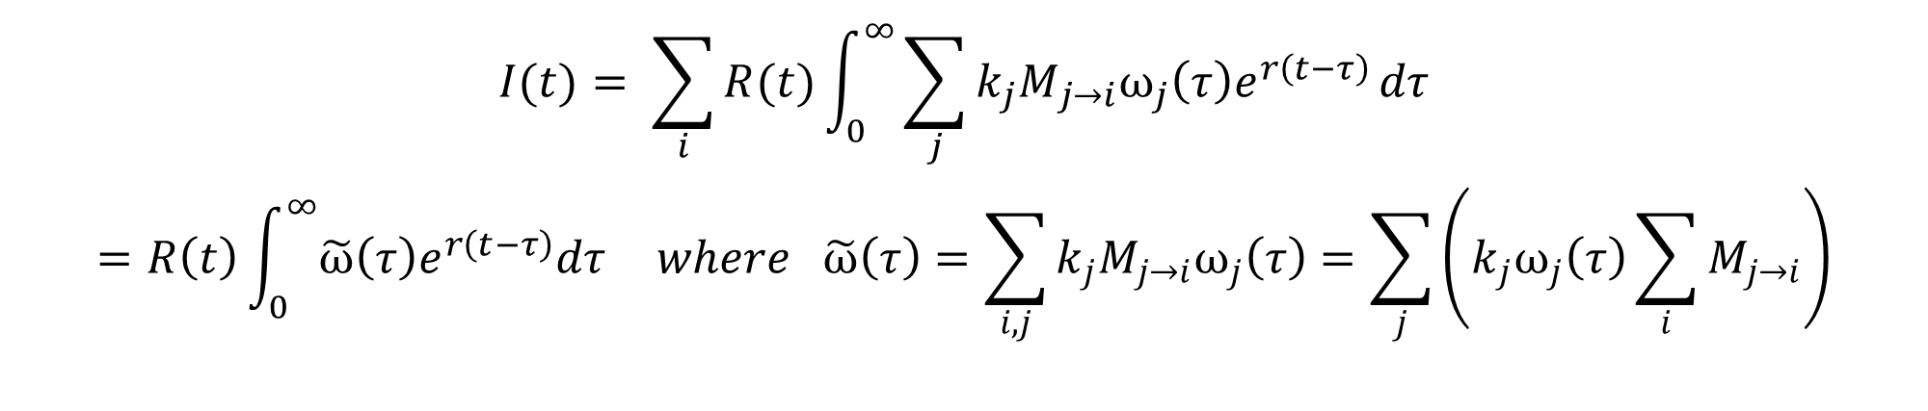
We can also produce a one-dimensional equivalent for use in EpiEstim
$$\left(\begin{matrix}I_{1}\left(t\right) \\ ⋮ \\ I_{n}\left(t\right)\end{matrix}\right)= \int_{0}^{∞}{\left(\begin{matrix}R_{1→1}\left(t\right)ω_{1}\left(τ\right) & ⋯ & R_{n→1}\left(t\right)ω_{n}\left(τ\right) \\ ⋮ & ⋱ & ⋮ \\ R_{1→n}\left(t\right)ω_{1}\left(τ\right) & ⋯ & R_{n→n}\left(t\right)ω_{n}\left(τ\right)\end{matrix}\right)}\left(\begin{matrix}I_{1}\left(t−τ\right) \\ ⋮ \\ I_{n}\left(t−τ\right)\end{matrix}\right)dτ$$
$$\left(\begin{matrix}I_{1}\left(t\right) \\ ⋮ \\ I_{n}\left(t\right)\end{matrix}\right)=\left(\begin{matrix}k_{1} \\ \begin{matrix}⋮ \\ k_{n}\end{matrix}\end{matrix}\right)e^{rt}$$
$$I(t)= \sum_{i}{R(t)\int_{0}^{∞}{\sum_{j}{{k_{j}M}_{j→i}ω_{j}\left(τ\right)e^{r\left(t−τ\right)}}}dτ}$$
$$=R\left(t\right)\int_{0}^{∞}{\tilde{ω}\left(τ\right)e^{r\left(t−τ\right)}dτ} where \tilde{ω}\left(τ\right)=\sum_{i,j}{{k_{j}M}_{j→i}ω_{j}\left(τ\right)}=\sum_{j}{\left(k_{j}ω_{j}\left(τ\right)\sum_{i}{M_{j→i}}\right)}$$
Notes:
In our work we apply the multi-type process using EpiEstim
This assumes a Poisson distributed offspring distribution, which convientily allows plotting of confidence intervals

Slide 12
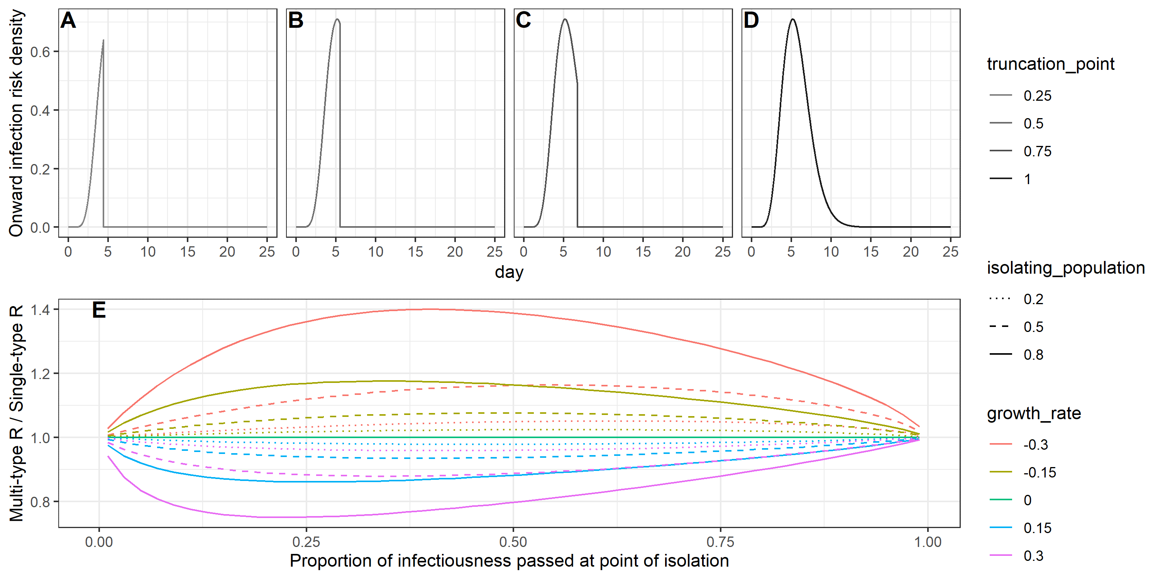
Case isolation

Slide 13
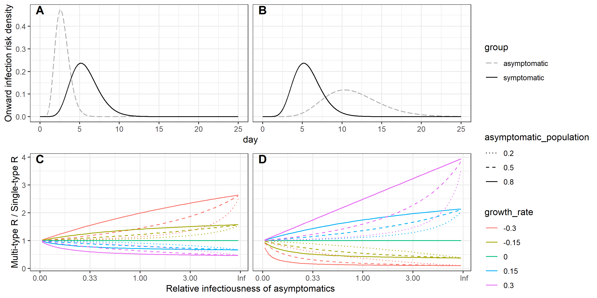
Asymptomatic transmission

Slide 14
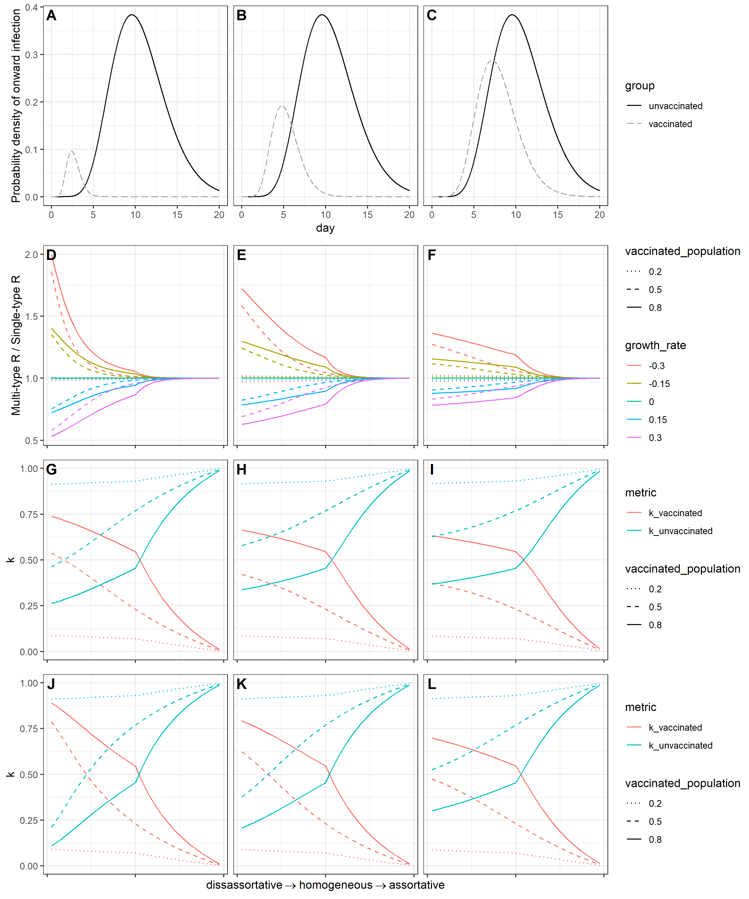
Vaccination
Notes:
Vaccination likely reduces both peak viral load and clearance time
We model this with a shrinking of the distribution in the y=x direction
Assume a fixed affect of susceptibilty

Slide 15
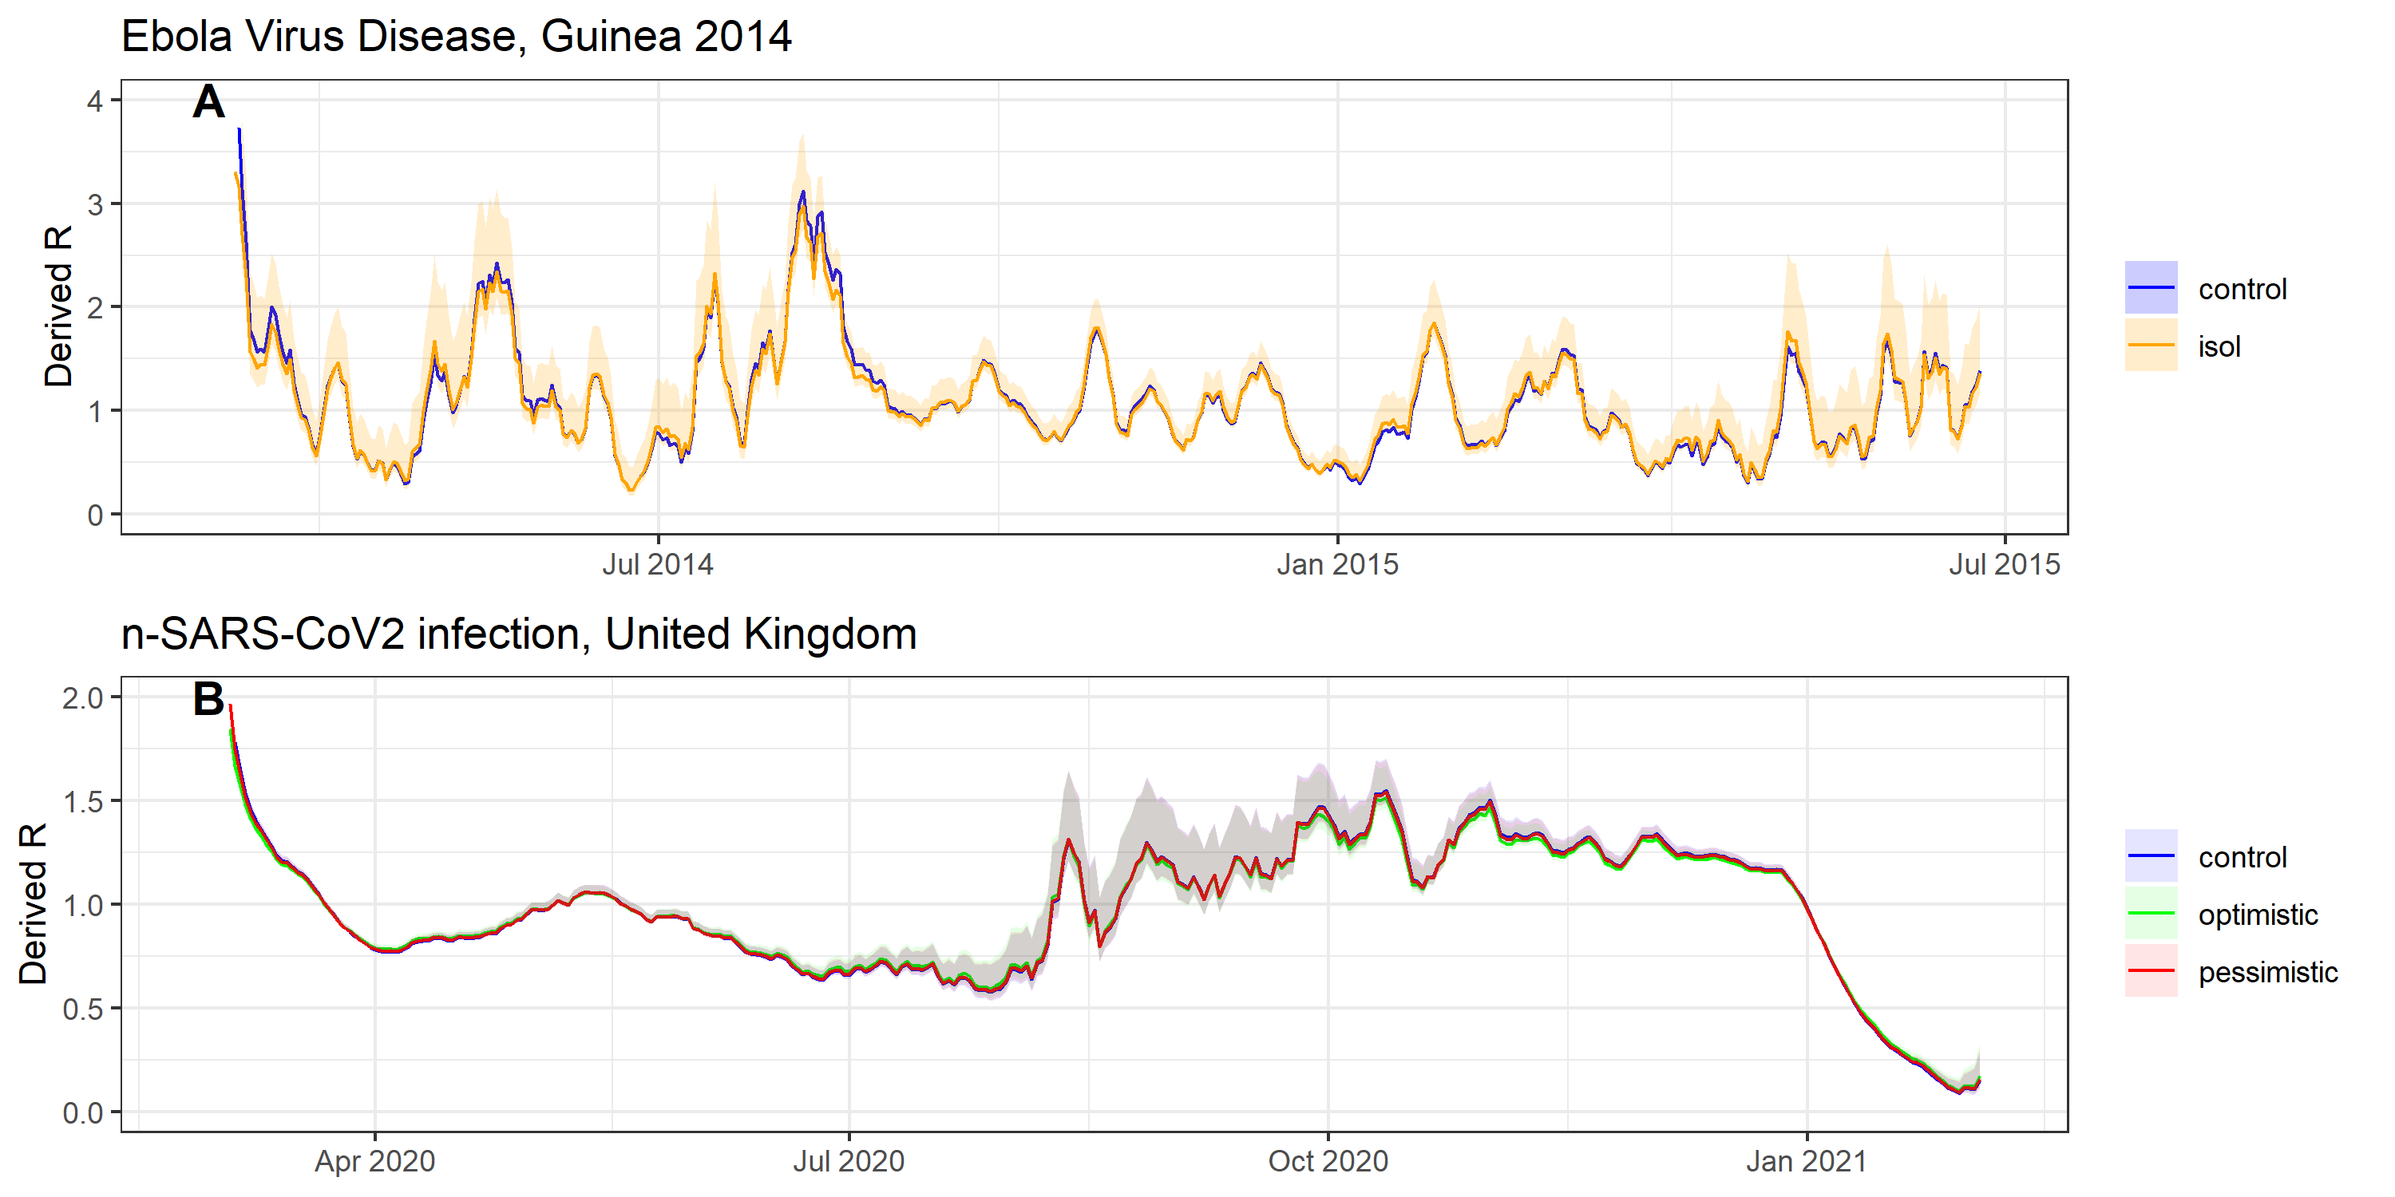
Ebola/SARS-CoV-2: Isolation vs non-isolation

Slide 16
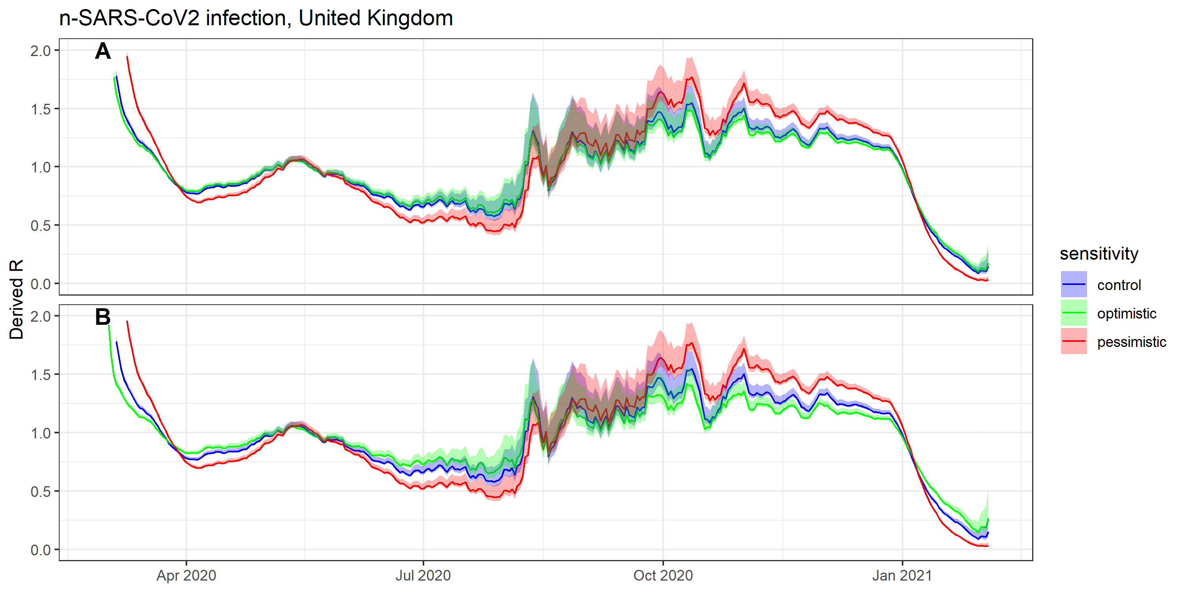
SARS-CoV-2: Asymptomatic transmission

Slide 17
Conclusions and Limitations
Heterogeneity in the generation time distribution can distort estimates of the reproduction number
The impact is small in the case of heterogeneity caused by symptomatic case isolation, but can be high if asymptomatic or vaccinated individuals have particularly different generation time distributions from the well charachterised group
In using the renewal equation, we assumed the generation time distribution depends only on time since infection, τ. This is open to challenge: behavior is likely to change as an epidemic progresses, for instance through a reduction in out-of-household contacts
For the multi-group case, we also assumed that relative infectiousness and susceptibility between groups remained constant through time. However, interventions that reduce susceptibility and infectiousness may have differential uptake between groups (e.g. compliance to isolation on symptom onset may be correlated with compliance of the group to mask-wearing and handwashing)

Slide 18
Moving forwards…
As vaccines against SARS-CoV-2 is rolled out, understanding the impact of the vaccine and of variants on the susceptibility and infectious profile will be increasingly important for an accurate inference of R
Given the vaccine priority schedule broadly follows an age-based approach, mixing between the vaccinated and unvaccinated groups will be more assortative
Estimating the contemporaneous generation time distribution should be regarded as similarly important to estimation of the reproduction number itself, which currently occupies the work of academic modelling groups worldwide for SARS-CoV-2
While estimation of the generation time distribution is necessarily a time-consuming endeavor, testing systems should integrate additional epidemiological information in tandem with their test and trace protocols. Updated estimates of the serial interval could be obtained by requiring test applicants to supply their symptom onset date, with linkage to traced contacts should they also enter the testing system.

Slide 19



Acknowledgements
Supervisors
Dr Anne Cori
Professor Neil Ferguson
Funding
Wellcome Trust

Slide 20
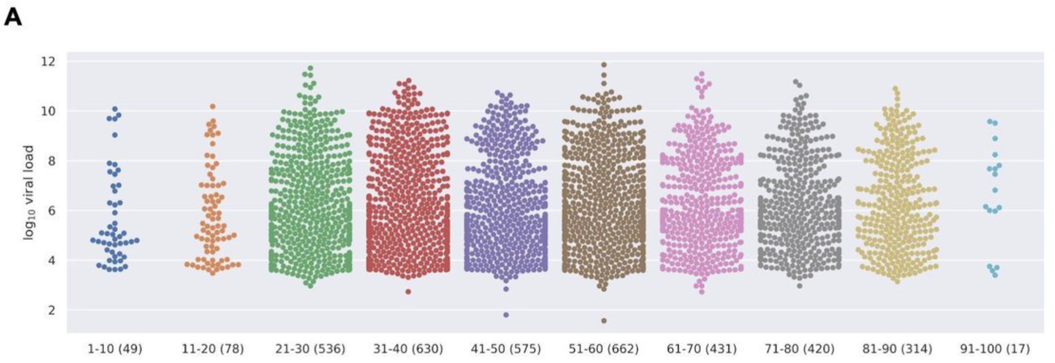
Viral shedding could be reduced by effective antivirals

