Slide 1
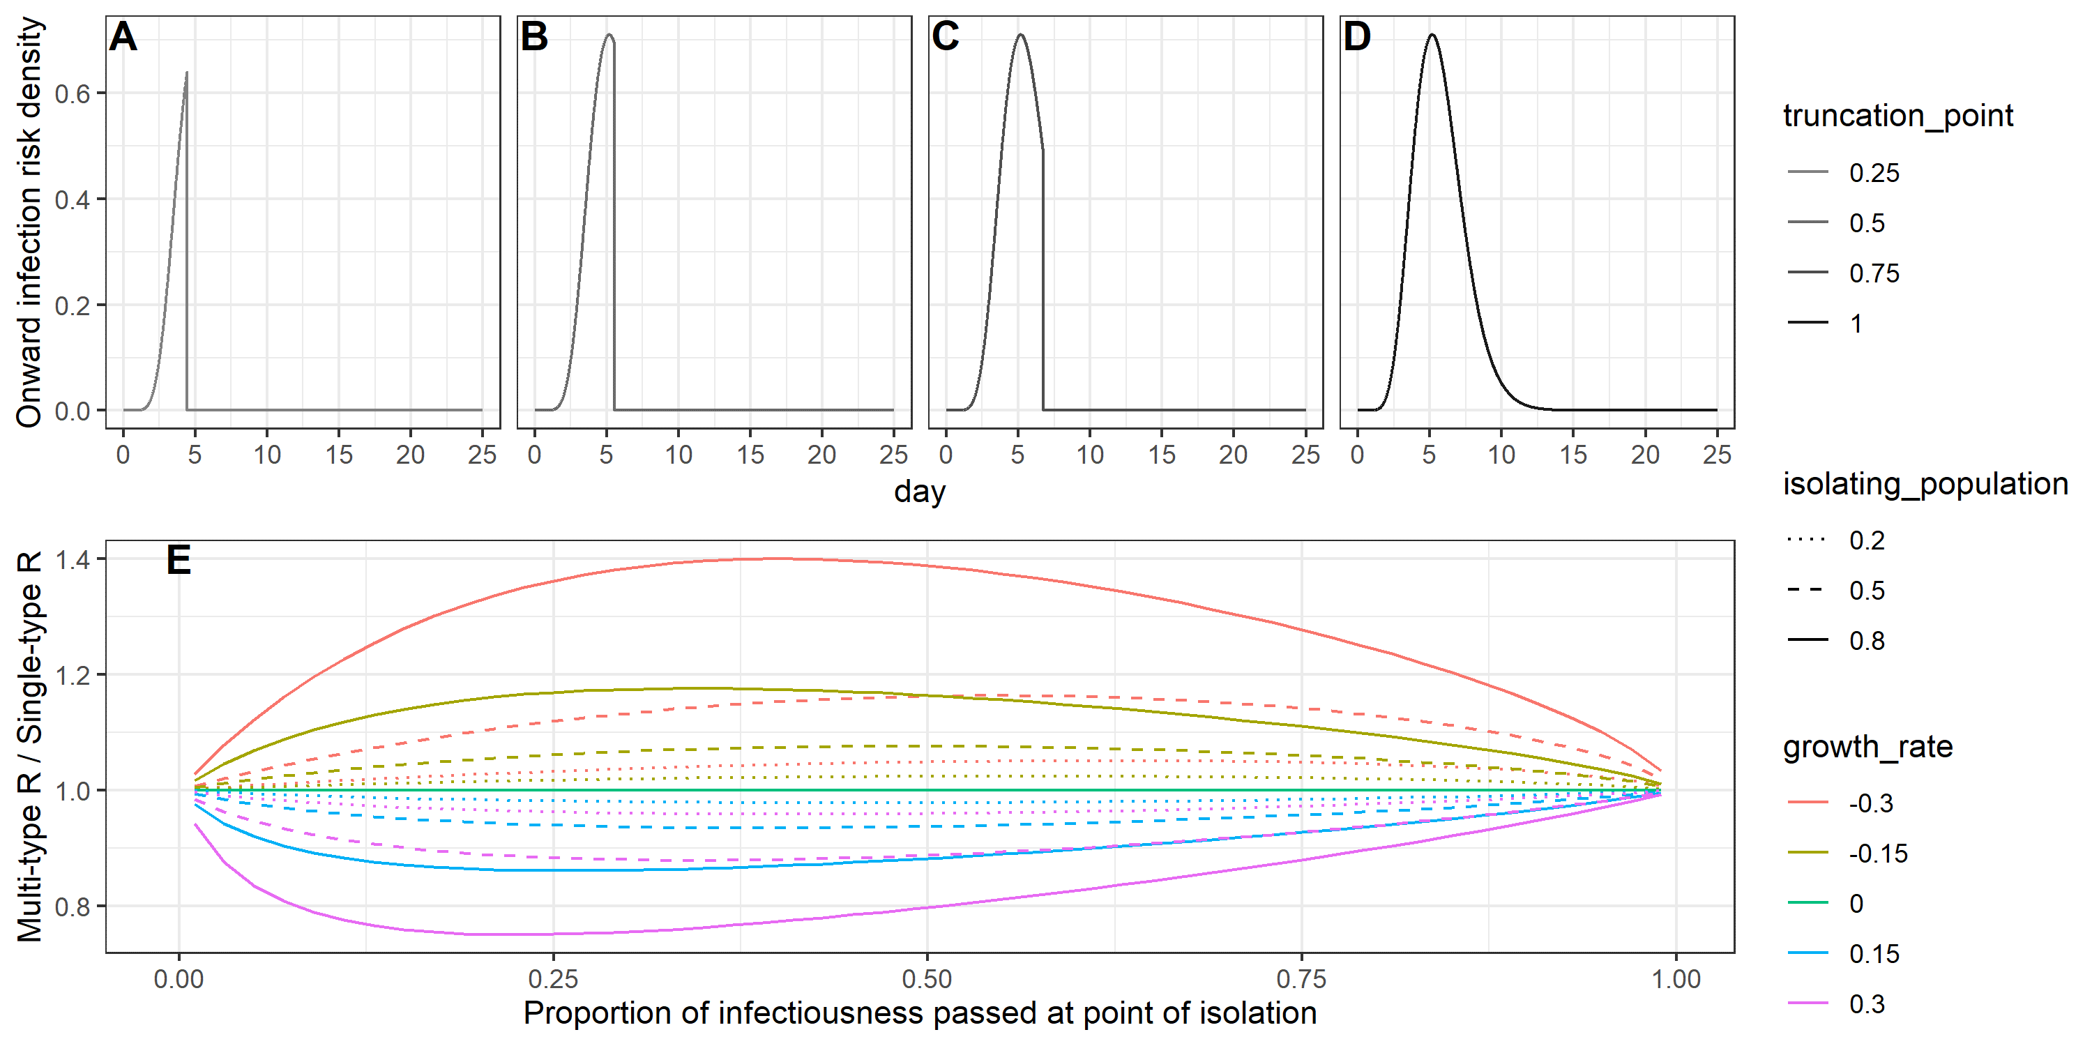
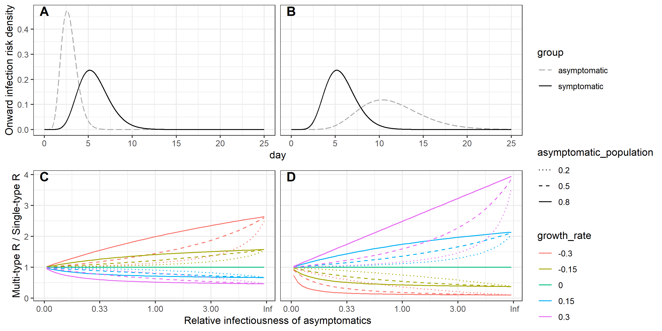
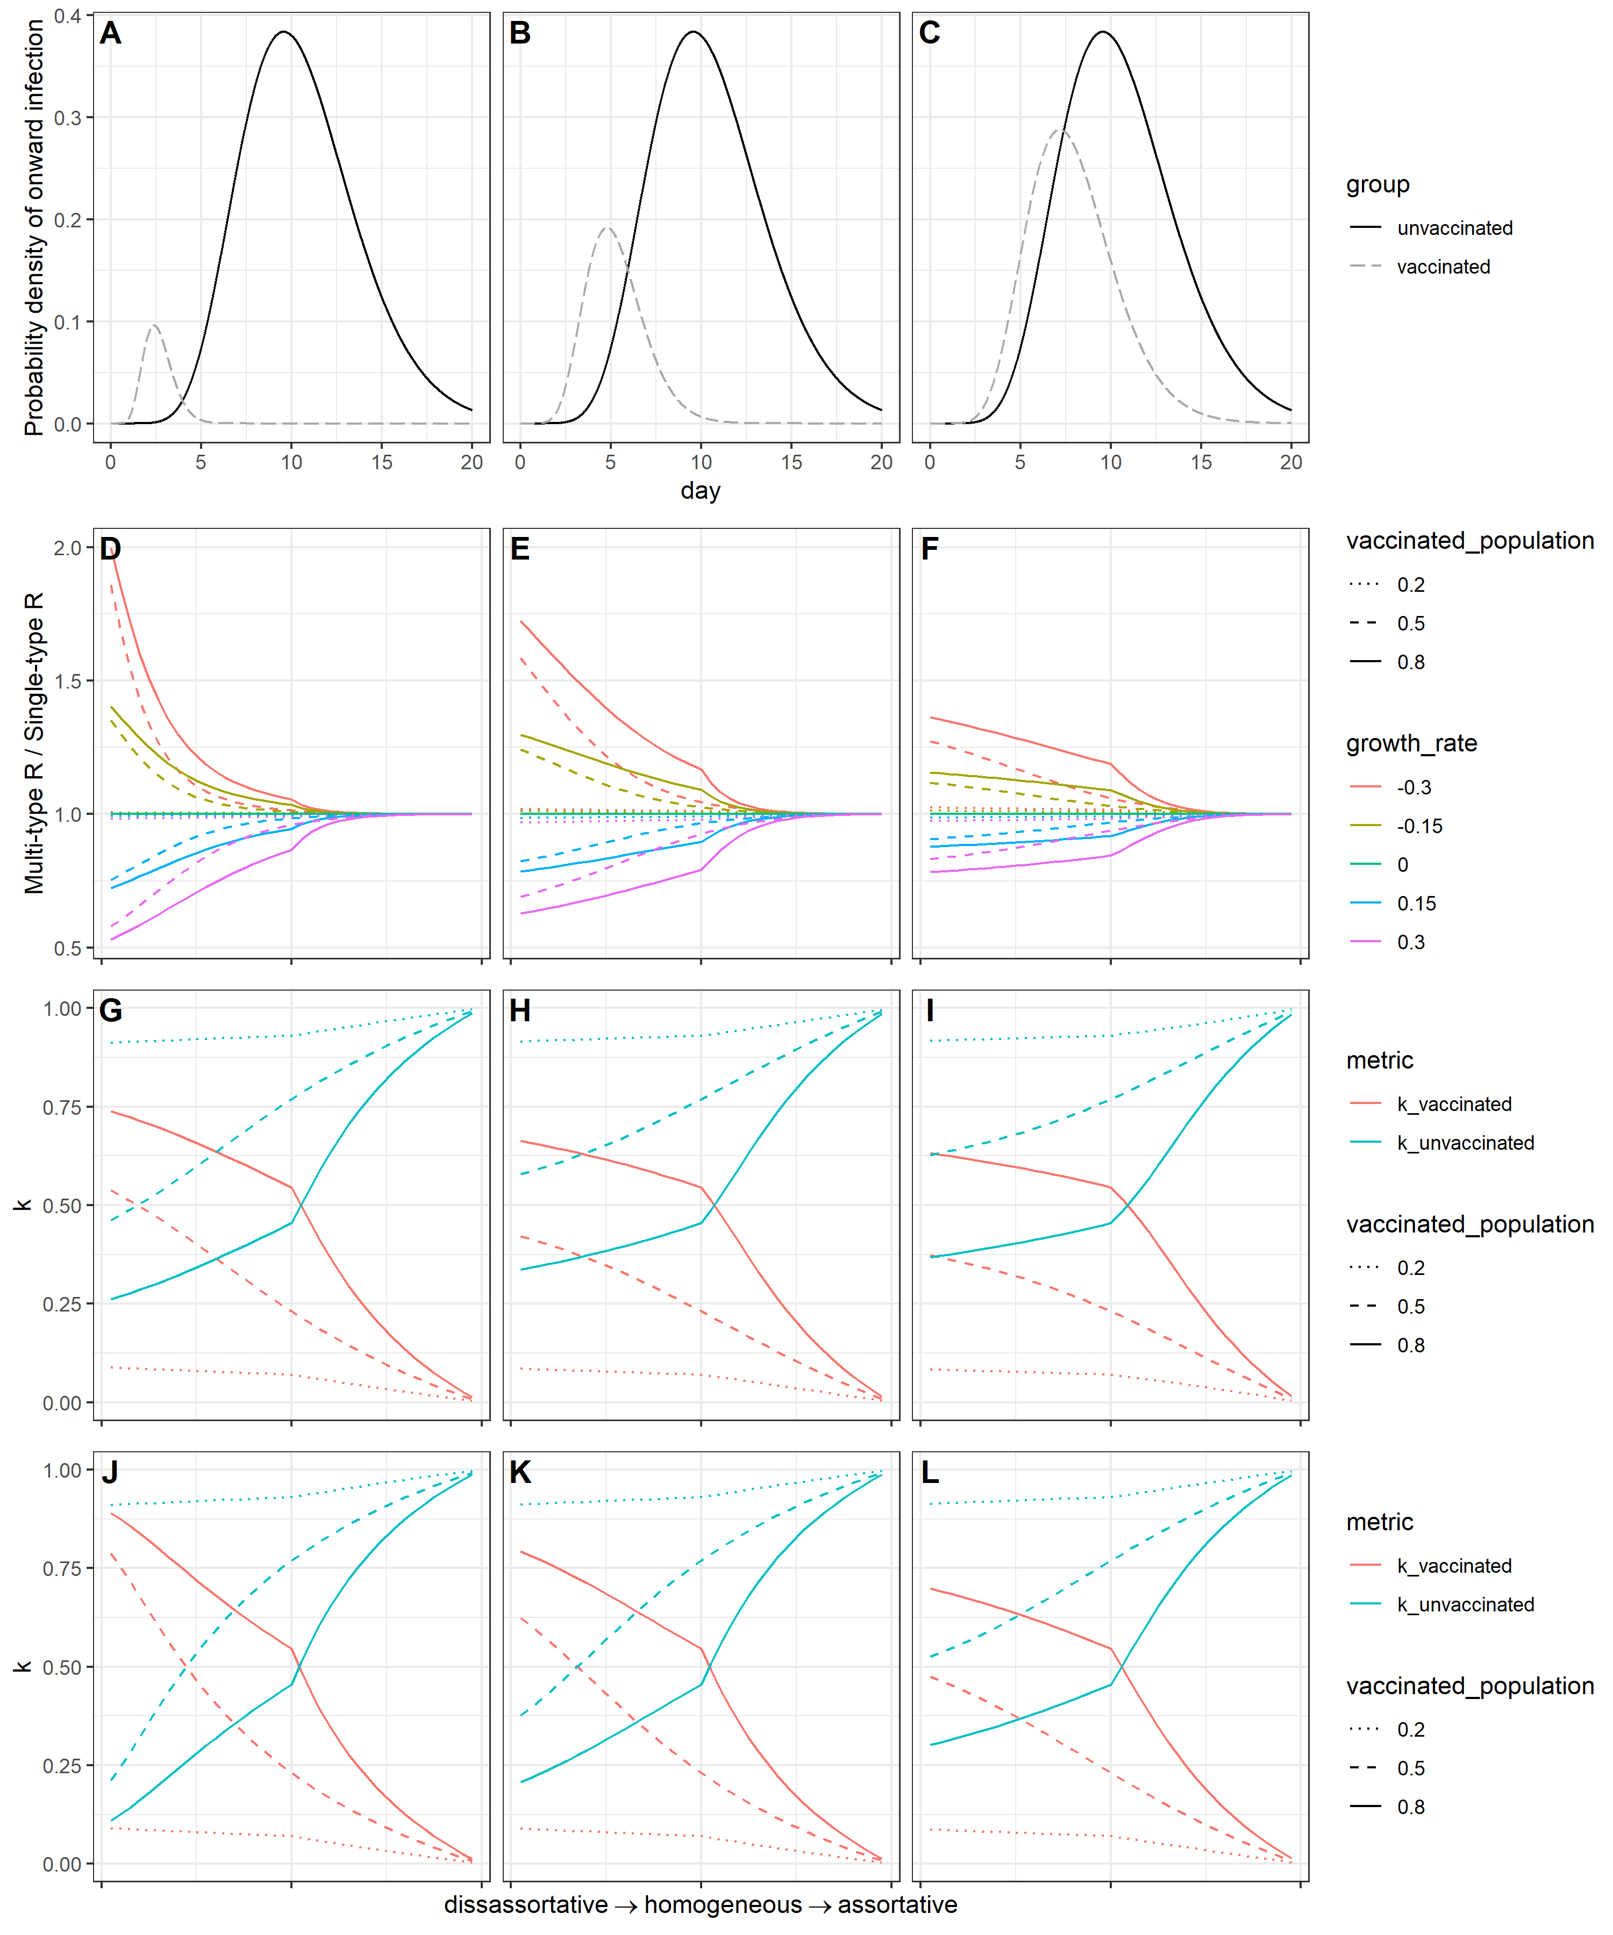
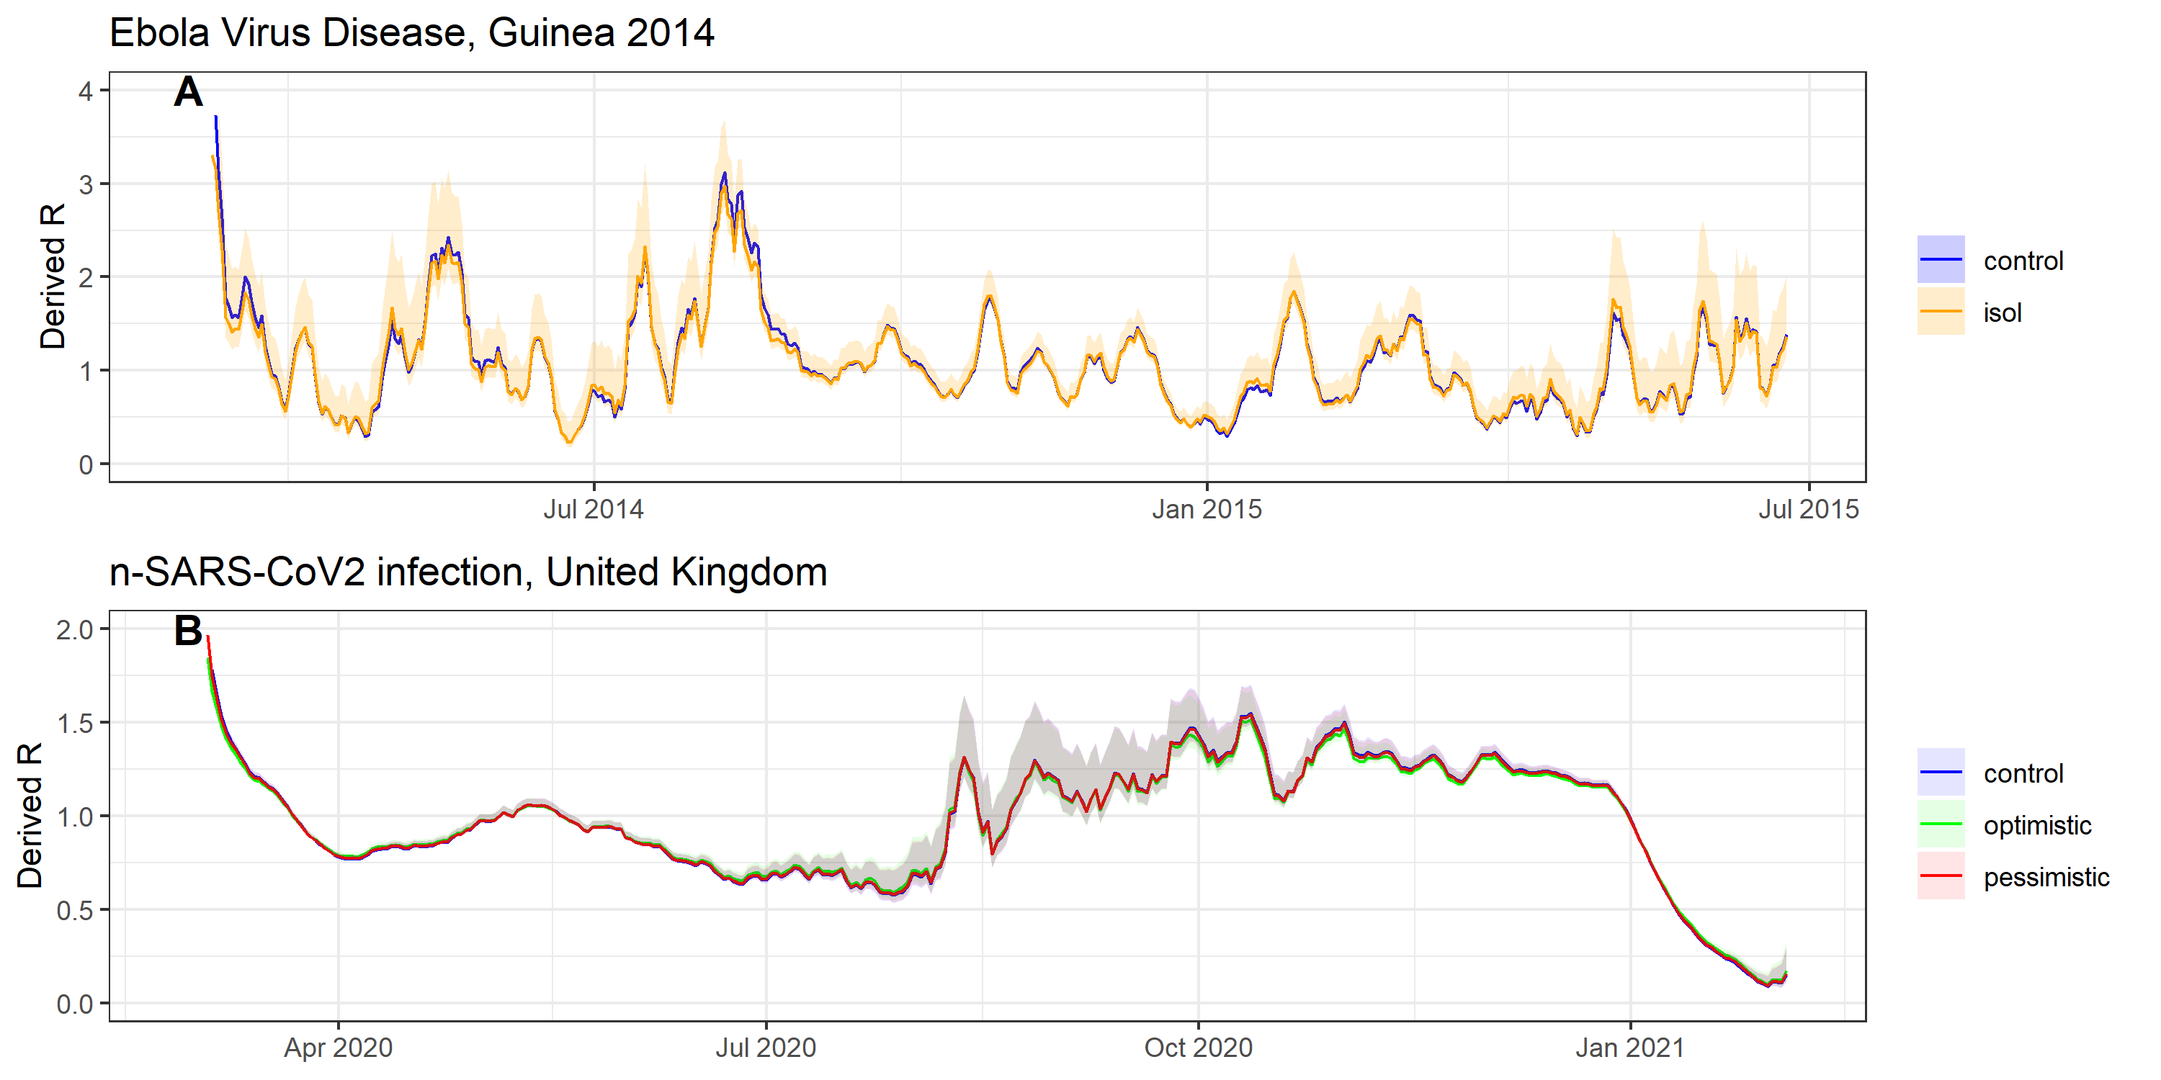
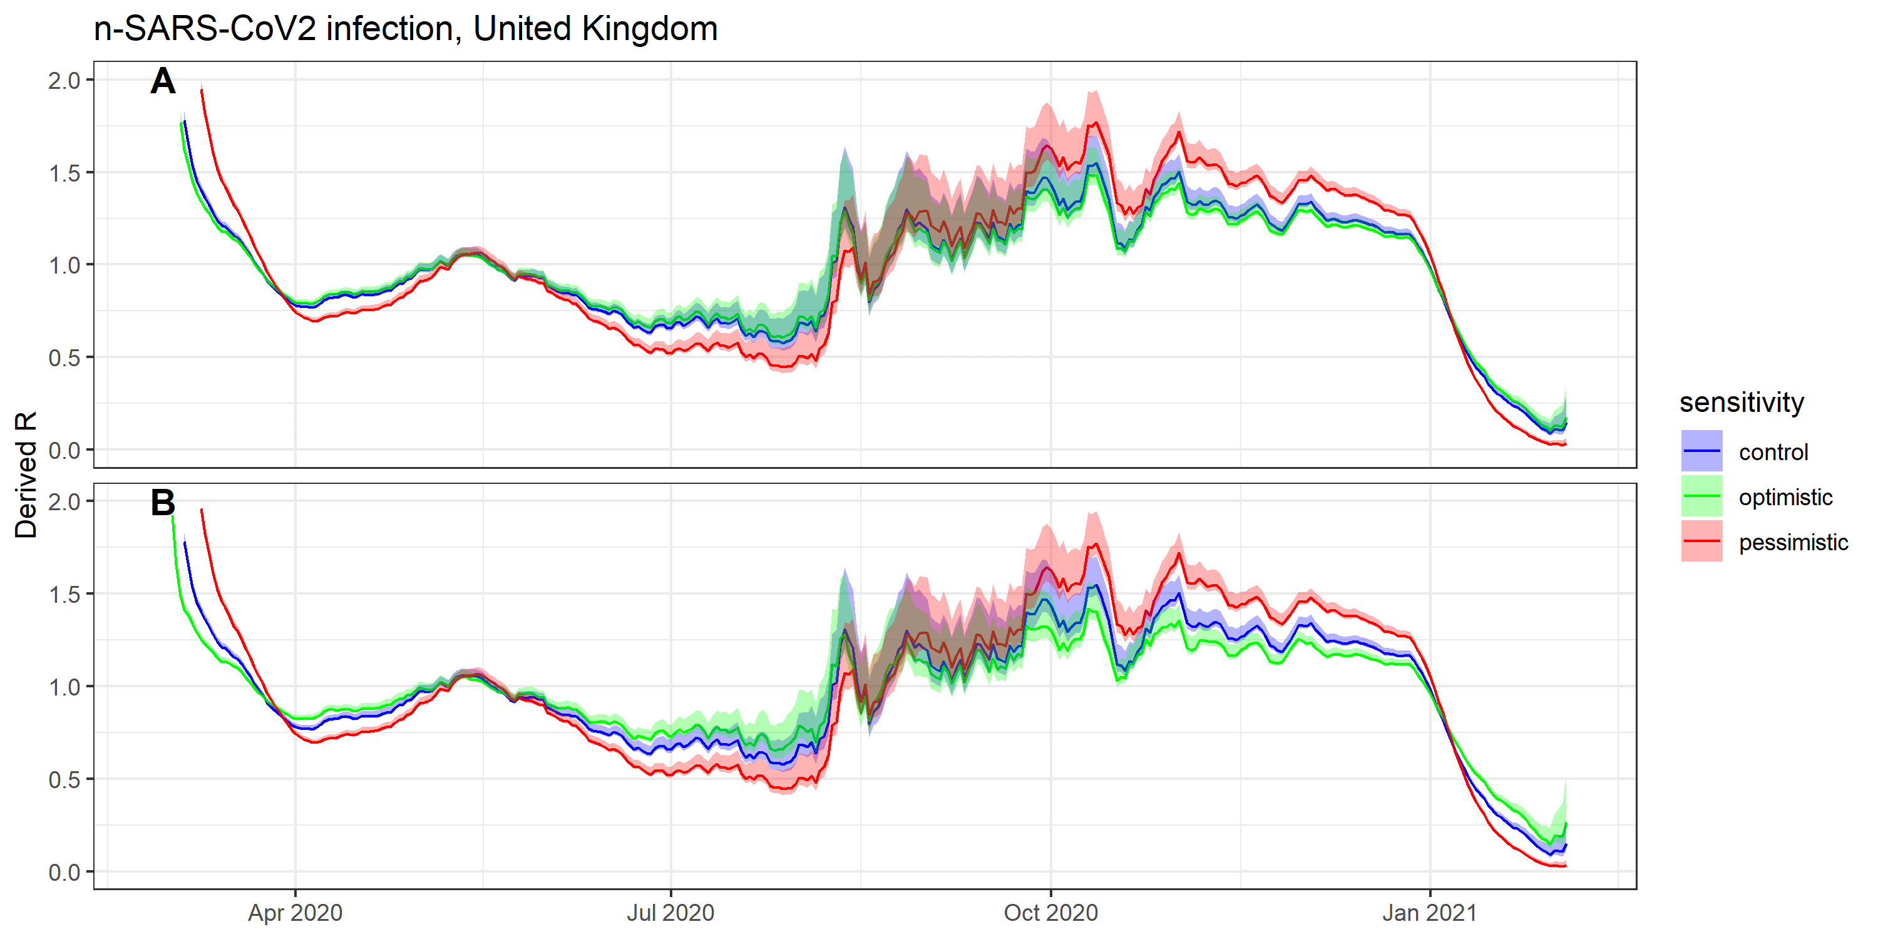
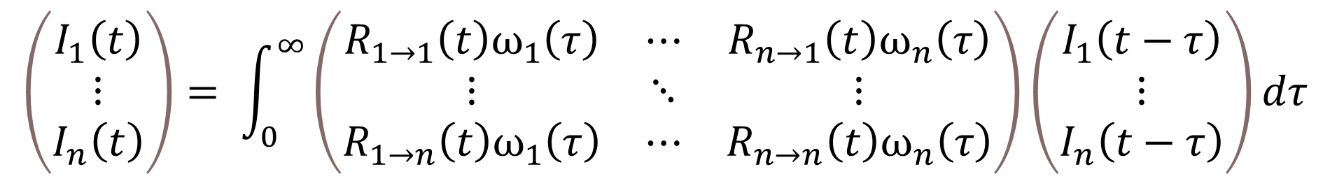
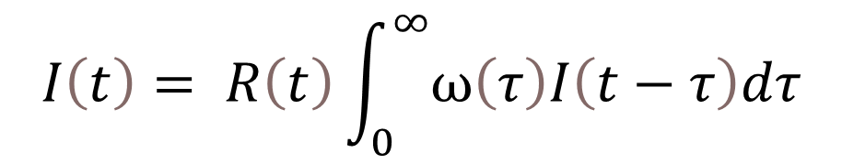
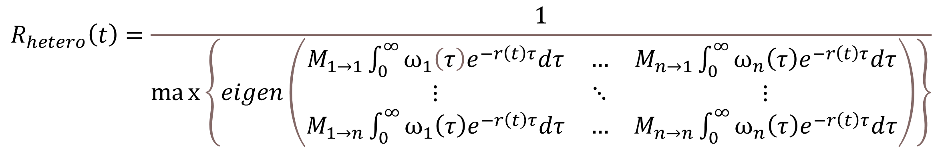
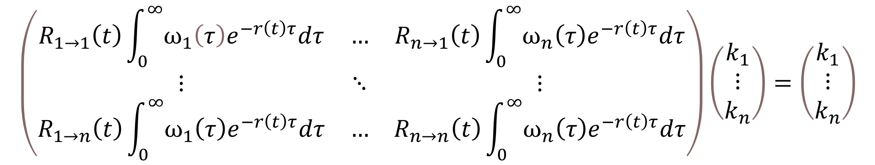
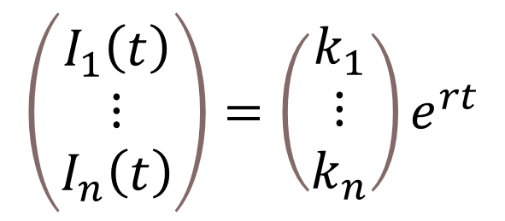
Inferring the reproduction number in heterogeneous epidemics
Background
Methods
A simple and widely used approach to estimate the effective reproduction number is via the renewal equation, in which all infected individuals are assumed to have the same infectious profile over time
However, variation in infectious profiles may results from biological and behavioral differences between individuals
Symptomatic or asymptomatic infection
Symptomatic self-isolation
Vaccination status
In a novel outbreak, initial estimates of the generation time distribution are typically based on an analysis of the “first few hundred cases” which are typically focused on symptomatic transmission only, with little emphasis on characterizing heterogeneities among infected individuals
In this paper, we derive a multi-type equivalent of the renewal equation which accounts for heterogeneity in infectious profiles, and explore how much the corresponding estimated R differs from a “naïve” R derived from a single-type branching process
We consider two applications to illustrate the potential impact on R estimates of neglecting heterogeneities: Ebola Virus Disease in Guinea in 2014-15, and to SARS-CoV-2 in the UK between March 2020 and January 2021
The renewal equation links the incidence of infection at time t with the reproduction number R(t) and the generation time distribution ω(τ)
$$I\left(t\right)= R\left(t\right)\int_{0}^{∞}{ω\left(τ\right)I\left(t−τ\right)dτ}$$
With heterogeneity in transmission, this can be adapted to a matrix equation
$$\left(\begin{matrix}I_{1}\left(t\right) \\ ⋮ \\ I_{n}\left(t\right)\end{matrix}\right)= \int_{0}^{∞}{\left(\begin{matrix}R_{1→1}\left(t\right)ω_{1}\left(τ\right) & ⋯ & R_{n→1}\left(t\right)ω_{n}\left(τ\right) \\ ⋮ & ⋱ & ⋮ \\ R_{1→n}\left(t\right)ω_{1}\left(τ\right) & ⋯ & R_{n→n}\left(t\right)ω_{n}\left(τ\right)\end{matrix}\right)}\left(\begin{matrix}I_{1}\left(t−τ\right) \\ ⋮ \\ I_{n}\left(t−τ\right)\end{matrix}\right)dτ$$
We assume a solution of the form below
$$\left(\begin{matrix}I_{1}\left(t\right) \\ ⋮ \\ I_{n}\left(t\right)\end{matrix}\right)=\left(\begin{matrix}k_{1} \\ \begin{matrix}⋮ \\ k_{n}\end{matrix}\end{matrix}\right)e^{rt}$$
This yields an eigenvalue equation
$$\left(\begin{matrix}R_{1→1}\left(t\right)\int_{0}^{∞}{ω_{1}\left(τ\right)e^{−r\left(t\right)τ}dτ} & … & R_{n→1}\left(t\right)\int_{0}^{∞}{ω_{n}\left(τ\right)e^{−r\left(t\right)τ}dτ} \\ ⋮ & ⋱ & ⋮ \\ R_{1→n}\left(t\right)\int_{0}^{∞}{ω_{1}\left(τ\right)e^{−r\left(t\right)τ}dτ} & … & R_{n→n}\left(t\right)\int_{0}^{∞}{ω_{n}\left(τ\right)e^{−r\left(t\right)τ}dτ}\end{matrix}\right)\left(\begin{matrix}k_{1} \\ \begin{matrix}⋮ \\ k_{n}\end{matrix}\end{matrix}\right)=\left(\begin{matrix}k_{1} \\ \begin{matrix}⋮ \\ k_{n}\end{matrix}\end{matrix}\right)$$
Results
XXX
The reproduction number will be the dominant eigenvalue of the next generation matrix constructed with the elements R_{i→j}. As such, we can factorise out R, leaving matrix elements M which represent the relative risk of transmission between groups i and j.
$$R_{hetero}\left(t\right)=\frac{1}{max\left\{eigen\left(\begin{matrix}M_{1→1}\int_{0}^{∞}{ω_{1}\left(τ\right)e^{−r\left(t\right)τ}dτ} & … & M_{n→1}\int_{0}^{∞}{ω_{n}\left(τ\right)e^{−r\left(t\right)τ}dτ} \\ ⋮ & ⋱ & ⋮ \\ M_{1→n}\int_{0}^{∞}{ω_{1}\left(τ\right)e^{−r\left(t\right)τ}dτ} & … & M_{n→n}\int_{0}^{∞}{ω_{n}\left(τ\right)e^{−r\left(t\right)τ}dτ}\end{matrix}\right)\right\}}$$
Discussion
While the impact of heterogeneity on the inferred reproduction number is limited in the case of heterogeneity caused by symptomatic case isolation, it can be considerable if asymptomatic or vaccinated individuals have particularly different generation time distributions from that of unvaccinated, symptomatic individuals
The difference in inferred R will be smaller for lower growth rates; in instances where the poorly-characterized groups represent a small part of the population; or where there is highly disassortative mixing between the well characterized and poorly characterized groups.
Multiple pathogens have been demonstrated to have both symptomatic and asymptomatic clinical courses, including important epidemic viruses SARS-CoV-2 (33), Influenza (34), Ebola Virus Disease (35) and Middle East Respiratory Syndrome (MERS) (36). Previous work has shown that a difference in the generation time distribution of asymptomatic vs symptomatic carriers of COVID can lead to biased estimates of the effective reproduction number (37).
Viral shedding will itself depend on individual viral load, and the efficiency and duration of viral expulsion. Viral load studies for influenza infection have shown that asymptomatic and paucisymptomatic cases had 1-2 log₁₀ fewer copies of viral RNA than symptomatic cases, as well as shorter shedding times (38). Similarly, studies on MERS have found the duration of PCR-positivity was increased with disease severity (39). Symptoms themselves also increase viral expulsion: a cough can produce an estimated 3,000 droplets, and a sneeze an estimated 40,000 (40); both far more efficient routes of viral expulsion than breathing or talking alone (41) which would be the typically transmission route for asymptomatic carriers. Conversely, development of symptoms is likely to reduce contacts outside of the household following the incubation period of an infection, especially in cases where self-isolation is mandated for those developing symptoms.
There have been varying conclusions from studies on the difference in viral load between symptomatic and asymptomatic infections in SARS-CoV-2 infection. Where some studies have found viral load to be similar between symptomatic and asymptomatic SARS-CoV-2 patients (42,43), others have found statistically significant differences in viral load (44,45) and clearance time (46,47), or that shedding duration increases with disease severity (48). A further study in Catalonia has found severity to be positively correlated with viral load, and that higher viral loads led to a greater extent of onward transmission (49). A recent literature review including 79 studies on SARS-CoV-2 concluded that the sum of evidence suggests viral load is similar between symptomatic and asymptomatic individuals, most studies ‘demonstrate faster viral clearance among asymptomatic than those who are symptomatic (50). Conversely, symptomatic SARS-CoV-2 infecteds are likely to reduce their contacts following onset. This was passed into UK law as a means of controlling the SARS-CoV-2 pandemic, with isolation of 10 days mandated for individuals developing symptoms (and receiving a positive test for) of COVID-19, and for their households (51).
Vaccination often has an important impact on viral load and/or infectiousness over time, for instance with oral poliovirus vaccine (OPV and inactivated poliovirus vaccine (IPV) (27,28). The importance of understanding the generation time distribution of multiple groups becomes increasingly important with disassortative mixing. This may be particularly important when estimating the reproduction number of sexually transmitted infections in heterosexual contact networks, for instance with HPV, for which vaccination uptake has previously been limited to females.
As vaccines against SARS-CoV-2 are rolled out over the coming months, understanding the impact of the vaccine on the susceptibility and infectious profile will be increasingly important for an accurate inference of R. Given the vaccine priority schedule broadly follows an age-based approach, mixing between the vaccinated and unvaccinated groups will be more assortative. It is also currently the case that the vaccine is not recommended for those under 18 years of age, among which significant assortative mixing occurs in schools.
Estimating the contemporaneous generation time distribution should be regarded as similarly important to estimation of the reproduction number itself, which currently occupies the work of academic modelling groups worldwide for SARS-CoV-2. Better capturing the heterogeneities of the generation time distribution will become increasingly important as vaccination is rolled out, as well as with the emergence of new strains which may exhibit different infectious profiles. Upcoming SARS-CoV-2 challenge trials in the UK should enable detailed analysis of viral load profiles and symptomatic rates, which can inform updated generation time distributions (51).
While estimation of the generation time distribution is necessarily a time-consuming endeavor, testing systems should integrate additional epidemiological information in tandem with their test and trace protocols. Updated estimates of the serial interval could be obtained by requiring test applicants to supply their symptom onset date, with linkage to traced contacts should they also enter the testing system. For a more direct means to estimate changes in the generation time distribution, or indeed the incubation period, individuals could be asked for dates of contact with known infected in the previous week, and this too linked with contacts who enter the test and trace system.
Not sure all this is really needed – could just cite Severe Acute Respiratory Syndrome Coronavirus 2 (SARS-CoV-2) Setting-specific Transmission Rates: A Systematic Review and Meta-analysis | Clinical Infectious Diseases | Oxford Academic (oup.com) which estimates that asymptomatic infections are 1/7th as infectious as symptomatic ones
Eisele TP et al. Short-term Impact of Mass Drug Administration With Dihydroartemisinin Plus Piperaquine on Malaria in Southern Province Zambia: A Cluster-Randomized Controlled Trial. J Infect Dis 2016 Dec 15, 214(12):1831–9
Huber JH et al. Quantitative, model-based estimates of variability in the generation and serial intervals of Plasmodium falciparum malaria. Malaria Journal 2016 Sep 22 15(1):490

