Slide 1
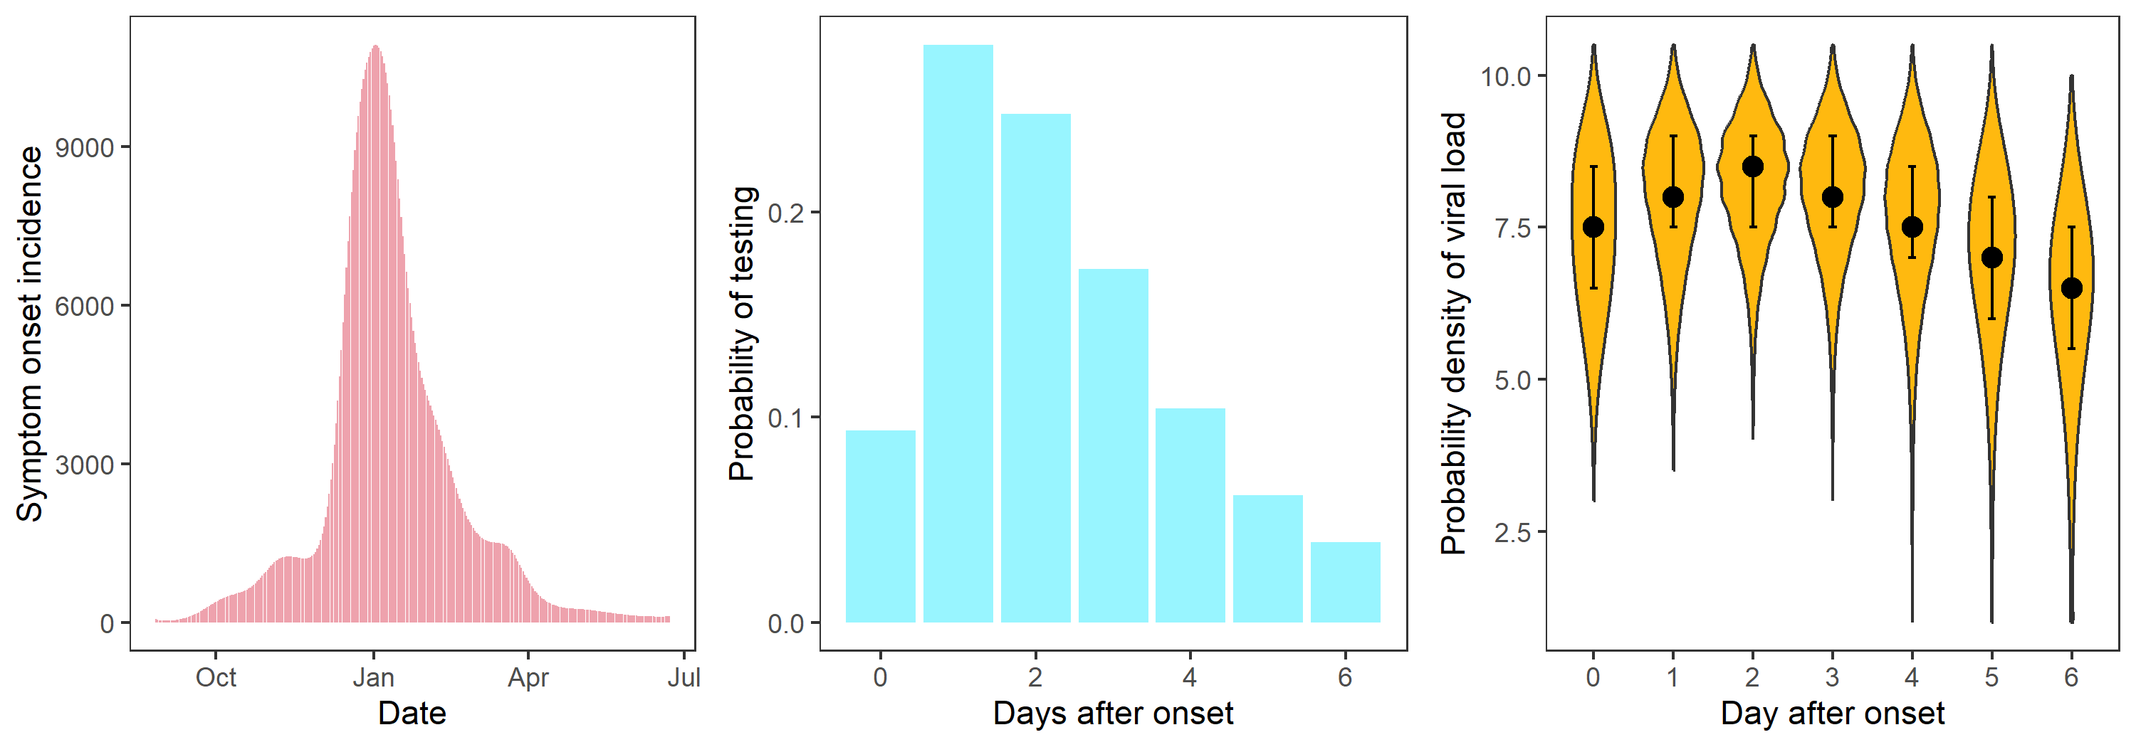
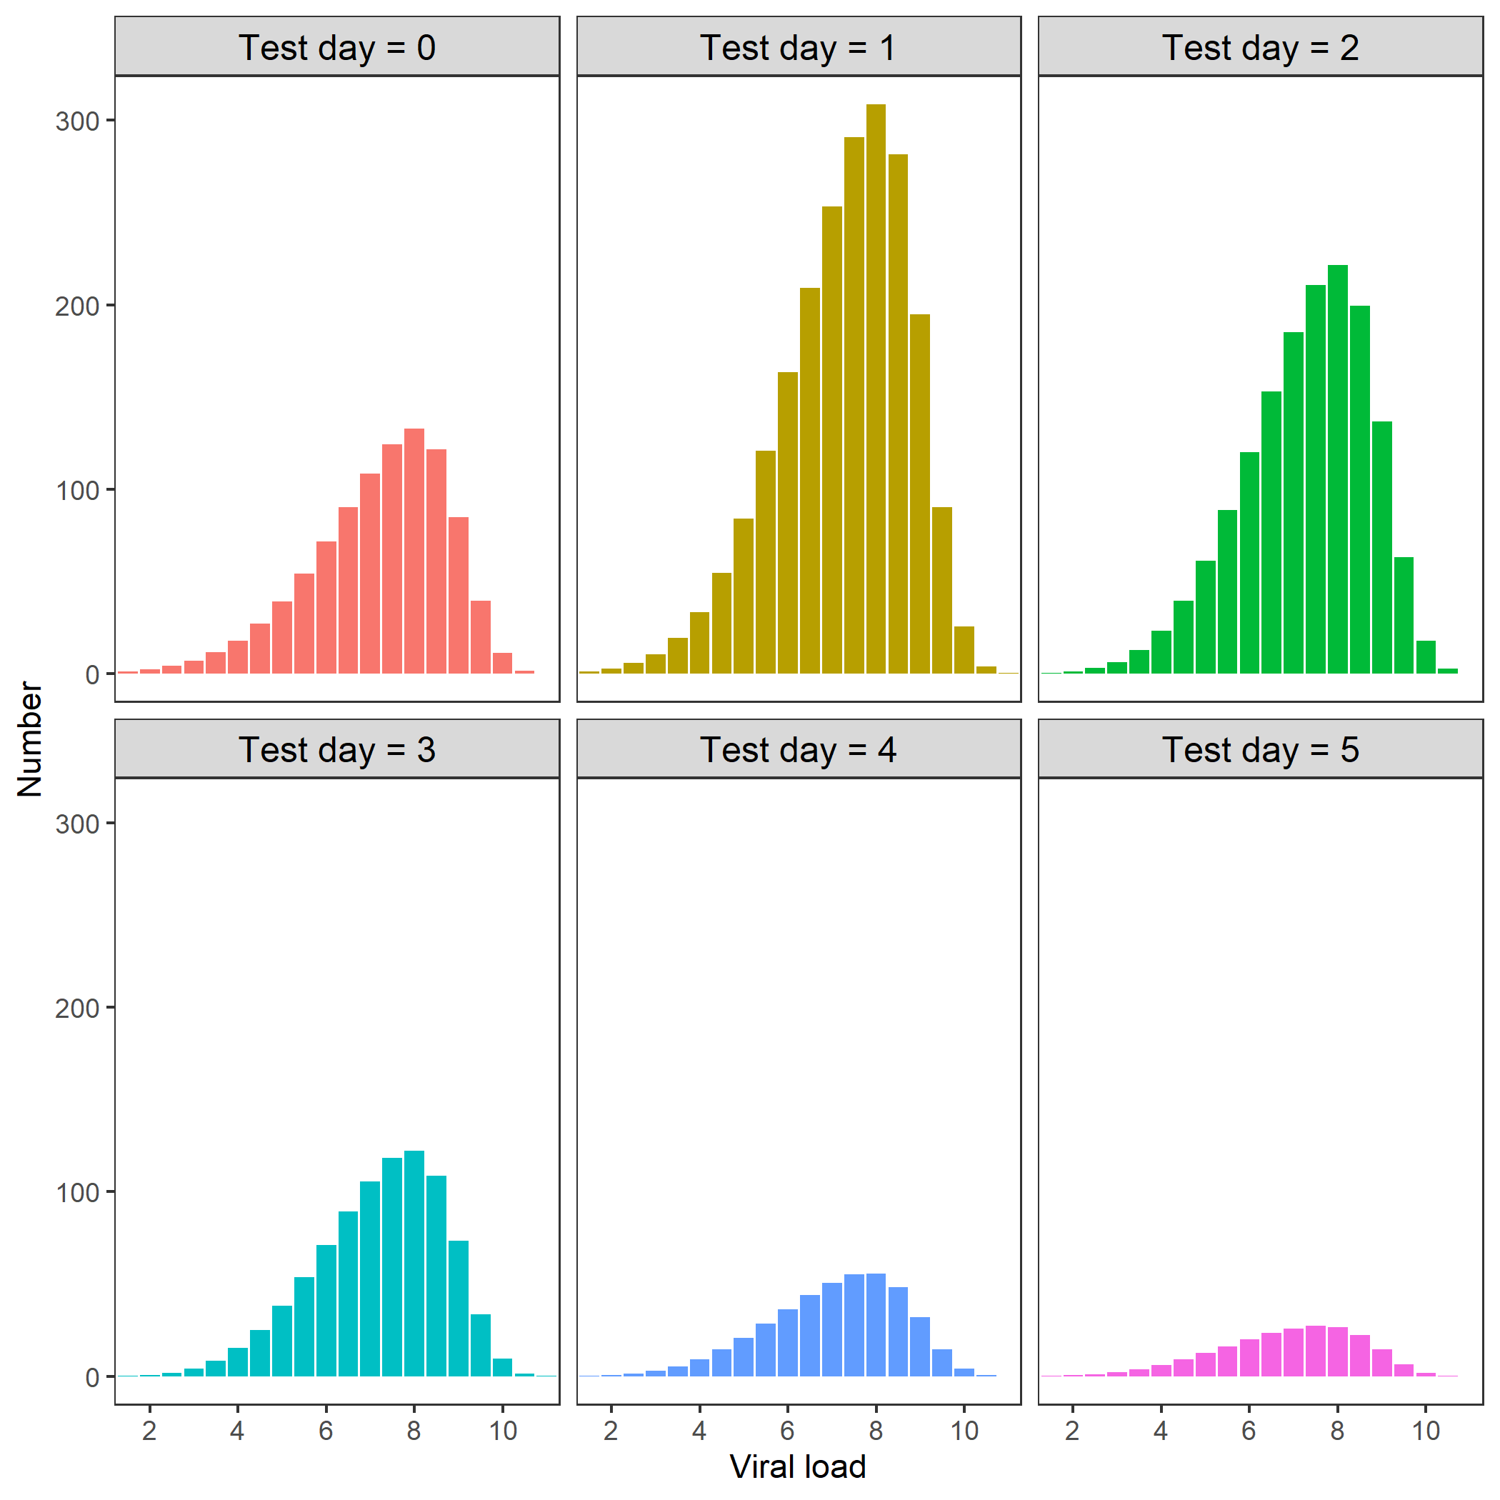
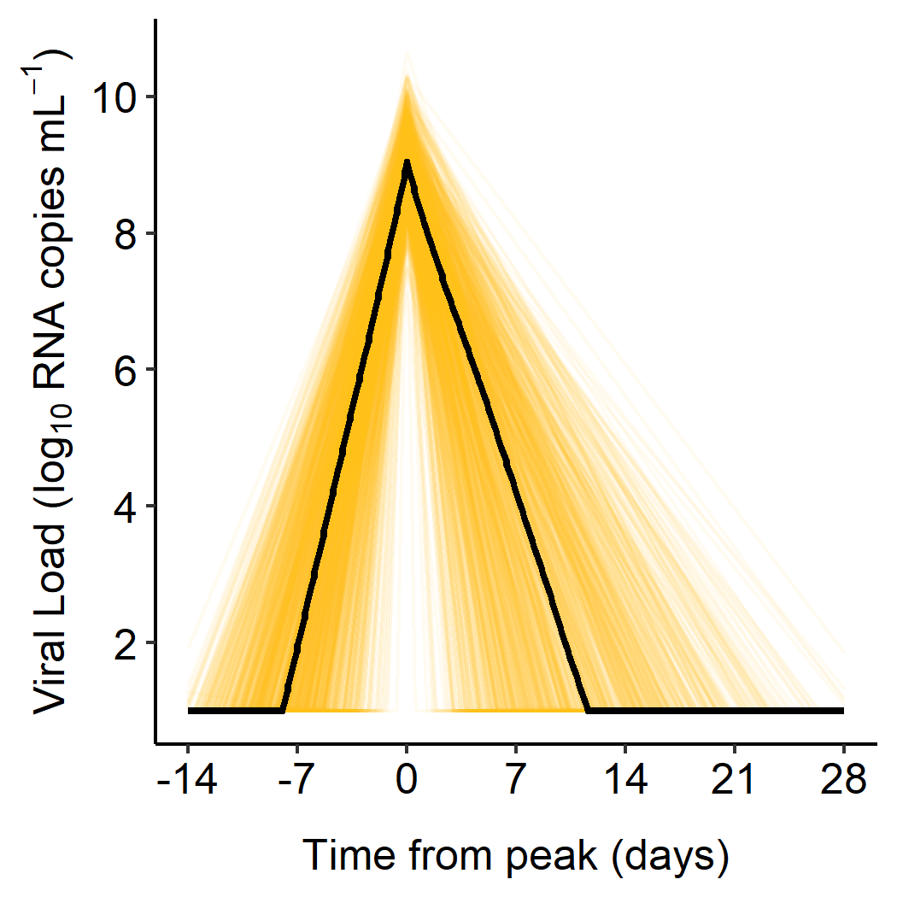
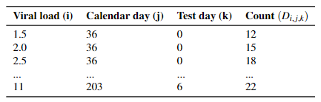

ϑ_{s}
ϑ_{test}
I(ϑ_{s})
δ_{k}^{test}(ϑ_{test} )
q_{i,k}(ϑ_{v,} ϑ_{symp})
ϑ_{symp}
Day j
N_{i,j,k}
ϑ_{v}
D_{i,j,k}
Likelihood

Slide 2



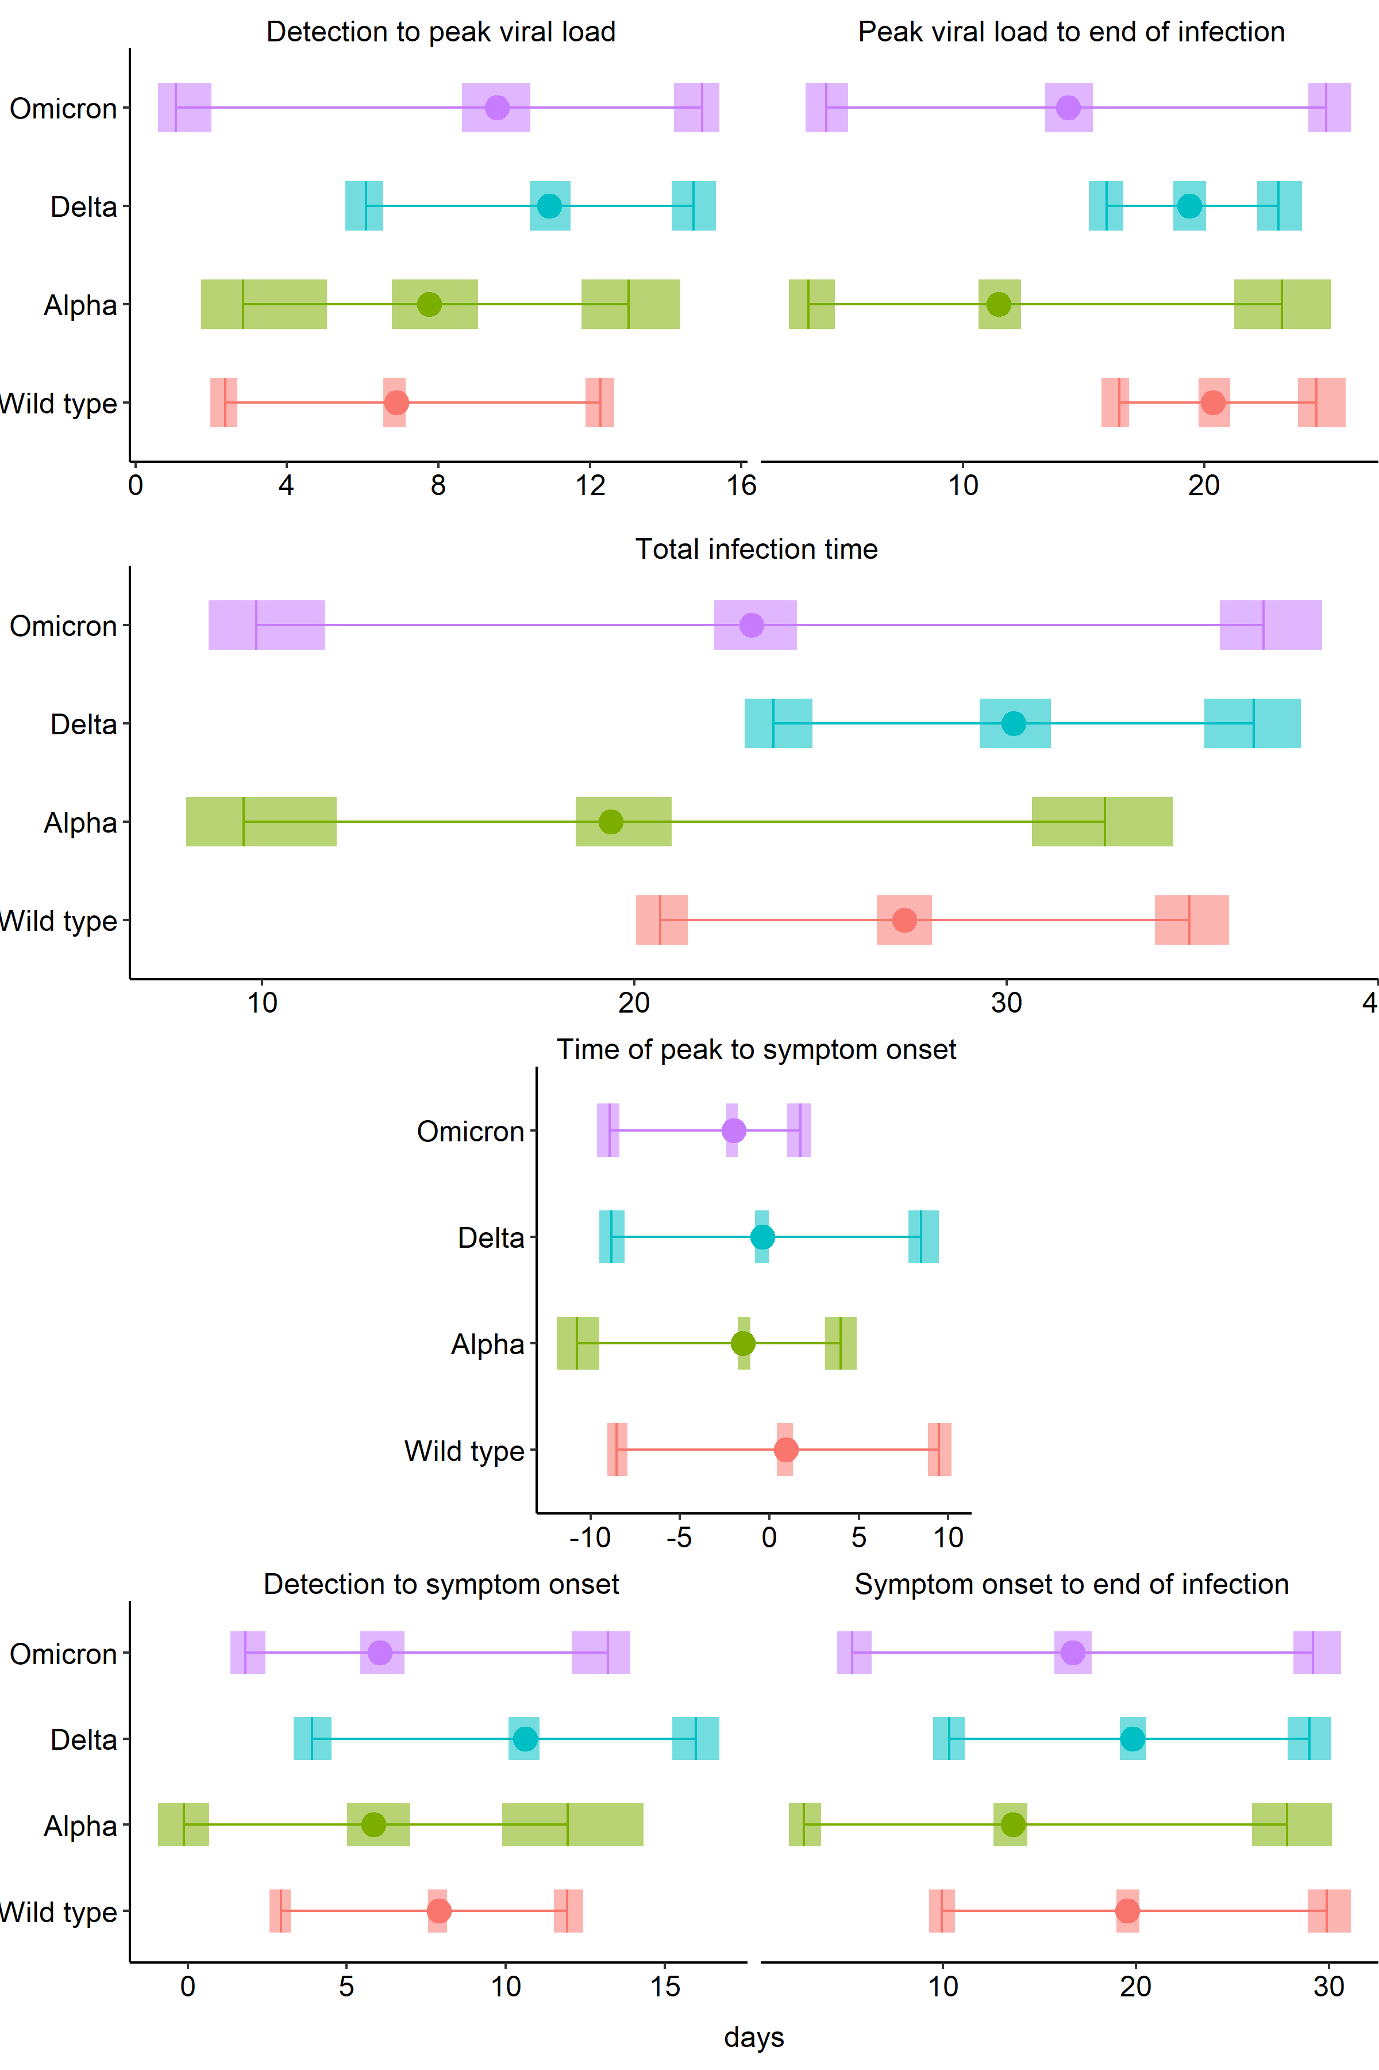
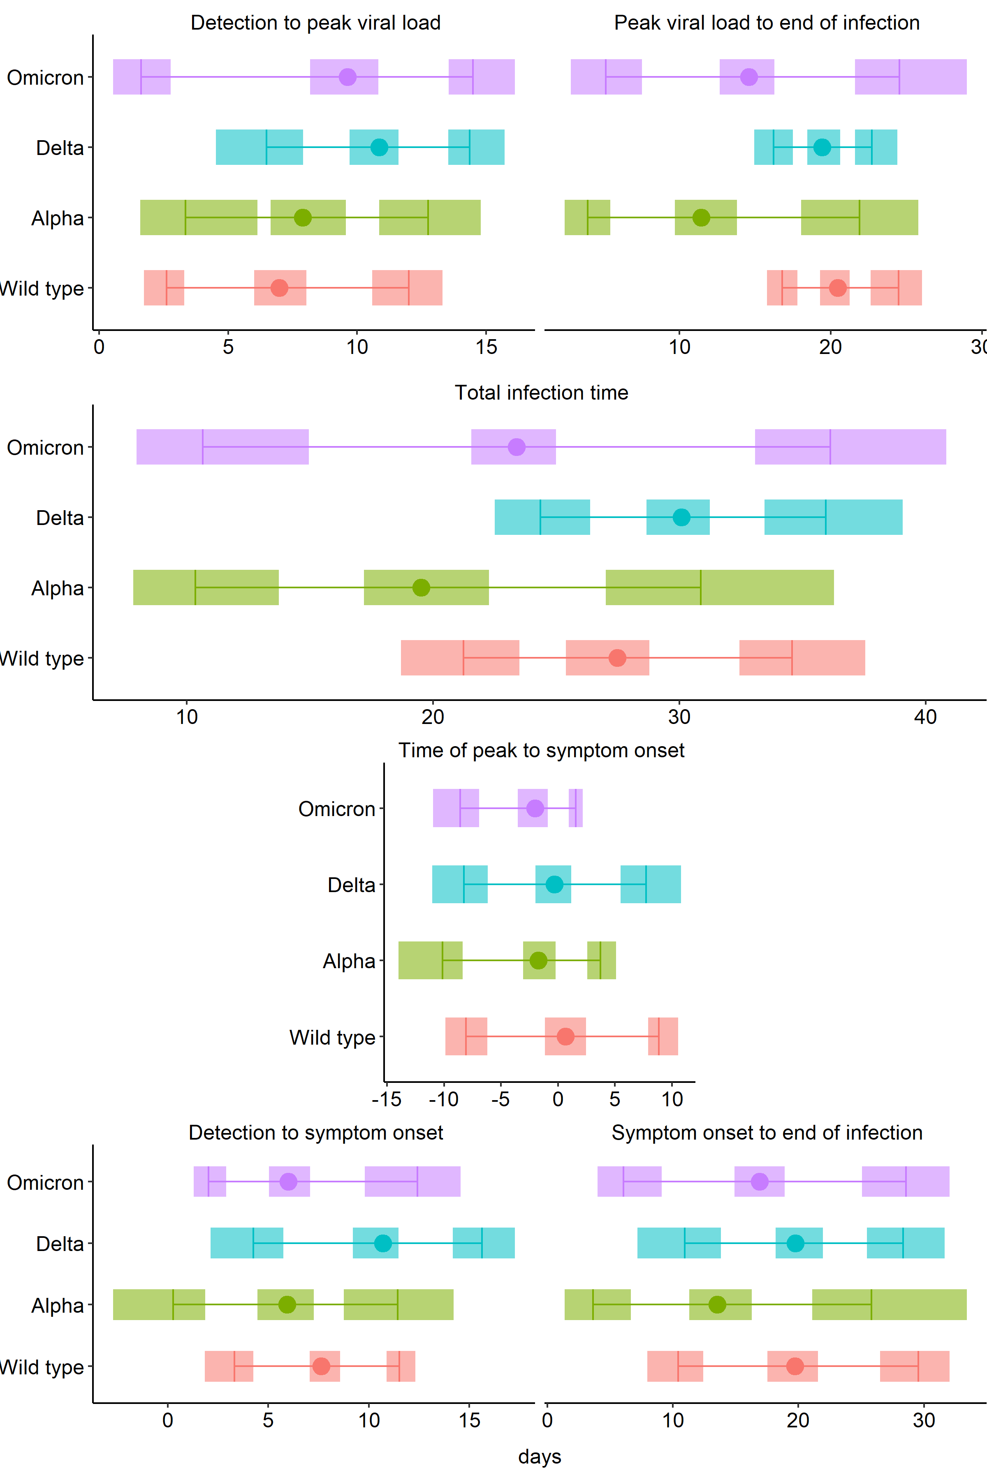

Detectable
Peak
Recovered
A
B
C
D
E
F
Detectable
Symptoms
Recovered

