Slide 1
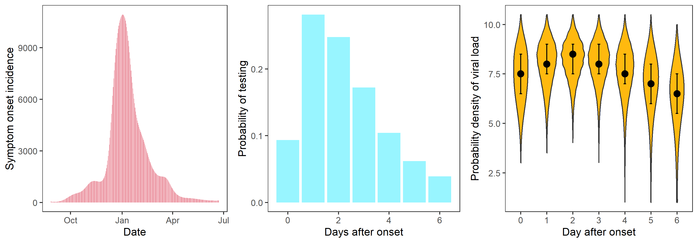
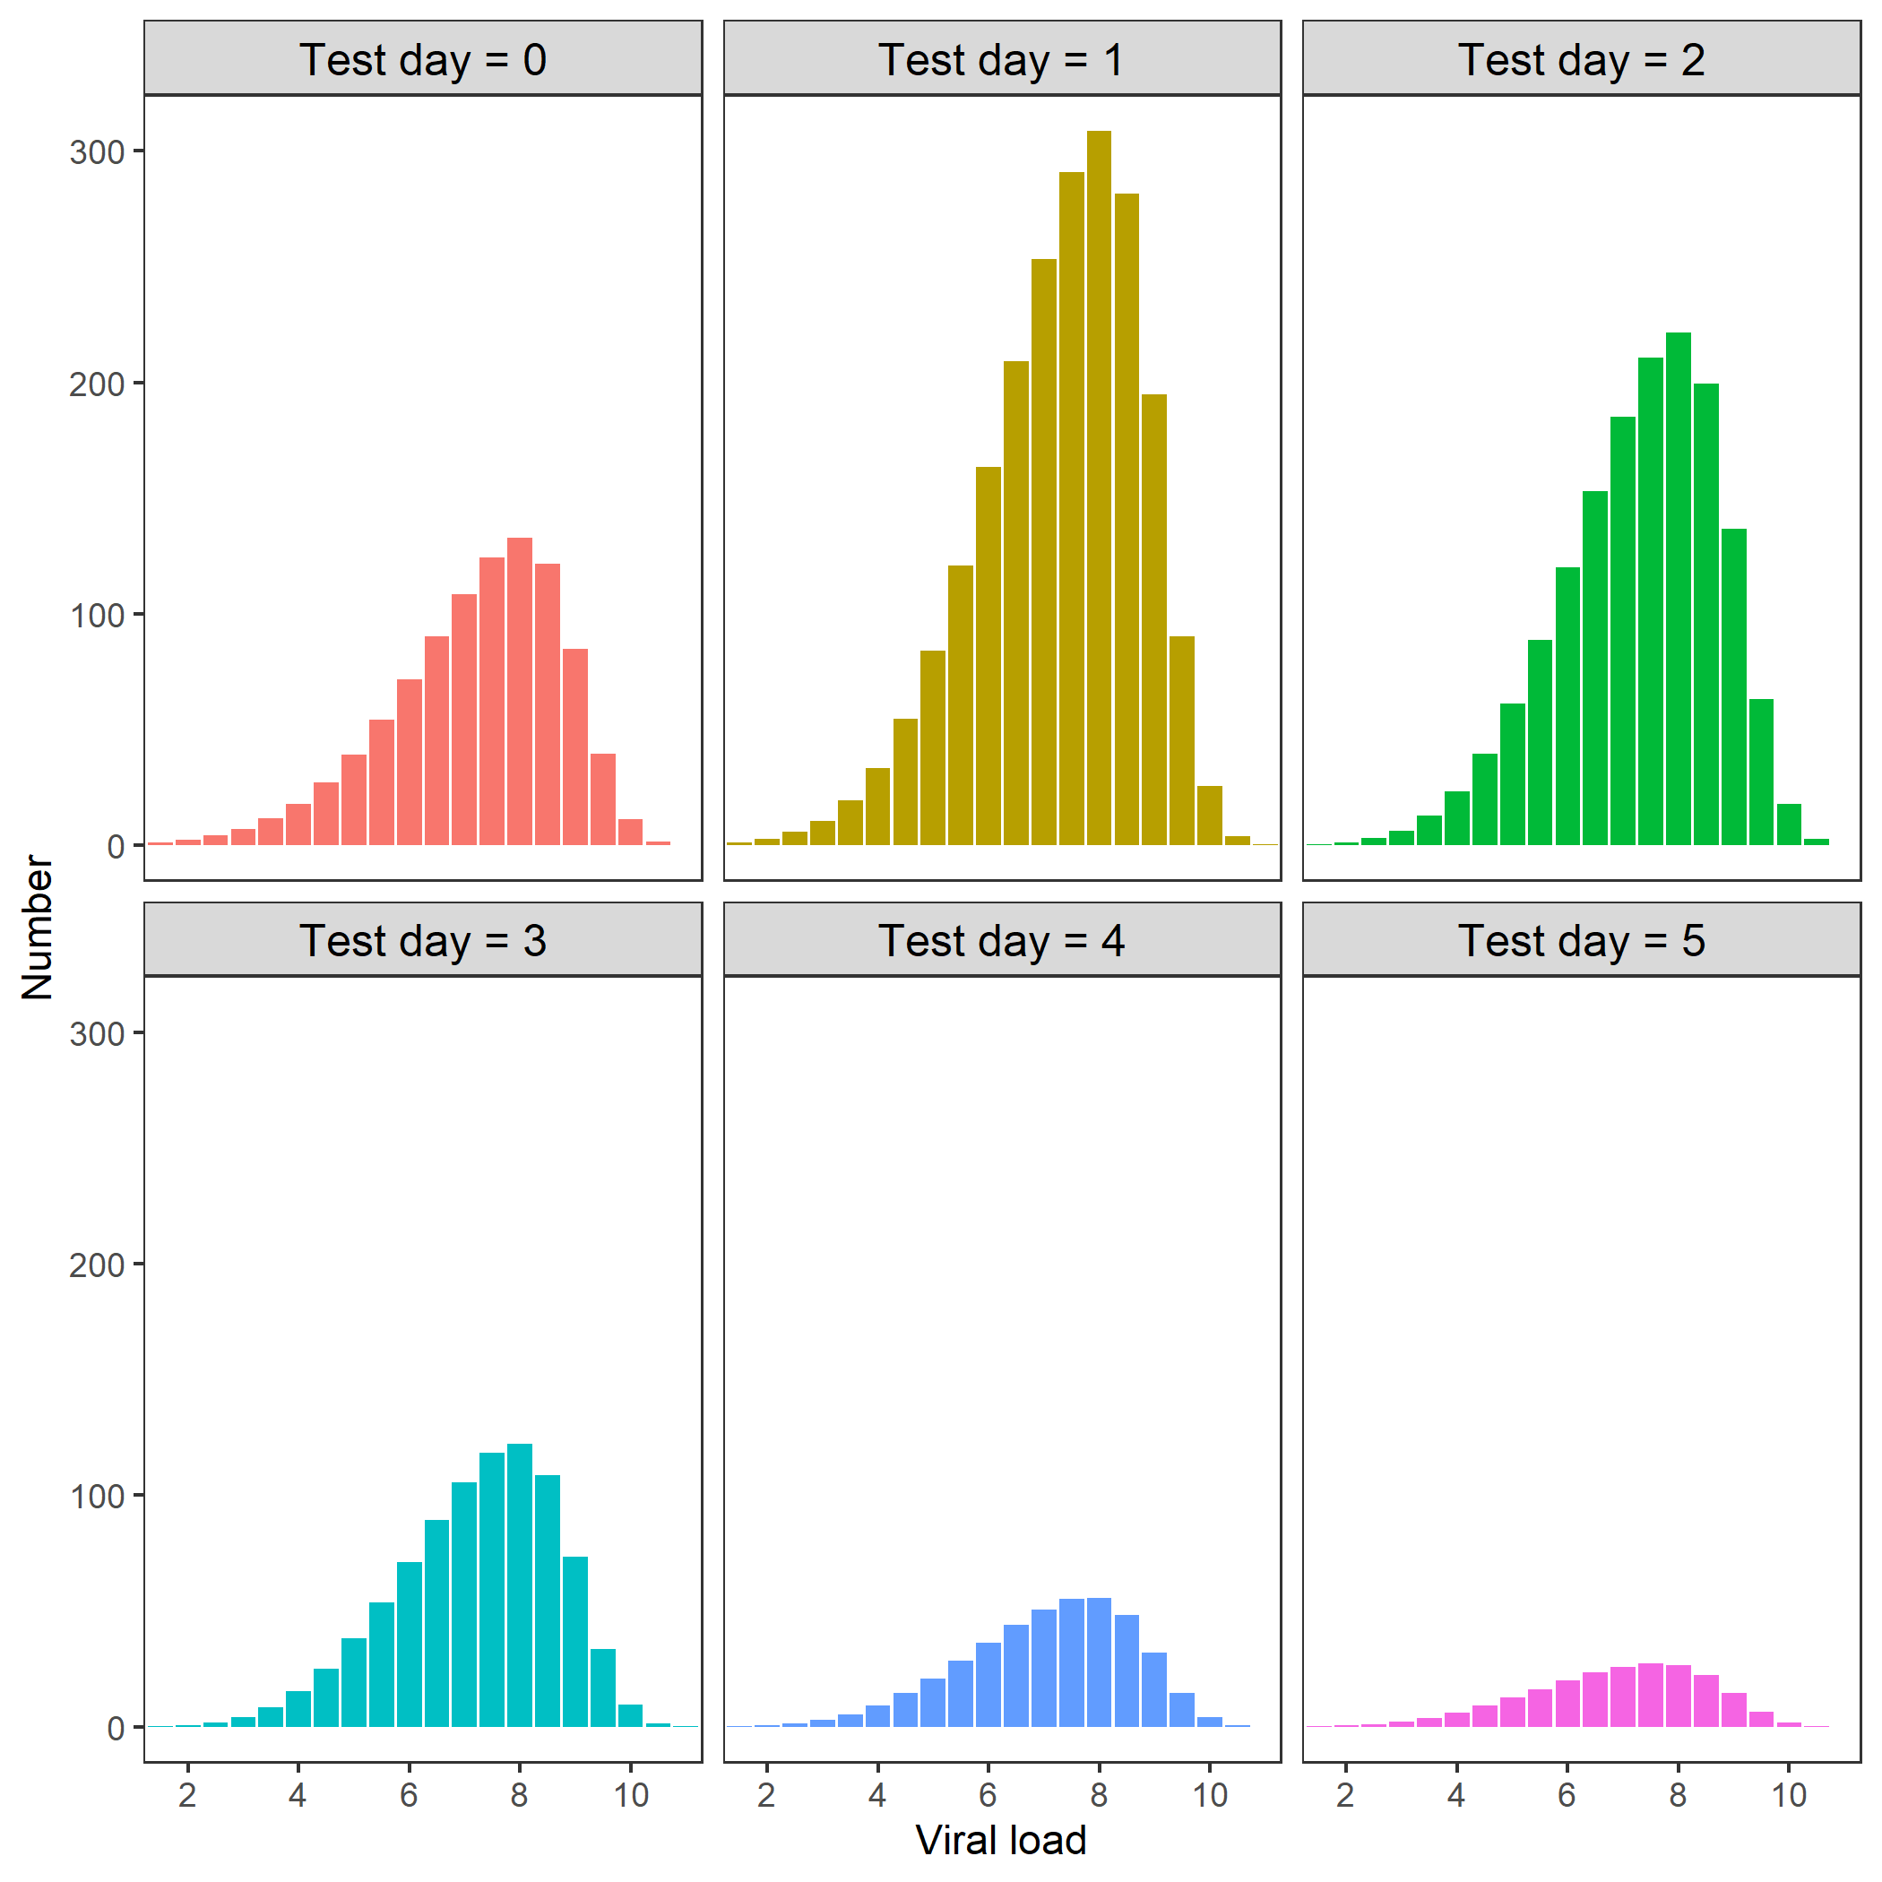
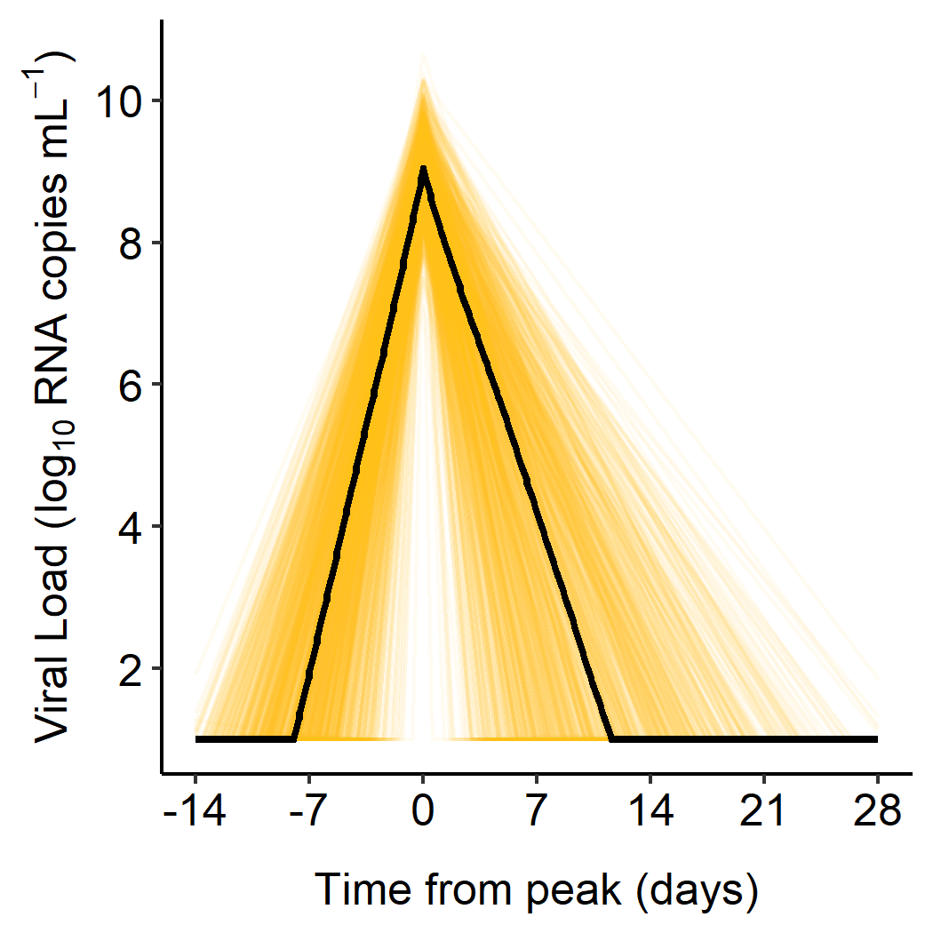
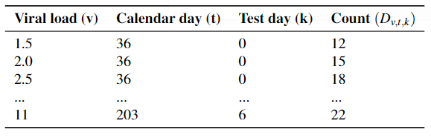

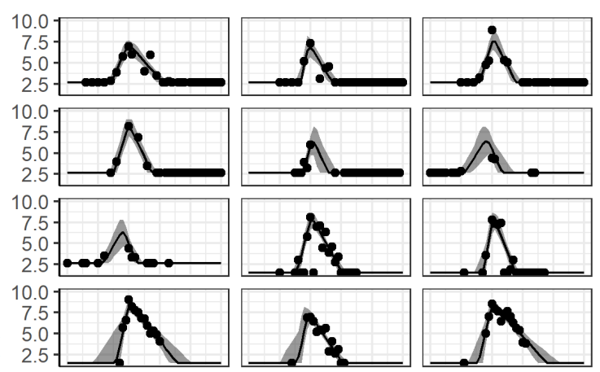
ϑ_{s}
ϑ_{test}
I(ϑ_{s})
3
δ_{k}^{test}(ϑ_{test} )
4
q_{v,k}(ϑ_{v,} ϑ_{symp})
5
5
5
2
ϑ_{symp}
Day j
N_{v,t,k}
1
ϑ_{v}
D_{v,t,k}
6
6
Likelihood
Prior P(ϑ)
7
7
POSTERIOR

Slide 2



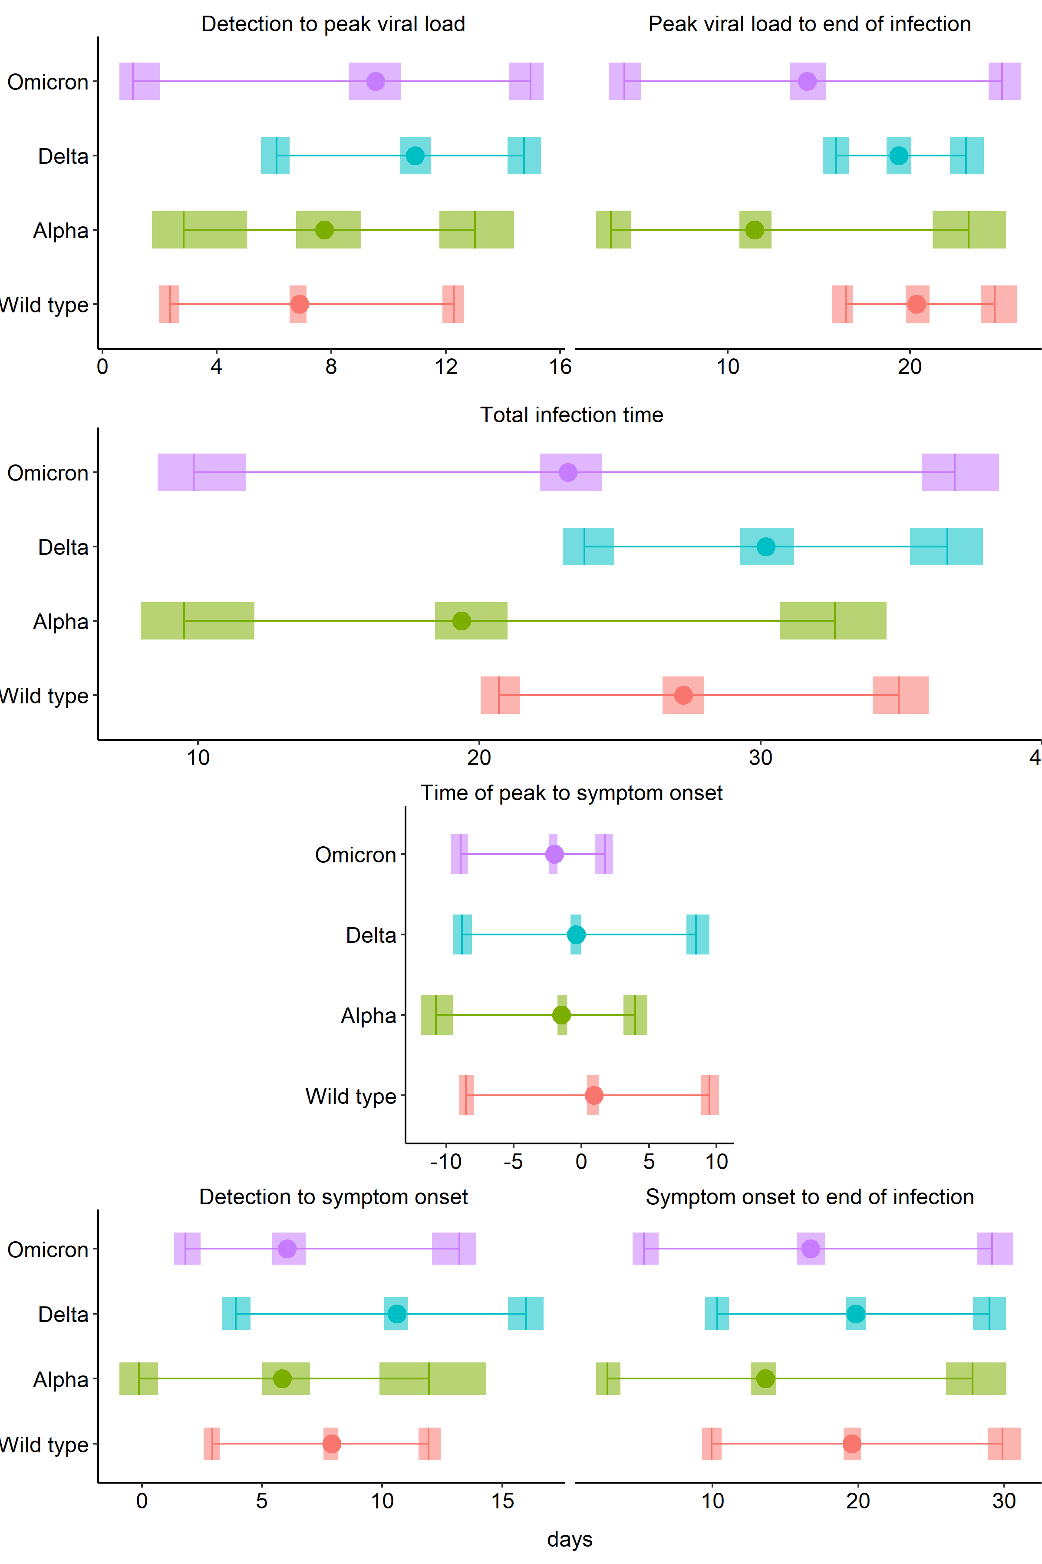
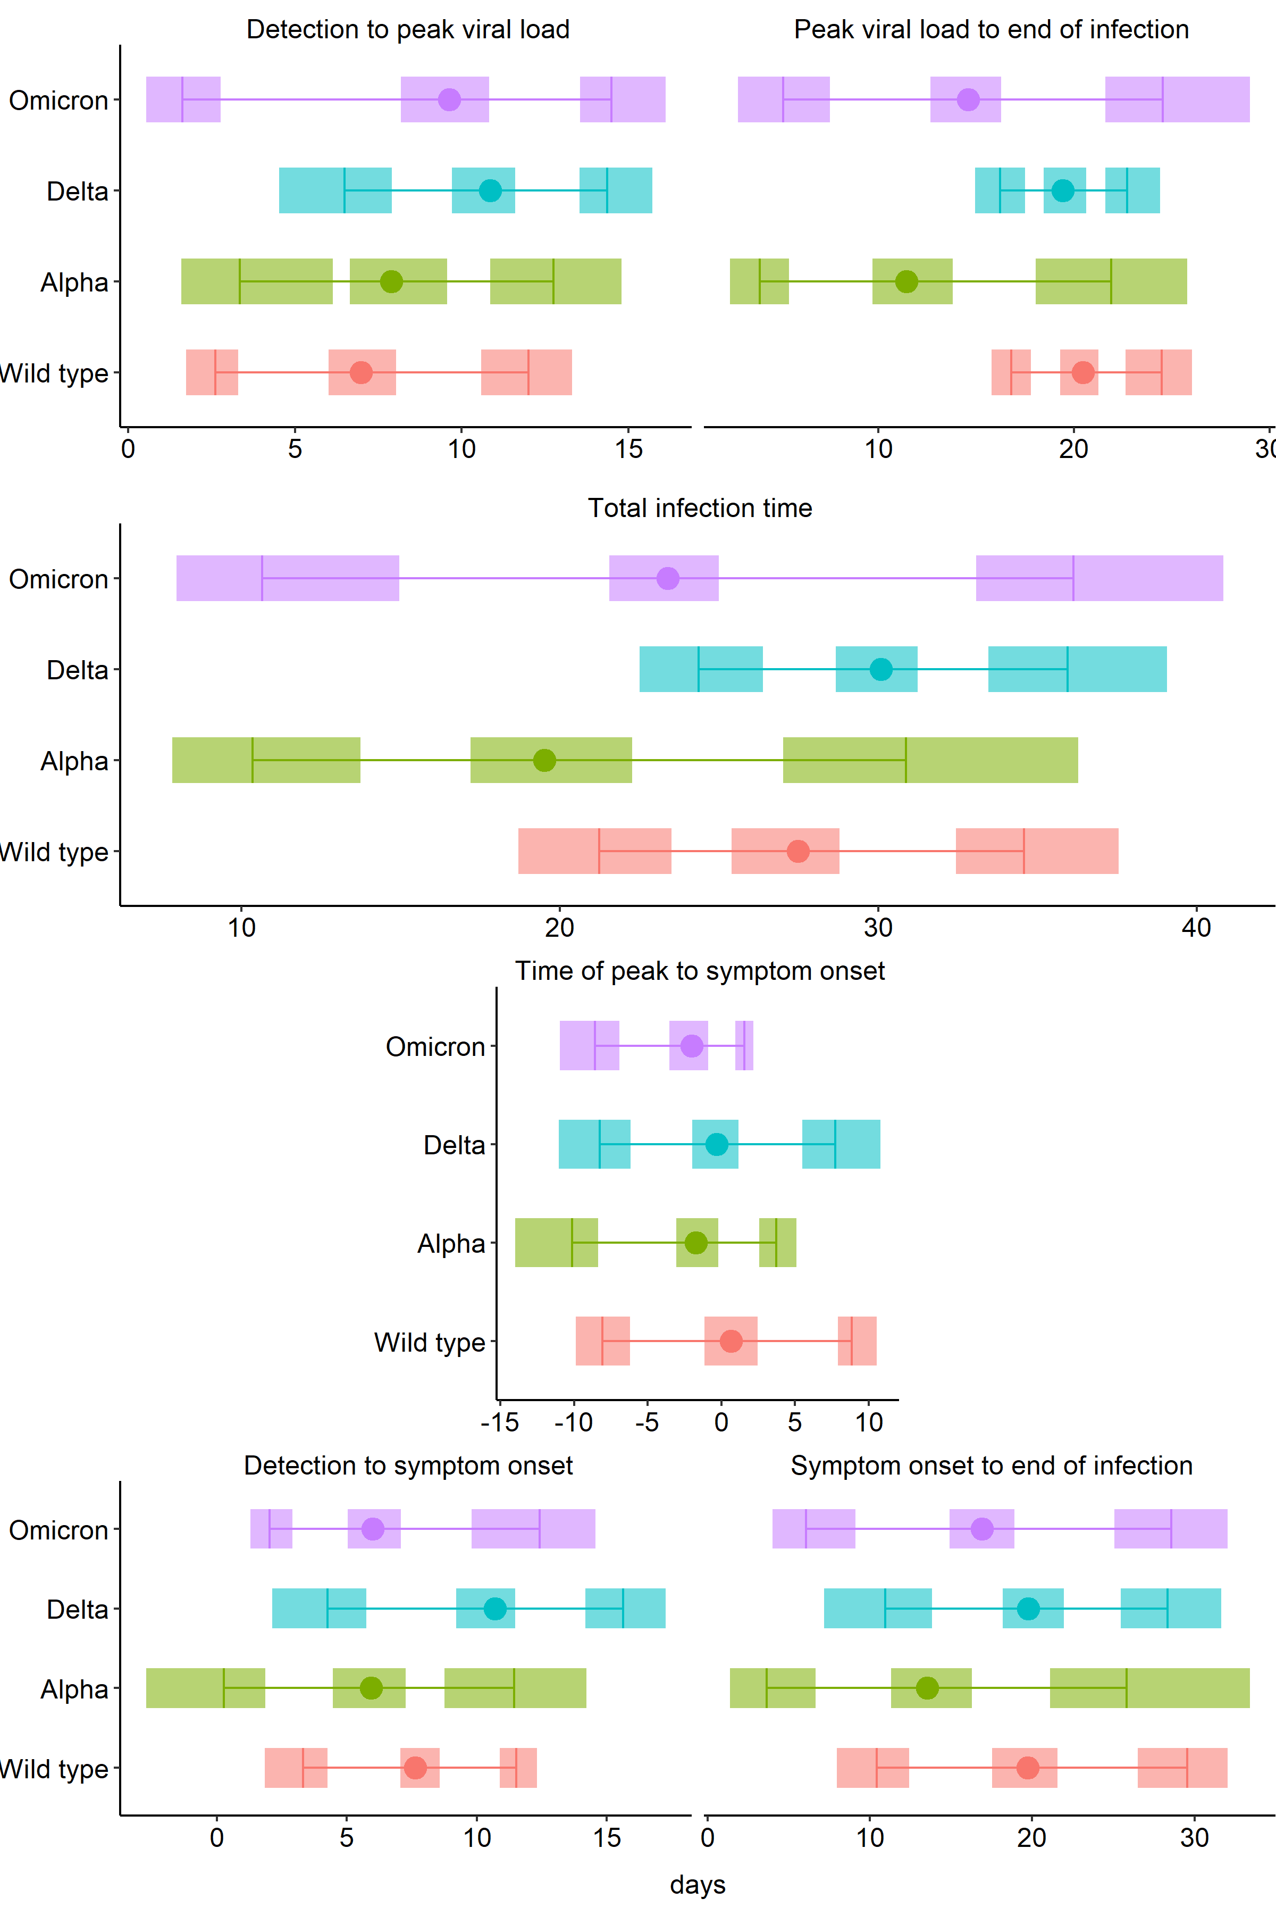

Detectable
Peak
Recovered
A
B
C
D
D
E
F
E
F
Detectable
Symptoms
Recovered

