Slide 1
The Geometric Observatory
for Financial Crisis Detection
22 instruments | 17 crises | 27 years of data

Slide 2
The Question
Can you detect financial crises early by measuring
the geometry of market returns?
We built 22 geometric observables inspired by quantum
information theory and tested them alongside 14 traditional
methods across 17 historical crises spanning 27 years.

Slide 3
The Observatory Analogy
A single weather sensor catches one type of event.
A modern weather station has many instruments.
Our 22 geometric channels span five families:
Metric (QFI, geodesic velocity, metric condition)
Curvature (Berry phase, sectional curvature, Ricci scalar)
Spectral (spectral gap, entropy, complexity)
Topological (Chern number, dimensional collapse)
Information (purity, fidelity, Hamiltonian sensitivity)

Slide 4
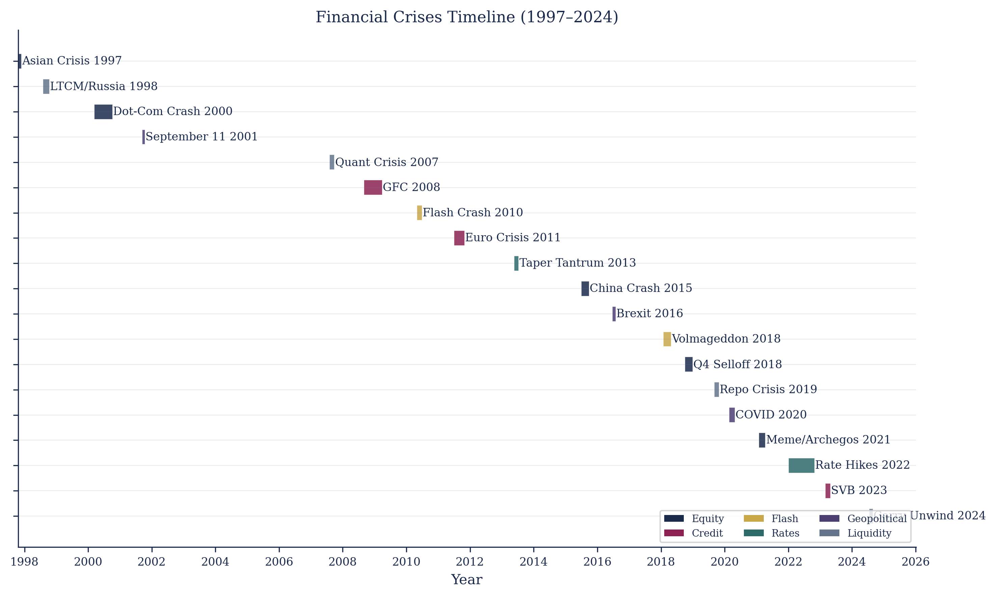
What We Tested
17 crises from 1997 (Asian Crisis) to 2024 (Carry Unwind) — 36 total methods: 22 geometric + 14 baselines

Slide 5
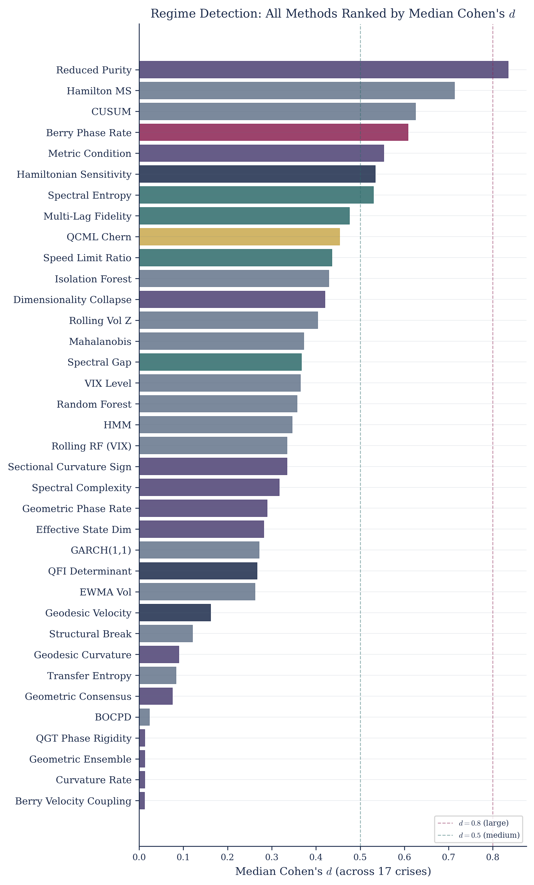
Finding 1: The Geometric Methods Work
Reduced Purity #1 (d = 0.834) | 8 of top 10 are geometric | Random Forest dropped from #1 to #17

Slide 6
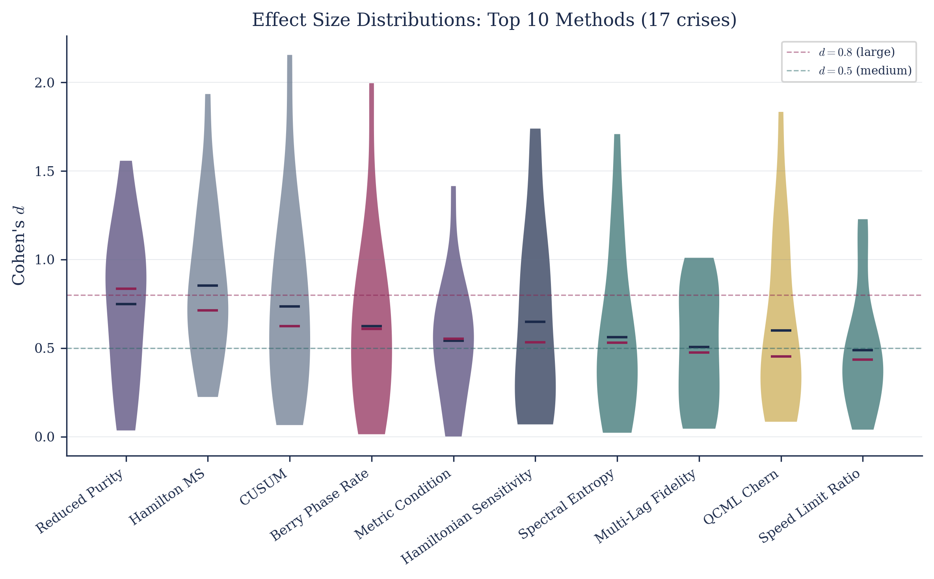
How Consistent Are the Top Methods?
Violin plots: distribution of Cohen's d across 17 crises. Wide = inconsistent. Narrow = reliable.

Slide 7
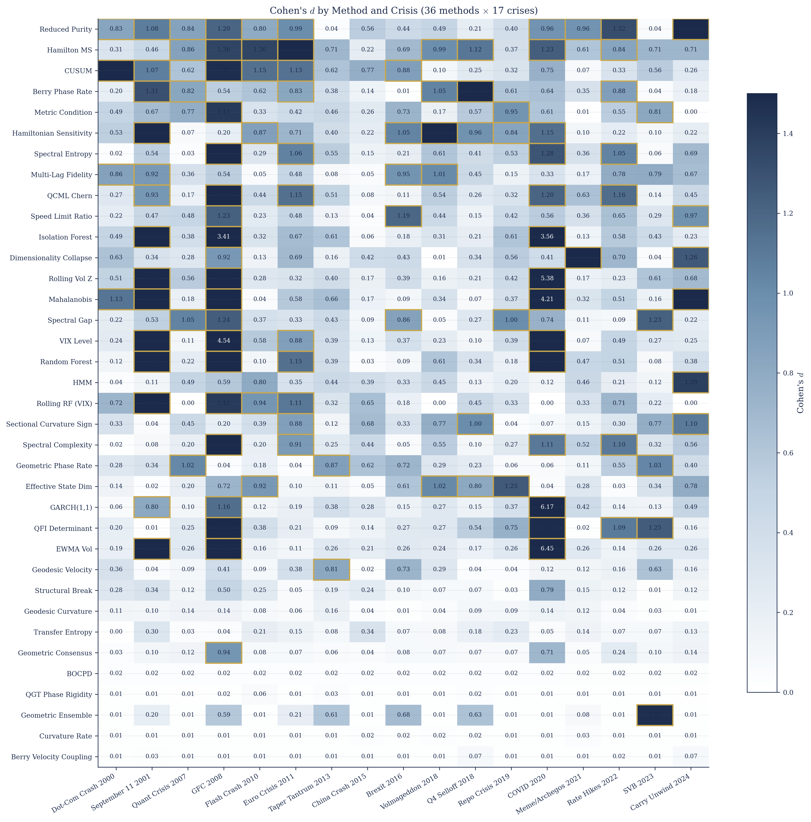
Finding 2: No Single Winner
14 different methods win across 17 crises

Slide 8
Each Crisis Has a Different Geometric Signature
2008 GFC → VIX Level wins (d = 4.5) — obvious vol spike
2018 Volmageddon → Hamiltonian Sensitivity (d = 1.7) — subtle structural shift
2021 Meme/Archegos → Dim. Collapse (d = 1.7) — hidden stress under calm surface
2016 Brexit → Speed Limit Ratio (d = 1.2) — rapid state transition
2022 Rate Hikes → Reduced Purity (d = 1.3) — prolonged regime change
Each geometric channel is like a different wavelength of light —
some crises are 'visible' only in certain channels.

Slide 9
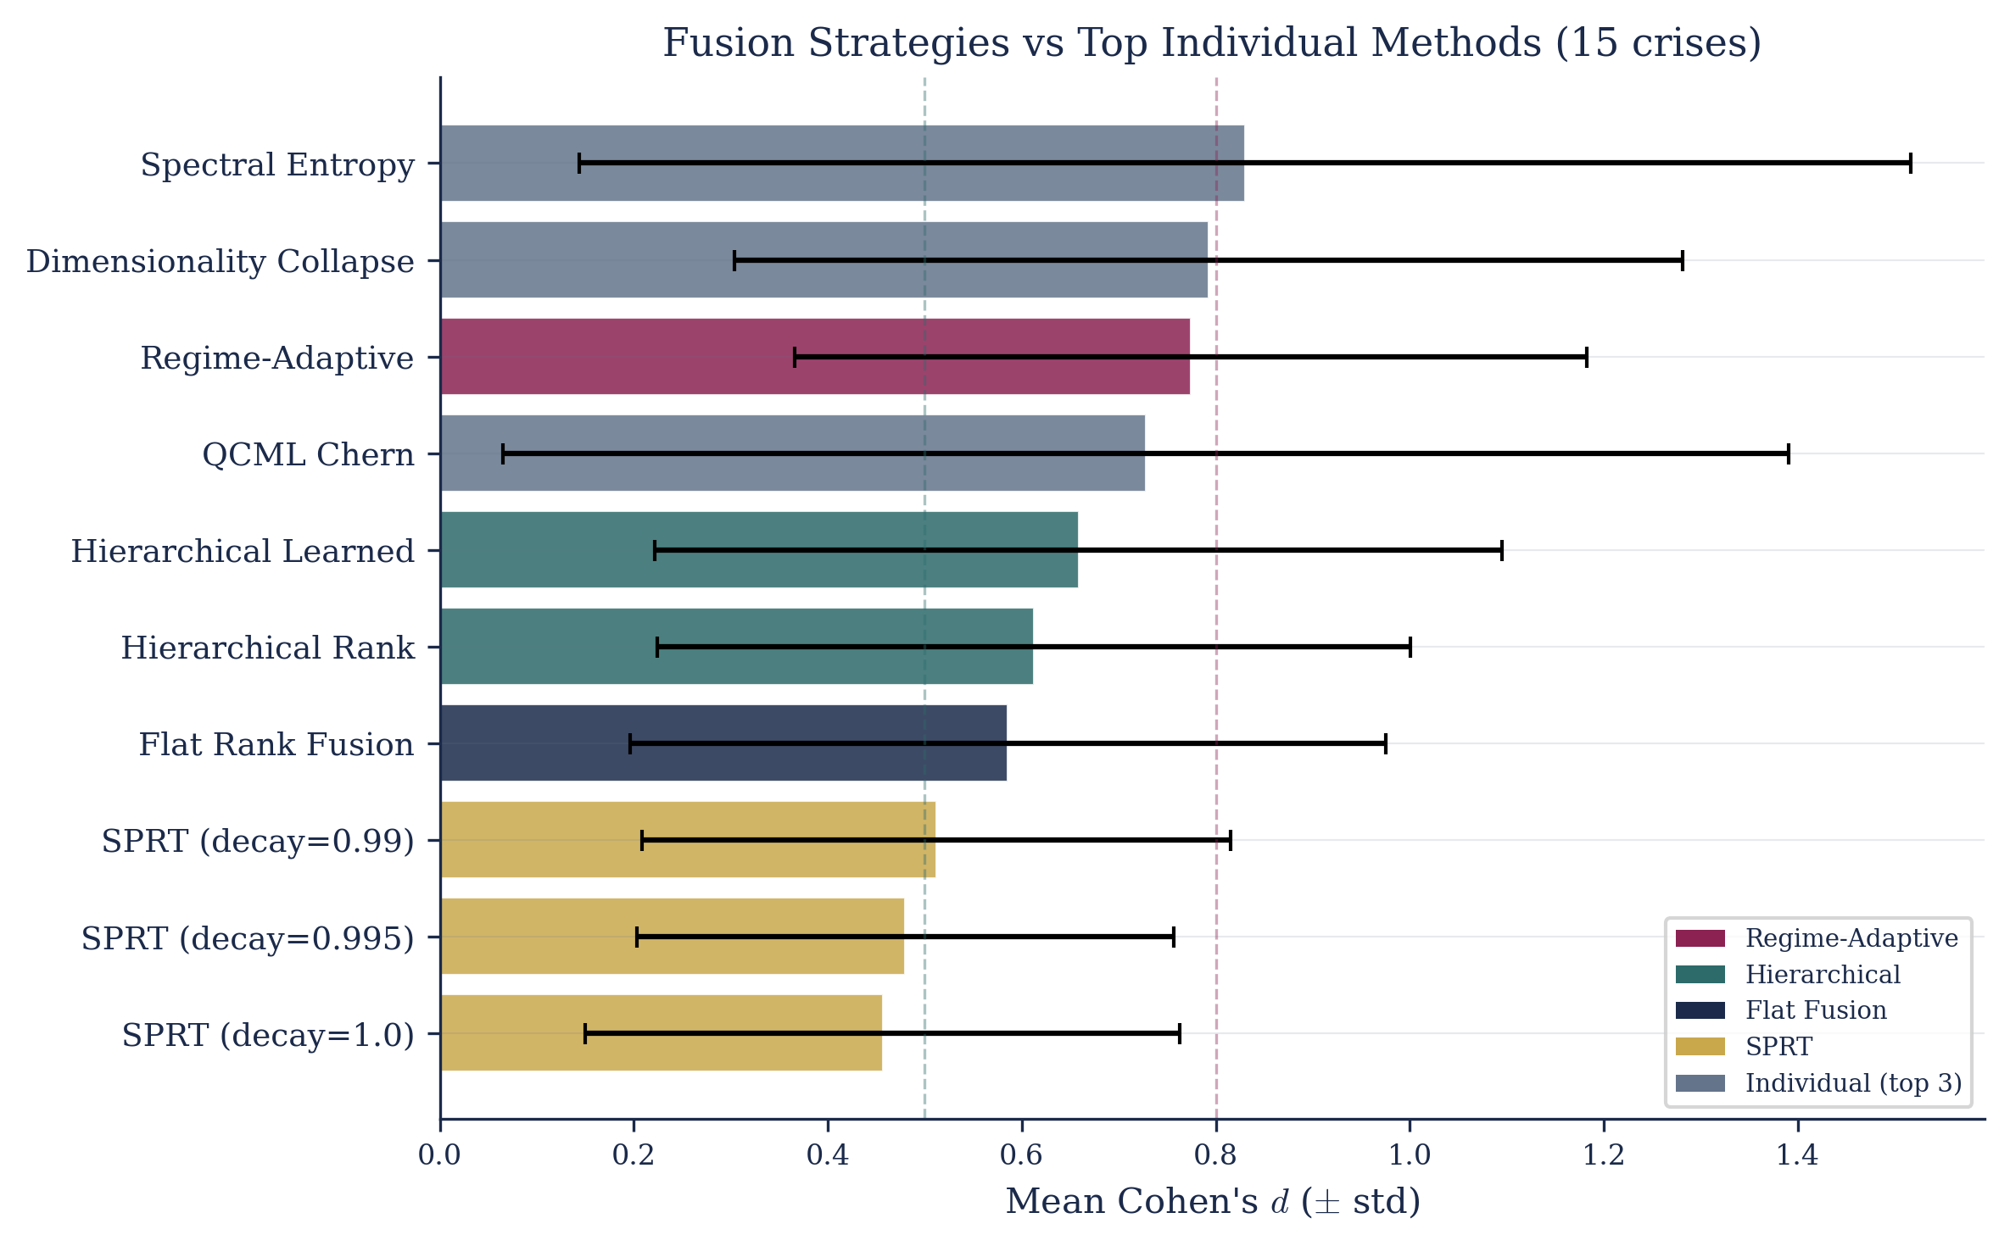
Finding 3: Fusion Beats Individuals
Regime-Adaptive fusion (d = 0.774) — top fusion, less variance than any individual champion

Slide 10
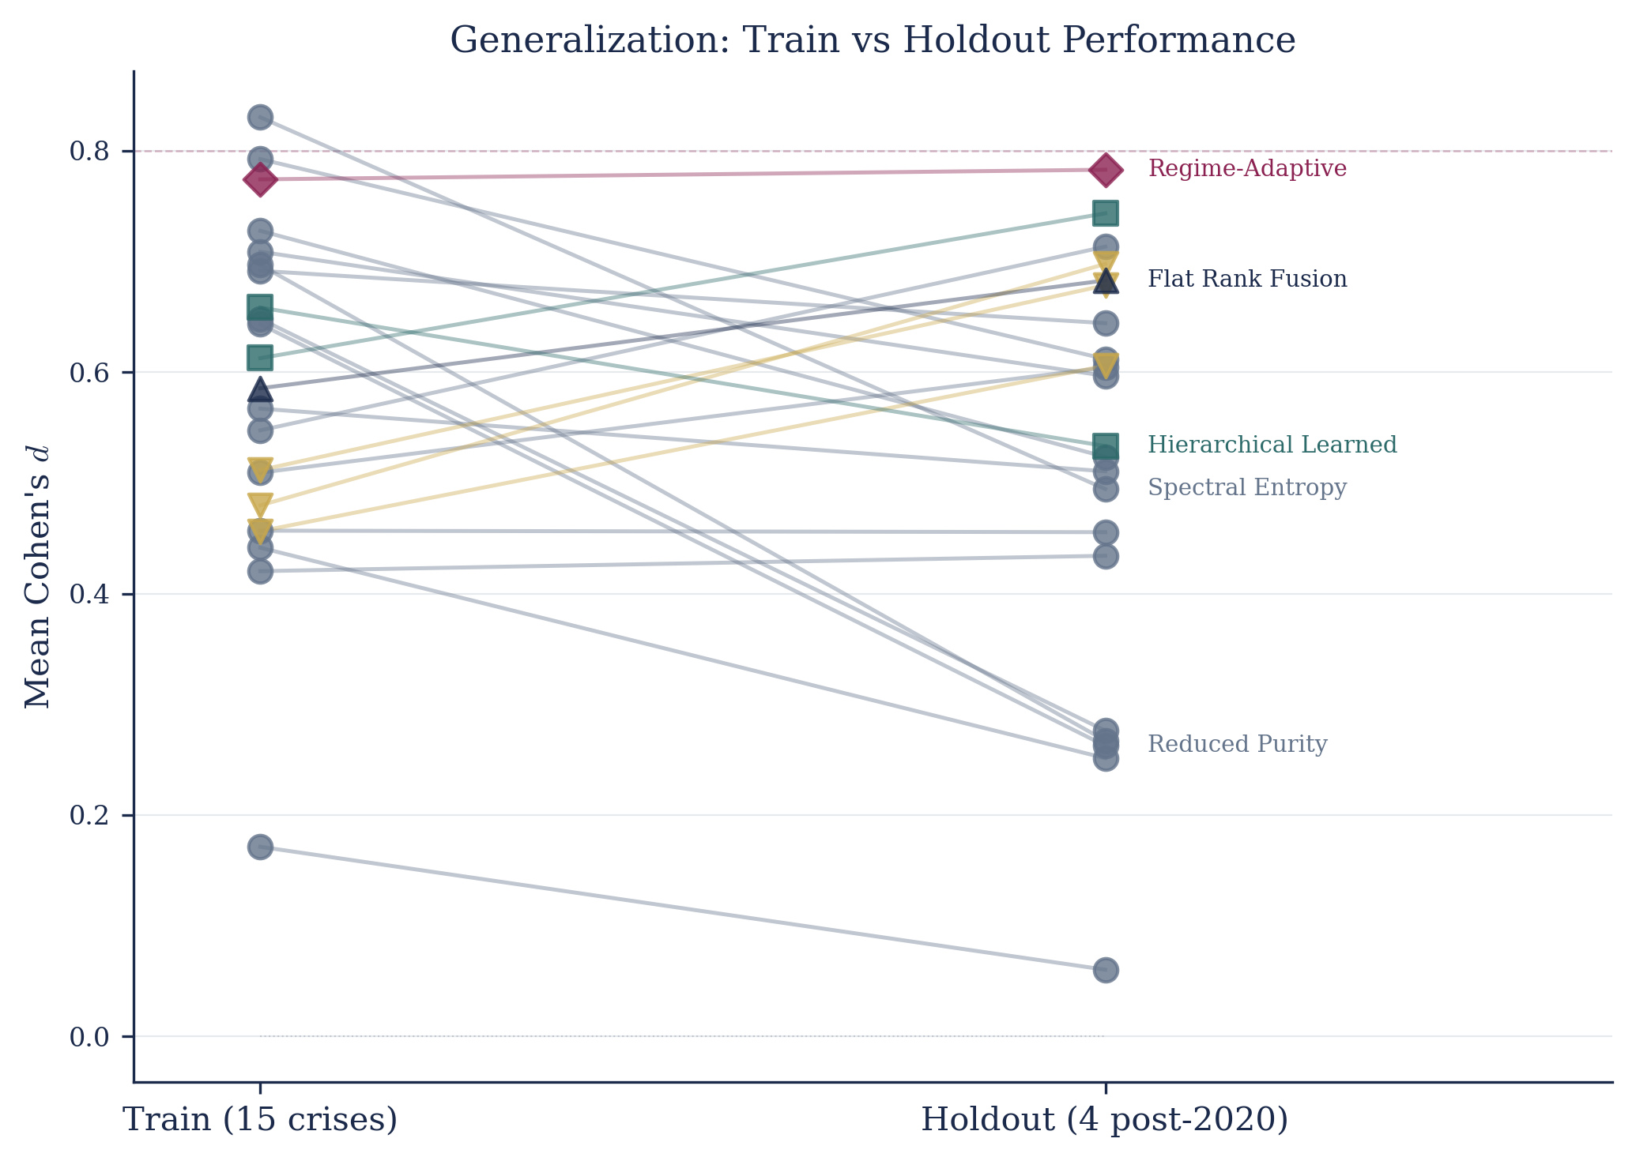
The Generalization Test
Train on 15 crises, hold out 4 post-2020 crises
Regime-Adaptive +1.1% | Reduced Purity −59% | The combination is more robust than any part

Slide 11
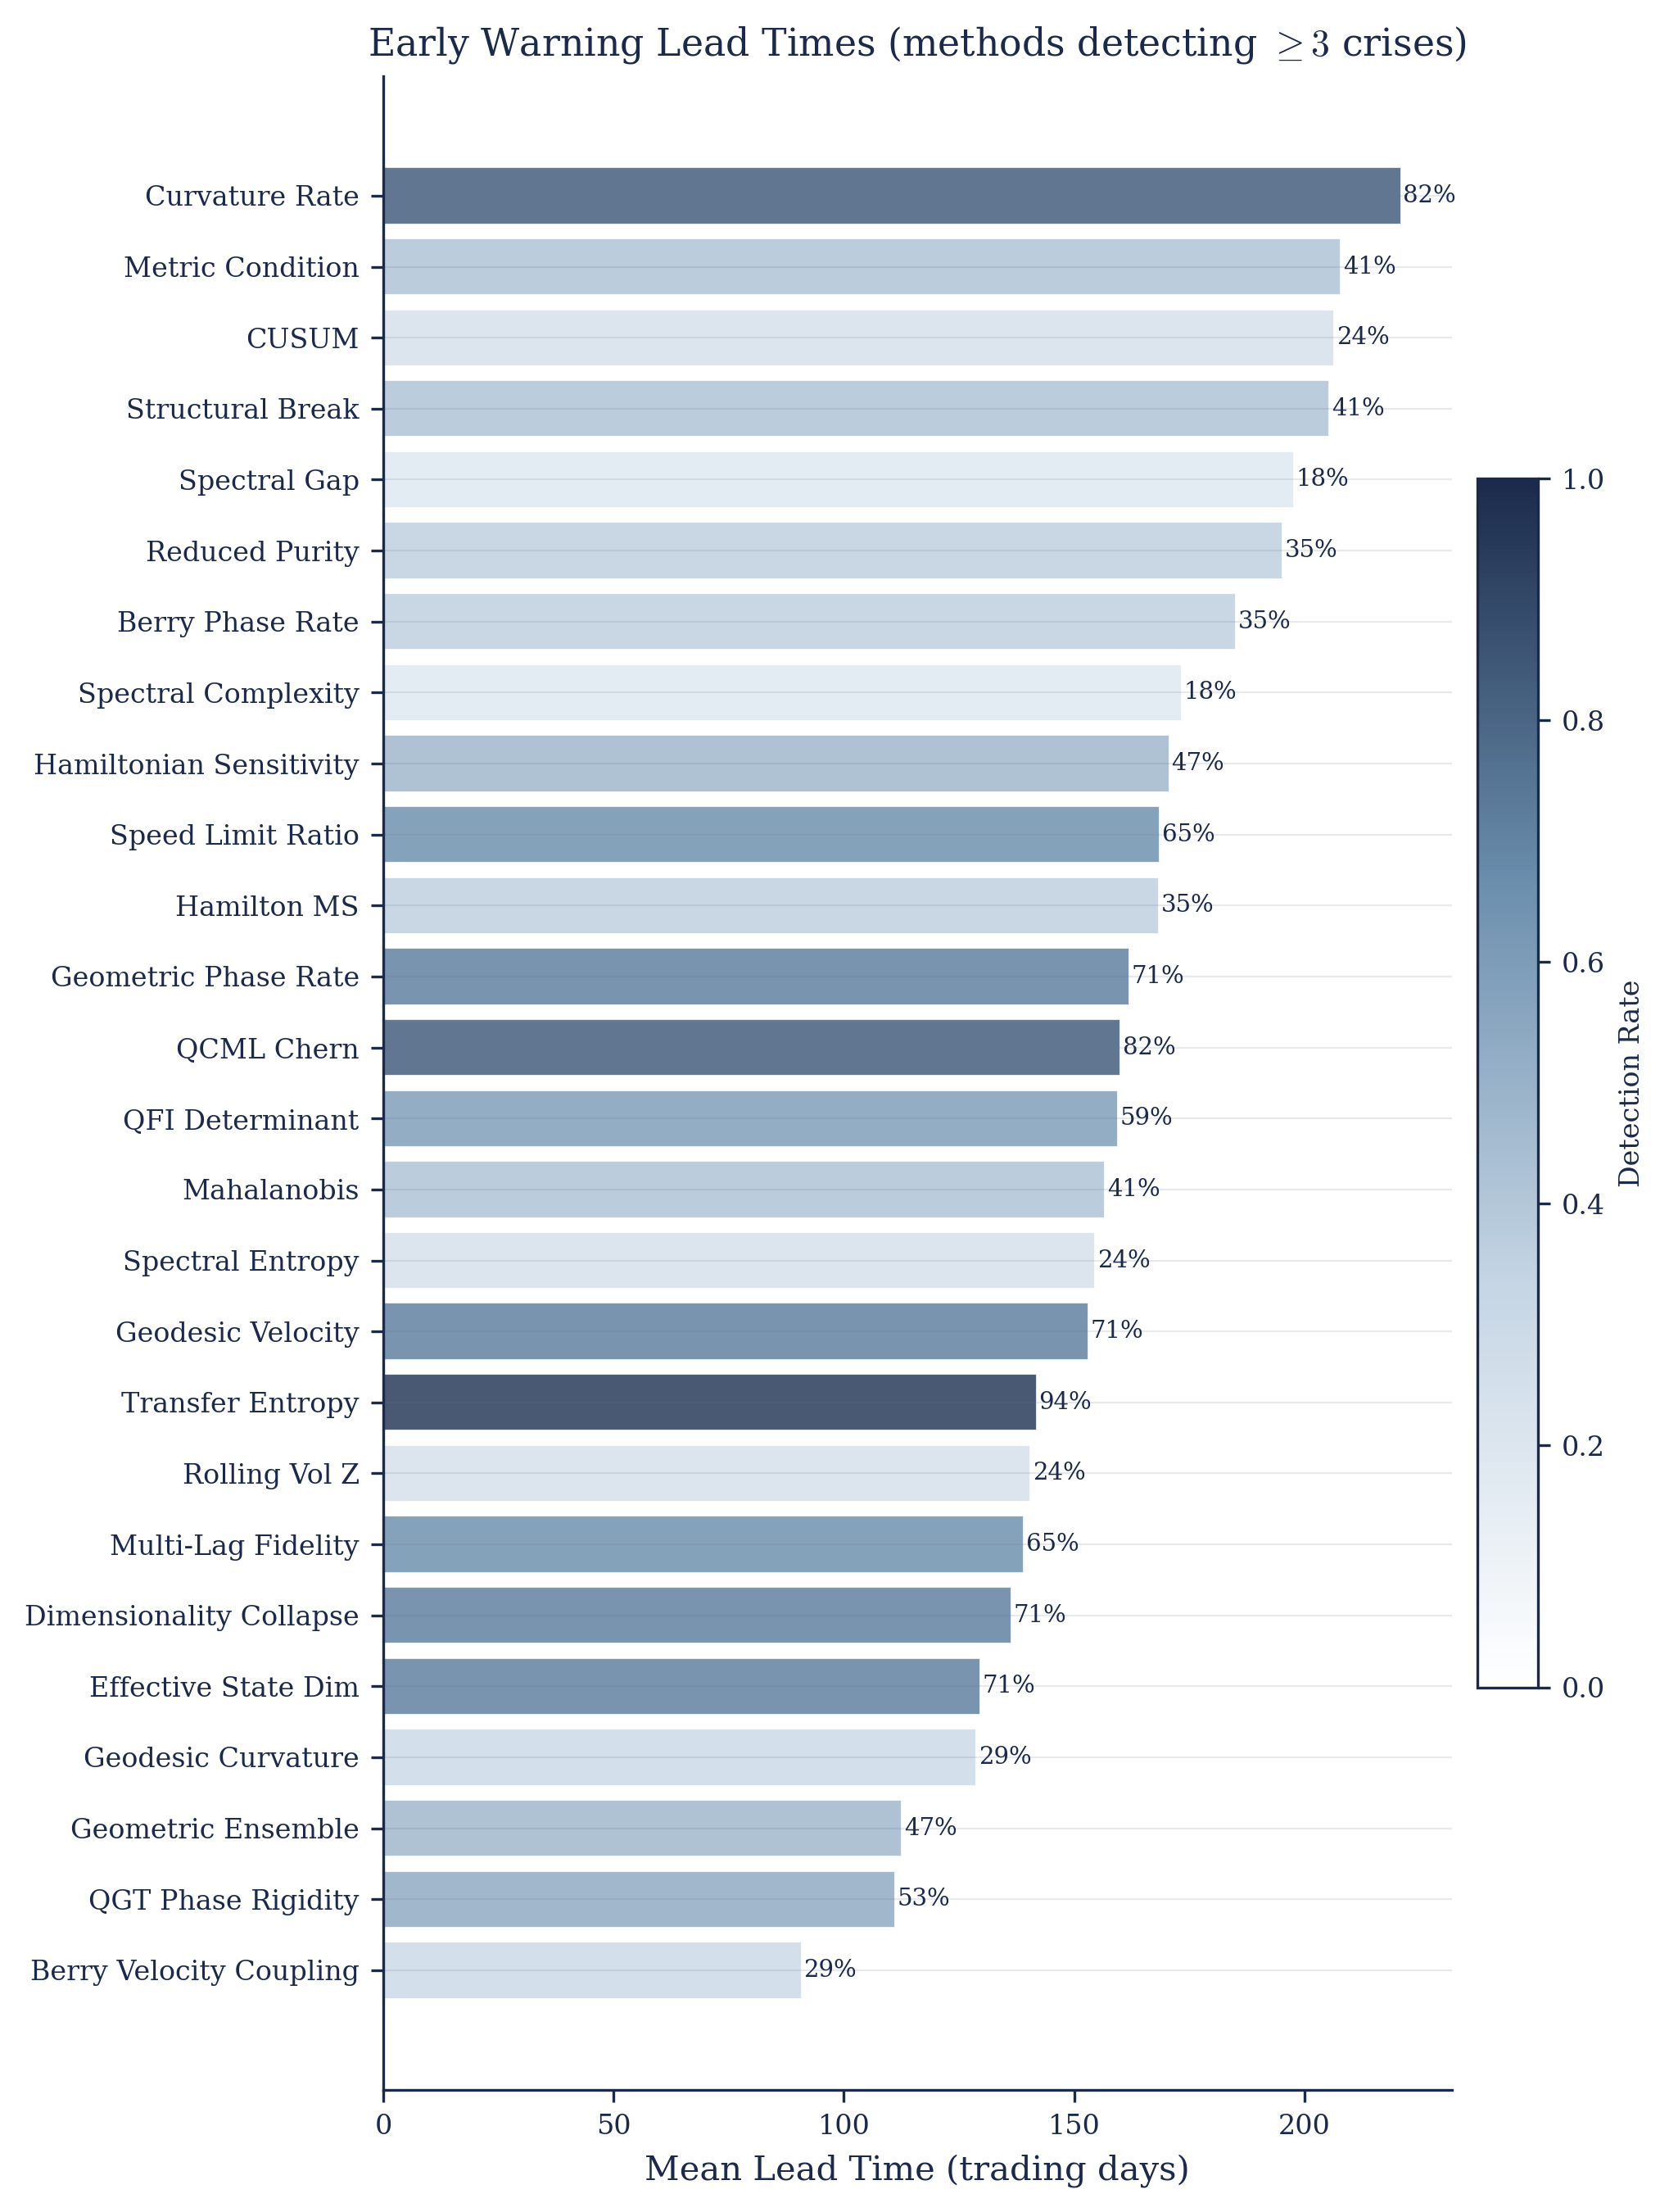
Early Warning: Lead Times
Many geometric methods detect crises 150–200+ days in advance — not just classification, actual early warning

Slide 12
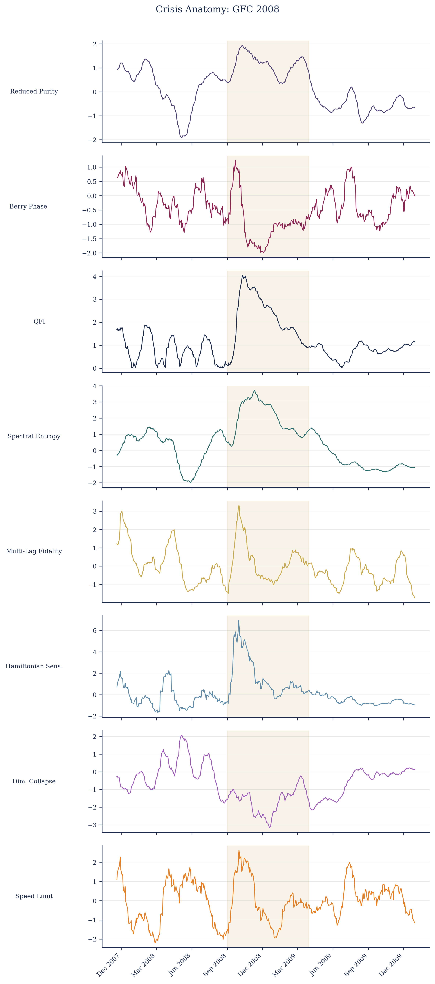
What It Looks Like: 2008 Global Financial Crisis
8 detectors showing real-time signals through GFC. Gold band = crisis period.

Slide 13
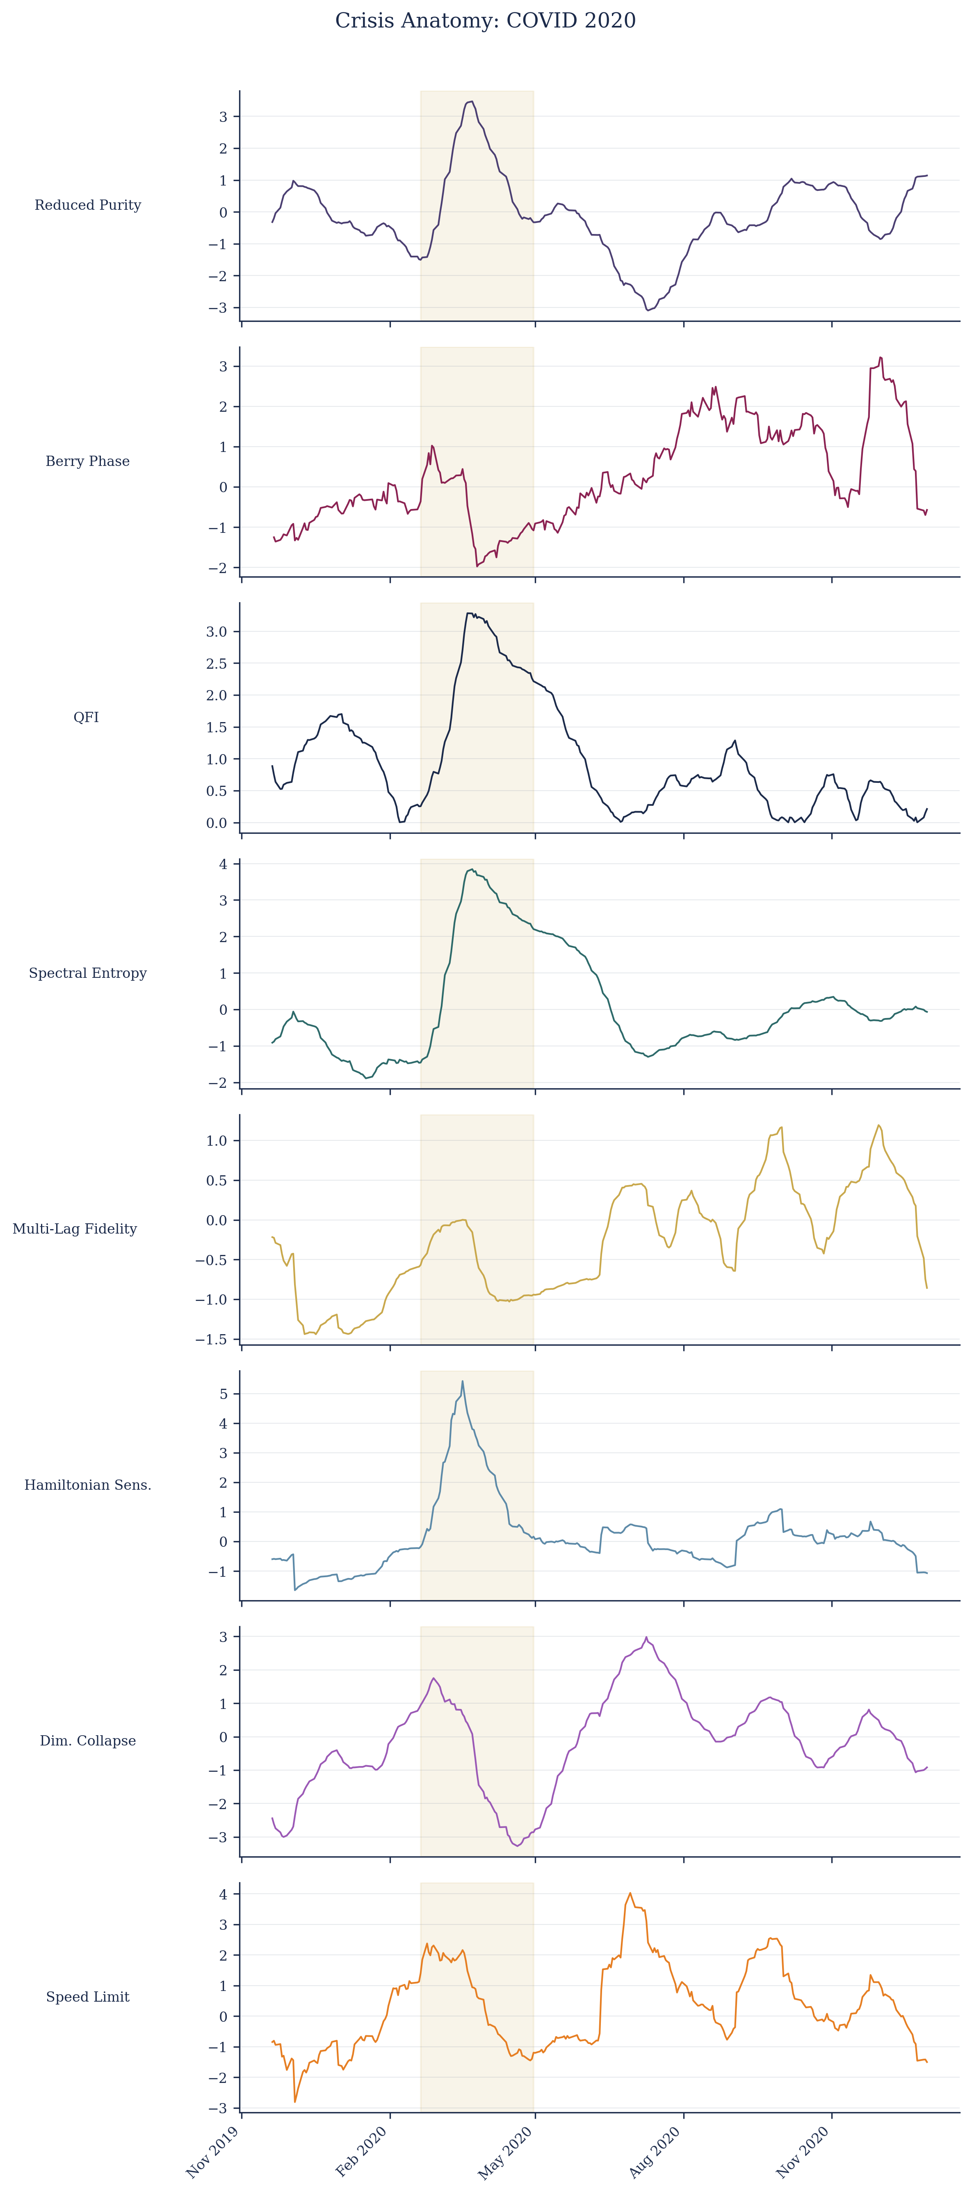
What It Looks Like: 2020 COVID Crash
Same 8 detectors, different crisis — different channels activate for different failure modes.

Slide 14
Implications
For finance:
Exploitable geometric structure in markets that vol-based methods miss entirely.
For the field:
The 'one model to rule them all' approach is wrong for crisis detection.
Adaptive fusion across channels is the way forward.
For quantum-inspired methods:
Hilbert space representation produces observables that are
both interpretable and empirically useful.

Slide 15
Honest Caveats
Median QCML ≈ median baselines (0.326 vs 0.352).
The top geometric methods are exceptional; the average is comparable.
Fusion Friedman test is non-significant (p = 0.538).
No fusion method statistically dominates. The case is about
consistency and generalization, not raw dominance.
Lead times are noisy — some early detections may be false positives.
Historical data only — no live forward test yet.

