Slide 1
Automatic Watering System
Cheng Fang – Will Hewes

Slide 2
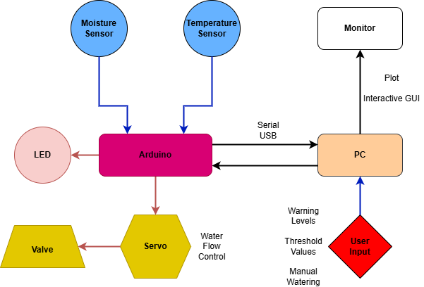
Block Diagram

Slide 3
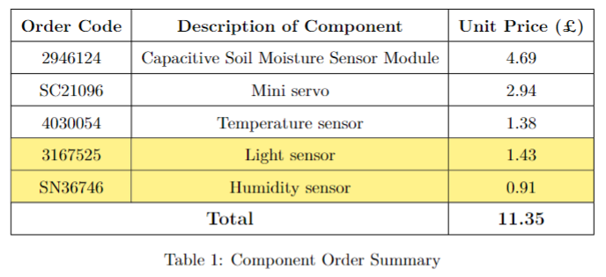
Components

Slide 4
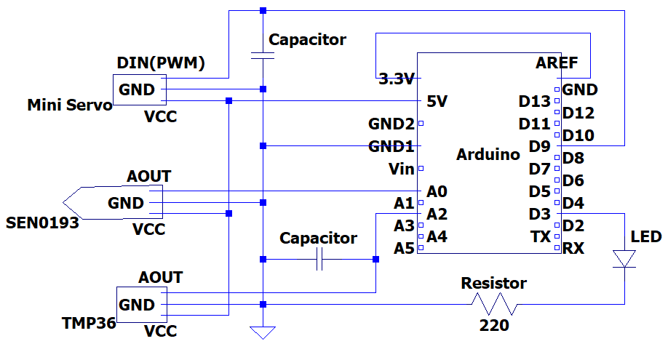
Analogue Circuitry

Slide 5
Firmware
1.Sensor reading
2.Actuator control
3.Threshold management
4.Warning mangement
5.Serial Communication(Sending Reading Recieveing command)
Main logic: handle serial input ->read sensors -> check threshold and water -> communicate to PC ->update warning LED 20HZ

Slide 6
Software
┌───────────────────────┐
│ main.py │ ← Entry point (COM port selection)
└──────────┬────────────┘
↓
┌──────────┴────────────┐
│ serial_handler.py │ ← Serial Communication
└──────────┬────────────┘
┌──────────┴────────────┐
│ gui.py │ ← Main GUI Window (QWidget)
└──────────┬────────────┘
┌──────────┴────────────┐
│ utils.py │ ← Utility functions (data processing/validation)
└───────────────────────┘

