Slide 1
Chapter 1
Introduction to Enterprise Risk Management and Insurance

Slide 2
Enterprise Risk Management
Logical process used by firms to deal with multifaceted exposures to loss.
Continuous process that identifies exposures and decides how to deal efficiently with them.
Process that examines all risks collectively.
Number of reasons:
  Catastrophic Loss Events.
  Corporate Financial Failures.
  Shrinking Employee Benefits.

Slide 3
Risk – Classification
Pure Risk - exposure that can result in a loss or no change (two possible outcomes).
Speculative Risk - exposure that can result in a loss, no change, or gain (three possible outcomes).

Slide 4
Risk – Classification
Diversifiable Risk – financial losses of a few members are spread across a much larger number of the group: “Risk Pooling.”
Non-Diversifiable Risk – cannot be spread, but affects all members.

Slide 5
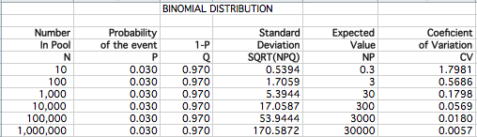
Spreading Risk

Slide 6
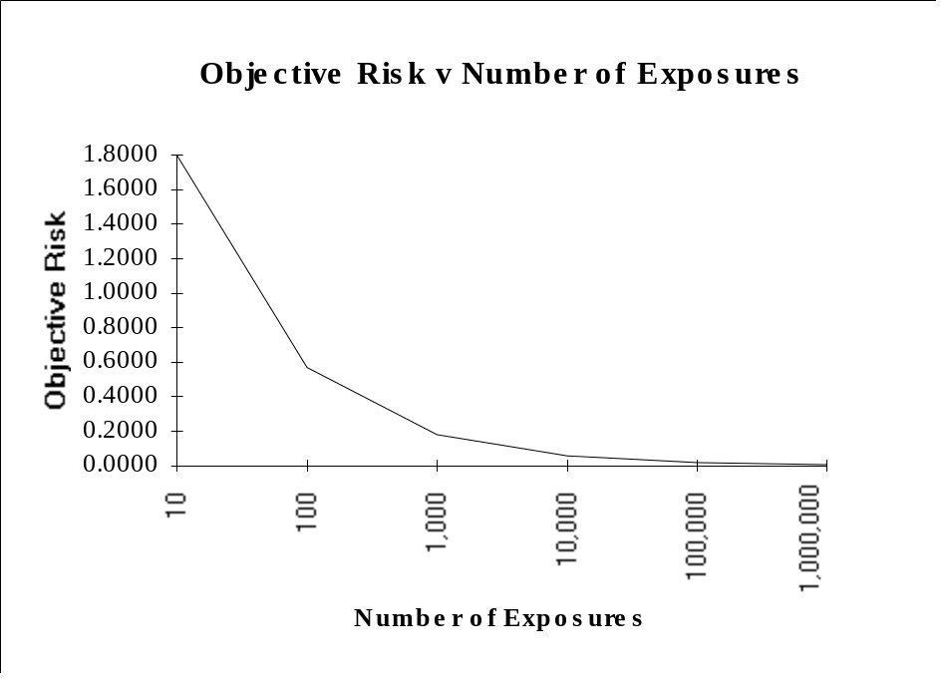
Spreading Risk

Slide 7
Insurance works well when:
Many individuals purchase
  Paying relatively small premium amounts
Few people collect
  Keeps rates affordable
  Losses can be large

Slide 8
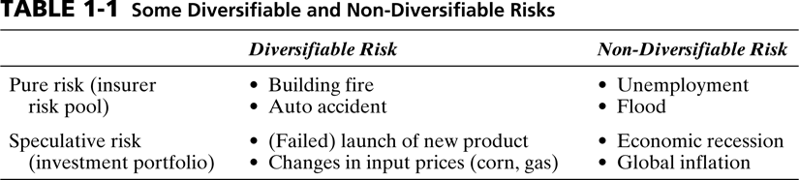
Risk – Classification

Slide 9
Risk – Classification
Risk Aversion – firms and individuals prefer to take less risk rather than more.
Risk-Return Trade-Off – if taking more risk, firms and individuals expect a higher return.

Slide 10
Benefits Compared to No Insurance
Stability of families.
Aids planning ability to businesses.
Facilitates credit transactions.
Anti-monopoly device.
Reduces credit costs.
Increases capital efficiency.

Slide 11
Social or Private?
Insurance is a financial agreement in which an individual pays a premium to transfer the financial consequences to a risk pool.
Social – administered and funded by governmental bodies.
Private – independently owned and operated.

Slide 12
Employee Benefit Plans
Nonwage compensation provided by firms as a protection from a number of personal pure risks:
  Health.
  Life.
  Disability.
  Retirement.

Slide 13
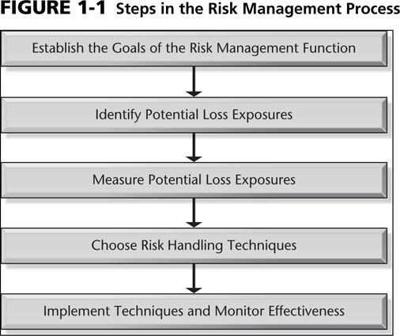
Risk Management Process

Slide 14
Identify Potential Loss Exposures
Property Risks.
Liability Risks.
Human Resource Risks.
Indirect Losses.

Slide 15
Measure Potential Loss Exposures
Frequency of the loss.
Severity of the loss.

Slide 16
Risk Handling Techniques
Loss control – reduce the frequency and/or severity.
Loss transfer – (contractual) arrangement to transfer risk to party that is best at mitigating, controlling, or bearing it.
Loss financing – arrangement to pay for future costs.

Slide 17
Loss Control - Reduction
Always engage in, if beneficial
Loss Reduction:
  Steps designed to reduce the frequency and/or severity.
  Take steps to reduce the damage before and after a loss

Slide 18
Loss Transfer
Hold harmless agreements - transfer of risk through a contract.
Hedging - take equal but opposite position on an even based on chance.
Financial risk management - techniques to deal with interest rate, currency value, and crop price changes.
Leases - transfers risk of obsolescence.

Slide 19
ERM – Integrated Framework
Top-Down Corporate Focus.
Broad Scope of Loss Exposures.
Portfolio Perspective for Diversification Opportunities.
Systematic Process of Risk Identification, Assessment, and Treatment.

Slide 20
ERM – Recent Loss Events
Hazard Risks, e.g. WTC or death of Michael Jackson.
Financial Risks, e.g. credit crisis started in an obscure part of real estate financing.
Operational Risks, e.g. supply chain disruption.
Strategic Risks, e.g. reputation loss.

