Slide 1
Chapter 3
Risk
Assessment and Pooling

Slide 2
Insurable Loss Exposures
Estimation of financial impact of each risk identified previously.
Two key statistical measures:
  Frequency with which losses occur.
  Their severity.

Slide 3
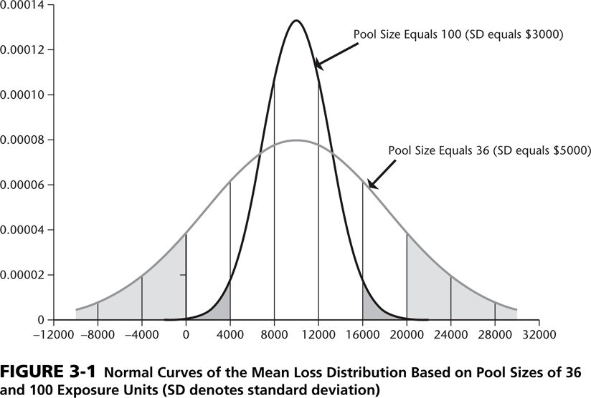
Basic Statistical Concepts - 1
Random Variable: Future value is not known with certainty.
Probability Distribution: Shows all possible outcomes for a Random Variable.

Slide 4
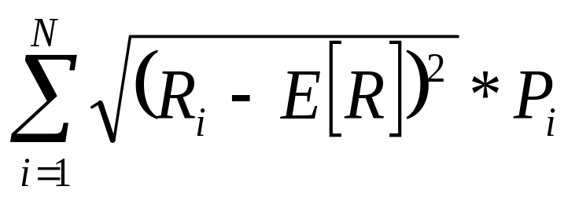
Basic Statistical Concepts - 2
Expected Value: Sum of the multiplication of each possible outcome of the variable with its probability.
E[R] = Σ R_{i} * P_{i}
Variance and Standard Deviation:
σ =

Slide 5
The Expected Value
Can be calculated by multiplying the expected losses with their probability and calculating the sum of all outcomes
Is a starting point for calculating an insurance premium or how much a firm should set aside each year to cover the losses

Slide 6
Average Loss
Estimating Loss Frequency (= Total Amount of Losses divided by Total Number of Accidents) and Loss Severity (= Total Number of Accidents divided by Total Units Analyzed).
Average Loss = Average Loss Frequency multiplied with Average Loss Severity.

Slide 7
Convolution
Calculates all possible combinations of losses indicated by the frequency and severity loss distributions, as well as their corresponding probabilities of occurring.
Often done by computer simulation due to complexity of calculations.

Slide 8
Risk Pooling
Risk can be reduced through diversification.
The creation of a pool of many (exposure) units helps the insurer to better predict any individual unit’s risk of loss.
The Probability Distribution matters!

Slide 9
Normal Probability Distribution
“Bell Curve”:

Slide 10
Confidence Interval - 1
Assuming Normal Distribution:
Estimated Mean Loss ± (k) * Estimated σ
Where:
  (k) = Specified number of standard deviations which reflect the uncertainty.
  σ = Standard Deviation calculated using loss data from past.
This is the Confidence Interval.

Slide 11
Confidence Interval - 2
(k) * Estimated σ is also called the Risk Charge.
It represents the margin of error.

Slide 12
Practical Considerations
Insurers sort consumers into homogeneous categories:
  Age.
  Gender.
  Etc.
Yet still independent of each other.
Insurers will not insure when these assumptions are violated.

Slide 13
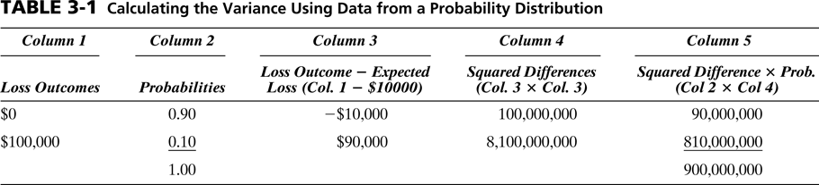

Slide 14
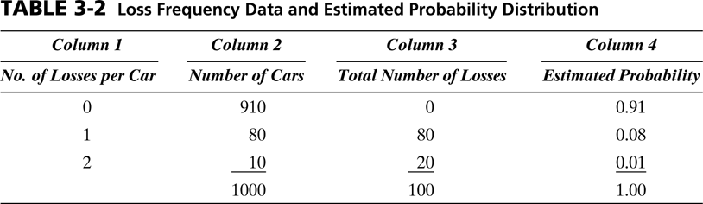

Slide 15
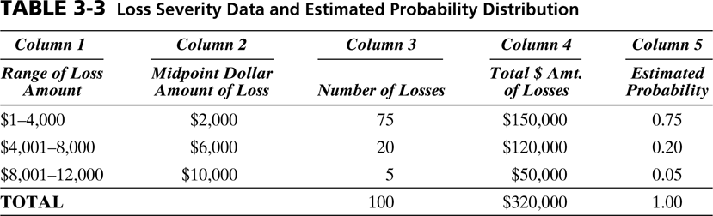

Slide 16
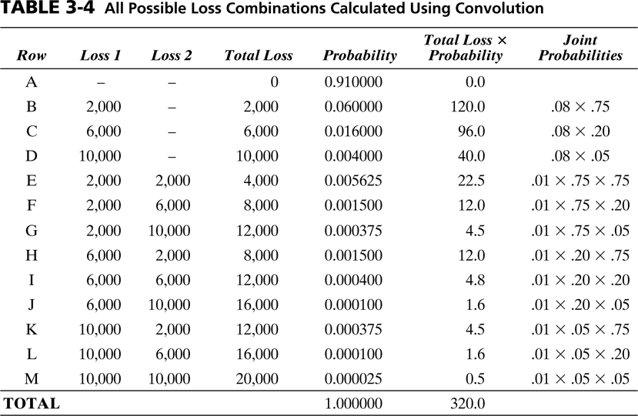

Slide 17
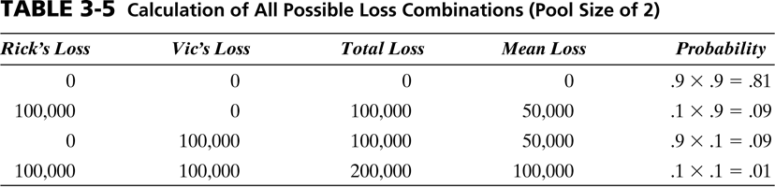

Slide 18
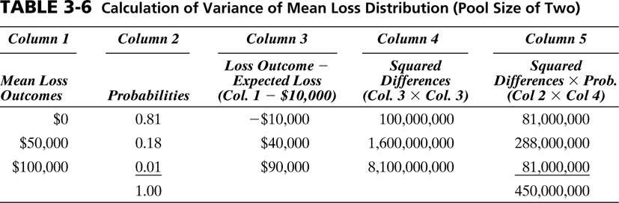

Slide 19
