Slide 1
Chapter 5
Risk Handling Techniques: Diversification and Hedging

Slide 2
Risk Bearing Institutions
Bearing risk collectively
Diversification
Examples:
  Pension Plans
  Mutual Funds
  Insurance Companies

Slide 3
Additional Benefits
Professional management
Administrative Services
Investment in Information
Investment in Infrastructure

Slide 4
State of the Economy Table
Shows returns in different situations with associated probability
Can calculate E[R] and σ again of investments given the different states of the economy
Note that this is a discrete probability distribution

Slide 5
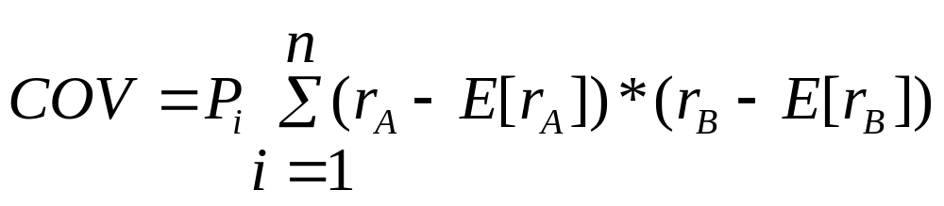
Creating a Portfolio
What matters is interrelationship between investments across different states of the economy:

Slide 6
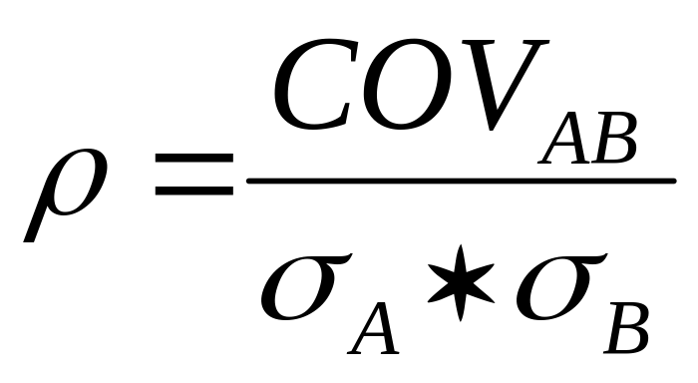
Correlation Coefficient - 1
A number that tells us whether two investments are statistically dependent:

Slide 7
Correlation Coefficient - 2
-1 ≤ ρ ≤ +1
Implications:
  Positive correlation
  Negative correlation
  Uncorrelated

Slide 8
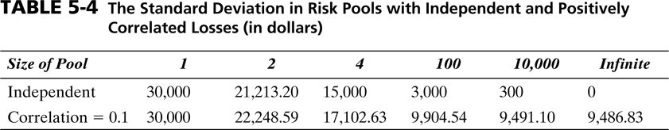
Diversification Again

Slide 9
Lessons
Perfect positive correlation among risk exposures is unlikely
Natural diversification occurs across uncorrelated risks
Bundling negatively correlated risk exposures dramatically reduce risk, see Hedging

Slide 10
Hedging
Taking two financial positions simultaneously whose gains will offset each other.
Hence ρ = -1
Examples:
  Currency Risk
  Interest Rate Risk
  Commodity Price Risk

Slide 11
Derivatives
A financial instrument whose value is based on the value of an underlying financial asset or commodity.
Examples:
  Futures Contract = Order to buy or sell an asset later at a specified price
  Forward Contract = Same, but not traded on an organized exchange

Slide 12
Derivatives - 2
Examples:
  Swaps = Counterparties exchange cash flows of one party's financial instrument for those of the other party's financial instrument.
  Call option = The right, but not the obligation, to buy the underlying asset
  Put option = The right, but not the obligation, to sell the underlying asset

Slide 13
Finally
Risk Management at the Boardroom Level increases Consistency and Negotiating Power
Remember: ERM is a holistic approach to risk management: Pure Risks and Speculative Risks for the firm!

Slide 14
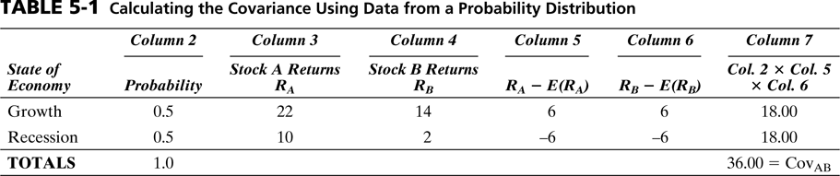

Slide 15
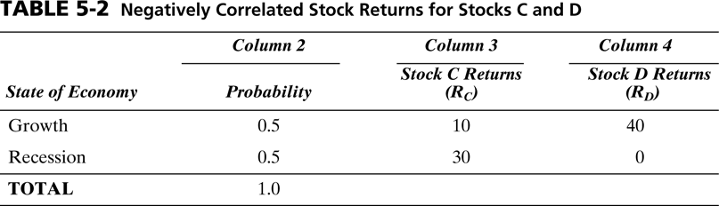

Slide 16
