Slide 1
Chapter 4
Risk Handling Techniques:
Loss Control,
Risk Transfer, and Loss
Financing

Slide 2
RM Statement of Objectives and Principles
Distinguish between pre-loss and post-loss objectives
Pre-loss objectives
  Survival and growth
  Compliance with government regulations
  Efficiency
  Procedures and principles are implemented and followed

Slide 3
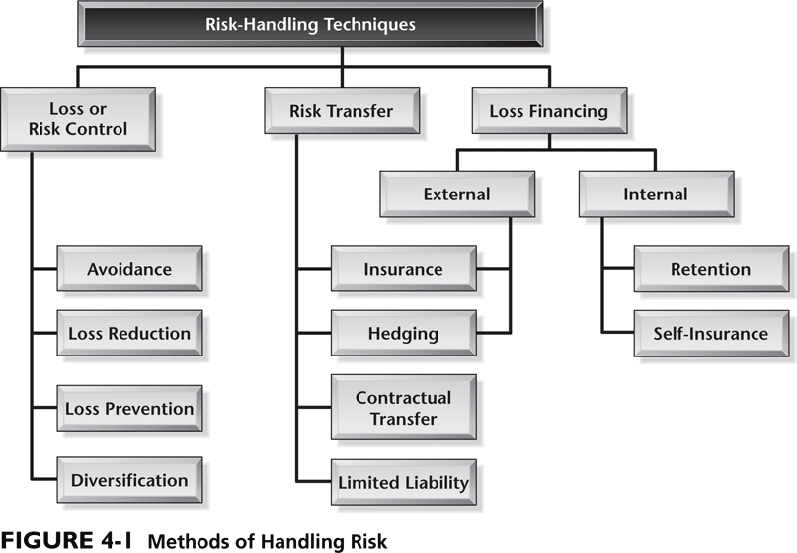
Risk Handling Techniques

Slide 4
Selecting the Risk Management Technique
Low
Frequency
High
Low
Assume
loss prevention
loss reduction
Loss Prevention
loss reduction
assume risk
Severity
High
Insure
risk transfer
loss reduction
loss prevention
Avoid
loss prevention
loss reduction

Slide 5
Loss of Income
Definition
Sources of Loss
Problems
  Can be seasonal in nature
  Difficult to measure
  Best measurement still can only be an estimate

Slide 6
Losses
Loss Prevention:
  Activities that prevent losses.
  Must be cost-efficient.
  Some losses will occur regardless. Hence:
Loss Reduction
  Aim is to minimize impact when losses occur.
  Duplication and Separation.

Slide 7
Measure (evaluation)
Maximum possible loss
  The absolute maximum dollar amount of damage
Maximum probable loss
  A conservative estimate of what is likely to occur in a worst case loss
Relative Frequency
  An estimate (numerical or verbal) as to the number of times the loss will occur

Slide 8
Loss Control - Prevention
Always engage in, if beneficial
Loss Prevention
  Take various steps to reduce the probability of losses occurring
How do you value the loss of life in the cost/benefit equation?

Slide 9
Loss Control - Reduction
Always engage in, if beneficial
Loss Reduction
  Steps designed to reduce the severity
  Take steps to reduce the damage before and after a loss

Slide 10
Government and Loss Control
Occupational Safety and Health Act of 1970 (OSHA)
Consumer Product Safety Act of 1972 (CPSA)
Comprehensive Environmental Response, Compensation Liability Act of 1980 (CERCLA) (Superfund)
Food and Drug Administration (FDA)
The Clean Air Act
The Water Pollution Control Act

Slide 11
Risk Transfer
Methods:
  Risk-bearing financial institutions – Take on financial risk for a fee
  Contractual transfer agreements - transfers risk to another party
  Hold harmless agreements - transfer of risk through a contract
  Limited Liability – provided to the owners of certain types of business organizational forms

Slide 12
Loss Financing - 1
Insurance:
  Transfer of risk to an insurer for a premium
  Appropriate when loss-frequency is low, but potential severity is high
  Also has financial advantages: Tax Issues
  Moral Hazard and Deductibles

Slide 13
Loss Financing - 2
Risk Assumption
  Deliberate decision:
    Size of firm
    Not always a choice
    Funded Risk assumption.
  Or not:
    Ignorance?

Slide 14
Loss Financing - 3
What is self-insurance?
  Why do companies self-insure?
    Save money
    Better control
      Loss prevention incentives
      Improved claims settlement
      Profitability and investment earnings
  Difference between self-insurance and risk assumption

Slide 15
Captive Insurance Companies
A method of self-insuring
A company formed to write insurance for a parent company
Motives for starting a captive
  Save the overhead and profits of the insurance company
  Earn investment income on the premium
  Tax advantages

Slide 16
Remember: Review and Update
Regularly review and update the process
  New assets or disposal of assets
  Valuation changes
  New products and processes, materials
  New personnel
  Law changes
  Currency fluctuations
  New contractual relationships

Slide 17
