Slide 1
Chapter 14
Professional Financial Planning

Slide 2
Introduction to Financial Planning
Life insurance and health insurance products should be viewed as tools to solve financial problems arising from life's (unfortunate) contingencies
Notes:
This chapter focuses on the process of professional financial planning and how life insurance and health insurance products are used as tools to solve many of these financial problems.
These financial problems arise out of:
Loss of life – arising from any cause – Are other people dependent upon you?
Loss of health – medical expenses as well as disabilities
Loss of income – unemployment (not covered in this chapter)
Reallocation of saving for retirement or other uses such as saving for a college education
Living beyond your financial means - longevity

Slide 3
Types of Financial Planners
Fee-only planners
Fee-based planners
Fee-offset planners
Commission based planners
Notes:
Fee-only planners charge a rate per hour for their service.
Fee-based planners charge a percentage of the assets being managed.
Fee-offset planners charge a set fee but reduce the fee based on any commissions earned from product sale.
Commission based planners earn income from the sale of products – investments and insurance.

Slide 4
Professional Designations
CFP – Professional Financial Planner
ChFC – Chartered Financial Consultant
PFS – Personal Financial Specialist
Notes:
Various professional designations exist to provide evidence of a planners professional status. These are an indication of the dedication for learning and keeping updated on financial planning subjects.

Slide 5
Financial Planning Process
1. Motivate and educate
2. Collect data and evaluate risk tolerance
3. Develop goals
4. Implement plans
5. Review and update plans
Notes:
The financial planning process entails a series of steps. Probably the most difficult one is to motivate the client or person to recognize that there is a problem.
The steps in the financial planning process are:
Motivate the client to appreciate the problems and take steps to start a solution.
2. Collect data from the client to develop a plan
3. Develop Goals and a strategy to meet those goals
4. Implement Plans that are agreed upon.
5. Regularly review and update the plans based on changes of goals, changes in tax and other laws, and progress toward the goals.

Slide 6
The Economic Value of Human Life
What is the economic value of a human life?
Wrongful death claims and human life value
Why doesn’t the human life value approach provide a 100% satisfactory solution for a life insurance purchase?
Notes:
There are a variety of methods used to determine how much life insurance one should buy.
The economic value of a human life is one solution that is not entirely satisfactory. This is also commonly referred to as the human life value approach.
This views the value of a human life similar to an income producing machine and equals the present value of revenue less self maintenance expenses. So theoretically, this is the amount that would be lost to the family if death occurred.
Wrongful death claims arise out of negligence and the economic value of a human life is a starting point for the judgment. The amount varies based on income status.
The human life value approach does not provide a satisfactory answer to the questions: Should I buy life insurance? And, How much to buy? For example, a single person with no dependents may not need life insurance because she has no obligations. Who are you going to leave the money to? For a low income family with several kids, the approach may not provide enough coverage to fund the family’s dreams if death occurs to the bread winner. So the approach does not provide satisfactory answers for answering the questions: Should I buy life insurance? And, how much should I buy?

Slide 7
The Needs-Based Purchase of Life Insurance
What financial problems arise if death occurs immediately?
Permanent needs versus temporary needs
Evaluate assets available to meet the needs
  Social Security, Group life insurance, personal savings, family resources (grandparents, employment of spouse), business interests, already-owned individual life insurance
  Purchase life insurance to meet unmet needs
Notes:
The needs based approach is a logical approach to determine whether
a person needs insurance and
how much should be purchased.
This construct is logical since it directly addresses identifying, measuring and solving financial problems caused by life’s contingencies.
The assumption is that death occurs immediately.
A list is made identifying the financial needs at death. What are the goals?
A dollar amount is identified next to the need to fund the goal.
Subtract out sources of assets that are already available to meet those needs.
The remaining amount is the additional amount of life insurance needed to meet those goals.
The goals can also be separated in temporary needs and permanent needs.
Temporary needs are ones that are paid for or reduce to zero if you survive. Example: mortgage, child dependency years.
Permanent needs exist regardless of when death occurs. Retirement funding is considered to be permanent because of the consequences of considering retirement saving temporary is negative.
Temporary needs and permanent needs come into play when trying to figure out the type of product to buy to meet those needs.

Slide 8
The Early Adult Years
Life insurance purchased primarily to protect against financial problems caused by premature death
Death is assumed to be immediate
What are these financial problems?
Notes:
The text divides the financial planning time horizon into trimesters.
The early adult years
The middle adult years
The later adult years
Each trimester presents different challenges although all financial problems still need to be addressed.
The early adult years focus on the problems of premature death.
Just like the needs-based approach, death is assumed to be immediate.
The major financial problems encountered during the early adult years are:
Funding for the dependent years of children
Funding income for a spouse
Paying for significant debt such as a mortgage
Pre-funding college education

Slide 9
Insuring the spouse, children, and college students.
Homemakers supply valuable economic services to the family
Children's premature death causes funeral expenses. The rationale for insuring children should be questioned
College students rarely need life insurance and college insurance plans rarely make any sense
Notes:
There are various opinions - some emotional while others logical - concerning insuring homemakers, children and college students.
Insuring homemakers
Homemakers supply valuable economic services to the family and is quite expensive to replace with substitute help. Homemakers need to be evaluated independently of the bread winner using the needs-based approach for determining how much life insurance should be purchased and if life insurance should be purchased on the homemaker.
Insuring Children
Insurance on children should occur ONLY AFTER needs of the parents are handled AND if there is a real justification for the insurance. A child’s death can be psychologically harmful. Funeral expenses and a time for adjustment may be justifications.
Insuring college Students
Insurance on college students should be viewed relative to the needs-based approach. Rarely does it make sense to insure college students unless there is some overriding identified need.

Slide 10
Financial Planning: The Middle Years
Characteristics include: independent children, mortgages repaid, and accumulated savings
Emphasis shifts from premature death of bread winner to retirement saving and planning
Estimate future retirement needs and how much is required to fund the need
Life insurance planning still remains important
Notes:
The characteristics of the middle adult years evolve to emphasize a different set of problems. The problems of the early adult years should not be ignored if they still exist. There is no magic time where the problems arise but as financial problems evolve, others may disappear.
Characteristics include:
Mortgages almost repaid or repaid
Children are independent and out of the household
Saving can be significant and being accumulated.
Often the main problems associated with the early adult years continue but the emphasis changes.
Life insurance still remains important
Shift from problems of premature death to retirement savings and planning
Retirement and savings planning becomes very important

Slide 11
Financial Planning: The Later Years
Focus turns to estate planning, and the consumption and distribution of assets
Estate planning
Wills
Notes:
The later adult years evolves into primarily dealing with the consumption and distribution of assets.
There are many complex problems associated with estate planning and wills to achieve goals.
The later adult years focus on:
Making sure there is sufficient assets to live on during retirement
Minimizing taxes at death
Maximizing the amount of assets going to heirs
Making charitable and other bequests

Slide 12
The Federal Estate and Gift Tax
Uniform transfer tax
Gross estate versus the taxable estate
Unlimited marital deduction
Gift tax exclusion
Notes:
These concepts are explained to illustrate the importance of financial planning. The tax planning concepts can be quite complicated and competent legal help is required to take advantage of tax planning techniques.
Uniform Transfer Tax The estate tax and the gift tax have been combined into the Uniform Transfer Tax. This is a tax on the transfer of assets during life or at death. The amount that can be transferred is currently increasing to $3.5 million (2009) that can be transferred without paying any tax. 2010 there will be no tax except a 35% gift tax and in 2011, the sunset provision requires to go back to the 2001 law.
Gross estate versus the taxable estate The gross estate is the total amount of assets that a person owns or controls at death. The taxable estate is the amount that the tax is applied to. These amounts can be quite different.
Unlimited marital deduction When one spouse dies, all of the assets may be transferred tax free to the surviving spouse as long as it is a non-terminable interest. That is – if the assets are not spent, destroyed, gifted away or a remarriage, the assets will be taxed when the surviving spouse dies.
Gift tax exclusion Each year a person may gift $11,000 (indexed annually now) without eroding the unified credit. If the spouse joins in on the gift $22,000 can be given each year to as many donees as you want. If sufficient time and number of donees a lot of assets can be distributed while alive which reduces the taxable estate at death without using any of the unified credit.

Slide 13
Life Insurance and Estate Planning
Why is life insurance often needed in estate planning?
The use of life insurance trusts
Survivorship life insurance (second-to-die life insurance)
Notes:
How does life insurance fit into estate planning?
Life insurance often is a critical part of the estate planning process for the following reasons:
The event that causes problems also is the event that can provide a solution – death.
Liquidity is often needed in an estate to continue income to survivors, pay death taxes, and last illness expenses.
Life insurance trusts. One goal of financial planning is to provide liquidity to the estate through the ownership of life insurance but not include the policy proceeds in the taxable estate. One way to do this is to use a life insurance trust that owns the contract and is the beneficiary. When death occurs, the trust buys assets of the estate or lends the estate money. The beneficiary of the estate then receives the assets of the life insurance trust.
Survivorship life insurance can also be used as an estate planning tool for husbands and wives. When the first spouse dies the 100% marital deduction can be used. And then when the second spouse dies, the life insurance pays dollars that can be used to pay the estate tax.

Slide 14
Liquidating Retirement Savings
Taxable savings – based on after-tax dollars
Tax deferred savings – generally based on before tax dollars
  Such as qualified pensions, IRAs, Keogh, 401k, 403b, etc.
  10% penalty for early withdrawal (59 ½)
  Penalty for starting distributions late (70 ½)
Notes:
Much planning goes into the distribution of saving to supplement or provide for retirement income. Due to the tax consequences and penalties, professional financial planners are very careful to weigh the consequences versus the need for income.

Slide 15
Business Uses of Life Insurance
Provide fringe benefits
  Group life insurance, split dollar plans
Protect firm from loss of key employee(s)
  Key employee life insurance
Aid in transferring ownership rights
  Buy-and-sell agreements
  Cross purchase plans versus entity plan
Notes:
Businesses use life insurance for a variety of purposes.
Why do businesses purchase life insurance? These are some of the reasons:
Provide fringe benefits to employees
group life insurance, split dollar plans
Protect firm from loss of key employee(s)
key employee life insurance is life insurance on an employee whose death would cause financial harm to the organization.
Aid in transferring business ownership rights called business continuation.
buy-and-sell agreements are contracts that force a buyer to buy and a seller to sell at a pre-arranged price. The trigger can be death, and it clearly can be funded with a life insurance contract.
cross purchase plans versus entity plan. Cross purchase plan is where for example 5 partners would buy insurance on each other partner leaving 5 x 4 contracts or 20 to be purchased. An entity plan is where the entity buys one contract on each partner.

Slide 16
The Taxation of Life Insurance
Death proceeds
  Estate Tax: if insured had an incidence of ownership at death, face amount paid to beneficiary is included in gross estate
  Income Tax: beneficiary receives principal amounts tax free. If paid over a period of time, interest income is taxable
Notes:
What happens when a death occurs with respect to taxation?
Estate Tax
If the insured had an incident of ownership at death, the face amount is payable to the estate or the benefits are used to directly pay for obligations of the estate, the face amount paid to beneficiary is included in gross estate.
An incidence of ownership is the ability to exercise control over the insurance contract. These rights include the ability to change the beneficiary, determine how dividends are to be used, and borrow against the cash value.
Income Tax
Beneficiary receives principle amounts tax free.
If the policy proceeds are paid over a period of time, interest income is taxable.

Slide 17
Taxation and Living Benefits
Participating Dividends - not taxable because they are considered a return of premium
Savings - amount withdrawn exceeding the cost basis in the contract is taxable to the owner
Notes:
These are the living benefits. How are they taxed?
Policy owner dividends
not taxable because they are considered a return of premium
Savings
Any amount withdrawn exceeding the cost basis in the contract is taxable to the owner.
Annual increases in cash value are not currently taxed as income.
The owner’s cost basis is equal to all premiums paid less any participating dividends received.

Slide 18
Taxation and Living Benefits
If a portion of the face amount is paid while a terminally ill person is still alive - the IRS does not tax that amount if certain requirements are met
These are called “Qualified Accelerated Death Benefits”
Notes:
Qualified Accelerated Death Benefits
Accelerated death benefits are payable when a person is certified as terminally ill and generally death is expected within 12 months.
If a portion of the face amount is paid while a terminally ill person is still alive - the IRS does not tax that amount if certain requirements are met.
Alternatively, a policy owner can sell her insurance contract to a viatical settlement company.

Slide 19
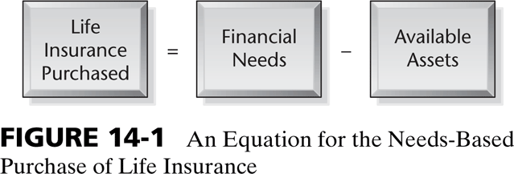

Slide 20
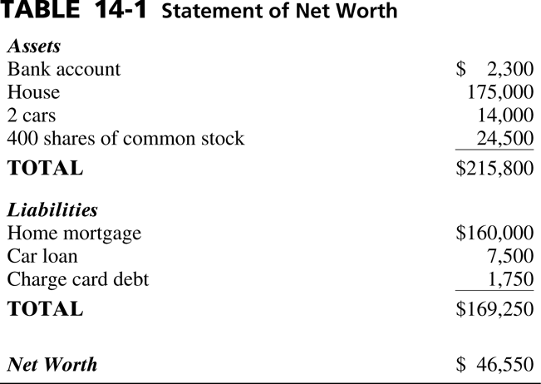

Slide 21
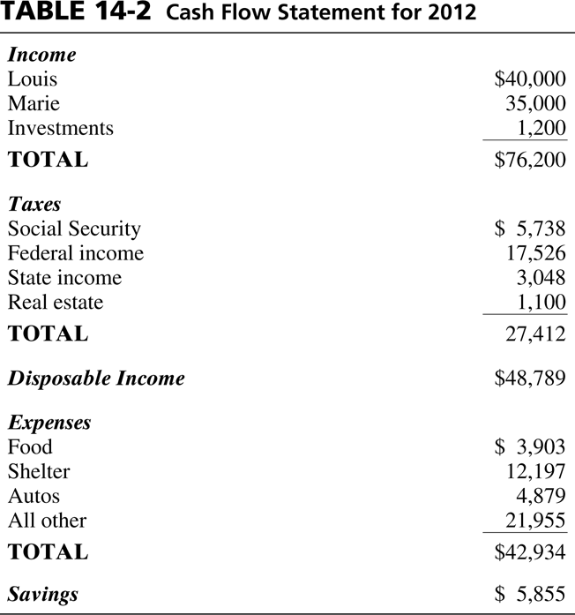

Slide 22
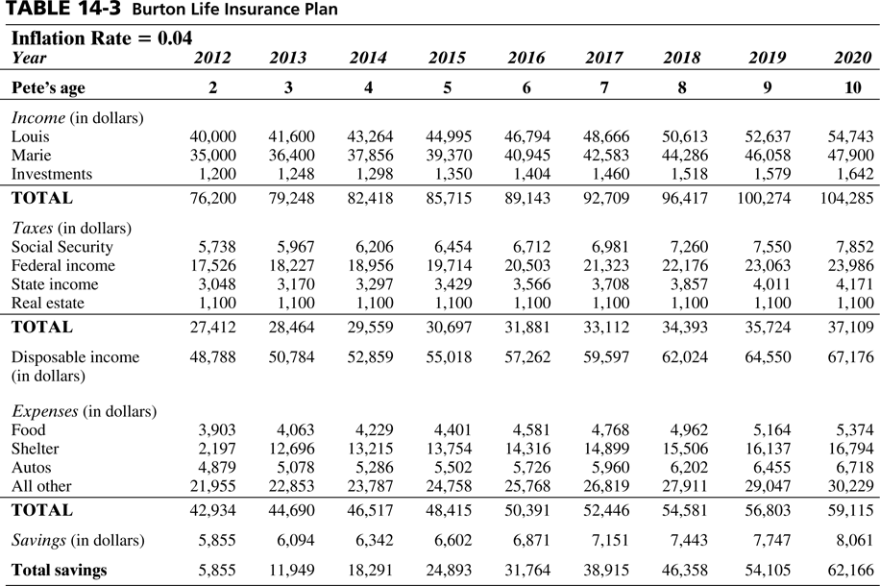

Slide 23
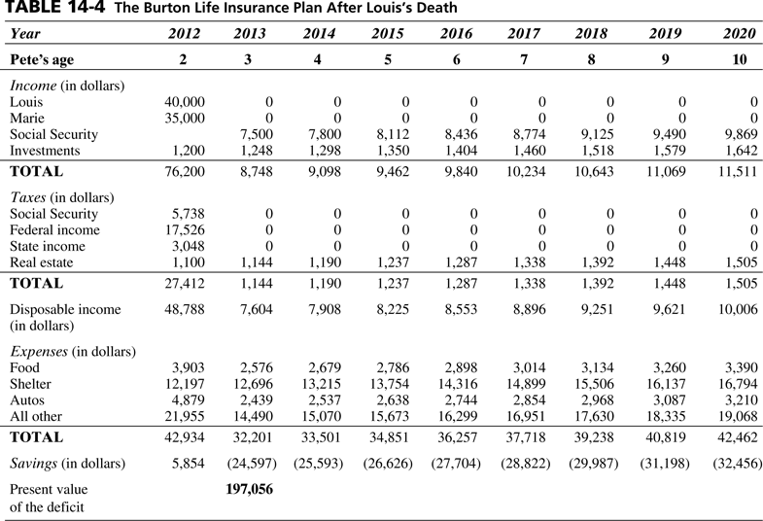

Slide 24
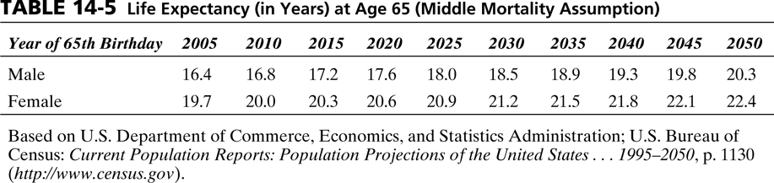

Slide 25
