Slide 1
Chapter 15
Life Insurance Policies

Slide 2
What Is Life Insurance?
Simply stated - The main purpose of life insurance is to pay dollars when the insured dies
The transaction requires:
  The pooling of exposures
  Financing (advance funding)
Notes:
Life insurance is a contract between several parties that promises to pay dollars when a person dies. This simple statement of what life insurance is masks much of the complexity of the product.
Life insurance is a complex product because of the many forms it comes in, the funding mechanism required to meet obligations on EVERY contract, and its variety of uses. In addition, there is a whole body of law that applies to the transaction.
In any event, similar to other insurance contracts, the transaction requires:
The pooling of exposures in order to calculate losses and make numbers highly predictable.
Financing (advance funding) in order to provide the required cash flow to pay expenses and the cost of the claims.
In general, life insurance contracts need to meet the insurability requirements discussed when the requirements of loss exposures were identified.

Slide 3
Ways Life Insurance Is Distributed
Group Life and Credit Life
Individual Life
Notes:
Life insurance is distributed in various ways.
Group Life and Credit Life is provided by organizations such as businesses or banks based on membership in the group. There is generally one master contract and benefits are provided based on a pre-selected formula or amount. This is a low cost distribution method. Credit life generally is purchased to pay off a loan balance and the cost of the insurance is debited to the account.
Industrial Life (debit or home service life) Industrial life is sold in small quantities. Previously this was sold as and called burial insurance. A debit agent collects small frequent payments for the coverage. Because of collection costs, this type can be expensive.
Individual Life Individual life insurance is sold by agents in larger amounts. Premiums are generally paid on a monthly, quarterly, semi-annual, or annual basis.

Slide 4
Parties to the Life Insurance Contract
Insurance Company
Insured
Policy owner
Beneficiary - typically has a contingent right if revocable
Notes:
There are four parties to a contract.
Insurance Company – the organization promising to pay the face amount of the contract or death benefit when the insured dies.
Insured – the insured is the object of the insurance whose death causes the insurer to pay a death claim.
Policy owner – the policy owner owns and controls the contract rights in the contract. Often the policy owner is the same as the insured.
Beneficiary – the beneficiary is the person(s) identified to receive the death benefit when the insured dies. The beneficiary only has a contingent right. The beneficiary will receive the benefits IF the policy is still in force, IF the insured dies, IF the beneficiary designation is not changed, and IF the policy proceeds have not been borrowed.
The students need to understand that the insured does not necessarily have to be the policy owner. Financial planning and tax considerations come into play when identifying the owner of the contract.

Slide 5
Rights of the Policy Owner
To assign rights
Control participating dividends (par)
Name the beneficiary
Control of cash value
Selection of dividend option
Exercise additional purchase options
Notes:
The insured is simply the object of the insurance. The policy owner controls the rights under the contract.
These are the rights as a policy owner – the person who owns the contract.
Assign rights – rights may be given away or assigned.
Control participating dividends (par) – the policy owner controls how dividends are used when paid by participating contracts.
Name the beneficiary – the policy owner can change the beneficiary.
Control of cash value – the policy owner can borrow cash value and in non-traditional contracts determine how the cash value is to be invested.

Slide 6
The Level Premium Concept
$
Over payment
Under Payment
Level premium
mortality curve
25
100
Age
Notes:
The funding mechanism in life insurance is different than the funding mechanism in the property and casualty industry. In the P&C industry, funding is required for losses based on an estimate of probability and severity. And it is a question of IF the loss will occur and how much. In life insurance it is NOT a question of IF, it is a question of WHEN. So all insureds that persist will produce a claim and the cash must be there to pay the loss.
The level premium process is explained.
As a result of self-selection problems and affordability problems, insurers developed the level premium process. The result is overpayment in the early years and underpayment in the later years giving rise to the cash value amount as shown in the next overhead. This process minimizes adverse selection and allows affordability.
Self selection – people in poor health tend to keep coverage, people in good health tend to leave as annual insurance prices would increase. This causes an even higher mortality curve.
Affordability – as prices go up on an annual basis, people who need coverage may not be able to afford it.

Slide 7
Term Life Insurance
Premiums
If Death
Face Paid To
Participating
Beneficiary
Dividends
x
Policy Term
If Paid
Notes:
Term insurance contracts are fairly straight forward contracts.
Term life insurance is purchased to cover a specific length of time – but not all of one’s life.
Premiums are paid each period
Participating dividends are paid to the policy owner if participating
If the insured dies during the policy period, the death benefit is paid to the beneficiary.
There is no cash value

Slide 8
Term life insurance
Provides only death benefits during policy term - pure protection
Strictly a temporary contract
Individual contract or a rider to other contracts
1, 5, 10, or 20 terms or to age 55 or 65
Premium increases each successive period
Notes:
The facts about term insurance contracts.
Provides only death benefits during policy term - pure protection
Strictly a temporary contract – the contract is not designed to handle permanent needs.
The term insurance contract can be an individual contract or a rider to other contracts
1, 5, 10, 20, terms or to age 55 or 65
Premium increases each successive term period when renewed

Slide 9
Term Insurance - Uses
Temporary needs
Funds for premiums limited but life insurance need is great
Remember:
  Does not involve saving
  Premiums increase with age
  Usually unavailable after age 70 - 75
  Most term polices do not pay a death claim because of the period being covered. This is why term is relatively inexpensive.
Notes:
The term insurance contract is designed to meet temporary needs.
Temporary needs are ones that are generally paid off while you are alive and are not present all of your life regardless of when death occurs.
A person would opt for term insurance when funds for premiums are limited but life insurance need is great
Remember:
Does not involve saving
Premiums increase with age
Usually unavailable after age 70 - 75
Most term polices do not pay a death claim because of the period being covered. This is why term insurance is relatively inexpensive.

Slide 10
Term Insurance
Renewable feature
Convertible feature
Notes:
These features can be added to the term insurance at an additional cost.
Renewable feature - The policy owner is able to renew the contract for an additional term without evidence of insurability. The ability to renew usually stops at a certain date – for example age 65. Each additional term, the premium goes up based on age, not based on health status.
Convertible feature – The policy owner is able to convert the term policy to a permanent form of coverage without evidence of insurability and before a certain date.
The renewable and convertible features essentially shift the risk of insurability to the insurance company.
Re-entry term life insurance shifts the risk of insurability to the insured. If the insured does not pass the medical exam to get low rates, rates are increased substantially.

Slide 11
Whole Life Insurance
$1,000
Policy face
Cash value
Level Premium
$14/year
100
25
age
Notes:
The cash value is a result of the level premium process.
If the total amount of assets held by the company is divided by the number of survivors having a claim on those assets, the cash value line per policy results.
When a person dies, the policy face is paid to the beneficiary.
The $1,000 can be viewed as the:
cash value + the net amount at risk = $1,000 or
Face amount is paid and the cash value remains in the pool and split among the survivors (survivor benefit)
Net amount at risk = 1,000 – cash value.

Slide 12
Participating Vs. Nonparticipating Policies
Participating policies pay participating dividends to policy owners who are owners of the company - non taxable since considered return of unneeded premium
Participation in expenses, investments, cost of insurance - long term trends
Nonparticipating - stock holders participate in the form of stockholder dividends - taxable.
Notes:
Mutual insurance companies sell participating policies and policy owners of participating policies have a right to participate in the good and bad performance of the company.
Participating dividends are non taxable since they are considered a return of unneeded premium
Participation in expenses, investments, cost of insurance - long term trends are tending to reduce the cost of insurance in the long-run.
Nonparticipating contracts - the stock holders participate in the form of stockholder dividends which is considered new money from the point of view of the IRS and taxable as dividend income.

Slide 13
Different Payment Patterns for Whole Life Insurance
$1,000
PVFB
Whole life
paid up at 65
20 pay life
10 pay life
Single premium
life (MEC)
x
time
100
Notes:
Based upon the amount of the annual premium, policy owners can accelerate the amount of cash value development and pay the contract up sooner than paying for life (or age 100, whichever comes first).
Whole life is paid until death and the pattern of cash value development is shown.
If one wants to pay the contract up sooner and pay no more premium payments, other options are available.
An analogy: Suppose you wanted to buy a house, you could pay with one check or could pay for it over any practical length of time. If you reduce the number of payments, each payment must go up. This is the same for purchasing the life insurance contract.
So, a paid up at 65, 20 pay whole life, 10 pay whole life and single pay whole life has an increasing premium, the fewer payments – all other factors the same.
PVFB = Present value of future benefits.
MEC = Modified Endowment Contract (a tax categorization).

Slide 14
Uses of Whole Life
Permanent Needs
  Burial
  Income for permanent dependents - spouse, child, parents
  Federal Estate Tax (FET)
  State death taxes
  Business continuation
  Estate planning
Notes:
Needs for insurance are split into permanent needs and temporary needs.
Permanent needs occur regardless of when the insured dies.
Temporary needs can reduce to zero over time.
Whole life insurance is primarily designed to handle permanent needs. These are some of the permanent needs.
Burial
Income for permanent dependents - spouse, child, parents
Federal Estate Tax (FET)
State death taxes
Business continuation
Estate Planning
Retirement income

Slide 15
Sources of Flexibility in the Traditional Whole Life Insurance Contract
Policy owner loans
  Liquidity, no credit problems, interest not deductible, interest can be added to the loan balance
  Use for college funding
  Loans and interest reduce the face amount
Nonforfeiture options
  Cash Surrender
  Reduced face amount paid-up insurance
  Extended term insurance
Notes:
Many people believe that the traditional whole life insurance contract is inflexible. The next three over heads provide a listing of the many sources of flexibility of the contract.
Policy owner loans can be used as a readily available source of cash.
Liquidity, no credit problems, interest not deductible, interest can be added to the loan balance
Use for college funding
Loans and interest reduce the face amount
Nonforfeiture options are used when the policy owner desires to stop paying premiums.
Cash Surrender
Reduced face amount paid-up insurance
Extended term insurance

Slide 16
Sources of Flexibility in the Traditional Whole Life Insurance Contract
Reinstatement provision
  Allows policy owner to reinstate the policy after an extended term or paid-up insurance conversion
  Requirements:
    Within 2 - 5 years after conversion
    Repay past due premium
    Repay outstanding loans and interest
    Evidence of insurability
Guaranteed Insurability Option
  Allows the policy owner to purchase additional amounts of insurance at specified dates without evidence of insurability
Notes:
Reinstatement provision - allows policy owner to reinstate the policy after an extended term or paid-up insurance conversion.
Requirements are:
Within 2 - 5 years after conversion
Repay past due premium
Repay outstanding loans and interest
Evidence of insurability
Guaranteed Insurability Option allows the policy owner to purchase additional amounts of coverage.
at specified dates or events
without evidence of insurability

Slide 17
Sources of Flexibility in the Traditional Whole Life Insurance Contract
Waiver of Premium
  Waives any premium payments while the insured is “disabled”
  After waiting period premiums due during waiting period usually refunded
Accelerated Death Benefits
  Pays a portion of the face amount when an insured is certified terminally ill - expected to die within 12 months
Notes:
Waiver of Premium
Waives any premium payments while the insured is “disabled”
After waiting period premiums due during waiting period usually refunded
Accelerated Death Benefits - pays a portion of the face amount when
An insured is certified terminally ill - expected to die within 12 months

Slide 18
Universal & Variable Policies
Interest or Earnings From Investments
Flexible Premiums
Investment Account
(Cash Value)
Monthly Administrative Charge
Withdraw and termination - service fee
Borrow - pay interest
Surrender - Surrender Charges
Monthly Cost
of life insurance
Notes:
Universal and variable life insurance contracts shift investment risk to the insured. These contracts are essentially buy-term-and-invest-the-difference strategies.
The way these work is:
Flexible premiums get paid into a cash value account
A monthly administrative charge is charged
The monthly cost of insurance is charged
Interest earnings are added.
At death, the death benefit is paid to the beneficiary
If the policy owner surrenders or borrows money there may be fees involved.
Flexible premiums = once the first premium is paid, the policy owner can increase, decreases or not pay any premium.

Slide 19
Universal Life -- Plan A
Death Benefit = Specified Amount
$100,000
Cash value
X age
Notes:
People buying universal life and variable-universal life can select the style of the face amount.
Either the death benefit can be level (Plan A) or increasing (Plan B).
This is Plan A – A level death benefit.
The cost of insurance is the rate on the actual insurance amount which is the $100,000 minus the cash value for each monthly period.
The portion of the graph that increases does so when the cash value exceeds certain minimums.
If the insurer did not increase the death benefit, the contract would be disqualified as an insurance contract. It therefore would be an investment contract and tax advantages associated with life insurance would be lost.

Slide 20
Universal Life -- Plan B
Death Benefit = Specified Amount + Cash Value
$100,000
$100,000
Cash Value
X age
Notes:
Plan B – An increasing death benefit.
In this case the death benefit starts off at $100,000 and increases or decreases with the amount of cash value.
So, the death benefit = $100,000 + cash value.
The mortality cost in this case is always based on the $100,000 specified amount because $100,000 of life insurance is always purchased.

Slide 21
Variable Life Insurance
Fixed premium contract
Cash value is invested at owner’s discretion in various funds
Face amount increases and decreases based on the value of the underlying portfolio
Notes:
Variable life insurance is another non-traditional life insurance contract.
The main difference between a variable life insurance contract and a universal contract is:
Fixed premium contract – the premium must be paid like a regular whole life insurance contract.
The cash value is invested at the owner’s discretion in various funds offered by the insurer
The face amount increases and decreases based on the value of the underlying portfolio

Slide 22
Other Types of Life Insurance
Flexible Premium Variable Life Insurance (FPVLI) or Variable - Universal
Endowment Life Insurance - not sold due to changes in tax law
Family Life Insurance policies
Notes:
Other types of life insurance include:
Flexible Premium, Variable Life Insurance (FPVLI) or Variable – Universal life insurance
This contract is very similar to ULI except a person is able to pick and choose investments like VLI.
Endowment Life Insurance - not sold due to changes in tax law
An endowment contract is a term contract that pays if death occurs or pays the face if the person survives.
Since there is too much cash value relative to the actual life insurance, the contract is classified as an MEC and no longer sold.
Family Life Insurance policies
These contracts purchase whole life on the bread winner and then term insurance on the members of the family. Some provide whole life on the spouse also.

Slide 23
Saving Using Life Insurance
Many consumers do not save unless forced to do so
Expert investment and diversification services
Federal income tax advantages
Protection from creditors

Slide 24
Buy Term and Invest the Difference
Arguments For:
  Death benefits and saving amounts available at death
  Life insurance needs do not exist after age 65
  Earnings outside cash value can be greater
Arguments Against:
  Safety, guaranteed earnings, and creditor protection is lost
  Most people are not skilled investors
  Most people cannot save regularly
  Needs continue beyond age 65
Notes:
I explain the buy-term-and-invest-the-difference strategy and discuss the arguments for and against doing so.
Arguments for:
Death benefits and saving amounts available at death
Life insurance needs to not exist after age 65
Earnings outside cash value can be greater
Arguments against:
Safety, guaranteed earnings, and creditor protection is lost
Most people are not skilled investors
most people cannot save regularly
needs continue beyond age 65

Slide 25
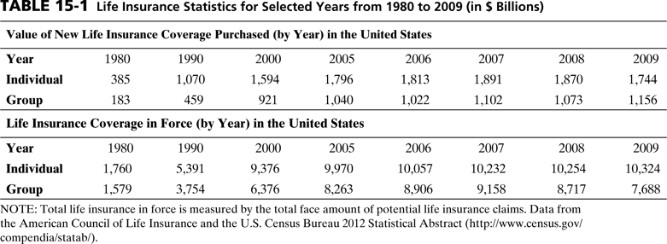

Slide 26
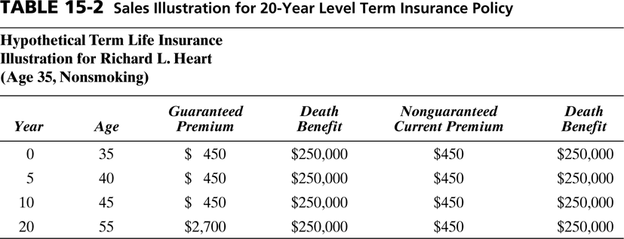

Slide 27
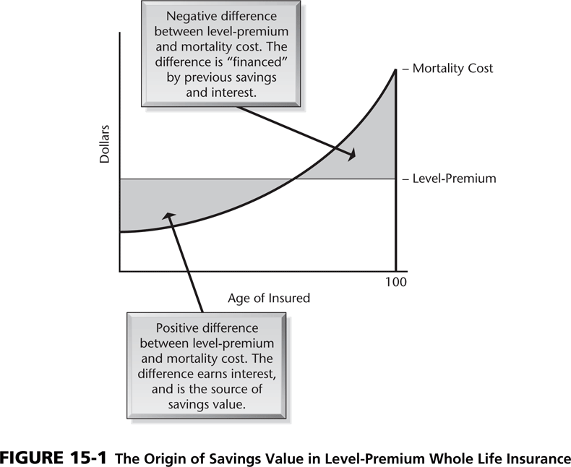

Slide 28
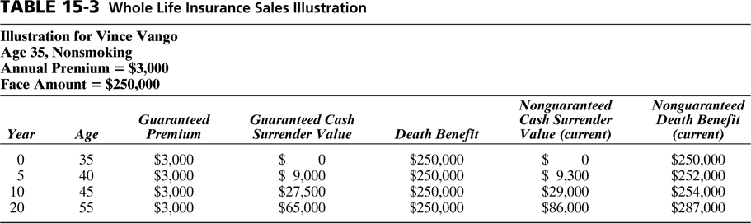

Slide 29
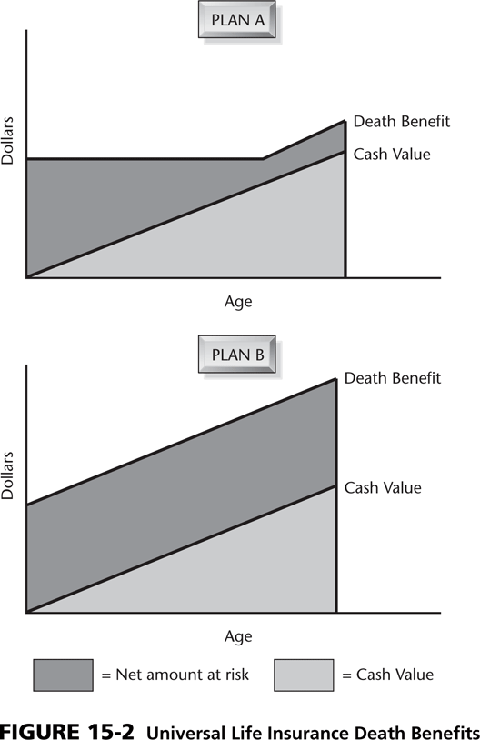

Slide 30
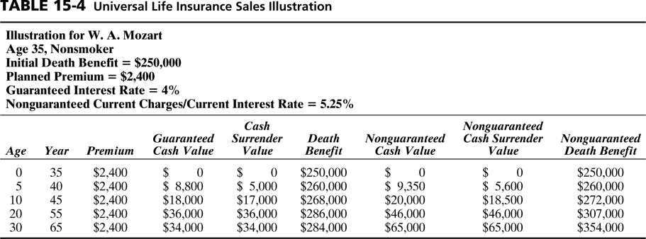

Slide 31
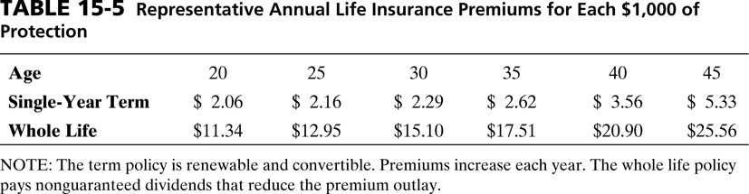

Slide 32
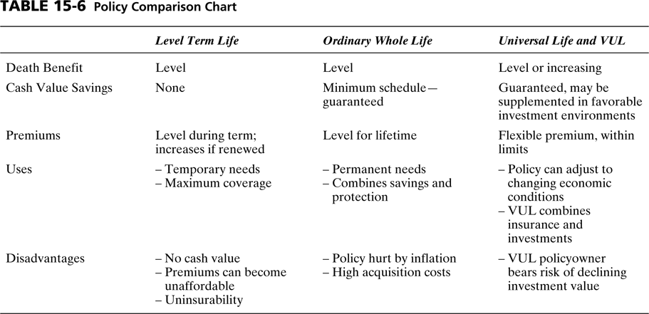

Slide 33
