Slide 1
Chapter 16
Standard Life Insurance
Contract
Provisions and Options

Slide 2
Policy Provisions
Beneficiary Designations
Grace Period
Reinstatement Provision
Incontestable Clause
Misstatement-of-Age Provision
Entire-Contract Provision
Annual Apportionment of Divisible Surplus
Suicide Clause

Slide 3
Policy Provisions
Beneficiary Designations
  Revocable versus irrevocable beneficiary designations
  Level of beneficiaries
  Class I vs. II or primary vs. contingent (secondary)
  Common disaster problems
    Order of death (insured and beneficiary) can be important
Notes:
Beneficiary designations are also optional. If no beneficiary is identified, the policy proceeds are paid to the policy owner. If the policy owner is the insured, the proceeds are paid to the insured’s estate.
Beneficiary designations are assumed to be revocable and may be changed by the policy owner at any time.
An irrevocable beneficiary cannot be changed unless the beneficiary agrees to the change.
When beneficiaries are designated, usually levels of beneficiaries are identified.
Primary or class I – identifies the people who receive the benefits if alive to do so.
Contingent or class II – identifies the people to receive the benefits if the primary is not alive to do so.
Common disaster problems – common law assumes that if the insured and primary beneficiary die in the same accident and it is not known who died first, it is assumed that the primary beneficiary died first and the benefits go to the contingent beneficiary. If it is known that the insured dies first, the benefits go to the beneficiary’s estate – not the contingent where you may want it to go. Common disaster clauses therefore are needed.

Slide 4
Grace Period
30 to 31 day period
  Premiums due but have not been paid
Lapse with no cash values
  Policy terminates after notification period
If cash value exists
  Policy continues under one of the nonforfeiture options – usually extended term
Notes:
The Grace Period
This is a 30 to 31 day period when premiums are due but have not been paid yet
Coverage continues to exist through this period.
If death occurs, the premium is deducted from the death benefits
If death does not occur and the premium is not received, the contract is said to lapse
When the contract lapses with no cash values the policy terminates after a notification period.
If cash value exists the policy continues under one of the nonforfeiture options – generally the extended term nonforfeiture option.

Slide 5
Reinstatement
Intent is to allow the policy owner to restore the contract after a paid-up or extended term conversion.
Requirements:
  Pay all arrears (missed premiums and interest)
  Reinstate within the prescribed time in contract
  Meet insurability standards
Original age versus attained age reinstatement
Notes:
The intent of the reinstatement provisions is to allow the policy owner to restore the contract after a paid-up or extended term conversion. The insured must meet certain requirements.
Requirements:
Pay all arrears (missed premiums and interest)
Reinstate within the prescribed time in contract
Meet insurability standards
Original age versus Attained age reinstatement
With the original age reinstatement, all arrears must be paid to retain the original premium payment level. With attained age reinstatement, the premium level is advanced to the new attained age and repaying arrears is not required
Many people believe that the reinstatement clause allows the policy owner to restart a policy that is no longer in force. This is not true. You cannot enforce a provision in a contract that no longer exists.

Slide 6
Incontestable Clause
Two years usually - can be less
This clause balances insurer’s right to underwriting information and policy owner’s and beneficiary's right for claims payment
Statute of limitations from inception of contract - not from time of discovery of problem
Modern wording: ". . .contestable within the life time of the insured."
Notes:
Incontestable clause – the insurer is allowed to contest the contract within two years (usually) of its start. After the period, the insurer is stopped from contesting the contract for almost any reason including fraud.
The two year time period can be less but not more than two years because fewer years favor the policy owner.
This clause basically balances the insurer’s right to full and truthful underwriting information and policy owner’s and beneficiary's right for claims payment. Otherwise, the insurer could wait many years including after death to contest the contract.
This is basically a statute of limitations from inception of contract - not from time of discovery of problem which is normal in business contracts.
Modern wording: ". . .contestable within the life time of the insured.“ If the insured dies, the contract is no longer contestable even in the two year period.
.

Slide 7
Reasons for Terminating or Contesting Contracts
Non-payment of premium (no cash value)
Accidental death questions
Misstatement of age or sex disputes
Validity of the entire contract
Interpretation of contract provisions
No insurable interest when started
Purchasing the contract with the intent to murder
Impersonating insured for medical exam
Notes:
Even though the incontestable clause seems to be absolute after the two year period, there are still reasons that the contract can be contested or terminated. Here is a non-exhaustive list of those reasons.
Non-payment of premium (no cash value)
Accidental death questions
Misstatement of age or sex disputes
Validity of the entire contract
Interpretation of contract provisions
No insurable interest
Purchasing the contract with the intent to murder
Impersonating insured for medical exam

Slide 8
Misstatement of Age
Normally would be contestable
But... because of insurance code, benefits are adjusted to an amount of coverage that would have been purchased given the true age and actual premium
  If premiums low - benefits adjust downward
  If premiums high - benefits adjusted up or premium refunded
    Depends on individual state law
Notes:
Misstatement of Age.
When a material underwriting factor is not disclosed correctly, this is normally grounds for avoiding the contract because of a material misrepresentation and the entire contract could be in questioned. This is especially true when older people are not able to prove their age because of wars, destruction or loss of records and other causes. Individuals can find it especially difficult to prove the age of the insured – especially after death.
To balance the rights of beneficiaries and the rights of the insurer, misstatement of age does not cause the destruction of the contract unless before the two year incontestable period the underwriting rules would not permit writing the contract at that age.
To resolve this issue misstatements of age cause the benefits to change to an amount that the actual premium would have purchased had the true age been known.

Slide 9
Entire Contract Clause
Incorporation by reference problem
Statutes supersede provisions
“Place of making rule”
  Last act to create a contract - laws of that state apply
Notes:
The entire contract clause.
Historically some companies would modify life insurance contracts by referencing in the contract other documents.
Consumers did not have ready access to the language of these referenced contracts and consumers were injured by the lack of full disclosure.
States now require the entire contract statute which states that no document may be used to interpret the contract unless it is physically included with the contract the policy holder received. This is why applications are copied and attached to contracts. If the application were not included, misstatements could not be contested.
Since states require minimum language in a contract and if not included, statues supersede the contract.
Sometimes there are disputes over where a contract should be litigated. Many states use the place of making rule which states that the law controls where the last act that created the contract occurred.

Slide 10
Divisible Surplus
(Participating Polices)
How participating dividends may be used
  Take the dividend in cash
  Interest option
  Reduce premium payments
  Paid-up additions
  Pay policy up sooner
  One year term insurance
Notes:
Participating contracts sold by mutual insurance companies have to evaluate their financial position and distribute divisible surplus at least annually. This amount may be used in various ways. The policy owner can:
Take the dividend in cash
Interest option – deposits the interest to the cash value amount
Reduce future premium payments
Purchase paid-up life insurance additions
Pay the policy up sooner
One year term insurance may be purchased

Slide 11
Optional Policy Provisions
Suicide Clause
  If suicide is within two years of issue, premium is returned.
  Some contracts do not include the clause - therefore always pay for suicide
  Legal presumption of survival instinct - presumption of accident over suicide
Notes:
The suicide clause is an optional provision which allows the insurance company to essentially destroy the contract if the insured commits suicide within a set period of time from inception. This balances the insurance company’s right to protect itself from people buying insurance with the intent of suicide, with the beneficiary’s right to receive benefits.
The suicide clause can be less than two years because this benefits the policy owner.
If suicide is within the time period the premium is returned.
Some contracts do not include the clause – in this case the contract will always pay for suicide.
There is a legal presumption of the survival instinct - so if there is any question of whether the death was an accident or suicide, the presumption is of accident over suicide.

Slide 12
Nonforfeiture Benefits
The source of nonforfeiture values is from the premium leveling process
Nonforfeiture options:
  Surrender the policy for cash
  Loan option
  Extended term coverage
  Paid-up insurance coverage
  Conversion to an annuity
Notes:
Nonforfeiture Benefits
Insurers developed the premium leveling process that resulted in overpayments of mortality costs in the early years and underpayments of mortality costs in the later years of the contract.
Some insurers used this process but when policy owners ceased payment and the contract was terminated, no refund for the overpayment was made.
Nonforfeiture benefits are required now which states that this is the policy owner’s money and it cannot be forfeited to the insurer in any way.
These are the nonforfeiture options or how the policy owner can use the values.
Surrender the policy for cash
Loan option- borrow the money
Extended term coverage (option)
Paid-up insurance coverage (option)
Conversion to an annuity

Slide 13
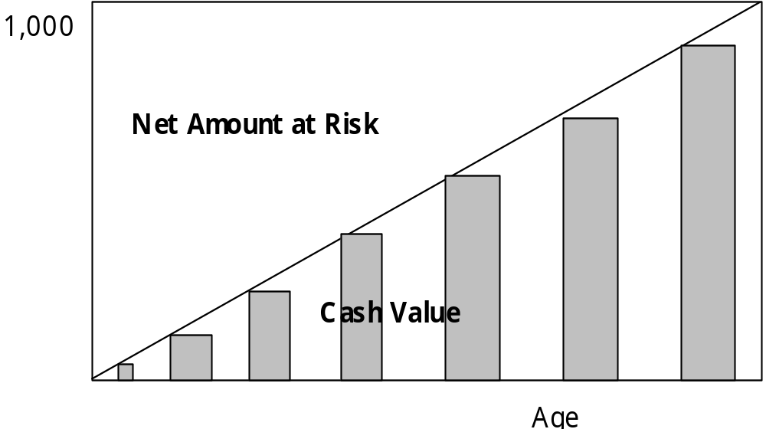
Normal Cash Value Pattern
Whole Life Insurance
Notes:
This is a picture of the normal cash value development in a whole life insurance contract illustrating the amount of cash value, surrender value or nonforfeiture value relative to the face amount

Slide 14
Policy Loans and Premium Default
Automatic Premium Loan (APL)
Extended Term Conversion
Paid-up insurance option when the contract was “rated”
Notes:
Policies containing cash value do not terminate if premiums stop.
Automatic Premium Loan (APL)
If APL is selected, a loan is taken from the cash value.
If APL is not selected the extended term option is provided.
For rated policies (ones where the premium was increased due to health problems) the paid-up option is alternatively selected.

Slide 15
Extended Term Insurance
Advantage: policy face remains constant for term
Disadvantage: must reinstate to restore face amount
If beneficiary designation irrevocable - need consent to borrow money
Notes:
The Extended Term Insurance Option
Advantage:
Policy face remains constant for term set by the amount of cash value and the age of the insured.
Disadvantage:
Must reinstate to restore face amount – reinstatement is not automatic
If beneficiary designation irrevocable - need consent to borrow money

Slide 16
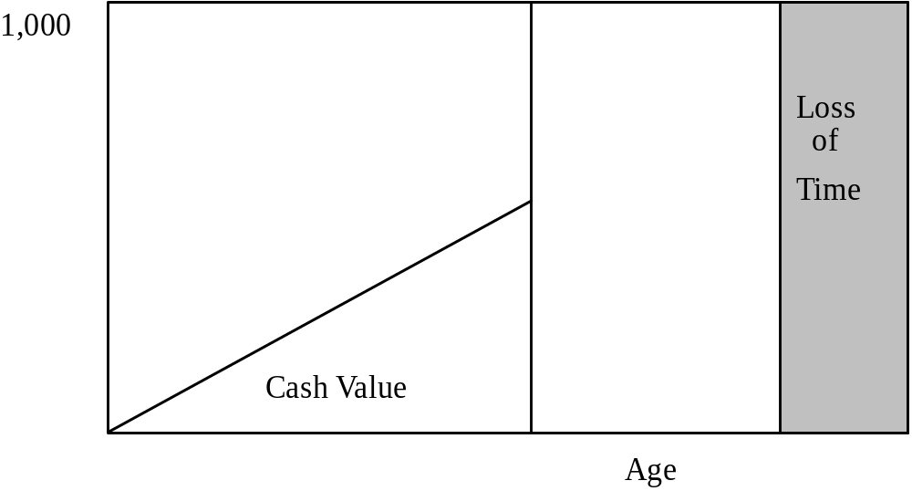
Extended Term Option
Extended Term
Notes:
With the extended term insurance option, the insurer exchanges the cash value amount for term insurance for the full face amount of the original contract. The length of time is set by the nonforfeiture tables and is a function of the age of the insured and the amount of cash value in the contract. The term length will be less than a person’s lifetime. So the insured loses time as shown by the graph.

Slide 17
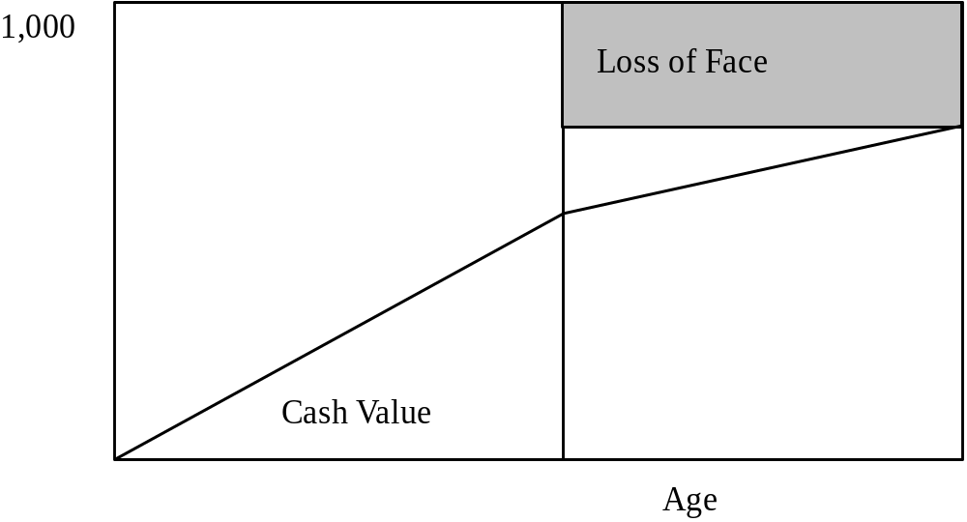
Paid-Up Insurance Option
Paid-up Insurance
Notes:
With the paid-up insurance option the insurer exchanges the cash value amount for whole life insurance for a reduced face amount. The amount of insurance is set by the nonforfeiture tables and is a function of the age of the insured and the amount of cash value in the contract. The face amount will be less than the original amount. So the insured loses face amount as shown by the graph.

Slide 18
Automatic Premium Loan (APL)
Advantage: loan automatically taken
  Pay back loan to restore face amount
Disadvantage: face amount declines
Notes:
There are advantages and disadvantages to the APL versus the extended term option.
APL
Advantages:
A loan is automatically taken out against the cash value amount
The loan can be just repaid to restore the face amount back to its original value.
Disadvantage:
The face amount declines each time an advance of the cash value takes place
Continuing interest charges erode the face amount.

Slide 19
Settlement at Death
Interest option
Fixed amount option
Fixed period option
Life annuity options - many types
Any other agreed upon method
Notes:
The settlement provisions provides methods to distribute the policy proceeds upon either the death of the insured or to the policy owner during life.
These are the options:
Interest option – the benefit amount is held by the insurer and interest only is paid to the recipient. If the beneficiary desires amounts beyond the interest amount it can be requested and distributed resulting in future interest payments to decline.
Fixed Amount option – the fixed benefit amount is distributed until interest and proceeds are distributed. If extra interest is paid additional payments will be made.
Fixed Period option – the proceeds and interest are distributed over a fixed period. The excess interest is paid, the benefit will increase.
Life annuity options - many types of annuity options are available based on life contingencies.
Any other agreed upon method

Slide 20
Other Available Riders and Options
Guaranteed insurability
Waiver of premium
Double indemnity
Disability income
Notes:
There are other options available that can be added to the insurance contract.
Guaranteed insurability – The policy owner is allowed to purchase additional amounts equal to the original face amount at specified intervals of time for a specified number of times. Some insurers add additional times for a birth or marriage.
Waiver of premium – The premium is waived during the period the insured is disabled. All other aspects of the insurance contract remain as if the premium were paid as normal.
Double indemnity – The face amount is doubled if the insured dies by specified events that are caused by an accident.
Disability income – provides spendable cash to the insured if the definition of disability is met. Usually $5.00 or $10.00 per thousand of life insurance is bought. There is a maximum the insurer will allow some to buy.

Slide 21
