Slide 1
ACIS Optical Sensitivity
Scott J. Wolk
CXC/SAO

Slide 2
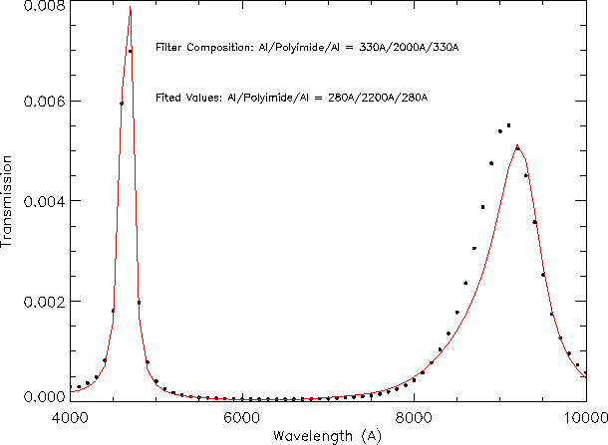
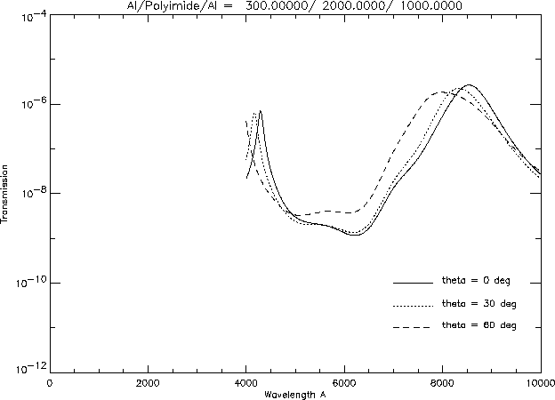
OBF Design
Optical blocking on both ACIS and HRC is achieved with a polyimide coated on both sides with a thin layer of aluminum
  ACIS-I Al/Polyimide/Al 1200Å 2000Å 400Å
  ACIS-S Al/Polyimide/Al 1000Å 2000Å 300Å
Calibration was performed via analytical methods.
  Results of the analysis where compared to non-flight filter.

Slide 3
Identification of Problem

Slide 4
Identification of Problem

Slide 5
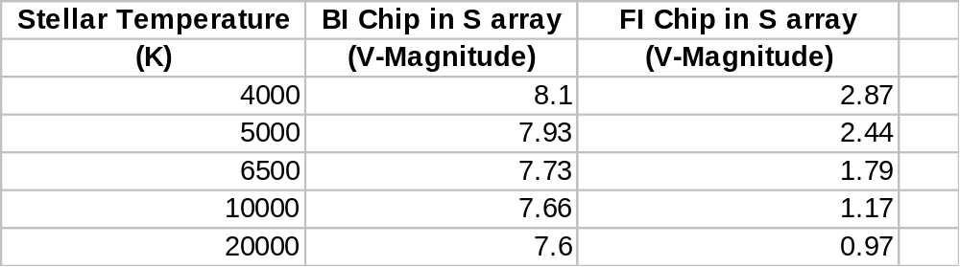
Quantification of Problem
The problem was traced to an interference effect which enhanced transmission at longer optical wavelengths.
This conclusion was confirmed by analysis of flight-like OBF spare.
Stellar magnitude required to produce 1ADU in a 3.3 second ACIS frametime.

Slide 6
Quantification of Problem
The problem was traced to an interference effect which enhanced transmission at longer optical wavelengths.
This conclusion was confirmed by analysis of flight-like OBF spare.
Stellar magnitude required to produce 1ADU in a 3.3 second ACIS frametime.

Slide 7
Amelioration -I
ACIS-I -Mars

Slide 8
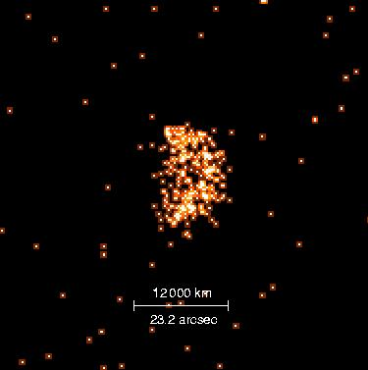
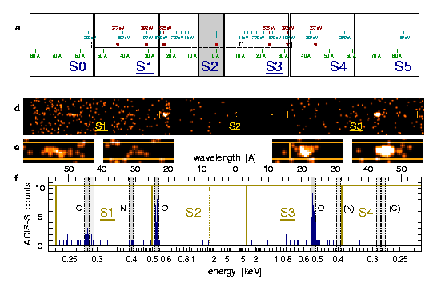
Amelioration -I
Shorter exposures
LETG - Venus

Slide 9
Amelioration -II
Change thresholds
  The event island
    What light leak really does
  Jupiter AO2
    What changing thresholds really does.
  AO4
    Jupiter
    Saturn

Slide 10
Jupiter Cal. Observations - AO2

Slide 11
Jupiter Cal. Observations - AO2

Slide 12
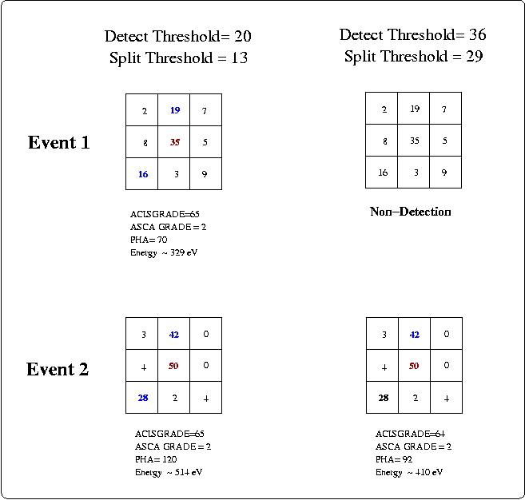
Energy and Grade Migration

