Slide 1
Experimental Details
Films of pBTTT are prepared on QCM sensors following unique fabrication/processing details
QCM is assembled and allowed to come to equilibrium
Pure solvent is introduced (150 μL) and allowed to come to equilibrium
Loaded solution (50 μL, 2 mg/mL) is added to the existing solvent to introduce dopant which results in mass uptake in the film which we model with the Sauerbrey formula

Slide 2
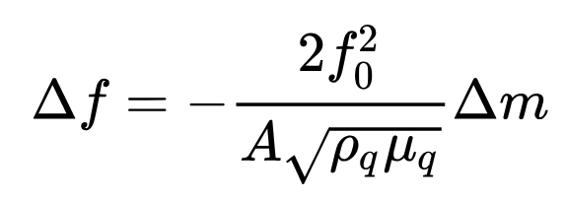
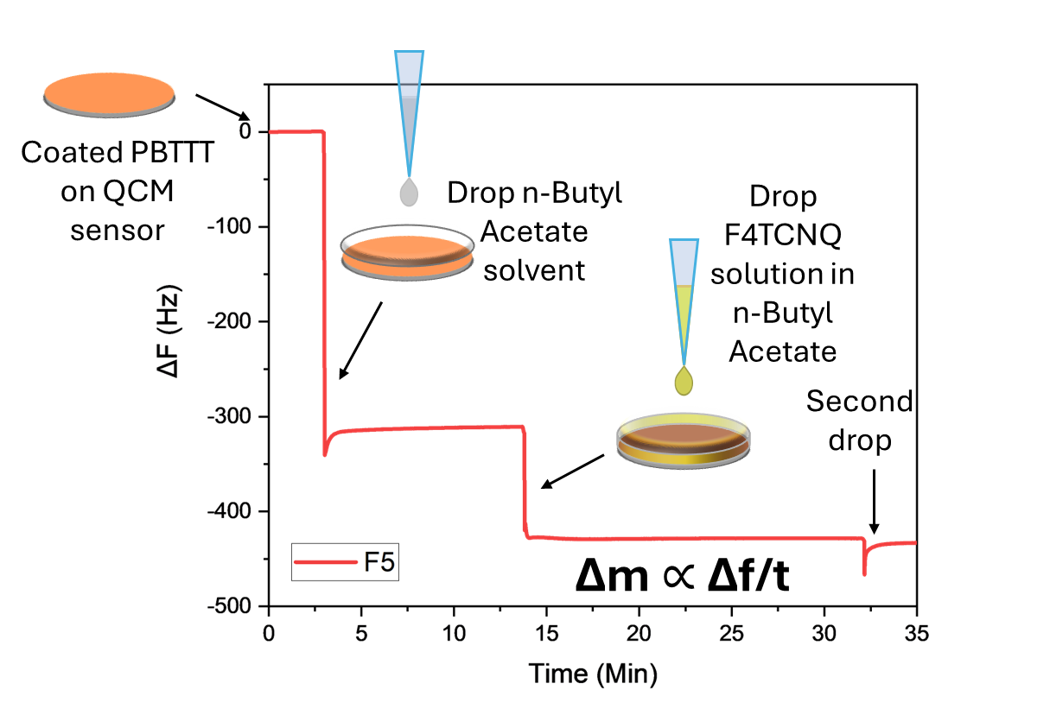
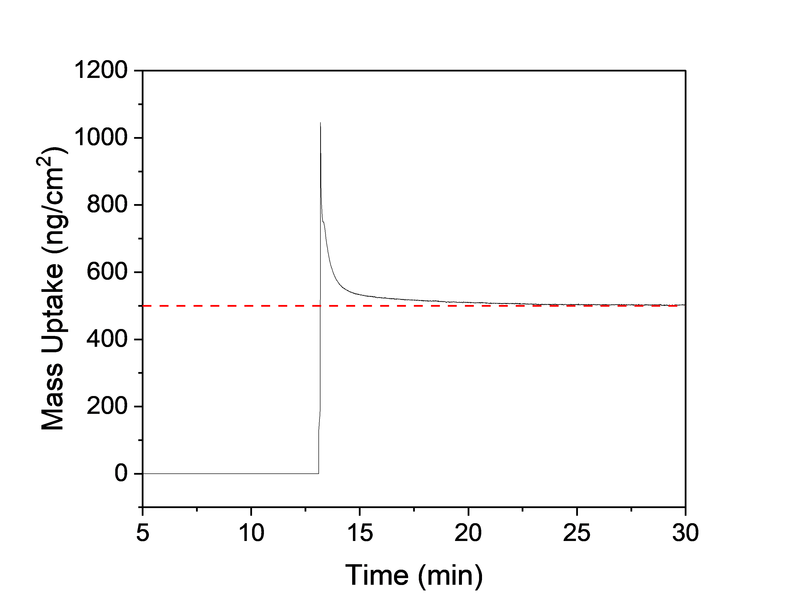
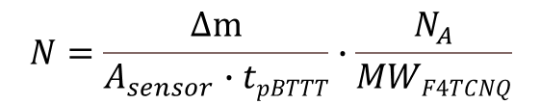
$$N=\frac{∆m}{A_{sensor}∙tpBTTT}∙\frac{N_{A}}{MWF4TCNQ}$$
Sauerbrey formula
N =3.7 x 10²⁰ cm⁻³
n = 2.5 x 10²⁰ cm⁻³
Doping efficiency:
χ = n/N = 0.67
Δm
Identifying the mass uptake and number of carriers from specEchem allows us to calculate doping effiency
QCM-D allows us to identify mass changes during doping associated with F4TCNQ uptake
2

Slide 3
Model: physical processes
Dopant
solvent
swollen
film
Doped
film
polymer
Diffusion: solvent molecules penetrate the polymer matrix via diffusion. Diffusion rate depends on solvent polarity, molecular size, and polymer packing/crystallinity (morphology). Creates a concentration gradient that drives further solvent uptake.
Swelling: As solvent enters, polymer chains gain mobility and expand. welling can be isotropic or anisotropic depending on film orientation and crystallinity. Changes film thickness, optical properties, and mechanical stress.
Morphological changes: Phase separation (if blends or additives are present).
Other phenomena: solvent evaporation, dewetting (less likely).
Solvent quality (good vs poor solvent for polymer).
χ parameter (Flory-Huggins interaction parameter).
Film thickness (thin films respond faster).
Polymer crystallinity and glass transition temperature (Tg).

Slide 4
Dopant uptake occurs very quickly, less than 5-10 seconds, consistent across samples

Slide 5
Questions

Slide 7
Dopant uptake varies between films, when comparing to carrier density obtained from specEchem we see doping efficiency ranging from 100% to 33%

