Slide 1
Conditionals

Slide 2
Review Last Session
Write the code to complete the following tasks
List
Create a new, empty list
Add 2 entries to the list
Change the second entry
Remove the second entry
Create a new list and initialize it with 3 entries
Modify the last entry in the new list
Access the first entry in the new list
Dictionaries
Create a new dictionary with initialized data, let’s make a phone book
Access an entry
Modify a phone number
Remove an entry
Add a new entry

Slide 3
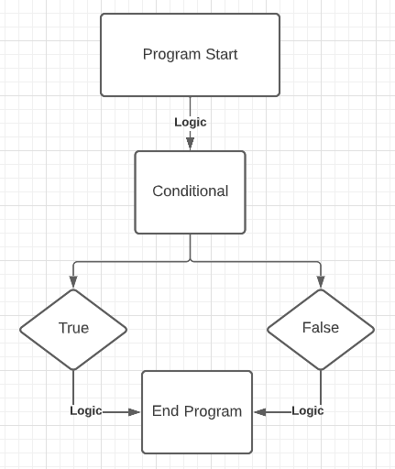
Conditionals
Conditionals operate on the basis of True or False
Adding conditionals to our programs allow us to drive the program's flow into different branches of logic

Slide 4

Conditionals
At the simplest level, we can print() the result of a conditional
Notice that we have "==" in this code snippet... This is saying "is the thing on the left side equal to the thing on the right side"
Since 1 is equal to 1, it will output True
This "==" is known as an operator

Slide 5
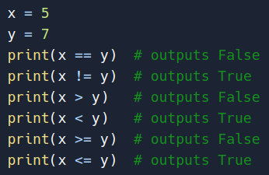
Conditionals: Operators
Your comparison operators are
== : Equal
!= : Not equal
> : Greater than
< : Less than
>=: Greater than or equal to
<=: Less than or equal to

Slide 6
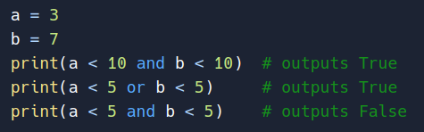
Conditionals: Operators
We can also create multi-condition logic using the "and" and "or" keywords
and : Both conditions must equate to True to return True
or : Either condition can be True to return True

Slide 7
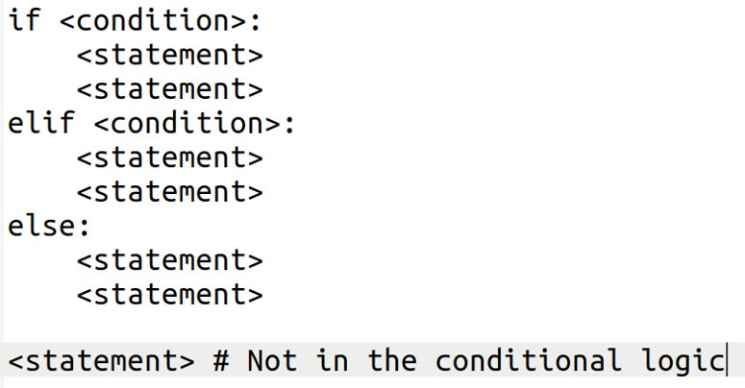
Conditionals: Program Flow
Now let's apply conditional operators to programs to control flow
Python keywords: if, elif, & else
Basic format for an if/elif/else chain below
Notice the indentation; this indicates that the code is specifically for a condition

Slide 8
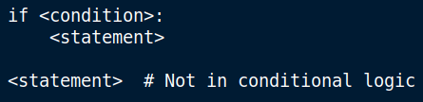
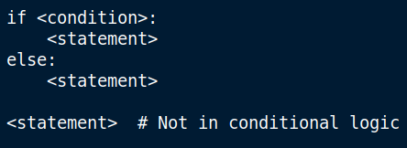
Conditionals: Program Flow
An if/elif/else chain can be as simple as just an "if"
It can also be just the if/else (binary choice)

Slide 9
Review
Write code to complete the following task
Imagine you operate a movie theater.
You have 3 ticket prices and their associated age ranges:
Adult (18 - 64): $15
Child (0 - 17): $8
Senior (65+): $10
Ask the user for their age and output the appropriate ticket price

Slide 10
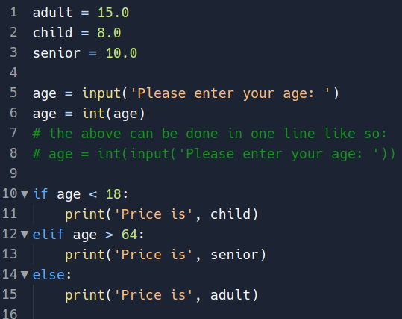
Review: Sample Solution 1

Slide 11
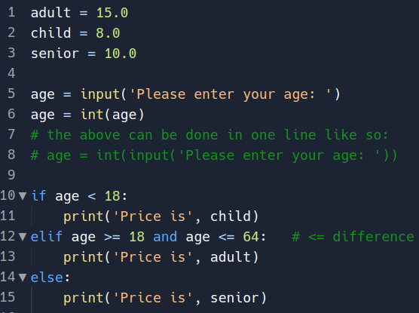
Review: Sample Solution 2

Slide 12
Review
Write the code to complete the task
Imagine you're writing software to calculate letter grades
Ask the user to enter the numeric score, and then output the letter grade
Assume the input is going to be an integer
Assume that ranges are the following:
A: 90 – 100
B: 80 – 89
C: 70 – 79
D: 60 – 69
F: 0 - 59

Slide 13
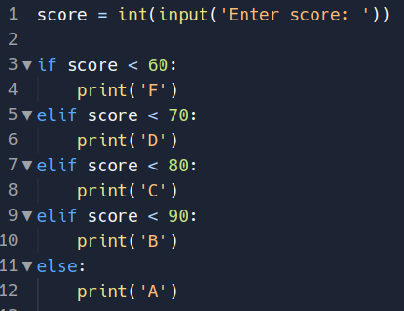
Review: Solution 1

Slide 14
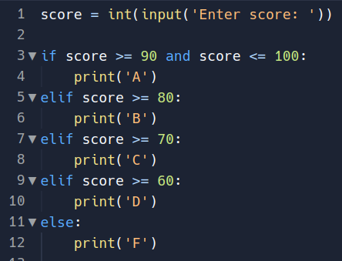
Review: Solution 2

Slide 15
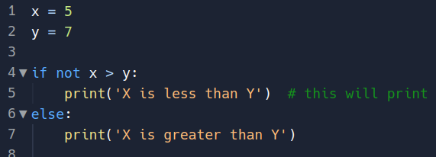
Conditional Notes
One keyword that I didn't cover was "not"
not – returns the inverse result

